Slide 1
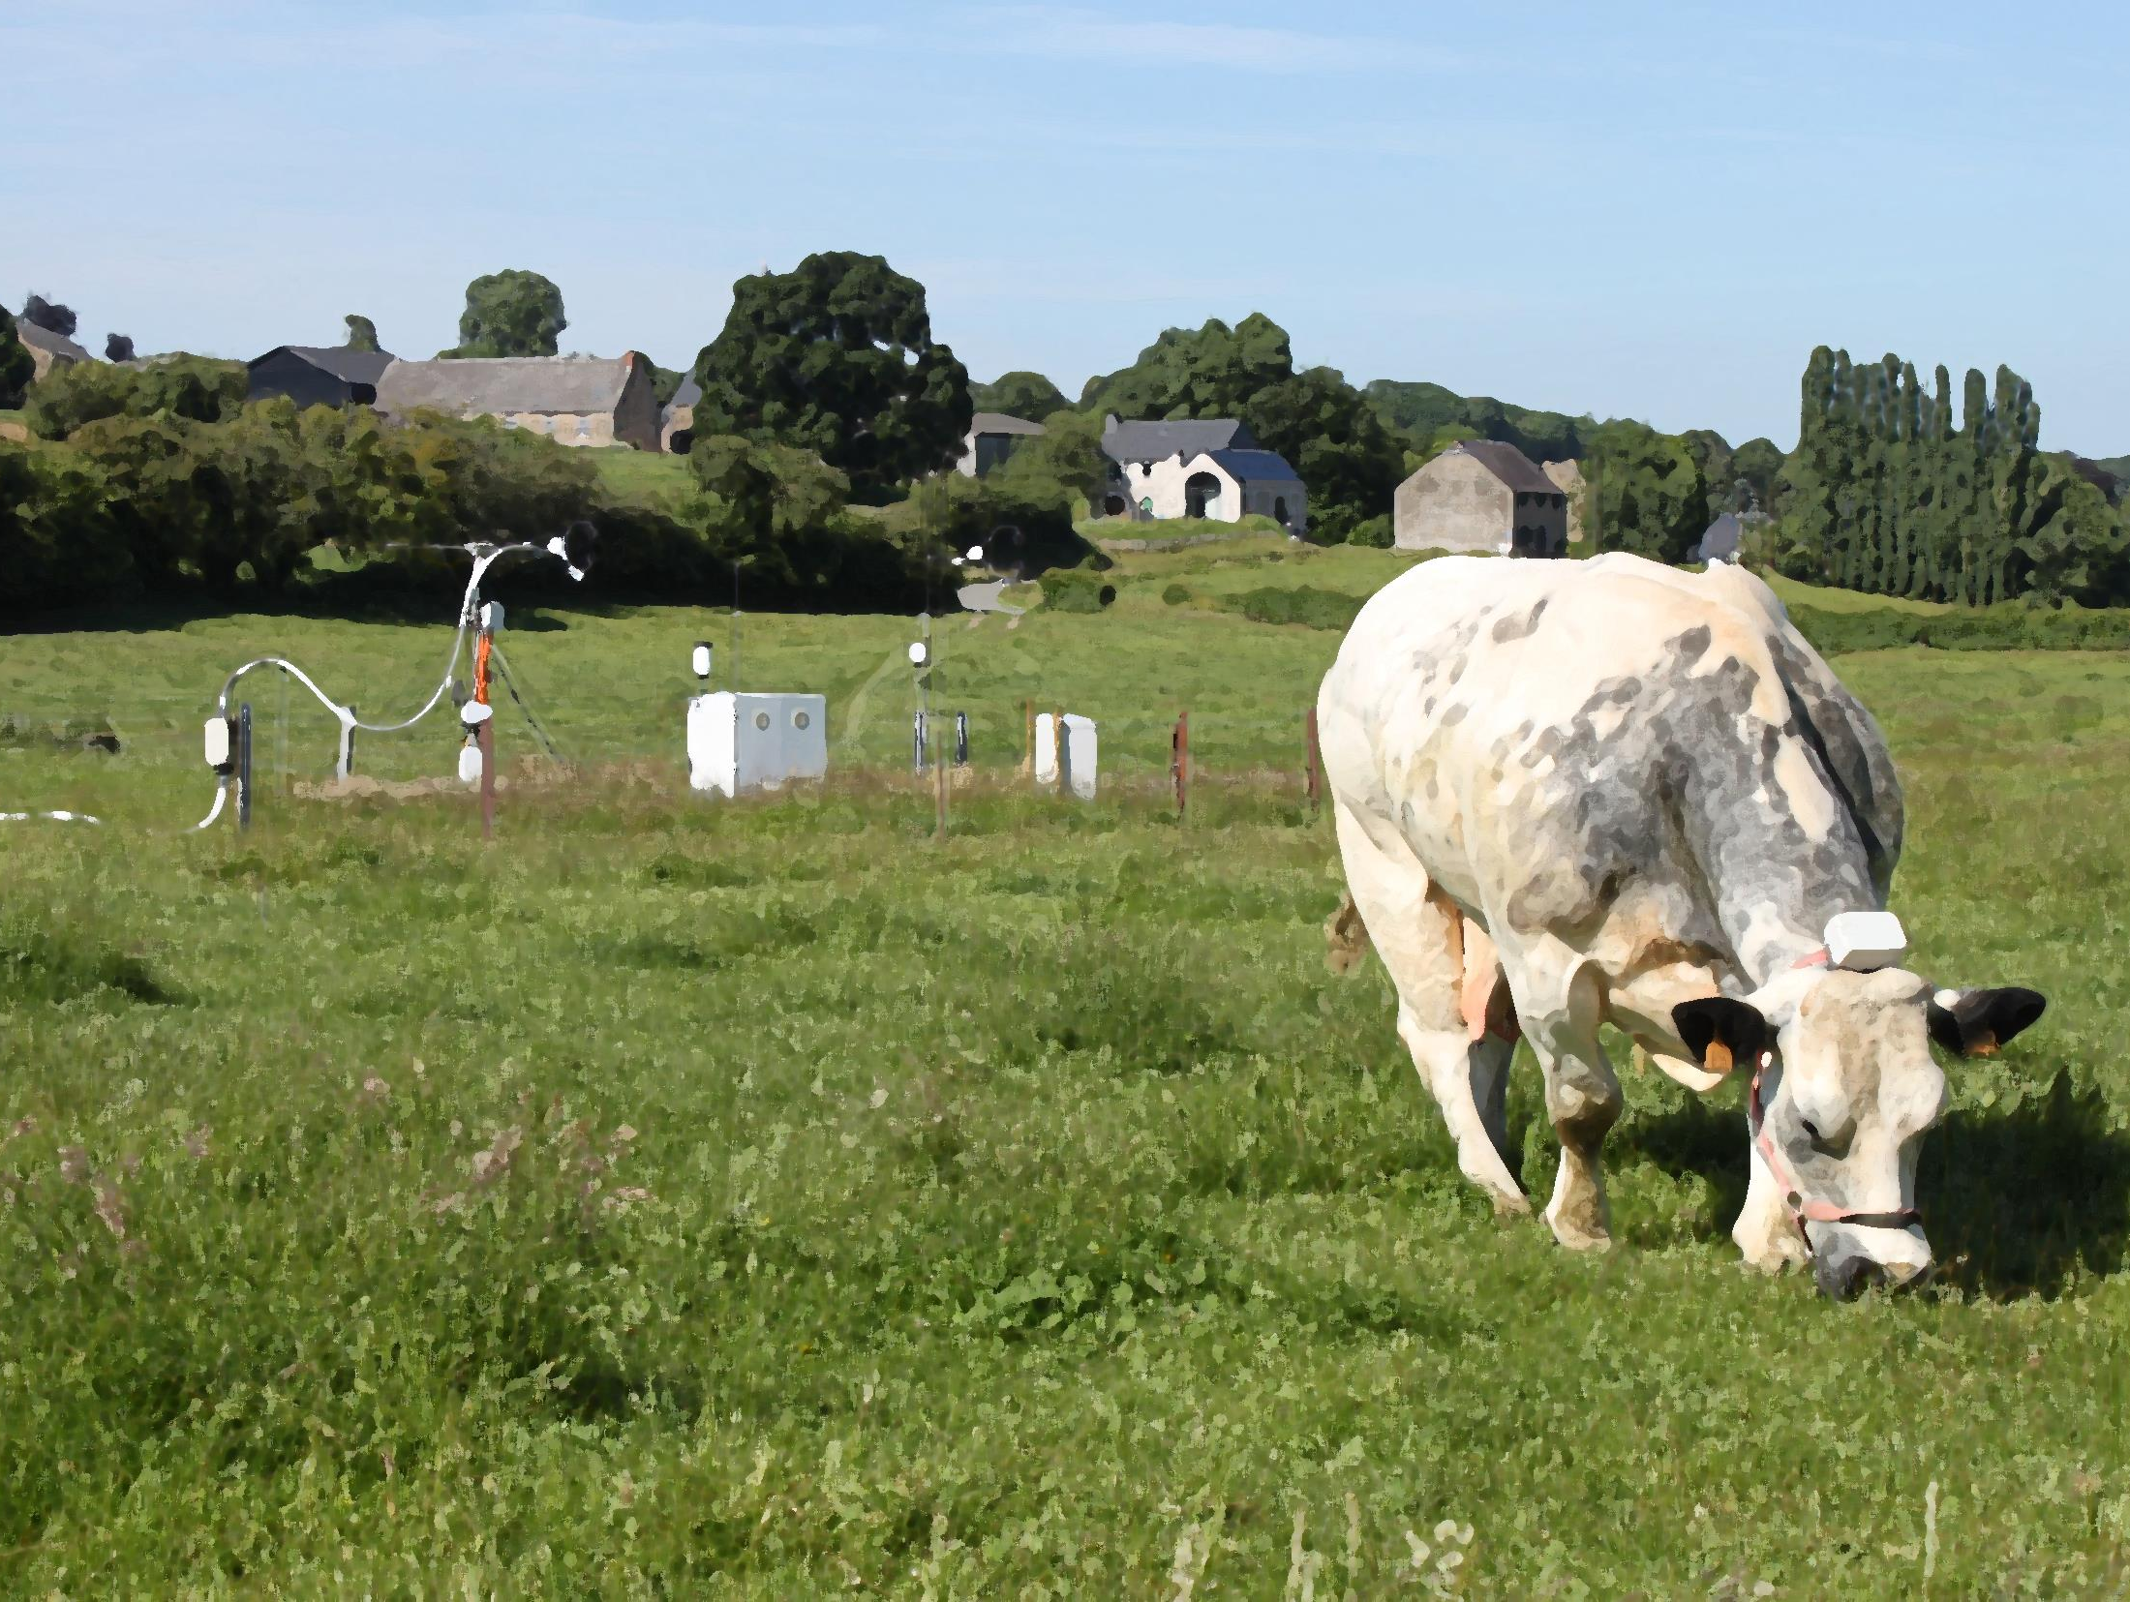
The role of cows on OVOC exchanges of a pasture Heinesch B. ¹, Michel C. ¹, Amelynck C. ², Schoon N. ², Mozaffar A. ², Aubinet M. ¹, Bachy A. ¹, Dumortier P. ¹ ¹ University of Liege (bernard.heinesch@uliege.be), ² Royal Belgian Institute for Space Aeronomy
Idea
Flux partitioning
Results
Take-home messages
Study site
M&M
PICO navigation
Please run the pptx (press F5)
vEGU 2021, session BG3.19 - 'Exchange of GHG and reactive gases in agricultural ecosystems'

Slide 2
The role of cows on OVOC exchanges of a pasture Heinesch B., Michel C., Amelynck C,. Schoon N.., Mozaffar A., Aubinet M., Bachy A. , Dumortier P.
Idea
Flux partitioning
Results
Take-home messages
Study site
M&M
[Idea]
Investigation of stress-related VOC exchanges on a pasture (project CROSTVOC)
The most obvious stress is the biotic one through grazing and trampling
But at the pasture scale and besides constitutive exchanges, the signal is blurred by emissions due to wastes and cow‘s exhalation
We propose a methodology to disentangle these contributions, based on eddy-covariance, enclosures, cow geo-location and activity devices and a footprint model.
We apply it on a pasture to help answering the questions:
How the total exchange of three OVOCs distribute between those components
how do contrasted grass management practices like continuous and rotational grazing affect OVOC flux dynamics

Slide 3
The role of cows on OVOC exchanges of a pasture Heinesch B., Michel C., Amelynck C,. Schoon N.., Mozaffar A., Aubinet M., Bachy A. , Dumortier P.
Idea
Flux partitioning
Results
Take-home messages
Study site
M&M
[Flux partitioning]
$$F_{meas}^{}=F_{ex}+F_{wa}+F_{gr}+F_{tr}+F_{cps}$$
$$F_{ind}^{} (indirect)$$
Besides phenology and meteorology that will drive spatially homogeneous F_{cps}, the instantaneous turbulent exchange measured from a specific footprint area will be influenced by
The presence of cows in this area
The time since the grazing/trampling /waste events in this area
=> Derivation of three indices characterizing the current footprint area:
SD_{f} : “How many cows currently in the footprint ?”, the stocking density
PH_{f} : “How many cows had stayed in the current footprint in the previous days ”, (Time-weighted) presence history
GH_{f} : “and were they grazing?” : :(Time-weighted) grazing history
A time-constant τ characterizing the indirect-emission time decrease is needed (for the time-weighted history)
F_{wa} : waste (urine & dung)
F_{cps} : constitutive plant-soil
F_{tr} : grazing
F_{ex} : exhalation
F_{tr} : trampling

Slide 4
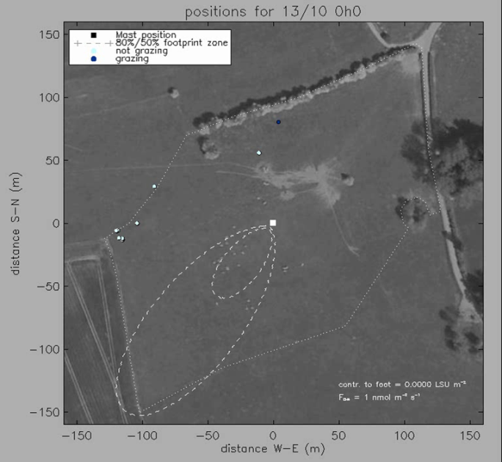
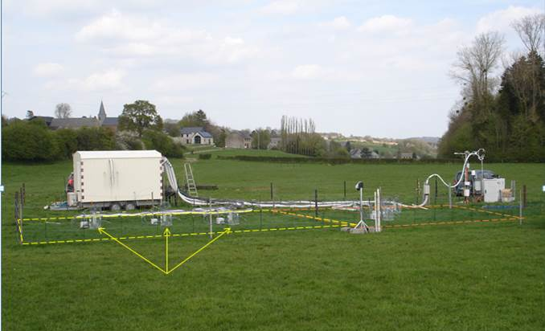
The role of cows on OVOC exchanges of a pasture Heinesch B., Michel C., Amelynck C,. Schoon N.., Mozaffar A., Aubinet M., Bachy A. , Dumortier P.
Idea
Flux partitioning
Results
Take-home messages
Study site
M&M
[M&M]
Methanol/acetaldehyde/acetone fluxes using eddy-covariance with a PTR-MS (same methodology as Bachy et al., 2016 in ACP, https://doi.org/10.5194/acp-16-5343-2016)
SD_{f} obtained using home-made geolocation devices (1) and a flux footprint model (2)
τ obtained using parallel enclosure measurement on non-grazed and recently grazed grass (3)
PH_{f} obtained using (1) + (2) + (3)
GH_{f} obtained adapting PHf with grazing activity information from on-cow activity devices (4)
(1), (2), (4)
(3)
Click on me for animation !
Cuvettes patch1
Cuvettes patch2
(3)

Slide 5
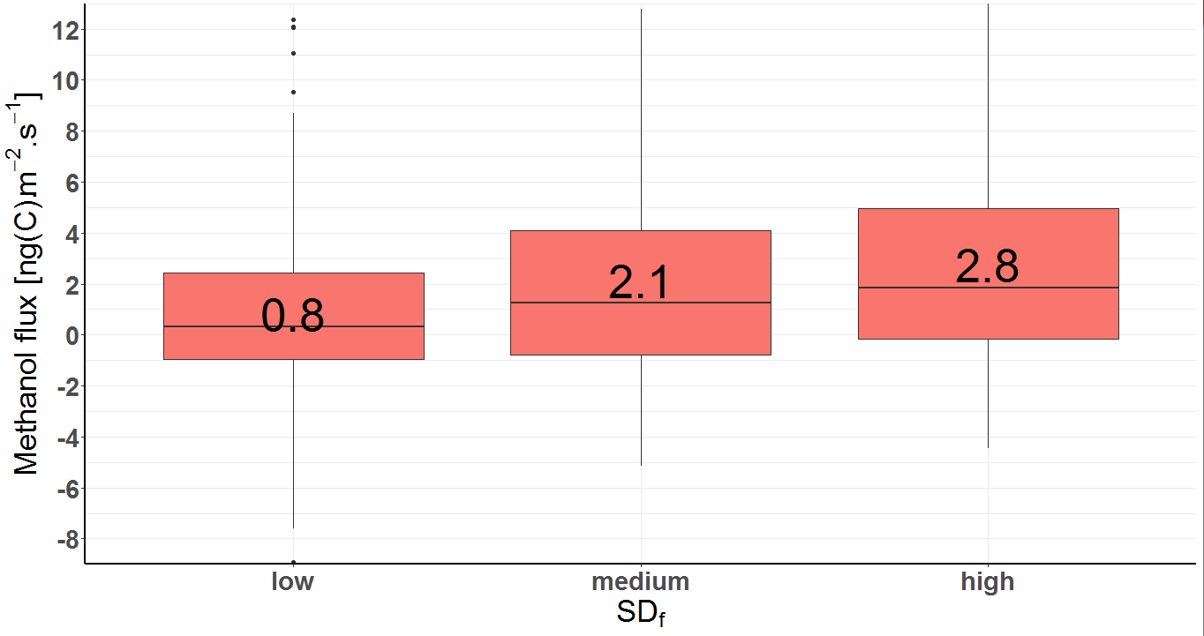
The role of cows on OVOC exchanges of a pasture Heinesch B., Michel C., Amelynck C,. Schoon N.., Mozaffar A., Aubinet M., Bachy A. , Dumortier P.
Idea
Flux partitioning
Results
Take-home messages
Study site
M&M
[Results-F_{ex}]
At nighttime F_{ex} is expected to be the dominant flux component. => We tested the nighttime methanol flux dependence on stocking density in the footprint.
Cow exhalation was
170 mgC(methanol) day⁻¹ cow⁻¹, representing only 2% of the EC flux in spring
83 mgC(acetone) day⁻¹ cow⁻¹, representing 9% of the EC flux in spring
negligible for acetaldehyde
allowed the estimation of the emission per head
Next

Slide 6
The role of cows on OVOC exchanges of a pasture Heinesch B., Michel C., Amelynck C,. Schoon N.., Mozaffar A., Aubinet M., Bachy A. , Dumortier P.
Idea
Flux partitioning
Results
Take-home messages
Study site
M&M
[Results: τ, time-constant decrease of F_{ind}]
Comparison of parallel grazed and non-grazed enclosures
Difference between grazed and non-grazed enclosures = F_{ind}
F_{ind} (F_{gr}+F_{tr}+F_{wa}) decreased quickly with time :
$F_{ind}=F_{ind,ini}{ e}^{−t/τ}$
τ can be determined for each compound :
Prev
Next

Slide 7
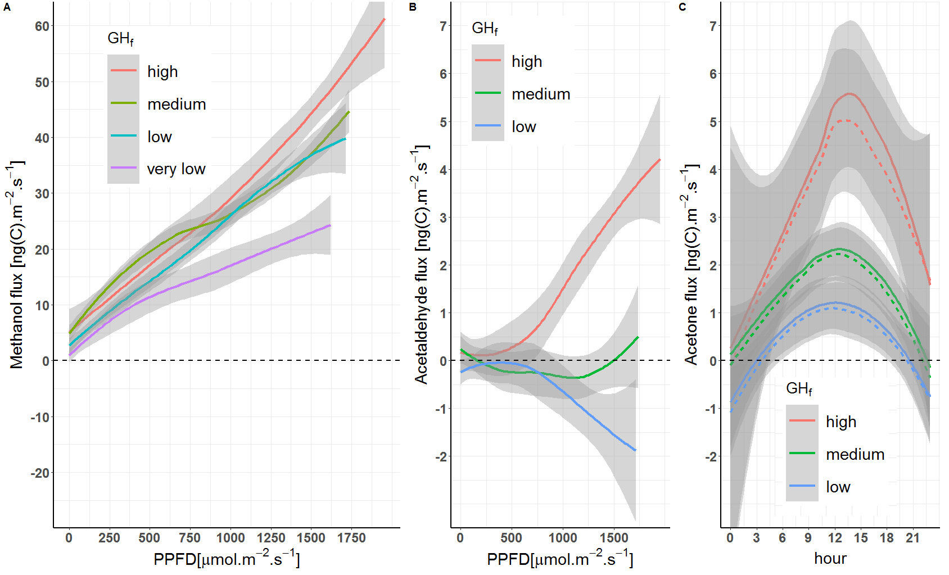
The role of cows on OVOC exchanges of a pasture Heinesch B., Michel C., Amelynck C,. Schoon N.., Mozaffar A., Aubinet M., Bachy A. , Dumortier P.
Idea
Flux partitioning
Results
Take-home messages
Study site
M&M
[Results-F_{ind}]
The highest GH_{f} class (highly and recently grazed footprints) showed doubled methanol emissions compared to the lowest GH_{f}
Effect even higher for acetaldehyde and acetone
Grazing is dominating F_{ind} : contribution of trampling and wastes has been found to be lower through analysis of specific wind directions with high presence of cows but low grazing activity (not shown)
Prev
Next
Day-time OVOC fluxes dependence on GH_{f}, beyond PPFD or time of the day .

Slide 8
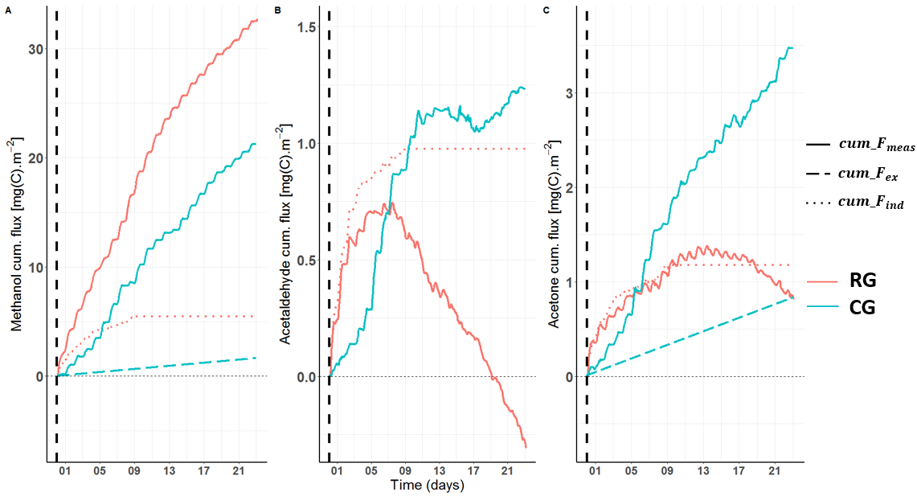
The role of cows on OVOC exchanges of a pasture Heinesch B., Michel C., Amelynck C,. Schoon N.., Mozaffar A., Aubinet M., Bachy A. , Dumortier P.
Idea
Flux partitioning
Results
Take-home messages
Study site
M&M
[Results-grass management pratices]
Eddy-covariance = continuous grazing (CG) and hypothesis that: Enclosures = rotational grazing (RG)
Comparison of cumulated fluxes and their components over a 23 days period after grazing in the enclosures and for the continuously grazed pasture
For CG, almost continuous emissions
For RG, after an initial emission burst due to heavy grazing, flux behavior depends on compound.
How to deal with such complex behaviors in upscaling models such as MEGAN ?
Prev
Cumulated fluxes over a 23 days period after grazing in the enclosures (RG) and for the continuously grazed pasture (CG).

Slide 9
The role of cows on OVOC exchanges of a pasture Heinesch B., Michel C., Amelynck C,. Schoon N.., Mozaffar A., Aubinet M., Bachy A. , Dumortier P.
Idea
Flux partitioning
Results
Take-home messages
Study site
M&M
[Take-home messages]
Disentangling flux components was possible but only with a heavily instrumented campaign.
Direct cows emissions (exhalation) of methanol and acetaldehyde are only a (very) small fraction of the pasture emissions. The contribution is more important for acetone.
Indirect emissions (grazing , trampling, wastes) have a huge impact on pasture exchanges of these 3 OVOCs and is dominated by grazing.
Flux dynamics is very different for continuous and rotational grazing

Slide 10
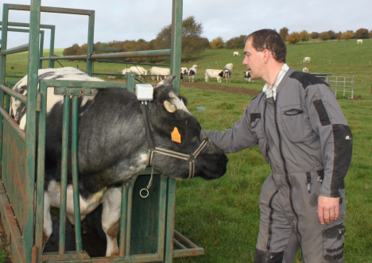
The role of cows on OVOC exchanges of a pasture Heinesch B., Michel C., Amelynck C,. Schoon N.., Mozaffar A., Aubinet M., Bachy A. , Dumortier P.
Idea
Flux partitioning
Results
Take-home messages
Study site
M&M
[Study site]
Dorinne in the Condroz region (Belgium)
Flux tower station started in 2010
ICOS candidate station (https://icos-belgium.be/, BE-Dor )
Intensive pasture of 4.2 ha, grazed continuously from ca. April to November by Belgian Blue heifers
https://www.icos-belgium.be/files/ICOS%20Wallonia%20handout%20v7.pdf

Slide 11
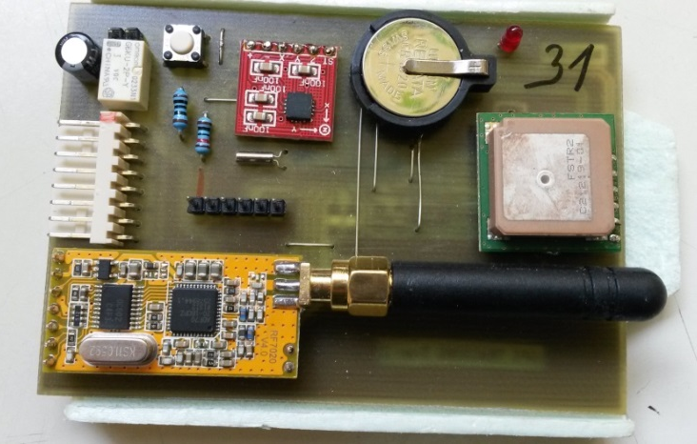
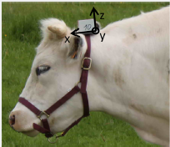
Snapshot of one day of on-cow geo-location (GPS) and activity data (inclinometer)
GPS
inclinometer
antena
[close]
GPS + inclinometer
See also Dumortier et al., 2021, AFM, https://doi.org/10.1016/j.agrformet.2020.108249

