Slide 1



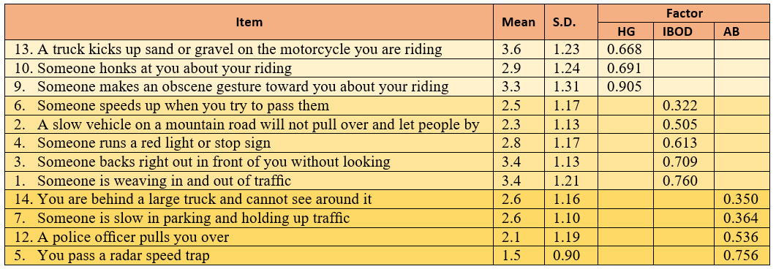


ASSESSING DRIVING ANGER AMONG VIETNAMESE MOTORCYCLISTS
Hiep Trung Bui
buitrunghiep@doct.uliege.be (+84) 935.743555
PARTNERS
RESEARCH INFORMATION
This study provides further insights into the current traffic situation in Vietnam. By examining the factor structure of the short version of Driving Anger Scale (DAS), this paper filled the research gaps concerning riding anger in the context of motorcycling-based traffic systems. The results offered a profound understanding on the anger-provoked circumstances, the road rage expression, its effects to driving outcomes among motorcyclists in Da Nang, a rapidly urbanizing city in the center of Vietnam.
Keywords: Driving Anger, Motorcyclist, On-Road Safety, Crash Involvement, Traffic Violation, Vietnam.
1. CONTEXT
4. RESULTS (Continue)
In Vietnam, nearly 79% of the population use motorcycle for regular commuting, which makes this country the top motorcycling countries in the world.
In 2018, more than 23 Vietnamese people died per day from road traffic collisions, and nearly 90% of victims are motorcyclists.
The problem of driving anger has not received enough attention in motorcycling countries.
Understanding driving anger is critical for reducing both the number of crashes and the severity of motorcyclists’ injury.
Pearson’s correlational analysis was adopted to examine the relationships between the 03 DAS dimensions with the continuous demographic variables. Age was negatively correlated to all anger driving subscales.
According to the MANOVA results, there were significant differences in DAS scores between the different Gender, Possession of university degree and Involvement in crash conditions.
The independent-samples t-test results showed that:
Gender, Possession of university degree had a significant effect on the anger level from HG.
There was a significant difference in AB subscale among traffic accident victims and riders who have not been involved in crashes.
For IBOD, provoked anger levels were similar between subgroups.
Logistic regression was performed to set-up a predictive model for motorcycle crash involvement on Vietnamese roads. Of the 11 predictor variables, only 4 were statistically significant: Age, Gender, HG, and AB.
Variables | Pillai's trace | F | Hypothesis df | Error df | p | Eta Squared
Gender | 0.010 | 3.109 | 3 | 958 | <0.001 | 0.026
Possession of university degree | 0.010 | 3.189 | 3 | 958 | 0.023 | 0.010
Possession of driving license | 0.006 | 1.860 | 3 | 958 | 0.135 | 0.006
Possession of own motorcycle | 0.008 | 2.509 | 3 | 958 | 0.058 | 0.008
Involvement in crash | 0.014 | 4.530 | 3 | 958 | 0.004 | 0.014
2. GOALS
The main objectives of this paper are:
Validate the factor structure of the DAS in a representative sample of Vietnamese riders;
Examine the relationships between the DAS factors, background variables, riding information and accident, traffic violation involvement.
3. ANALYSIS PATHWAY
Variable | Odd ratio | Sig. | 95% C.I.for EXP(B)
 |  |  | Lower | Upper
Age | 0.905 | 0.000 | 0.857 | 0.956
Gender (cat = Male) | 1.372 | 0.033 | 1.026 | 1.833
Hostile gesture | 0.843 | 0.036 | 0.718 | 0.989
Arrival-blocking | 1.495 | 0.000 | 1.204 | 1.857
5. CONCLUSIONS
4. RESULTS
A 12-item Vietnamese version of the DAS was explored and could be applied to investigate driving anger in other motorcycling countries.
In term of Vietnamese motorcyclists, the study reveals that:
They rarely use safety equipment while riding.
Younger riders tend to become more angered than the elder riders.
Females reported a higher angry level by HG than males.
The university graduates reported less anger toward HG than people without a university degree.
Riders who experienced more anger by HG were less likely to be involved in traffic accidents than those who had a lower anger level.
Motorcyclists who showed more anger because of AB are expected to have higher odds for having crashes than those who did not.
The EFA of DAS revealed a notable clear three-factor structure, which explained 41.4% of the total variance:
- Hostile gesture (HG): 3 items
- Infringements by other drivers (IBOD): 5 items
- Arrival-blocking (AB): 4 items

