Slide 1
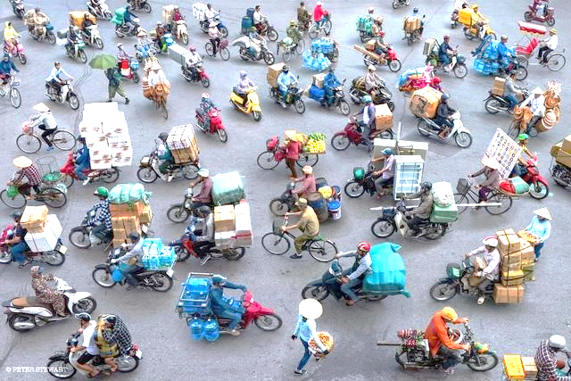
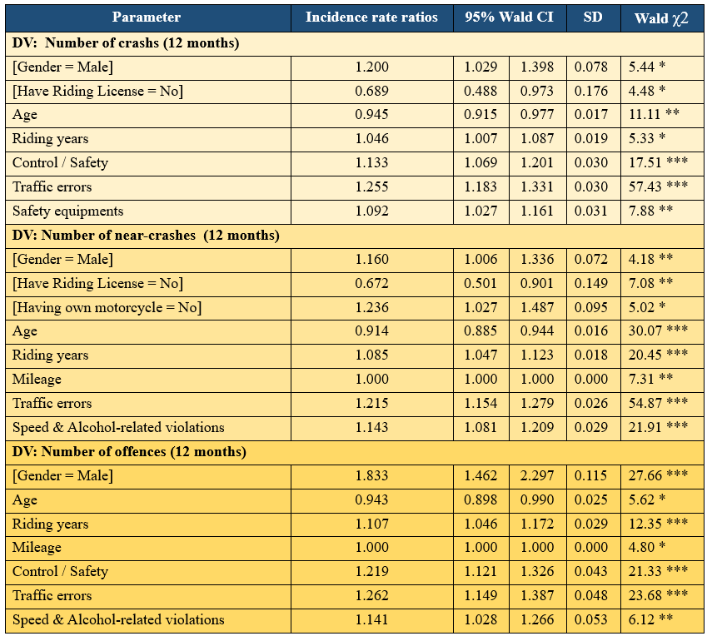
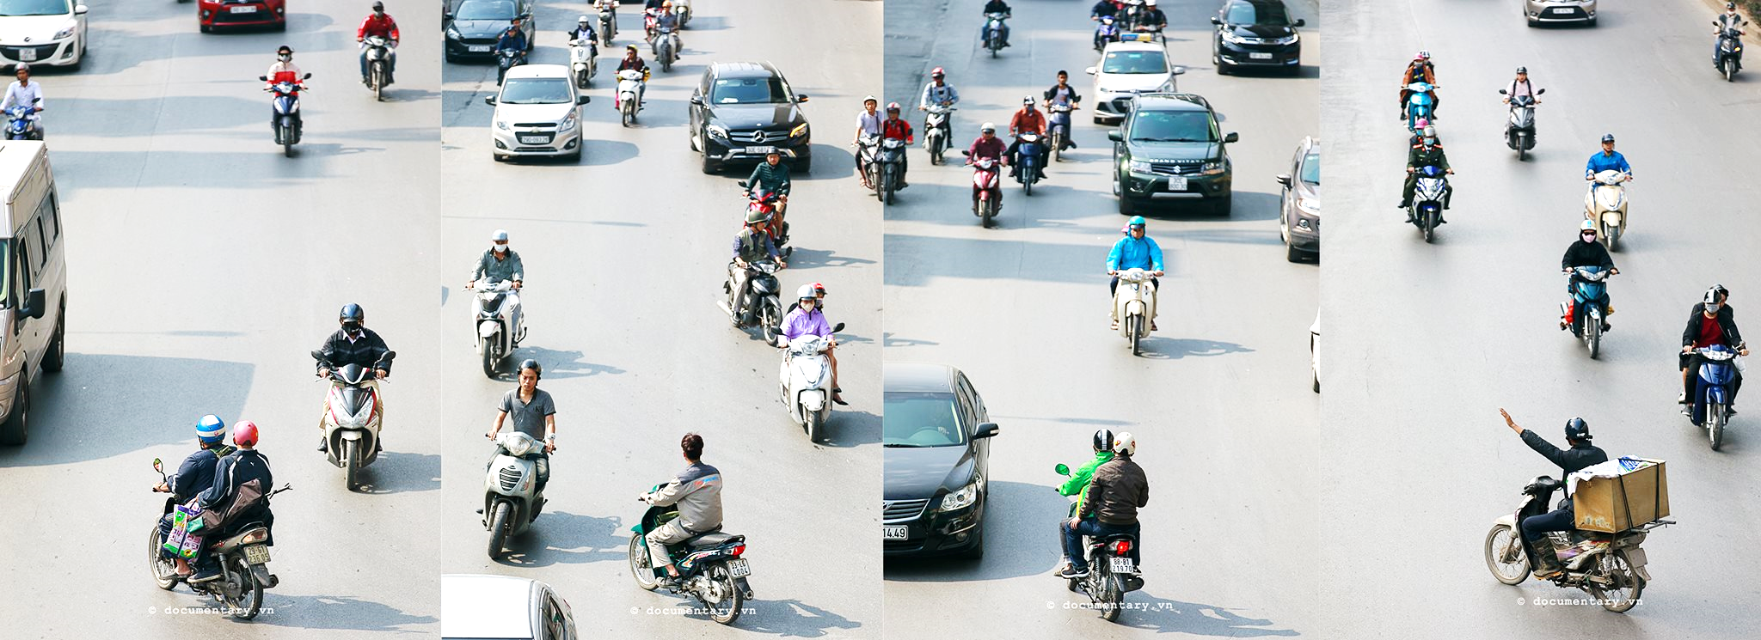
EXPLORATION OF FACTORS THAT INFLUENCE MOTORCYCLISTS’ ROAD USE BEHAVIOR IN DANANG, VIETNAM
Bui Trung Hiep
buitrunghiep@doct.uliege.be (+84) 935.743555
PARTNERS
RESEARCH INFORMATION
The primary goal of this PhD research is the exploration of factors that influence motorcyclists’ on-road safety, with the main focus on the discovering the causations that lead to the irrational, dangerous riding behaviours in Danang, a rapidly urbanising city in the centre of Vietnam.
Keywords: motorcycle, riding behaviours, Vietnam, Danang, low/middle-income, motorcycling country, accident risks, traffic violations, road traffic safety campaigns.
1. CONTEXT
2. GOALS
In Vietnam, the motorcycle is the major mode in traffic flow, and 79% of the population use motorcycle for regular commuting, which makes this country the top motorcycling countries in the world.
In 2018, The National Traffic Safety Committee of Vietnam announced that there are more than 8.500 people die each year from road traffic accidents, and about 90% of victims are motorcyclists and their passengers.
It is unexpected that there is virtually a deficiency of systematic research on riding behaviours, one of the main factors threatening road safety, and its outcomes in Vietnam.
This PhD research was motivated by the urgent need to investigate the on-road safety of motorcyclists in Vietnam.
Validate the factor structure of the MRBQ (Motorcycle Riding Behaviours Questionnaire) in a representative sample of Vietnamese riders;
Examine the relationships between the MRBQ factors, background variables, riding information and accident, traffic violation involvement;
Study the effects of personality traits, safety attitudes, anger expressions on motorcycle riding outcomes;
Analysis traffic data to predict motorbike crash risk;
Assess the performance of traffic safety campaigns.
3. RESULTS FOR GOAL (1) & (2)
The EFA of MRBQ using Vietnamese sample data was performed and revealed a notable clear four-factor structure, which explained 43.5% of the total variance:
- Control errors / Safety behaviours: 9 items, Cronbach’s alpha = 0.082
- Traffic errors: 13 items, Cronbach’s alpha = 0.819
- (Using) Safety equipment: 8 items, Cronbach’s alpha = 0.893
- Speed and Alcohol-related violations: 6 items, Cronbach’s alpha = 0.828
In the analyses of accident risks and traffic violations among motorcyclists, their age, gender, highest education level attained, possession of a riding license, riding years, years of holding the riding license, annual mileage, motorcycle ownership and MRBQ factors were used as predictors. The table displays the results of negative binomial regression analyses.
CONCLUSIONS
1
This study gives some new understanding of current traffic situations in Vietnam.
A 36-item Vietnamese version of the MRBQ was explored and could be replicated to investigate riding behaviours in other motorcycling countries.
Following the significant relationships between predictors and accident risks, new effective on-road safety campaigns can be developed to focus on reducing specific deviant riding behaviours in Vietnam.
2
3

