Slide 1


BIVEC - GIBET
Transport Research Day 2021
THE EFFECTS OF PERSONALITY FACTORS & ATTITUDES TOWARD TRAFFIC SAFETY
ON DRIVING OUTCOMES IN A TYPICAL MOTORCYCLING COUNTRY
Authors: Hiep Trung Bui, Tung Son Nguyen, Ismaïl Saadi, Mario Cools

Slide 2

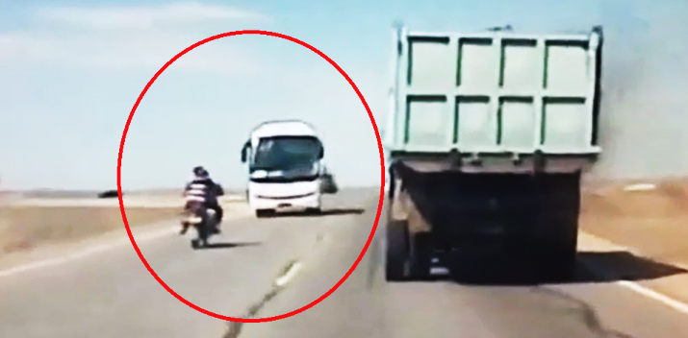
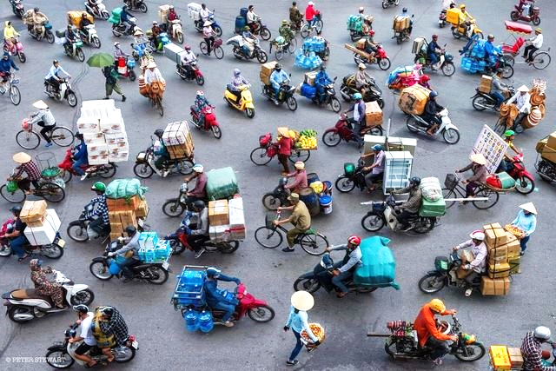
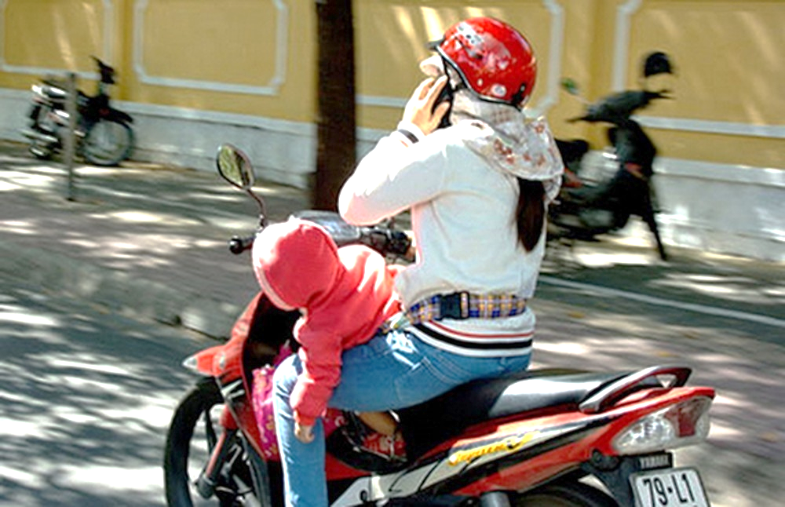
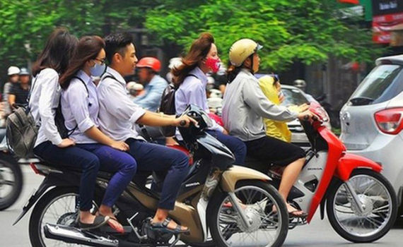
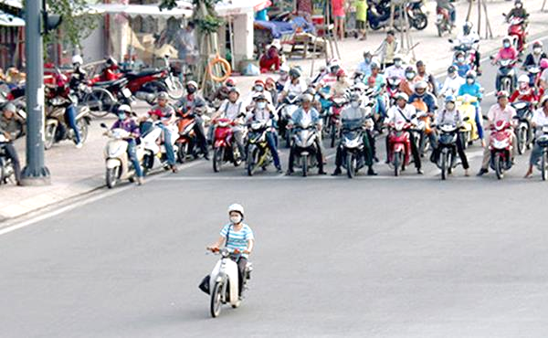
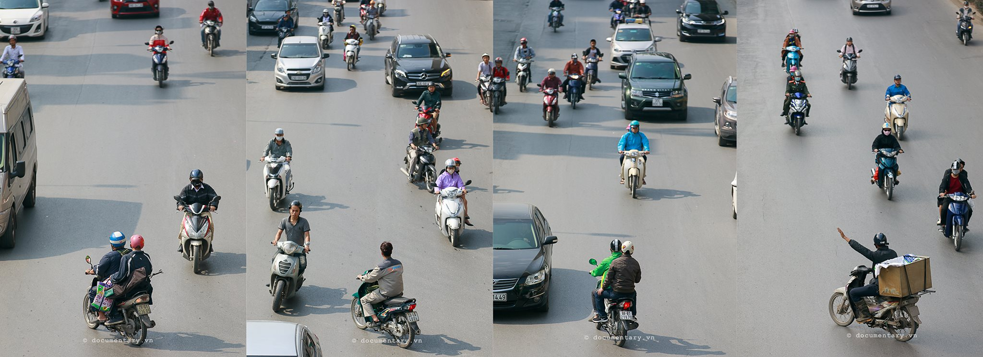
VIETNAM – TYPICAL MOTORCYCLING COUNTRY (2020)

Slide 3
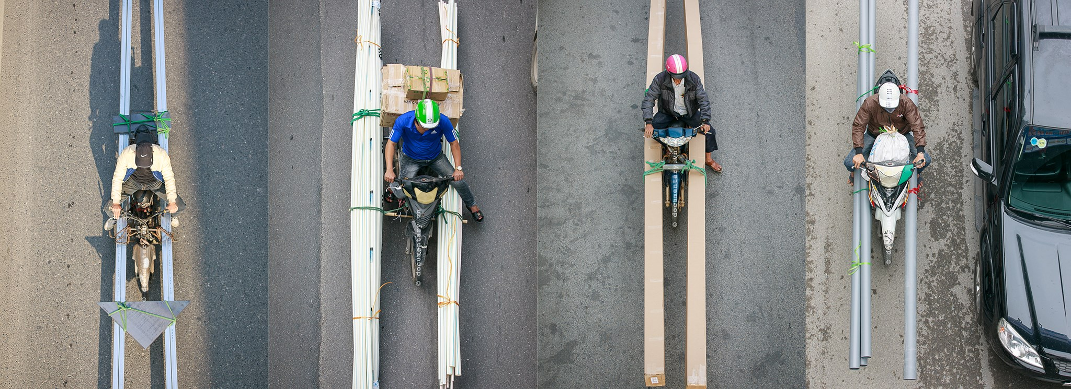
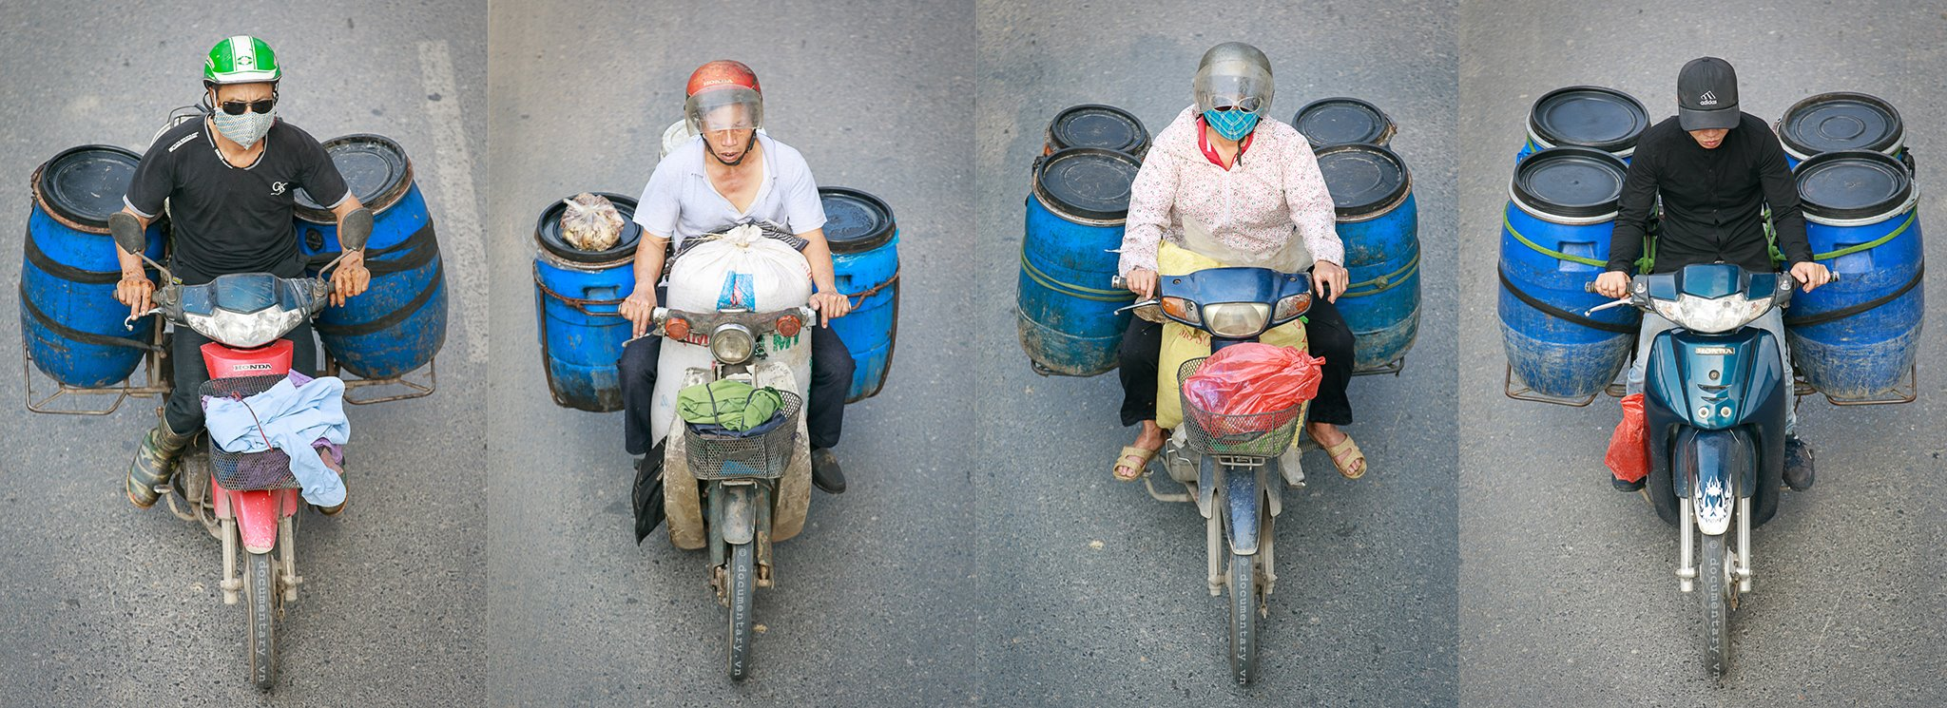
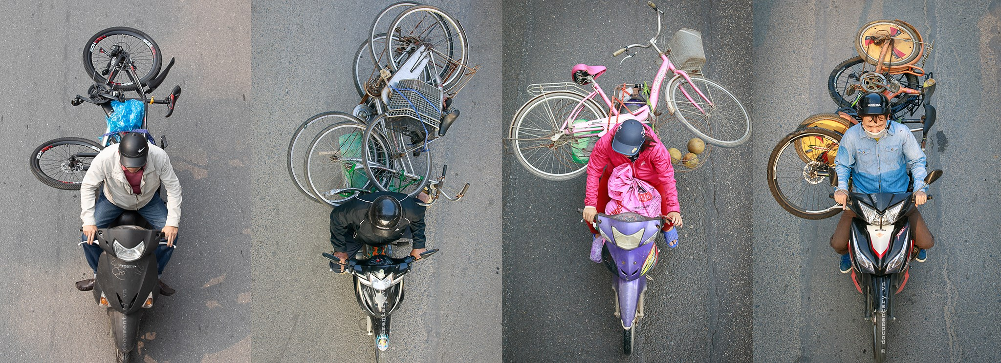
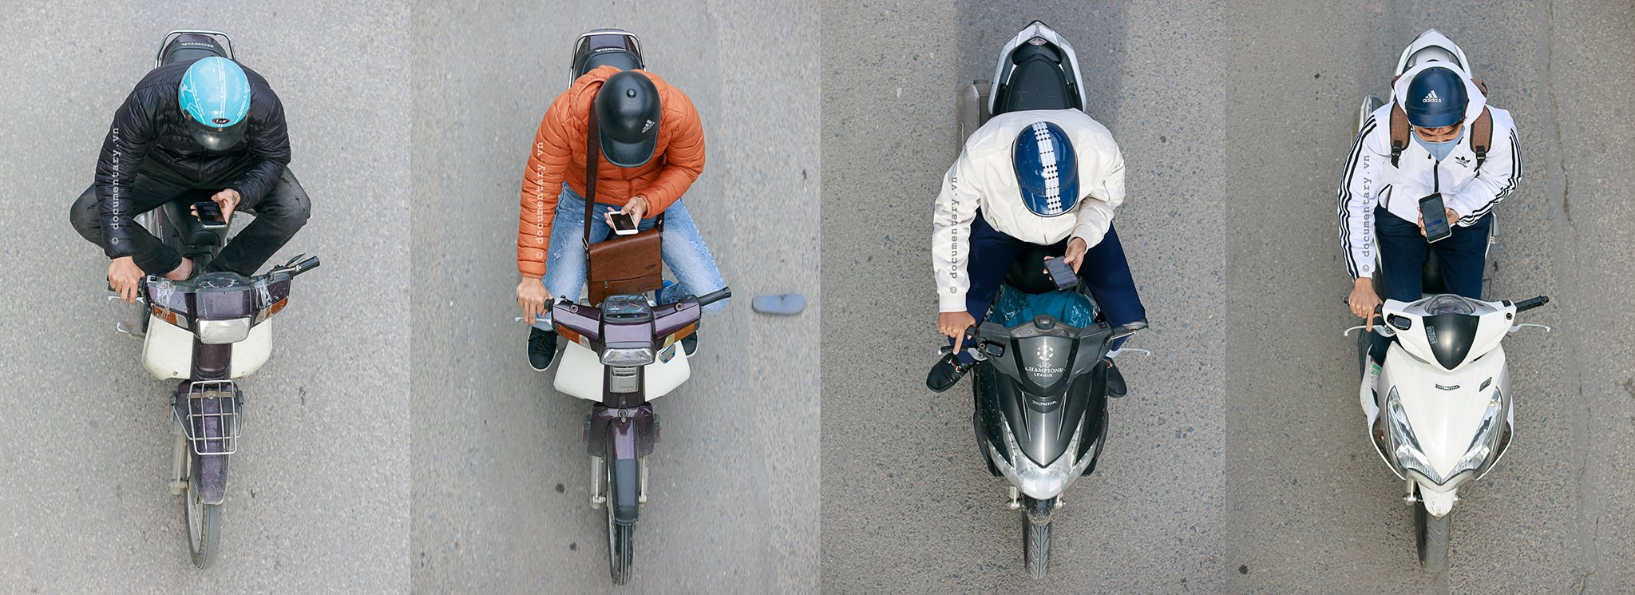
VIETNAM – TYPICAL MOTORCYCLING COUNTRY (2020)

Slide 4
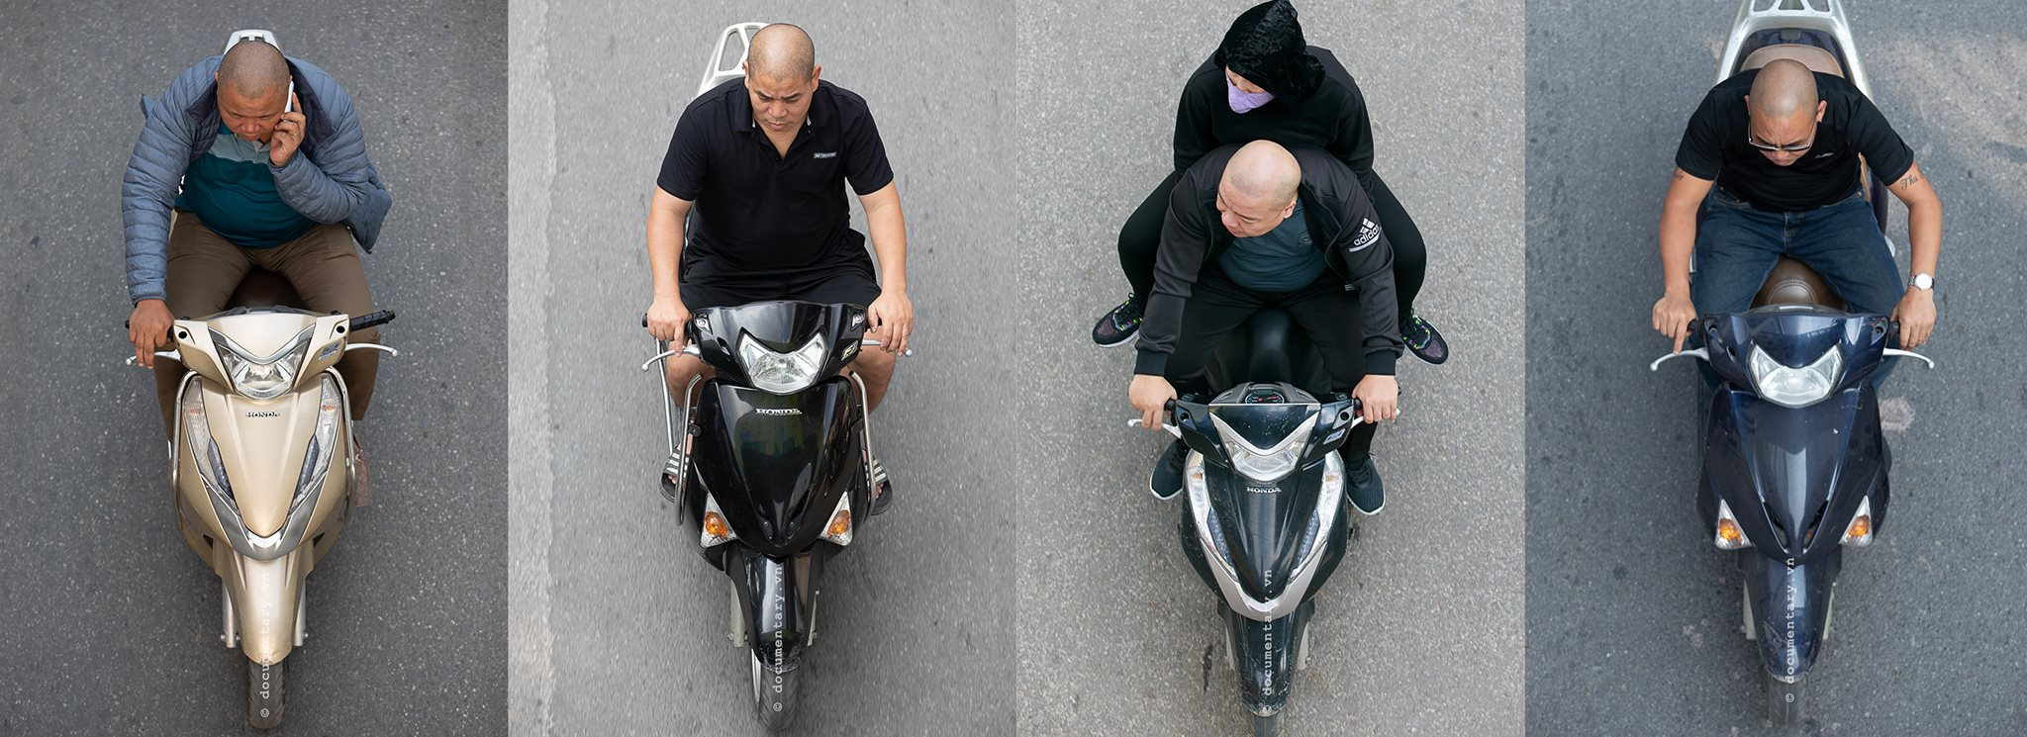
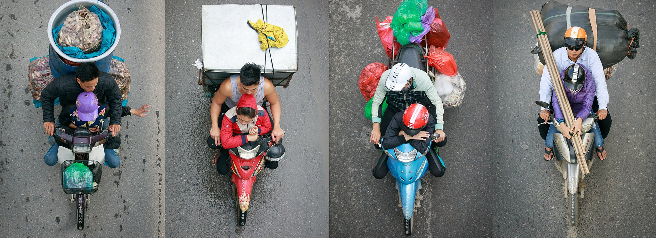
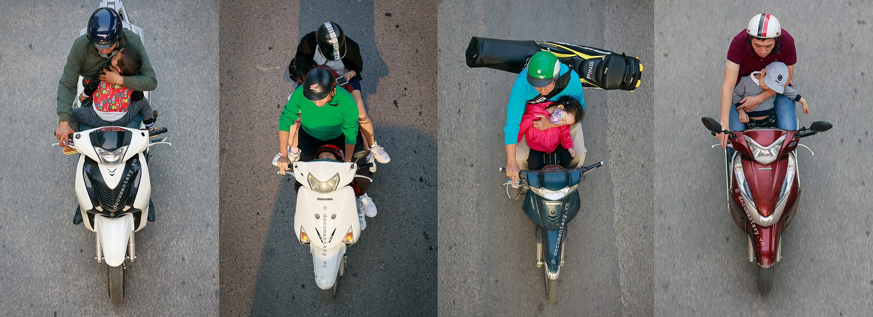
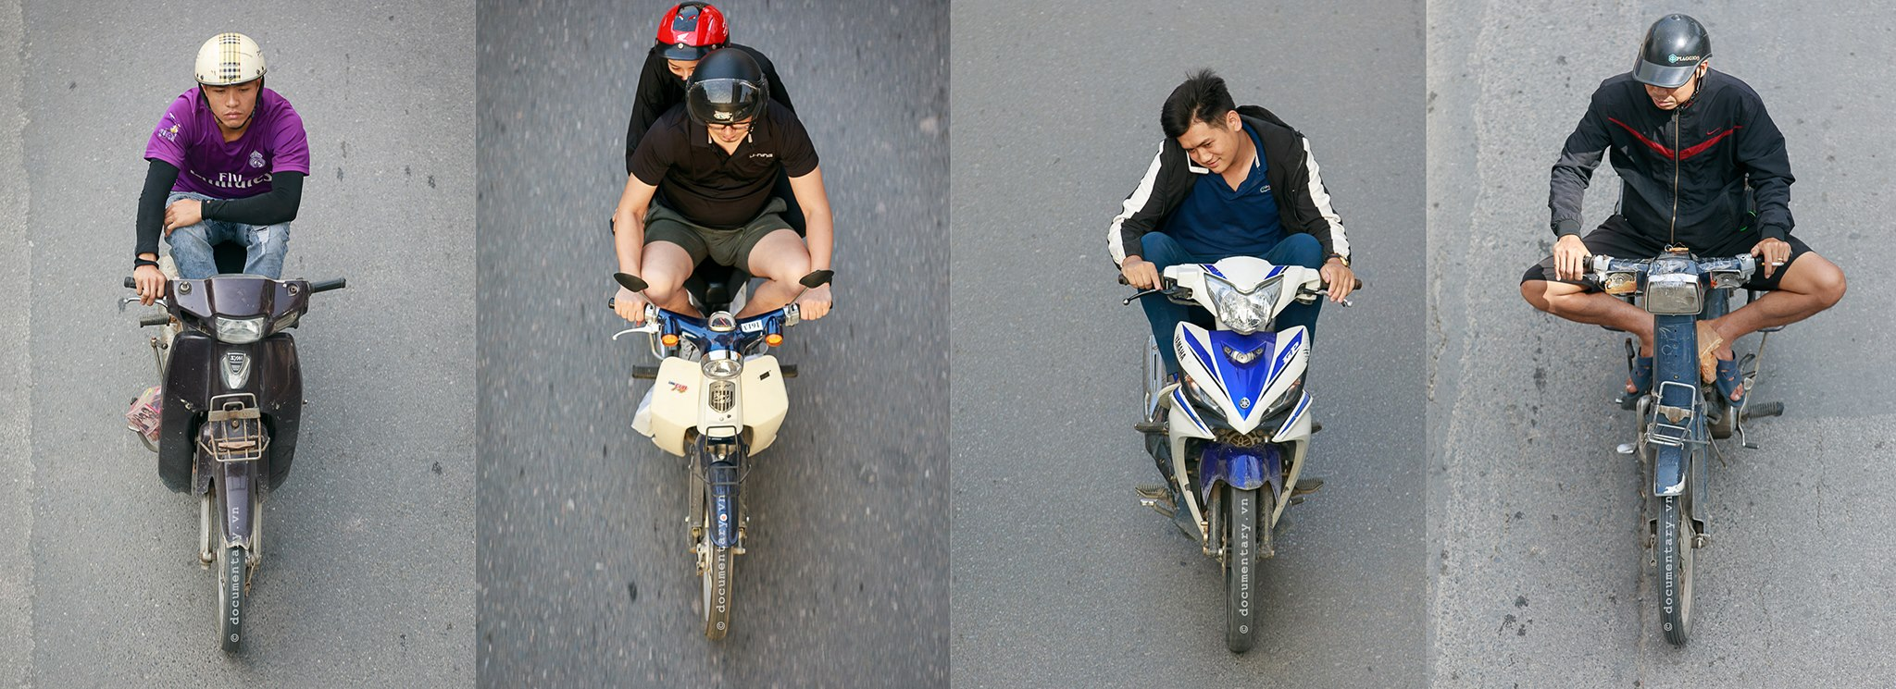
VIETNAM – TYPICAL MOTORCYCLING COUNTRY (2020)

Slide 5
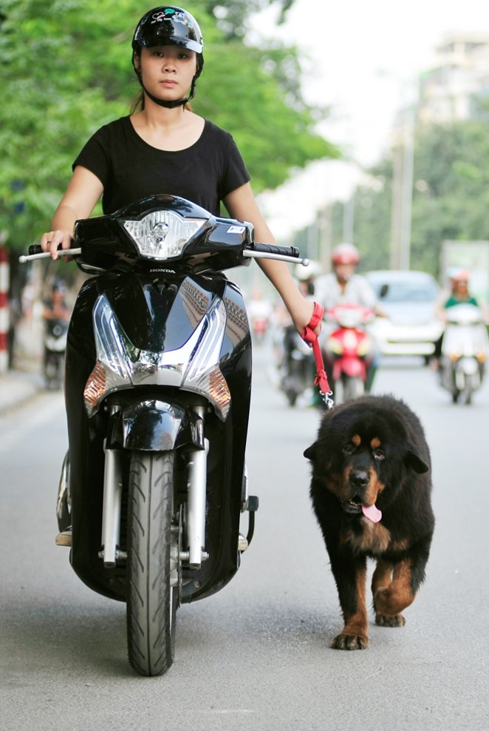
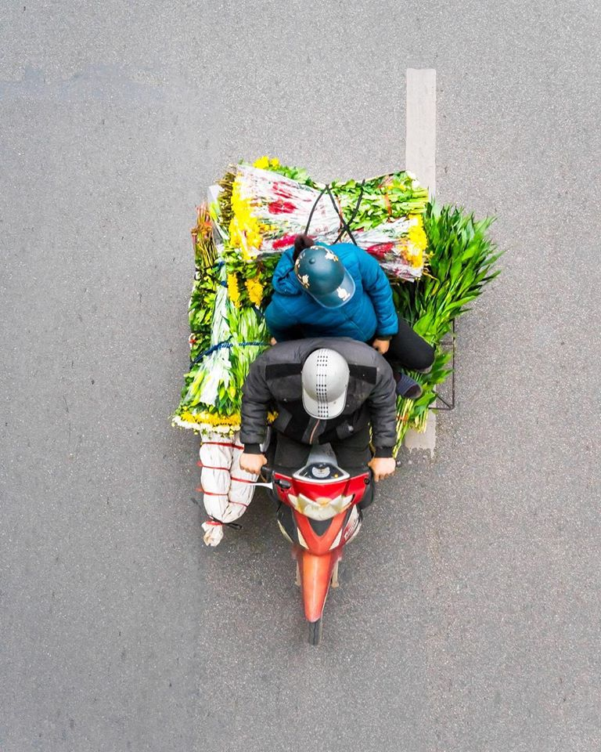

VIETNAM – TYPICAL MOTORCYCLING COUNTRY (2020)

Slide 6

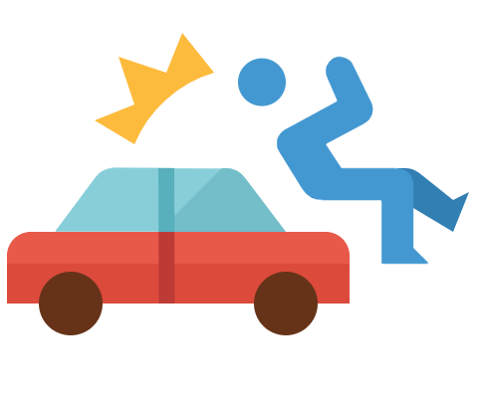



VIETNAM – TYPICAL MOTORCYCLING COUNTRY (2020)
86% of the households owning at least one motorcycle
8.177 road traffic accidents occurred
6.575 people were killed on-road
4.354 road users were seriously injured
>90% of victims were motorcyclists and their passengers

Slide 7
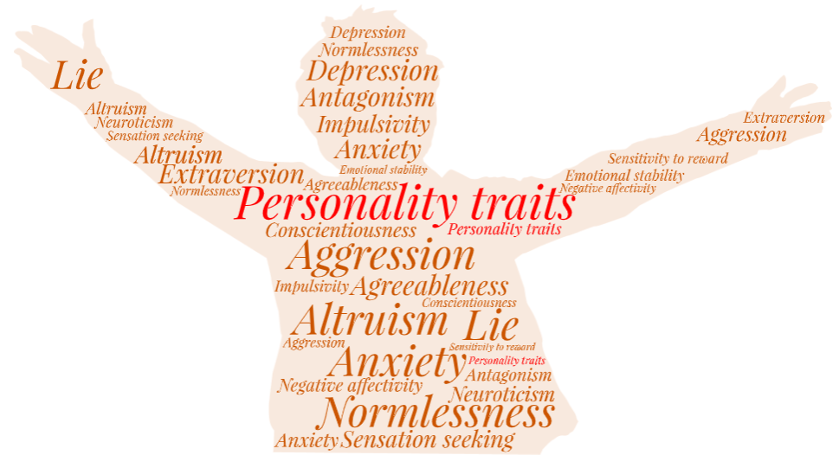
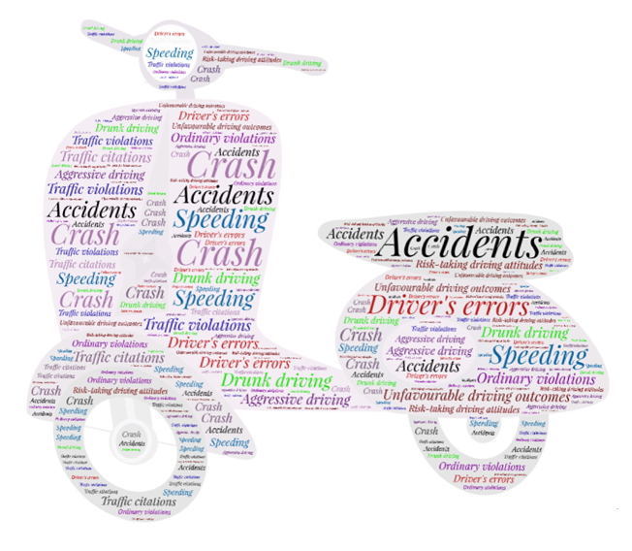
PERSONALITY TRAITS (PT) & DRIVING OUTCOMES
PT have long been approved as important factors that were firmly linked with
risky driving behaviours (RDB) and on-road hazards

Slide 8
PT - ATS - RDB
PT may influence dangerous driving tendencies both directly and indirectly through the effects of ATS
Integrating both PT and ATS approaches effectively contributed to a comprehensive understanding of the mechanisms underlying drivers' RDB.

Slide 9
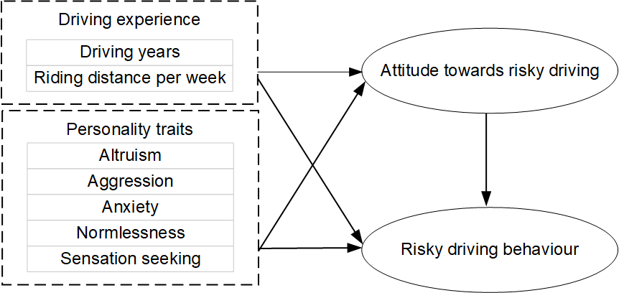
INTRODUCTION
This study investigates the relationships between the driving experience, personality traits, attitudes towards traffic safety (ATS), risky driving behaviours (RDB) and driving outcomes in a traditional motorcycling country.

Slide 10

INTRODUCTION
The main aims:
explore the differences in the driving experience, PT, ATS and RDB between motorcyclists who had adverse driving outcomes and those who did not;
analyse the relationships between those factors among Vietnamese motorcyclists.

Slide 11

METHOD
Questionnaire included four sections:
  PT – 26 items - Altruism | Anxiety | Aggression | Normlessness | Sensation seeking
  ATS – 16 items - Fun-riding | Speeding | Traffic flow vs Rule obedience
  RDB - 14 items - Self-assertiveness | Speeding | Rule violation
  Demographic background - Driving experience – Driving outcomes
1.373 valid samples were retained for further analysis
Notes:
"Willingness to do things that bring advantages to others“
"An unpleasant feeling of nervousness or concern about something that is occurring or may happen in the future“
"Spoken or physical action that threatens or involves harm to someone“
"The perception that inappropriate behaviours are required to achieve certain goals“
"Tendency to seek out varied, complex, novel, and intense experience"
These personality dimensions were found to have significant relationships with risk-taking behaviours in traffic.
"near-crash" as "dangerous traffic situations where motorcyclists are fortunate enough to escape from the collision"
"crash" as "a traffic accident involvement leading to injuries, and/or material damage".
"motorcycle crashes" as "collisions with someone or something, or coming off the bike but excluding dropping or knocking it over while parked"
"near-crash" as "almost had a crash but did not".

Slide 12

ANALYSIS
Descriptive statistical analysis: Explore the characteristics of the respondents
Cronbach alpha, Composite reliability: Assess the internal consistency of each sub-scale
Two-step SEM method: Investigate the relationship between PT, ATS and RDB

Slide 13
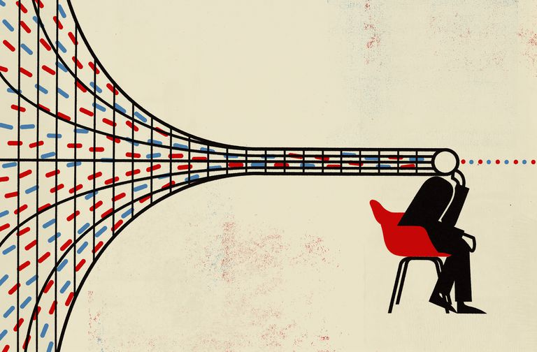
RESULTS
The mean age: 22.91 years old. 94.5% had valid driver's licences.
86.1% rode daily.
The primary reason for riding was to get to work/study locations (97.7%).
The mean time spent riding: 4.25 years.
The weekly riding distance: 81.7 kilometres.
In the last 12 months:
  58.3% had near-crash;
  32.9% had crash;
  12.6% confirmed being penalized for traffic violations.
Notes:
"near-crash" as "dangerous traffic situations where motorcyclists are fortunate enough to escape from the collision"
"crash" as "a traffic accident involvement leading to injuries, and/or material damage".
"motorcycle crashes" as "collisions with someone or something, or coming off the bike but excluding dropping or knocking it over while parked"
"near-crash" as "almost had a crash but did not".

Slide 14
RESULTS
T-Tests
There were significant gaps in terms of Driving years and RDB between those who had at least one negative driving outcome (near-crash, crash, traffic offence) last year and those who did not.
Notes:
A motorcyclist with a longer driving history and dangerous driving patterns experienced more traffic safety issues.
These sub-groups were as follows:
Motorcyclists who didn't have at least one near-crash last year (No_NC) and those who had (Had_NR);
Motorcyclists who didn't have at least one crash last year (No_C) and those who had (Had_C);
Motorcyclists who didn't commit at least one traffic offence last year (No_O) and those who did (Had_O).

Slide 15
RESULTS
T-Tests
People involved in near-crash circumstance reported greater Weekly driving distances
and higher ratings in 03 traits (Altruism, Aggression, Anxiety).

Slide 16
RESULTS
T-Tests
Normlessness & Aggression scores of people involved in Crash were significantly higher.
The No_O group had lower scores in Normlessness.

Slide 17
RESULTS
T-Tests
In all aspects of ATS, the No_O group scored more positive than the Had_O group.

Slide 18
RESULTS
STRUCTURAL EQUATION MODELING (SEM)
The CFA results indicated a good fit.
  Absolute fit indices: RMSEA=.05 <.06, PClose=.95>.05; GFI=.92>.9, SRMR=.06<.08
  Incremental fit indices: CFI=.90
  Parsimonious fit indices: Chisq/df=4.12 <5, AGFI=.90
  Each construct's square root of AVE > The inter-construct correlation coefficients => Confirming Discriminant validity
SQUARE ROOT OF AVE
Notes:
CFA was applied to assess the validity and reliability of the latent constructs of PT, ATS and RDB.
The CFA results indicated a good fit between the model and the data.
Each construct's square root of AVE was greater than the inter-construct correlation coefficients, confirming discriminant validity
The composite reliability values of all construct were higher than .6, supporting convergent validity

Slide 19
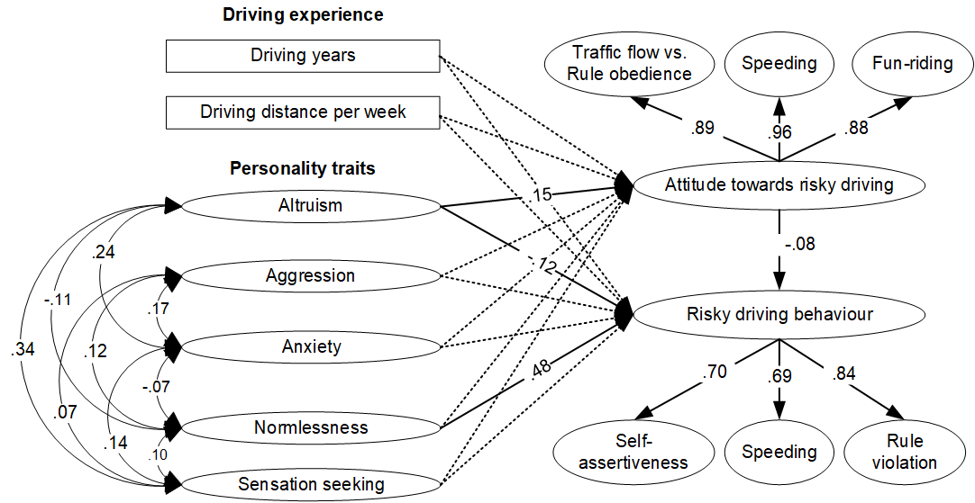
RESULTS
STRUCTURAL EQUATION MODELING
The SEM results showed a good fit.
Only Altruism positively impact ATS.
Normlessness and Altruism directly influenced RBD.
The impact of ATS on RBD was significantly negative.
Notes:
We performed SEM analysis to investigate the model proposed. dashed line indicates non-significant path
The impact of ATS on RBD was significantly negative, meaning that the more positive attitude, the less likely that driver exhibited unsafe driving behaviours.
All coefficients had expected signs.
ATS partially mediated the interaction between Altruism and RDB among the Vietnamese sample.
Vietnamese with high scores on Altruism was likely to have positive ATS and less likely to exhibit RDB.
Normlessness positively correlated with RDB without mediation.
Motorists with higher scores in Normlessness trait faced more traffic problems.

Slide 20
FINDINGS
The more driving years in a disordered traffic system - The more likely they experience adverse situations
Motorcyclists
  performed RDB more frequently => more likely to had negative traffic outcomes
  with more positive ATS => less likely to be fined for the Violation
  with high scores on Aggression => had greater probabilities of near-crash / crash
  with a high level of Normlessness => more likely to have accident involvement, traffic violations
  scored higher on Anxiety => near-crash occurred more often
Notes:
Normlessness must be seriously taken into account when developing road safety policy.
Policy-makers should prioritise impacting and raising riders' ATS to reduce RDB and traffic offences in Vietnam

Slide 21
CONCLUSIONS
This research demonstrated the relationships between the driving experience, PT – ATS – RDB in a traditional motorcycling country.
Vietnamese motorcyclist with certain traits were more likely to commit RDB or involve in traffic accidents, those individuals should be identified and accommodated through relevant personality change interventions during the motorcycle safety courses.
Future studies may delve deeper by supplementing other representative PT of Vietnamese to reveal their relationships with traffic risk factors.

Slide 22




THANK YOU

