Slide 1


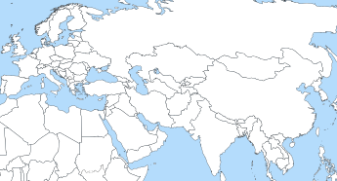

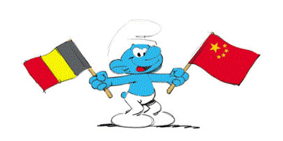

Biography
Hangbiao SONG
2019.09- Doctoral candidate Geomechanics
University of Liege, Belgium
Join Project: EURAD - WP HITEC
2016.09-2019.07 Master degree Geotechnical engineering
Hohai University, China
2012.09-2016.07 Bachelor degree Civil engineering
Henan University, China
Grant
China Scholarship Council (CSC)
NO.201906710096
Notes:
Within task 2, we planned to focus especially on the subtask 2.2, dedicated to advection, with the aim of conceptualizing the gas transport mechanisms at micro and macro scales.
To that end, we are interested:
- on the one hand in gas transfers through the excavation damaged zone
- on the other hand in gas migrations in the sound rock layers

Slide 2
Motivation and aims
In the Near Field (EDZ)
The heat generated by the radioactive waste may affect the transport properties of the host rock
  Discrepancy of thermal expansion between water and clay rock [1]
  Over-pressure induces fracture re-opening or propagation [2]
  Alter the transport properties, i.e. permeability
In the Far Field
The zone located half-way between two cells will be subjected to tensile or shear failure [3]
  Thermal loading from both sides (distance, intensity)
  Reactivate old fractures or faults
Clay rocks
P_{w}
Pore water
Surface
Clay rock
…
…
Cell
Question:
How good are the current THM models in representing the stress changes at repository conditions?
-1000 m
Notes:
So far, our work focussed on the modelling of gas transfers in the EDZ.
The first objective was to develop a numerical model capable of reproducing the argillaceous rock environment surrounding the deep geological disposal. It can first be considered as a multiphysics porous medium. Moreover to properly model the localisation processes characterizing this zone, we have rather recourse to a model of second gradient type. And finally, a permeability evolution with strain has also been integrated into the model.
This model is currently operational
The second objective was to applied the developed model to the case of a large-scale gallery. At the present time, we have reached the final stage of these simulations, by performing a sensitivity study to highlight the effect of permeability variations, the effect of variations of H2 entry pressure or the influence of the type of gas relative permeability formulation
The last part of this task is to present and publish the results to the scientific community. The writing of an article is under process while the presentation of the results had to be postponed due to the crisis. This last point appears to be the only noticeable effect of the current situation on our work.

Slide 3
Motivation and aims
« Subtask 2.3 – Influence of Temperature on Clay-Based Material Behaviour »
Numerical code: Lagamine created by ULiege[4-5]
Step 1 Develop a thermo-mechanical model for clay rock
  Near field and far field
  Elastic-visco-plastic model
  Represent the response of clay rocks to extensional stress pathways
Step 2 Develop a microstructured model for thermo-mechanical application
  Thermal-mechanical effects
  Reproduce the strain localization in EDZ
Step 3 Perform 2D/3D FE modelling of a conceptual storage drift
  Investigate the effect of clay rocks parameters on physical response
Notes:
The next task will focus on the gas transfers in the sound rock layers and for this part we planned to go from the macroscale to the microscale.
The first phase will aim to develop at the microscopic scale the hydraulic model of gas flow in a low permeability medium, without taking into account the mechanical behaviour of the matrix, which will include the definition of a discrete channel flow model in the form of a capillary network, its numerical implementation and validation against the literature.
The second phase will aim to complexify the purely hydraulic model develop previously by adding the constitutive law of the mechanical behaviour of the clay rock established on the same representative elementary volume of the microstructure, taking into account the influence of the mechanics on the flow as well as the influence of the flow on the mechanics.
The third phase will aim at integrate the HM model derived at the microscopic scale into the pre-existing FE2 framework in the FE code, which will make it possible to calculate the macroscopic flow from homogenization and localisation equations by assuming a periodicity of the microscopic structure. Then the numerical lab tests will be simulated to validate the model and finally, a variability study at the scale of the sample will be performed to identify the pores connected to the scale of the sample, to those forming a closed porosity.
This second task is going to start next semester.

Slide 4
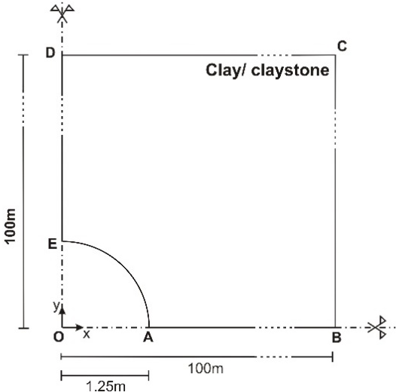
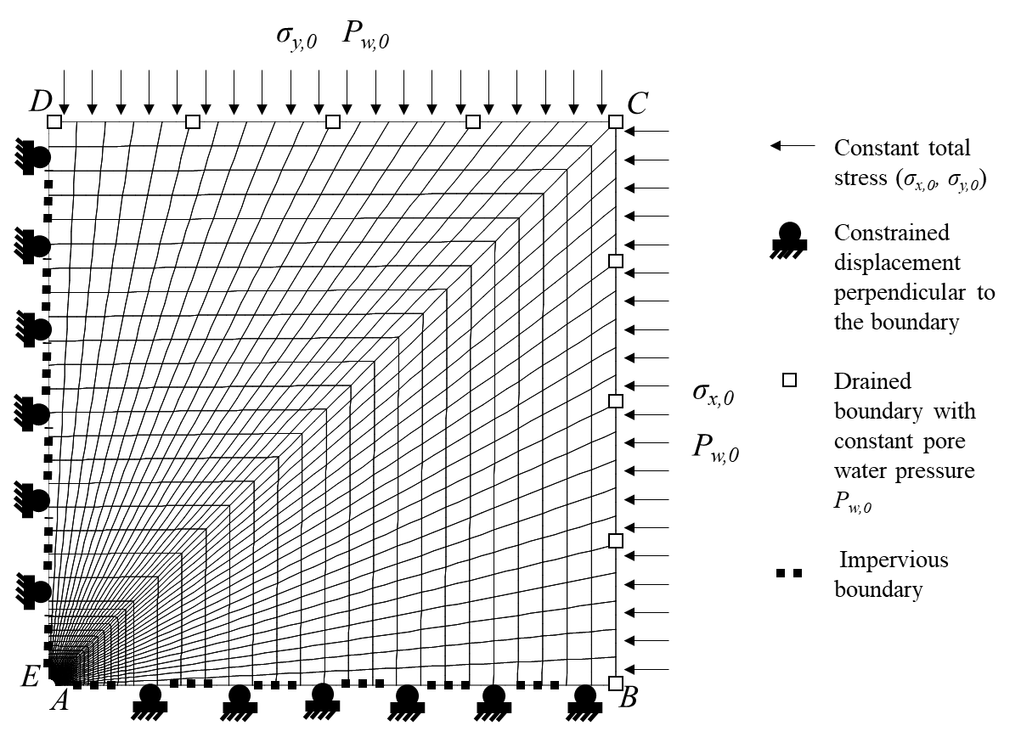
Current work
« Subtask 2.3 – THM modelling of effect of temperature in near and far field: selection of benchmark exercises »
2D generic models:
Elastic isotropy + isotropic stress
Benchmark exercises focus on near-field effects of excavation and heating
Two different host rocks: Boom Clay and COx
Elastic isotropy and elastic anisotropy
Isotropic stress and anisotropic stress state
Elastic anisotropy + anisotropic stress
Notes:
Within task 2, we planned to focus especially on the subtask 2.2, dedicated to advection, with the aim of conceptualizing the gas transport mechanisms at micro and macro scales.
To that end, we are interested:
- on the one hand in gas transfers through the excavation damaged zone
- on the other hand in gas migrations in the sound rock layers

Slide 5
References
S. Ghabezloo, J. Sulem, Stress dependent thermal pressurization of a fluid-saturated rock. Rock Mech. Rock Eng., 42(1):1-24, 2009.
Y.C. Feng, J.F. Jones, K.E. Gray, A Review on Fracture-Initiation and -propagation pressures for lost circulation and wellbore strengthening. SPE Drill. Completion, 31(2): 1-11, 2016.
X.L. Li, TIMODAZ: A successful international cooperation project to investigate the thermal impact on the EDZ around a radioactive waste disposal in clay host rocks. J. Rock Mech. Geotech. Eng., 5(3): 231-242, 2013.
B. Pardoen, J. Talandier and F. Collin, Permeability evolution and water transfer in the excavation damaged zone of a ventilated gallery, International Journal of Rock Mechanics and Mining Sciences, 85, 192-208, 2016.
B. Pardoen and F. Collin, Modelling the influence of strain localisation and viscosity on the behaviour of underground drifts drilled in claystone, Computers and Geotechnics, 85, 351-367, 2017.
Notes:
References

