Slide 1
Do standardised genotypes in Hardy-Weinberg equilibrium enhance local breeds assignment accuracy?
EAAP Annual Meeting 2021
H. Wilmot^{1,2} and N. Gengler²
¹National Fund for Scientific Research (F.R.S.-FNRS), Rue d'Egmont, 5, 1000 Brussels, Belgium
² TERRA Research and Teaching Centre, Gembloux Agro-Bio Tech, University of Liège, Passage des Déportés, 2, 5030 Gembloux, Belgium

Slide 2
EAAP Annual Meeting 2021
Introduction
Importance of inclusion of animals with unknown pedigree to Herdbook of endangered breeds
Ongoing development of genomic tools for breed assignment
1

Slide 3
EAAP Annual Meeting 2021
To study the impact of four pre-treatments modalities
No pre-treatment (A)
Standardization of genotypes (B)
HW equilibrium filter (C)
Standardization of genotypes in HW equilibrium (D)
On the performances of a genomic breed assignment tool developed for three local endangered cattle breeds
https://doi.org/10.1111/jbg.12643
2

Slide 4
EAAP Annual Meeting 2021
Introduction
Importance of inclusion of animals with unknown pedigree to Herdbook of endangered breeds
Ongoing development of genomic tools for breed assignment
Impact of pre-treatments on their accuracy and performances?
3

Slide 5
EAAP Annual Meeting 2021
Objectives
To study the impact of four pre-treatments modalities
No pre-treatment (A)
Standardisation of genotypes (B)
HW equilibrium filter (C)
Standardisation of genotypes in HW equilibrium (D)
On the performances of a genomic breed assignment tool developed for three local endangered cattle breeds
4

Slide 6
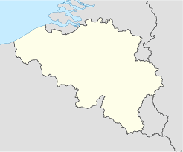
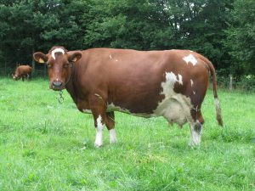
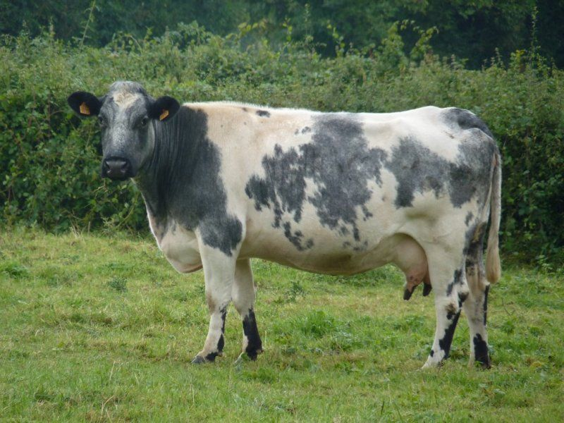
EAAP Annual Meeting 2021
188 East Belgian Red and White (EBRW)
Belgium
1364 Dual-Purpose Belgian Blue (DPBB)
84 Red Pied of Ösling (RPO)
Luxembourg
5

Slide 7
EAAP Annual Meeting 2021
Development of the model
Consequence of pre-treatments on SNPs panel selection by partial least squares-discriminant analysis (PLS-DA):
A: 2,084 SNPs
B: 2,005 SNPs
C: 1,930 SNPs
D: 1,843 SNPs
Classification using nearest shrunken centroids (NSC)
6

Slide 8
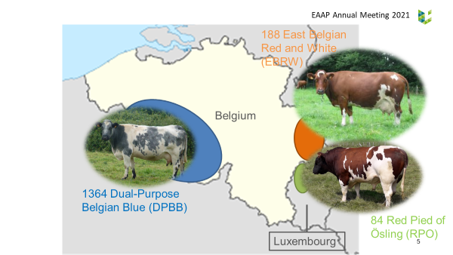
EAAP Annual Meeting 2021
Percentage of correct assignment
7
Notes:
No significant differences/ B and D performs better for EBRW and RPO/ Larger CI for breeds with less animals to test

Slide 9
EAAP Annual Meeting 2021
Distribution of EBRW animals per probability interval
8

Slide 10
EAAP Annual Meeting 2021
Distribution of EBRW animals per probability interval
Mean | 98.79% | 99.21% | 99.13% | 98.66%
SD | 4.68% | 4.50% | 4.28% | 4.85%
9

Slide 11
EAAP Annual Meeting 2021
Overlap of proportion of discarded animals per number of models
10
Notes:
Models are mostly in agreement. It is however less the case for EBRW.

Slide 12
EAAP Annual Meeting 2021
Distribution of discarded DPBB animals per probability interval
11

Slide 13
EAAP Annual Meeting 2021
Distribution of discarded DPBB animals per probability interval
Mean | 95.57% | 99.15% | 95.44% | 96.95%
SD | 11.81% | 2.25% | 10.29% | 7.09%
12

Slide 14
EAAP Annual Meeting 2021
Distribution of discarded EBRW animals per probability interval
13

Slide 15
EAAP Annual Meeting 2021
Distribution of discarded EBRW animals per probability interval
Mean | 90.98% | 89.50% | 82.42% | 88.30%
SD | 10.47% | 20.31% | 19.82% | 17.12%
14

Slide 16
EAAP Annual Meeting 2021
Distribution of discarded RPO animals per probability interval
15

Slide 17
EAAP Annual Meeting 2021
Distribution of discarded RPO animals per probability interval
Mean | 92.15% | 98.36% | 96.87% | 92.39%
SD | 15.76% | 3.00% | 5.32% | 12.09%
16

Slide 18
EAAP Annual Meeting 2021
Conclusion
There are no significant differences of performances for any of the pre-treatment modalities
No clear pattern Case by case
In general, the standardisation (B) shows slightly better results in terms of animals to be included and of probabilities to belong to the breed
Hardy-Weinberg equilibrium filter probably does not add/retrieve relevant information
Difficult to make the distinction between the number of SNPs and the effect of the pre-treatment by itself
17

Slide 19
Thank you for your attention! Questions?
Hélène Wilmot
PhD Student
Helene.Wilmot@uliege.be

