Slide 1
Bringing symmetry between and within safety and security cultures
Colin Glesner - 15/10/2020

Slide 2
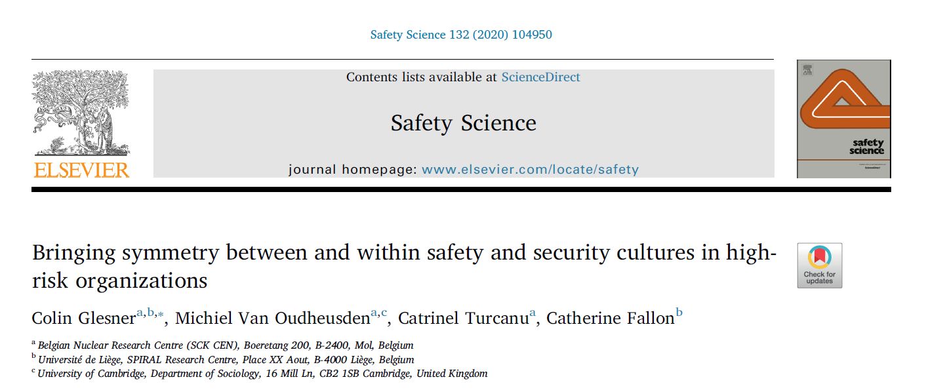
What do ‘safety culture’ and ‘security culture’ encompass and how do they relate to each other ?
Literature analysis: academic literature, institutional and policy documents

Slide 3
“safety culture” and “security culture”: two gaps
Security culture concept = underdeveloped
Subordination of ‘security culture’ to ‘safety culture’
What is the interaction between safety and security cultures?
Human centric
Procedures, technologies mostly seen as passive tools

Slide 4
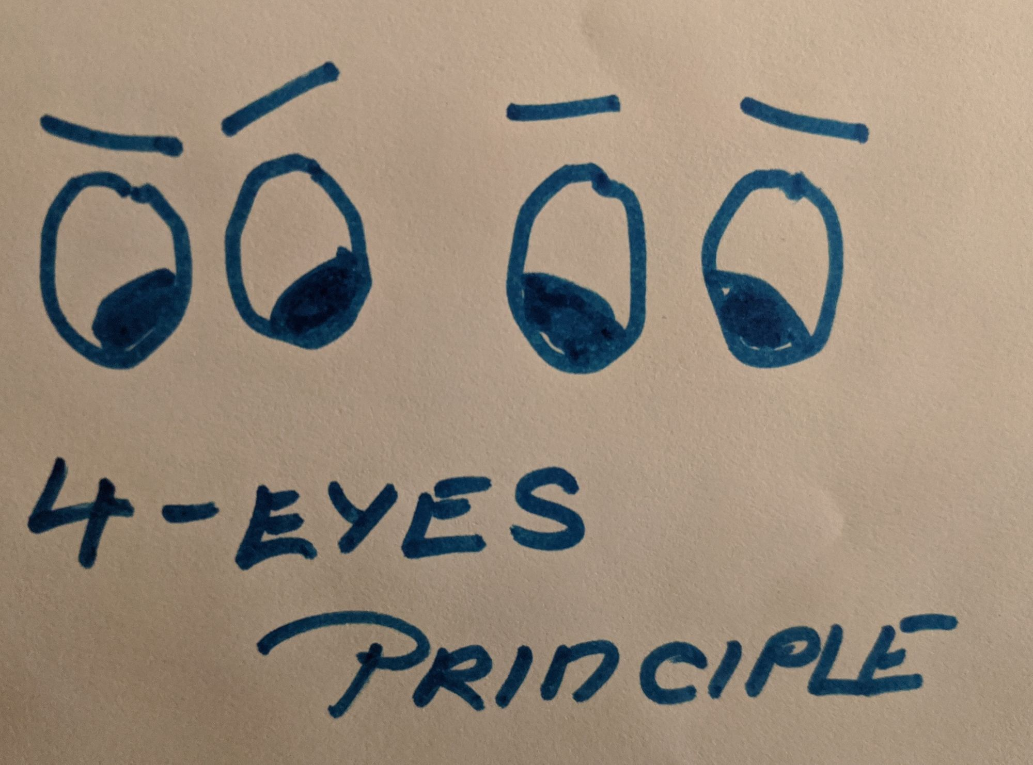
Non-humans co-produce safety and security cultures
Security culture concept = underdeveloped
Subordination of ‘security culture’ to ‘safety culture’
What is the interaction between safety and security cultures?
Human centric
Procedures, technologies mostly seen as passive tools

Slide 5
Recommendations to High-risk organizations
Investigate the mutual shaping ‘safety culture’ and ‘security culture’
Recognize the central role of materialities: technologies and procedures into s&s cultures

Slide 6
Copyright © SCK CEN
PLEASE NOTE!
This presentation contains data, information and formats for dedicated use only and may not be communicated, copied, reproduced, distributed or cited without the explicit written permission of SCK CEN. If this explicit written permission has been obtained, please reference the author, followed by ‘by courtesy of SCK CEN’.
Any infringement to this rule is illegal and entitles to claim damages from the infringer, without prejudice to any other right in case of granting a patent or registration in the field of intellectual property.
SCK CEN
Belgian Nuclear Research Centre
Foundation of Public Utility
Registered Office: Avenue Herrmann-Debrouxlaan 40 – BE-1160 BRUSSELS
Operational Office: Boeretang 200 – BE-2400 MOL

