Slide 1
Two sides of the same coin? Exploring the tensions between nuclear safety and security
Colin GLESNER - 15/10/2020

Slide 2
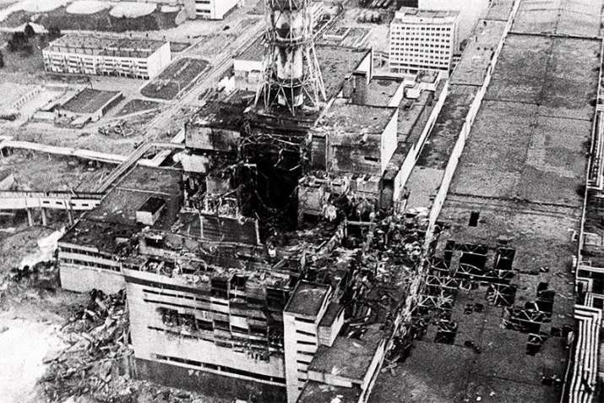
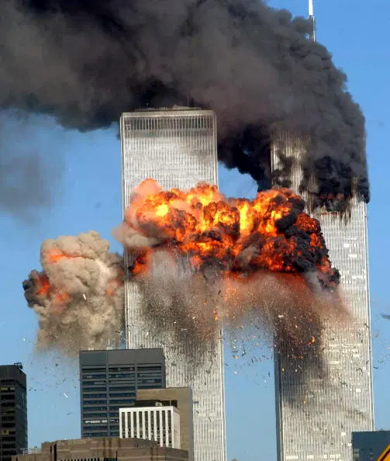
What are safety and security?
Safety
Non-malevolent and non-intentional
Security
Malevolent and intentional
Chernobyl
9/11

Slide 3
How are nuclear safety and security practiced?
Contrasting dominant imaginary on nuclear safety and security interplay with how they are practiced in a nuclear research center

Slide 4
Imagining safety and security interactions in the nuclear field
Imaginary: Collective visions of desirable futures, which also have a performative dimension, in a sense that these visions are produced and enacted in conjunction with technologies, actions and materialities in our society (Jasanoff & Kim, 2009)
Dominant international institutions:
International Atomic energy Agency (IAEA)
Western European Nuclear Regulator Association (WENRA)

Slide 5
Imagining safety and security interactions in the nuclear field
Shared overarching goal
Nuclear safety and security of research reactors have the same ultimate goal – to protect individuals, the public, and the environment from harmful effects of ionizing radiation. (IAEA, 2019).

Slide 6
Safety and security dominant imaginary
Common overarching goal
Integrated approach
Focus on synergies
Marginalize tensions
Can be avoided, overcomed
“Security measures and safety measures have to be designed and implemented in an integrated manner to develop synergy between these two areas” (WENRA, 2019)
- Passive system
- Containment structure of nuclear reactors
- Surveillance Cameras
Notes:
Put quotes on synergies
Find other instances of synergies

Slide 7
Practicing safety and security in the nuclear field: about tensions: Fieldwork
Nuclear Research Center
Developing innovative and peaceful applications of nuclear for society.
Semi-structured interviews (15)
Participant observations
Meeting observations (10)

Slide 8
Practicing safety and security in the nuclear field: about tensions
‘The [vision] we had on safety-security interface is a good way forward. But this is the conceptual [aspect], in practice, this is problematic…. Sometimes you see a difference between objectives and implementation.’ (interview with a member of the management of the NNR)
Safety and security interplay are rather tense!
Tensions: ‘the clash of ideas or principles or actions and the discomfort that may arise as a result’ (Stohl & Cheney, 2001)
multiple visions
Multiple groups of actors
Discomfort at the individual level

Slide 9
Safety & security tensions
‘I need a specialist for a unknown company to repair something very urgent. I can put five guards around this person and he can do his job and everything will be fine, but because this person is unknown for the security unit, they will not allow him access to the site.’ (interview with a member of the nuclear safety unit in the nuclear research center)
‘The labelling of hazardous materials is problematic for security reasons. It indicates where dangerous materials are located’ (interview with a member of the nuclear security unit in the nuclear research center)
‘You have the [four eyes principle] now that people always have to be in pairs to do things so they can control each other. Well, that creates a lot of mistrust. (interview with a member of the industrial safety unit in the nuclear research center)
‘There are problems of collaborations between safety and security units. The visions are a bit blocked.’ (interview with a member of the industrial safety unit in the nuclear research center)

Slide 10
Where does these tensions originate?
Roots of safety-security tensions
Organizational factors:
Lack of collaboration between units
Paradoxes
Confidentiality | Transparency
Movement restriction | Movement facilitation
Distrust | Trust
Paradoxes: Two or more elements that are sound and accepted individually, “but taken together they seem to be inconsistent or incompatible” (Poole and Van de Ven 1989, p. 563).”

Slide 11
How should the safety and security interplay be addressed?
The integrated approach ‘silences’ paradoxes between s&s
Identify paradoxes and tensions
Create venues to engage with paradoxes
Recognize their centrality in safety-security interplay
Managing paradoxical tensions also helps individuals, groups, and firms to be flexible and resilient, fostering more dynamic decision making. (Smith, 2014)
Notes:
exlplain

