Slide 1
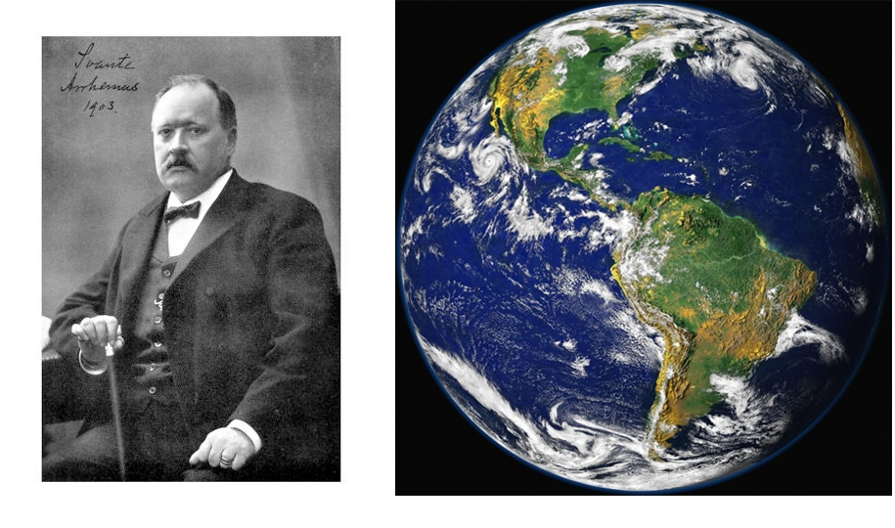
Svante Arrhenius the father of climate change (1896)
https://www.rsc.org/images/Arrhenius1896_tcm18-173546.pdf

