Slide 1
Journée micro et mini cogénérations
Tests en laboratoire et monitoring in-situ d’une installation hybride pile à combustible – chaudière à condensation
Vincent Lemort – vincent.lemort@uliege.be
Nicolas Paulus – nicolas.paulus@uliege.be
Camila Dávila – cdavila@uliege.be

Slide 2
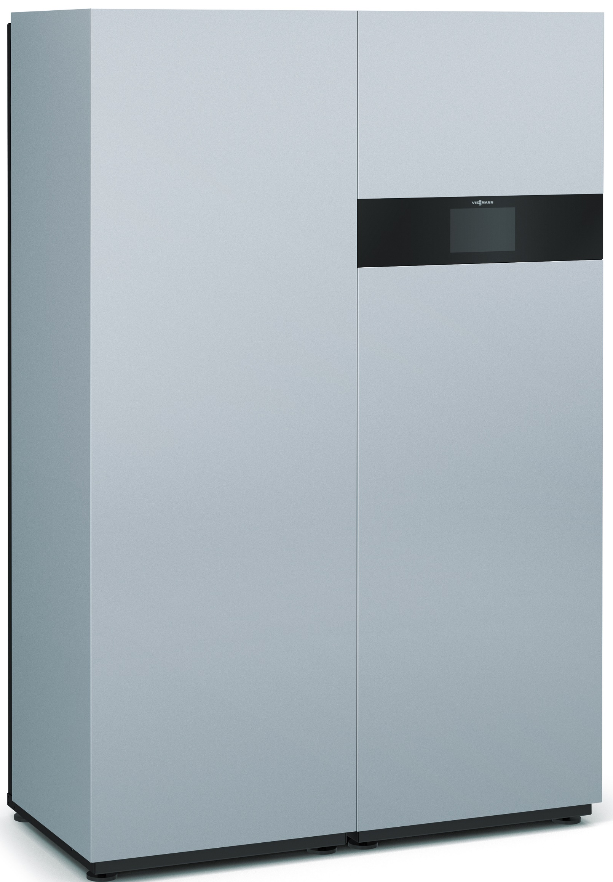
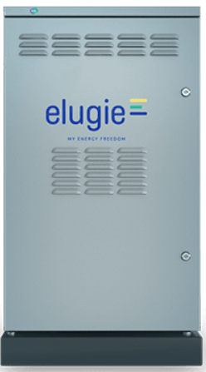
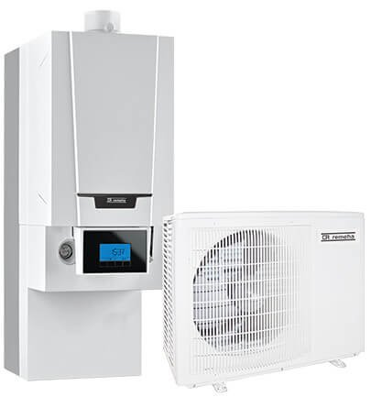
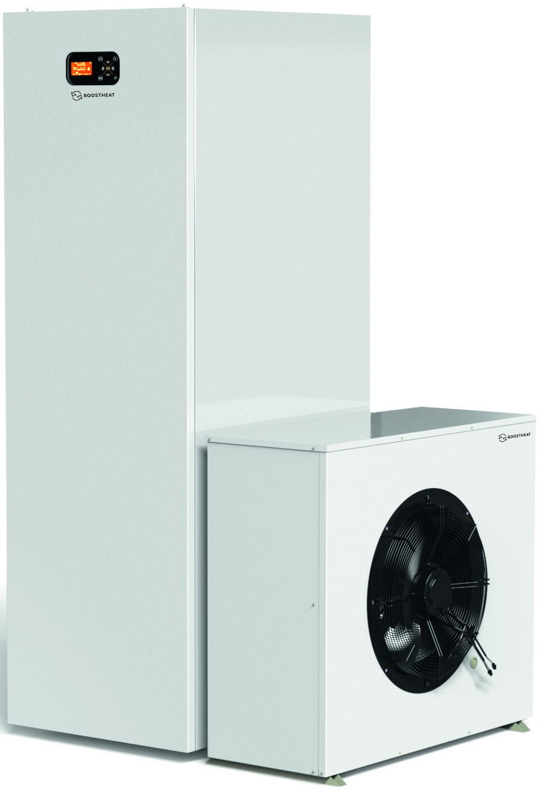
Description of the project
Collaborative study with Gas.be
Study divided on two main parts:
  Laboratory tests to estimate the energy and environmental performance of various heating and micro-CHP systems driven by natural gas.
  Monitoring in-situ of the same systems installed on residential buildings in Belgium for a two years period.
Both parts will set a basis for create modeling tools oriented to simulate the impact of choices in terms of home heating systems. Thanks to this, we will be able to perform studies for different applications and ranges of operation.
Different systems for heating and DHW
  Vitovalor PT2 PEMFC
  MyChi SOFC
  Robur K18 condensing gas absorption heat pump
  Remeha Tzerra hybrid electric heat pumps Tests on climatic chamber
  BoostHeat hybrid Gas / Air / Water heat pump

Slide 3
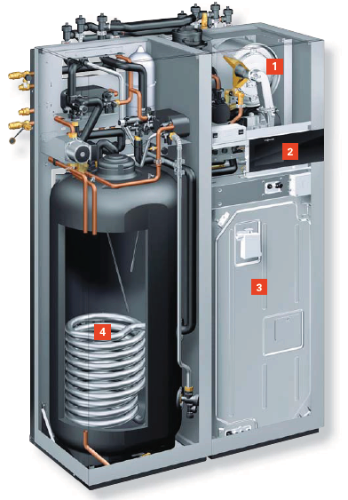
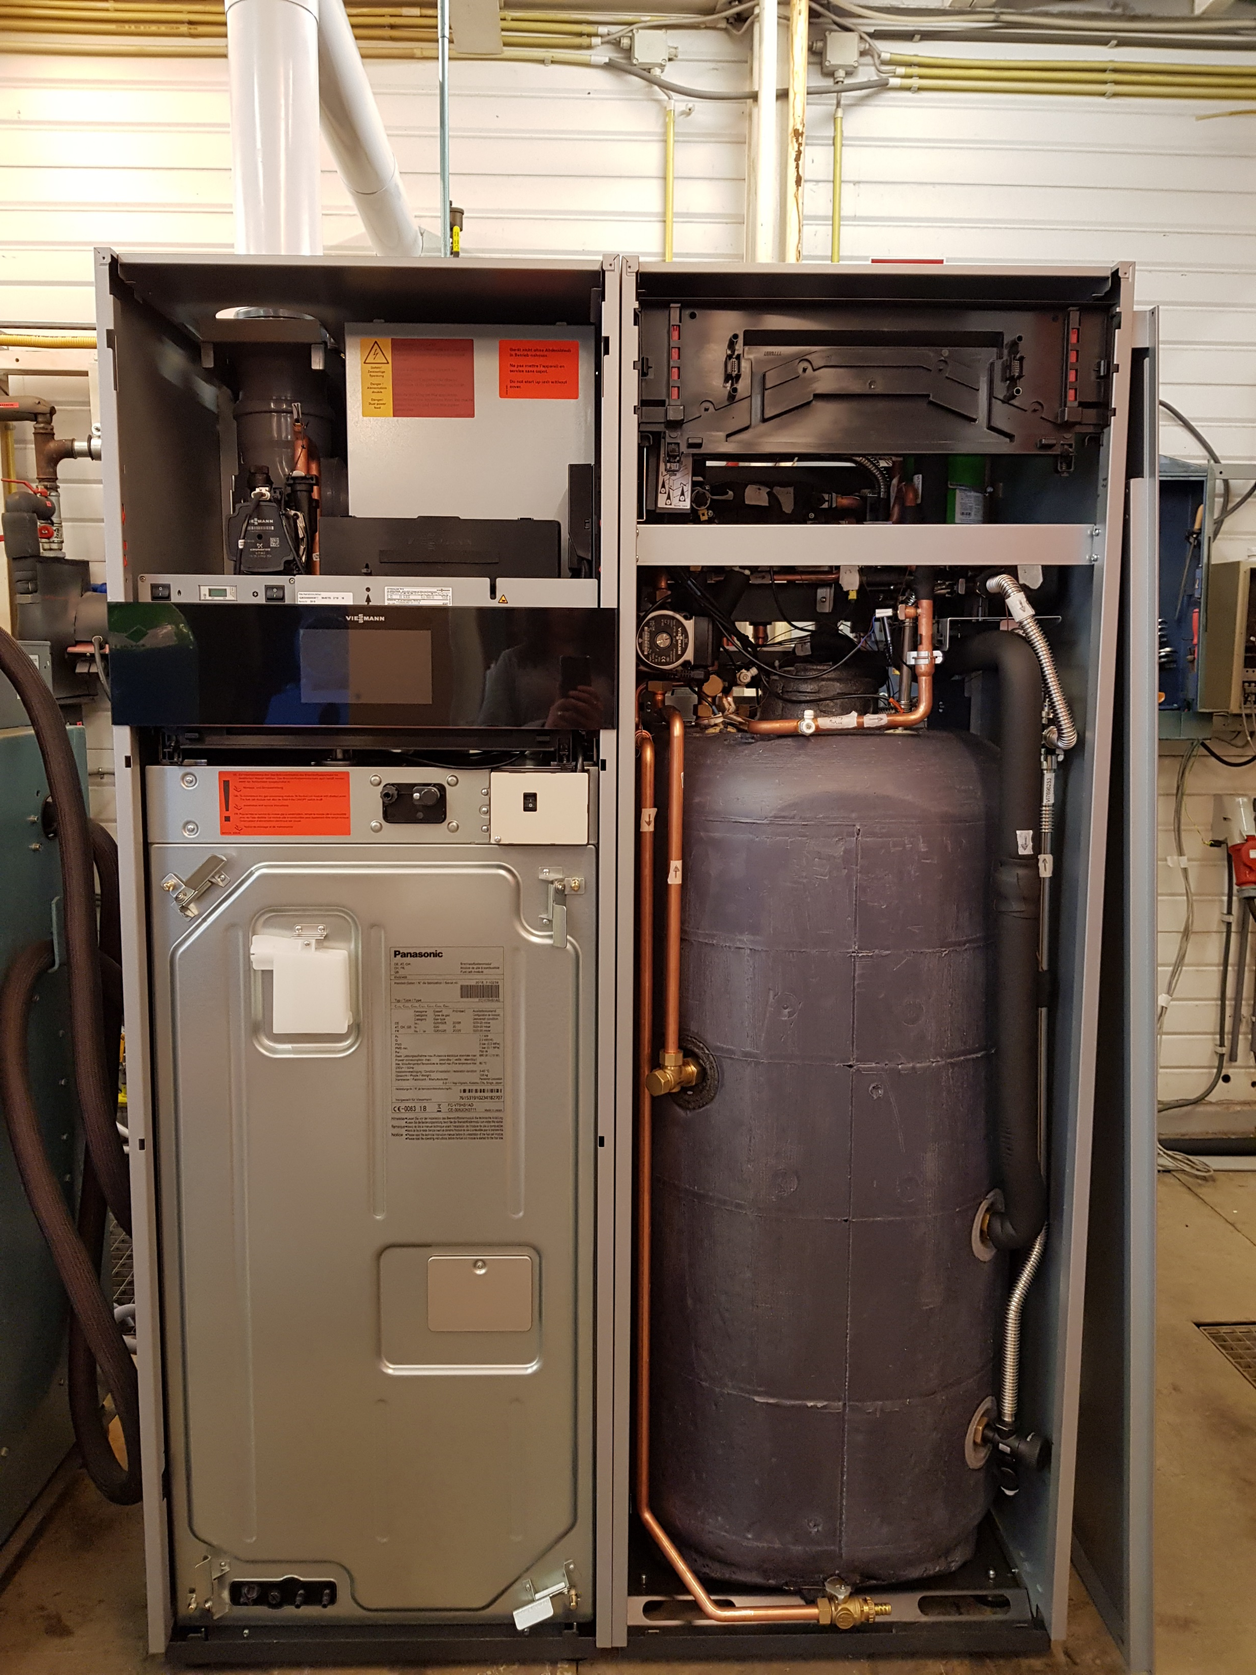
Vitovalor PT2 – Main features
Heating output | TV/TR 60/40 °C 30.8 kW TV/TR 36/30 °C 0.9 kW
Electrical output FC | 750 W
Thermal output FC | 1.1 kW
FC electrical efficiency | 37%
Overall FC efficiency | Up to 92%
Peak load boiler termal efficiency | Up to 98%
Electr. Power consumption | 28 W standby 1400 W maximum
Gas consumption | 3.38 m³/h natural gas
Permissible ambient temperature | Max.: 40°C Min.: 5°C
System intended to produce domestic hot water and heating for residential buildings
Two modules connected by four water lines:
  Generation module, composed by a PEM fuel cell on the bottom and a gas condensing boiler on top
  Storage module, composed by a 220 l stainless steel cylinder

Slide 4
Vitovalor PT2 – Water circuits and test bench diagram
Water diagram of the system
Diagram of the test bench

Slide 5
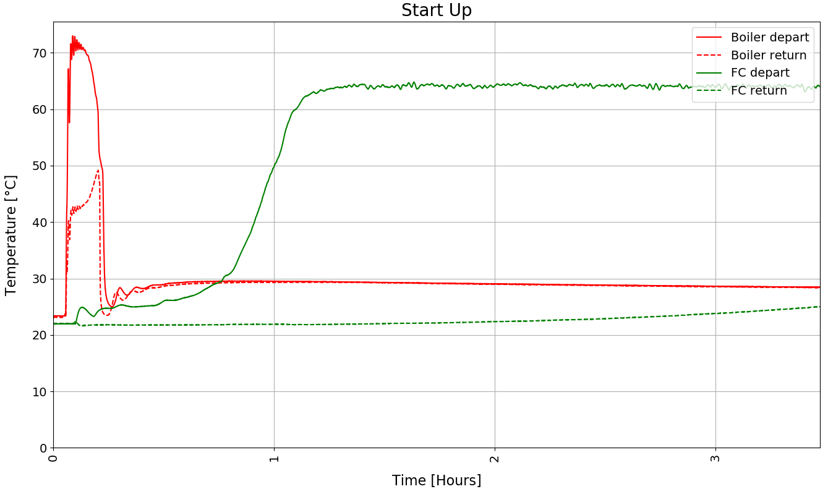
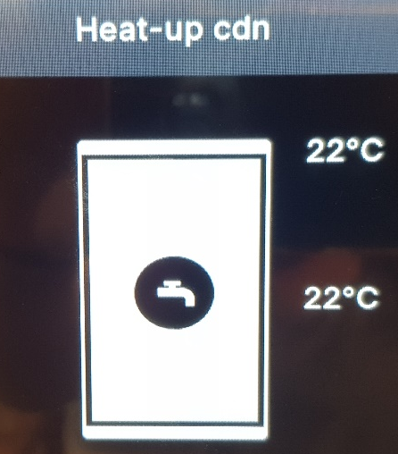
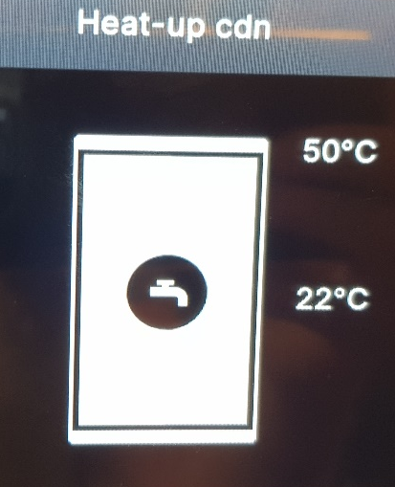
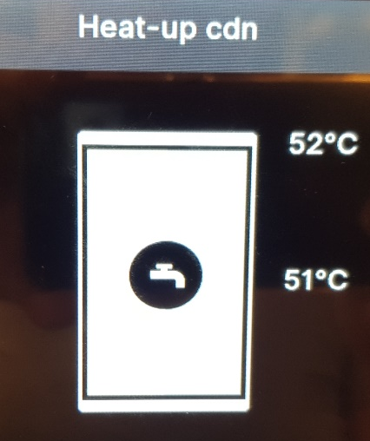
Vitovalor PT2 – Start up and internal control
Start up process
  When the heating and/or the DHW production are set “On”, heating cycles will be forced
  The initial heating process is the same and independent of the set parameters and it’s made by both the boiler and the fuel cell
  Raise the temperature of the bottom part of the tank takes around 5-6 hours and it is made by the fuel cell
  When the tank temperature goes under a certain value (e.g. heat loses or hot water demand) a new cycle starts. This was observed during the nights due to a heat and electricity production of the fuel cell
Control
  The internal control of the system does not allow the normal user to operate just with the fuel cell (this means, turn Off the boiler)
  The system is driven by heat demand. Is designed to a fuel cell start up only if the heat can be rejected to the buffer tank. This means, around 5-6 hours of continuous operation or a bottom tank temperature under 40-42°C
In conclusion, if we impose a demand, we will be using the energy stored on the buffer tank; the temperature will decrease (eventually, to 20-22°C) and we will force a new heating cycle.
Once we reach this point, we will perform the tests. Like this, we will avoid the effect of the storage on the performance estimations since all the heat produced at this point will be immediately delivered to the system that requires it. Also, both systems will have reached their maximum heat production (this means, fuel cell at full capacity and boiler on regular On/Off cycles)

Slide 6
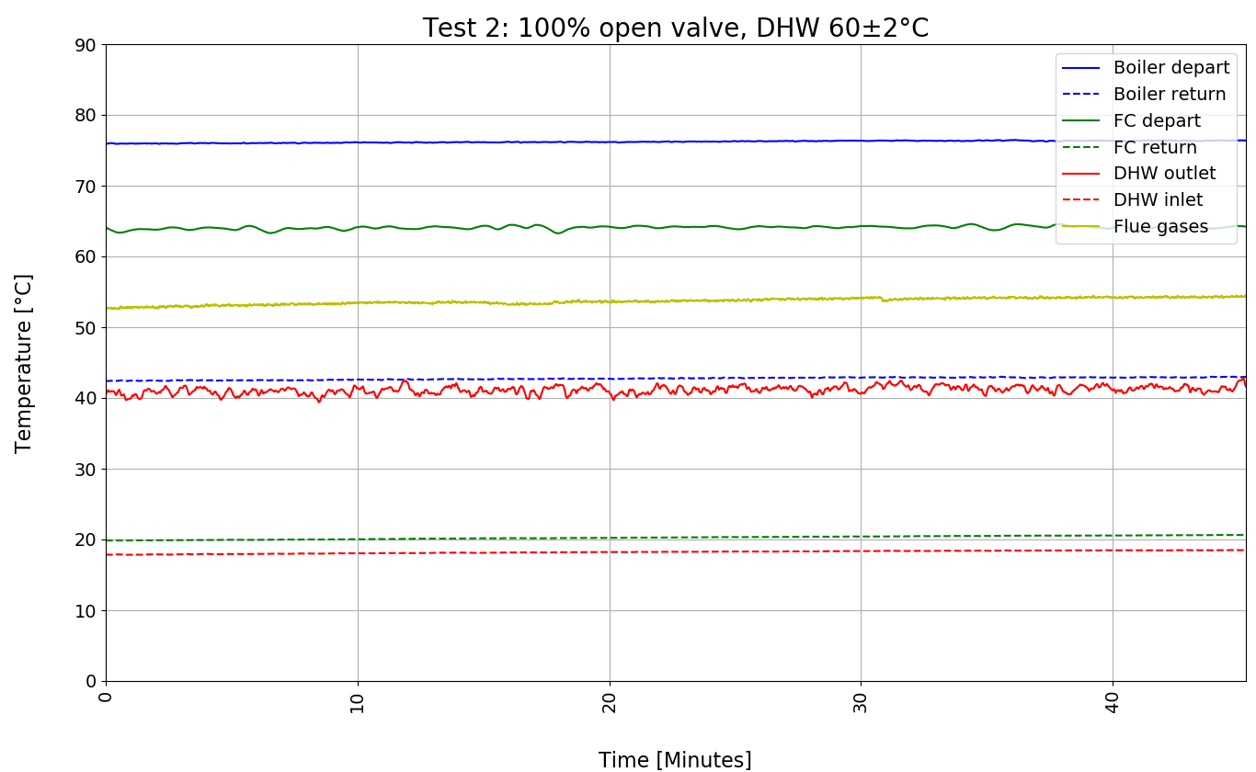
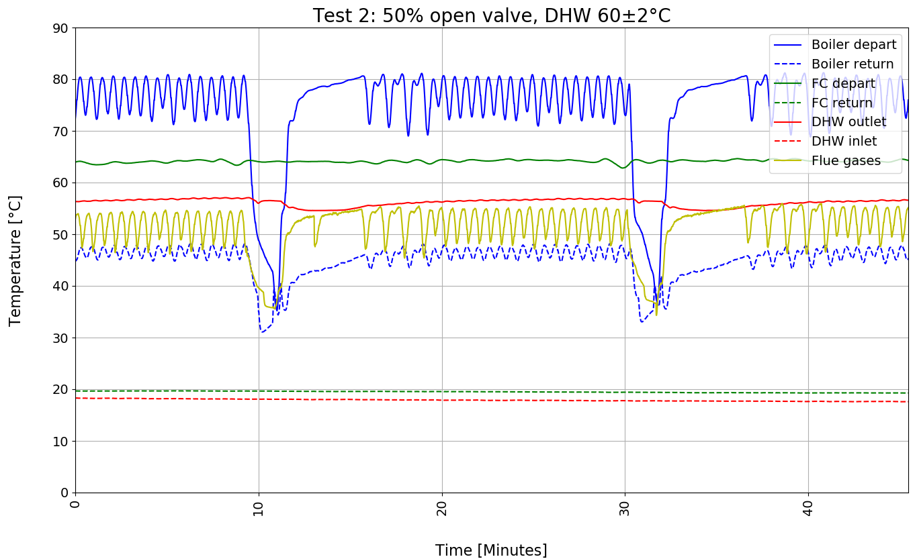
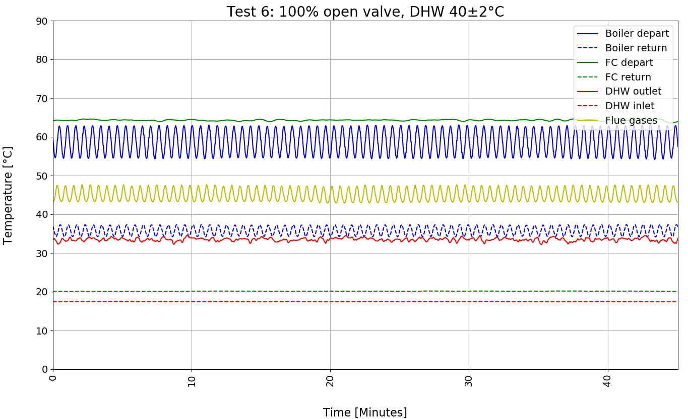
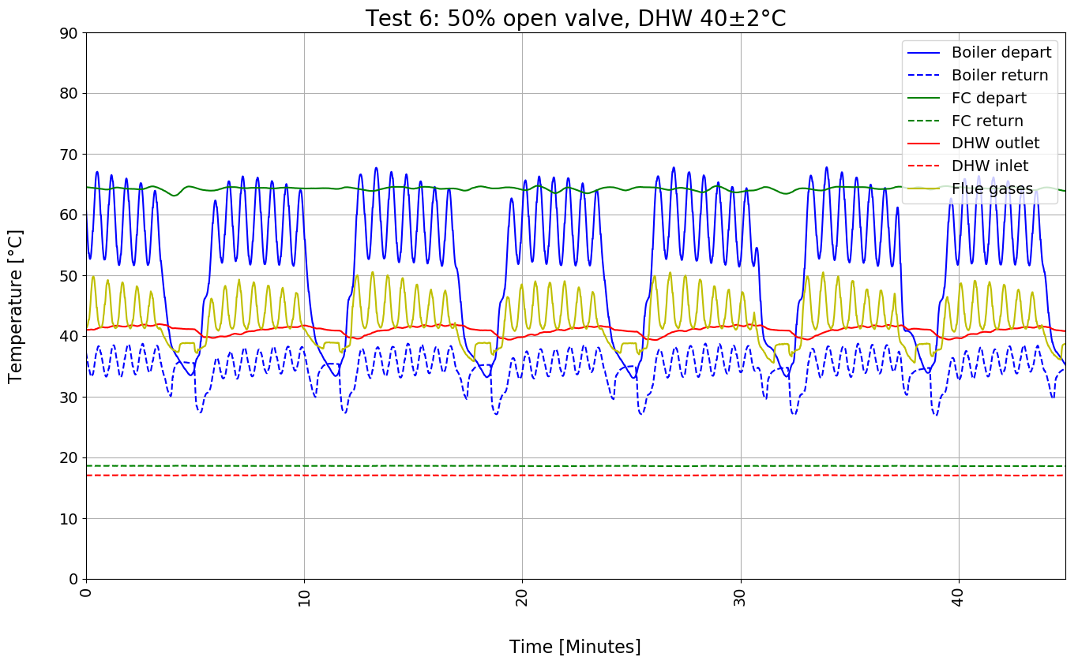
Response of the system to DHW demand

Slide 7
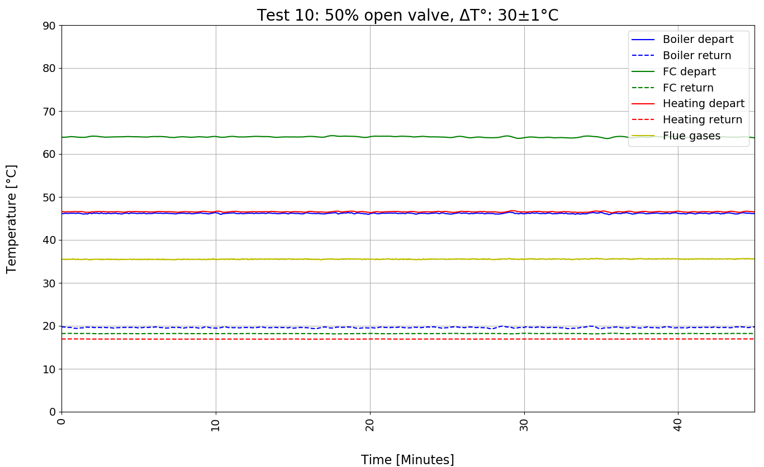
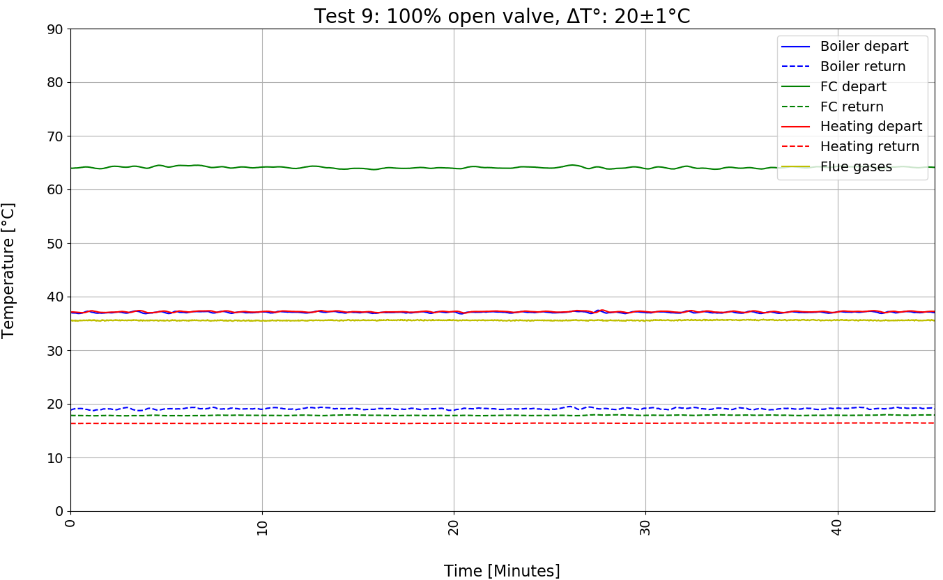
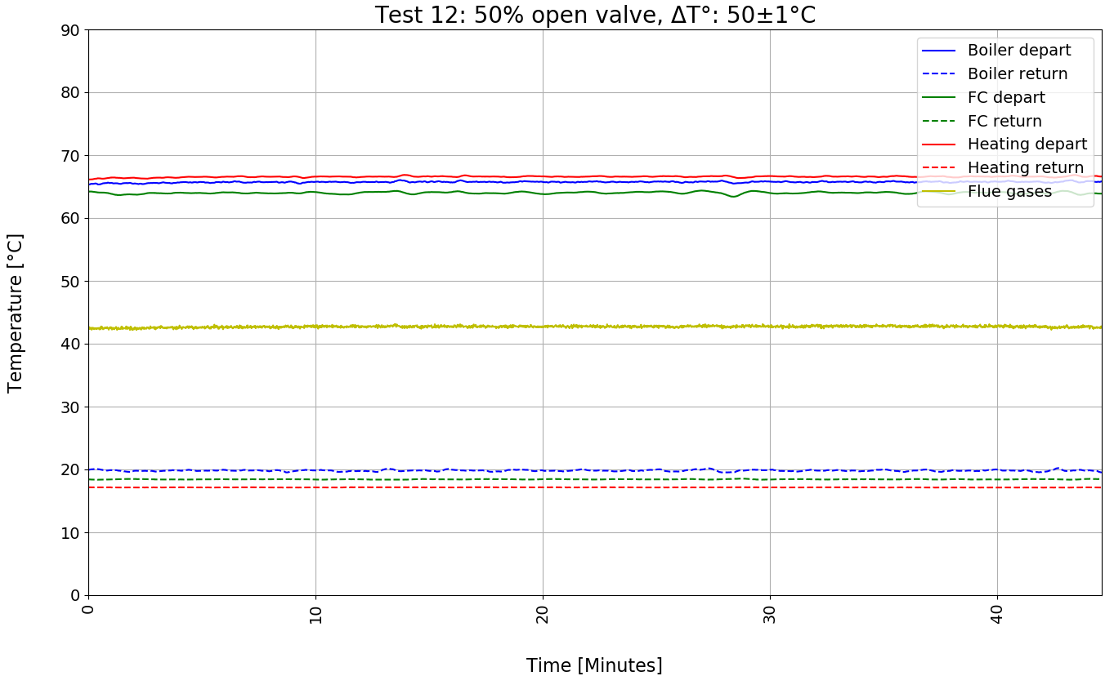
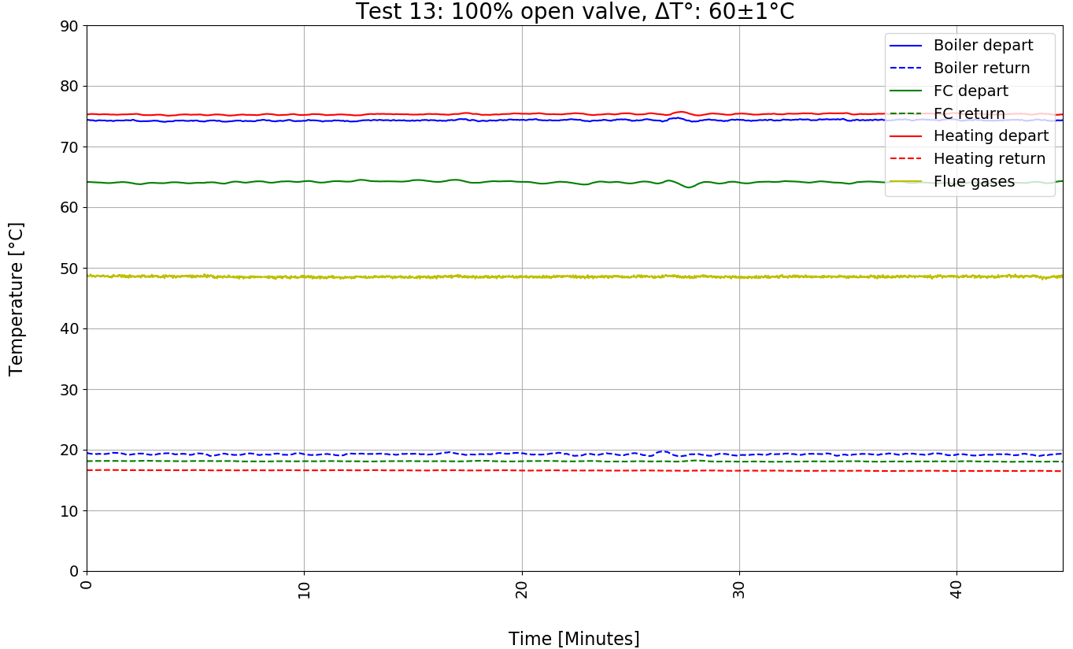
Response of the system to heating demand

Slide 8

Results – Test campaign and efficiencies
A test campaign based on EN 50465 and the restrictions of the system is proposed
For the efficiency estimations a daily value of PCS was used
The efficiencies were estimated as
𝛈$=\frac{\dot{m}∗cp∗∆T+W_{el}/1000}{{\dot{V}}_{gas}∗PCS}$
Efficiency results:
 | DHW 100% |  |  | DHW 50%
 | η_Syst | η_Th | η_El | η_Syst | η_Th | η_El
T2, DHW 60°C | 0.81 | 0.79 | 0.02 | 0.82 | 0.80 | 0.02
T3, DHW 55°C | 0.82 | 0.80 | 0.02 | 0.83 | 0.80 | 0.03
T4, DHW 50°C | 0.82 | 0.80 | 0.02 | 0.83 | 0.80 | 0.03
T5, DHW 45°C | 0.83 | 0.81 | 0.02 | 0.83 | 0.80 | 0.03
T6, DHW 40°C | 0.84 | 0.81 | 0.03 | 0.86 | 0.82 | 0.04
T7, DHW 35°C | 0.86 | 0.82 | 0.04 | 0.89 | 0.84 | 0.05
T8, DHW 30°C | 0.87 | 0.82 | 0.05 | 0.88 | 0.81 | 0.07
Proposed test campaign:
DHW |  |  | Heating
60 ± 2 °C | Valve 50% | Valve 100% | Off
55 ± 2 °C | Valve 50% | Valve 100% | Off
50 ± 2 °C | Valve 50% | Valve 100% | Off
45 ± 2 °C | Valve 50% | Valve 100% | Off
40 ± 2 °C | Valve 50% | Valve 100% | Off
35 ± 2 °C | Valve 50% | Valve 100% | Off
30 ± 2 °C | Valve 50% | Valve 100% | Off
Off |  |  | Δ(20 ± 1) °C | Valve 50% | Valve 100%
Off |  |  | Δ(30 ± 1) °C | Valve 50% | Valve 100%
Off |  |  | Δ(40 ± 1) °C | Valve 50% | Valve 100%
Off |  |  | Δ(50 ± 1) °C | Valve 50% | Valve 100%
Off |  |  | Δ(60 ± 1) °C | Valve 50% | Valve 100%
 | Heating 100% |  |  | Heating 50%
 | η_Syst | η_Th | η_El | η_Syst | η_Th | η_El
T13, ΔT 60°C | 0.83 | 0.81 | 0.02 | 0.85 | 0.83 | 0.02
T12, ΔT 50°C | 0.86 | 0.83 | 0.02 | 0.86 | 0.84 | 0.02
T11, ΔT 40°C | 0.87 | 0.84 | 0.03 | 0.87 | 0.84 | 0.03
T10, ΔT 30°C | 0.88 | 0.84 | 0.04 | 0.89 | 0.84 | 0.04
T9, ΔT 20°C | 0.88 | 0.82 | 0.06 | 0.89 | 0.83 | 0.06
Variation of the demand

Slide 9



Field Monitoring – Configuration and sensors
T°
H
Outdoor
T°
H
Grid electrical rejection
Indoor
Electrical consumption from grid
Elecricity produced
Electricity consumed
Wh
Gas input
Wh
PEMFC gas boiler
hybrid
DHW depart
T°
DHW return
T°
T°
Space heating depart
T°
Space heating return
+ Data computation via Wireless Mbus protocol and FTP upload thanks to 4G board

Slide 10
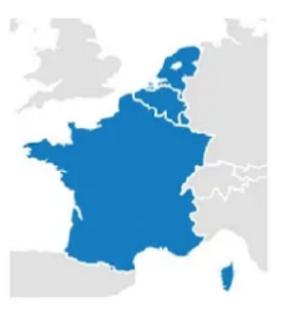
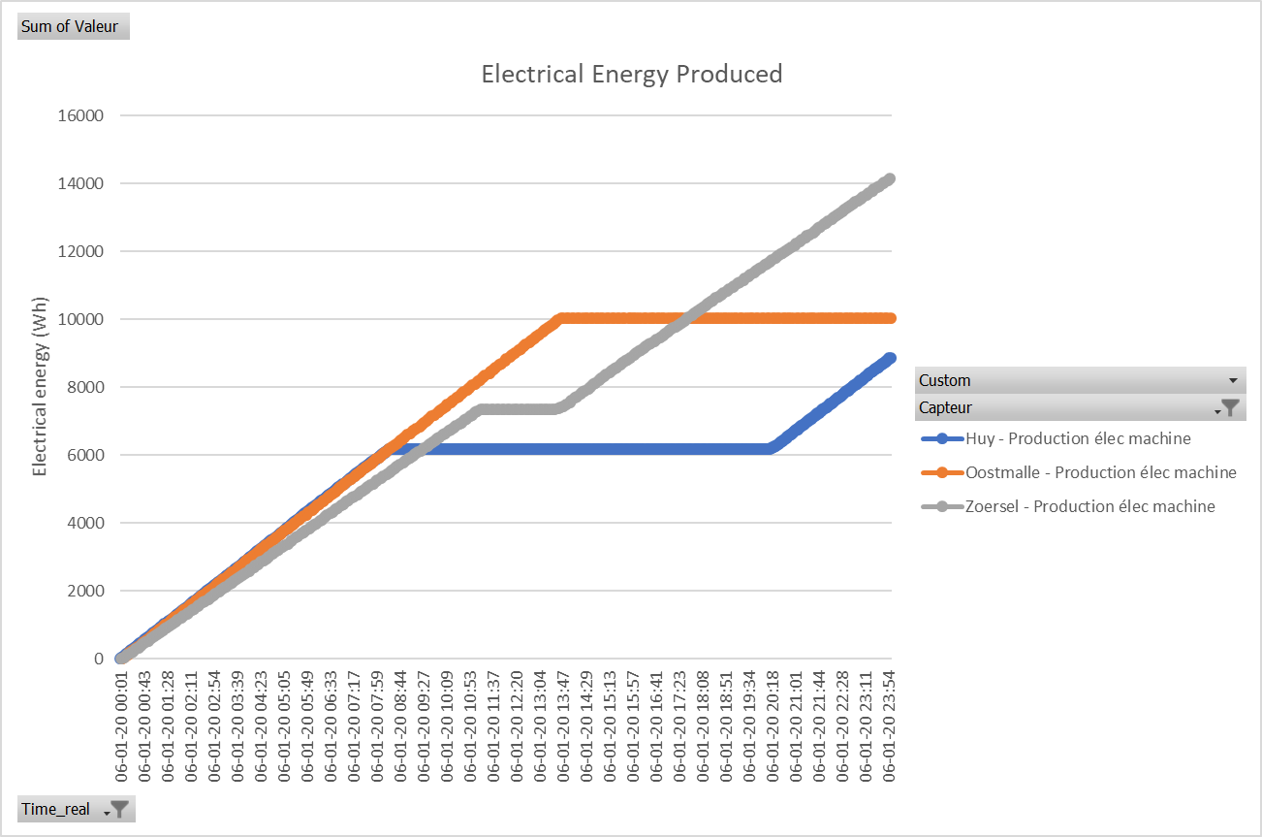
Field Monitoring – Vitovalor electricity produced (Wh)
Oostmalle
Zoersel
Huy
Net power : 730 W
Net power : 650 W
Electrical power delivered repeatability noticeable
Less power for Zoersel site →
What about the electrical consumption of the machine ?

Slide 11
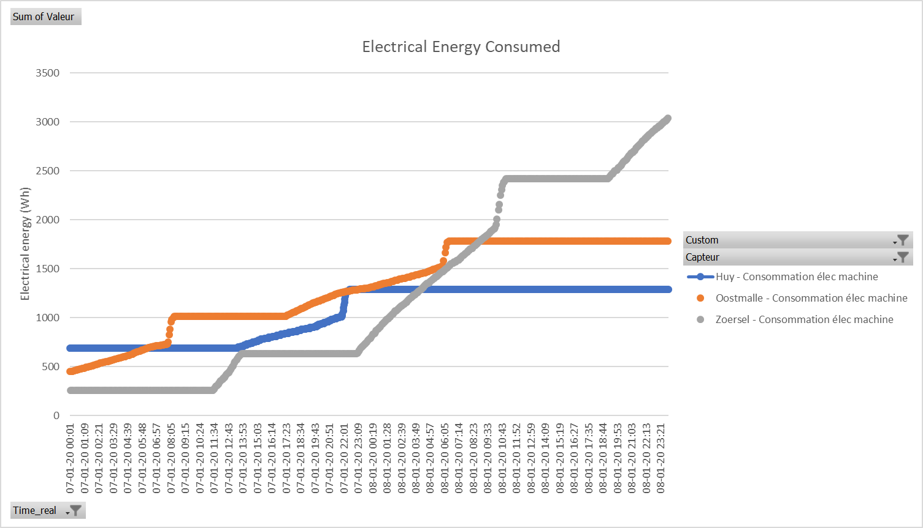
Field Monitoring – Vitovalor electricity consumed (Wh)
Electrical power consumed similar for Huy & Oostmalle
About 2 times greater for Zoersel (probably due to pressure drops within the installation – way bigger house)
For Huy & Oostmalle, big power demand of the machine when the fuelcell stops. Happens also sometimes in Zoersel…
→ Under investigation
?

Slide 12
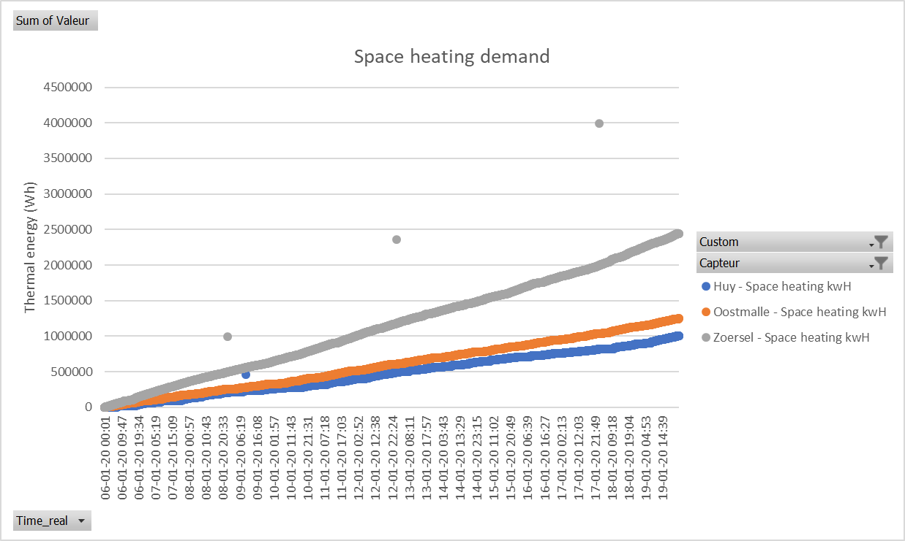
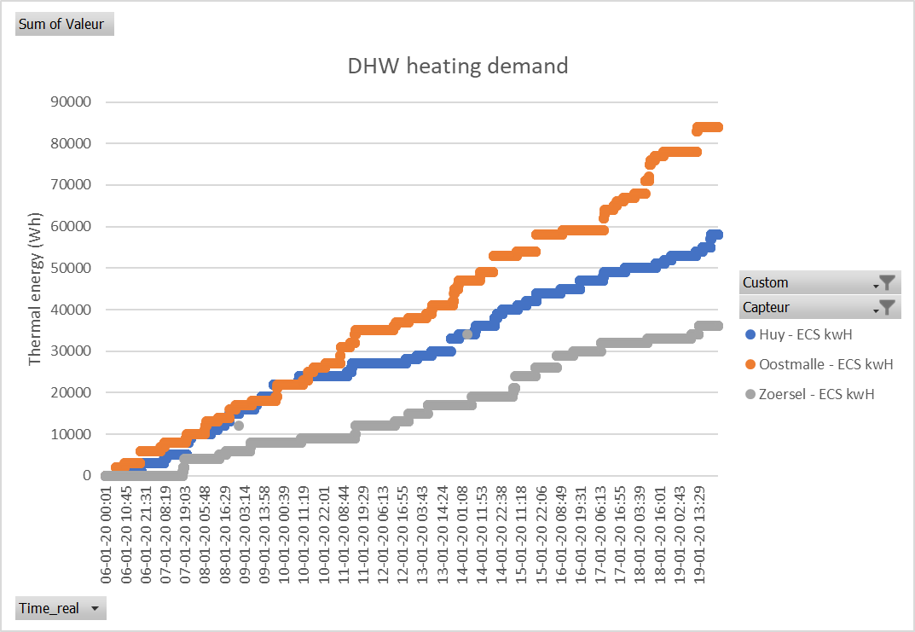
Field Monitoring – Vitovalor heat generation (Wh)
Indeed, Zoersel is a way bigger house
But they shower less ?

Slide 13
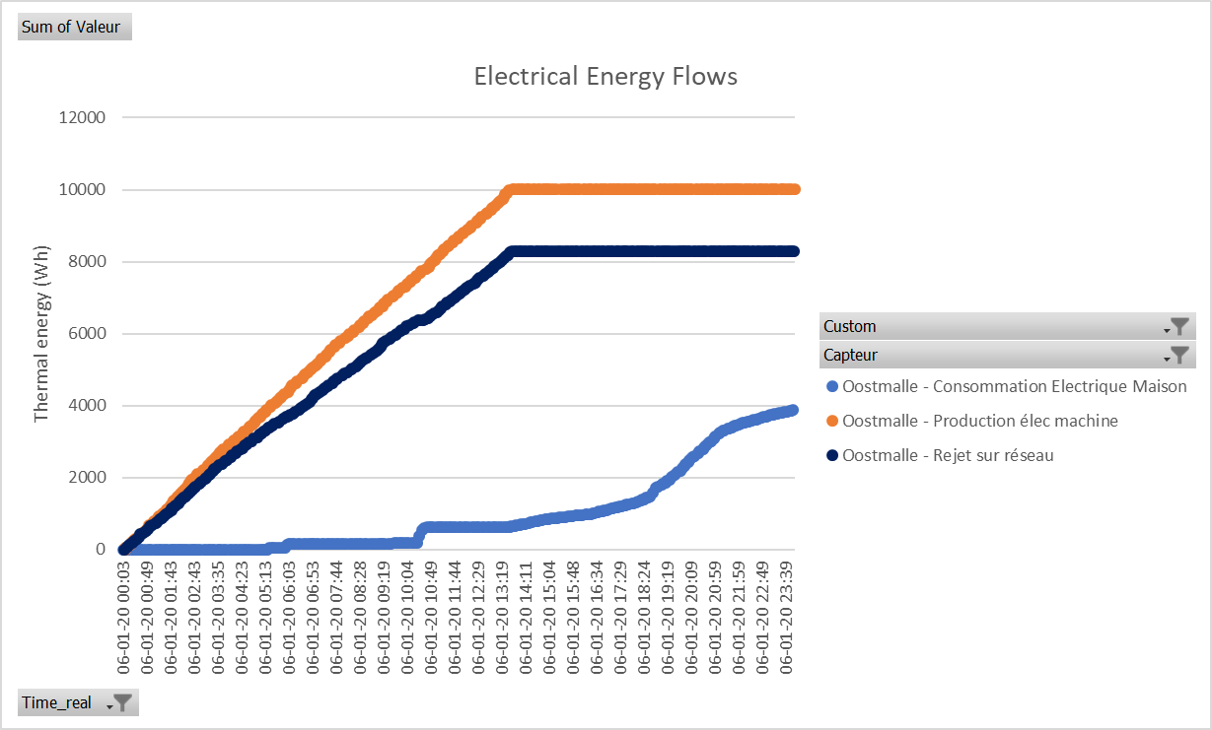
Field Monitoring – Vitovalor electrical flows (Wh)
Machine is shut down while evening peak – too bad ☹
Net power : 730 W
Net power : 610 W
Machine is not enough for morning peaks
In those winter days : - Electricity produced is about 180% higher than needed by the house but still they have to take electricity from the grid
- Lot of energy is rejected on the grid (about 80% of the production)
Draft numbers → they depend on the time scale and day chosen as it will be shown later

Slide 14
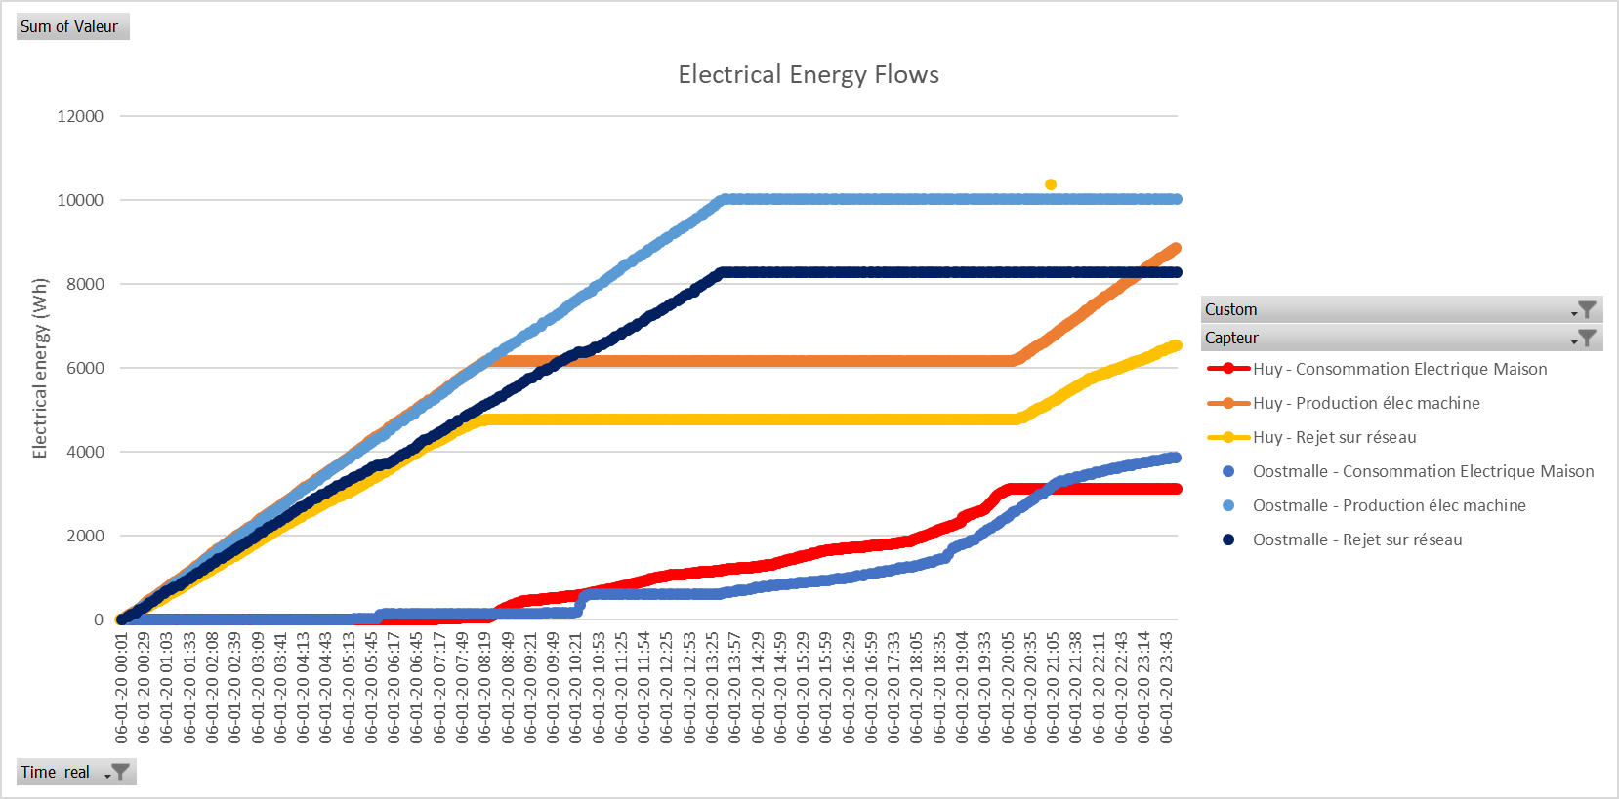
Field Monitoring – Vitovalor electrical flows (Wh)
Behavior is similar for both houses and not ideal (machine shut down during that day – January 6th) – high rejection on the grid that day

Slide 15
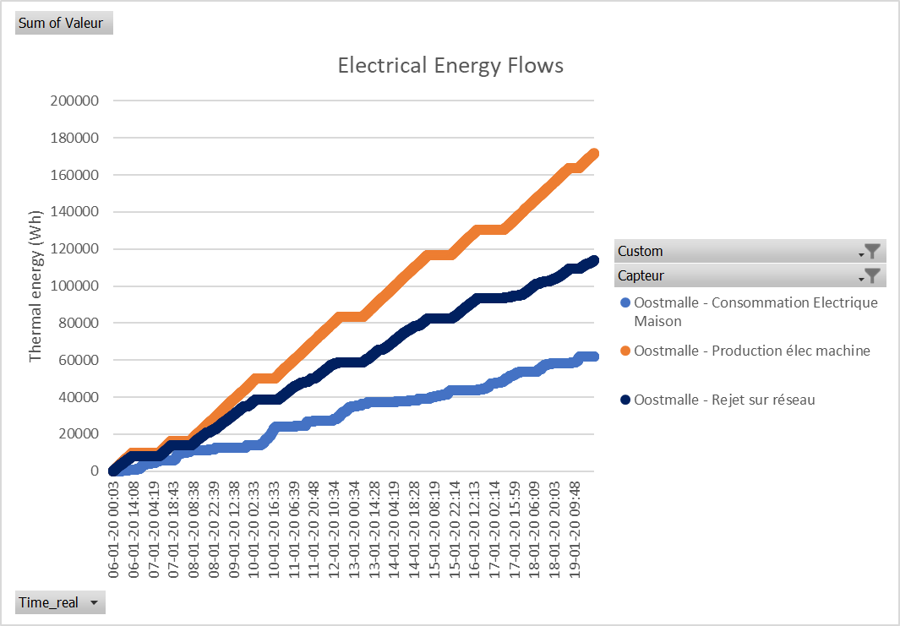
Field Monitoring – Vitovalor electrical flows (Wh)
On-site consumption
γ_{s}= Supply cover factor =
On-site production
On-site consumption
γ_{d}= Demand cover factor =
On-site consumption
Total electicity consumed
Consumption from the grid
Total electricity consumed
On-site consumption
Both factors depend on the time scale you are studying :

Slide 16
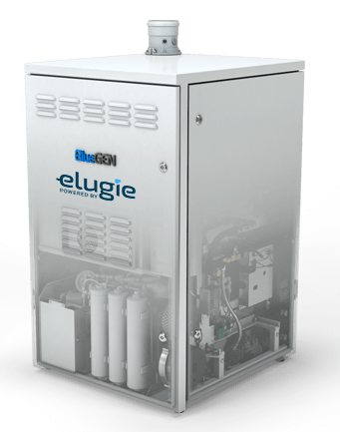
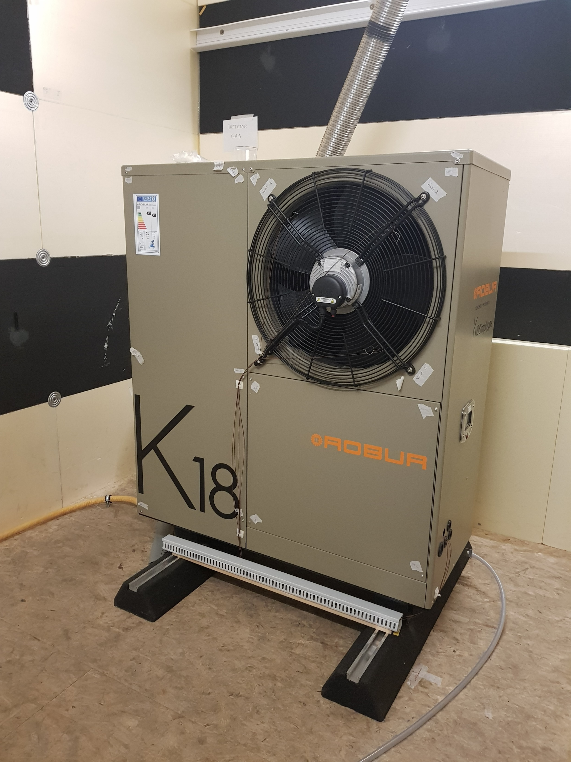
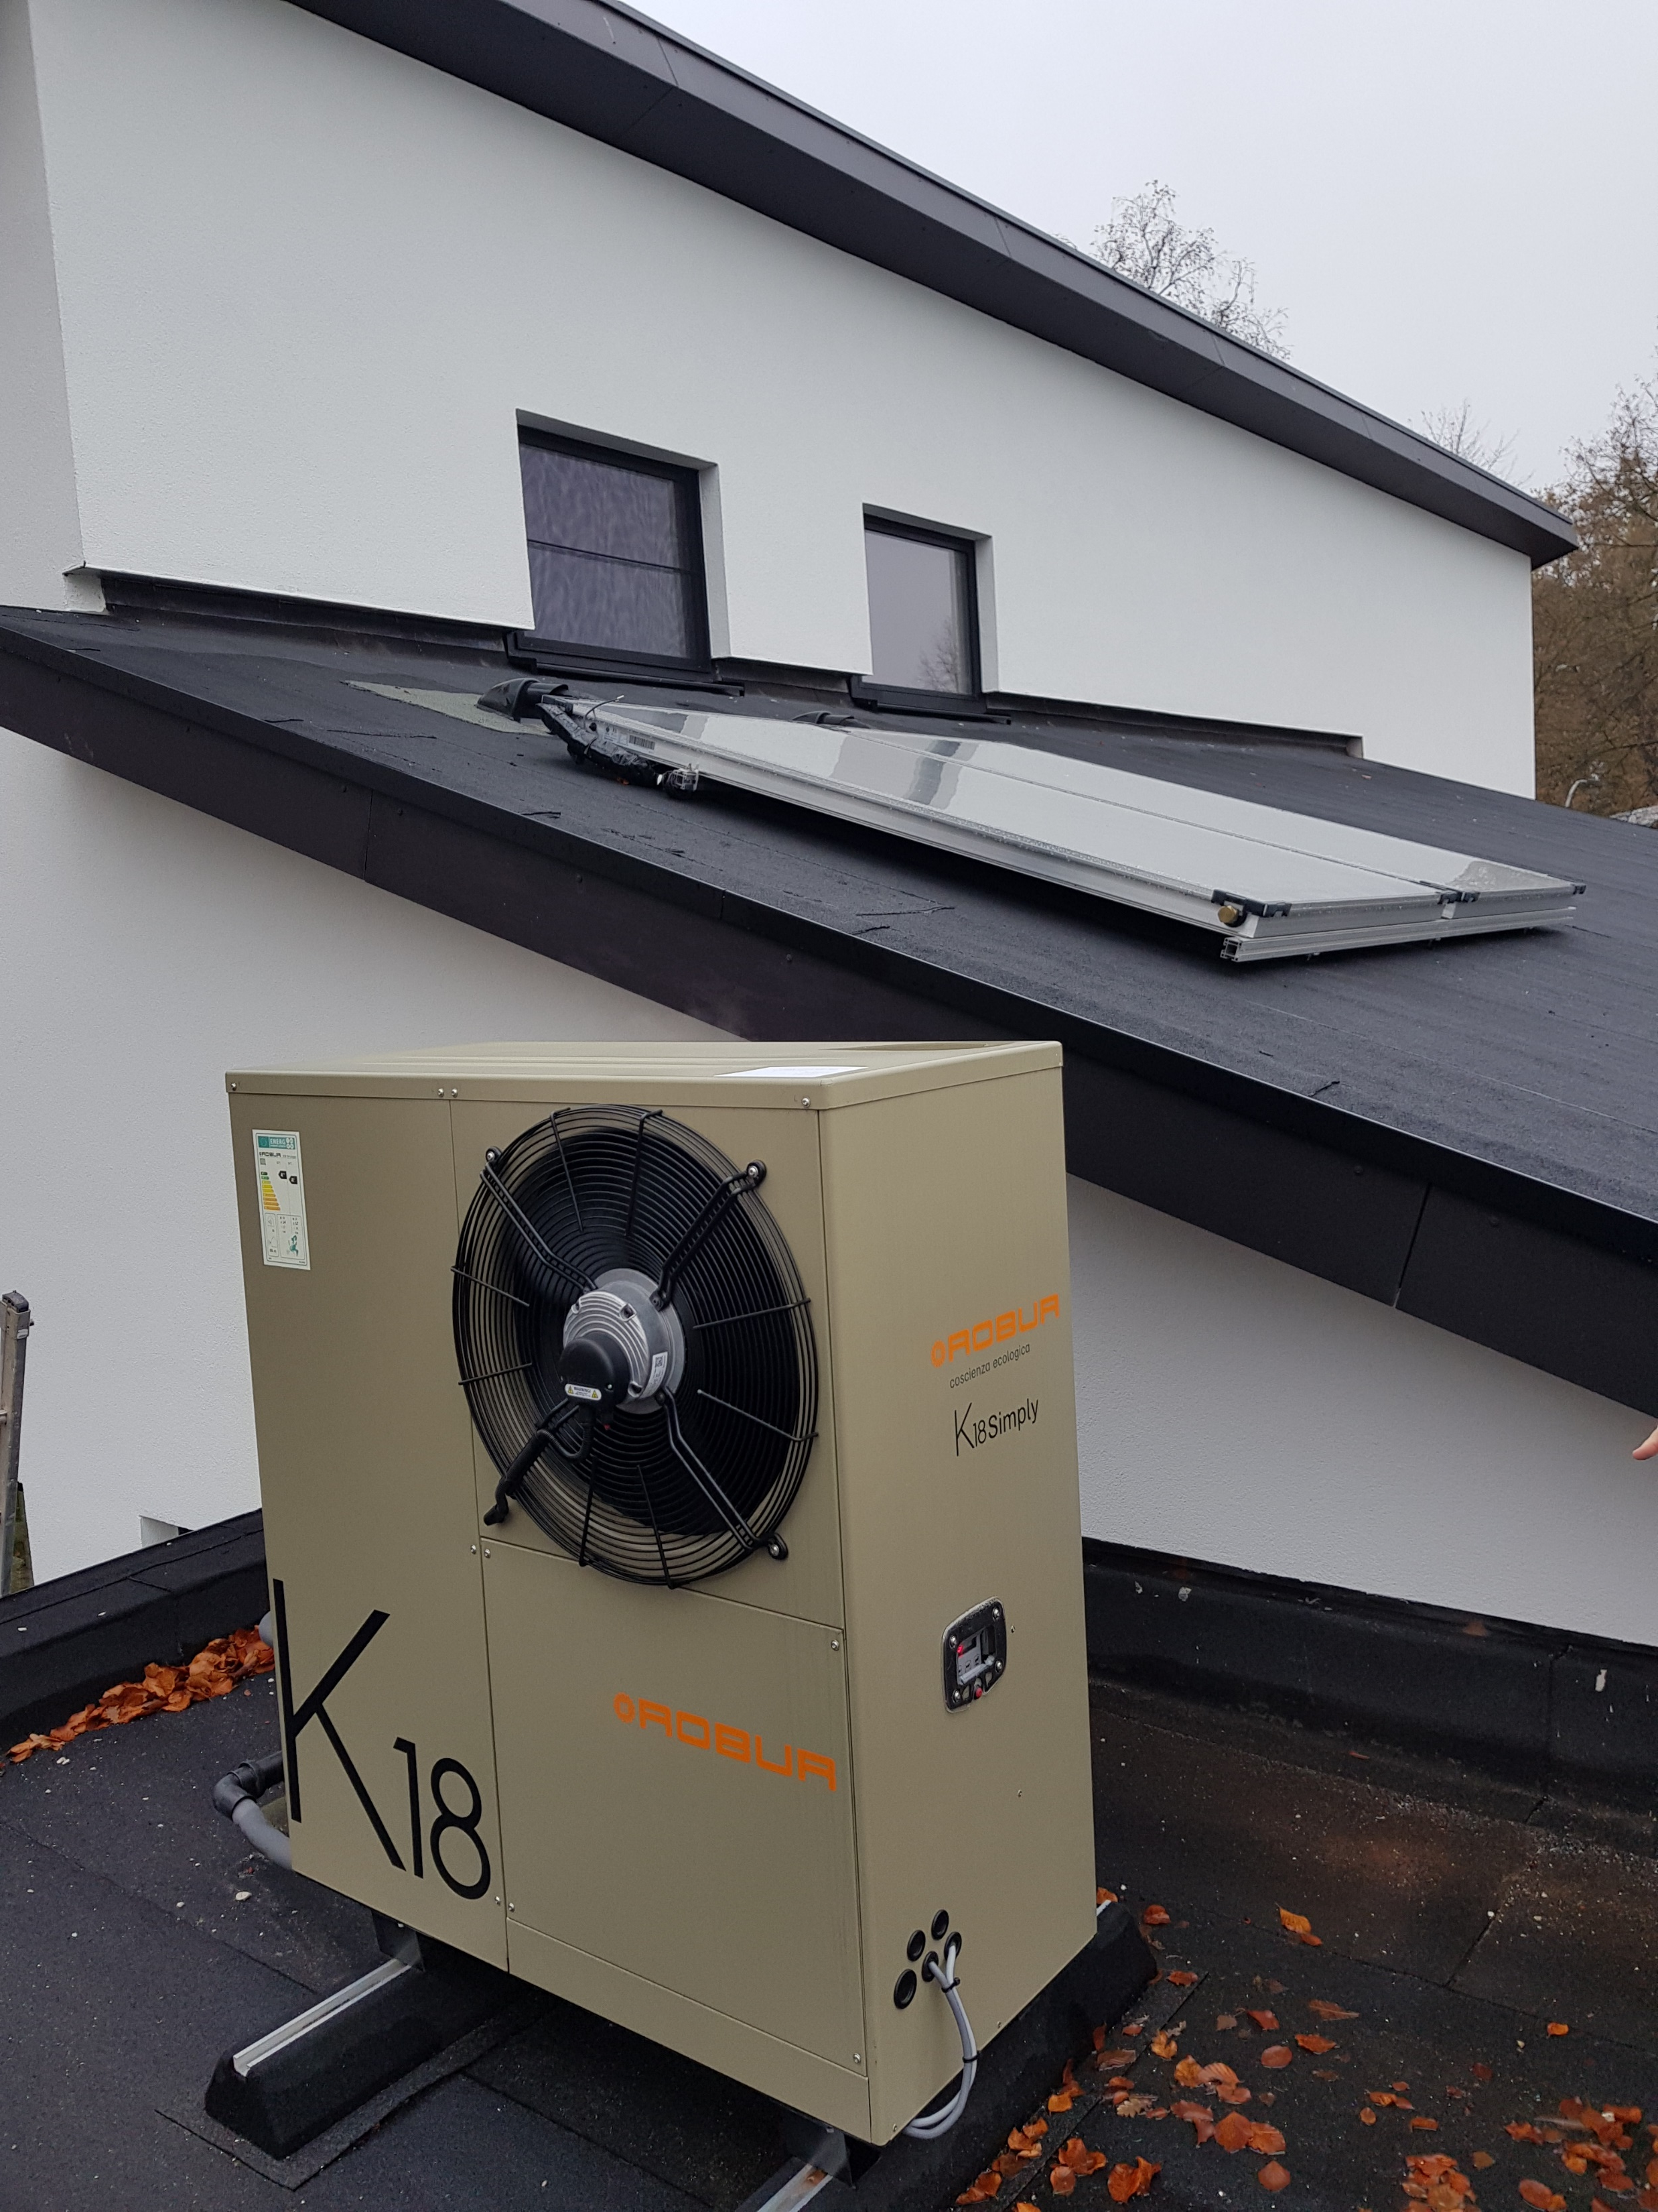
Conclusions and further work
Conclusions
Due to the size of its components, the fuel cell contribution to the global performance is small compared to that of the boiler
Variations of the global efficiency linked mainly to the depart water temperature (between 3-6%)
More analysis should be done, but the suitability of the system will be link to the final user's behavior and application
Monitoring has just started & will go on for 2 more heating season → monitoring numbers needs to be confirmed
Further work
Laboratory: - Future test campaign to estimate the performance of the fuel cell and the boiler separately
- Analysis of the flue gases: NOx, SOx, CO2 and fine particles
- A SOFC MyChi from Elugie will be tested this year
Monitoring: - Two houses with MyChi systems will be monitored
Global: - Compare laboratory and monitoring results between them and also with other systems monitored and tested at ULiège

