Slide 1
From dark-anoxia to light: alternative electron flows for photosynthesis induction in Chlamydomonas reinhardtii
Damien Godaux, Benjamin Bailleul, Nicolas Berne, René Matagne, Claire Remacle, Pierre Cardol
Laboratoire de génétique et physiologie des microalgues,
Institut de Botanique, Université de Liège, Belgique.
Institut de biologie physico-chimique, Université Pierre et Marie Curie, Paris
15 mai 2014

Slide 2
Photosynthetic linear electron transfer pathway
Stroma
NADP⁺
NADPH
Calvin (CO₂ fixation)
ATP
ADP + Pi
ATP synthétase
H⁺
H⁺
Lumen
Linear electron flow

Slide 3
Alternative photosynthetic electron transfer pathway
Calvin (CO₂ fixation)
Mitochondrial activity
NADPH
NADP⁺
O₂ (Mehler reaction)
Stroma
Fdx
ATP
ADP + Pi
ATP synthase
Ptox
H⁺
Lumen
O₂ (Chlororespiration)
H⁺
When light returns, ability to reactivate photosynthesis is obviously of major importance for the cell (growth, photoinhibition):
Prevent photoinhibition before Calvin cycle reactivation
Restauration of ATP/NAD(P)H ratio suitable for carbon dioxyde fixation

Slide 4
Alternative photosynthetic electron transfer pathway
2H⁺
H₂
HydA
Calvin (CO₂ fixation)
NADP⁺
NADPH
Stroma
Fd
ATP
ADP + Pi
ATP synthétase
H⁺
Lumen
H⁺
Calvin (CO₂ fixation)
Stroma
Nda2
PGR5/
PGRL1
ADP + Pi
ATP
ATP synthétase
H⁺
Lumen
H⁺
Hydrogenase-related electron flow
Cyclic electron flow

Slide 5
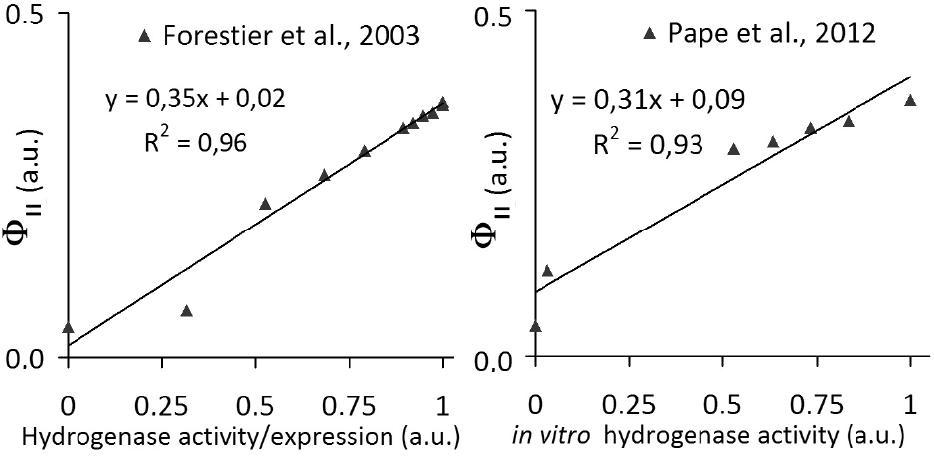
At the onset of light (anoxia), hydrogenase consumes 100 percent of the electron flow
> 12h
up to 3h
up to 3h
Forestier et al., 2003
Pape et al., 2012
Godaux et al., (2013) Int. J. Hydrogen Energy
A novel screening method for hydrogenase-deficient mutants in Chlamydomonas reinhardtii based on in vivo chlorophyll fluorescence and photosystem II quantum yield

Slide 6
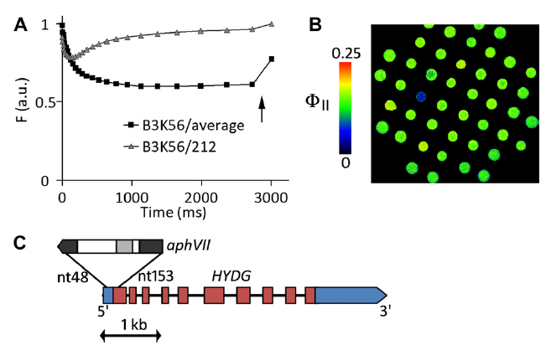
→ Set up of a new fluorescence screen to isolate mutants
impaired in hydrogenase activity
Advantage of the screen:
→ Fast
→ Sensitive
→ Non invasive
hydG-2

Slide 7
State transitions and hydrogenase are both critical for photosynthesis induction in anoxia
→ When hydrogenase is not expressed, state two promotes photosynthesis reactivation
Ghysels et al., (2013) PLoS ONE
Function of the chloroplast hydrogenase in the microalga Chlamydomonas: the role of hydrogenase and state transitions during photosynthetic activation in anaerobiosis

Slide 8
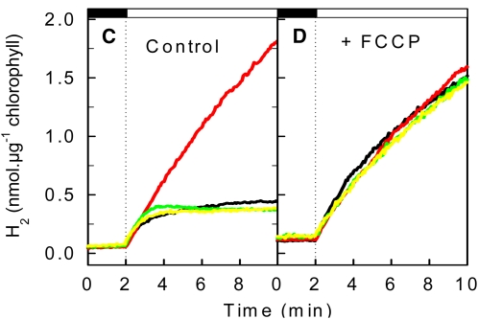
Tolleter et al., 2011:
Proton gradient generated by CEF provokes a strong inhibition of electron supply to the hydrogenase in Wt, which is released in the pgrl1 mutant
Cournac et al., 2002:
CO2 uptake started together with an increase in the O2 production rate,
both phenomena likely reflecting the activation of the Calvin cycle

Slide 9
2H⁺
H₂
HydA
Stroma
NADP⁺
NADPH
Calvin (CO₂ fixation)
PGR5/
PGRL1
Fdx
ATP
ADP + Pi
ATP synthétase
H⁺
H⁺
Lumen
Linear electron flow
Hydrogenase-related electron flow
Cyclic electron flow

Slide 10
Generation of a double mutant defected for hydrogenase activity and PSI-CEF
→ Obtention of hydG-2/Pgrl1 strain
Témoin d’amplification du DNA (600bp)
Amplifaction dans le gène hydG (809bp)
Amplifaction dans le gène pgrl1 (895bp)
hydG-2⁻
137C
hydG-2⁻
137C
Pgrl1
hydG-2
hydG-2/Pgrl1
hydG-2/Pgrl1
137C
Pgrl1
Pgrl1
hydG-2/Pgrl1

Slide 11
Survival of the cell (transiently placed in anoxic environment)

Slide 12
Experimental conditions:
Time of anoxia: 1h (Godaux et al., 2013; Forestier et al., 2003)
Light intensity: 200µmol photon.m⁻².s⁻¹

Slide 13
ElectroChromism Shift (ECS):
Photochemical rate of membrane potential formation
→ No photochemistry in hydG-2/Pgrl1
Notes:
13

Slide 14
ElectroChromism Shift (ECS):
Photochemical rate of membrane potential formation
No photochemistry in hydG-2/Pgrl1
Simples mutants display transitional phenotypes

Slide 15
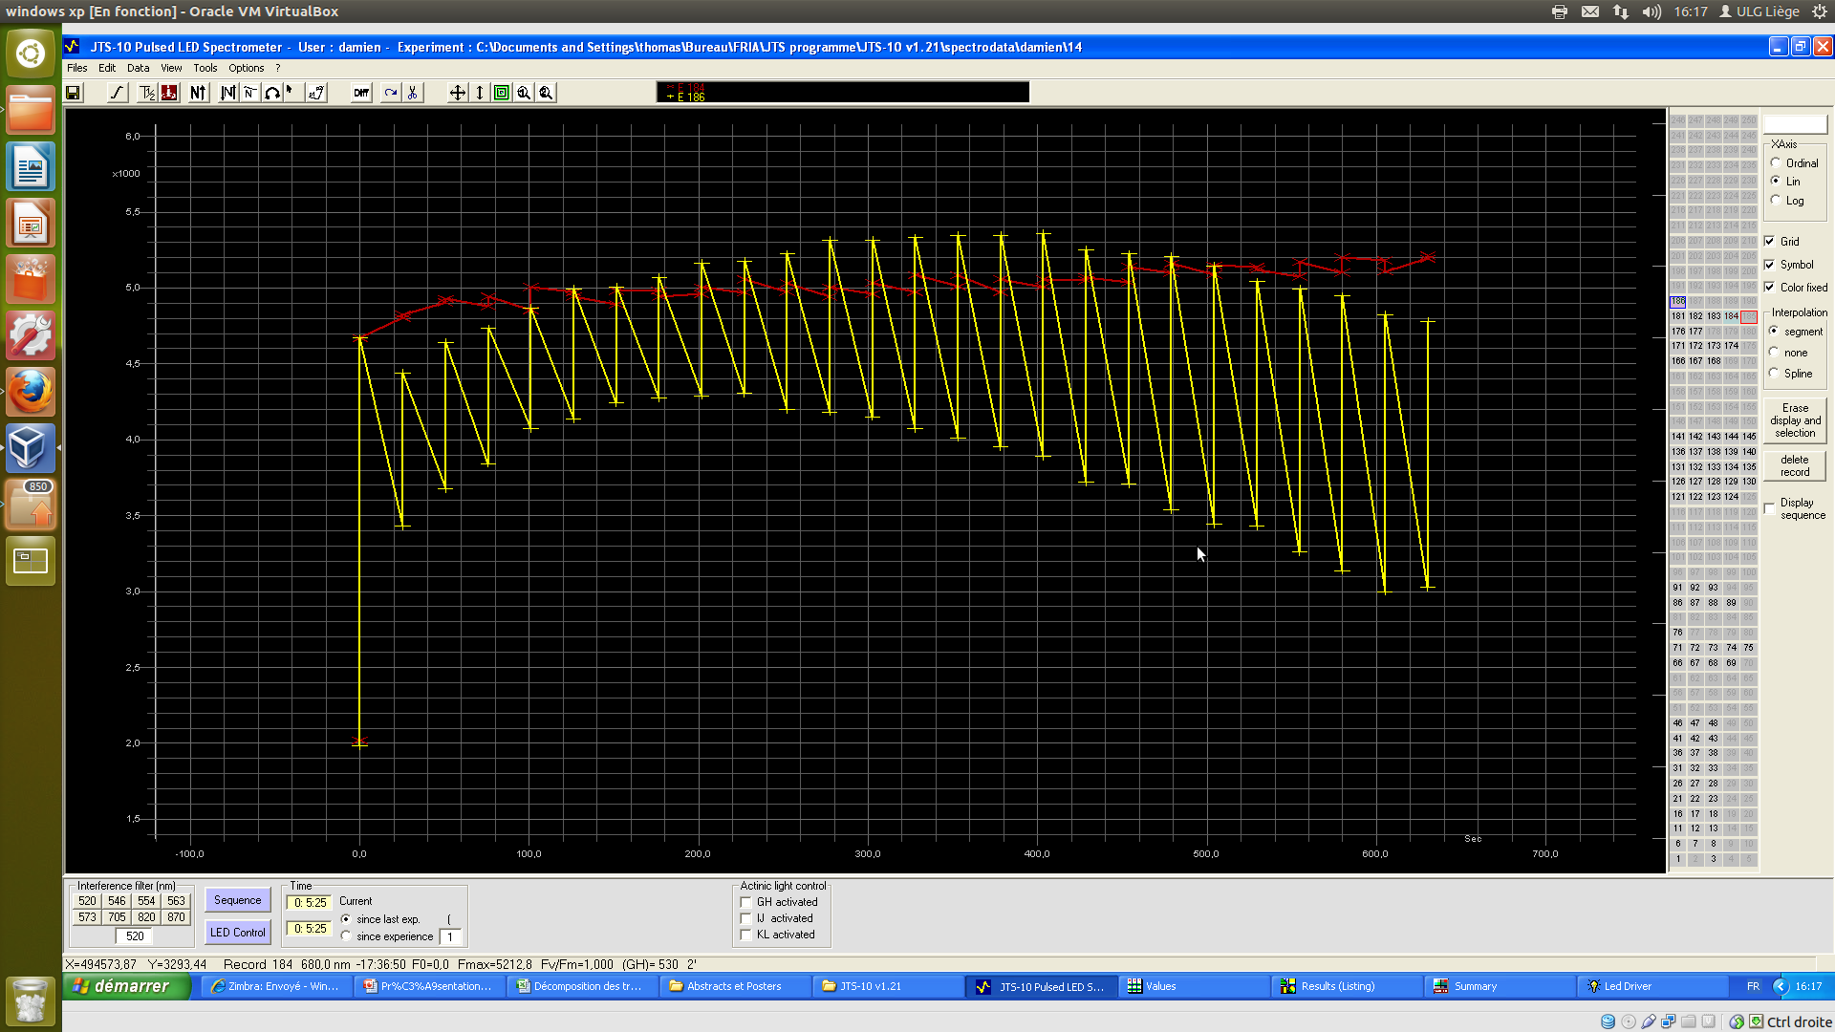
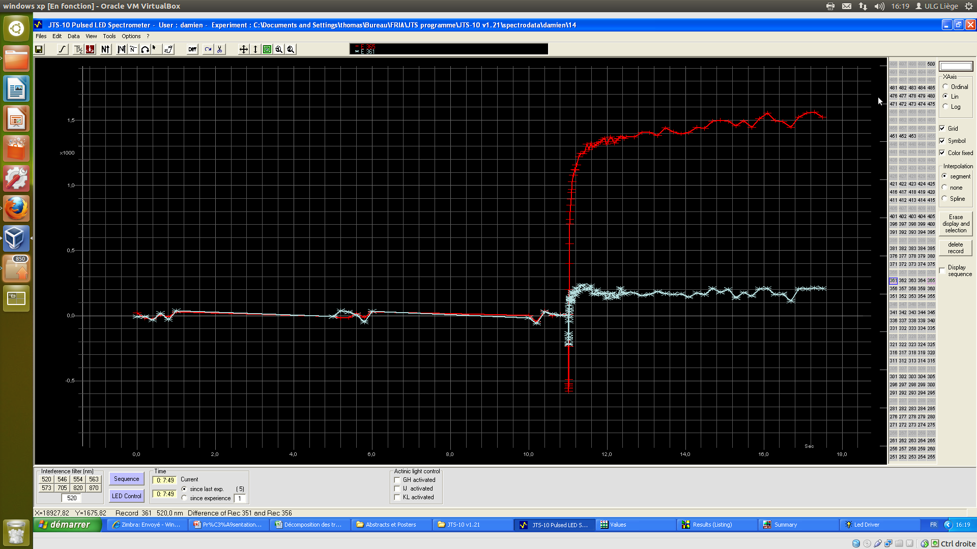
PSII/PSI efficiency and hydrogen evolution rate
1. PSII efficiency ΦII= (Fm’-Fs)/Fm’
2. Hydrogen evolution rate:
mV.s⁻¹ → nmol H2.µg chloro⁻¹.sec
Fm’
Fs
Time (sec)
2. PSII efficiency ΦI= (Pm’-Ps)/(Pm-P0)
P0
Pm (O2/DCMU/DBMIB/HL)
Ps
Pm’
Notes:
15

Slide 16
No electron transfer in hydG-2/Pgrl1 strain
Which electron transfer in wild type strain?

Slide 17
→ Gradient-dependent reactivation of Calvin cycle

Slide 18
NADPH/
NADP⁺
CBB
Nda2
Pgr5/L1
Fnr
ETR_{PS2} = ETR_{H2} + ETR_{CO2}
ETR_{PSI} = ETR_{H2} + ETR_{CO2} + ETR_{CEF}
Y_{PSII} et Y_{PSII} mesurés expérimentalement
H₂ (nmoles H₂ µg chl s⁻¹) → é s⁻¹ PS1⁻¹
Au début de l’éclairement Y_{PS2} = Y_{H2} (
Pour estimer les flux : pas de mesure de la taille d’antenne (pas de variation de Fm)
Au début de l’éclairement, transport linéaire vers H2 (donc YPS=YPS1=YH2)
Puisque ETR(PS1,2,H2,ECS) nul chez Hydg et ETR(PS1,2,H2,ECS) identiques chez PGRL et WT
Par ailleurs, Y_{PSII} et H₂ stables en présence de GA chez le WT.
I (gh4 530 ~200 photons nm⁻² s⁻¹ ou ~200 s⁻¹ PS⁻¹ : Y_{PSII} =~0.5, qP = 0.625 et ETR_{PSII}=~125 e⁻ s⁻¹
en aérobie (manip 19/11/12 et synthèse Nico);
Damien Y_{PSII} 0.5 en conditions oxiques; 10µg chl/ml; P700_{Max}~0.002-0.0025
Godaux, 2012 : 2.6 nmoles H₂ min⁻¹ µg chl⁻¹ = 28 e⁻ s⁻¹ PS⁻¹ (en utilisant 64 mM⁻¹)
Godaux 2014 : 0.02 nmoles H₂ s⁻¹ µg chl⁻¹ = 20 e⁻ s⁻¹ PS⁻¹ (en utilisant 100 mM⁻¹)
Y_{PSII}~0.15 ; qP=0.19 et ETR_{PSII} ~20 e⁻ s⁻¹
(en tenant compte que la taille d’antenne PSII est deux fois plus faible à l’état II )
H₂O/O₂
PQH₂/PQ
Fd_{r/o}
H₂/H⁺
PSII
HydA
Cytb6f+PSI

Slide 20
Wild-Type
Dark
NADPH/
NADP⁺
240s
NADPH/
NADP⁺
Nda2
CBB
CBB
Nda2
25
Pgr5/L1
Fnr
Pgr5/L1
Fnr
25
15
H₂O/O₂
PQH₂/PQ
Fd_{r/o}
H₂/H⁺
H₂O/O₂
25
PQH₂/PQ
Fd_{r/o}
1
H₂/H⁺
PSII
HydA
PSII
40
HydA
Cytb6f+PSI
Cytb6f+PSI
10s
NADPH/
NADP⁺
CBB
360s
NADPH/
NADP⁺
CBB
Nda2
Nda2
40
Pgr5/L1
Fnr
Pgr5/L1
Fnr
5
40
20
20
40
H₂O/O₂
PQH₂/PQ
Fd_{r/o}
H₂/H⁺
H₂O/O₂
PQH₂/PQ
Fd_{r/o}
H₂/H⁺
PSII
20
HydA
PSII
45
HydA
Cytb6f+PSI
Cytb6f+PSI
120s
NADPH/
NADP⁺
480s
NADPH/
NADP⁺
CBB
CBB
Nda2
10
Nda2
50
Pgr5/L1
Fnr
10
Pgr5/L1
Fnr
1
50
20
50
H₂O/O₂
20
PQH₂/PQ
Fd_{r/o}
10
H₂/H⁺
H₂O/O₂
PQH₂/PQ
Fd_{r/o}
H₂/H⁺
PSII
40
HydA
PSII
50
HydA
Cytb6f+PSI
Cytb6f+PSI

Slide 21
pgrl1
Dark
NADPH/
NADP⁺
CBB
240s
NADPH/
NADP⁺
CBB
Nda2
Nda2
10
Pgr5/L1
>1
Pgr5/L1
Fnr
Fnr
10
H₂O/O₂
PQH₂/PQ
Fd_{r/o}
H₂/H⁺
H₂O/O₂
20
PQH₂/PQ
Fd_{r/o}
10
H₂/H⁺
PSII
HydA
PSII
20
HydA
Cytb6f+PSI
Cytb6f+PSI
10s
NADPH/
NADP⁺
CBB
300s
NADPH/
NADP⁺
Nda2
CBB
Nda2
20
Pgr5/L1
Fnr
Pgr5/L1
Fnr
20
H₂O/O₂
15
PQH₂/PQ
Fd_{r/o}
15
H₂/H⁺
30
Fd_{r/o}
10
H₂/H⁺
H₂O/O₂
PQH₂/PQ
PSII
15
HydA
PSII
30
HydA
Cytb6f+PSI
Cytb6f+PSI
120s
NADPH/
NADP⁺
480s
NADPH/
NADP⁺
Nda2
CBB
CBB
3
Nda2
25
5
Pgr5/L1
Pgr5/L1
Fnr
8
Fnr
25
15
12
35
10
H₂O/O₂
PQH₂/PQ
Fd_{r/o}
H₂/H⁺
H₂O/O₂
PQH₂/PQ
Fd_{r/o}
H₂/H⁺
PSII
20
HydA
PSII
35
HydA
Cytb6f+PSI
Cytb6f+PSI

Slide 22
hydG
Dark
NADPH/
NADP⁺
240s
NADPH/
NADP⁺
Nda2
CBB
CBB
Nda2
Pgr5/L1
Fnr
Pgr5/L1
Fnr
20
20
15
H₂O/O₂
PQH₂/PQ
Fd_{r/o}
H₂/H⁺
H₂O/O₂
PQH₂/PQ
Fd_{r/o}
H₂/H⁺
PSII
HydA
PSII
35
HydA
Cytb6f+PSI
Cytb6f+PSI
10s
NADPH/
NADP⁺
CBB
300s
NADPH/
NADP⁺
CBB
Nda2
Nda2
Pgr5/L1
Fnr
Pgr5/L1
Fnr
5
35
35
H₂O/O₂
PQH₂/PQ
Fd_{r/o}
H₂/H⁺
H₂O/O₂
PQH₂/PQ
Fd_{r/o}
H₂/H⁺
PSII
HydA
PSII
40
HydA
Cytb6f+PSI
Cytb6f+PSI
120s
NADPH/
NADP⁺
CBB
480s
NADPH/
NADP⁺
CBB
Nda2
Nda2
Pgr5/L1
Fnr
Pgr5/L1
Fnr
20
<5
<1
45
<5
45
H₂O/O₂
PQH₂/PQ
Fd_{r/o}
H₂/H⁺
H₂O/O₂
PQH₂/PQ
Fd_{r/o}
H₂/H⁺
PSII
25
HydA
PSII
45
HydA
Cytb6f+PSI
Cytb6f+PSI

Slide 23
hydG pgrl1
Dark
NADPH/
NADP⁺
CBB
Nda2
Pgr5/L1
Fnr
H₂O/O₂
PQH₂/PQ
Fd_{r/o}
H₂/H⁺
PSII
HydA
Cytb6f+PSI
5s-480s
NADPH/
NADP⁺
CBB
Nda2
<5
Pgr5/L1
Fnr
H₂O/O₂
PQH₂/PQ
Fd_{r/o}
H₂/H⁺
PSII
<5
HydA
Cytb6f+PSI
Et plus ?

Slide 24
Conclusion
Generation of HydG-2/Pgrl1 strain
Calvin cycle reactivation is gradient-dependent, stops H2 and improve PSII efficiency
Only Hydrogenase-related LEF and PGRL1-dependent CEF take place in ATP generation. Lost of both AEF is detrimental for photosynthesis induction
Both are required for an efficient activation of Calvin cycle (intermediary phenotype, more pronounced in Pgrl1 deficient strain)
Hydrogenase allows a LEF at the beginning of the illumination. Then, CEF activity takes place for the formation of an additional trans-thylakoidal proton gradient used to generate ATP

Slide 25
Results
Absence of Hyd-related LEF and Pgrl1-dependent CEF is detrimental for the survival of the cell (growing phenotype and photoinhibition?)
→ Both alternative electron flows provide obvious advantage for Chlamydomonas in their natural habitat

Slide 26
Conclusion
Generation of HydG-2/Pgrl1 strain
Calvin cycle reactivation is gradient-dependent, stops H2 and improve PSII efficiency
Only Hydrogenase-related LEF and PGRL1-dependent CEF take place in ATP generation. Lost of both AEF is detrimental for photosynthesis induction
Both are required for an efficient activation of Calvin cycle (intermediary phenotype, more pronounced in Pgrl1 deficient strain)
Hydrogenase allows a LEF at the beginning of the illumination. Then, CEF activity takes place for the formation of an additional trans-thylakoidal proton gradient used to generate ATP
Outlooks
Growing phenotype and ROS generation to demonstrate the importance of these alternative electron flows for the cell in their natural habitat
Discussion
Effect of O₂ in H2 cessation and in photosynthesis induction?
Model for electron flow during photosynthesis induction

Slide 27
Special thanks to…
Dr. Pierre Cardol
Dr. Benjamin Bailleul
Prof René Matagne
Nicolas Berne
Prof. Claire Remacle
Laboratoire de génétique et physiologie des microalgues. Institut de Botanique (B22),
Université de Liège, Belgique.

Slide 28
supplemental
Croissance en conditions oxiques + photosynthèse
Evolution du Fm pendant la réactivation.

