Slide 1



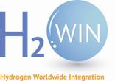

From photosynthetic regulation to enzymo-electrochemistry: Two case studies to explore hydrogen bioproduction
Facultad de Estudios Superiores Iztacala, Mexico. November 30, 2020.
Damien Godaux. Genetics and physiology of microalgae laboratory
Phytosystems. Faculty of sciences, Department of life sciences, University of Liège, Belgium
Supervisors: Prof. Claire Remacle
Dr. Pierre Cardol
Dr. Philippe Lorge
Funding: The FNRS
The Walloon region
H2WIN

Slide 2
General context
The problem of fossil fuels :
Poviding energy to keep our society moving
Running out
Impact on climate change
O
O
H
H
H
H
H
H
H
H
C
C
C
C
ENERGY + CO₂ (!) +H₂O
C
H
H
H
C
C
H
C
H
H
H
H
H
H

Slide 3
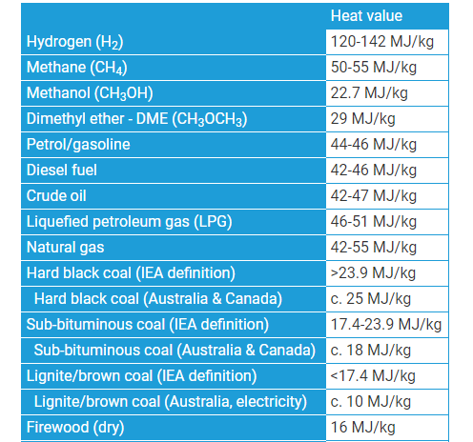
General context
Hydrogen (H₂) as a fuel:
Highest energy content per mass
Source: www.world-nuclear.org

Slide 4
General context
Hydrogen (H₂) as a fuel:
Highest energy content per mass
Clean combustion into water
O
O
H
H
ENERGY + H₂O

Slide 5
General context
Hydrogen (H₂) as a fuel:
Highest energy content per mass
Clean combustion into water
Wide range of possible applications
● Decarbonize transport (cars, buses, trains and boats)
● Distribution of energy across sectors and regions (efficient energy integration)
● Decarbonize feedstock for chemical processes (metallurgy, fertilizers industry, etc)
● System resilience acting as a buffer with intermittent energy (solar, wind, etc)

Slide 6
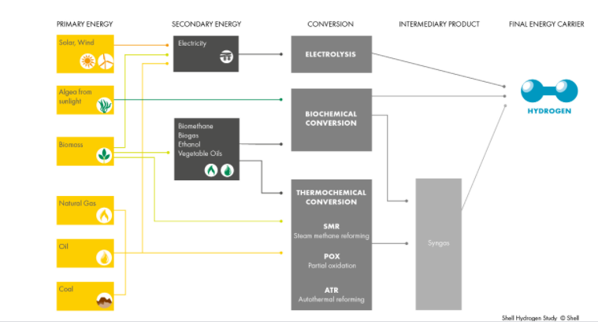
General context
Hydrogen production:
No CO₂ footprint
CO₂ producing methods

Slide 7
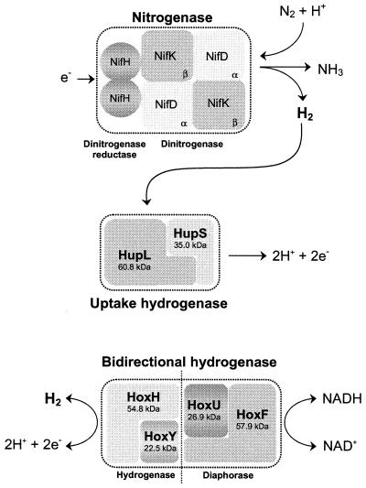
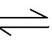
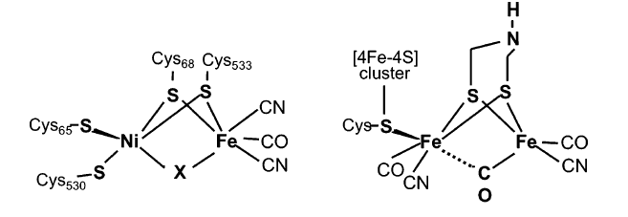
General context
Hydrogenases:
a
● 2H⁺+2e⁻ H₂ (a)
● Present in Bacteria, Archaea and Eukaryota
● Involved in various anaerobic bioenergetic processes
● Oxygen-sensitive
Hydrogenase
b
c
Vignais and Billoud, 2007
Schematic structure of active center in NiFe hydrogenases (b) and FeFe hydrogenases (c)

Slide 8
Part I:
Interplay between photosynthesis and hydrogenase
In the green microalga Chlamydomonas reinhardtii

Slide 9
General context
Hydrogen production:

Slide 10
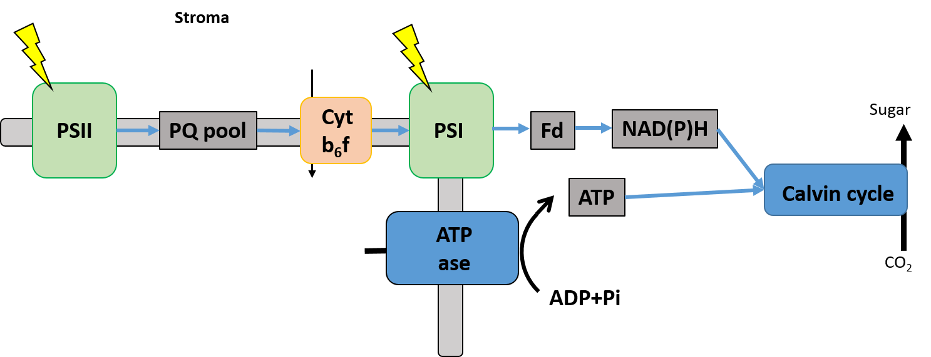
Introduction
Photosynthesis:
Light energy
O
H
O
H
+
+
H
C
O
C
O
C
O
O
O
O
H
H
C
H
H
H
Carbon dioxide
Water
Oxygen
Sugar

Slide 11
Introduction
Light-dependent reaction:
Light energy
Chemical energy (NADPH and ATP)
+
O
H
O
H
+
+
H
C
O
C
O
C
O
O
O
O
H
H
C
H
H
H
Carbon dioxide
Water
Oxygen
Sugar
Photosynthesis pathway
Stroma
2H₂O
4 + O₂
H⁺
Lumen

Slide 12
Introduction
Light-independent reaction:
Light energy
Chemical energy (NADPH and ATP)
-
O
H
O
H
+
+
H
C
O
C
O
C
O
O
Introduction
O
O
H
H
C
H
H
H
Carbon dioxide
Water
Oxygen
Sugar
Calvin cycle
Stroma
2H₂O
4 + O₂
H⁺
Lumen

Slide 13
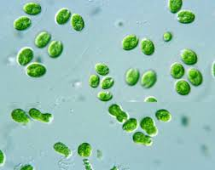
FeFe hydrogenase in Chlamydomonas reinhardtii
Introduction
Hydrogenases …
● Presence hydrogenase enzymes (HydA) in Chlamydomonas reinhardtii
● Hydrogen evolution in the dark (fermentation) and in the light (photosynthesis)
● Short burst of hydrogen upon a shift from dark anoxia to light
● Expression and activity are sensitive to oxygen
● Two maturation factors (HydEF and HydG) are required for the activity
… and hydrogen metabolism in Chlamydomonas
Photosynthesis pathway
H₂
HydA
Stroma
H⁺
2H₂O
4 + O₂
H⁺
Lumen

Slide 14
Aim
Better understanding of the hydrogen metabolism in Chlamydomonas reinhardtii
Role of an oxygen sensitive enzyme in photosynthesis
Aim
Photosynthesis pathway
H₂
HydA
Stroma
2H₂O
4 + O₂
H⁺
Lumen

Slide 15
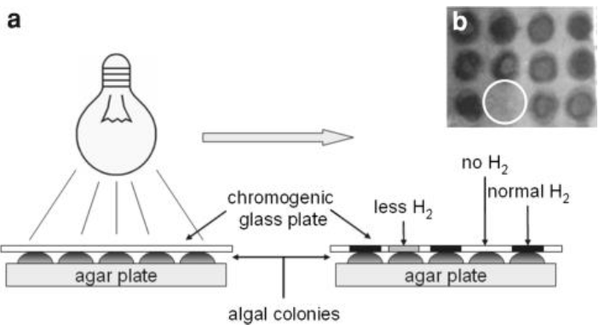
Isolation of mutants impaired in hydrogen metabolism
Results
● Short burst of hydrogen upon a shift from dark anoxia to light
● Tungsten oxide chromogenic sensor turns in blue in contact to H2
Chromogenic sensor
→ Time consuming
→ Invasive
→ Not sensitive
Isolation of HydEF deficient strain (hydEF) (Posewitz et al., 2004)

Slide 16
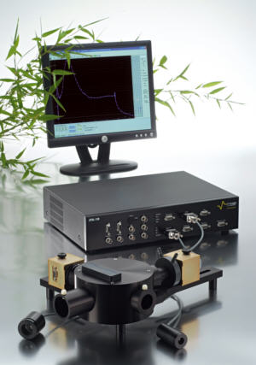
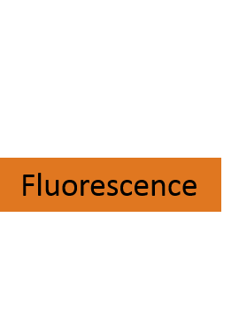


Use of PSII fluorescence to set up of a new screen
to isolate mutants impaired in hydrogenase activity
Results
PSII fluorescence
as an indicator of photosynthetic energy conversion in higher plants and algae
H₂
HydA
Joliot type spectrometer (JTS)
→ PSII (fluorescence) efficiency
Photosynthesis pathway

Slide 17
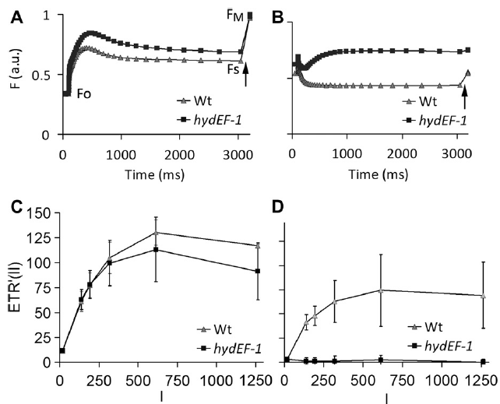
Use of PSII fluorescence to set up of a new screen
to isolate mutants impaired in hydrogenase activity
Results
*
* hydEF mutant isolated by Posewitz et al., 2004
Fluorescence is higher in absence of hydrogenase activity
Notes:
17

Slide 18
Use of PSII fluorescence to set up of a new screen
to isolate mutants impaired in hydrogenase activity
Results
1: Specific to anoxia?
2: Effect of light intensity?
3: Sensitivity?
*
* hydEF mutant isolated by Posewitz et al., 2004
Photochemical yield of photosystem II (ΦII)
PSII relative electron transport rate (ETR’) = ΦII*Ilum
Notes:
18

Slide 19
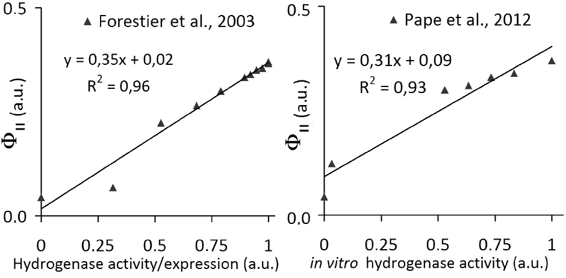
Use of PSII fluorescence to set up of a new screen
to isolate mutants impaired in hydrogenase activity
Results
‘
1: Specific to anoxia? √
2: Effect of light intensity? √
3: Sensitivity? √
Light intensity
Hydrogenase activity/expression
Notes:
19

Slide 20
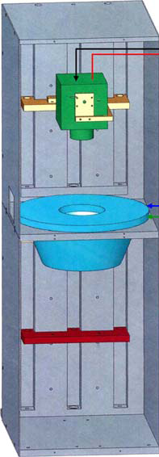
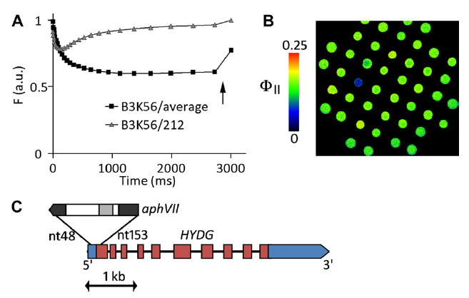
Set up of a new fluorescence screen to isolate mutants
Impaired in hydrogenase activity : Proof of concept
Results
Fluorescence screening on a mutants library obtained by random mutagenesis
Fluorescence screening
Isolation of hydG-2 strain
Notes:
20

Slide 21
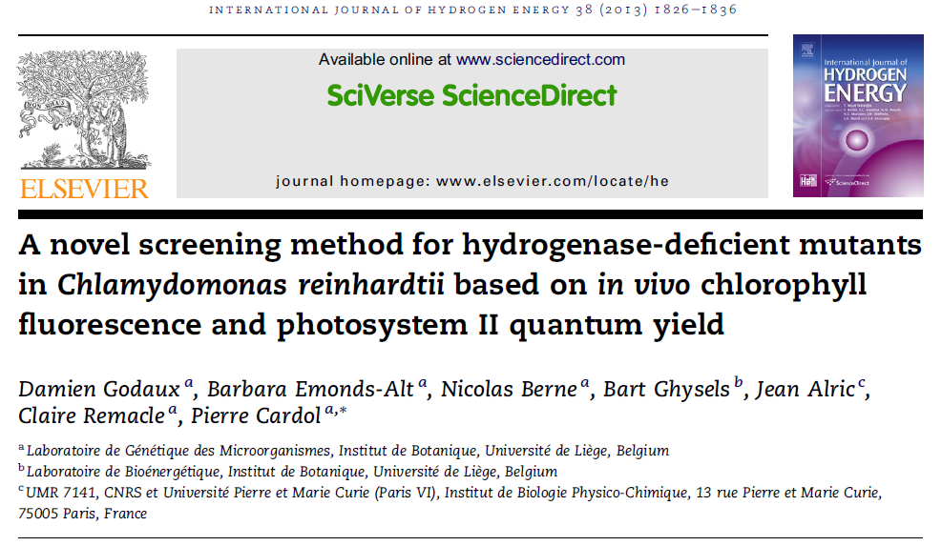
Take home message
Results
● Development of a fluorescence-based screening method to identify new players in hydrogenase activity and hydrogen metabolism
→ Fast
→ Non invasive
→ Sensitive
Notes:
21

Slide 22
Aim
Better understanding of the hydrogen metabolism in Chlamydomonas reinhardtii
Role of an oxygen sensitive enzyme in photosynthesis
Aim
Photosynthesis pathway
H₂
HydA
Stroma
2H₂O
4 + O₂
H⁺
Lumen

Slide 23
Aim
Starting hypothesis: Competition between hydrogenase and Calvin cycle activities ?
Aim
Photosynthesis pathway
H₂
HydA
?
Stroma
2H₂O
4 + O₂
H⁺
Lumen

Slide 24
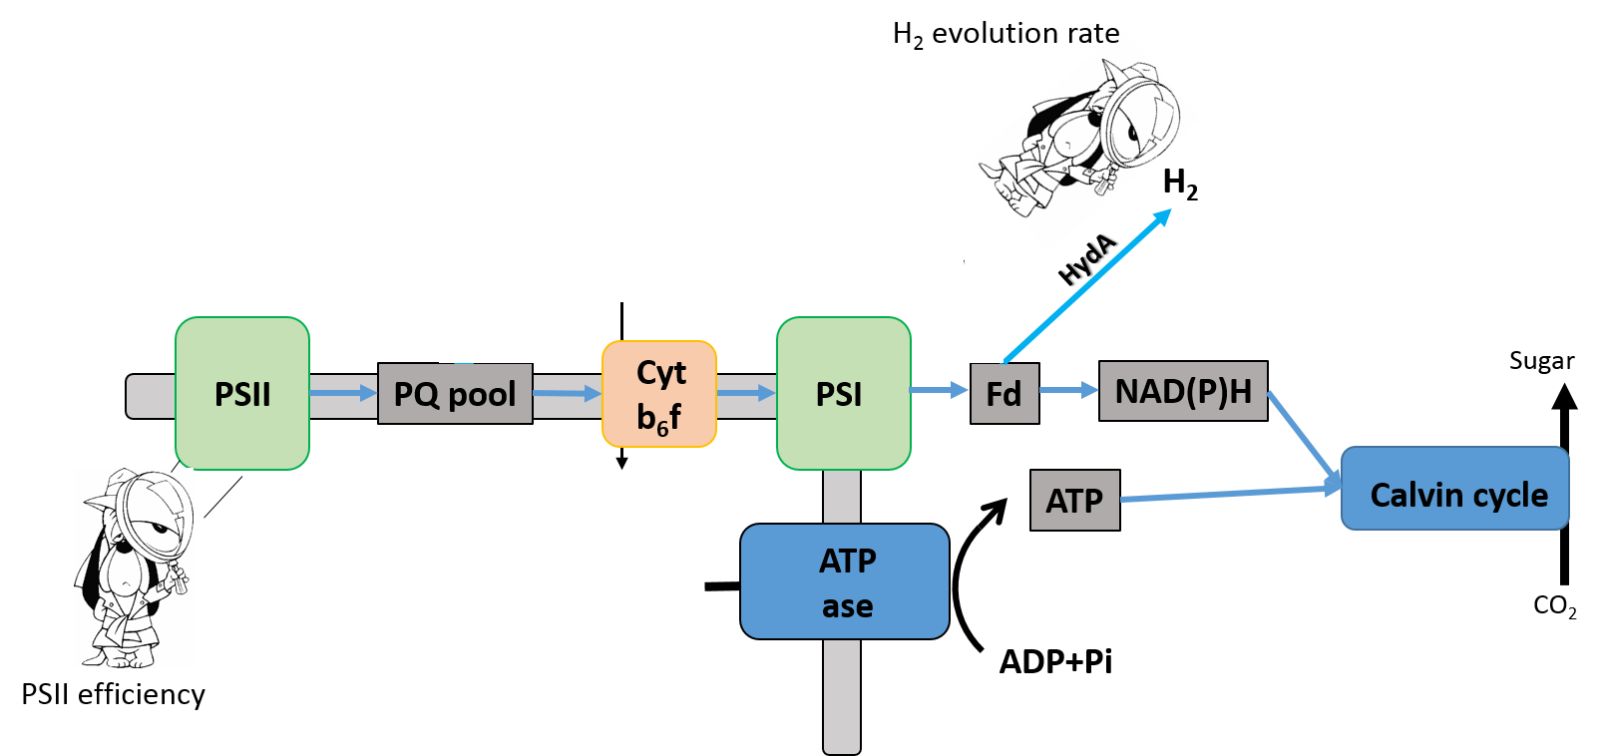
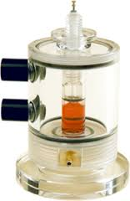
Tools
Competition between hydrogenase and Calvin cycle activities
Modified Clark electrode
→ H₂ production
Joliot type spectrometer (JTS)
→ PSII (fluorescence) efficiency

Slide 25
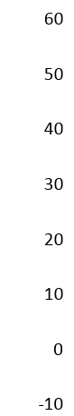
Results
Competition between hydrogenase and Calvin cycle activities
wt
ETR
Time (s)
● Hydrogen evolution stops when PSII efficiency increases

Slide 26
Results
Competition between hydrogenase and Calvin cycle activities
Glycolaldehyde
wt
wt (GA)
ETR
Time (s)
Time (s)
● Hydrogen evolution stops when PSII efficiency increases
● Hydrogen production is extended in presence of glycolaldehyde
→ Competition between hydrogenase and Calvin cycle activities

Slide 27
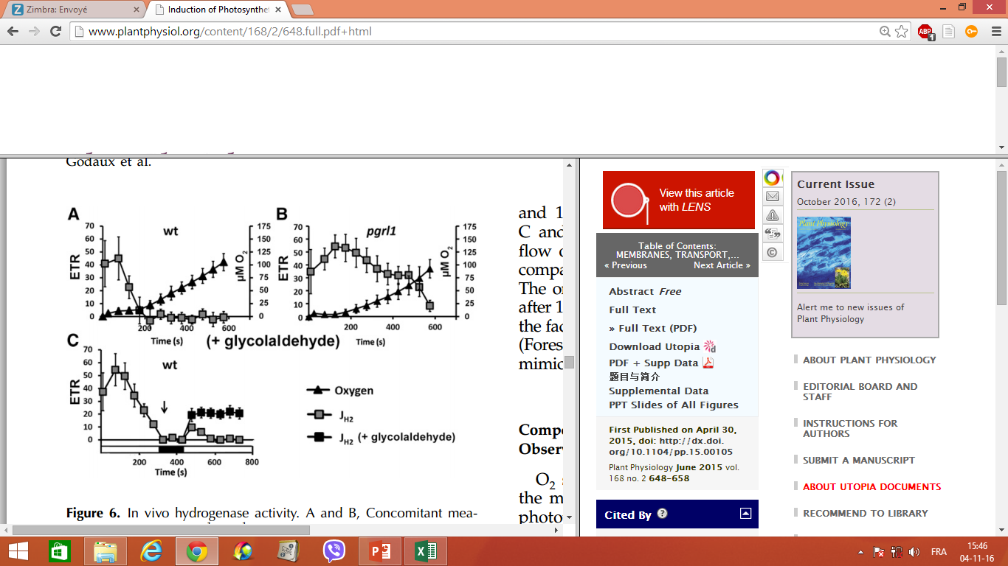
Results
Competition between hydrogenase and Calvin cycle activities
Glycolaldehyde
→ Hydrogen production stops because of Calvin cycle reactivation prior to oxygen sensitivity

Slide 28
Aim
Understanding the interplay between hydrogenase and Calvin cycle reactivation
Aim
Photosynthesis pathway
H₂
HydA
?
Stroma
2H₂O
4 + O₂
H⁺
Lumen

Slide 29
Introduction
Light-dependent reaction:
Light energy
Chemical energy (NADPH and ATP)
+
O
H
O
H
+
+
H
C
O
C
O
C
O
O
O
O
H
H
C
H
H
H
Carbon dioxide
Water
Oxygen
Sugar
Photosynthesis pathway
Stroma
1.3 ATP per NADPH
2H₂O
4 + O₂
H⁺
Lumen

Slide 30
Introduction
Light-independent reaction:
Light energy
Chemical energy (NADPH and ATP)
+
O
H
O
H
+
+
H
C
O
C
O
C
O
O
Introduction
O
O
H
H
C
H
H
H
Carbon dioxide
Water
Oxygen
Sugar
Calvin cycle
Stroma
1.5 ATP per NADPH
2H₂O
4 + O₂
H⁺
Lumen

Slide 31
Introduction
Photosynthetic alternative electron flows in oxic condition:
● Calvin cycle requirement: 1,5 ATP/NADPH
● Linear electron flow: ≈1,3 ATP/NADPH
Photosynthesis needs alternative pathways to optimize ATP versus NADPH production
O₂
O₂
Nda2-CEF
Mehler
O₂
Pgrl1-CEF
Mitochondria
Ptox
H⁺
Cyt b₆f
Sugar
PSII
PQ pool
PSI
Fd
NAD(P)H
H⁺
H⁺
ATP
Calvin cycle
2H₂O
4H⁺ + O₂
H⁺
H⁺
H⁺
ATP
ase
H⁺
H⁺
H⁺
H⁺
CO₂
H⁺
H⁺
ADP+Pi

Slide 32
Introduction
Photosynthetic alternative electron flows in anoxic condition:
● Unbalenced ATP/NADPH ratio towards NADPH
Photosynthesis needs alternative pathways to optimize ATP versus NADPH production
H₂
Pgrl1-CEF
HydA
H⁺
Cyt b₆f
Sugar
PSII
PQ pool
PSI
Fd
NAD(P)H
H⁺
H⁺
ATP
Calvin cycle
2H₂O
4H⁺ + O₂
H⁺
H⁺
H⁺
ATP
ase
H⁺
H⁺
H⁺
H⁺
CO₂
H⁺
H⁺
ADP+Pi

Slide 33
Results
Calvin cycle reactivation upon dark anoxic conditions
wt
wt (GA)
ETR
Time (s)
Time (s)
→ Competition between hydrogenase activity and Calvin cycle reactivation

Slide 34
Results
Calvin cycle reactivation upon dark anoxic conditions
CCCP
wt
wt (GA)
wt (CCCP)
ETR
Time (s)
Time (s)
Time (s)
Competition between hydrogenase activity and Calvin cycle reactivation
Calvin cycle reactivation is ATP-dependent (protons gradient)

Slide 35
Results
Calvin cycle reactivation upon dark anoxic conditions
Competition between hydrogenase activity and Calvin cycle reactivation
Calvin cycle reactivation is proton gradient-dependent (ATP)
Photosynthetic alternative electron flows in anoxic condition:
H₂
Pgrl1-CEF
HydA
H⁺
Cyt b₆f
Sugar
PSII
PQ pool
PSI
Fd
NAD(P)H
H⁺
H⁺
ATP
Calvin cycle
2H₂O
4H⁺ + O₂
H⁺
H⁺
H⁺
ATP
ase
H⁺
H⁺
H⁺
H⁺
CO₂
H⁺
H⁺
ADP+Pi

Slide 36
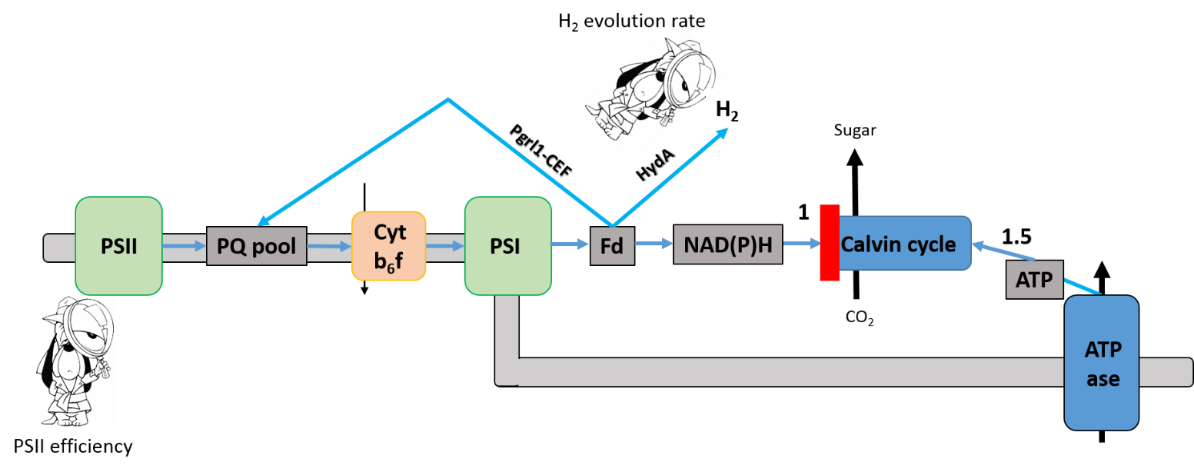
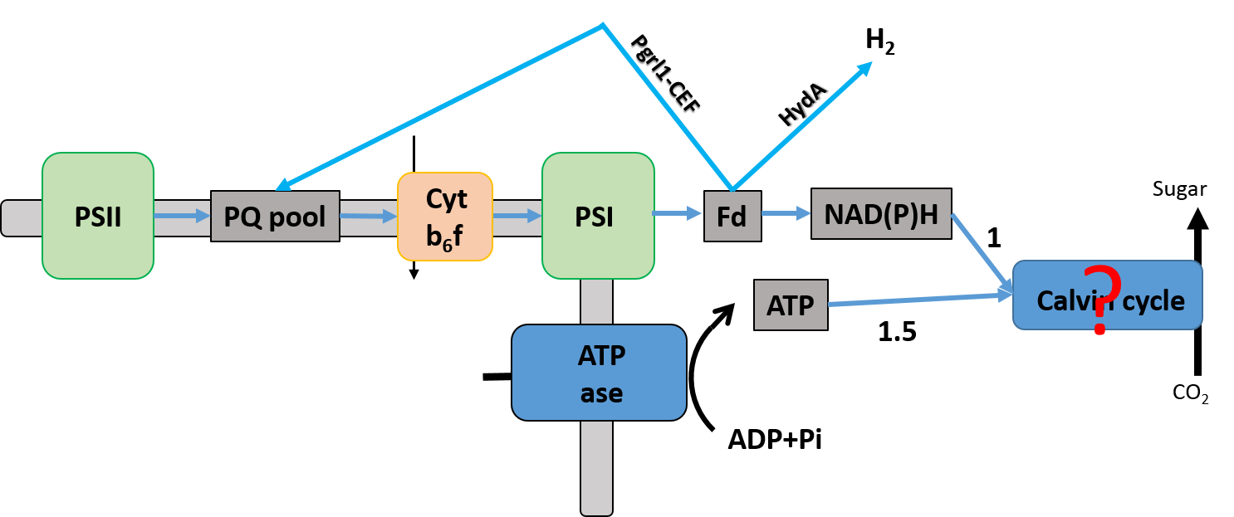
Results
Calvin cycle reactivation upon dark anoxic conditions
wt
hydg-2
pgrl1
pgrl1 hydg-2
ETR
Time (s)
Time (s)
Time (s)
Time (s)
● Hydrogenase is important for Calvin cycle induction
● Pgrl1-CEF is important for Calvin cycle induction
● Calvin cycle reactivation is prevented in absence of both hydrogenase activity and Pgrl1-CEF

Slide 37
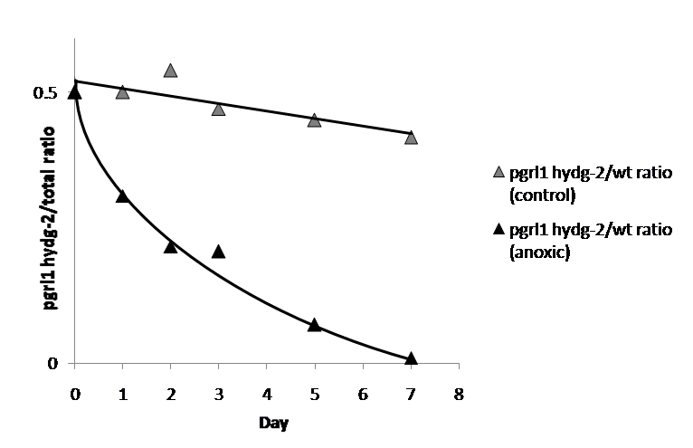
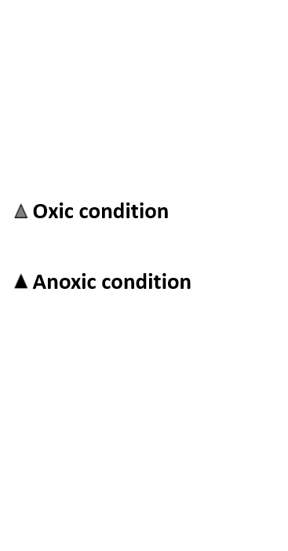
Results
Concomitant absence of hydrogenase and CEF
is detrimental for cell growth
3/3-h dark/light cycles
0
3
6
9
12
15
18
21
24
50
% pgrl1 hydg-2
Fluorescence screening to determine pgrl1 hydg-2 population versus wild type
● Hydrogenase activity or CEF are detrimental for the survival of the cell,
in conditions where photosynthesis reactivation occured
Notes:
37

Slide 38
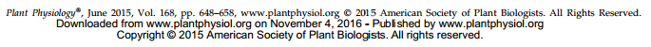
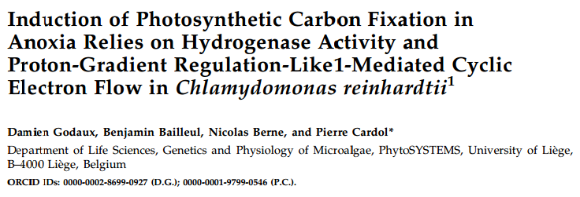
Take home messages
conclusion
● Hydrogen photoproduction stops because of Calvin cycle reactivation prior to
oxygen sensitivity
● Either hydrogenase activity or Pgrl1-CEF is required for Calvin cycle reactivation

Slide 39
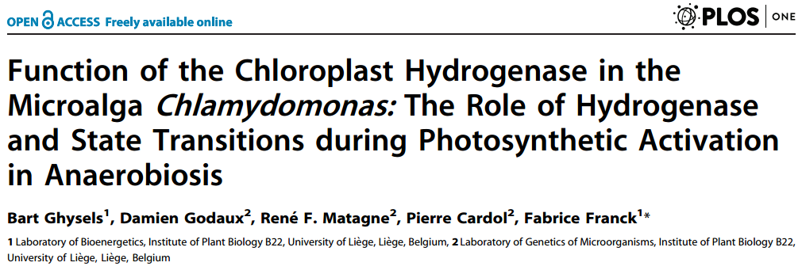
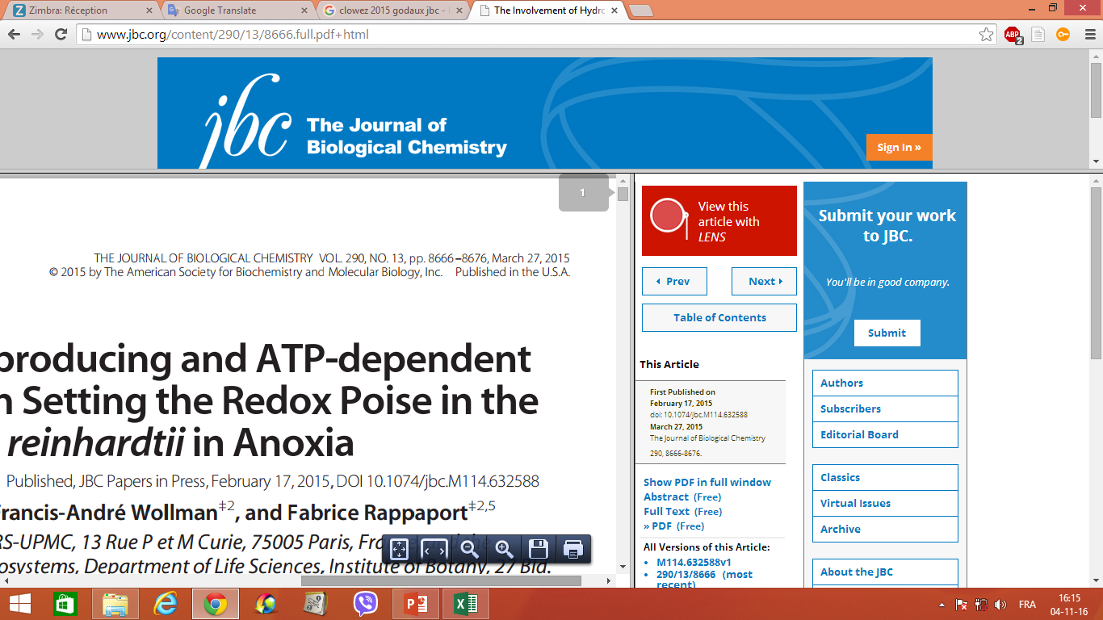
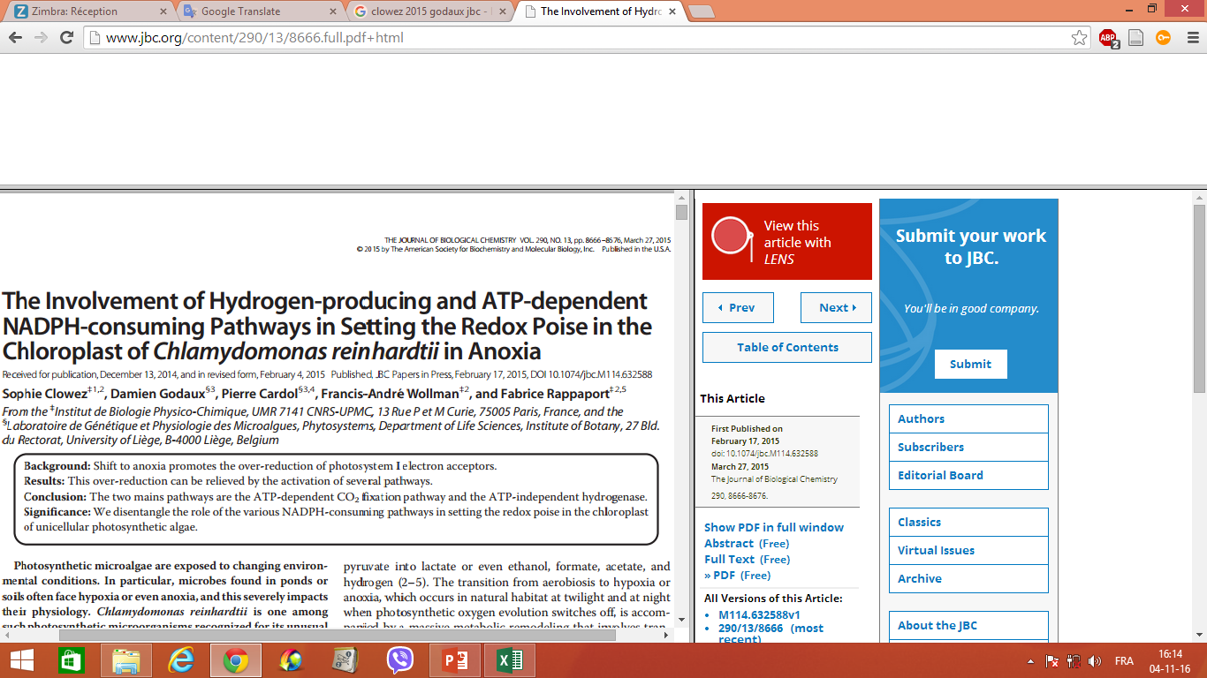
Take home messages
conclusion
● Hydrogen photoproduction stops because of Calvin cycle reactivation prior to
oxygen sensitivity
● Either hydrogenase activity or Pgrl1-CEF is required for Calvin cycle reactivation
and then cell survival

Slide 40
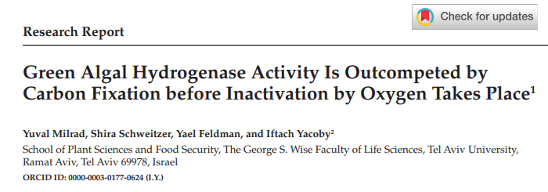
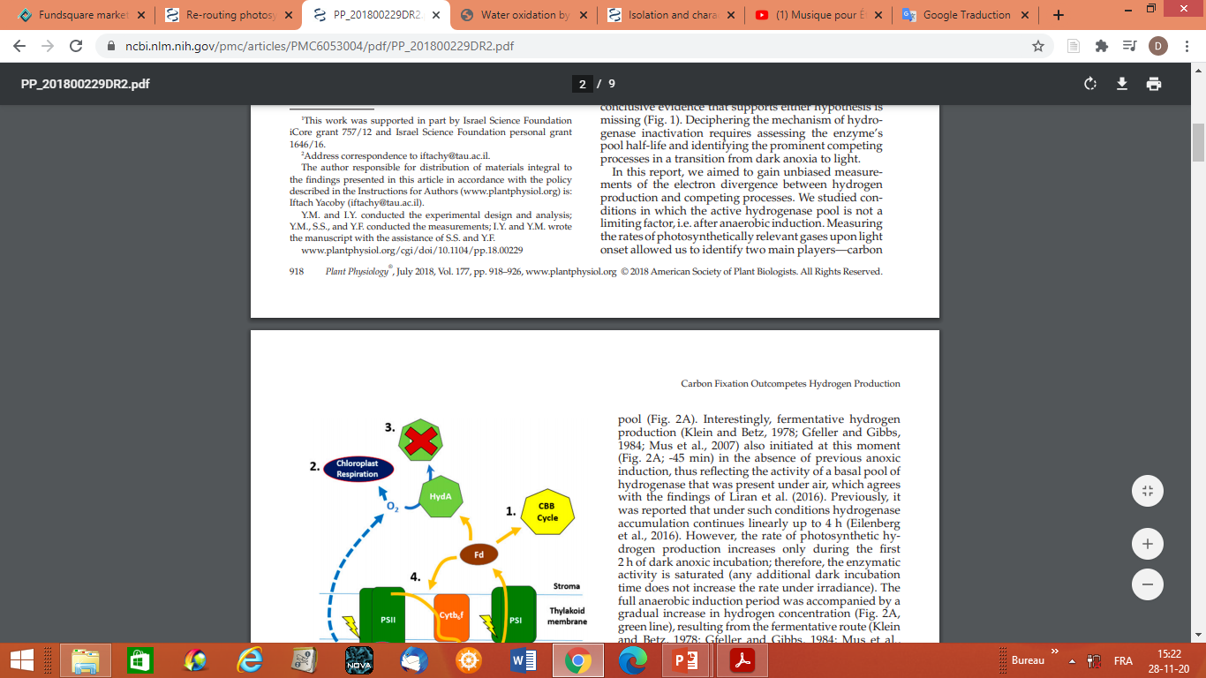
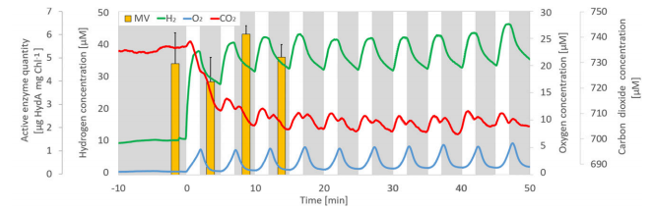
Studies related to our work
conclusion

Slide 41
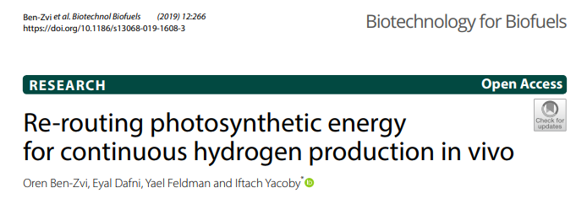
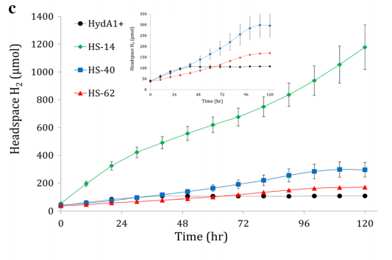
Studies related to our work
conclusion

Slide 42
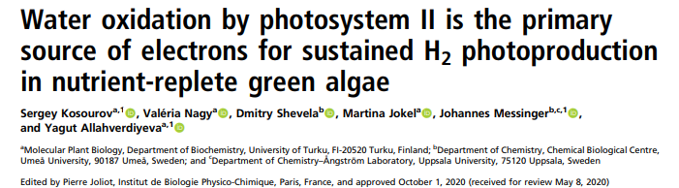
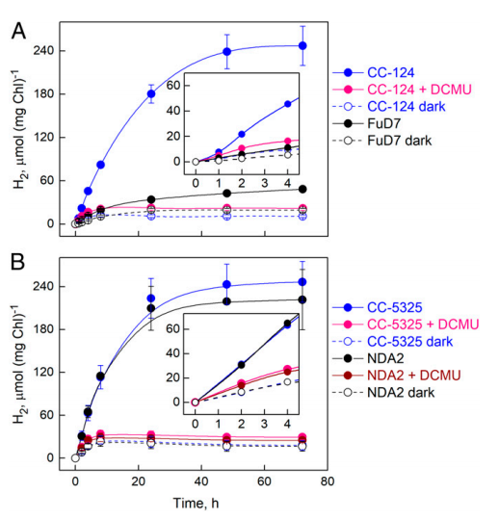
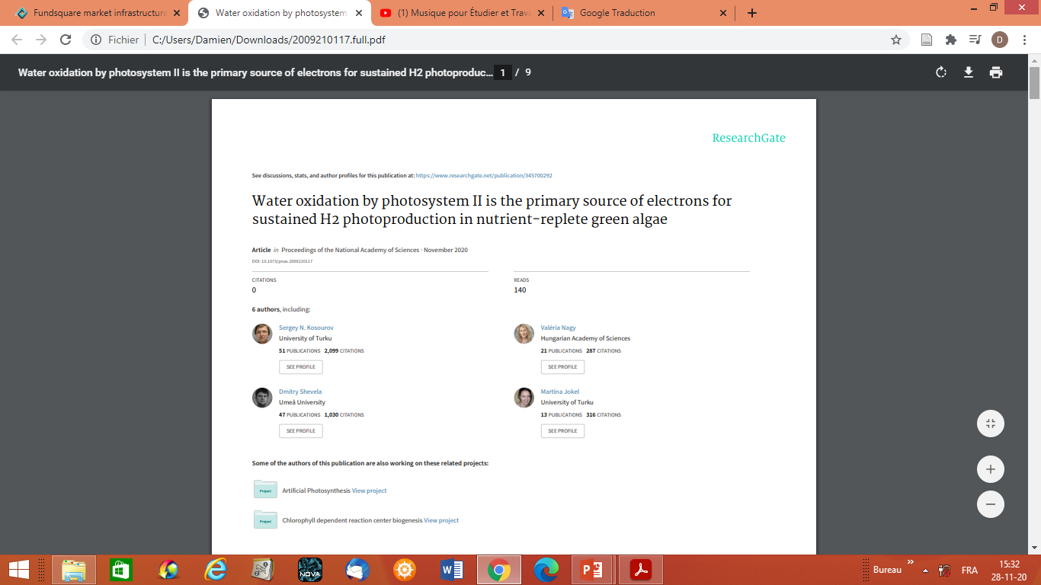
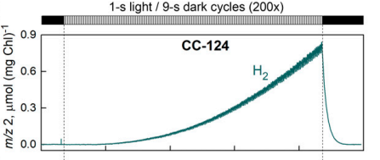
Studies related to our work
conclusion

Slide 43
Part II:
(Photo)Electro-enzymatic device to convert electricity
into molecular hydrogen

Slide 44
General context
Hydrogen production:

Slide 45
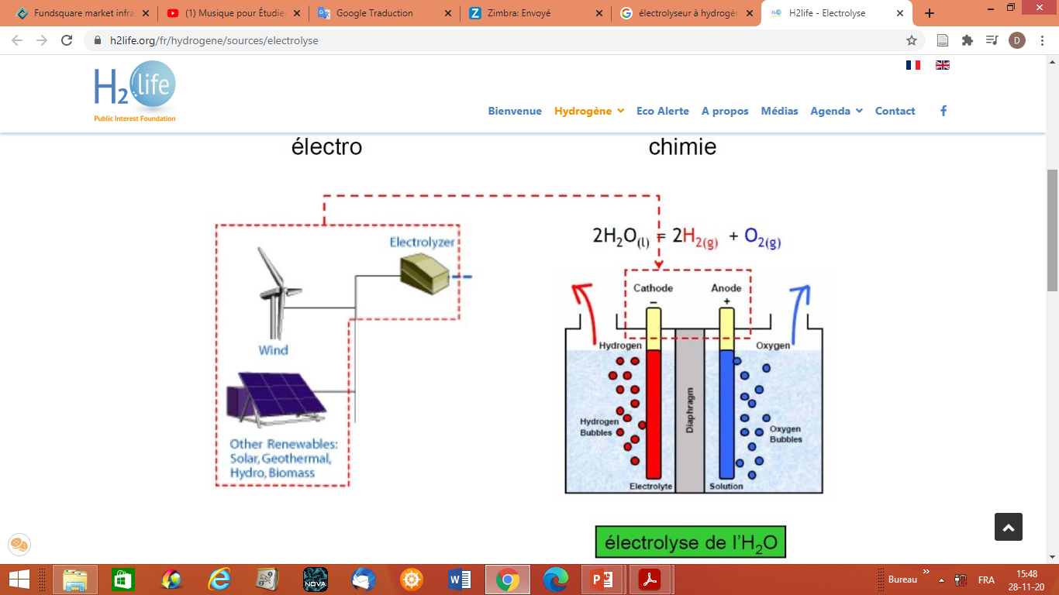
Introduction
(Photo)Electro-enzymatic device to convert electricity
into molecular hydrogen
Hydrogen production by water electrolysis
Source: www.h2life.org

Slide 46
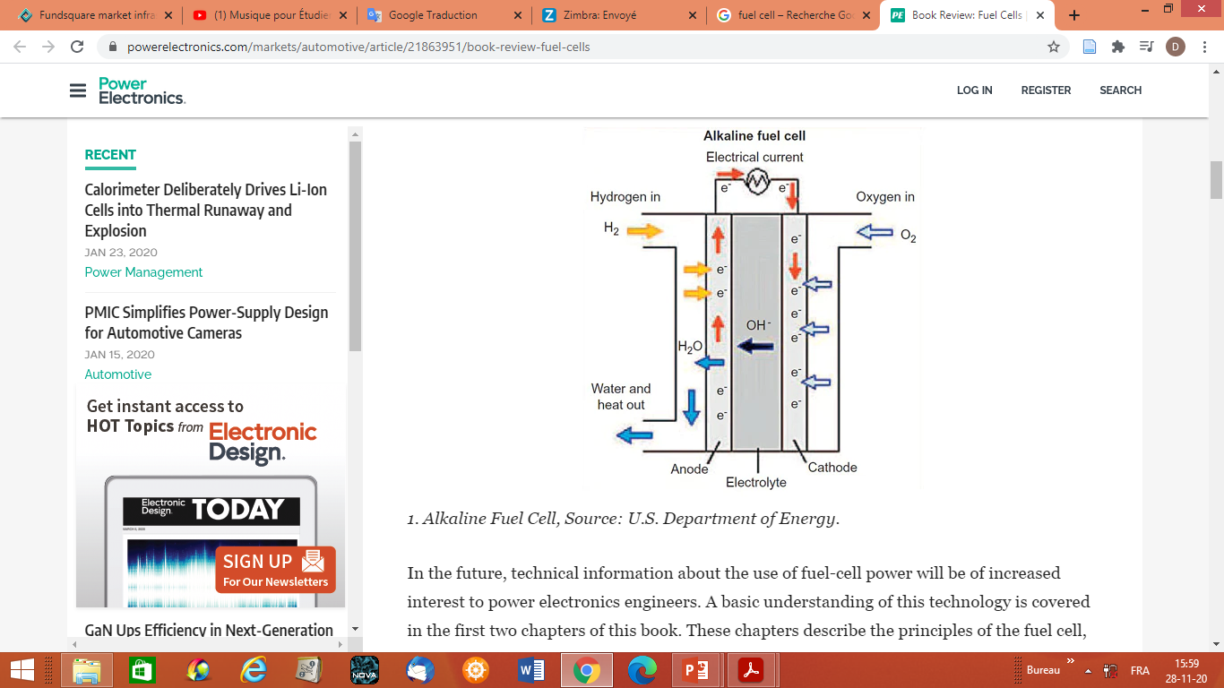
Introduction
(Photo)Electro-enzymatic device to convert electricity
into molecular hydrogen
Hydrogen consumption by fuel cell
Source: www.powerelectronics.com

Slide 47
Introduction
(Photo)Electro-enzymatic device to convert electricity
into molecular hydrogen
Hydrogen production by water electrolysis:
Could Hydrogenases replace metal catalyst in electrolyser?
Hydrogenase
● 2H⁺+2e⁻ H₂
Source: www.h2life.org

Slide 48
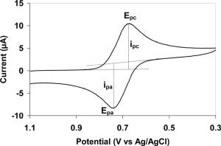
Introduction
(Photo)Electro-enzymatic device to convert electricity
into molecular hydrogen
Principle of Cyclic Voltammetry
Positive current = anodic oxidation
Negative current = cathodic reduction
Modified from: www.wikipedia.com

Slide 49
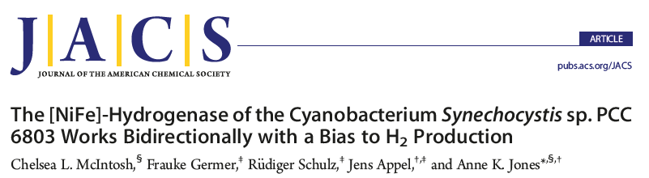
(Photo)Electro-enzymatic device to convert electricity
into molecular hydrogen

Slide 50
(Photo)Electro-enzymatic device to convert electricity
into molecular hydrogen
Hydrogen consumption by fuel cell:
Could Hydrogenases replace metal catalyst in fuel cell ?
Hydrogenase
● 2H⁺+2e⁻ H₂
Source: www.powerelectronics.com

Slide 51
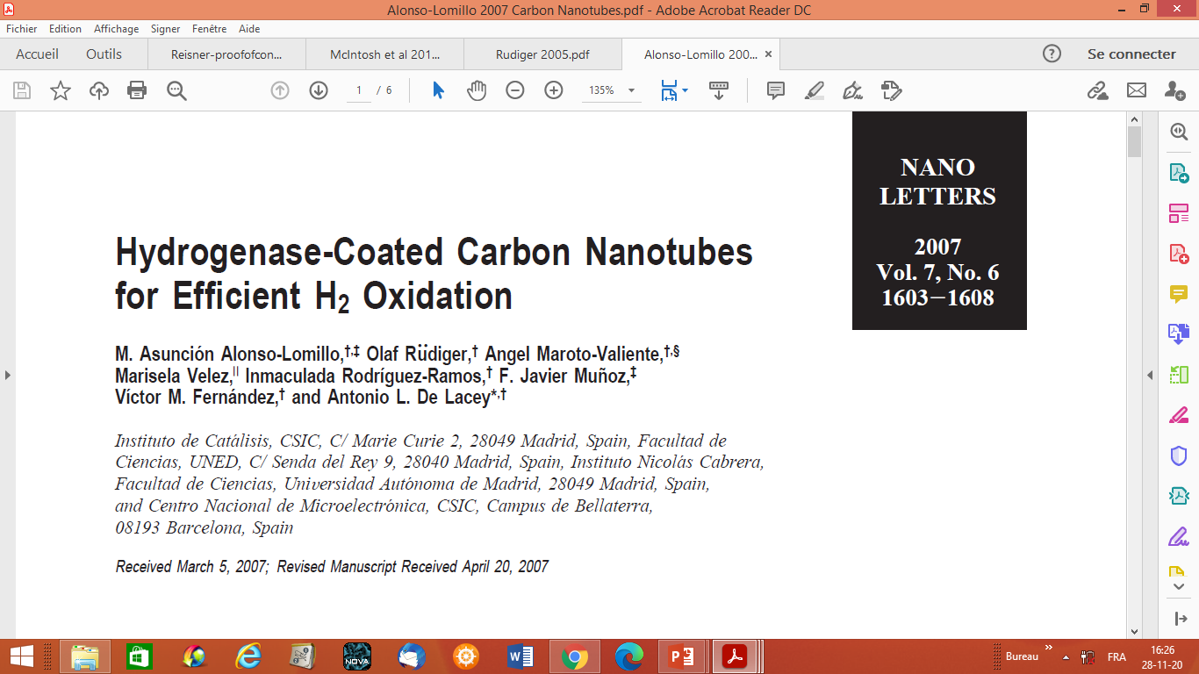
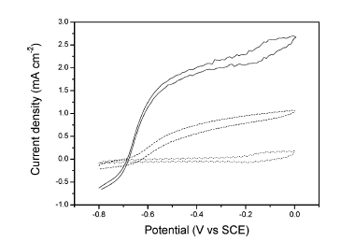
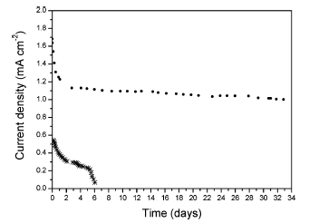
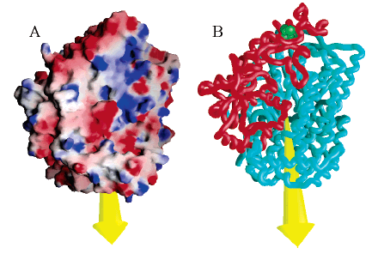
(Photo)Electro-enzymatic device to convert electricity
into molecular hydrogen
Rudiger et al., 2005

Slide 52
(Photo)Electro-enzymatic device to convert electricity
into molecular hydrogen
Hydrogen and oxygen consumption by fuel cell:
Could enzymes replace metal catalysts in fuel cell?
● Hydrogénase: 2H⁺+2e⁻ H₂
● Bilirubin oxidase: 2bilirubin+O₂ 2biliverdin +2H₂O
Source: www.powerelectronics.com

Slide 53
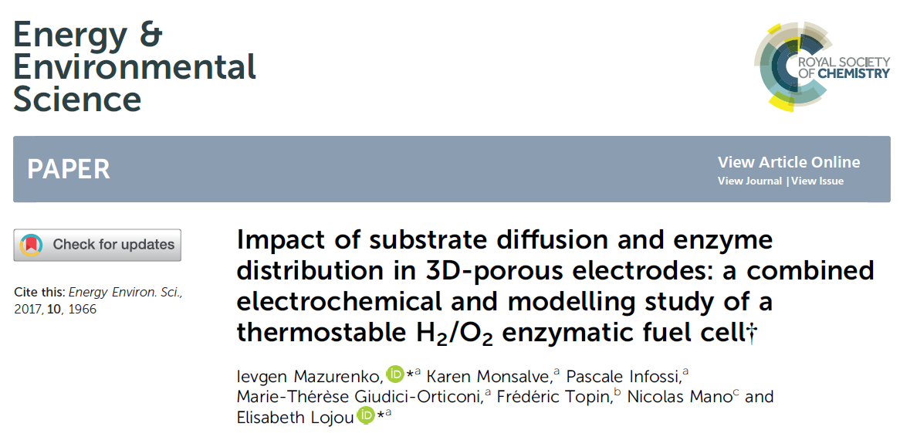
(Photo)Electro-enzymatic device to convert electricity
into molecular hydrogen

Slide 54
(Photo)Electro-enzymatic device to convert electricity
into molecular hydrogen

Slide 55
(Photo)Electro-enzymatic device to convert electricity
into molecular hydrogen
● Hydrogénase: 2H⁺+2e⁻ H₂
Bioanode
Biocathode
● Bilirubin oxidase: 2bilirubin+O₂ 2biliverdin +2H₂O

Slide 56
(Photo)Electro-enzymatic device to convert electricity
into molecular hydrogen

Slide 57
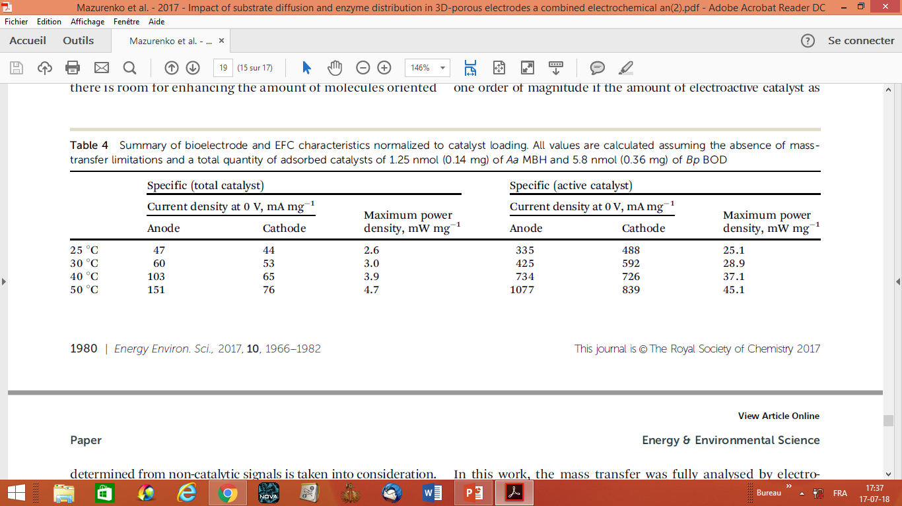
(Photo)Electro-enzymatic device to convert electricity
into molecular hydrogen

Slide 58
(Photo)Electro-enzymatic device to convert electricity
into molecular hydrogen
Hydrogen production by water electrophotolysis:
Could enzymes replace metal catalysts in electrolyser ?
● Hydrogénase: 2H⁺+2e⁻ H₂
● Photosystem II: 2H₂O+light 4H⁺+4e⁻+O₂
Source: www.h2life.org

Slide 59
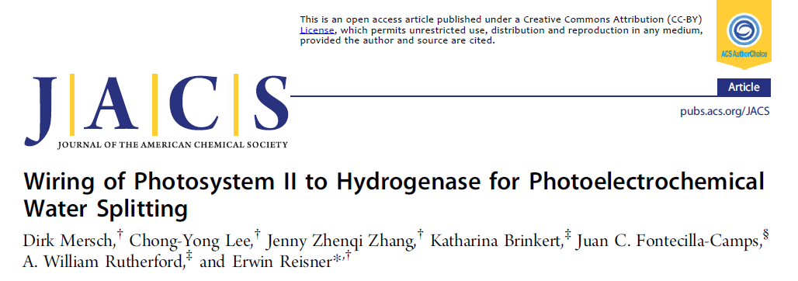
(Photo)Electro-enzymatic device to convert electricity
into molecular hydrogen

Slide 60
(Photo)Electro-enzymatic device to convert electricity
into molecular hydrogen
Hydrogenase cathode
PSII anode

Slide 61
(Photo)Electro-enzymatic device to convert electricity
into molecular hydrogen

Slide 62
Anecdotes
“I believe that water will one day be employed as fuel, that hydrogen and oxygen which constitute it, used singly or together, will furnish an inexhaustible source of heat and light, of an intensity of which coal is not capable”.
Jules Verne, 1874

Slide 63
Anecdotes
Hydrogen standard atomic weight is 1,008.
The World Hydrogen Day has been derived from this fact and is on the 8th of October of each year.

Slide 64
From photosynthetic regulation to enzymo-electrochemistry: Two case studies to explore hydrogen bioproduction
Thank you for your attention

