Slide 1


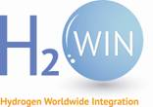


From physiological function of HydA to electrochemical characterization of HoxEFUYH:
Two case studies to explore hydrogen photoproduction
Madrid. January 10, 2017.
Damien Godaux. Genetics and physiology of microalgae laboratory
Faculty of sciences, Department of life sciences, University of Liège, Belgium
Supervisors: Prof. Claire Remacle
Dr. Pierre Cardol
Dr. Philippe Lorge
Funding: FNRS (PhD thesis fellowship)
Walloon region and H2WIN (Post-doc fellowship)

Slide 2
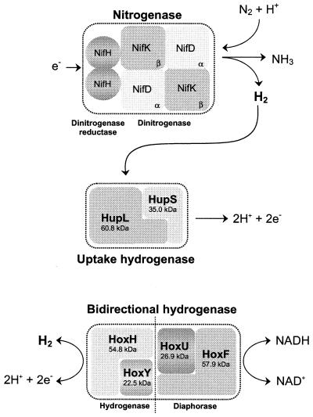
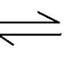
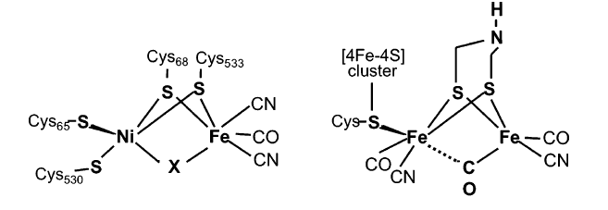
Hydrogenases:
Introduction
a
● 2H⁺+2e⁻ H₂ (a)
● Present in Bacteria, Archaea and Eukaryota
● Oxygen-sensitive
● Involved in various anaerobic bioenergetic processes such as fermentation and photosynthesis
Hydrogenase
b
c
Vignais and Billoud, 2007
Schematic structure of active center in NiFe hydrogenases (b) and FeFe hydrogenases (c)

Slide 3
Part I:
Function of the chloroplastic hydrogenase in
the microalga Chlamydomonas reinhardtii:
A travel from dark to light
Promoteur: Dr. Pierre Cardol
Co-promoteur: Prof. Claire Remacle
Genetics and physiology of microalgae laboratory
University of Liège, Faculty of sciences, Department of life sciences
2011-2014

Slide 4
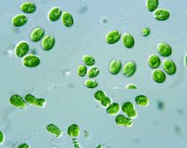
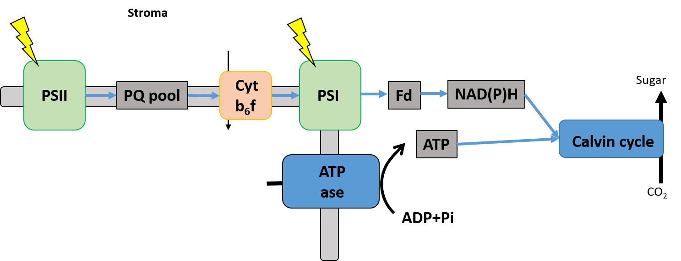
FeFe hydrogenase in Chlamydomonas reinhardtii
Introduction
Hydrogenase …
● Presence of two hydrogenase genes in the nuclear genome of Chlamydomonas reinhardtii
● Two maturation factors (HydEF and HydG) are required for the activity
● Expression and activity are sensitive to oxygen
● Hydrogen evolution in the dark (fermentation) and in the light (photosynthesis)
● Safety valve to avoid overreduction of photosynthesis pathway
● Short burst of hydrogen upon a shift from dark anoxia to light
… and hydrogen metabolism in Chlamydomonas
Photosynthesis pathway
H₂
HydA
Stroma
H⁺
2H₂O
4 + O₂
H⁺
Lumen

Slide 5
Aims of my PhD thesis
Aims
● Set up of a new fluorescence screen to isolate mutants
impaired in hydrogenase activity
● Study the role of hydrogenase in photosynthesis reactivation
Photosynthesis pathway
H₂
HydA
Stroma
2H₂O
4 + O₂
H⁺
Lumen

Slide 6
Aims of my PhD thesis
Aims
● Set up of a new fluorescence screen to isolate mutants
impaired in hydrogenase activity
● Study the role of hydrogenase in photosynthesis reactivation
Photosynthesis pathway
H₂
HydA
Stroma
2H₂O
4 + O₂
H⁺
Lumen

Slide 7
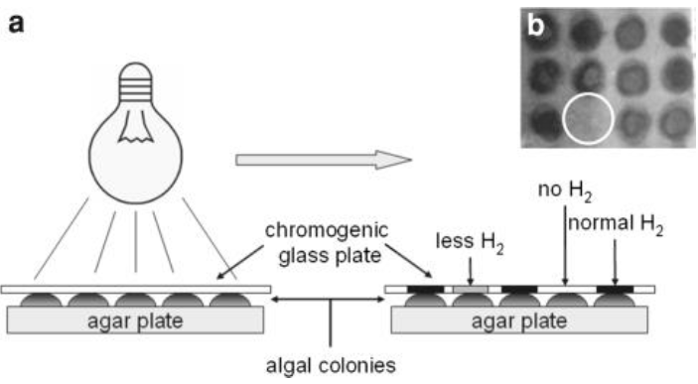
Set up of a new fluorescence screen to isolate mutants
impaired in hydrogenase activity
Introduction
● Safety valve to avoid overreduction of photosynthesis pathway
● Short burst of hydrogen upon a shift from dark anoxia to light
● Tungsten oxide chromogenic sensor turns in blue in contact to H2
Chromogenic sensor
Isolation of HydEF deficient strain (hydEF) (Posewitz et al., 2004)

Slide 8
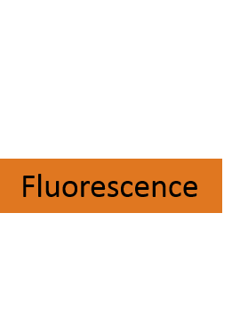

Set up of a new fluorescence screen to isolate mutants
impaired in hydrogenase activity
Introduction
● Safety valve to avoid overreduction of photosynthesis pathway
● Short burst of hydrogen upon a shift from dark anoxia to light
● Chlorophyll fluorescence is an indicator of photosynthetic energy conversion in higher plants, algae and bacteria
H₂
HydA
Photosynthesis pathway

Slide 9
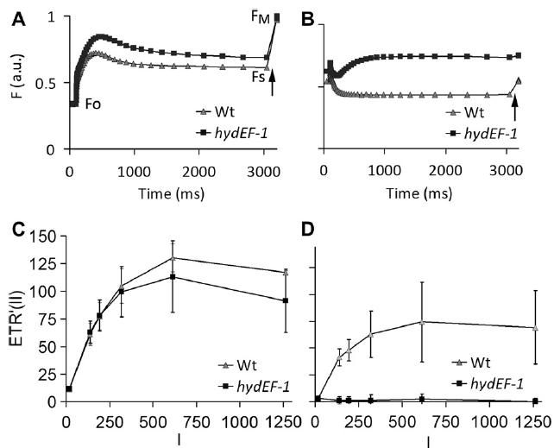
Set up of a new fluorescence screen to isolate mutants
impaired in hydrogenase activity
Results
1: Specific to anoxia?
2: Effect of light intensity?
3: Sensitivity?
4: Effect of acclimation time?
*
* hydEF mutant isolated by Posewitz et al., 2004
Photochemical yield of photosystem II (ΦII) = Fv/Fm’ or (Fm’-Fs)/Fm’
PSII relative electron transport rate (ETR’) = ΦII*Ilum
Notes:
9

Slide 10
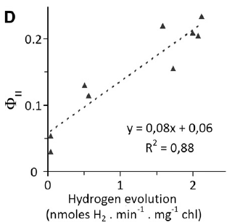
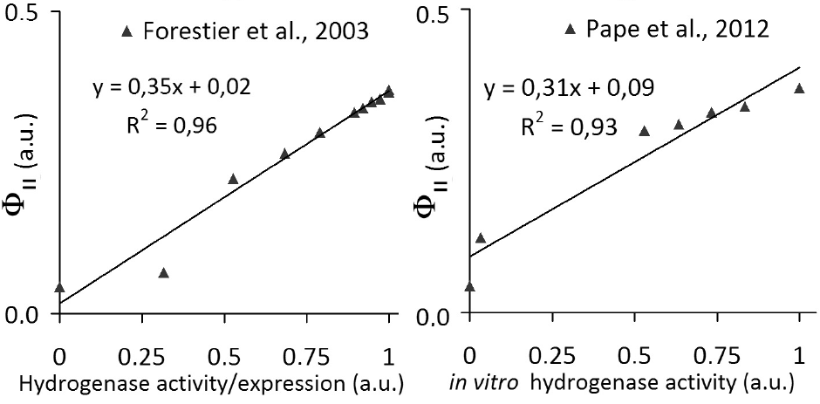
Set up of a new fluorescence screen to isolate mutants
impaired in hydrogenase activity
Results
‘
1: Specific to anoxia? √
2: Effect of light intensity? √
3: Sensitivity? √
4: Effect of acclimation time? √
>12h
up to 3h
Light intensity
Hydrogen evolution
Hydrogenase activity/expression
Notes:
10

Slide 11
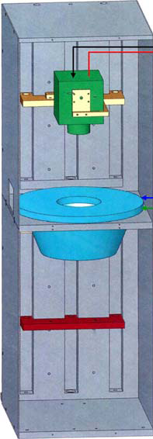
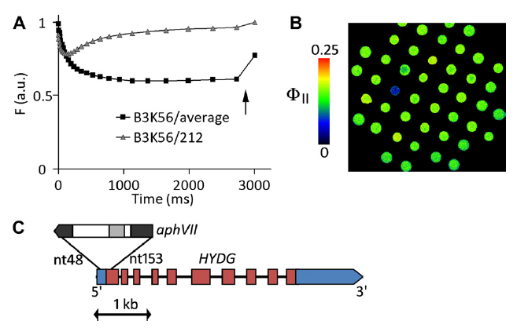
Set up of a new fluorescence screen to isolate mutants
Impaired in hydrogenase activity : Proof of concept
Results
Fluorescence screening on a mutants library obtained by random mutagenesis
Fluorescence screening
Isolation of hydG-2 strain
Notes:
11

Slide 12
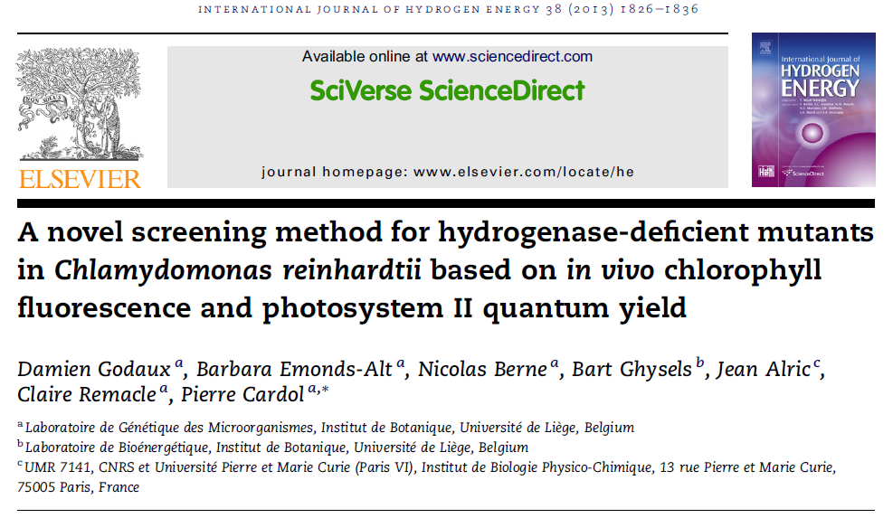
Take home message
Conclusion
● Development of a fluorescence-based screening method to identify new players in hydrogenase activity and hydrogen metabolism
→ Fast
→ Non invasive
→ Sensitive
Notes:
12

Slide 13
Aims of my PhD thesis
Aims
● Set up of a new fluorescence screen to isolate mutants
impaired in hydrogenase activity
● Study the role of hydrogenase in photosynthesis reactivation
Photosynthesis pathway
H₂
HydA
Stroma
H⁺
H⁺
H⁺
2H₂O
4 + O₂
H⁺
H⁺
H⁺
H⁺
H⁺
H⁺
Lumen

Slide 14
Photosynthetic alternative electron flows
Introduction
Photosynthesis needs alternative pathways to optimize the energetic balance
● Calvin cycle requirement: 1,5 ATP/NADPH
● Linear electron flow: ≈1,3 ATP/NADPH
H⁺
Cyt b₆f
Sugar
PSII
PQ pool
PSI
Fd
NAD(P)H
H⁺
H⁺
ATP
Calvin cycle
2H₂O
4H⁺ + O₂
H⁺
H⁺
H⁺
ATP
ase
H⁺
H⁺
H⁺
H⁺
CO₂
H⁺
H⁺
ADP+Pi
1.5 ATP/NADPH required
for carbon fixation

Slide 15
Photosynthetic alternative electron flows in oxic condition
Introduction
Photosynthesis needs alternative pathways to optimize the energetic balance
● Water-water cycle (involving Ptox, Mehler reaction and NADPH exchange with mitochondria)
● PSI-CEF (Pgrl1 and Nda2 pathway)
O₂
O₂
Nda2-CEF
Mehler
O₂
Pgrl1-CEF
Mitochondria
Ptox
H⁺
Cyt b₆f
Sugar
PSII
PQ pool
PSI
Fd
NAD(P)H
H⁺
H⁺
ATP
Calvin cycle
2H₂O
4H⁺ + O₂
H⁺
H⁺
H⁺
ATP
ase
H⁺
H⁺
H⁺
H⁺
CO₂
H⁺
H⁺
ADP+Pi

Slide 16
Photosynthetic alternative electron flows in anoxic condition
Introduction
Photosynthesis needs alternative pathways to optimize the energetic balance
● PSI-CEF (mainly through the Pgrl1 pathway)
● HydA activity
Nda2-CEF
H₂
Pgrl1-CEF
HydA
H⁺
Cyt b₆f
Sugar
PSII
PQ pool
PSI
Fd
NAD(P)H
H⁺
H⁺
ATP
Calvin cycle
2H₂O
4H⁺ + O₂
H⁺
H⁺
H⁺
ATP
ase
H⁺
H⁺
H⁺
H⁺
CO₂
H⁺
H⁺
ADP+Pi

Slide 17
● Study the role of hydrogenase in photosynthesis reactivation
Introduction
Starting hypothesis :
● Key factor for Calvin cycle reactivation ? Restore energetic balance for carbon fixation !
● How to restore the energetic balance ? HydA and Pgrl1-CEF !
H₂
Pgrl1-CEF
HydA
H⁺
Cyt b₆f
Sugar
PSII
PQ pool
PSI
Fd
NAD(P)H
H⁺
H⁺
ATP
Calvin cycle
2H₂O
4H⁺ + O₂
H⁺
H⁺
H⁺
ATP
ase
H⁺
H⁺
H⁺
H⁺
CO₂
H⁺
H⁺
ADP+Pi

Slide 18
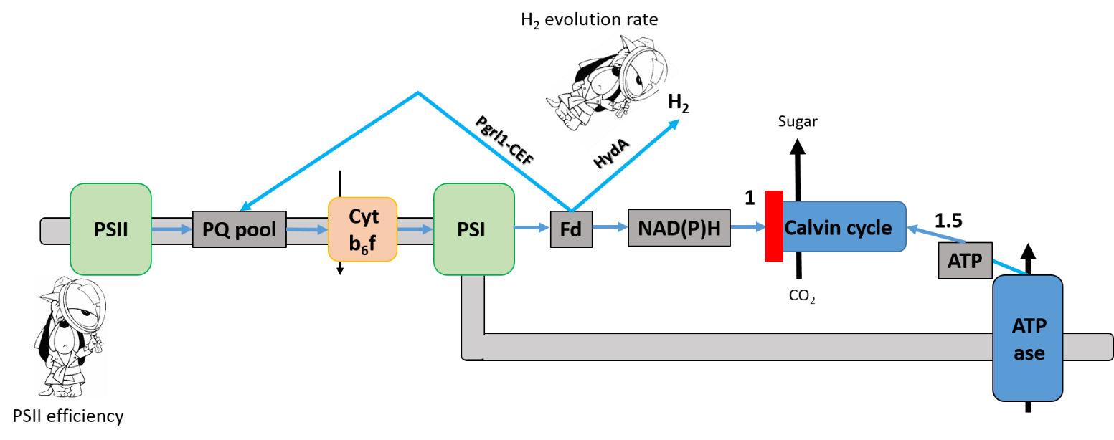
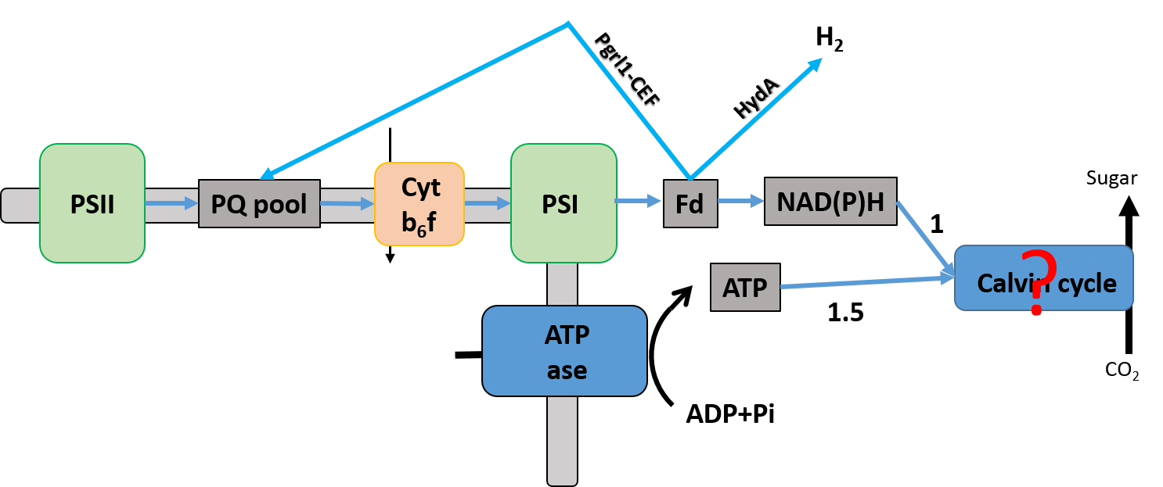
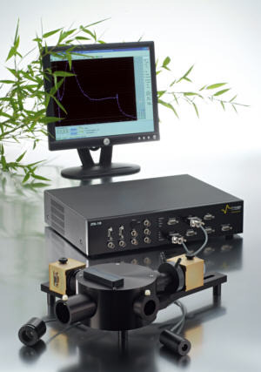
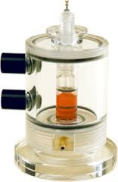
● Study the role of hydrogenase in photosynthesis reactivation
Tools
Modified Clark electrode
→ H₂ production
Joliot type spectrometer (JTS)
→ PSII (fluorescence) and PSI (absorbance) efficiency

Slide 19
Tools
wild type
pgrl1
(Tolleter et al., 2011)
hydg-2
(Godaux et al., 2013)
pgrl1 hydg-2

Slide 20
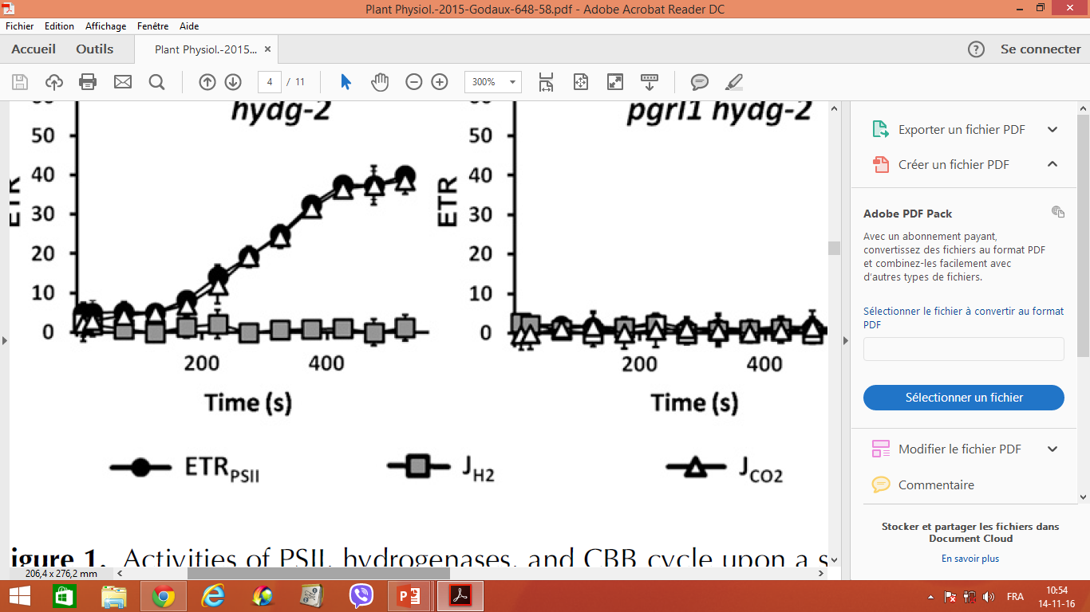
Key factor for Calvin cycle reactivation ?
Results
A
● Hydrogen evolution decreases when PSII efficiency increases
● Increase in PSII efficiency reflects induction of Calvin cycle
● ETR PSII = J CO2 + J H2
● J CO2 = ETR PSII – J H2

Slide 21
Key factor for Calvin cycle reactivation ?
Results
A
● Hydrogen evolution decreases when PSII efficiency increases
● Increase in PSII efficiency reflects induction of Calvin cycle
● Such induction is proton gradient-dependent
→ Need to restore energetic balance
B
C
● ETR PSII = J CO2 + J H2
● J CO2 = ETR PSII – J H2

Slide 22
Are HydA and Pgrl1 involve in restoring the energetic balance ?
Results
● Both HydA and Pgrl1-CEF are involved
in Calvin cycle induction.
● ETR PSII = J CO2 + J H2
● J CO2 = ETR PSII – J H2

Slide 23
Are HydA and Pgrl1 involve in restoring the energetic balance ?
Results
● Both HydA and Pgrl1-CEF are involved
in Calvin cycle induction.
● Calvin cycle reactivation is prevented
in absence of both hydrogenase activity
and Pgrl1-CEF.
● ETR PSII = J CO2 + J H2
● J CO2 = ETR PSII – J H2

Slide 24
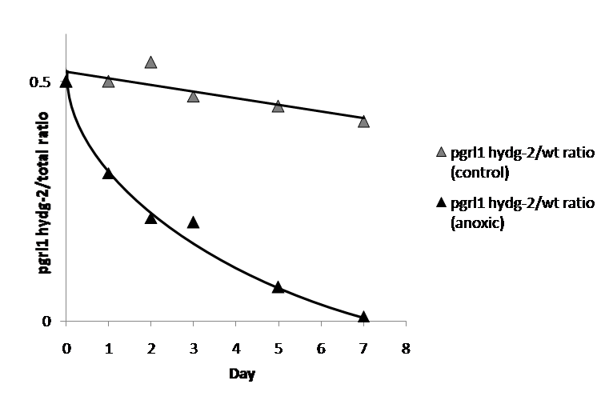
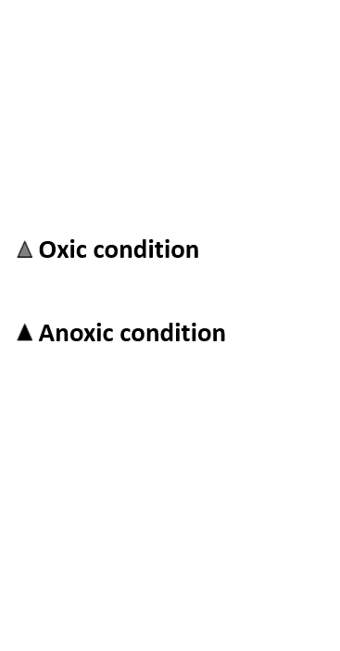
Results
Concomitant absence of hydrogenase and CEF
is detrimental for cell growth
3/3-h dark/light cycles
0
3
6
9
12
15
18
21
24
50
% pgrl1 hydg-2
Fluorescence screening to determine pgrl1 hydg-2 population versus wild type
● Hydrogenase activity or CEF are detrimental for the survival of the cell,
in conditions where photosynthesis reactivation occured
Notes:
24

Slide 25
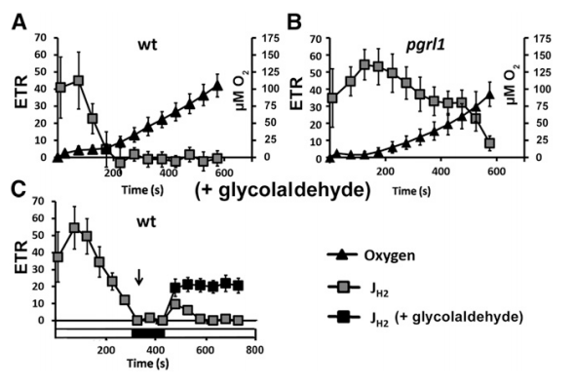
results
Hydrogen production stops because of Calvin cycle reactivation
prior to oxygen sensitivity
● In wild type, hydrogen production stops before the increase of oxygen level (A)
● In pgrl1, hydrogen production remains high even when oxygen level is high (B)
● In wild type, addition of GA allows continuous hydrogen production (C)

Slide 26
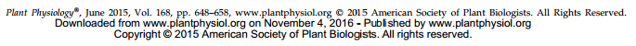
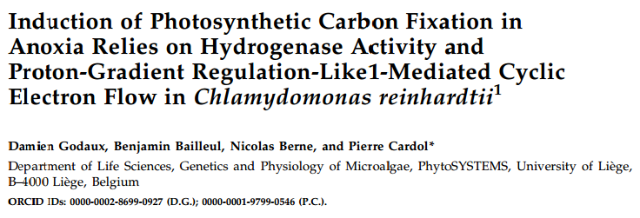
Take home messages
conclusion
● Calvin cycle reactivation is proton gradient-dependent (ATP production)
● Hydrogen photoproduction stops because of Calvin cycle reactivation prior to
oxygen sensitivity
● Either hydrogenase activity or Pgrl1-CEF is required for Calvin cycle reactivation
and then cell survival

Slide 27
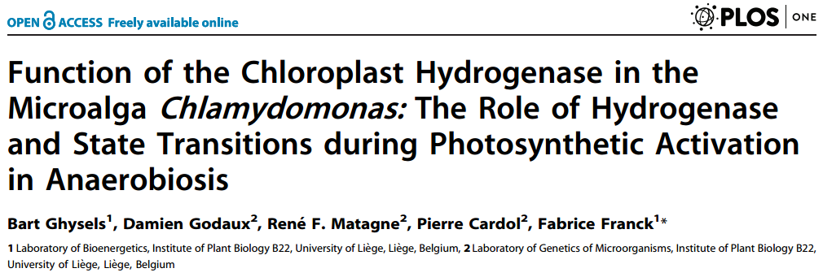
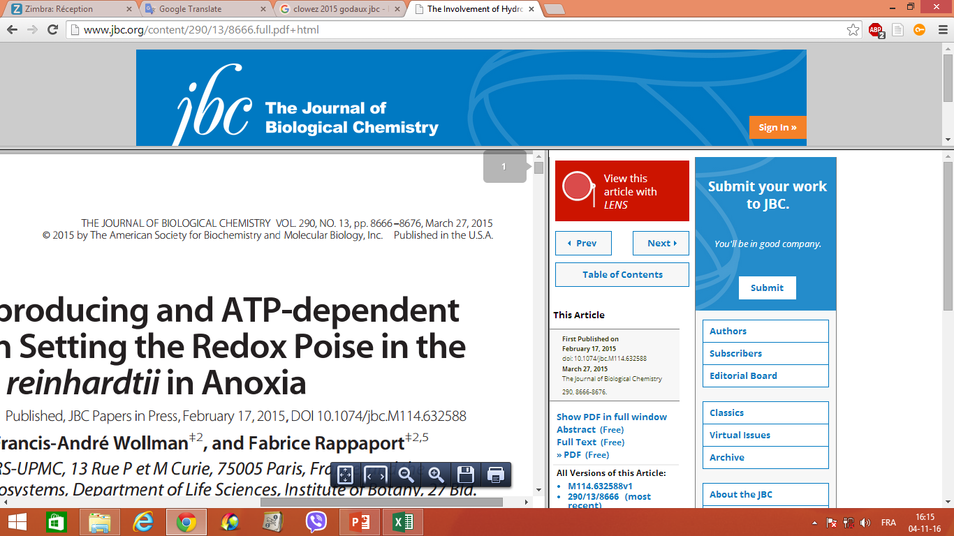
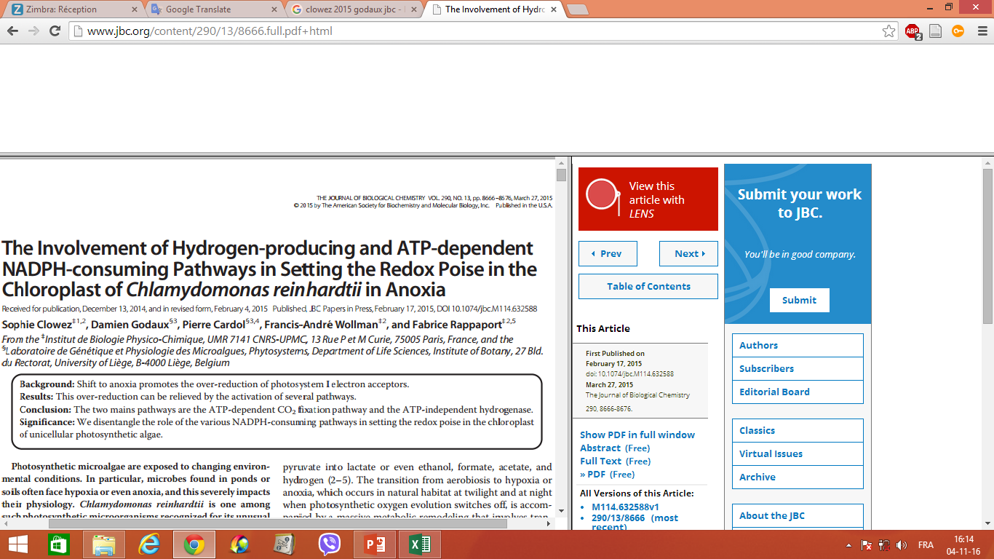
Take home messages
conclusion
● Calvin cycle reactivation is proton gradient-dependent (ATP production)
● Hydrogen photoproduction stops because of Calvin cycle reactivation prior to
oxygen sensitivity
● Either hydrogenase activity or Pgrl1-CEF is required for Calvin cycle reactivation
and then cell survival

Slide 28
Part II:
Self-sustained photoelectrochemical device to convert light into molecular hydrogen
Dr. Philippe Lorge
Prof. Claire Remacle
Genetics and physiology of microalgae laboratory
University of Liège, Faculty of sciences, Department of life sciences
2015-2016

Slide 29
Self-sustained photoelectrochemical device to convert light
into molecular hydrogen
Introduction
Hydrogenase cathode
PSII anode
(Mersch et al., 2015)

Slide 30
Self-sustained photoelectrochemical device to convert light
into molecular hydrogen
Introduction
Hydrogenase cathode
Capacity (turnover)
O₂ resistance
Ability of purification
Ability of implementation
Hydrogenase cathode
PSII anode
(Mersch et al., 2015)

Slide 31
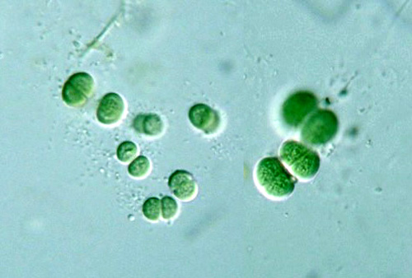
Who is Synechocystis ?
Introduction
● Unicellular non-nitrogen fixing cyanobacteria
● Use as a model for photosynthesis, carbon and nitrogen fixation, hydrogen photoproduction, etc
● Both phototrophic and heterotrophic growth (low-cost media)
● Already cultivated at large scale (agri-food and cosmetic industries)
● HoxEFUYH is a pentameric bidirectional hydrogenase of the NAD(P)- reducing class
● HoxEFUYH mights function as an electron safety valve
(McIntosh et al., 2011)

Slide 32
Why Synechocystis ?
Introduction
● Expression under aerobic conditions
● After O₂ inactivation, HoxEFUYH is rapidly reactivated by O₂ when exposed to reducing conditions
● Turnover in vivo is underestimated (Prof. Jens Appel, Hydrogenase conference)
● Genetic modification (add a « Strep-tag » (Germer et al., 2009))
● Purification protocole available (Schmitz et al., 2002)
● Bais toward protons reduction (McIntosh et al., 2011)
(McIntosh et al., 2011)

Slide 33
Why Synechocystis ?
Introduction
B
C
A
(A) Proton reduction catalytic voltammograms for HoxEFUYH at various pH values
(B) Normalized reduction activity at 560 mV derived from voltammograms such as those shown in panel A
(C) Fraction of enzyme reductively reactivated after O₂ inhibition as a function of potential.
(Data from McIntosh et al., 2011)

Slide 34
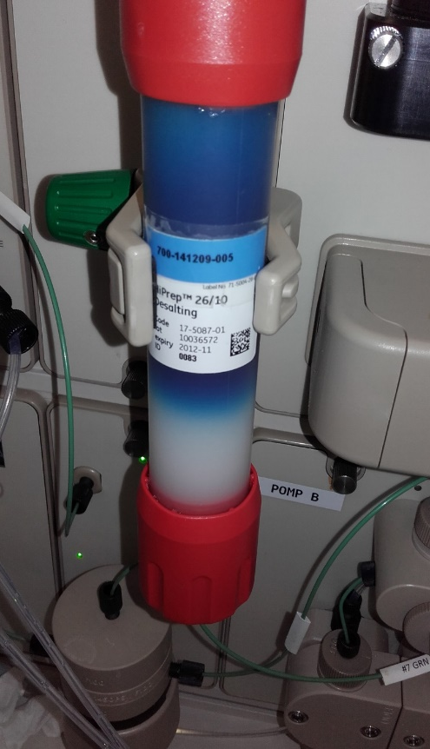
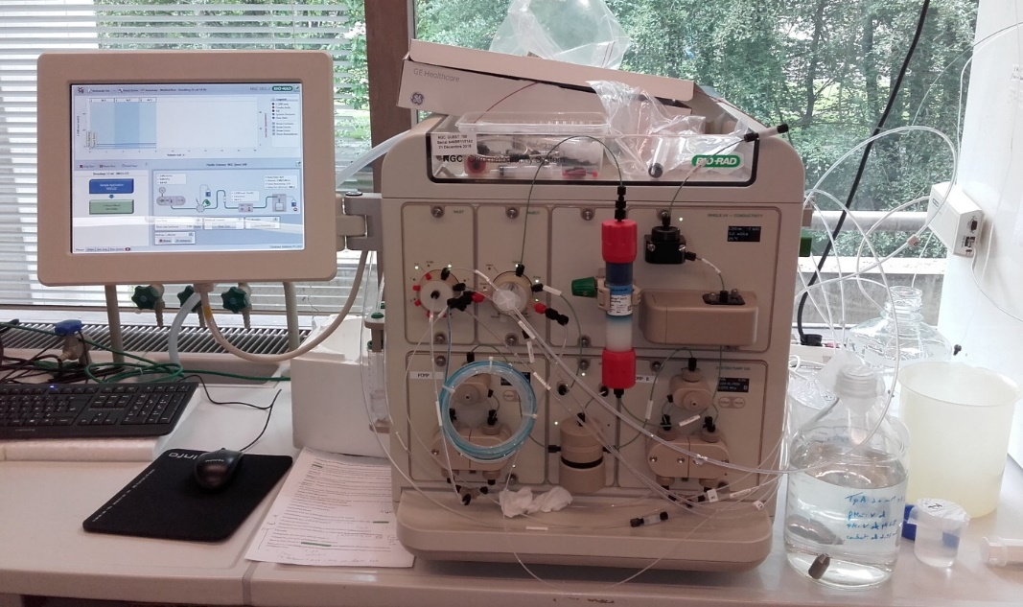
HoxEFUYH Purification:
Results
● In collaboration with purification platform of Ulg (Fabrice Bouillenne, CIP)
● Under oxic conditions
● Based on Schmitz et al., 2002
● 4 successives stages of purification (ammonium sulfate precipitation, ion exchange, hydrophobic interaction and size exclusion chromatographies)
● Designed for large scale purification

Slide 35
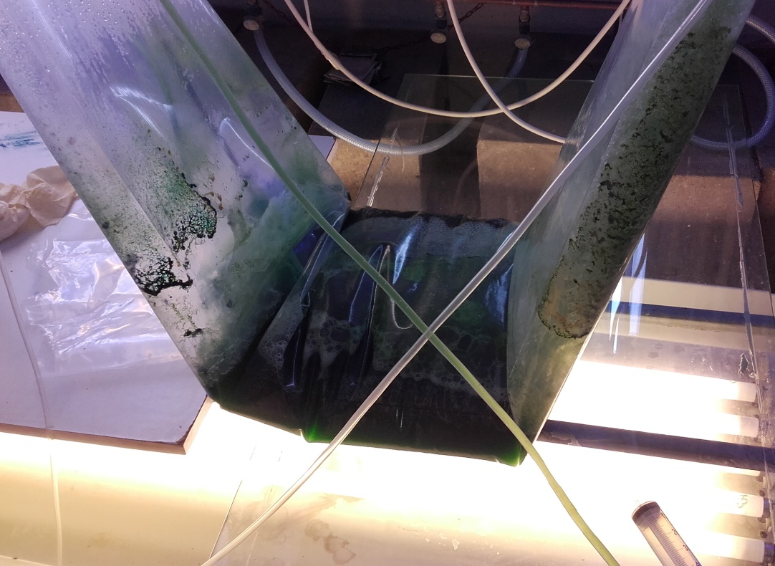
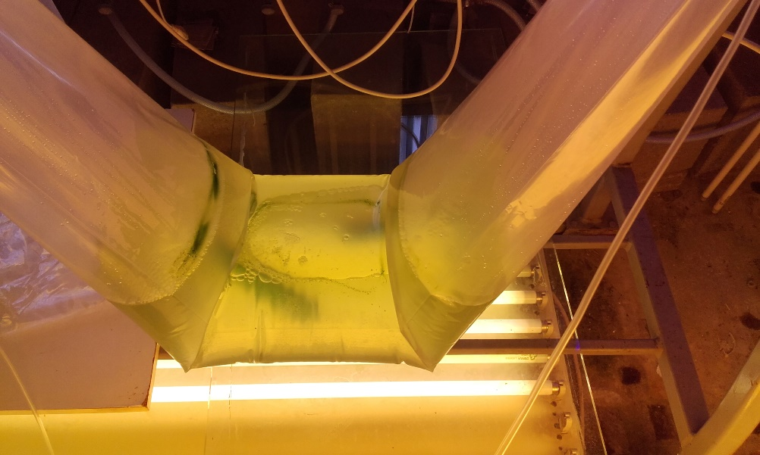
HoxEFUYH Purification:
Results
● In collaboration with purification platform of Ulg (Fabrice Bouillenne, CIP)
● Under oxic conditions
● Based on Schmitz et al., 2002
● 4 successives stages of purification (ammonium sulfate precipitation, ion exchange, hydrophobic interaction and size exclusion chromatographies)
● Designed for large scale purification
20L plastic bag
2 weeks cultivation

Slide 36
Experimental conditions:
Results
● Glassy carbon electrode (r=0.25cm, area=0.196cm²)
● MES buffer 20mM, NaCl 50mM, MgCl₂ 2mM, pH 6.3 (bubbled with nitrogen)
● 15µg of purified HoxEFUYH dried on the electrode under vacuum
● Nafion membrane to limit desorption
● Scan rate of 20mV/s
● Calomel reference

Slide 37
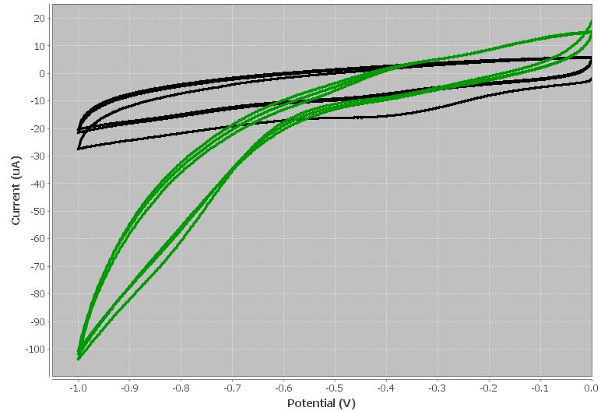
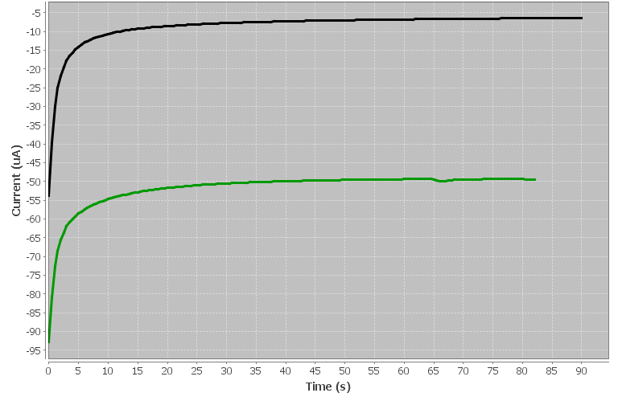
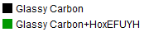
Electrochemical experiments:
Results
● Glassy carbon electrode (r=0.25cm, area=0.196cm²)
● MES buffer 20mM, NaCl 50mM, MgCl₂ 2mM, pH 6.3 (bubbled with nitrogen)
● 15µg of purified HoxEFUYH dried on the electrode under vacuum
● Nafion membrane to limit desorption
● Scan rate of 20mV/s
● Calomel reference
- 0.35V vs SHE
→ ≈ 50 µA
- 0.8V vs Calomel
- 0.56V vs SHE
From -0.76V vs SHE…
…to 0.24V vs SHE

Slide 38
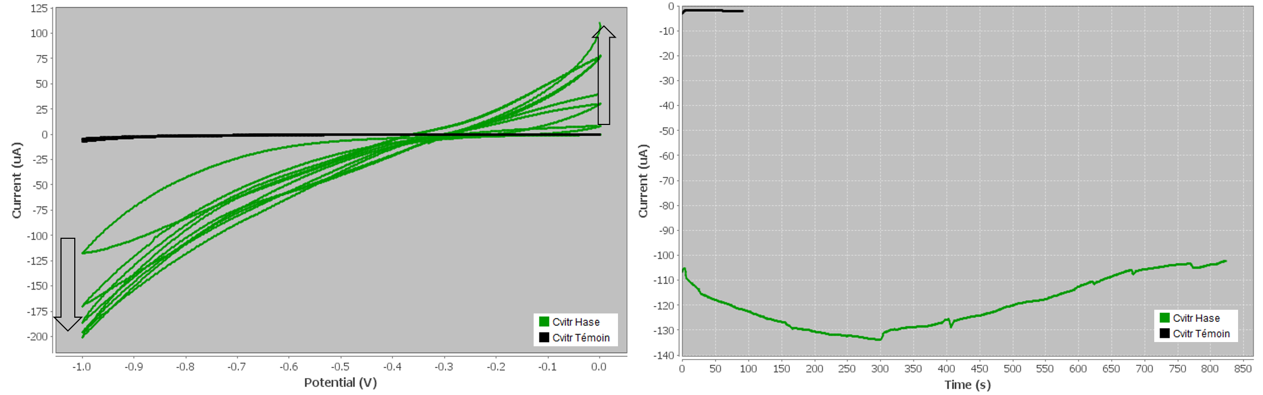
Electrochemical experiments:
Results
● Glassy carbon electrode (r=0.25cm, area=0.196cm²)
● MES buffer 20mM, NaCl 50mM, MgCl₂ 2mM, pH 6.3 (bubbled with nitrogen)
● 30µg of purified HoxEFUYH dried on the electrode under vacuum
● Nafion membrane to limit desorption
● Scan rate of 20mV/s
● Calomel reference
● Reproductibility issue (shape, zero current potential, pH, stability)
- 0.8V vs Calomel
- 0.56V vs SHE
- 0.15V vs SHE
→ ≈ 100 µA.cm⁻²
From -0.76V vs SHE…
…to 0.24V vs SHE

Slide 39
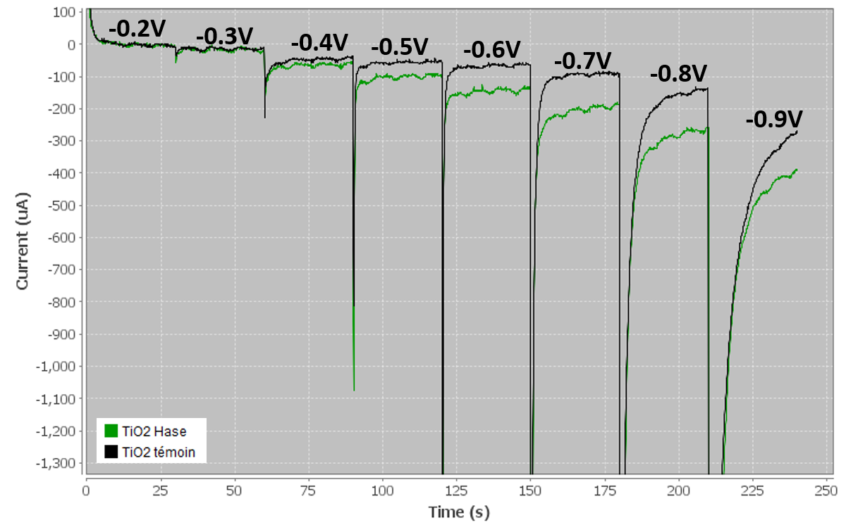
Electrochemical experiments:
Results
● Glassy carbon electrode (r=0.25cm, area=0.196cm²)
● MES buffer 20mM, NaCl 50mM, MgCl₂ 2mM, pH 6.3 (bubbled with nitrogen)
● 30µg of purified HoxEFUYH dried on the electrode under vacuum
● Nafion membrane to limit desorption
● Calomel reference
● Coupling between PSII-anode and
Hydrogenase-cathode

Slide 40
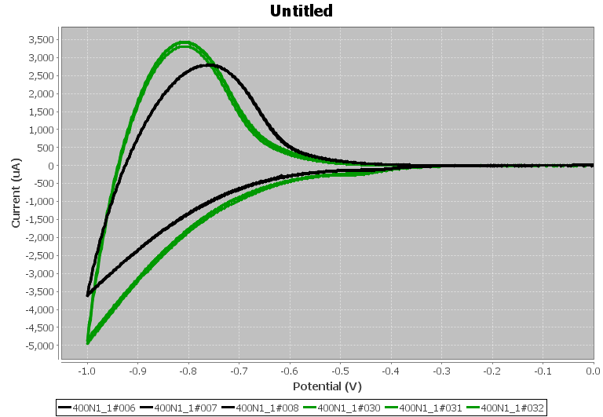
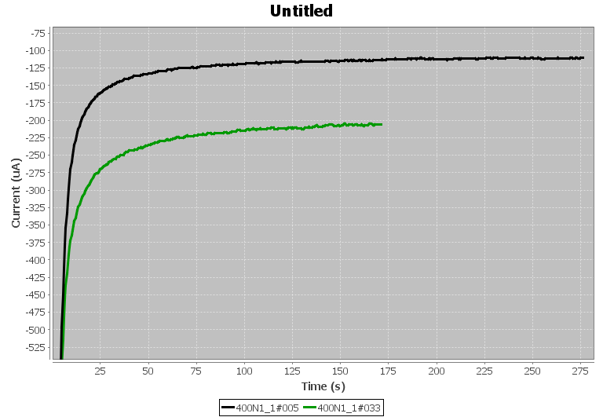
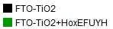
Electrochemical experiments:
Results
● FTO-TiO₂ semi-conductor electrode (area=4cm²)
● MES buffer 20mM, NaCl 50mM, MgCl₂ 2mM, pH 6.3 (bubbled with nitrogen)
● 30µg of purified HoxEFUYH dried on the electrode under vacuum
● Dialysis membrane to limit desorption
● Scan rate of 20mV/s
● Calomel reference
→ ≈ 100 µA.cm⁻²
-0.36V
vs SHE
Hydrogenase effect?
- 0.8V vs Calomel
- 0.56V vs SHE
From -0.76V vs SHE…
…to 0.24V vs SHE

Slide 41
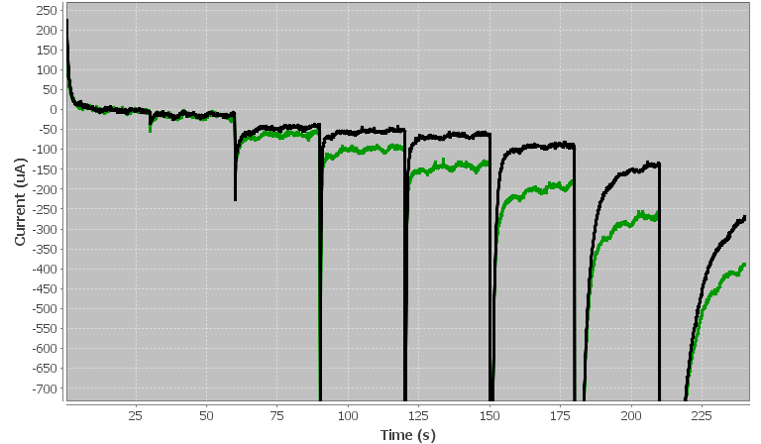
Electrochemical experiments:
Results
● FTO-TiO₂ semi-conductor electrode (area=4cm²)
● MES buffer 20mM, NaCl 50mM, MgCl₂ 2mM, pH 6.3 (bubbled with nitrogen)
● 30µg of purified HoxEFUYH dried on the electrode under vacuum
● Dialysis membrane to limit desorption
● Scan rate of 20mV/s
● Calomel reference
● H₂ detection from -0.6V vs Calomel
(Unisense hydrogen microsensor)
-0.2V
-0.3V
-0.4V
-0.5V
-0.6V
-0.7V
-0.8V
-0.9V

Slide 42
Short stay in Lojou lab (Marseille):
Results
● Improve skill and understanding in electrochemistry
● Covalent fixation of HoxEFUYH to carbon nanotubs
Very low signal
Very low stability
Very low signal
Good stability

Slide 43
Short stay in Lojou lab (Marseille):
Results
● Improve skill and understanding in electrochemistry
● Covalent fixation of HoxEFUYH to carbon nanotubs
● Electrode preparation or HoxEFUYH purification ?

Slide 44
Short stay in here in Madrid:
Results
● Improve skill and understanding in electrochemistry
● Incorporation of HoxEFUYH into the cobaltocene redox polymers (overpotential, current stability and turnover)
→ First lesson: Improve the purification protocole to obtain a better activity (≈ factor fifty compared to D. gigas)

Slide 45
Prospects:
Prospects
Part I:
● Factors limiting hydrogen photoproduction in vivo (Lorenzo Durante, PhD student, Ulg (Belgium); Dr. Maria Ghirardi, NREL (USA)).
● Understanding the PSI-CEF function in photosynthesis regulation (Dr. Benjamin Bailleul, IBPC (France)).
● Physiological function of HoxEFUYH in Synechocystis (Prof. Jens Appel, Kiel (Germany)).
Part II:
● Improve skill and understanding in electrochemistry
● Increase current density and stability (electrode modification, redox polymer)
● Increase biomass (large scale Synechocystis cultivation)
● Optimise the purification process (Strep-tag)

Slide 46
From physiological function of HydA to electrochemical characterization of HoxEFUYH:
Two case studies to explore hydrogenase-dependent hydrogen production
Thank you for your attention

Slide 48
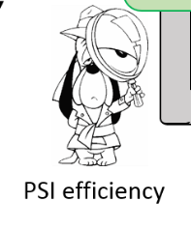
Results
Evidence for Pgrl1-CEF in physiological conditions
● ETR PSI = ETR PSII + J CEF
● J CEF= ETR PSI – ETR PSII
● PSI-CEF is transitory induced
● First measurement of PSI-CEF in physiological
conditions in Chlamydomonas reinhardtii.
Notes:
48

