Slide 1
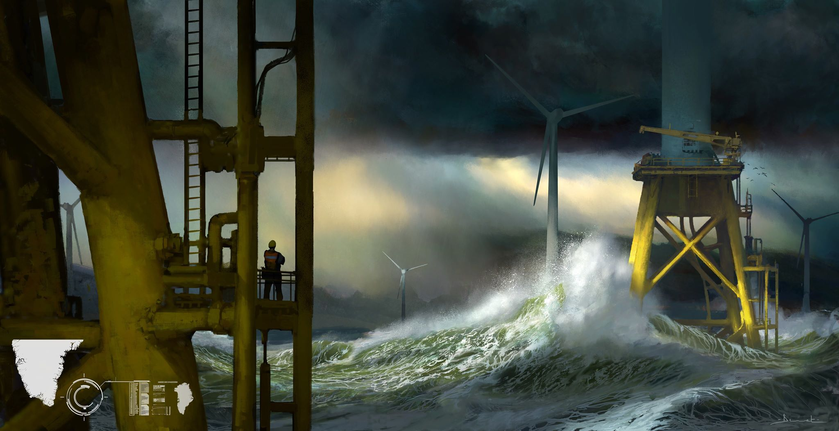

Harvesting wind energy in Greenland: a huge step towards the building a global electrical grid
Prof. Damien ERNST
Stanford Decarbonizing the Grid Workshop: The role of grid interconnection.
Video of the conference : https://www.youtube.com/watch?v=c7JJWwOq2JU

Slide 2
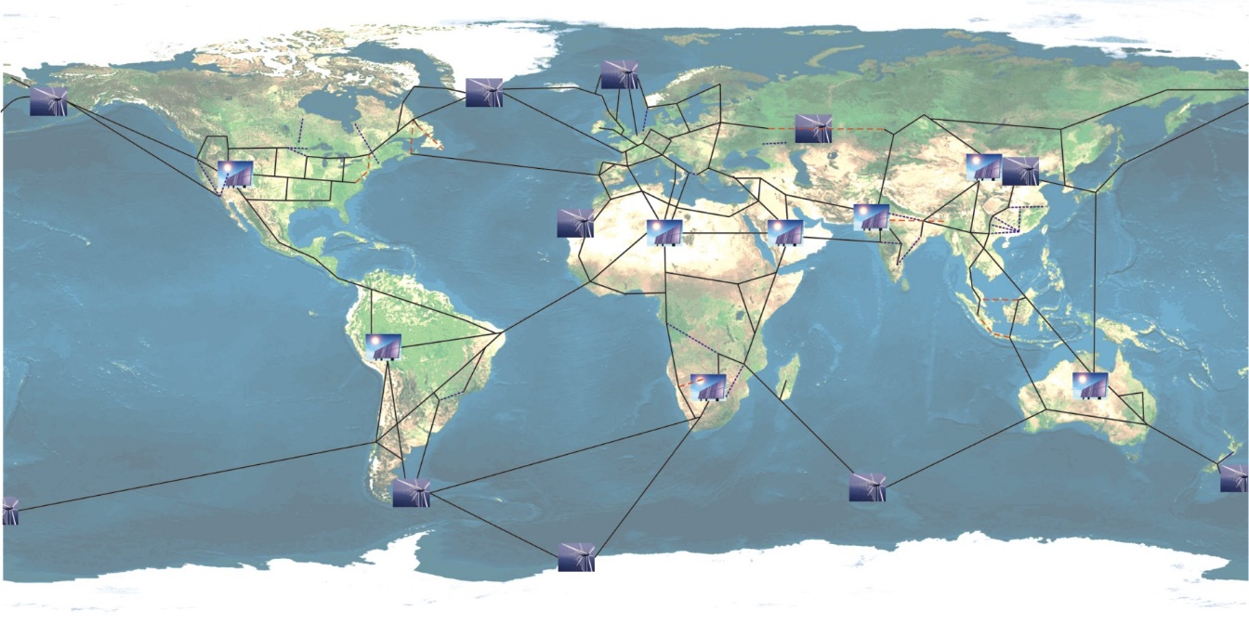
What is a Global Grid?
A global grid is an electrical network spanning the whole planet and connecting together the world’s consumers and producers of electricity. Its backbone would be made of (very long) High Voltage Direct Current (HVDC) links.
This concept of Global Grid was first introduced in: Chatzivasileiadis, S., Ernst, D., & Andersson, G. (2013). The Global Grid. Renewable Energy, Volume 57, pages 372-383.
.

Slide 3
A Global Grid as a wonderful tool for decarbonizing the world
Fact 1: Natural smoothing of renewable energy sources and loads in a global grid setting. Very little investment in storage needed.
Fact 2: Renewable electricity – in €/MWh – is very cheap in high-density renewable energy fields (e.g., Atacama desert for solar energy, Greenland coast for wind energy).
Fact 3: Transporting electricity over long-distances is becoming cheap.
Given Fact 1 + Fact 2 + Fact 3, a Global Grid offers a true possibility for putting fossil fuels out of business everywhere for electricity generation (even without a CO2 tax).

Slide 4
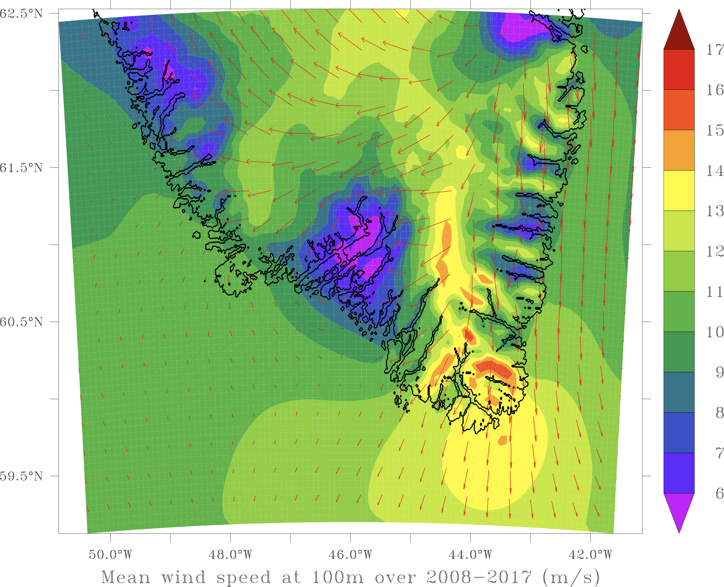
Why harvesting wind energy in the southeast Greenland?
1. High winds.
2. Decorrelation with European wind patterns.
3. Huge areas. No NIMBY issues.
4. Half-way between Europe and the US.
5. Nice flagship project for accelerating the building of the global grid.

Slide 5
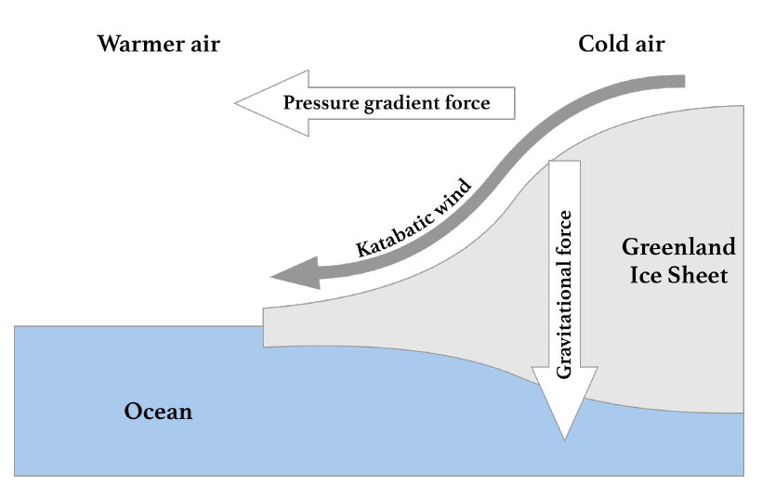
Winds in the southeast Greenland
In the southeastern part of Greenland, general circulation winds (driven by the Sun’s energy) add up to Katabatic winds.
Katabatic winds are the result of heat transfer processes
between the cold ice cap and the warmer air mass above it.
When the air mass temperature is higher than that of the ice sheet, the former is cooled down by radiation, thus the air density increases forcing it down the sloping terrain.
The flow of katabatic winds is driven by gravity, temperature gradient and inclination of the slope of the ice sheet.

Slide 6
Data acquisition for our analysis
We relied on data reanalysis to reconstruct wind signals from past in situ and satellite observations.
The regional MAR (Modèle Atmosphérique Regional) model was used for data reanalysis over Greenland. This model can represent well physical processes in Greenlandic regions, including Katabatic winds. Boundary conditions determined by the ERA5 reanalysis model.
Hourly values of wind speed at 100 meters above ground level are generated using the reanalysis models for the period 2008-2017.

Slide 7
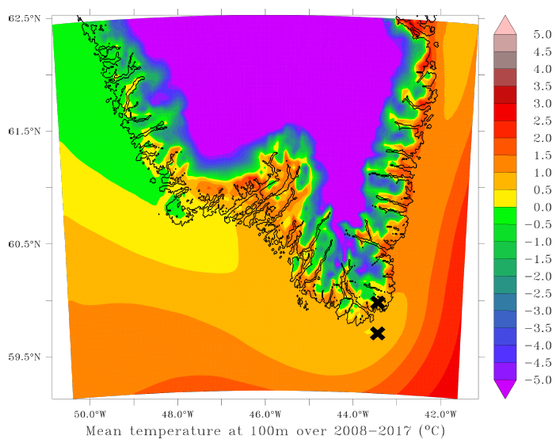
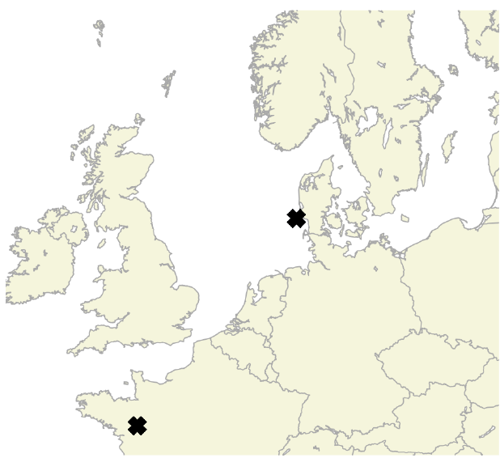
Regions selection for our analysis
Two areas in Greenland: one offshore (GR_{OFF}) and one onshore (GR_{ON}).
Temperatures too mild to have a frozen sea or permanent ice on-shore.
Two areas in Europe: one offshore wind farm in Denmark (DK) and one on-shore wind farm in France (FR).

Slide 8
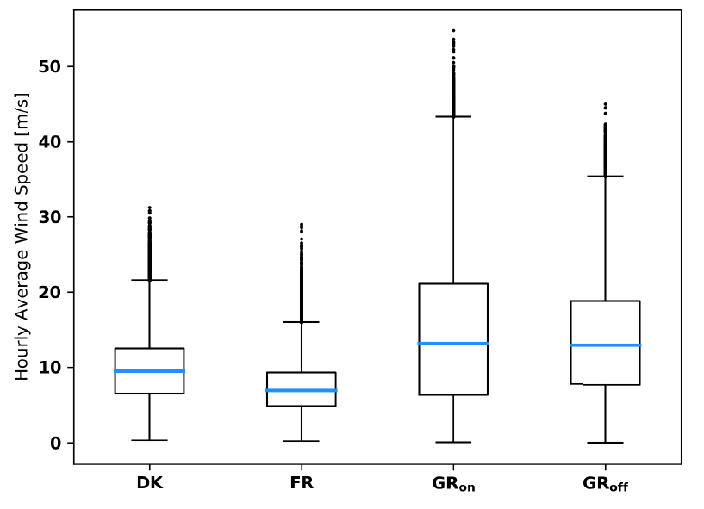
Wind ressource assessment
Higher mean wind speeds in Greenland than in the two European locations.
Distribution of wind speeds more assymetric for GR_{off} and GR_{on} than for DK and FR.
The high standard deviations of the wind speeds in Greenland do not correspond to a high turbulence intensity, but to the strong influence of seasonality of the local natural resource.

Slide 9
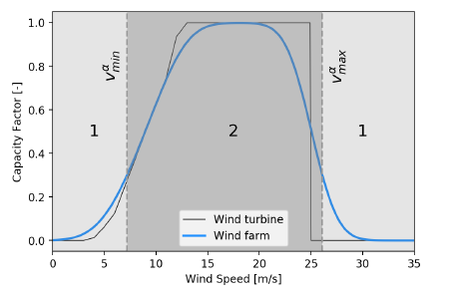
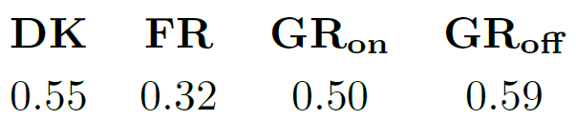
Load factors of the wind farms
Single turbine and wind farm transfer functions. Example of wind farm power curve aggregation based on multiple aerodyn SCD 8.0/168 units.
Capacity factors for the different locations

Slide 10
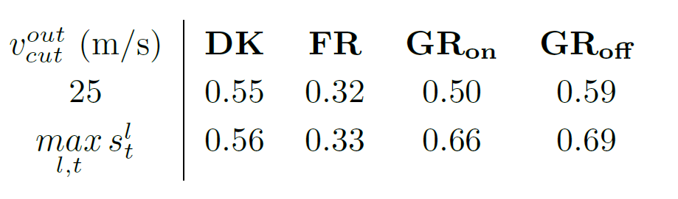
Capacity factors versus
cut-out wind speed for the wind turbines.
Highest wind speed observed
Important remarks for manufacturers of wind turbines willing to tap into the Greenland wind energy market:
Wind turbines capable of operating with higher cut-out speed lead to significantly higher load factors in Greenland.
May also be interesting to design wind turbines which saturate in terms of power output for higher wind speeds (i.e., turbines having a higher rated output speed).

Slide 11
Critical time windows for studying the complementarity of wind production
A window of duration ẟ is said to be critical for a set of locations if the average power generated in those locations over the time window is below a fraction α of the installed capacity.
Conjecture: The export of wind energy from Greenland to Europe would reduce to zero the number of these long critical periods of times during which Europe could not rely on wind energy to cover a significant amount of its energy needs (or more generally renewable energy - a phenomenon known as Dunkelflaute in German).

Slide 12
Occurrence of critical time windows
« Probability » of occurrence of critical time windows when using as set of locations: the two European locations (black); the Greenland sites (green) and all the four locations (blue).

Slide 13
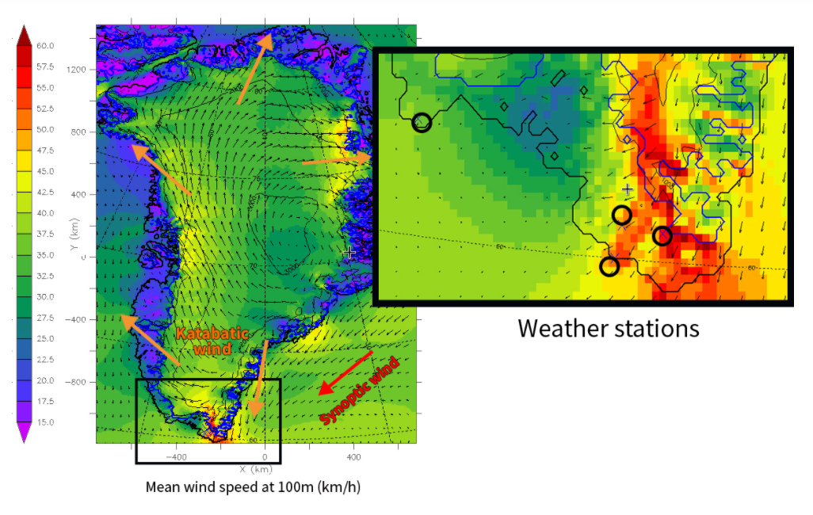
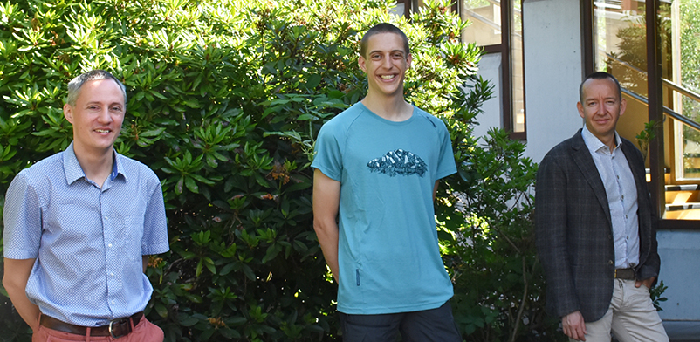
Katabata project
Goal of the project: installing three weather stations in the South-East of Greenland. The wind in this area has never been properly measured before!
The team: Dr. Xavier Fettweis, Michaël Fonder and Prof. Damien Ernst

Slide 14
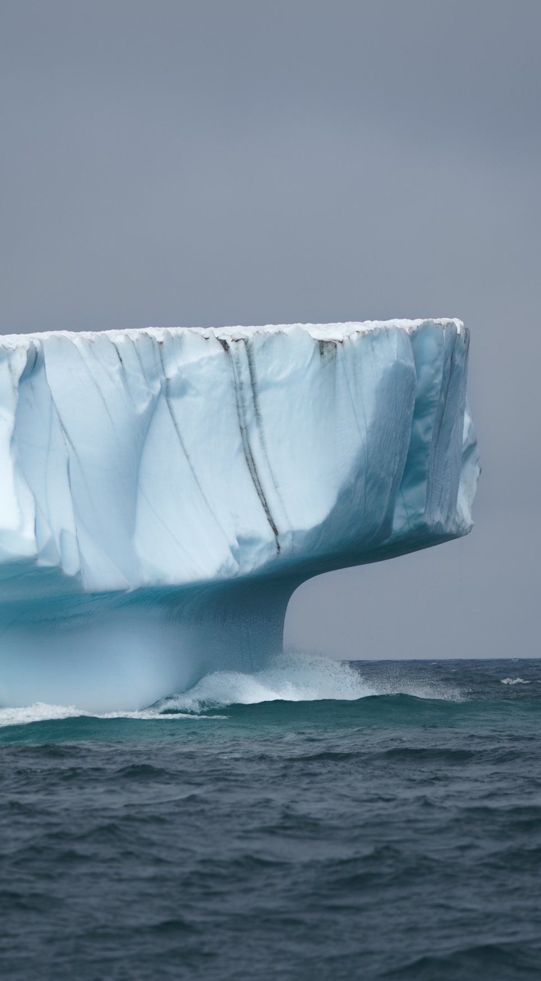
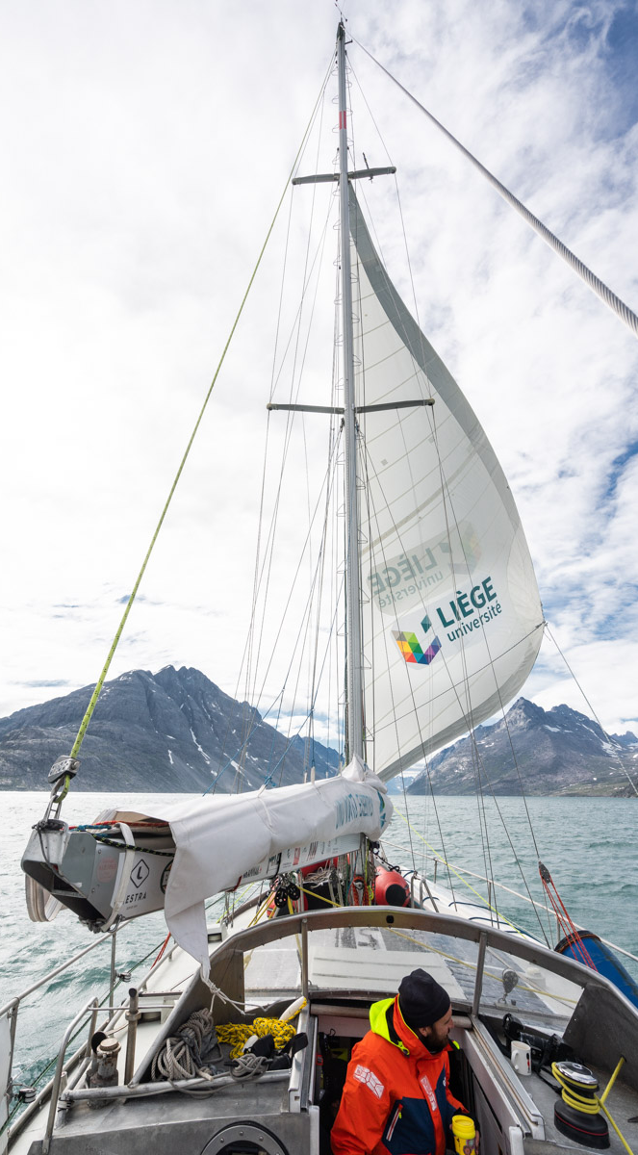
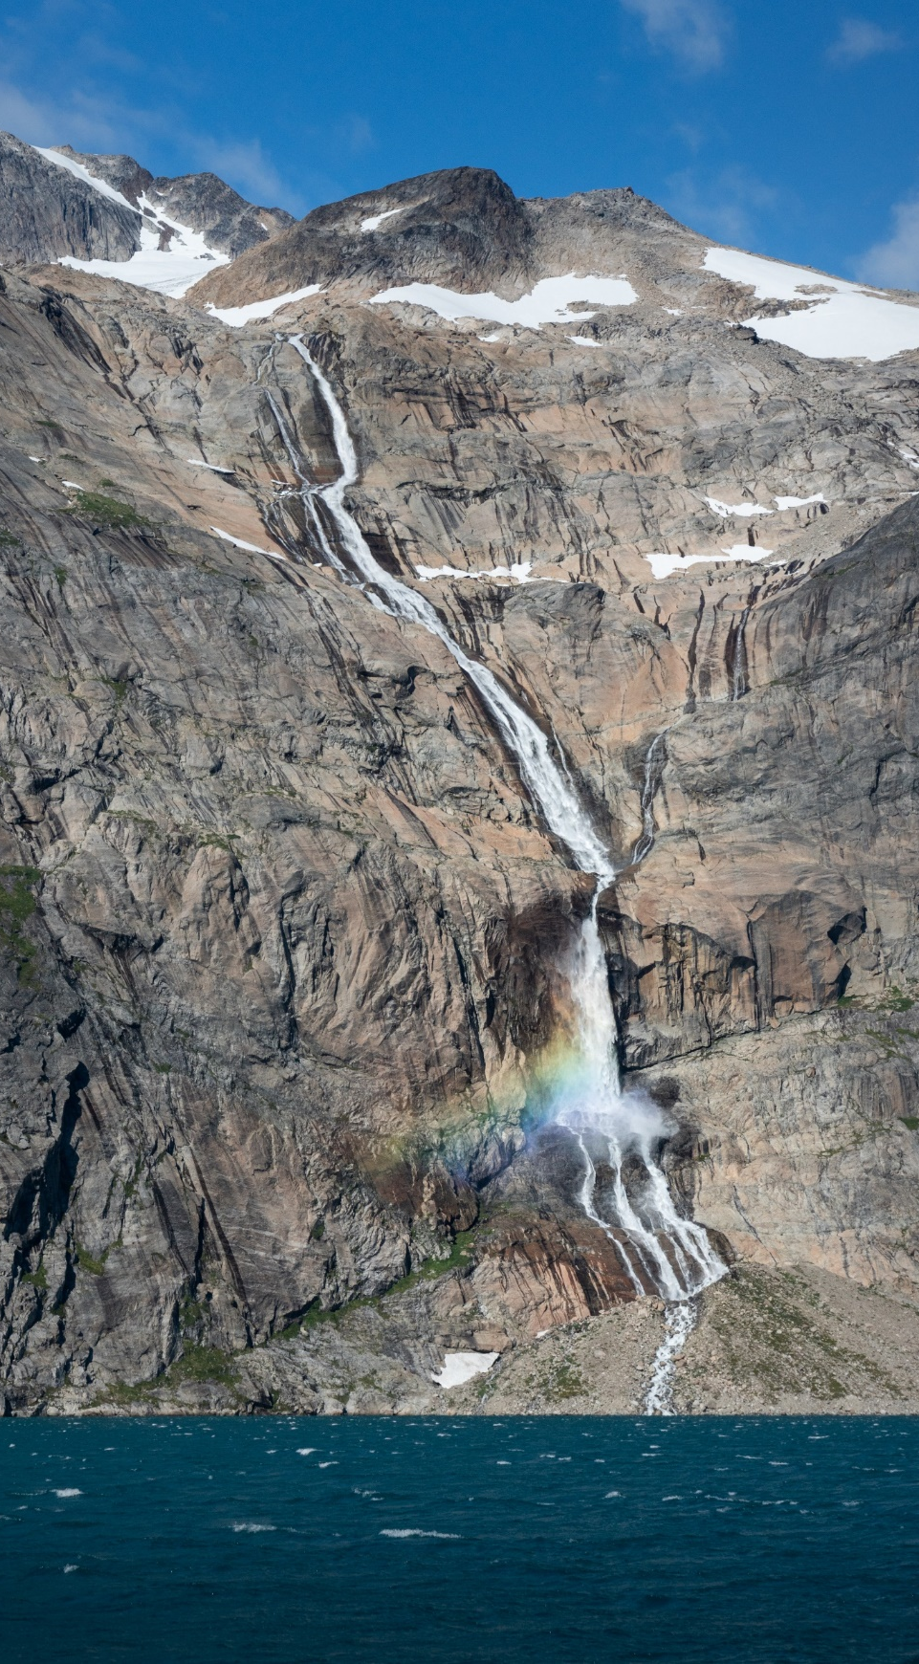
Arrival in Greenland

Slide 15
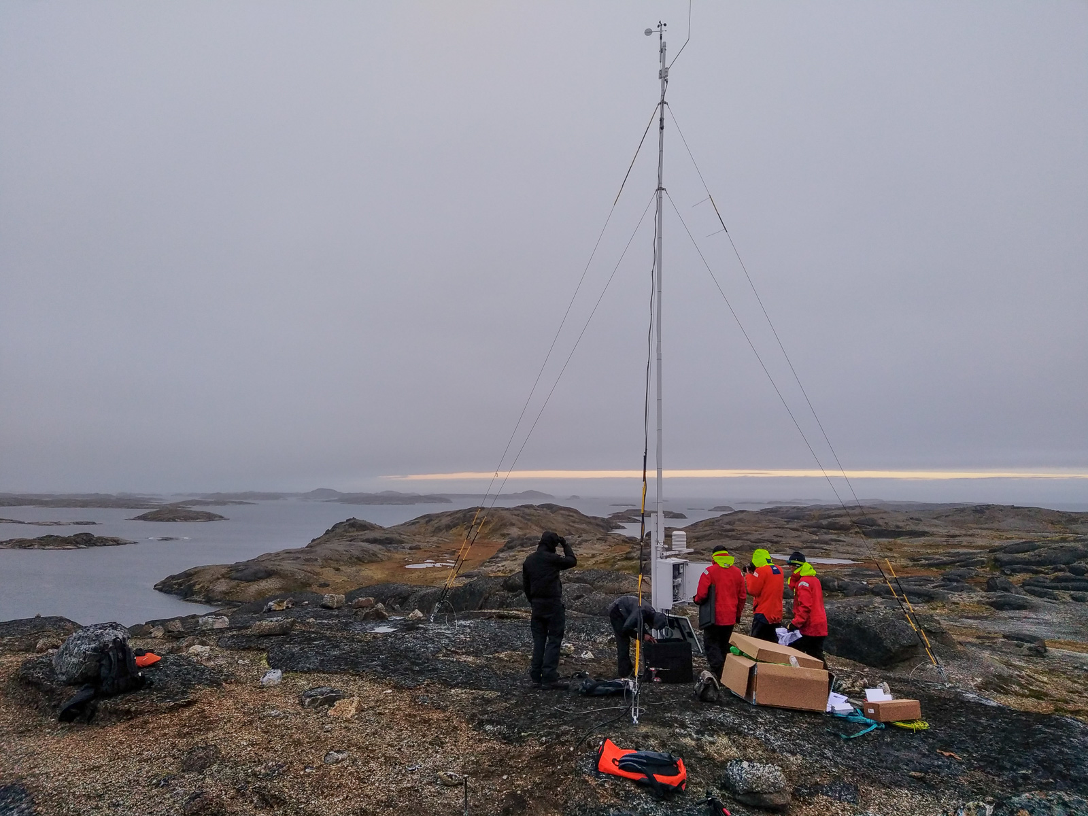

Slide 16
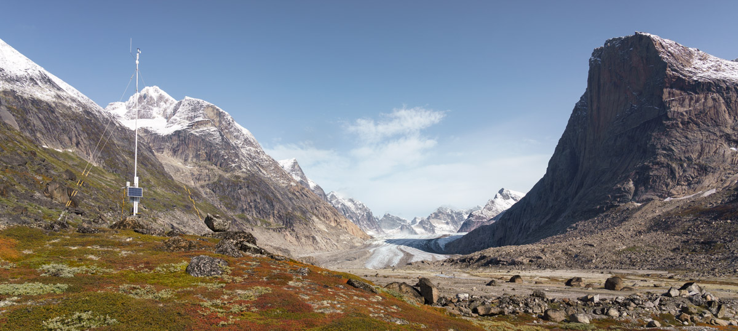

Slide 17
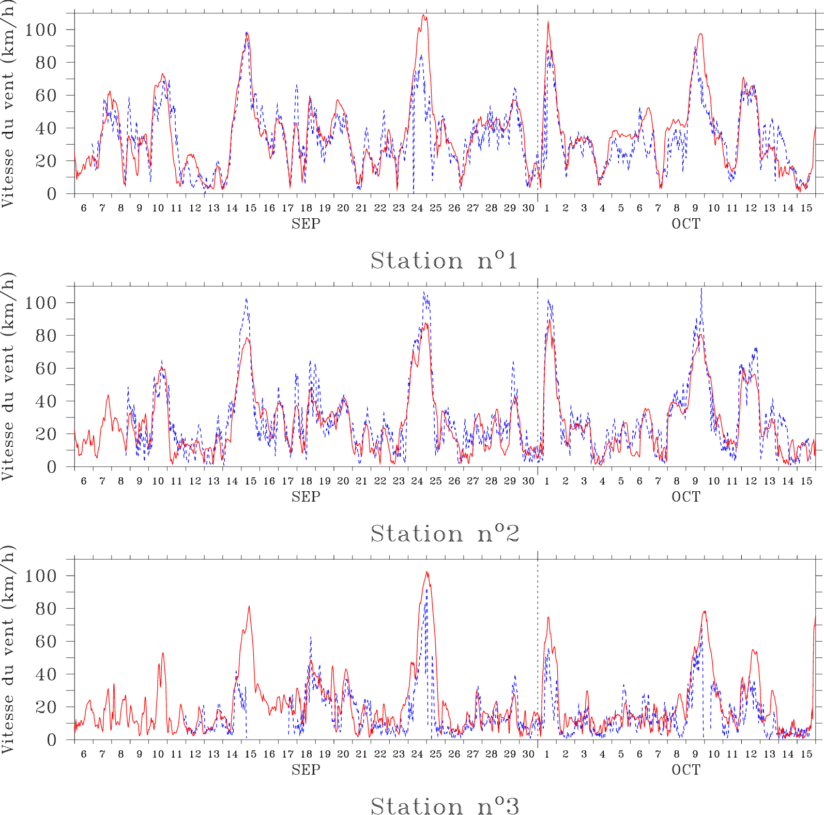
First comparison: MAR vs observations
AWS1
Correlation: 0.87
Bias=+2.4km/h RMSE=11km/h
Mean: 34±20km/h
1 observation every 20m from 6 SEP 2020 to 15 OCT 2020.
Wind measured at 10m
AWS2
Correlation: 0.9
bias=-2km/h
RMSE=10km/h
Mean: 29±23km/h
AWS3
Problem with the censor when high wind speeds
Correlation: 0.86
bias=+4km/h
RMSE=11km/h
Mean: 17±17km/h
MAR is able to simulate both spatial and temporal variability observed until now at the 3 stations

Slide 18
References
Chatzivasileiadis, S., Ernst, D., & Andersson, G. (2013). The Global Grid. Renewable Energy, Volume 57, pages 372-383.
Berger, M., Radu, D., Fonteneau, R., Henry, R., Glavic, M., Fettweis, X., Le Du, M., Panciatici, P., Balea, L., Ernst, D. (2018). Critical Time Windows for Renewable Resource Complementarity Assessment. Energy, Volume 198.
Radu, D., Berger, M., Fonteneau, R., Hardy, S., Fettweis, X., Le Du, M., Panciatici, P. Balea, L. & Ernst, D. (2019). Complementarity Assessment of South Greenland Katabatic Flows and West Europe Wind Regimes. Energy, Volume 175, pages 393-401.
The Katabata project. Website:
https://www.katabata-project.uliege.be/cms/c_5785924/en/katabata-about

