Slide 1
RapidILL at the University of Liège, an experience feedback after some months
February 17, 2021
Fabienne Prosmans, ILL Coordinator
François Renaville, Head of Library Systems

Slide 2
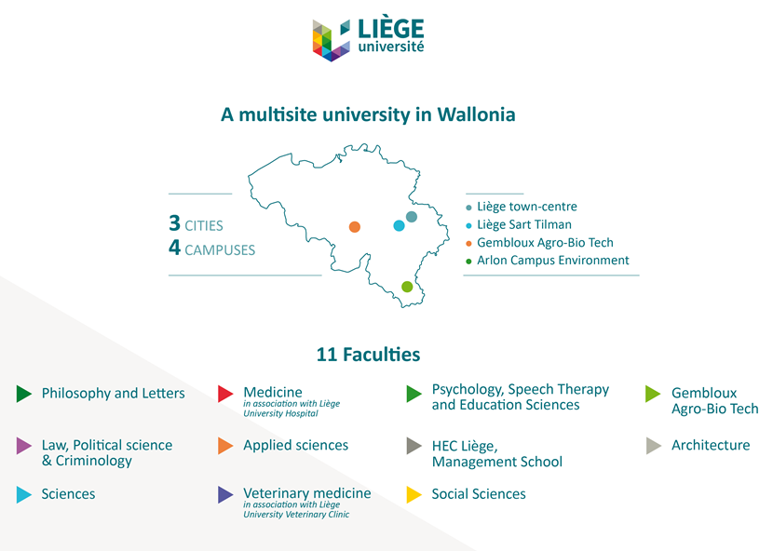
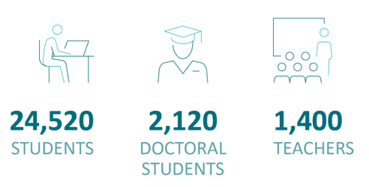

Slide 3
University of Liège Library
3 main libraries
composed of 16 branches
spread on 4 campuses in 3 cities
Staff: ca 110 people
ILL:
Staff 1 FTE (6 operators)
Coordinator: 0,1 FTE

Slide 4
From a trial at the beginning of the Covid19 crisis…
Proposal from Ex Libris to integrate the Covid19 Pod to test RapidILL
For borrowing requests for electronic journal articles or book chapters
Advantages:
Discovery of a service “at the right time”
Covid-19: Positive responses to users’ requests when
Our library branches were closed
Our usual partners no longer offered ILL services
Results:
Approximately 200 requests satisfied from April 23 to August 31
95% of the requests submitted to RapidILL (positive matching) were satisfied
Delivery time: from a few hours to a few days (WE)

Slide 5
… to a subscription to RapidILL
Subscription from Sept 2020
ULiège has integrated the following pods:
Academic Pod E (Very High or High research activity universities*)
Academic Pod I (Doctoral/Research universities*)
Academic Pod M (Large Master’s degree granting institutions*)
Cosmo Pod (open to all institutions subscribing to RapidILL)
No French-speaking pod at this time
Really necessary?
Other interesting RapidILL members for us:
Belgian universities: UGhent, KU Leuven, Free Univ of Brussels
Université Clermont Auvergne
Swiss partners: BCU Lausanne, SLSP (< Rapido)
* According to the Carnegie Classification of Institutions of Higher Education

Slide 6
Why has ULiège decided to subscribe to RapidILL?
Integration of RapidILL with Alma
Avoids encoding and tracking our requests in the Belgian ILL platform (Impala) or the German platform (Subito)
Several steps of the workflow can be made automatic
In Alma, the RapidILL partner can be automatically assigned to an article or chapter request in digital format
Sending a borrowing request from Alma to RapidILL can be automatic
If the request is accepted and processed in RapidILL, the file can directly be emailed to the requester (without the intervention of an operator)

Slide 7
Why has ULiège decided to subscribe to RapidILL?
Lower costs?
Annual subscription to RapidILL <--> On-demand fees for Impala and Subito
Consequence: reduction (or even suppression) of ILL charges to our users?
To compensate the cancellation of a subscription?
Positive feedback from ILL staff following the test

Slide 8
Configuration
Configuring the RapidILL partner
Borrowing requests:
Define a rule so that the RapidILL partner is automatically assigned to each borrowing request in digital format
When it cannot be fulfilled by a RapidILL partner, RS operators proceed manually and check if an Impala or Subito partner can fulfill.
Lending requests:
Export of electronic and print holdings to RapidILL: creation of sets and publication profiles (OAI)
Selection of Electronic Collections (mostly journal articles and book chapters)
Physical items that can be requested for a lending request (-> digitization of chapters)
Rota algorithm working fine (unfortunately no priority for electronic materials)
Respect of licenses for electronic materials (national delivery vs international delivery)

Slide 9
Borrowing requests - Statistics
Many canceled requested in Jan related to a single journal that no RapidILL partner could provide.
Year | Borrowing Requests | Borrowing Filled | Borrowing Unfilled | % Filled | System Avg % Filled | % Unfilled | System Avg % Unfilled | Avg Filled TAT (Hours) | System Avg Filled TAT (Hours)
Calendar 2021 | 153 | 89 | 61 | 58% | 93% | 40% | 4% | 13 | 15
January | 153 | 89 | 61 | 58% | 93% | 40% | 4% | 13 | 15
Calendar 2020 | 557 | 539 | 36 | 97% | 94% | 6% | 5% | 11 | 13
December | 118 | 113 | 6 | 97% | 94% | 5% | 5% | 10 | 14
November | 131 | 129 | 6 | 98% | 95% | 5% | 3% | 11 | 13
October | 66 | 65 | 3 | 98% | 95% | 5% | 3% | 13 | 13
September | 44 | 42 | 2 | 95% | 94% | 5% | 4% | 10 | 14
August | 33 | 29 | 3 | 91% | 93% | 9% | 6% | 9 | 15
July | 62 | 60 | 10 | 97% | 93% | 16% | 6% | 13 | 14
June | 15 | 14 | 2 | 93% | 93% | 13% | 5% | 7 | 13
May | 74 | 74 | 4 | 100% | 93% | 5% | 6% | 8 | 13
April | 14 | 13 | 0 | 100% | 92% | 0% | 7% | 12 | 12

Slide 10
Borrowing requests - Statistics
From Nov 2020, RapidILL became the automatically assigned ILL partner in Alma

Slide 11
Lending requests - Statistics
Year | Lending Requests | Lending Filled | Lending Unfilled | % Filled | System Avg % Filled | % Unfilled | System Avg % Unfilled | Avg Filled TAT (Hours) | System Avg Filled TAT (Hours)
Calendar 2021 | 320 | 233 | 65 | 73% | 64% | 20% | 30% | 15 | 11
January | 320 | 233 | 65 | 73% | 64% | 20% | 30% | 15 | 12
Calendar 2020 | 154 | 119 | 31 | 77% | 67% | 20% | 31% | 13 | 10
December | 124 | 95 | 27 | 77% | 70% | 22% | 31% | 15 | 11
November | 30 | 24 | 4 | 80% | 70% | 13% | 27% | 6 | 10

Slide 12
Lending requests - Statistics

Slide 13
Lending requests - Statistics

Slide 14
For the near future…
Curious to see if our (French-language) collections will be of interest outside of Belgium (print journals, Cairn.info, OpenEdition...)
Monitoring of the evolution of Rapido
Continued use of Impala (physical supply)
RapidILL = additional partner (priority), but not exclusive
P2P ILL project with a Belgian institution for physical supply

Slide 15
Thank you!
Fabienne Prosmans Fulfillment and ILL Coordinator fprosmans@uliege.be | François Renaville Head of Library Systems francois.renaville@uliege.be

