Slide 1
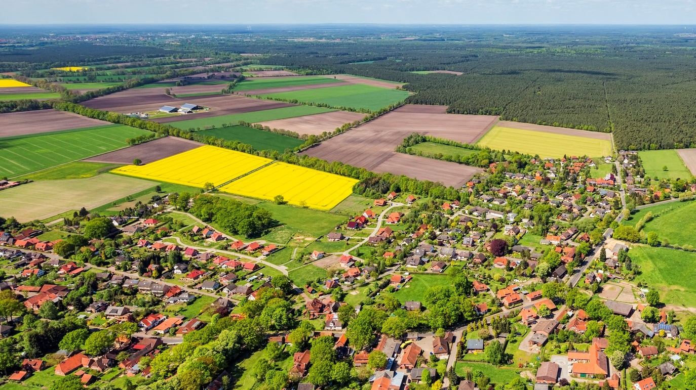


A parsimonious urban production
Valentine Defer
What’up in Wallonia?
International Environmental Management
ISIGE, the 29th of Jan 2021
Notes:
PAGE DE SECTION / Page avec possibilité d'insertion d'un titre de chapitre et d'un sous-titre

Slide 2
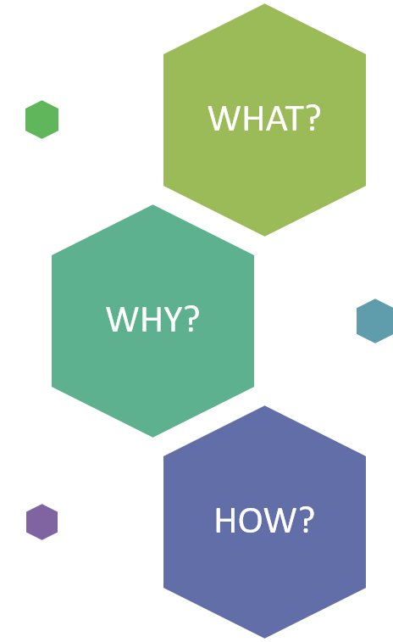
What does « land take » mean ?
Why is it crucial to address it’s progression ?
What tools to respond to land take ?

Slide 3
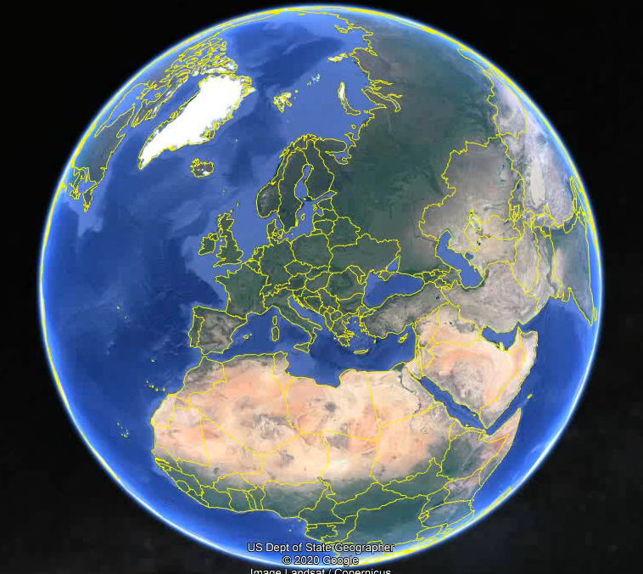
Welcome to Wallonia
one of the 3 regions of Belgium
where we speak French and a little German
first fully industrialized area in continental Europe (coal, iron and steel)
leaving slag heaps and declining industrial landscapes along the Sambre and the Meuse rivers

Slide 4
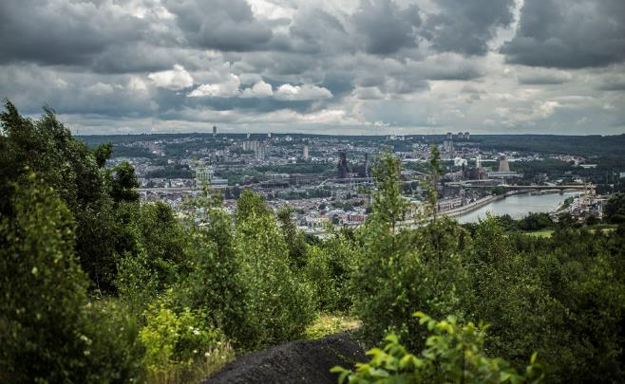
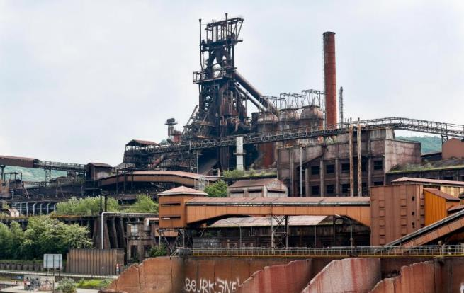
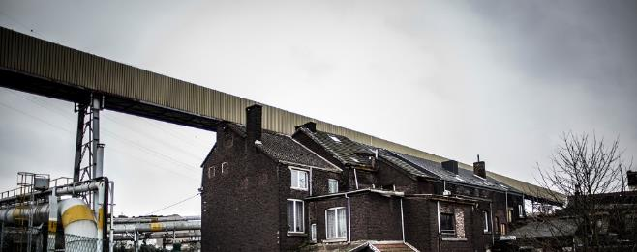
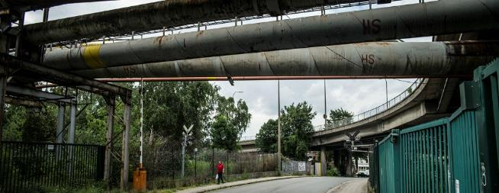

Slide 5
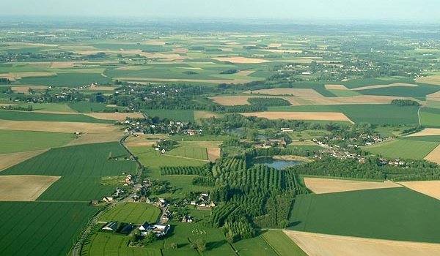
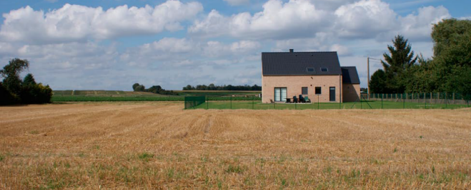
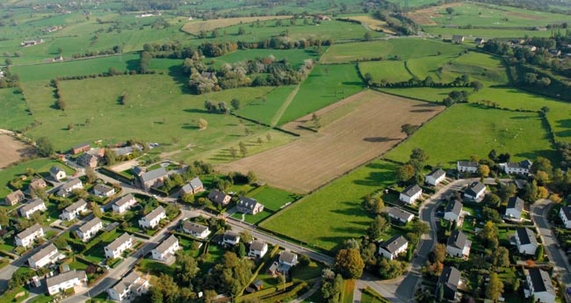
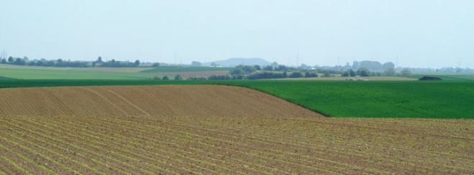

Slide 6
WHAT?
What does « land take » mean ?

Slide 7
LAND TAKE
Agricultural, forest and other semi-natural land taken for the purpose of urban and other artificial land development.
(Land take in Europe, EEA 2019).

Slide 8
TAKEN LAND
NON TAKEN LAND

Slide 9
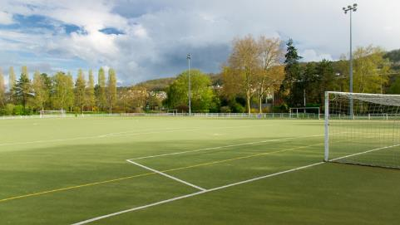
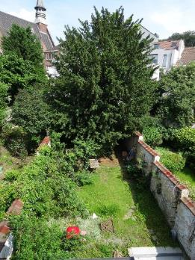
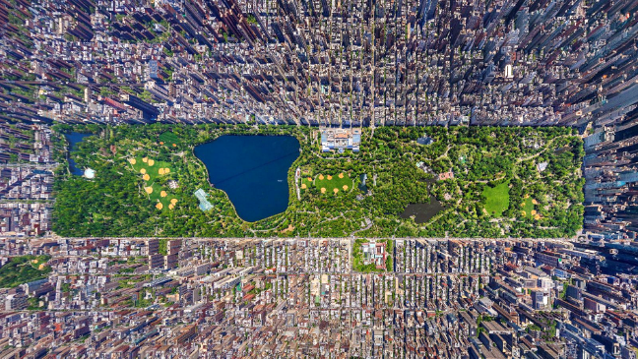
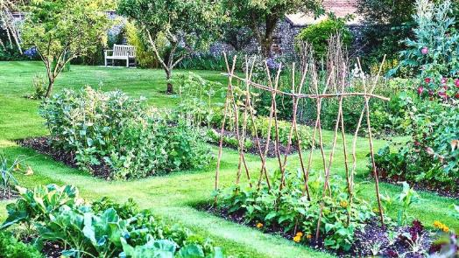
TAKEN LAND

Slide 10
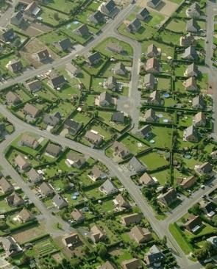
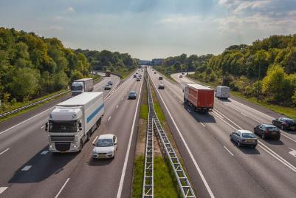
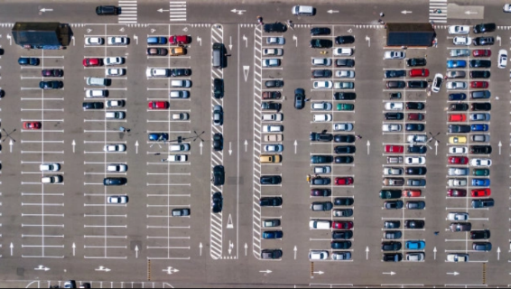
TAKEN LAND
SEALED LAND

Slide 11
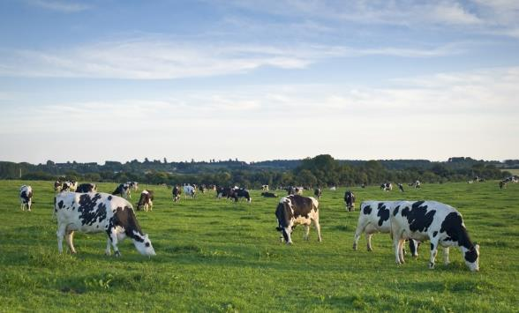
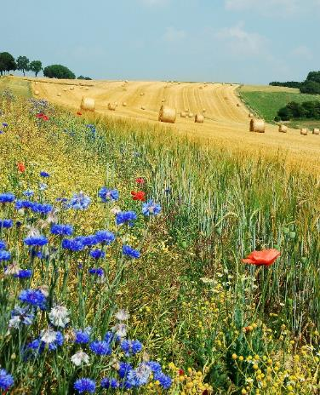
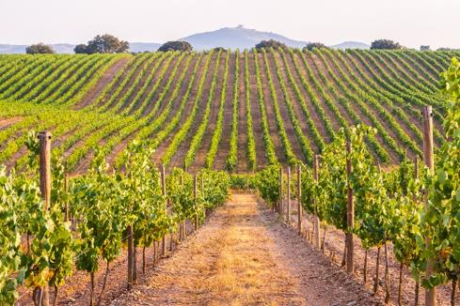
NON TAKEN LAND

Slide 12
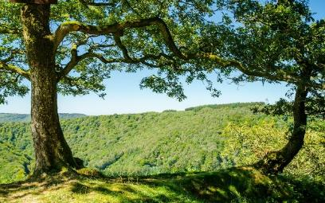
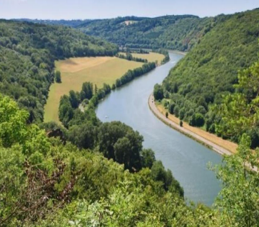
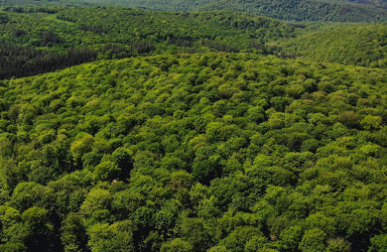
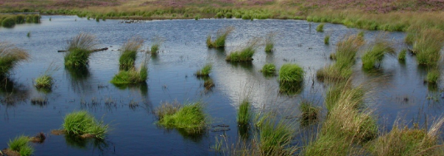
NON TAKEN LAND
NATURAL LAND

Slide 13
TAKEN LAND
Urban parks
Outdoor leisure facilities
Gardens …
NON TAKEN LAND
Fields
Pastures
Vineyards …
SEALED LAND
Buildings
Parkings
Roads …
NATURAL LAND
Wetlands
Water courses
Forests …

Slide 14
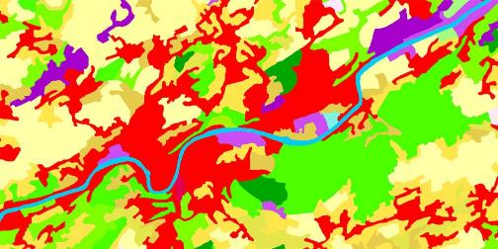
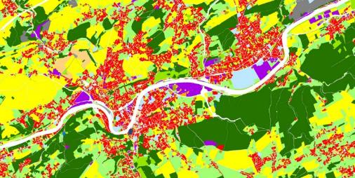


WHAT?
Monitoring the land
Land cover
The characteristics of a land surface as determined by the unique way in which it reflects and absorbs light.
Land use
The total of arrangements, activities, and inputs that people undertake in a certain land cover type.

Slide 15





WHAT?
What’s up in Wallonia ?
Land cover
CORRINE Land cover
Land use
IWEPS + CPDT research

Slide 16
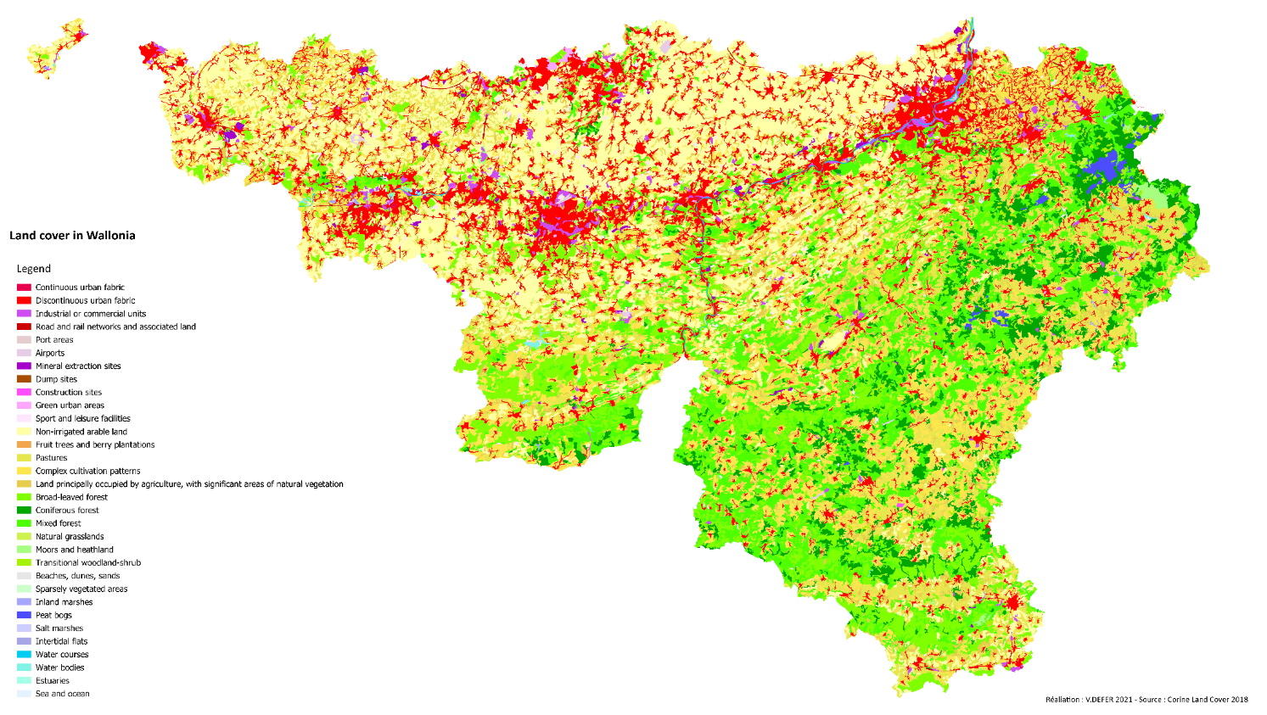


CORRINE Land Cover 2018

Slide 17
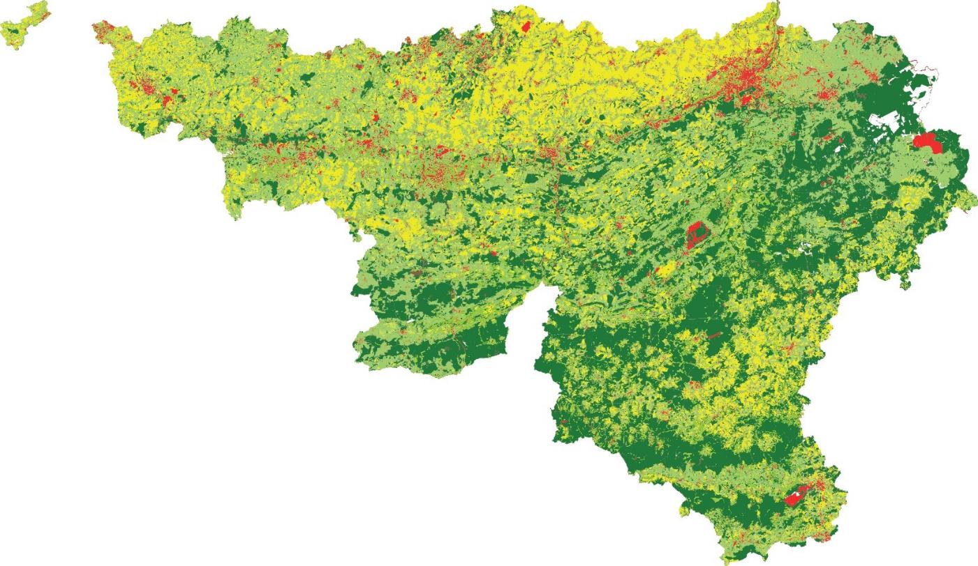


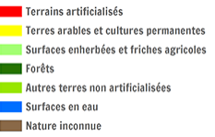
Cadastre 2020
Land use in Wallonia
Legend

Slide 18

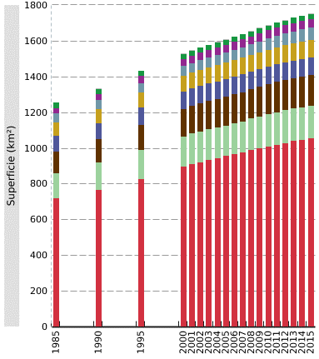





Evolution of land take in Wallonia by land use (CPDT, 2019)

Slide 19
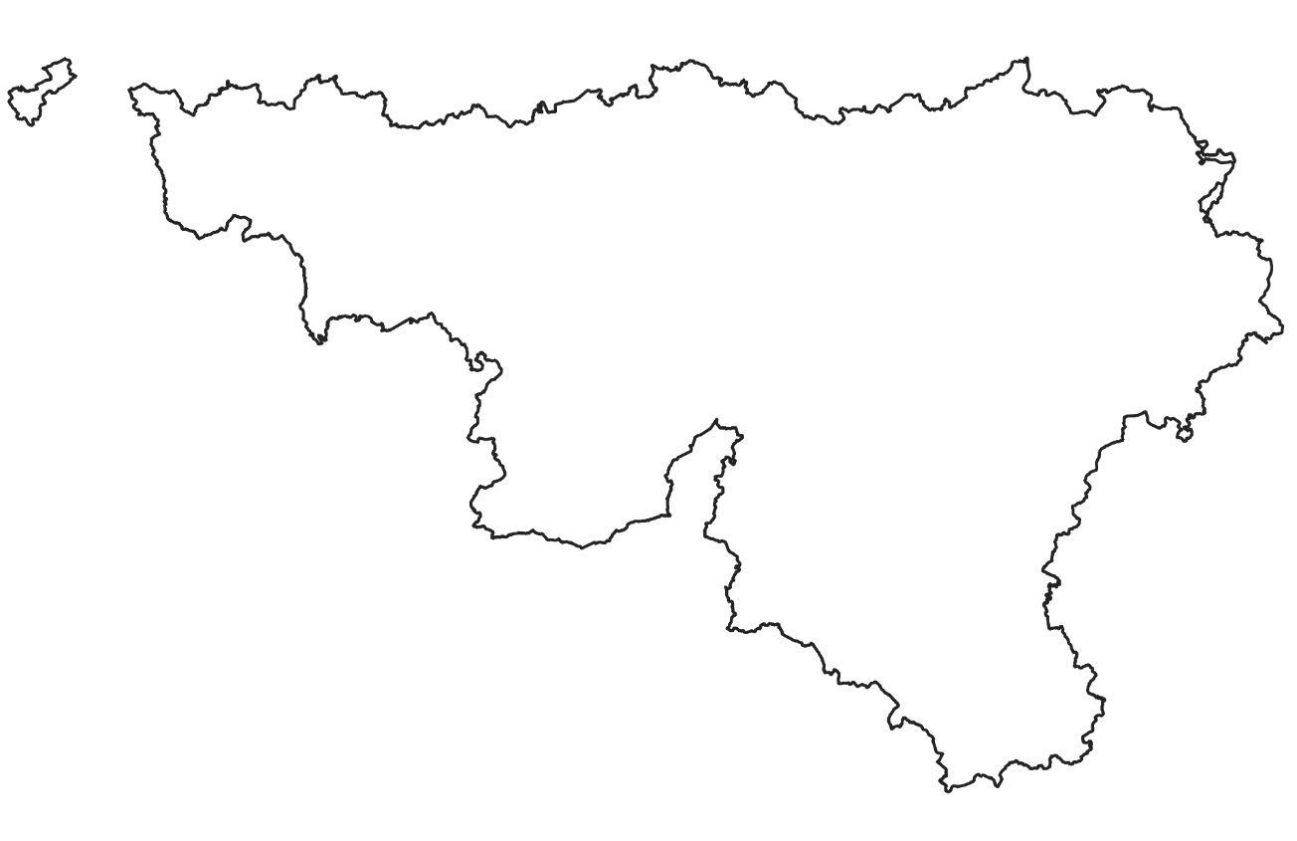
10,7% of tot. Wallonian land is taken
i.e. an increase of 15,8 km² per year

Slide 20
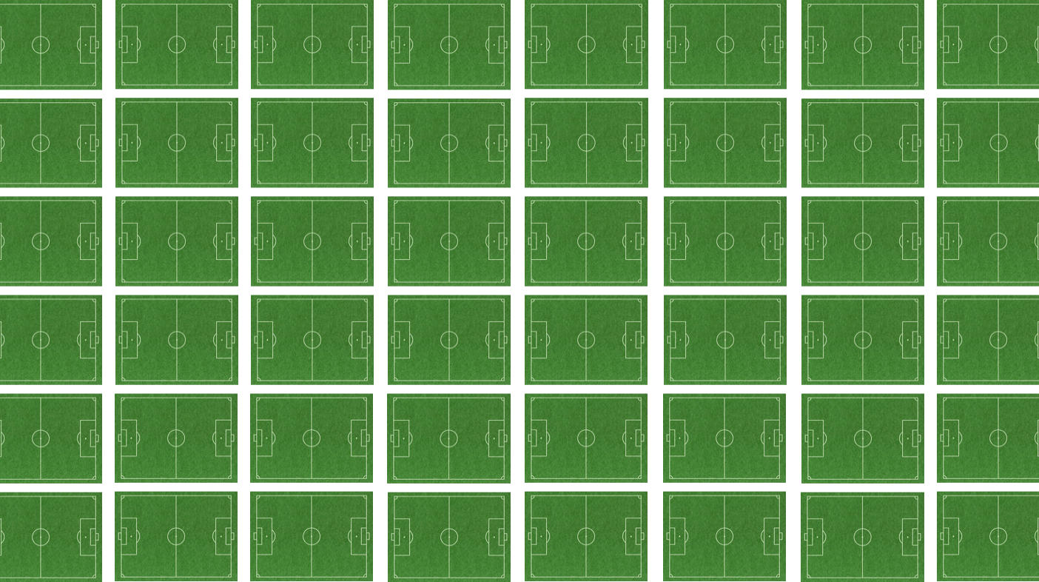
= more than 2.200 soccer fields per year

Slide 21
WHAT?
What about your Region ?

Slide 22
WHY?
Why is it crucial to address land take progression ?

Slide 23
Land take impacts

Slide 24
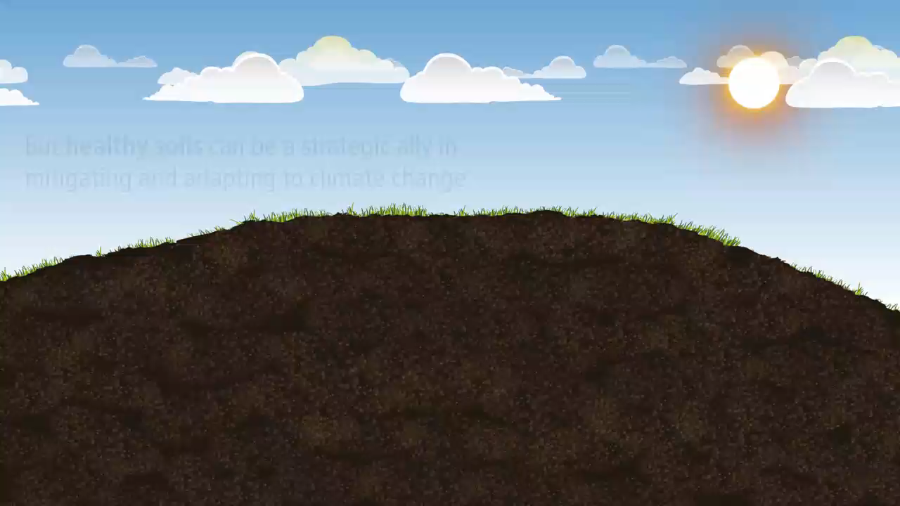

Land is an ally in mitigating and adapting to climate change

Slide 25
WHY?
Does your Region recognize those challenges ?

Slide 26
HOW?
One key issue in managing land take

Slide 27

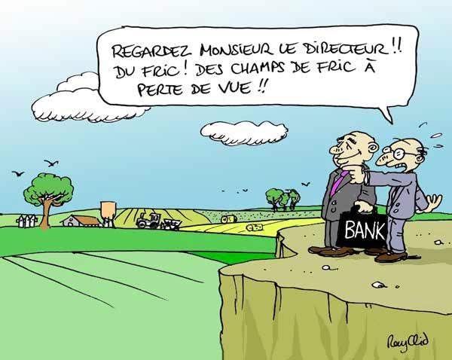
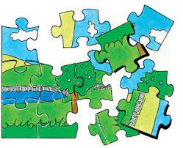
LAND CONTROL
Look boss, money fields!

Slide 28
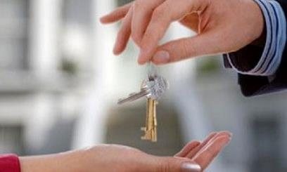
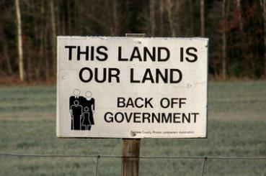

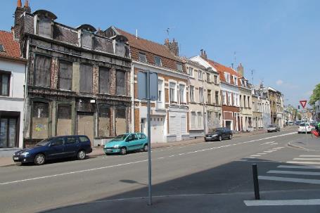
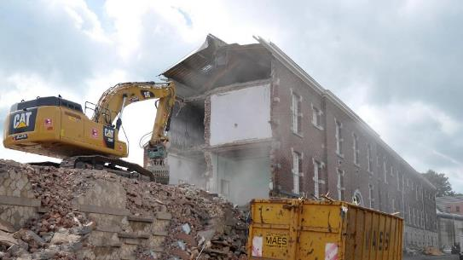
LAND CONTROL

Slide 29
HOW?
What tools to respond to land take ?

Slide 30

Notes:
Law and regulations

Slide 31
(chosen extracts)
“achieve no net land take by 2050”
The Vision: By 2050 the EU (…) respects resource constraints and planetary boundaries, thus contributing to global economic transformation. (…) All resources are sustainably managed, from raw materials to energy, water, air, land and soil. Climate change milestones have been reached, while biodiversity and the ecosystem services it underpins have been protected, valued and substantially restored.
Milestone: By 2020, EU policies take into account their direct and indirect impact on land use in the EU and globally, and the rate of land take is on track with an aim to achieve no net land take by 2050 ; soil erosion is reduced and the soil organic matter increased, with remedial work on contaminated sites well underway.

Slide 32

« aim for 0 km²/year by 2050 »
(chosen extracts)
Une gestion rationnelle du territoire économe en ressources passe par une maitrise de l’urbanisation. Pour limiter l’artificialisation du territoire, les surfaces déjà urbanisées sont optimalisées en priorité avant d’envisager toute extension.
Le bâti existant est réutilisé, rénové ou réaffecté et les friches sont réhabilitées. Les toitures plates sont rentabilisées et dévolues à la localisation d’équipements de production d’énergies renouvelables, la végétalisation, la culture de légumes, etc.
Les schémas communaux prévoient une densité appropriée dans les zones destinées à l’urbanisation en tenant compte des spécificités du territoire communal. De manière générale, la mitoyenneté et la compacité du bâti sont également privilégiées.
Mesures de gestion et de programmation : Réduire la consommation des terres non artificialisées à 6 km²/an d’ici 2030, soit la moitié de la superficie consommée actuellement et tendre vers 0 km²/an à l’horizon 2050.

Slide 33
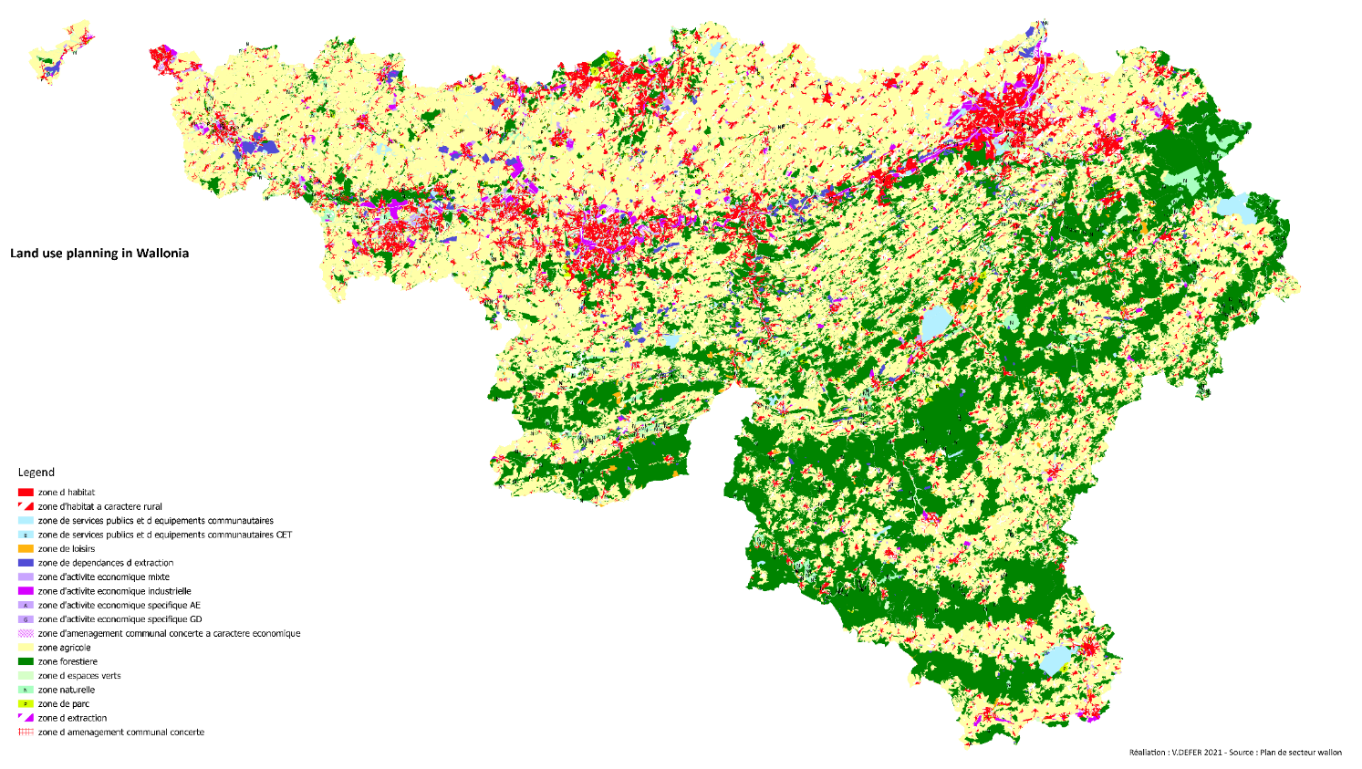
Plan de secteur
Zoning in Wallonia

Slide 34
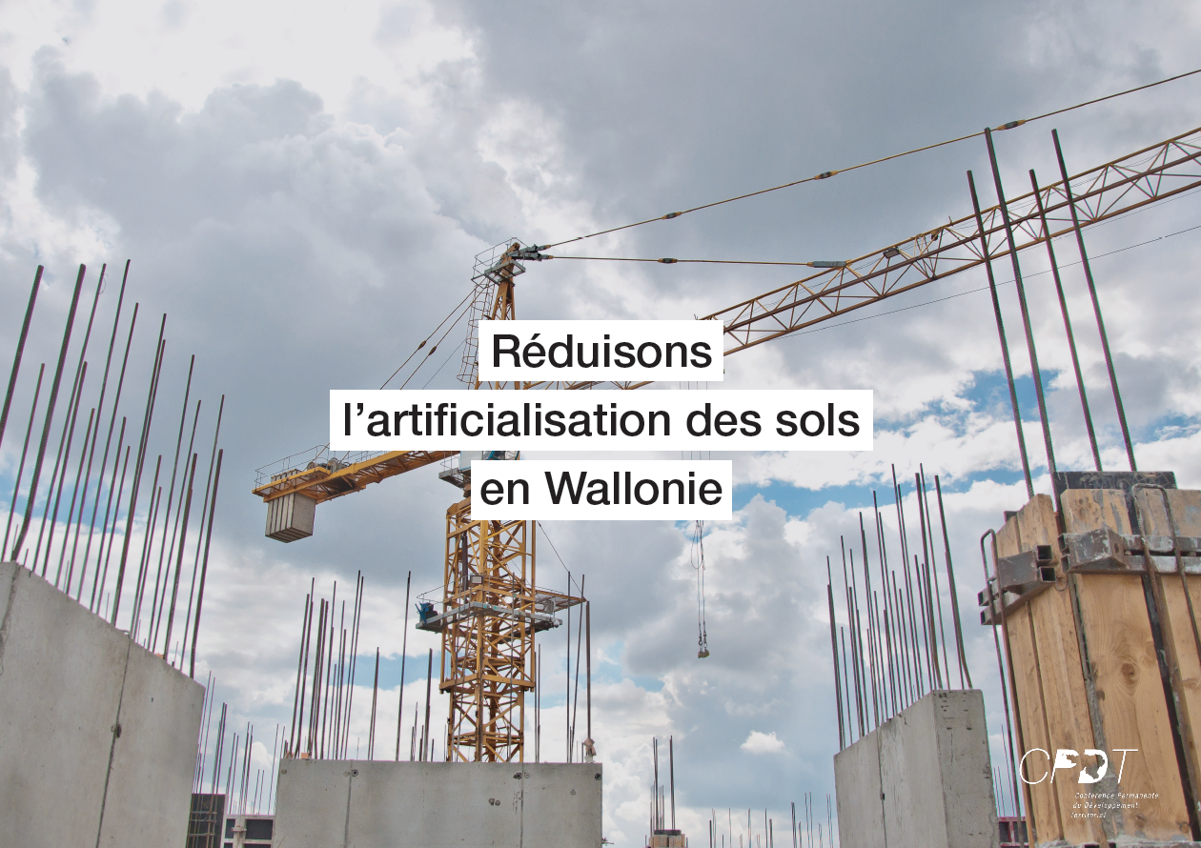

Slide 35
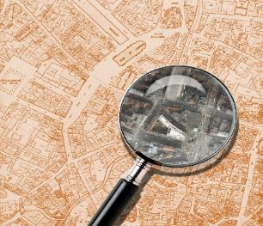

Slide 36

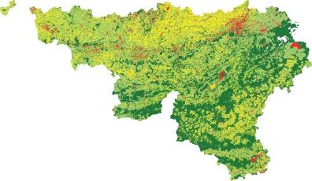
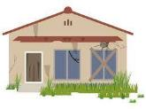



Slide 37


Slide 38

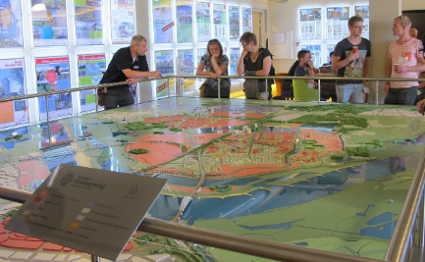

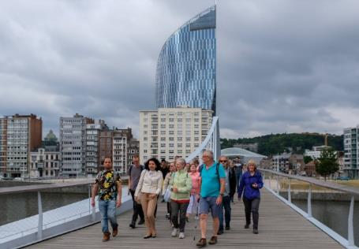


Slide 39


“Stop beton” main blockages from the population in Wallonia
- deep respect for private property rights
- weak expertise in land policy
- deep respect for the autonomy of local authorities
- planning considered as a brake for economic development
Are the blockages specific to Wallonia (Belgium)?
Source: Halleux, Leipzig 2020

Slide 40
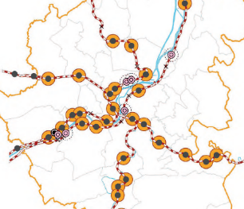

Slide 41
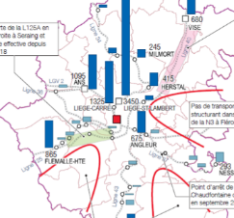
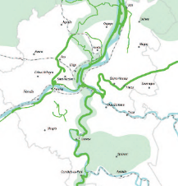







Slide 42


Slide 43


Slide 44



Slide 45


Slide 46


Slide 47





Slide 48




Sum of inhabitants and projected jobs
Total area of the territory (-) area of public open spaces in the territory

Slide 49


Slide 50



Slide 51




Slide 52


Slide 53



Slide 54
HOW?
What’s your opinion on these tools and their possible implementation in your Region ?

Slide 55
Thank you !
Notes:
PAGE DE FIN 1 / Possibilité de personnaliser le texte

Slide 56
Notes:
PAGE IDENTITÉ ULIÈGE

Slide 57
Urban sprawl, a multidimensional notion

