Slide 1


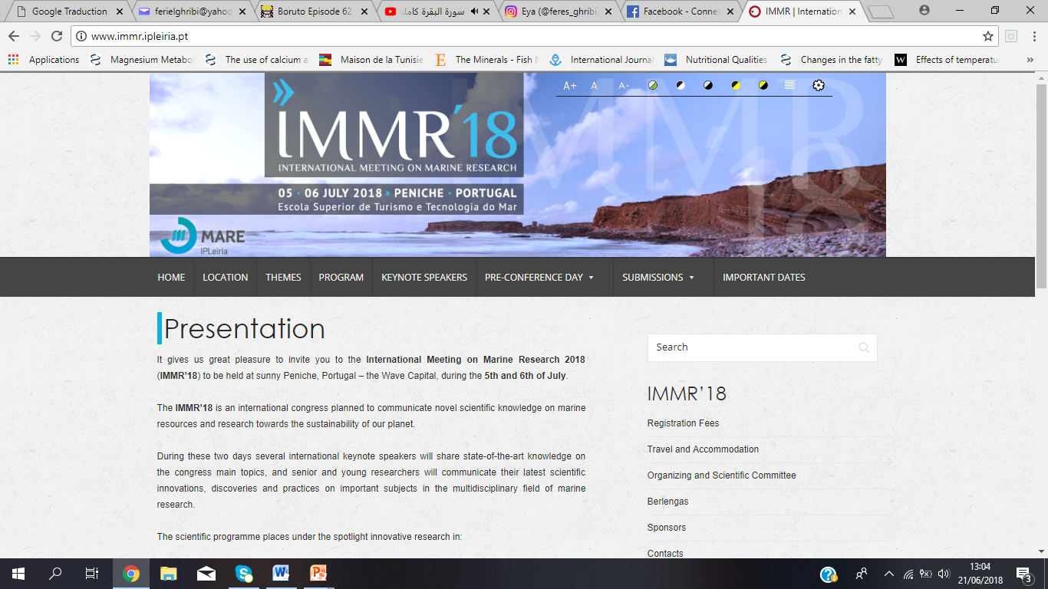



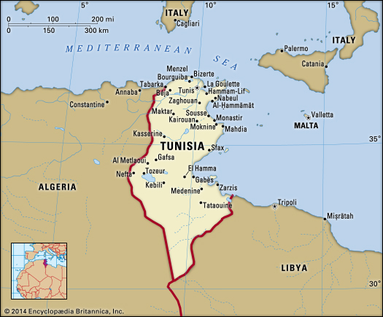
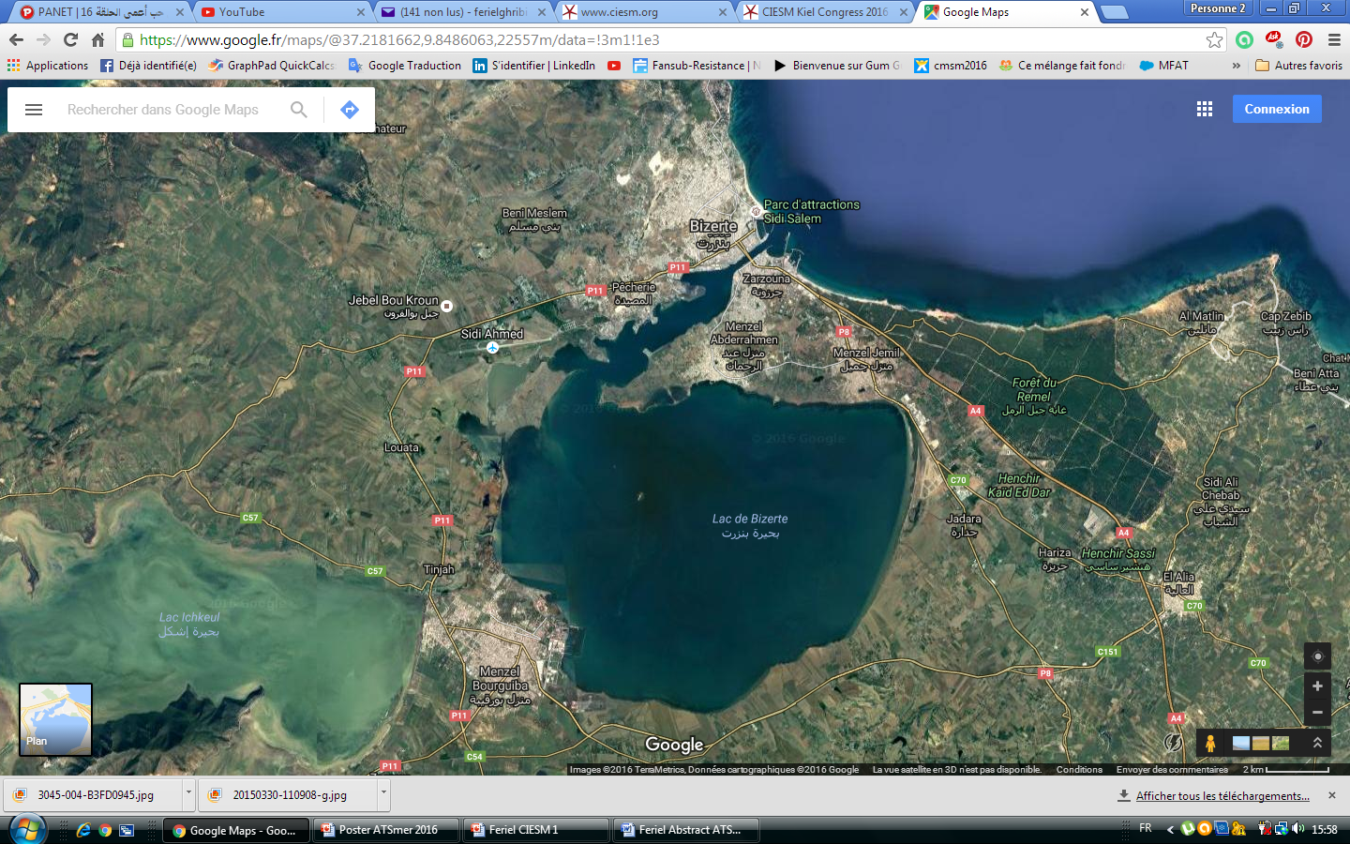
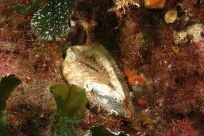
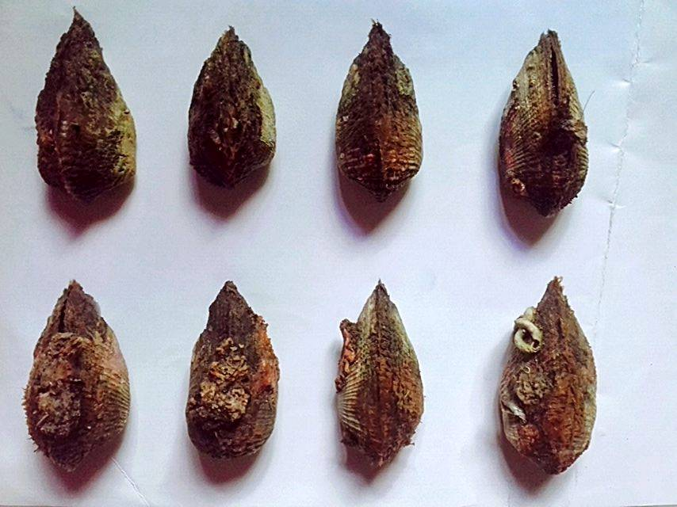
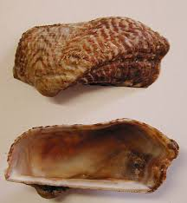


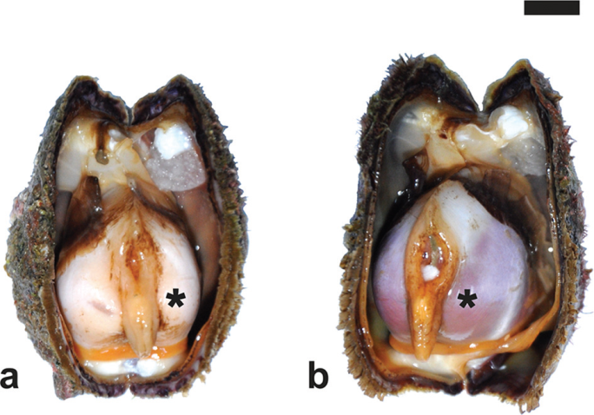
Effects of increasing temperatures on biomarker responses and accumulation of trace elements in the Ark shell (Arca noae) from Bizerte lagoon
Feriel GHRIBI¹*, Jonathan RICHIR² , Safa BEJAOUI¹, Dhouha BOUSSOUFA¹ , M’hamed El CAFSI¹ , Sylvie GOBERT²
¹Unit of Physiology and Aquatic Environment, University of Tunis El Manar Tunis- Tunisia
²Laboratory of Oceanology - MARE Centre - University of LIEGE - B6C - 4000 LIEGE - Sart Tilman - Belgium
The Bizerte lagoon is one of the most studied coastal areas in Tunisia, it is used for shellfish production since 1964 and supports various industry and agriculture activities (Barhoumi 2014). This lagoon inhabit a wide diversity of marine invertebrates, among them the valuable shellfish Noah’s ark (Arca noae). The present study examines the influence of increasing temperature on biochemical biomarkers and trace elements bioaccumulation in the total edible tissue of the comestible bivalve Arca noae.
ferielghribi@yahoo.fr
INTRODUCTION
MATERIALS & METHODS
Fig. 2. Bizerte Lagoon sampling site
120 mature specimens of Arca noae (Fig. 1) (55.23-65.08 mm) were collected during winter and summer 2014 from Bizerte Lagoon (northern Tunisia) (Fig. 2) at a depth of 3 meters by scuba diving in the southern sector of the lagoon far from urban and industrial sources of pollution but this site remained influenced by agricultural inputs. Ten trace elements (Ni, Cr, Cd, Fe, Zn, Mn, Al, Cu, Se and Pb) were analyzed in A . noae tissues (N=30 per season) by inductively coupled plasma mass spectrometry (ICP-MS) (Richir 2012). For biomarkers analysis, whole animal soft tissues (N=30 per season) were removed from -80 °C, thawed on ice and homogenized, individually, with an ultra Turrax® in phosphate buffer (0.1 M, pH= 7.4) then centrifuged at 9000×g for 20 min at 4°C. Tissues homogenates aliquots were used for biomarker assays: (1) metallothioneins (MTs) (Viarengo et al. 1997), (2) malondialdehyde (MDA) (Draper & Hadley 1990), (3) glutathione peroxidase (GPx) (Flohe & Gunzler 1984), (4) reduced gluthatione (GSH) (Ellman 1959) and (5) acetylcholinesterase (AChE) (Ellman et al. 1961).
Ghribi 2014
Fig. 1. Arca noae
Ghribi 2017
RESULTS & DISCUSSION
Table 1. Seasonal Trace element (TE) concentrations in Arca noae sampled from Bizerte Lagoon (Letters indicate significant differences at p < 0.05).
Trace element (TE) concentrations in mg/Kg dry weight decreased in the following order: Zn> Fe> Al> Mn> Cu> Se> Pb> Cd> Ni> Cr (Table 1).
The rise of temperature (T°C) from 12°C in winter to 28°C in summer (Ghribi et al. 2018) coincided with the high bioaccumulation of TE, expression of MDA, GPx, GSH and MTs and the inhibition of AChE activity in A. noae tissues (Table 1, Fig. 3).
Statistical analysis (Spearman's rank correlation) showed that all TE and biomarkers were significantly positively correlated with T, with the exception of Zn, Cd and AChE that was negatively correlated with this parameter.
The increase of TE levels in Ark shells during summer is probably related to the evaporation process (Edyokapi, 2016) due to increased temperature that favors the concentration of these TE in the Bizerte lagoon.
The application of PCA analysis (Fig. 4) indicated a clear separation of individuals according to seasons. To sum up, the summer season was marked by significant TE bioaccumulation, high levels of MDA, GSH, GPx and MTs and low AChE activity in A. noae.
Trace elements (mg / kg DW) | Winter 2014 | Summer 2014
Ni | 0,39±0,13 ª | 0,59 ± 0,12 ^{b}
Fe | 128±23ª | 183 ± 40^{b}
Cr | 0,26±0,04 ª | 0,38 ± 0,16 ^{b}
Mn | 11±5,34 ª | 19 ± 5.75 ^{b}
Cu | 3,78±0,16 ª | 6,37 ± 0,40 ^{b}
Zn | 168±21ª | 176 ± 19 ^{b}
Cd | 0,77 ± 0,21ª | 0,91 ± 0,22 ^{b}
Al | 21±3,14 ª | 117±38^{b}
Se | 3,55±0,38ª | 4,74±0,14^{b}
Pb | 0,49±0,09 ª | 1,83±1,68^{b}
A
B
CONCLUSIONS
Fig. 3. Seasonal variation of AChE, GPx, GSH, MDA and MTs in the soft tissues of A. noae collected from Bizerte lagoon
(Letters indicate significant differences at p < 0.05).
T (°C) appears to be a determinant factor on the variability of biomarker responses and TE bioaccumulation in A. noae. Overall, the combined effects of chemical contamination and increased temperature in summer appear to induce a highest metabolic adaptation response and can therefore be used to determine thresholds of effectiveness and facilitate the interpretation of monitoring biomarkers.
REFERENCES
Fig. 4. Principal component analysis (PCA) of trace elements and biomarker responses seasonally recorded in soft tissues of A. noae in relation to temperature (T) of Bizerte lagoon waters. A. 2D factor loadings plot and B. 2D scores plot in the space defined by the two first components of the PCA.
Barhoumi B. 2014. Biosurveillance de la pollution de la lagune de Bizerte (Tunisie) par l'analyse comparée des niveaux de contamination et de l'écotoxicité des sédiments et du biote. Thèse de doctorat. Université de Bordeaux, 245p ; Draper H.H. & Hadley M. 1990. Malondialdehyde determination as index of lipid peroxidation. Method. Enzymol. 86: 421-431 ; Ellman G.L. 1959. Tissue sulfhydryl groups. Archives of Biochemistry and Biophysics, 82: 633 70-77 ; Flohe L. & Gunzler W.A.1984. Assays of gluthathione peroxidase. Methods in Enzymology, 642 105 : 114-121 ; Richir J. 2012. Coastal pollution of the Mediterranean and extension of its biomonitoring to trace elements of emerging concern. Thèse de doctorat, Université de Liège, 249p ; Viarengo A., Ponzano E., Dondero F., Fabbri R. 1997. A simple spectrophotometric method for metallothionein evaluation in marine organisms: An application to Mediterranean and Antarctic mollusks. Mar. Environ. Res. 44: 69-84 ; Ellman G.L., Courtney K.D., Anders V., Featherstone R.M. 1961. A new and rapid colorimetric determination of acetylcholinesterase activity. Biochem. Pharmacol. 7: 88-95. Ghribi F., Boussoufa D., Aouini F., Bejaoui S., Chetoui I., Rabeh I , El Cafsi M. 2018. Seasonal variation of biochemical composition of Noah's ark shells (Arca noae L. 1758) in a Tunisian coastal lagoon in relation to its reproductive cycle and environmental conditions. Aquatic Living Resources, 31:15 ; Edokpayi J.N., Odiyo J.O., Popoola O.E., Msagati T.A.M. 2016. Assessment of Trace Metals Contamination of Surface Water and Sediment: A Case Study of Mvudi River, South Africa. Sustainability, 8: 1-13.

