Slide 1
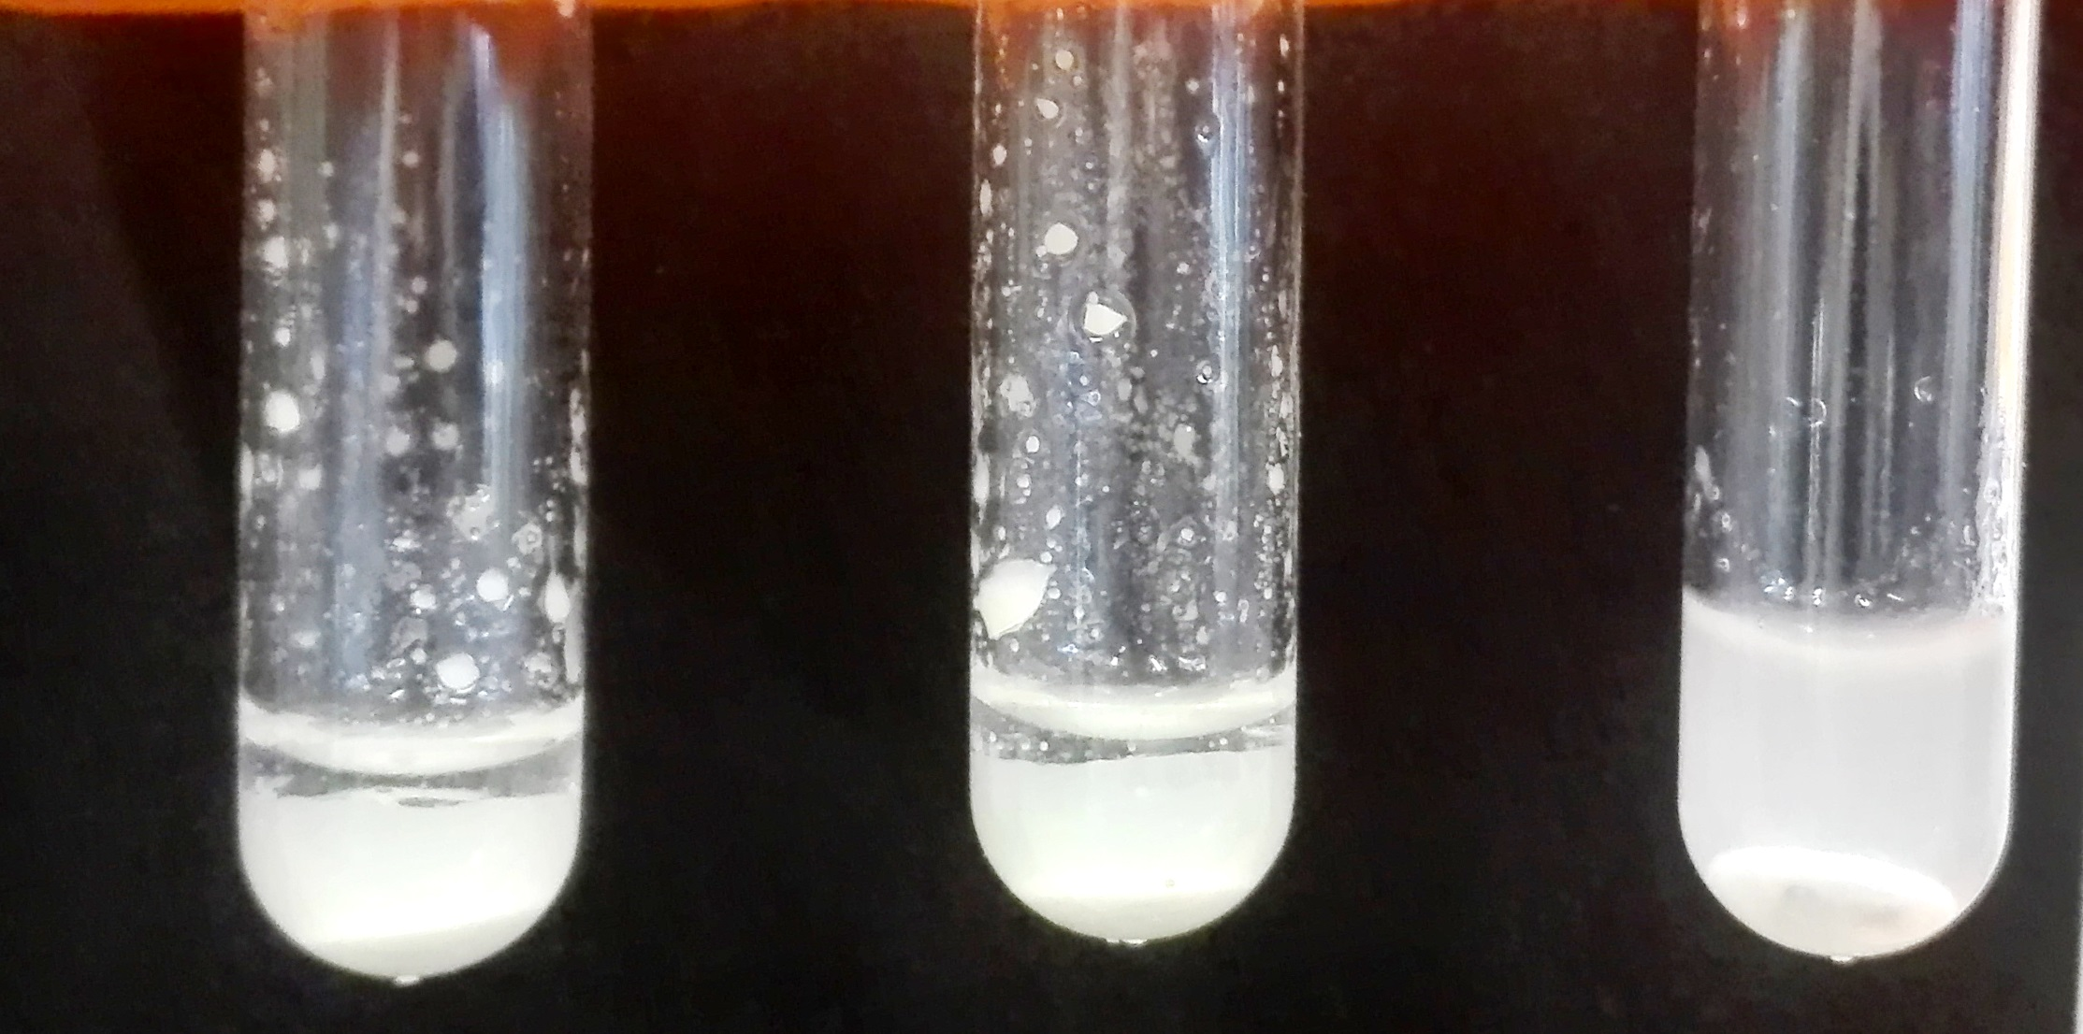
L.O.U.I.S Test evaluation to rapid detection of Salmonella sp. and Yersinia sp. in animals
DUPREZ JN.¹, MAINIL J.¹, THIRY D.¹, VOLPE R.² ,LINDEN A.²
.¹ Bacteriology, Infectious deseases department, FARAH, Uliege
.² Wildlife hearth and diseases, Infectious deseases department, FARAH, Uliege
Introduction : In veterinary medicine, and especially in wildlife, the search for the bacterial genera Salmonella and Yersinia is common. Despite the use of enrichment and selective media (Rappaport broth, Modified BPLS medium, Yersinia selective broth and Yersinia CIN agar), we are regularly confronted with suspicious colonies which, after biochemical identification (API 10S© or 20E ©), turns out to be false positives. With the disappearance in more or less short time of the API galleries, the confirmation will become even more difficult. In 2004, G. Wilson developed a rapid confirmation test of the genera Salmonella and Shigella in human medicine: Lysine, ONPG, Urease, Indol screening test (LOUIS test) which is carried out in 3 hours with a sensitivity of 100% and a specificity of 94%. This study proposes to asses this test for Salmonella sp. in veterinary medicine and see if it isadaptable for research of the genus Yersinia.
Material and method : In order to evaluate the test, 18 control strains and 50 wild strains ( 16 Salmonella of 12 serovar and 12 Yersinia (5 enterocolitica, 6 pseudotuberculosis, 1 kristensenii) isolated from different species (Deer, Roe, Cow, Rabbit, Hare, Boar, Dog, Guinea fowl) were cultured on LB agar and incubated at 37 ° C. All strains were identified by API 20E or/and MALDI-TOF. From the colonies, suspensions of opacity > 5 McFarland were performed and distributed into 3 microtubes at 200 μl / tube. In each tube, a substrate pellet was added (Diatabs © LDC/INDOL, ONPG, UREE/INDOL, ROSCO, Denmark). The LDC and UREE tubes were covered with a few drops of paraffin oil. The whole was incubated for 3h at 37 ° C. LDC, ONPG, UREE test readings were performed directly by color observation. The addition of Kovacs reagent in the LDC tube and acid iron perchloride III in the UREE tube allowed reading of the INDOL and TDA. A test got a score of 1 if positive and 0 if negative. The 5-digit code obtained was compared with interpretation table. We have modified Wilson's reading table to include Yersinia and some other genera often isolated in veterinary medicine.
Right :Inoculed test before incubation
Left : LDC IND ONPG UREE TDA Salmonella ser. Dublin
Klebsiella oxytoca
Proteus vulgaris
LDC | ONPG | UREE | IND | TDA | Code | Presomptive identification
- | - | - | - | - | 00000 | Shigella sp. or LDC- Salmonella
- | - | - | + | - | 00010 | Shigella sp.
- | - | + | - | - | 00100 | Yersinia pseudotuberculosis
- | - | + | - | + | 00101 | Proteus sp. , Providencia sp. , Morganella morganii
- | - | + | + | + | 00111 | Proteus sp. , Providencia sp. , Morganella morganii
- | + | - | - | - | 01000 | Shigella sonnei, Shigella dysenteriae, Pantoea(Enterobacter) sp. , Citrobacter sp.
- | + | - | + | - | 01010 | Klebsiella sp. Pantoea (Enterobacter) sp., Citrobacter sp.
- | + | + | - | - | 01100 | Yersinia enterocolitica and Y.pseudotuberculosis, Citrobacter sp.
- | + | + | + | - | 01110 | Yersinia sp. (except Y.pseudotuberculosis, pestis and aldovae), Citrobacter sp.
+ | - | - | - | - | 10000 | Salmonella sp.
+ | - | - | + | - | 10010 | Escherichia LAC-
+ | + | - | - | - | 11000 | Salmonella Arizonae, Serratia sp.
+ | + | - | + | - | 11010 | Escherichia coli , Klebsiella sp, Serratia odorifera
+ | + | + | + | - | 11110 | Klebsiella sp.
Test | Positif | Doubtful | Negatif
LDC
ONPG
UREE
INDOL | ring |  | ring
TDA | precipitate
Colors readind table
Modified Wilson’s interprétation table
Results:
All Salmonella were correctly identified but we got 9 false positives. The sensitivity is 100%, specificity 83.3%.
For Yersinia strains, 10 strains are correctly identified, but we have got 1 false negative and 3 false positives. The sensitivity is 82.7% and the specificity is 96.3%
Genus | N= | Identified like Salmonella | Identified like Yersinia
Citrobacter | 6 | 1 | 3
Enterobacter | 4 | 0 | 0
Escherichia | 8 | 0 | 0
Klebsiella | 4 | 0 | 0
Proteus | 6 | 1 | 0
Providencia | 8 | 2 | 0
Salmonella | 16 | 16 | 0
Serratia | 4 | 4 | 0
Yersinia | 12 | 1 | 10
Discussion and perspective :
During our tests, the LDC and UREE test readings were sometimes difficult after 3 hours (doubtful results). An additionnal incubation of 30 min allowed a clear reading except in one case.
The LOUIS TEST is a rapid alternative for commercial gallery to identify suspicious colonies in Salmonella/Yersinia research.
For this study, we used commercial tabs but it’s possible to reduce the cost by preparing the media thought we should evaluate this test with home made solution.
Acknowledgments: I would like to thank Professor A. Linden and Professor. C. Boko for allowing me to use their strains to carry out this study as well as Professor J. Mainil and Doctor D. Thiry carefully reading.
References :
-« Rapid and economical method for biochemical screening of stool isolates for Salmonella and Shigella species », G. Wilson, Journal of clinical Microbiology, Oct 2004 p 4821-4823
- Productsheet « Screenig for Salmonella and Shigella in faecal samples », Rosco Diagnostica, octobre 2009

