Slide 1
GRAVL

Slide 2
Contributors
The GRAVL concept was developed at the Alpbach Summer School 2019 in Austria, organised by FFG and ESA.
The mission was selected for subsequent development at the Post-Alpbach Event in ESA Academy's Training and Learning Facility at ESEC-Galaxia in Belgium.
Student contributors: A. Adler¹, N. Anthony², M. Archimbaud³, S. Beeck⁴, I. Bjorge-Engeland⁵, E. Bogacz⁶, F. Boutier⁷, V. Camplone⁸, H. Collier⁹, C. Dandumont¹⁰, O. Dhuicque¹¹, B. Drozd¹², M. Eizinger¹³, M. Fayolle-Chambe ¹⁴, V. Galetsky¹⁵, B. Linder¹⁶, E. Lopez-Contreras¹⁷, M. Milasevicius¹⁸, F. Mueller¹⁹, T. Nielsen²⁰, M. Noeker²¹, S. Ocaña Losada²², A. Pagu²², J. Vilaboa Pérez¹⁰, A. Putz¹³, L. Salfenmoser²³, G. Salvia²⁴, A. Savu²⁵, L. Schreiter²⁶, M. Stefko²⁷, E. Weterings², D. Wischert²⁸, J. Woodwark²⁹, R. Zeif³⁰.
Tutors: Q. Chen^{i}, J. Praks^{ii}, O. Carraz^{iii}, A. Ivanov^{iv}, J. Loicq^{v}, M. Lavagna^{vi}, J. Vennekens^{vii}, R. Haagmanns^{vii}.
Notes:
1: Duale Hochschule Baden-Württemberg, 2: Luleå University of Technology, 3: Ecole Polytechnique Féminine, 4: Technical University of Denmark, 5: University of Bergen, 6: University College Dublin, 7: École polytechnique fédérale de Lausanne, 8: International Research School of Planetary Sciences, 9: Trinity College Dublin, 10: University of Liège - Centre Spatial de Liège, 11: CNES/ONERA/Observatoire de Paris, 12: Warsaw University of Science and Technology, 13: Fachhochschule Wiener Neustadt, 14: Delft University of Technology, 15: Instituto Superior Tecnico, 16: Stockholm University, 17: Polytechnic University of Catalonia, 18: Vilnius Gediminas Technical University, 19: German Aerospace Center, 20: University of Oslo, 21: Royal Observatory of Belgium and Université catholique de Louvain, 22: University of Oxford, 23: TU Berlin, 24: Institut Politechnique des Sciences Avancees, 25: Technical University of Civil Engineering Bucharest, 26: University of Bern, Astronomical Institute, 27: Eidgenössische Technische Hochschule Zurich, 28: ESA, 29: University of Edinburgh, 30: Graz University of Technology.
i: University of Luxembourg, ii: Aalto University, iii: European Space Research and Technology Centre (ESTEC), iv: Skolkovo Institute of Science and Technology, v: University of Liège, vi: Politecnico di Milano, vii: European Space Agency

Slide 3
Introduction

Slide 4
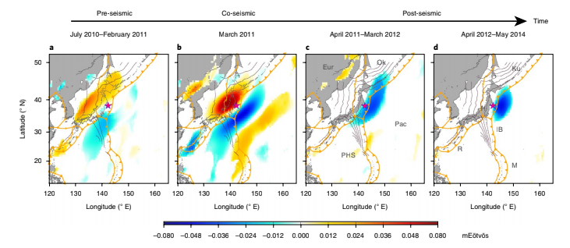
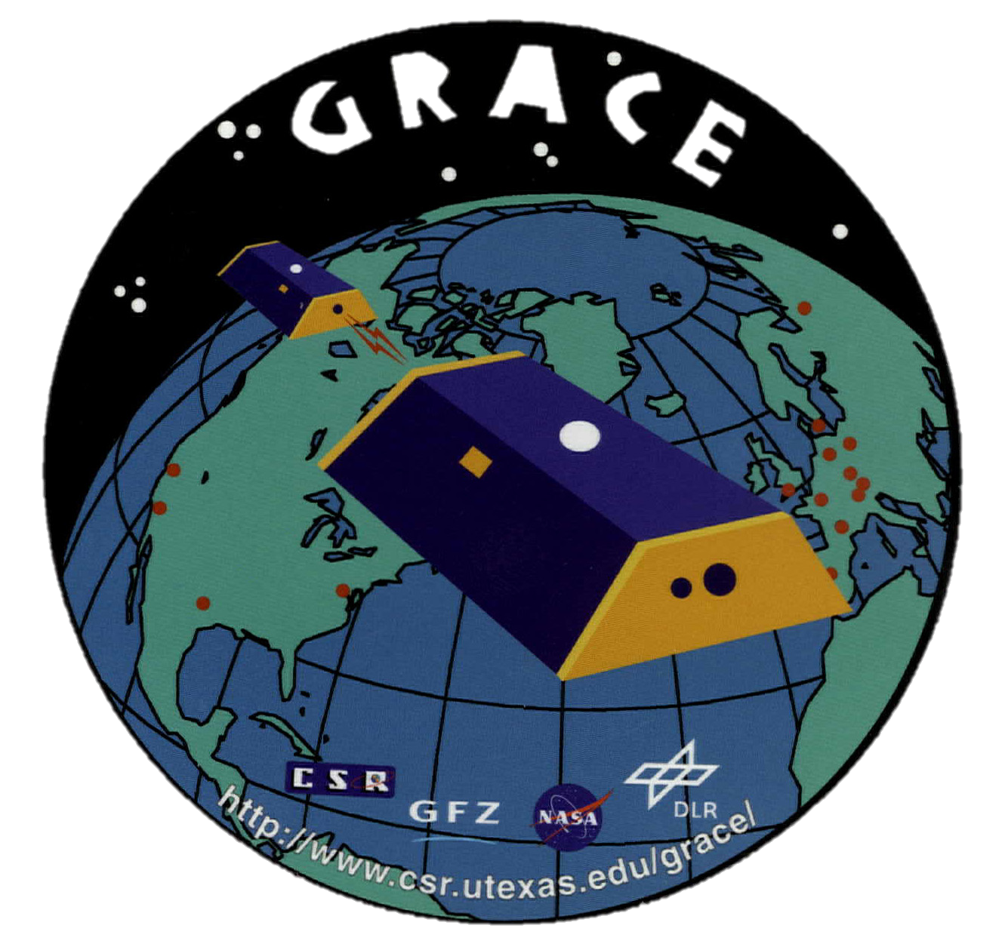
GRACE results
GRACE demonstrated feasibility of pre-, co- and post- seismic detection of Mw 8.3 event
2010: Pre-seismic
2011: Co-seismic
2012-14: Post-seismic
Panet et al., Nature Geoscience, 2018
Notes:
The GOCE (Gravity Field and Steady-State Ocean Circulation Explorer, 2009-2013) mission consisted of a single spacecraft, carried six accelerometers, flew at low altitudes, which allowed for the retrieval of the static gravitational field at a high spatial resolution of 100 km and sensitivity of 1 mGal.
In contrast, the GRACE (Gravity Recovery and Climate Experiment, 2002-2017) and GRACE Follow-On missions (2018- present) have performed along-track microwave ranging to detect deviations from the expected orbits of two spacecrafts.
It was possible to reach a higher sensitivity (up to 1 μGal) at lower spatial resolution, around 300 km, which provided opportunities to detect gravity signatures caused by large earthquakes [8].
However, its relatively low sensitivity and spatial resolution enables the detection of earthquakes with magnitudes above MW 8.3.
In addition, an understanding of the mechanisms and timescales of far-field motions leading to seismic events remains challenging.
An important limitation comes from an incomplete description of seismic mass fluxes at depth along plate boundaries.
A future mission with higher spatial resolution would provide significant benefits.
Therefore, concepts for gravity measurements from space have been and currently are under investigation.
NGGM (Next Generation Gravity Mis- sion) concept of a GRACE-like mission with an additional satellite pair at different inclination is under investigation.
Other concepts are GETRIS and MOBILE, which proposed constellations that use high precision, high–low inter-satellite links to measure the radial distance between spacecraft orbiting the Earth at different altitudes.

Slide 5
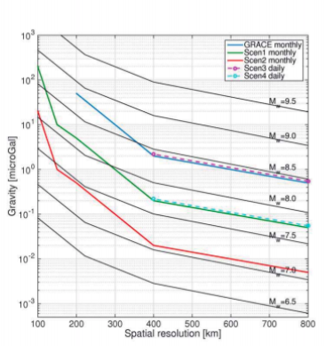
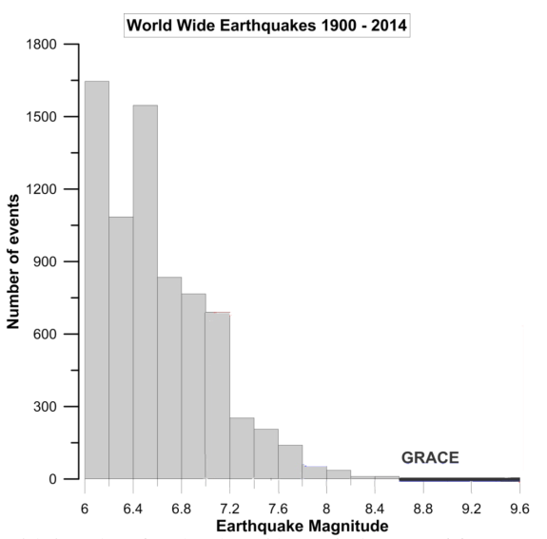
Science proposal
Extend the detection threshold to lower magnitude events > Mw 6.5
Requirement | Value
Spatial resolution | 100 km
Sensitivity | 0.1 µGal
Temporal resolution | 3 days
Measurement duration | 7 years
Coverage | ± 60° latitude
Mw 9.5
~3,000 more earthquakes seen compared to GRACE
GRACE
Mw 9.0
Gravity / µGal
Mw 8.5
GRAVL
Mw 8.0
GRAVL
Mw 7.5
Mw 7.0
Mw 6.5
Spatial resolution
Pail et al, DGK report 320, 2015
Notes:
1 µGal = 0.01 µm/s²
Primary science objective: improving spatial and temporal resolution of high sensitivity gravity field measurements.
Improving both spatial and temporal resolution to 100 km and 3 days, and the Earth’s gravity field to a precision of 0.1 μGal will provide the basis for an improved understanding of the geophysical pre-, co- and post-processes governing seismic events.
Such understanding will not only improve the understanding of these often devastating events, possibly contributing to eventually achieving predictability, but also the interior of our planet.
The upper mantle’s rheology is not very well understood; however, it can be derived from mass displacement observations.
According to Panet et al., better constraints on the rheology of the crust and mantle can provide a wealth of geophysical information.
Here, one of the least understood and most important parameters is the mantle viscosity.
A better understanding of this parameter will improve the understanding of the dynamics inside the mantle and the behaviour of convective flows.
By gathering data on silent earthquakes, understanding of these rare and long-timescale events is improved.
Finally, knowledge of mass movement associated with seismic events in areas with currently sparse coverage by ground measurement networks is improved, especially addressing inaccessible areas such as the oceans.
Secondary science objectives
Improving the spatial resolution also enables a better understanding of ocean currents, including how they are affected by climate change.
It can also improve understanding of the hydrological cycle.
Changes in the Earth’s water storage distribution cause variations in the Earth’s gravity field.
As an example, the Atlantic Meridional Overturning Circulation (AMOC) is a collection of large ocean currents that plays a key role in regulating the Earth’s climate.
Ice melting in the North Atlantic Ocean may slow this process down or eventually even cause its stop completely.
Proper, long-time monitoring of the AMOC would help in understanding its response to climate change.
The hydrological cycle is the succession of the phenomena of flow and circulation inside the terrestrial hydrosphere, and the changes in its physical state (liquid, gaseous and solid).
It refers to the continuous exchange of water mass between different areas of the Earth: ocean bodies, various surface waters and groundwater.
Gravity measurements with improved spatial resolution would allow for the monitoring of water storage changes in not only the large river basins, but also smaller ones.
±60˚ latitude gives coverage for M>6.5 of 98% based on 1970 – 2014 data
A 7 year duration give a 99% probablility of a silent earthquake ocurring during the lifespan of the mission.

Slide 6
GRAVL mission concept

Slide 7
GRAVL concept summary
Measurement of trajectory perturbations of test masses in Low Earth Orbit (LEO) by measuring time-of-flight (TOF) or laser pulses transmitted by active spacecraft in Medium Earth Orbit (MEO).
Constellation of LEO S/C: low drag, as simple and rigid as possible, no active attitude control beyond de-tumbling. Good position, attitude and acceleration knowledge to compensate for non-gravitational forces and other uncertainties.
MEO S/C: stabilised, active pointing of laser pulse,
high precision clock.
Aiming to achieve 100 km
spatial resolution and 1 µGal
sensitivity, roughly equivalent to 30 nm ranging precision.
TOF laser rangefinding from MEO
Ranging
g
LEO test masses with prism retroreflectors

Slide 8
Measurement concept

Slide 9
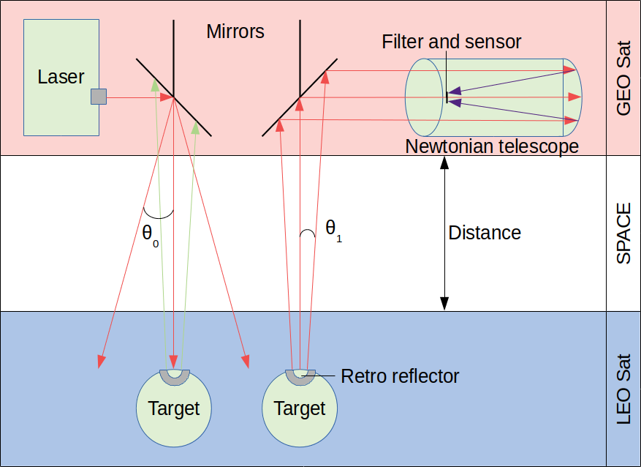
Laser ranging: concept
MEO-LEO vertical distance changes → radial gravity field
MEO pointing mirrors slewed to LEO target location to within laser spot diameter.
Laser pulses sent from MEO satellite.
Pulses reflected by retro reflector on LEO satellite.
Laser pulses received in MEO by photodiode.
Time of flight of pulses measured.
Multiple LEO S/C tracked by single MEO – either via sequential targeting, or multiple lasers.
MEO Sat
15,000 km
Notes:
The outgoing laser beam divergence is such that the beam spot at LEO intersects the circle of uncertainty in the LEO spacecraft position provided by GNSS data uplinked to the MEO satellite, thus ensuring the beam hits the retroreflector.
Roughly 0.01 degrees of pointing precision is required by MEO satellite laser pointing system.
MEMS mirrors are envisaged for this task.
The returning beam divergence is the proportion of the outgoing beam divergence sampled by the retroreflector, in the case where frame dragging is assumed (next slide).
The returning spot at the telescope is therefore relatively compact and can be captured by a sub-metre aperture.
Further details on the power calculation are included in slide 10.
Bandpass filter to isolate laser signal from background radiation.

Slide 10
Retroreflectors
Mirror-based corner cube retroreflectors return beam along reciprocal of incident beam vector.
Relative motion of the two spacecraft can cause the returning beam to “miss” the detector due to time-of-flight delay. Two solutions are possible – either increase beam divergence (thus losing intensity), or ensure that the reflected beam is correctly directed towards the detector, regardless of the relative motion.
There is evidence that glass prism based retroreflectors with certain refractive index exhibit a relativistic frame-dragging phenomenon, where the returning beam is returned exactly towards the source, regardless of the relative motion.
  See Vasil’ev et al., “Effect of the optical medium in optical location”, Pis’ma Zh. Eksp. Teor. Fiz. 55 No.6, 317-320, 1992.
In this case the beam does return to the emitter/receiver satellite and the returning beam divergence does not need to be increased.
Notes:
The Vasil’ev paper forms an important basis of the concept: without the frame dragging effect significant modifications to the entire concept are required including a move to active LEO spacecraft attitude control and spoiling of retroreflector return beams, causing issues for spacecraft fuel consumption, and laser link power budget.
Where possible we would advise on further testing of retroreflector performance to verify the Vasil’ev result prior to further mission development.

Slide 11
Laser ranging: power calculation
Predicted laser link path loss varies greatly depending mainly on retroreflector model applied to compensate for velocity aberration:
  Assuming validity of the Vasil’ev model, a reasonably-sized 6cm glass prism retroreflector applying the frame-dragging Vasil’ev model would exhibit gain of 76 dB.
  A small 9 mm reflector that only relies on optical beam divergence provides 40 dB (a loss of over 3 orders of magnitude as opposed to the previous case).
  Other methods such as retroreflector spoiling would likely provide gain that is in-between these two extreme cases.
Utilizing a 15,000 km equatorial MEO orbit for the upper satellite instead of GEO results in 12 dB power gain due to reduced free space loss.
Depending on the choice of these parameters (and validity of models), total link loss is estimated between -32 (best assumptions) and -80 dB (worst assumptions).
Assuming a pulsed laser source with peak power of at least one kilowatt, the returning beam power is then expected to be on the order of tens of microwatts or better, which should be well within the detectable region.
For more details see laser link document in attachments (final slide).

Slide 12
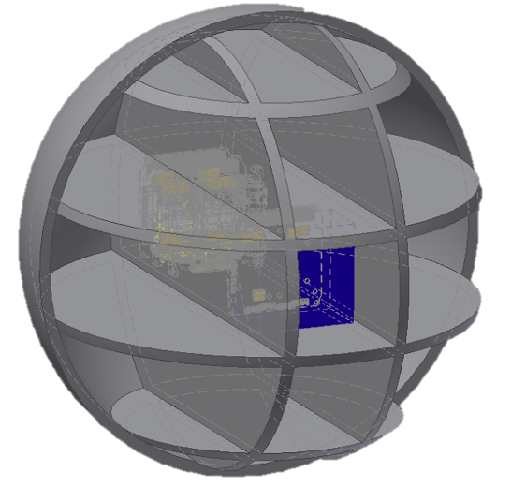
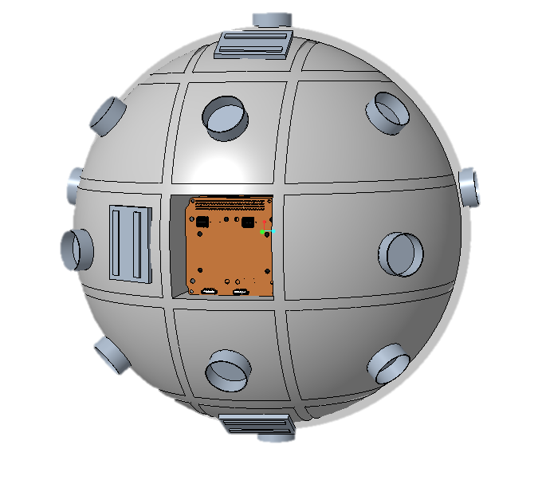
LEO spacecraft design concept
Good ballistic coefficient 0.008 m²/kg
GNSS for position knowledge
Solar panels
Sensors for
attitude knowledge
Accelerometer at C.O.M
Magnetorquers for detumbling
Multiple passive prism retroreflectors 20° acceptance angle
Notes:
Heritage from passive designs such as LAGEOS and LARES, as well as active satellites such as DANDE (Uo Collorado).
Roughly 500 mm diameter.
Low thermal expansion coefficient optical bench linking retroreflectors to centre of mass.
Non-standard shape causes challenges for both manufacture and launch but allows for non-actively controlled attitude, which brings significant benefits in areas including: ranging precision; fuel requirement; knowledge of non-conservative forces.
Multiple patch antennae for communication at any attitude.
Rest of surface covered with solar cells to maximise power generation.

Slide 13
Other instrumentation
MEO high precision clock
  Time of flight measurement between pulse send and receive.
  Clock precision has large impact on ranging result and so gravity measurement.
  Better than 3x10⁻¹⁶ s precision required.
LEO & MEO accelerometry
  To compensate for non-gravitational forces, approximately 1x10⁻⁸ ms⁻² precision req’d.
LEO attitude determination
  To calculate position of reflecting retroreflector from centre of mass along measurement vector (as S/C is not attitude controlled), approx. 0.02˚ precision req’d.
LEO position knowledge
  To allow pointing of MEO laser to ensure spot intersects LEO S/C: GNSS sufficient.
  Higher precision for gravity field retrieval (cm) via post-processing.
Notes:
Clock
Detailed characterisation of delays required within timing hardware and software due to high precision requirement.
Accelerometry
Accelerometry to track non-conservative forces including atmosopheric drag (order 10E-7 ms-2) and radiation pressure (order 10E-8 ms-2)
These estimates are for a 0.5 m diameter spacecraft with ballistic coefficient of 0.008 m2/kg at an altitude of 500 km
Attitude
Although attitude is not actively controlled on LEO spacecraft beyond detumbling, attitude knowledge is required as angular position of reflecting retroreflector relative to vector between LEO and MEO centres of mass needs to be known.
A 0.02 degree rotation of the LEO spacecraft gives a 15 nm change in the distance from LEO S/C centre of mass to retroreflector along the line between the two S/C centre of mass.
Position
The MEO laser mirror must be slewed to each visible LEO target with repeat measurement of the same target within roughly 8 seconds to meet the spatial resolution requirement.
The LEO spacecrafts’ positions and trajectories must be communicated to the MEO spacecraft with sufficient precision that the slew mirror can position the laser spot with enough accuracy to overlap the trye LEO spacecraft position.

Slide 14
Accuracy and precision - challenges
Best available clock has 1x10⁻¹⁵s noise floor, require 1x10⁻¹⁶s
  Use high frequency laser pulse train to give n measurements per single observation.
  Averaging n measurements reduces error by √n.
  High repeat rate required.
Attitude knowledge of LEO S/C to 0.05˚ required
  Star trackers for absolute position update and ring laser gyroscopes for precision.
Accelerometry to 1x10⁻⁸ms⁻² e.g. MicroSTAR
Thermal effects
  Change in position of retroreflectors relative to LEO S/C centre of mass due to thermal expansion.
  With a low CTE material optical bench (e.g. CTE = 1x10⁻⁶m/m K, some composites), would require temperature knowledge to roughly 0.02˚ to equal ranging precision requirement.
Notes:
Clock
An averaging approach is used to reduce the noise floor of the clock to achieve acceptable timing precision.
A high frequency pulsed laser allows many timing measurements to be made per observation, allowing the noise floor to be reduced to 1E-16s.
A further analysis of timing system errors is required to ensure all error sources are quantified and compensated for.
A pulsed laser also brings benefits by reducing the overall power requirement of the system and reducing thermal loads on optical components.
Attitude
Star trackers are used to update the absolute attitude of the LEO spacecraft and update the high precision measusurements provided by the ring laser gyroscopes, which experience drift over time.
Accelerometry
Atmospheric drag and radiation pressure are anticipated to contribute roughly 10E-8 ms-2 of acceleration, which must be accounted for allow retrieval of the gravity field signal
Thermal
Both differential and uniform heating of the spacecraft must be considered, requiring a network of temperature sensors to construct a 3D model of thermal distortions and so precisely map the relative positions of both retroreflectors and laser send and receive hardware relative to their respective spacecrafts’ centre of masses.

Slide 15
Mission profile

Slide 16
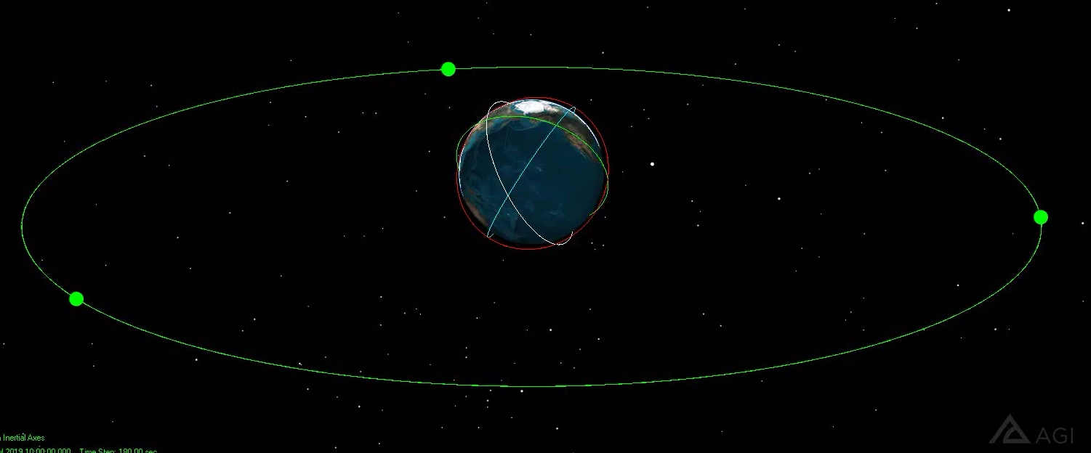
LEO and MEO orbits
Notes:
Animation showing schematically the proposed mission concept.
MEO satellites aquire and measure distance to visible LEO satellites in succession, with roughly 10s interval between ranging measurements to the same satellite to provide the spatial resolution of 100 km required.

Slide 17
Orbits – trade-offs
Target 100 km spatial resolution.
Translates to time interval of ~ 10 seconds between sampling points of the same LEO test mass, assuming a LEO orbital height of 500 km.
Latitudinal coverage up to ±60˚ would include 98% of events > Mw 6.
Original concept had 3 satellites in geostationary orbit, giving full coverage of all longitudes, however with varying sensitivity, since the measurement vector is exactly vertical only directly under the GEO satellites.
A MEO orbit is preferable due to more uniform sensitivity around different longitudes, and avoidance of expensive GEO slots for 3 satellites.
However, trade-offs include a larger gravitational effect on the higher satellite, and the ranging vector being at a greater angle to the gravity vector for a larger proportion of measurements.

Slide 18
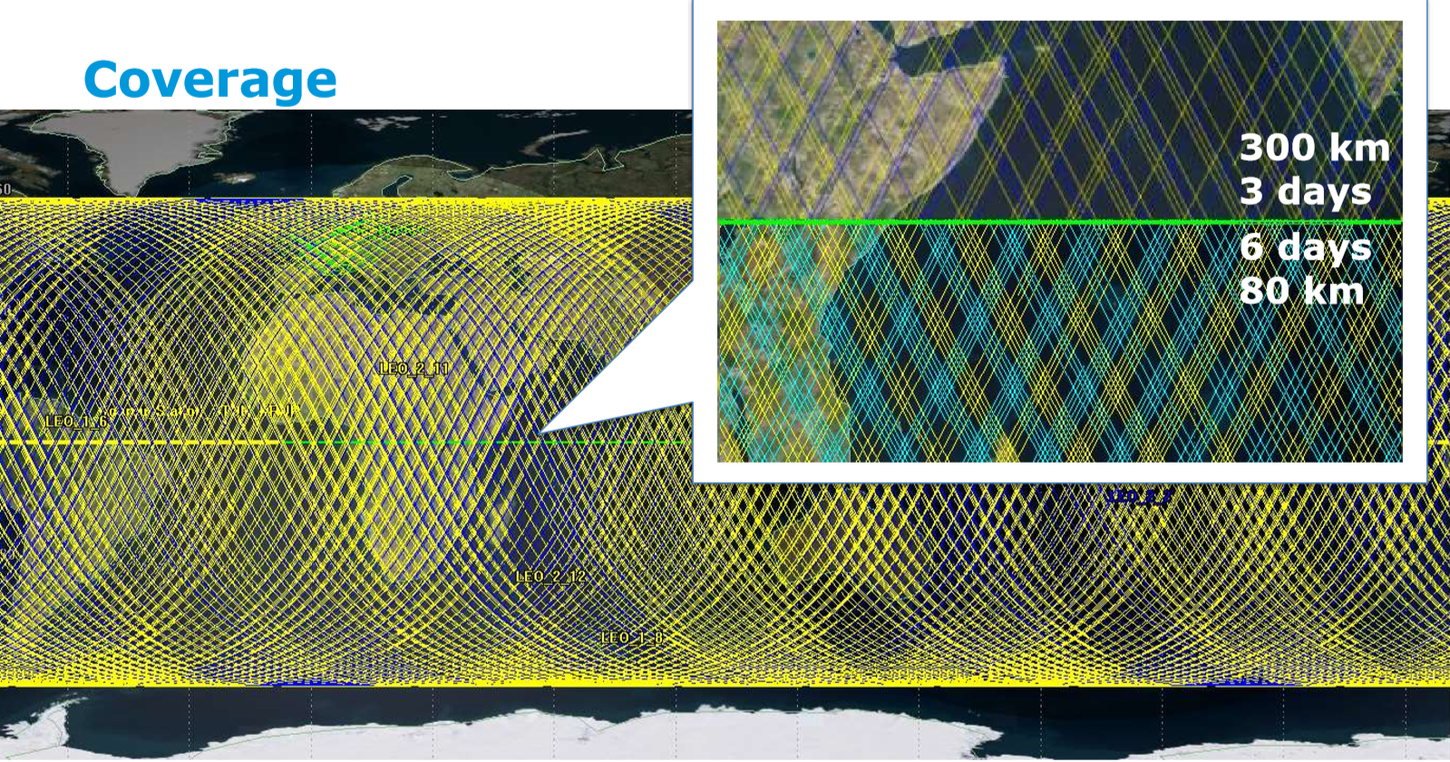
LEO Ground Track Coverage
6 S/C x 2 planes @ 60deg inclination

Slide 19
Outlook
Requirements for payload capabilities (two-way laser ranging precision & measurement frequency) should be reassessed more thoroughly – i.e. a specific model and the inversion procedure necessary to transform the raw ranging data into spherical harmonic coefficients of Earth’s mass distribution must be defined, and the requirements based off this model.
This should be followed by assessment of specific payload TRL, especially the spaceborne MEO laser ranging platform (power requirements, optics, and thermal stability are expected to be a challenge).
After this, design of the LEO & MEO spacecraft can be finalized (based off design work already carried out at Alpbach & Post-Alpbach workshops for previous iterations of the concept – certain subsystems can be completely reused).

Slide 20
The student members of the GRAVL team would like to thank all Alpbach Summer School, FFG and ESA staff, and academic tutors for their support during work on this mission concept.

Slide 21
Further information
Available under following link:
https://drive.google.com/open?id=1cTB8DbphVr4xAqtZHeIdrS3cHDUGOsZq
Team Green GRAVL Report – Alpbach Summer School 2019.
GRAVL laser link budget analysis document.

