Slide 1






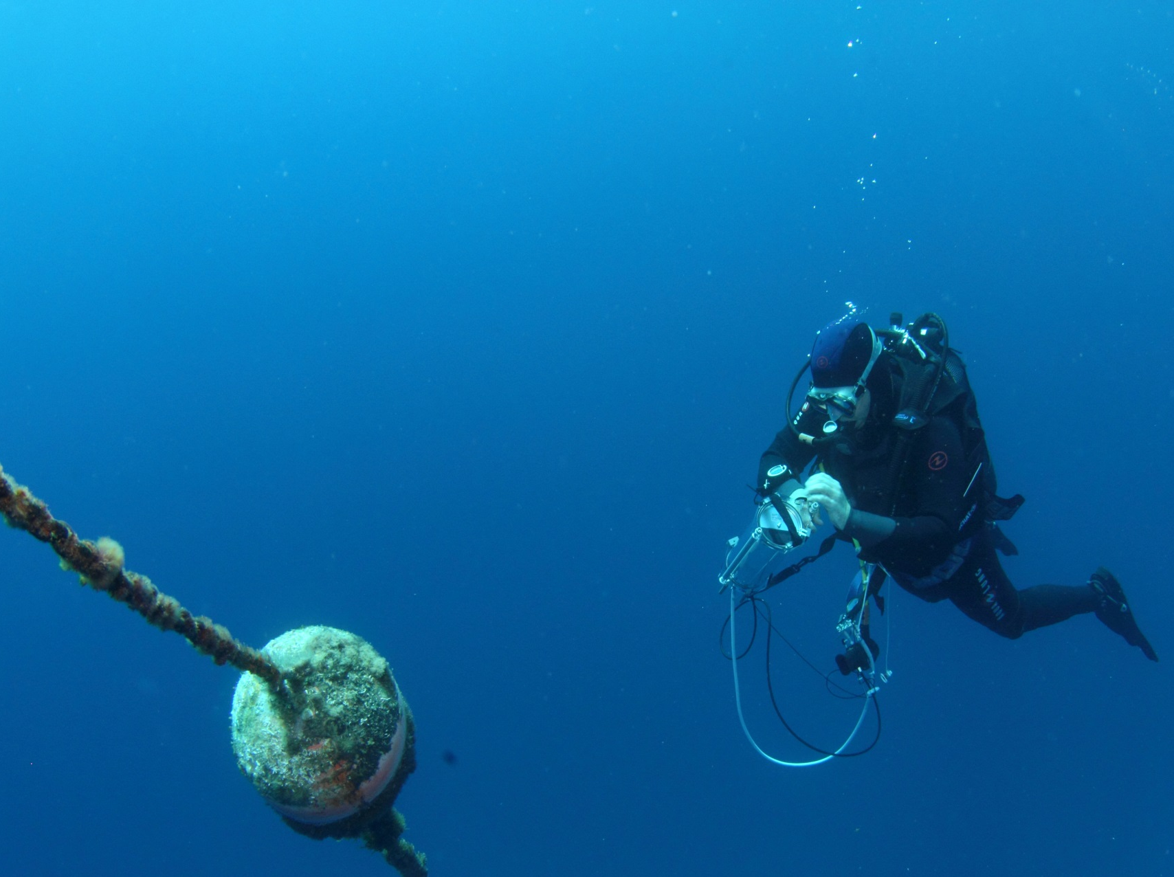
Experimental shading effects on the photosynthetic activity of the seagrass Posidonia oceanica
Richir J., Borges A. V., Champenois W., Chou L., Descy J.-P., Leduc M., Lepoint G., Walz S. & Gobert S.
11-10-2018,
Liège

Slide 2
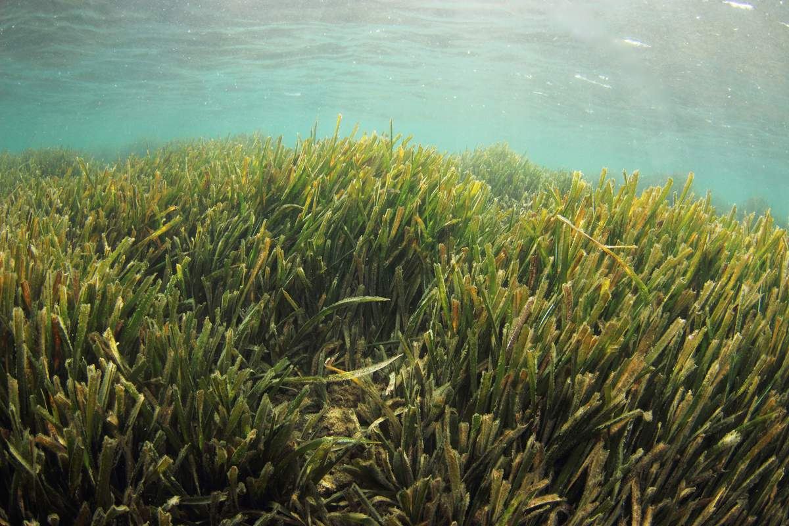
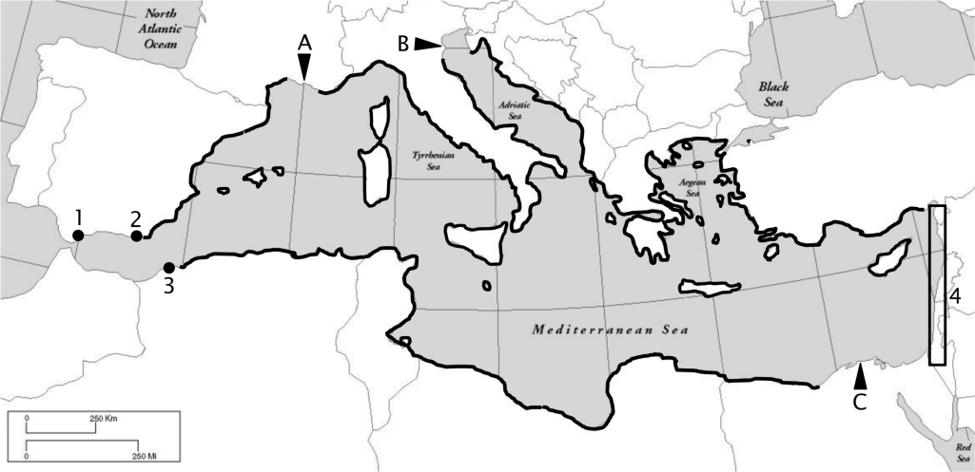
Posidonia oceanica, a Mediterranean endemic seagrass species
Michel, 2012

Slide 3
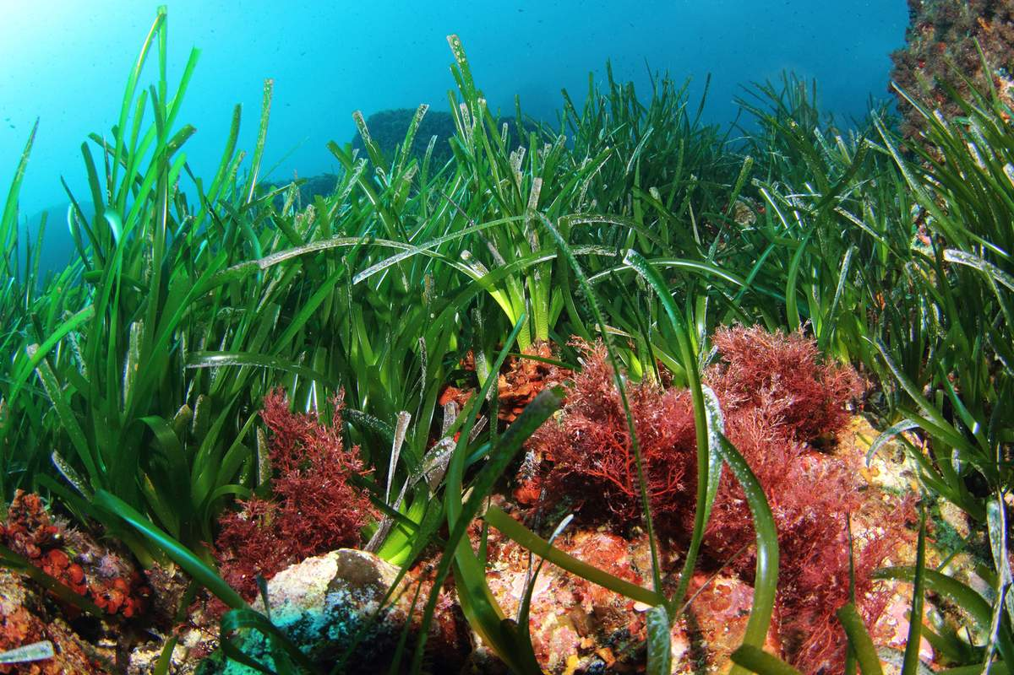
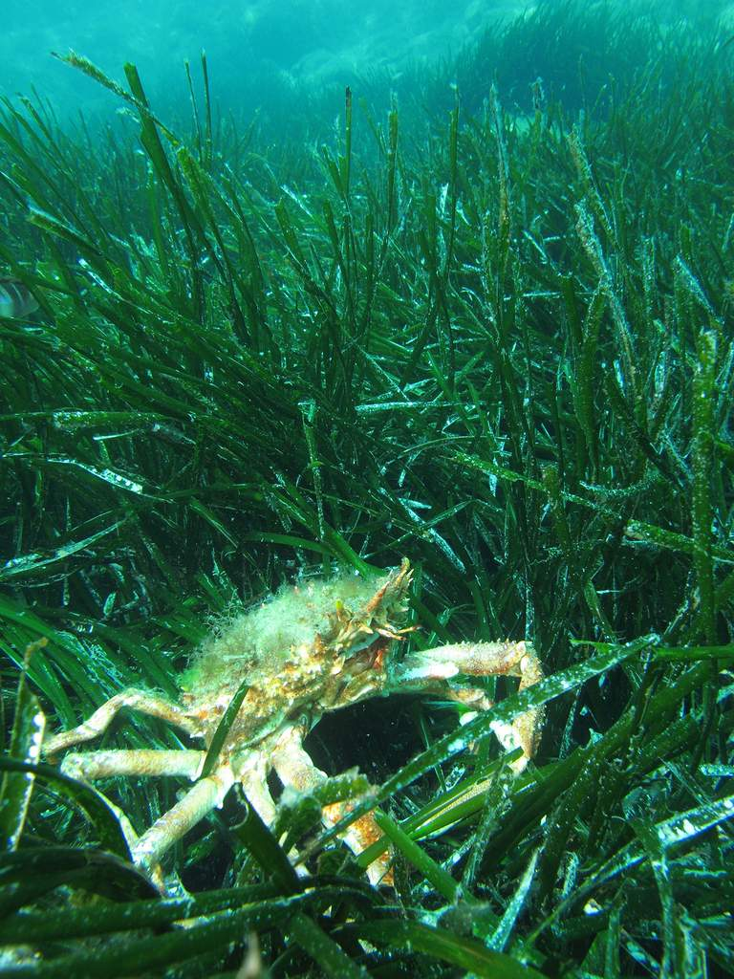
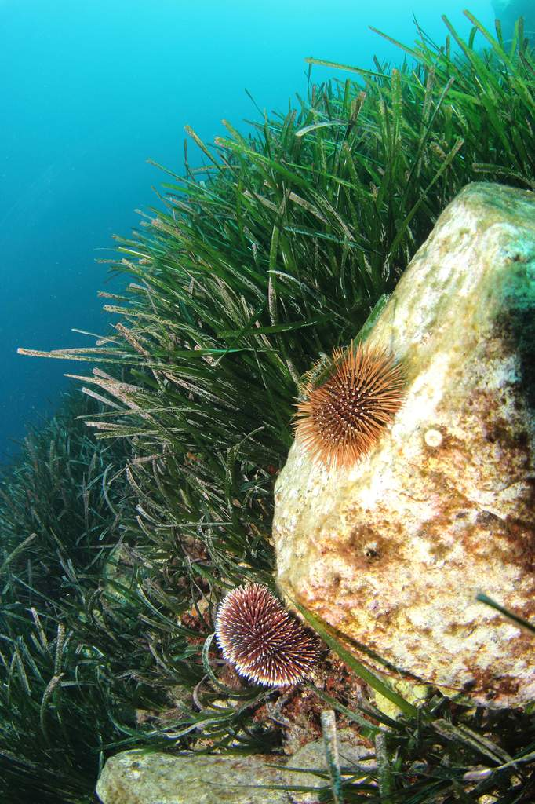
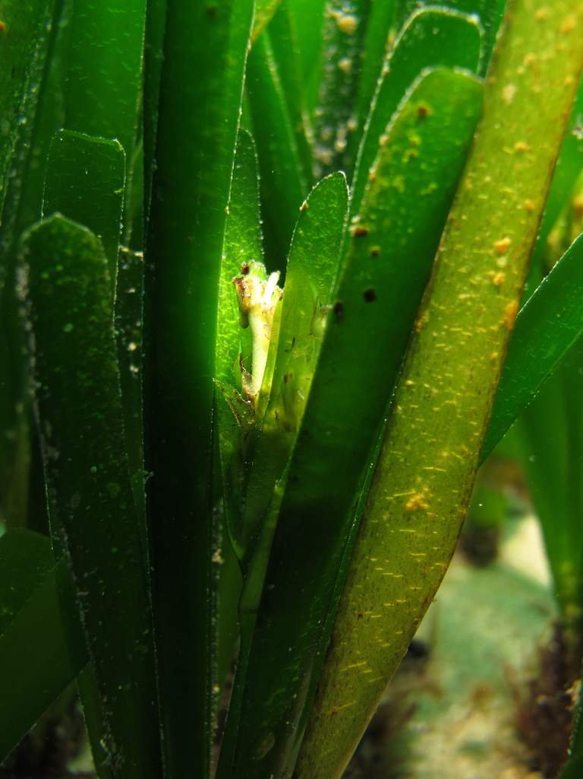
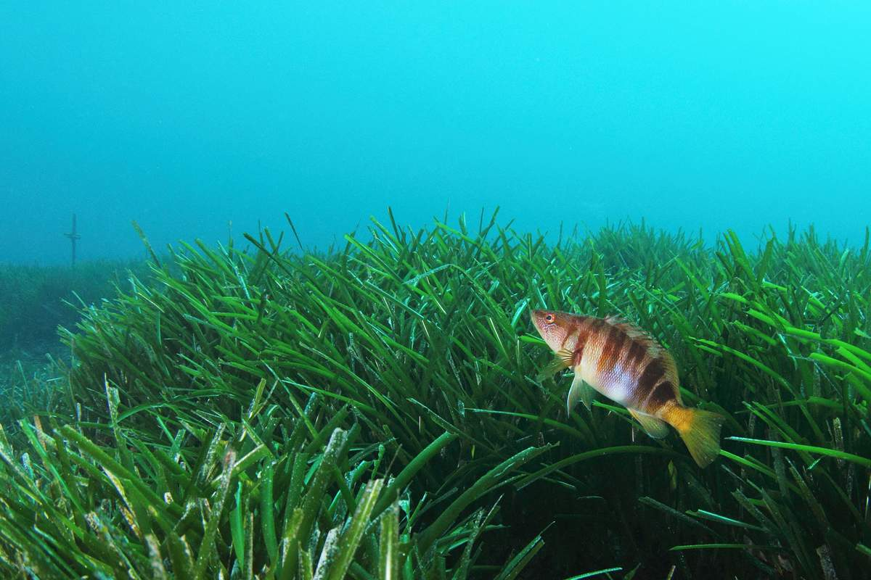

Slide 4
eutrophication,
sediment resuspension,
installation of marine structures …
Leoni et al., 2008

Slide 5
WARNINGS
=
Early biomarkers of stress
Leoni et al., 2008

Slide 6
? ? ?
" effects of small reductions of light have been relatively little studied "
" most of the studies are performed over short periods, and only show responses to short-term disturbances "
Leoni et al., 2008

Slide 7
? ? ?
" effects of small reductions of light have been relatively little studied "
" most of the studies are performed over short periods, and only show responses to short-term disturbances "
The aim of our study was to follow P. oceanica
physiological responses: photosynthesis to
low to medium light reduction
over the growing period
Leoni et al., 2008

Slide 8
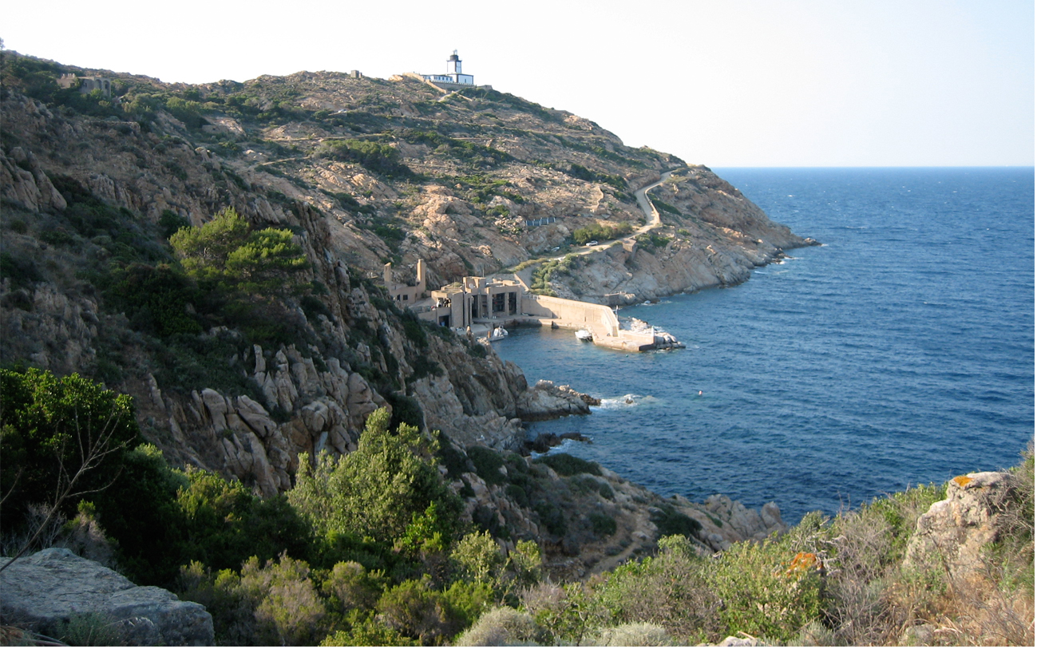

Slide 9
15m depth
April to August
~ 90 dives (> 100H)
30%
15%
60%
control

Slide 10
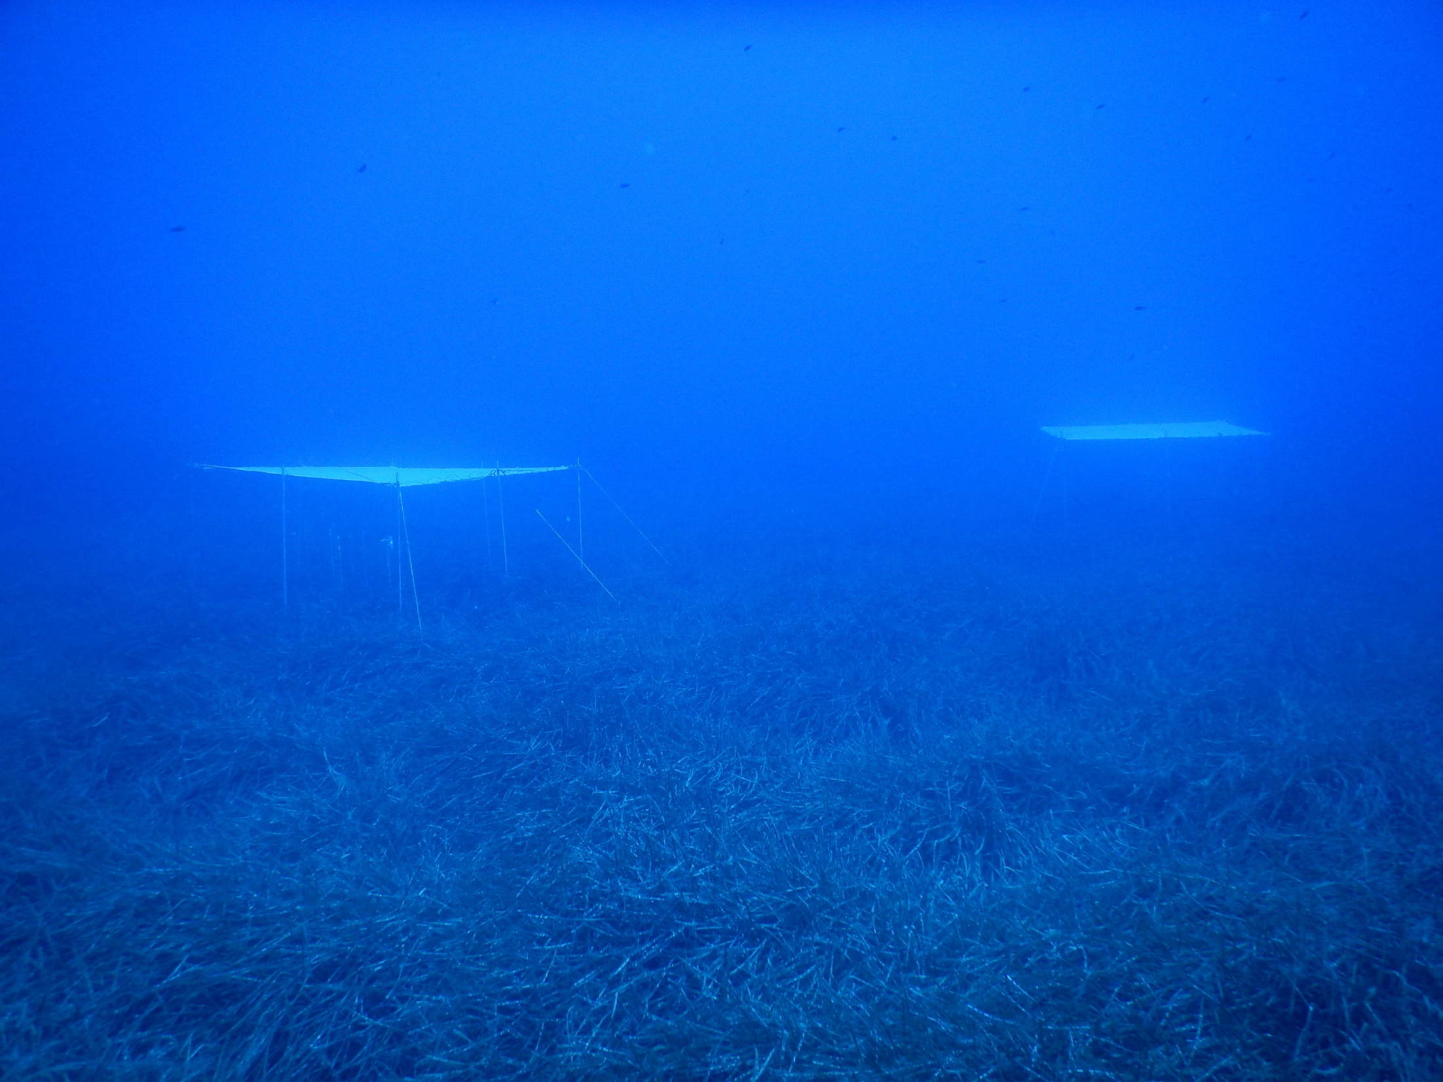

Slide 11
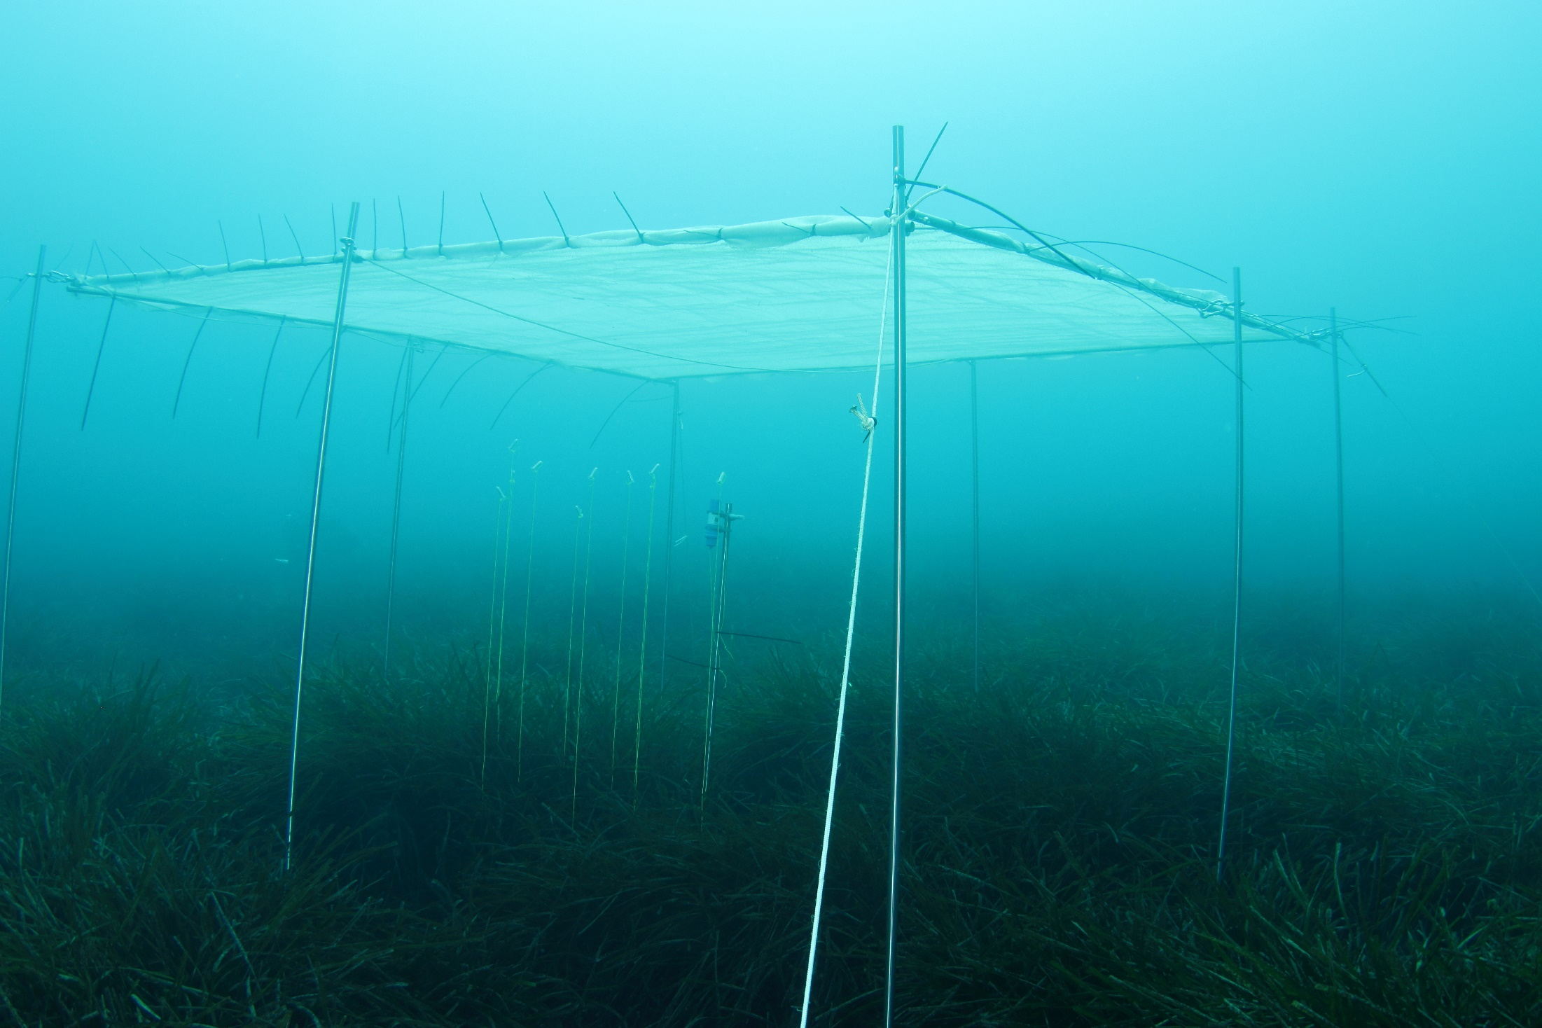
Notes:
The Mediterranean is submitted to numerous anthropogenic threats, among them the chemical contamination of its densely anthropized coasts. The red circles on this map hilights pollution hot spots along Mediterranean coasts.

Slide 12
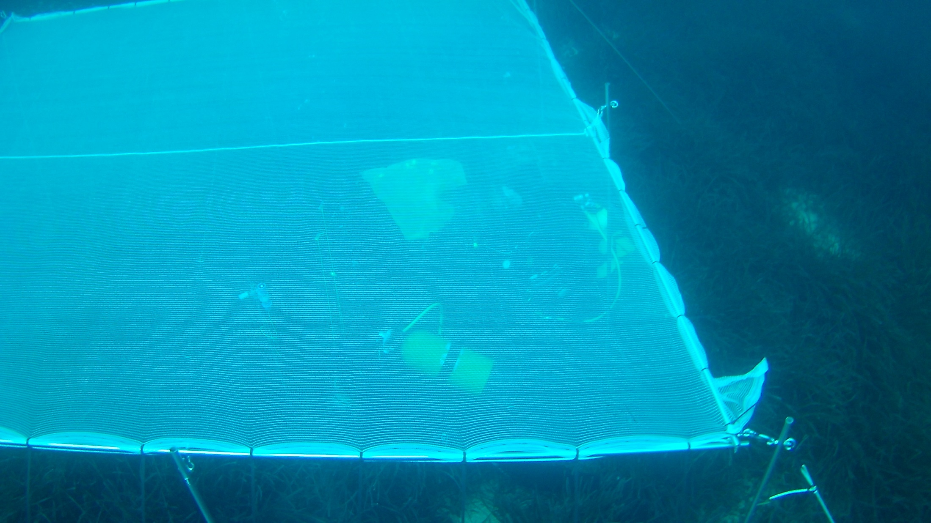

Slide 13
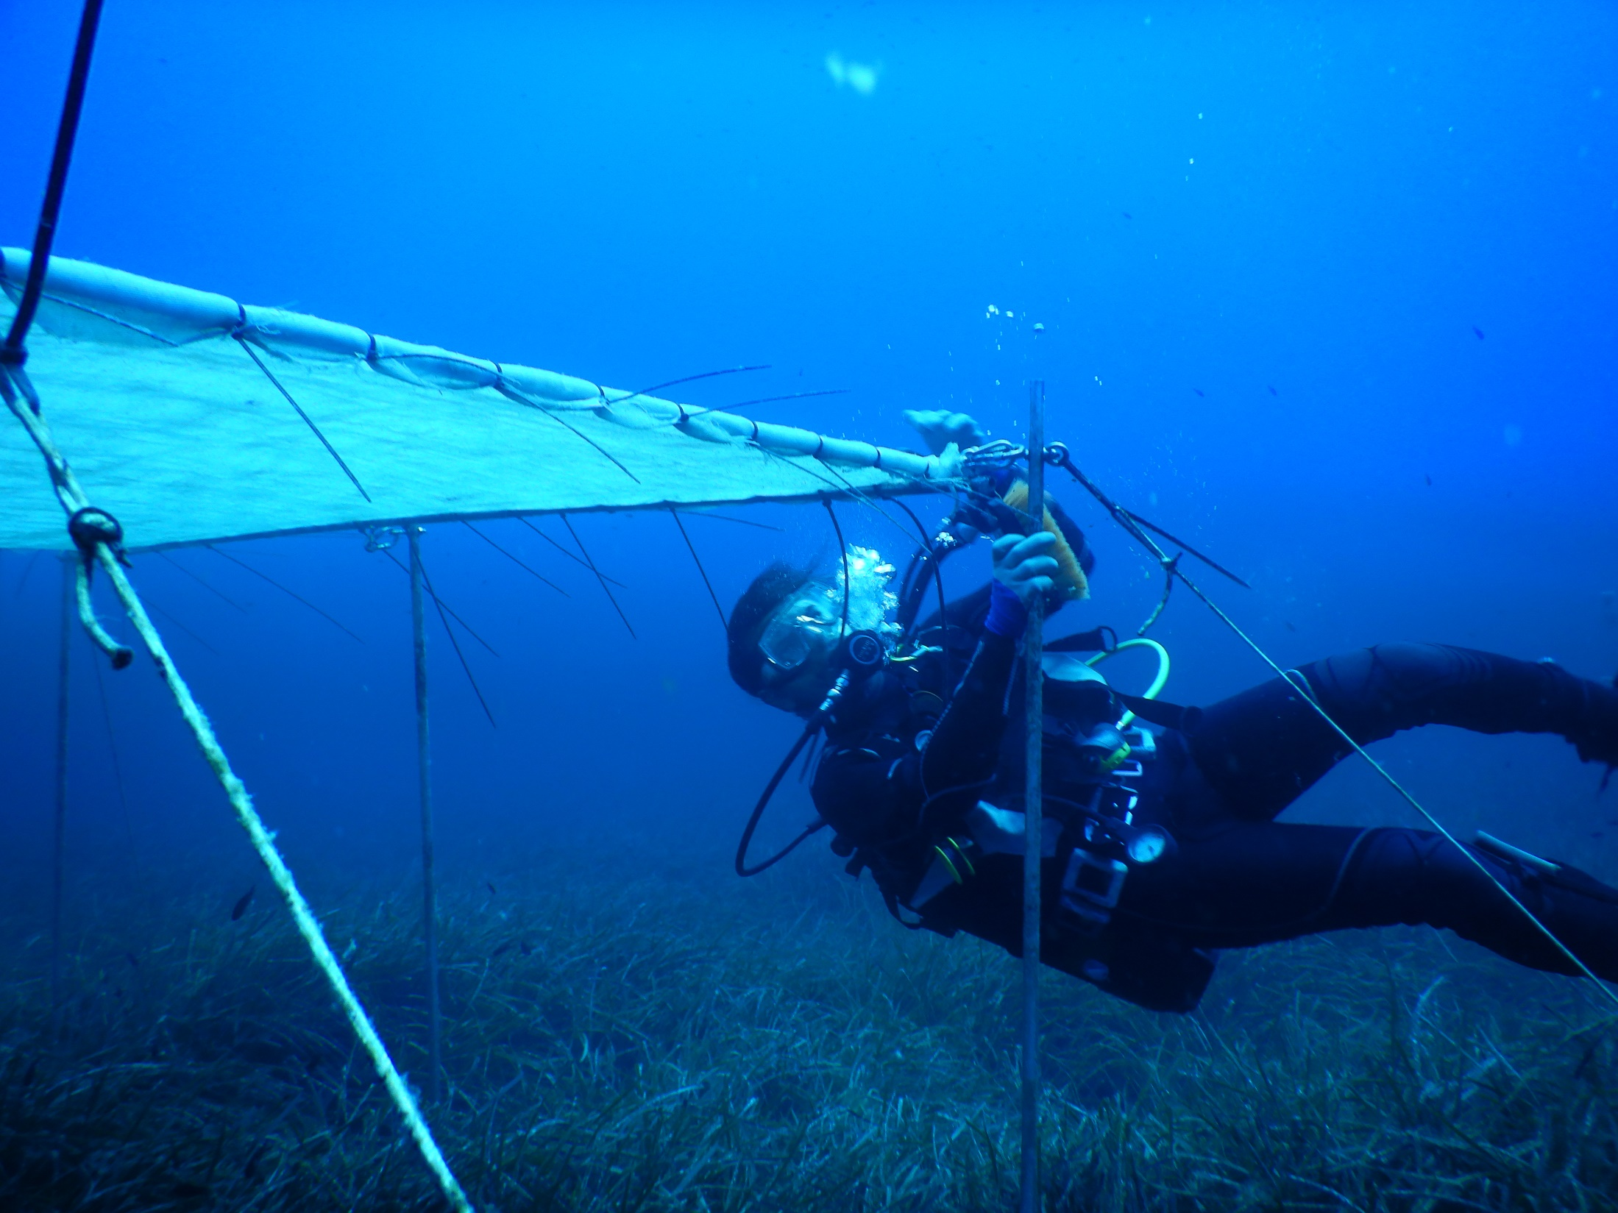

Slide 14
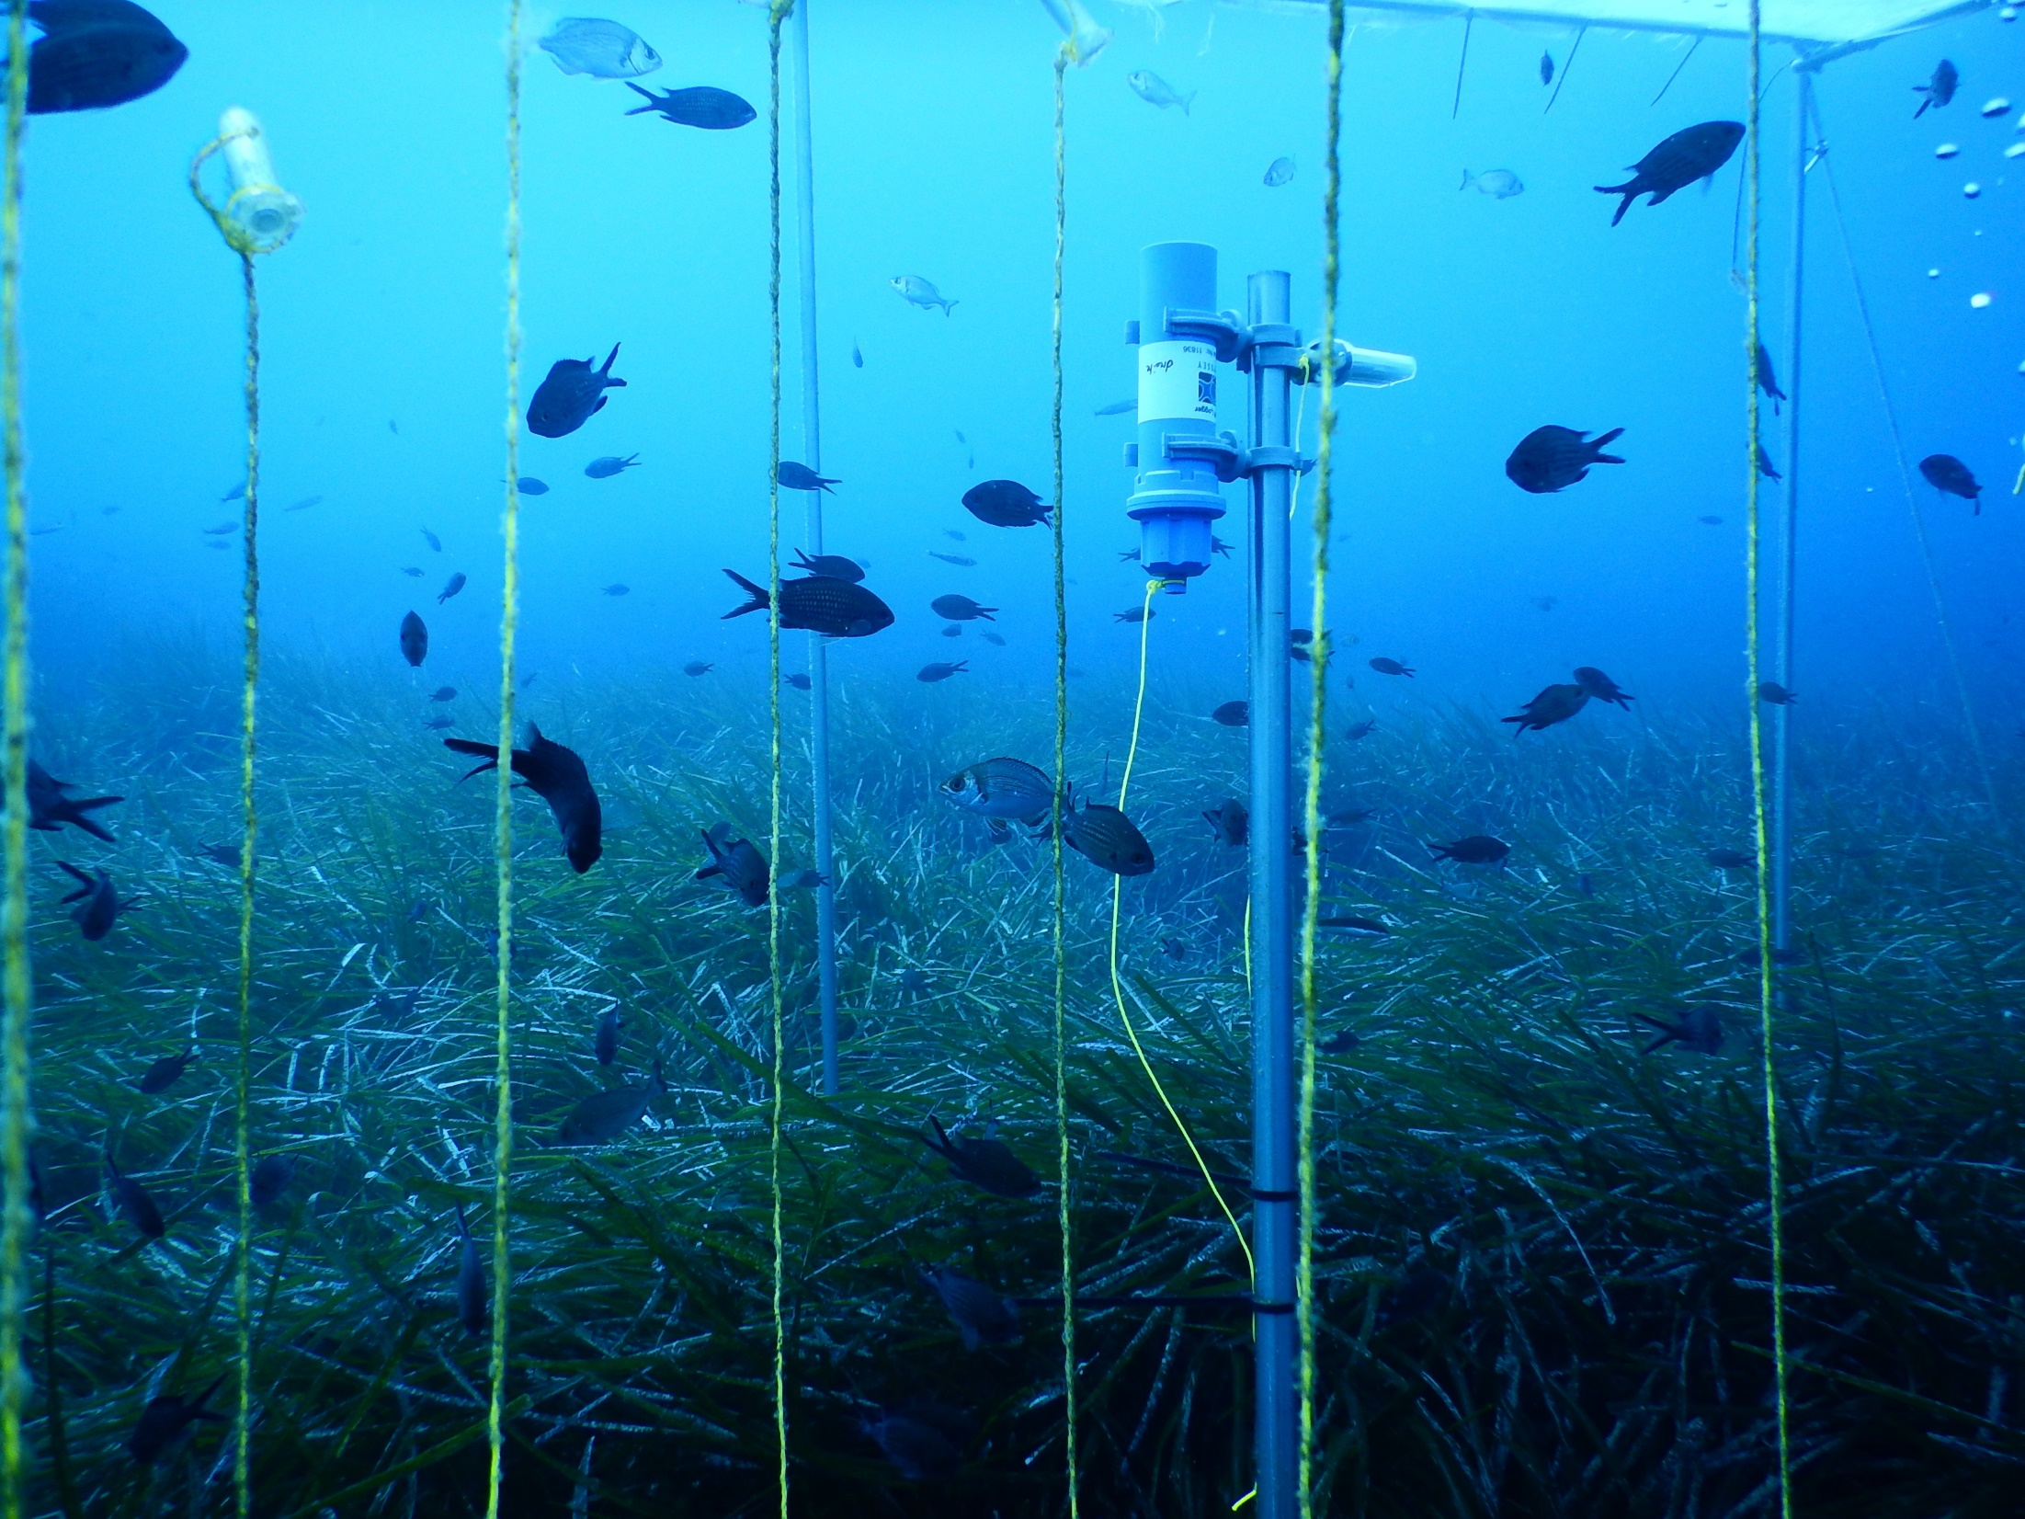

Slide 15
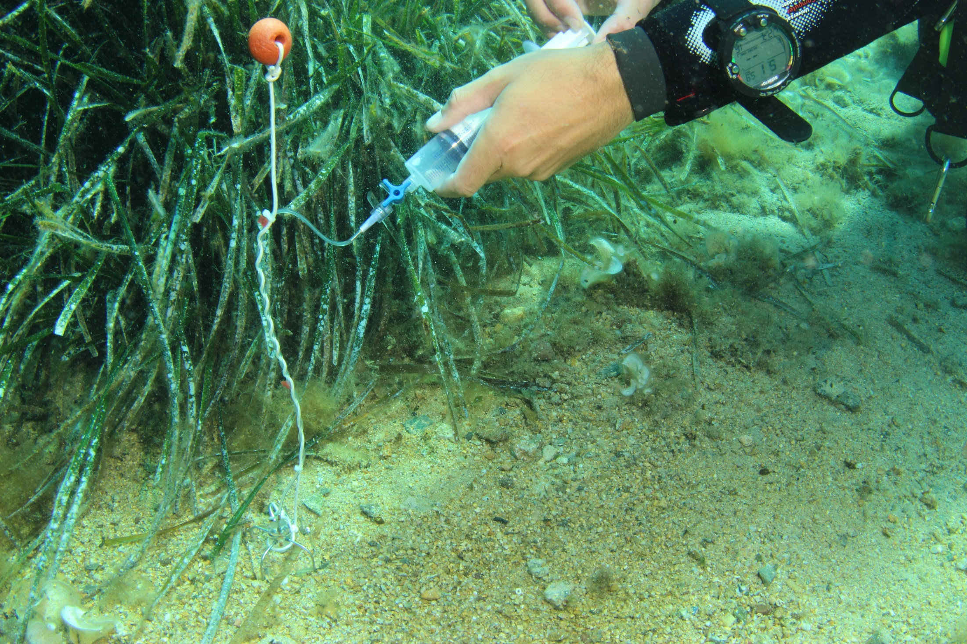

Slide 16
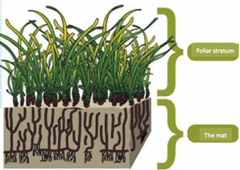
SHADING
O₂
O₂
H₂S, CH₄,
N₂O
H₂S, CH_{4,}
N₂O

Slide 17
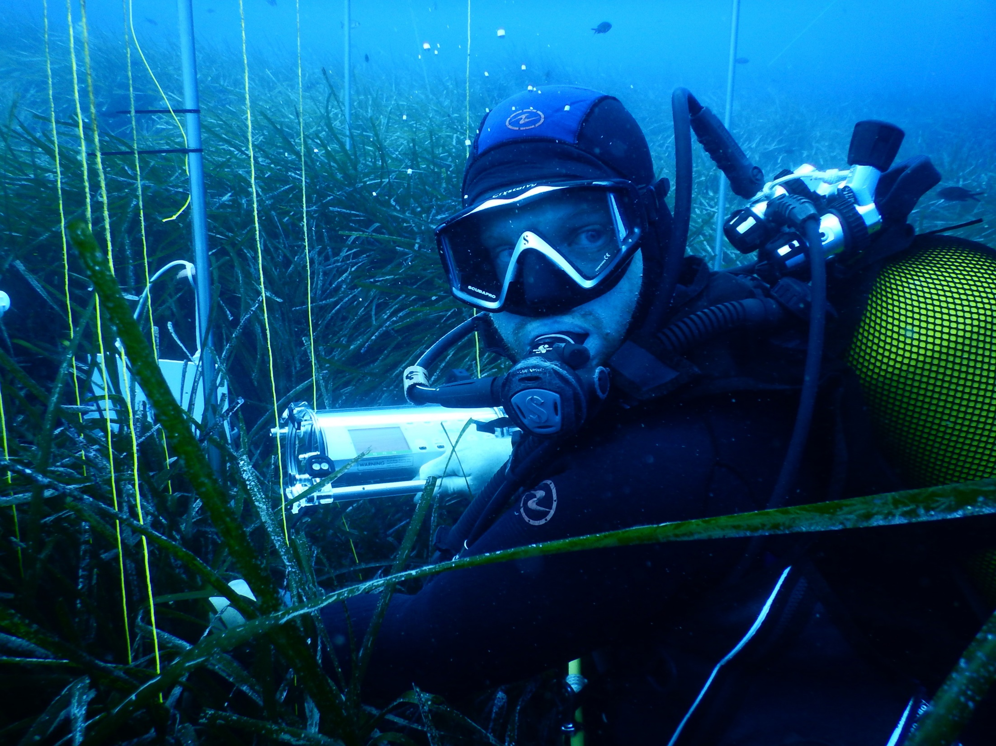

Slide 18
Diving-PAM fluorometer records
effective photochemical efficiency (in situ) = light adapted Yield
Rapid Light Curve (RLC, in situ) = photosynthetic plasticity
maximum photochemical efficiency (in situ) = dark adapted Yield
Photosynthesis-Irradiance curve (PI-curve, in the lab.) = efficiency and capacity of plant photosynthesis
Notes:
The Mediterranean is submitted to numerous anthropogenic threats, among them the chemical contamination of its densely anthropized coasts. The red circles on this map hilights pollution hot spots along Mediterranean coasts.

Slide 19
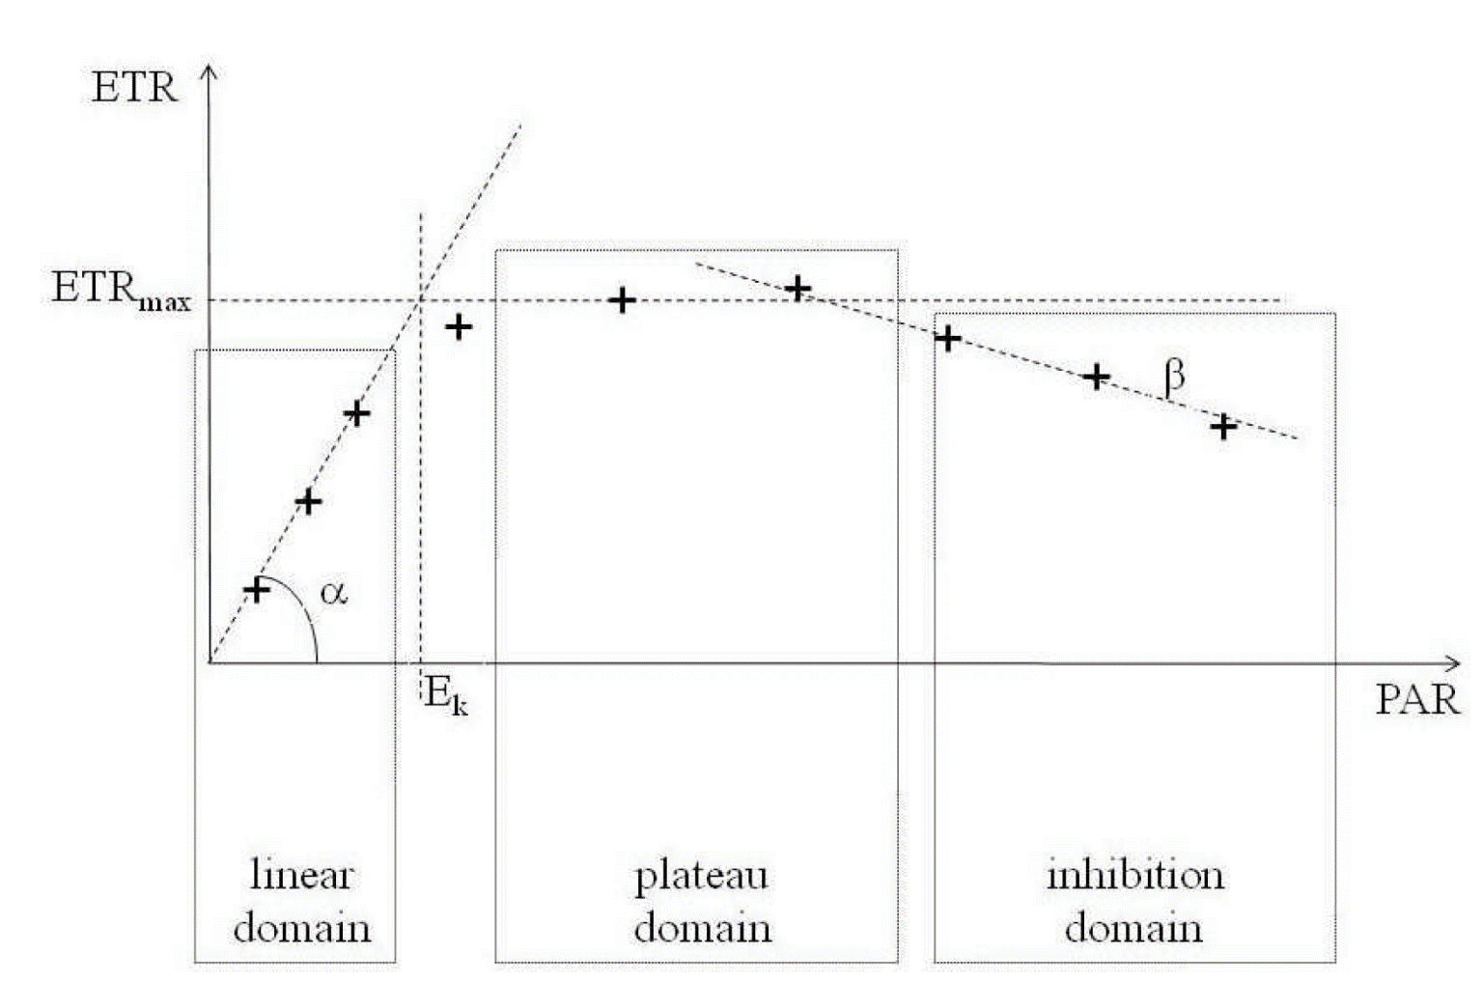
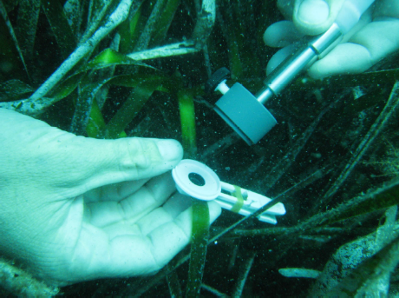
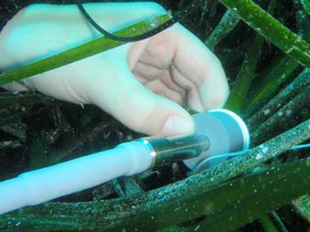
PI-curve & RLC
P_{max}
ETRm
Ik
maximum photosynthesis: P_{max}, ETRm
initial slope of photosynthesis: α
onset of light saturation: Ik
Notes:
The Mediterranean is submitted to numerous anthropogenic threats, among them the chemical contamination of its densely anthropized coasts. The red circles on this map hilights pollution hot spots along Mediterranean coasts.

Slide 20
PI-curve & RLC
RLC «rapid» 10 sec. intervals
P_{max}
ETRm
PI-curve «steady-state»
3 min. intervals
Ik
maximum photosynthesis: P_{max}, ETRm
initial slope of photosynthesis: α
onset of light saturation: Ik
Notes:
The Mediterranean is submitted to numerous anthropogenic threats, among them the chemical contamination of its densely anthropized coasts. The red circles on this map hilights pollution hot spots along Mediterranean coasts.

Slide 21
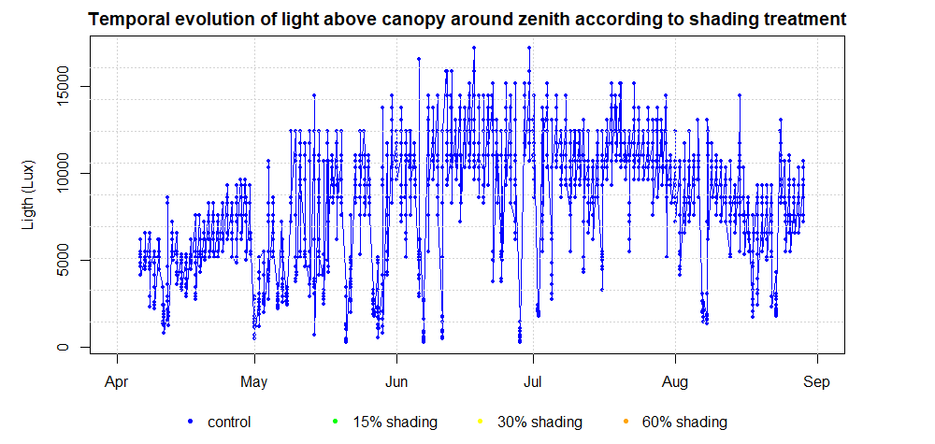
Light
Notes:
The Mediterranean is submitted to numerous anthropogenic threats, among them the chemical contamination of its densely anthropized coasts. The red circles on this map hilights pollution hot spots along Mediterranean coasts.

Slide 22
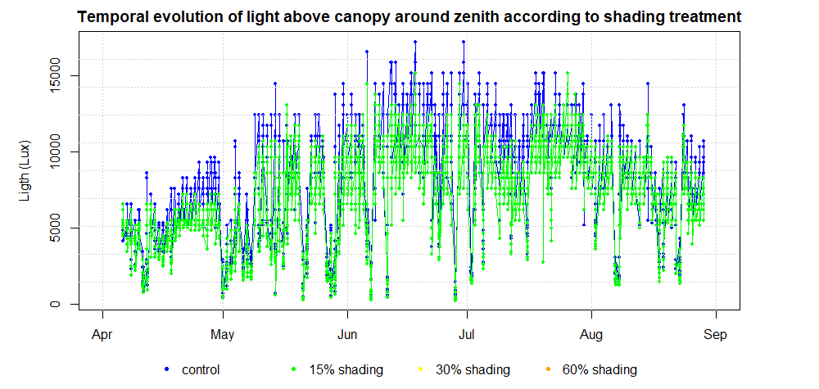
Light
Notes:
The Mediterranean is submitted to numerous anthropogenic threats, among them the chemical contamination of its densely anthropized coasts. The red circles on this map hilights pollution hot spots along Mediterranean coasts.

Slide 23
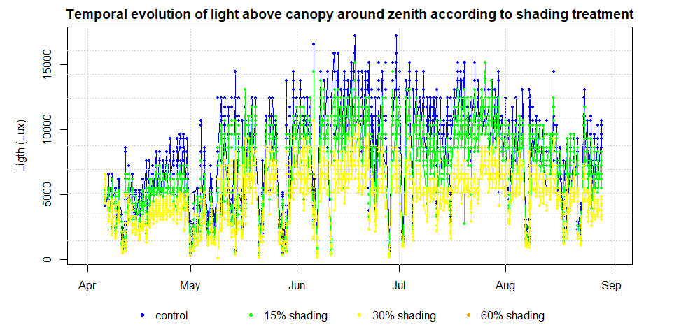
Light
Notes:
The Mediterranean is submitted to numerous anthropogenic threats, among them the chemical contamination of its densely anthropized coasts. The red circles on this map hilights pollution hot spots along Mediterranean coasts.

Slide 24
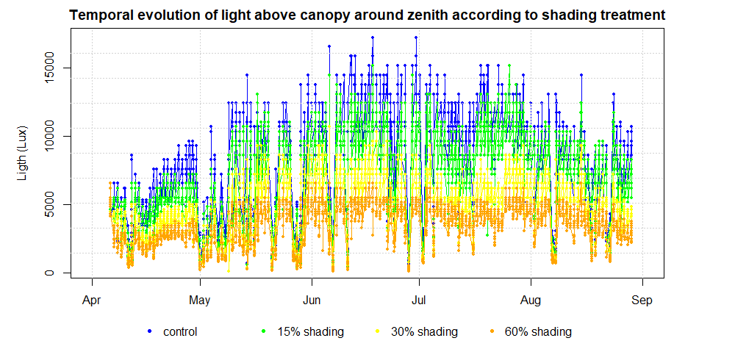
Light
Notes:
The Mediterranean is submitted to numerous anthropogenic threats, among them the chemical contamination of its densely anthropized coasts. The red circles on this map hilights pollution hot spots along Mediterranean coasts.

Slide 25
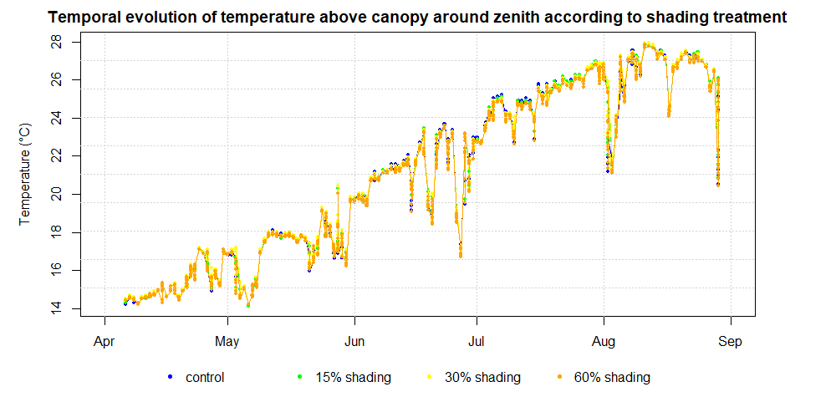
Temperature
Notes:
The Mediterranean is submitted to numerous anthropogenic threats, among them the chemical contamination of its densely anthropized coasts. The red circles on this map hilights pollution hot spots along Mediterranean coasts.

Slide 26
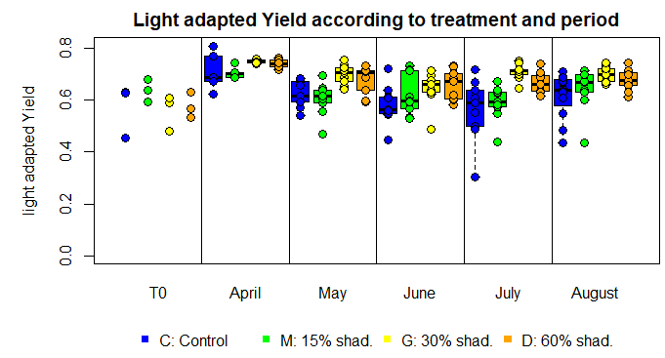
Effective photochemical efficiency
Notes:
The Mediterranean is submitted to numerous anthropogenic threats, among them the chemical contamination of its densely anthropized coasts. The red circles on this map hilights pollution hot spots along Mediterranean coasts.

Slide 27
Effective photochemical efficiency
Notes:
The Mediterranean is submitted to numerous anthropogenic threats, among them the chemical contamination of its densely anthropized coasts. The red circles on this map hilights pollution hot spots along Mediterranean coasts.

Slide 28
Which means …
The efficiency of photon utilization decreases from spring to summer according to shading treatment (so light availability)
Notes:
The Mediterranean is submitted to numerous anthropogenic threats, among them the chemical contamination of its densely anthropized coasts. The red circles on this map hilights pollution hot spots along Mediterranean coasts.

Slide 29
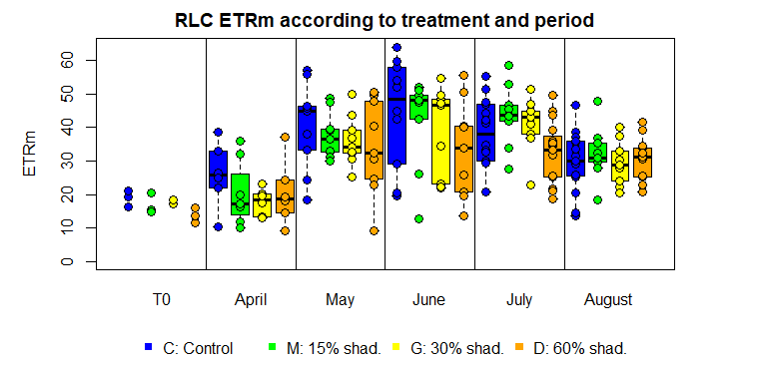
Rapid Light Curves: max. electron transfert rate
Notes:
The Mediterranean is submitted to numerous anthropogenic threats, among them the chemical contamination of its densely anthropized coasts. The red circles on this map hilights pollution hot spots along Mediterranean coasts.

Slide 30
Rapid Light Curves: max. electron transfert rate
Notes:
The Mediterranean is submitted to numerous anthropogenic threats, among them the chemical contamination of its densely anthropized coasts. The red circles on this map hilights pollution hot spots along Mediterranean coasts.

Slide 31
Rapid Light Curves: max. electron transfert rate
Notes:
The Mediterranean is submitted to numerous anthropogenic threats, among them the chemical contamination of its densely anthropized coasts. The red circles on this map hilights pollution hot spots along Mediterranean coasts.

Slide 32
Rapid Light Curves: max. electron transfert rate
Notes:
The Mediterranean is submitted to numerous anthropogenic threats, among them the chemical contamination of its densely anthropized coasts. The red circles on this map hilights pollution hot spots along Mediterranean coasts.

Slide 33
Which means …
photon utilization decrease when light decrease
ETRm seasonal cycle is reduced and shifted when light availability decreases
Notes:
The Mediterranean is submitted to numerous anthropogenic threats, among them the chemical contamination of its densely anthropized coasts. The red circles on this map hilights pollution hot spots along Mediterranean coasts.

Slide 34
Rapid Light Curve
maximum photosynthesis: ETRm
initial slope of photosynthesis: α
onset of light saturation: Ik
Ik
Notes:
The Mediterranean is submitted to numerous anthropogenic threats, among them the chemical contamination of its densely anthropized coasts. The red circles on this map hilights pollution hot spots along Mediterranean coasts.

Slide 35
Rapid Light Curve
maximum photosynthesis: ETRm
initial slope of photosynthesis: α
onset of light saturation: Ik
ETR_{max}
α
Ik
Ik
Notes:
The Mediterranean is submitted to numerous anthropogenic threats, among them the chemical contamination of its densely anthropized coasts. The red circles on this map hilights pollution hot spots along Mediterranean coasts.

Slide 36
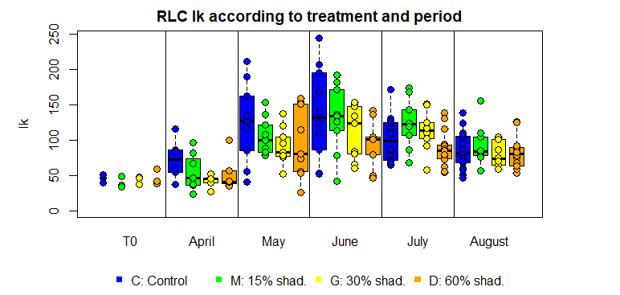
Rapid Light Curves: Ik
Notes:
The Mediterranean is submitted to numerous anthropogenic threats, among them the chemical contamination of its densely anthropized coasts. The red circles on this map hilights pollution hot spots along Mediterranean coasts.

Slide 37
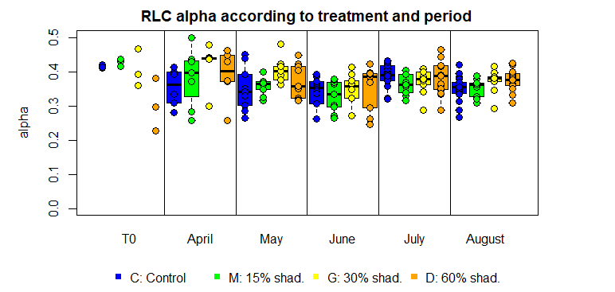
Rapid Light Curves: alpha
Notes:
The Mediterranean is submitted to numerous anthropogenic threats, among them the chemical contamination of its densely anthropized coasts. The red circles on this map hilights pollution hot spots along Mediterranean coasts.

Slide 38
Which means …
photon utilization decrease when light decrease
ETRm decrease and shift when light decrease
Ik and α model parameters respectively decrease and increase when light availability decreases
Notes:
The Mediterranean is submitted to numerous anthropogenic threats, among them the chemical contamination of its densely anthropized coasts. The red circles on this map hilights pollution hot spots along Mediterranean coasts.

Slide 39
Which means …
photon utilization decrease when light decrease
ETRm decrease and shift when light decrease
Ik and α decrease and increase when light availability decreases
      Posidonia oceanica has adapted its photosynthetic activity to light availability: the seagrass shows great photosynthetic plasticity to changing ambient light conditions.
Notes:
The Mediterranean is submitted to numerous anthropogenic threats, among them the chemical contamination of its densely anthropized coasts. The red circles on this map hilights pollution hot spots along Mediterranean coasts.

Slide 40
Which means …
photon utilization decrease when light decrease
ETRm decrease and shift when light decrease
Ik and α decrease and increase when light availability decreases.
      Posidonia oceanica has adapted its photosynthetic activity to light availability: the seagrass shows great photosynthetic plasticity to changing ambient light conditions.
PI-curve parameters: P_{max}, α and Ik did not differ among treatments
Notes:
The Mediterranean is submitted to numerous anthropogenic threats, among them the chemical contamination of its densely anthropized coasts. The red circles on this map hilights pollution hot spots along Mediterranean coasts.

Slide 41
Which means …
photon utilization decrease when light decrease
ETRm decrease and shift when light decrease
Ik and α decrease and increase when light availability decreases.
      Posidonia oceanica has adapted its photosynthetic activity to light availability: the seagrass shows great photosynthetic plasticity to changing ambient light conditions.
PI-curve parameters: P_{max}, α and Ik did not differ among treatments
Plant photosynthetic apparatus little or not affected
Notes:
The Mediterranean is submitted to numerous anthropogenic threats, among them the chemical contamination of its densely anthropized coasts. The red circles on this map hilights pollution hot spots along Mediterranean coasts.

Slide 42
Which means …
photon utilization decrease when light decrease
ETRm decrease and shift when light decrease
Ik and α decrease and increase when light availability decreases.
      Posidonia oceanica has adapted its photosynthetic activity to light availability: the seagrass shows great photosynthetic plasticity to changing ambient light conditions.
PI-curve parameters: P_{max}, α and Ik did not differ among treatments
Plant photosynthetic apparatus little or not affected
Seasonal trends of H₂S, CH₄ & N₂O in sediment pore-water, bur little differences among treatments
Notes:
The Mediterranean is submitted to numerous anthropogenic threats, among them the chemical contamination of its densely anthropized coasts. The red circles on this map hilights pollution hot spots along Mediterranean coasts.

Slide 43
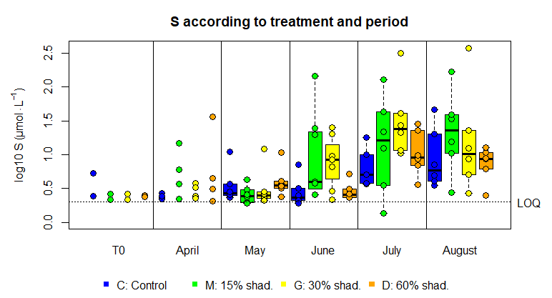
H₂S in porewater
Notes:
The Mediterranean is submitted to numerous anthropogenic threats, among them the chemical contamination of its densely anthropized coasts. The red circles on this map hilights pollution hot spots along Mediterranean coasts.

Slide 44
Which means …
photon utilization decrease when light decrease
ETRm decrease and shift when light decrease
Ik and α decrease and increase when light availability decreases
      Posidonia oceanica has adapted its photosynthetic activity to light availability: the seagrass shows great photosynthetic plasticity to changing ambient light conditions
PI-curve parameters: P_{max}, α and Ik did not differ among treatments
Plant photosynthetic apparatus little or not affected
Pore-water H₂S, CH₄ & N₂O: little differences among treatments
Plant lowered photosynthetic activity did not result in pore- water chemical changes
Notes:
The Mediterranean is submitted to numerous anthropogenic threats, among them the chemical contamination of its densely anthropized coasts. The red circles on this map hilights pollution hot spots along Mediterranean coasts.

Slide 45
And next …
      Posidonia oceanica has adapted its photosynthetic activity to light availability: the seagrass shows great photosynthetic plasticity to changing ambient light conditions
Plant photosynthetic apparatus little or not affected
Plant lowered photosynthetic activity did not result in pore- water chemical changes
Further studies and complementary analyses:
● on seagrass samples - biometry, growth, sugars, C, pigments, DMSP and DMSO
● on canopy and pore-water samples - nutrients
to strengthen these conclusions
Notes:
The Mediterranean is submitted to numerous anthropogenic threats, among them the chemical contamination of its densely anthropized coasts. The red circles on this map hilights pollution hot spots along Mediterranean coasts.

Slide 46


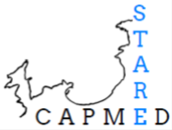
Thank
you for
your attention

Slide 47
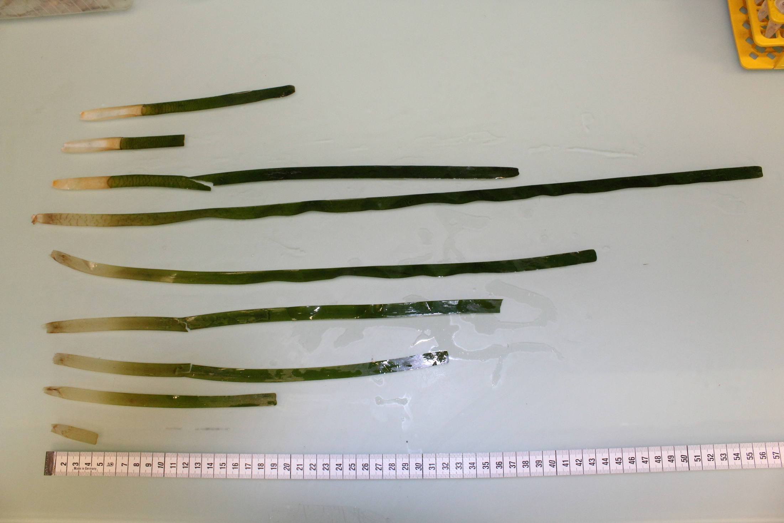

Slide 48
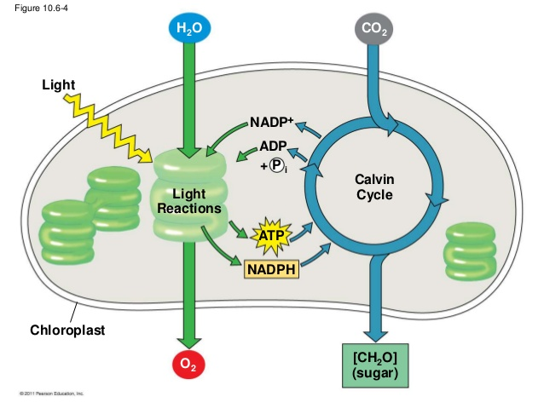
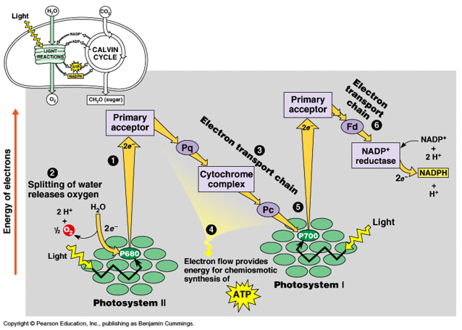
The light reactions
Chemical equation of photosynthesis:
6CO₂ + 6H₂O → C₆H₁₂O₆ + 6O₂
_{Light energy}
Campbell & Race, © Pearson Education Inc.

Slide 49
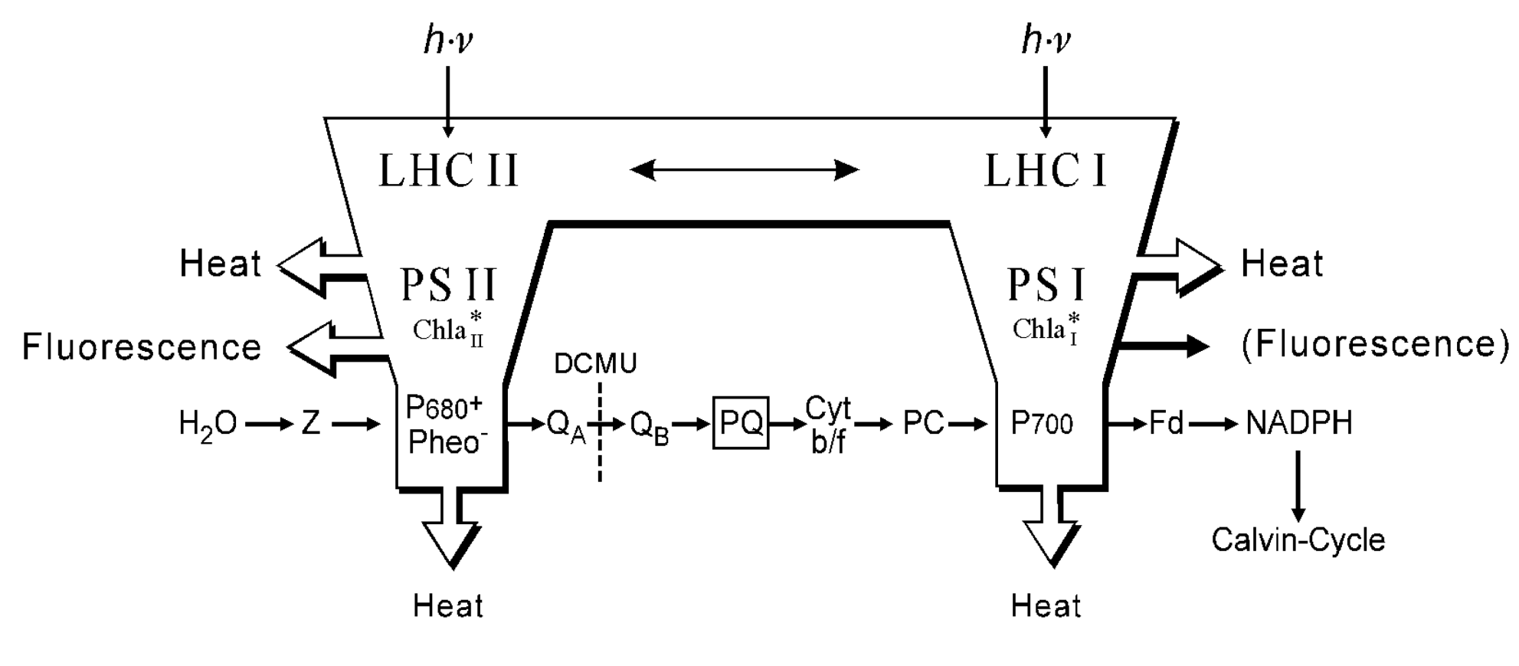
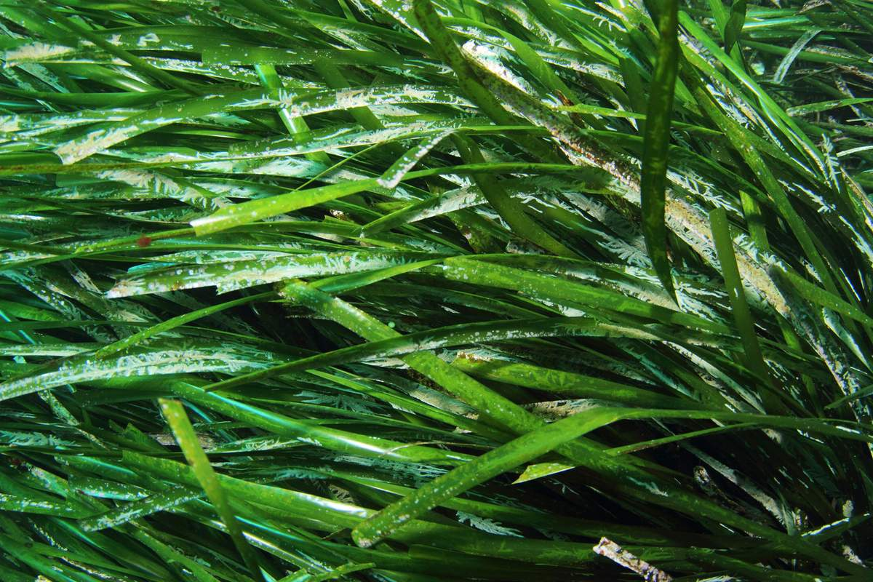
Fluorescence emission
© Walz Inc.
Fluorescence emission is complementary to the alternative pathways of
de-excitation, which are photochemistry and heat dissipation.

Slide 50
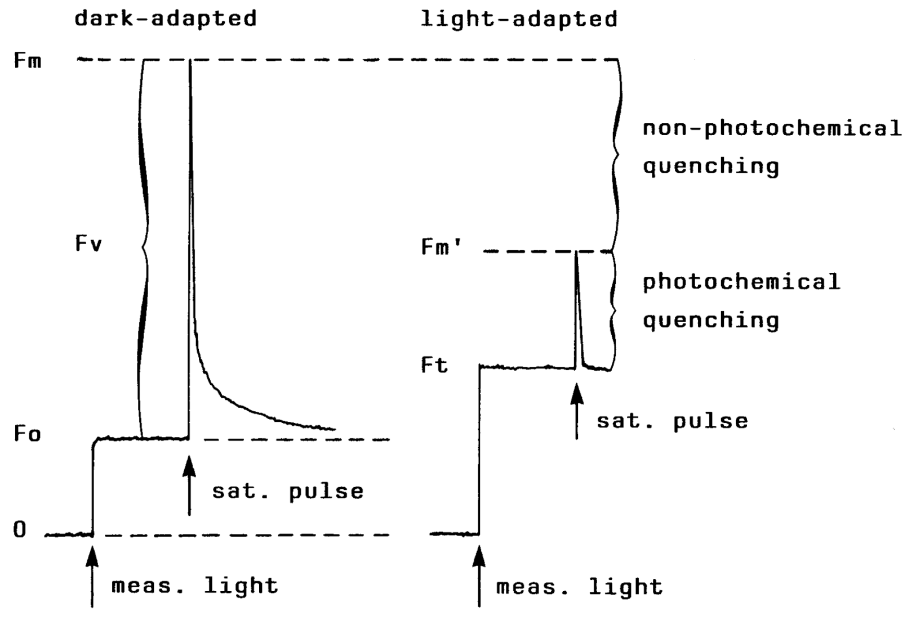
Fluorescence measurement
YIELD = (Fm’-F)/Fm’ = ΔF/Fm’
Fluorescence yield is highest when the yields of photochemistry and heat dissipation are lowest
© Walz Inc.
Notes:
The Mediterranean is submitted to numerous anthropogenic threats, among them the chemical contamination of its densely anthropized coasts. The red circles on this map hilights pollution hot spots along Mediterranean coasts.

Slide 51
ETR - RLC
Relative Electron Transfert Rate : ETR = YIELD x PAR x 0.5 x ETR-factor
Rapid Light Curve : insight into the physiological flexibility with which a sample can adapt its photosynthetic aparatus to rapid changes of ligh intensity.
(Lassauque, 2008)
Notes:
The Mediterranean is submitted to numerous anthropogenic threats, among them the chemical contamination of its densely anthropized coasts. The red circles on this map hilights pollution hot spots along Mediterranean coasts.

Slide 52
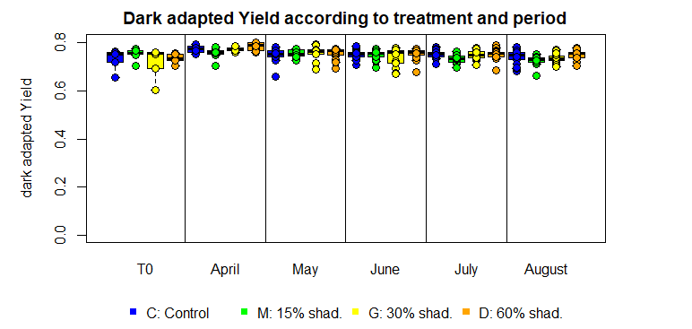
Maximal photochemical efficiency
Notes:
The Mediterranean is submitted to numerous anthropogenic threats, among them the chemical contamination of its densely anthropized coasts. The red circles on this map hilights pollution hot spots along Mediterranean coasts.

Slide 53
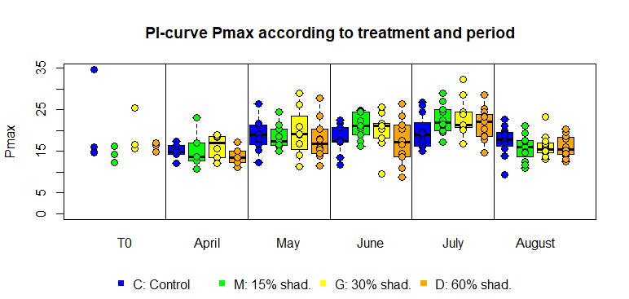
PI-curves: maximal photosynthesis
Notes:
The Mediterranean is submitted to numerous anthropogenic threats, among them the chemical contamination of its densely anthropized coasts. The red circles on this map hilights pollution hot spots along Mediterranean coasts.

Slide 54
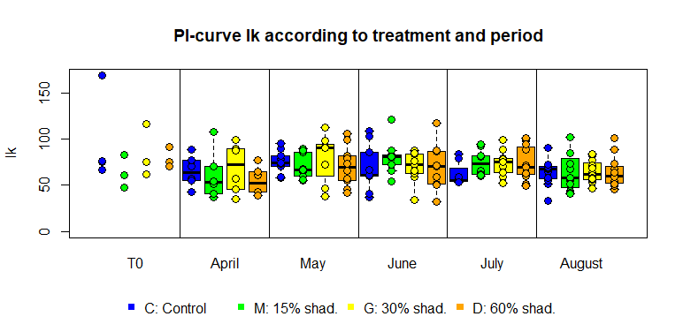
PI-curves: Ik
Notes:
The Mediterranean is submitted to numerous anthropogenic threats, among them the chemical contamination of its densely anthropized coasts. The red circles on this map hilights pollution hot spots along Mediterranean coasts.

Slide 55
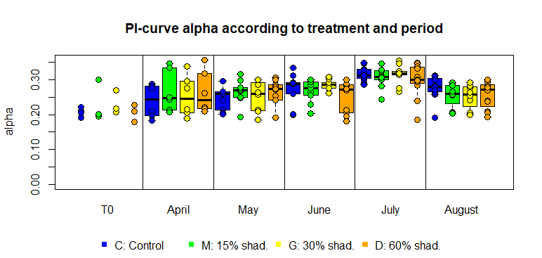
PI-curves: alpha
Notes:
The Mediterranean is submitted to numerous anthropogenic threats, among them the chemical contamination of its densely anthropized coasts. The red circles on this map hilights pollution hot spots along Mediterranean coasts.

Slide 56
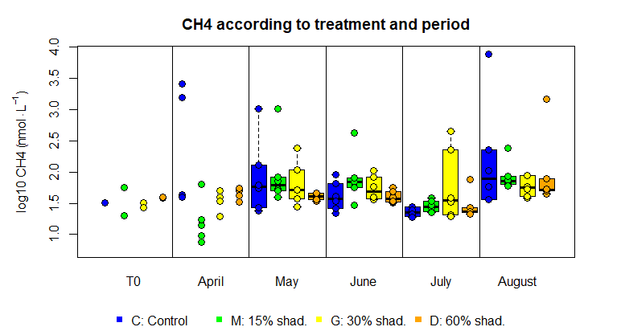
CH₄ in porewater
Notes:
The Mediterranean is submitted to numerous anthropogenic threats, among them the chemical contamination of its densely anthropized coasts. The red circles on this map hilights pollution hot spots along Mediterranean coasts.

Slide 57
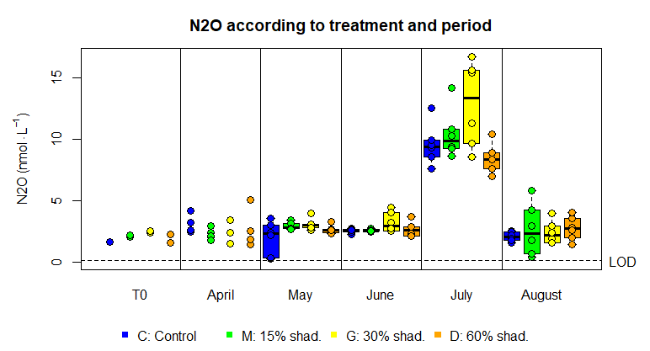
N₂O in porewater
Notes:
The Mediterranean is submitted to numerous anthropogenic threats, among them the chemical contamination of its densely anthropized coasts. The red circles on this map hilights pollution hot spots along Mediterranean coasts.

Slide 58
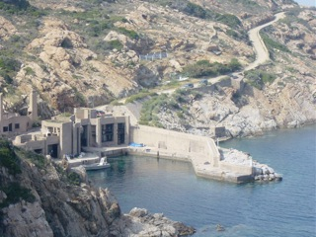
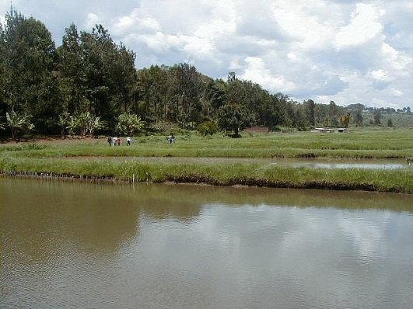
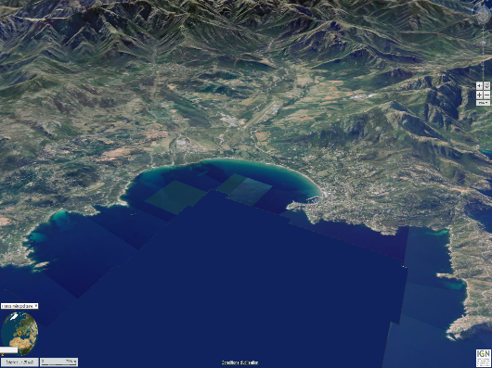
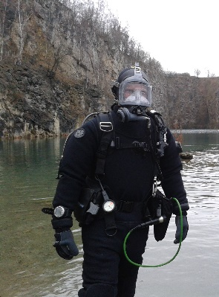
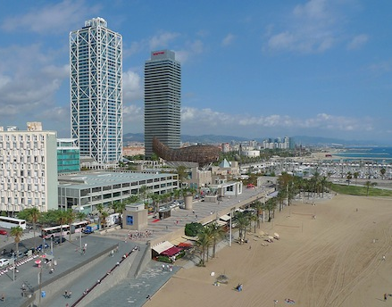
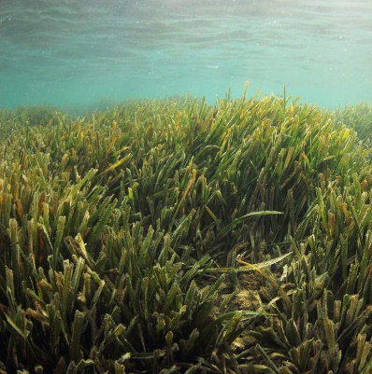
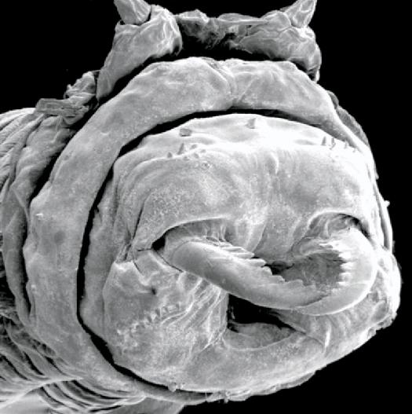



Post-doc Stareso
Licence FUNDP
Master ULg
SPW
2000
2004
2017
2005
2007
2012
2013
2014
2015
Post-doc ULiège
DES FUSAGx
PhD ULg
Post-doc IMS
Post-doc UMONS
DMSP
DMSO

