Slide 1
Etude de la photosynthèse de Posidonia oceanica
par fluorimétrie
modulée
Richir J., Abadie A., Borges A., Champenois W., Lepoint G., Santos R., Silva J.,
Lejeune P. & Gobert S.
26-07-2018,
ULiège

Slide 2
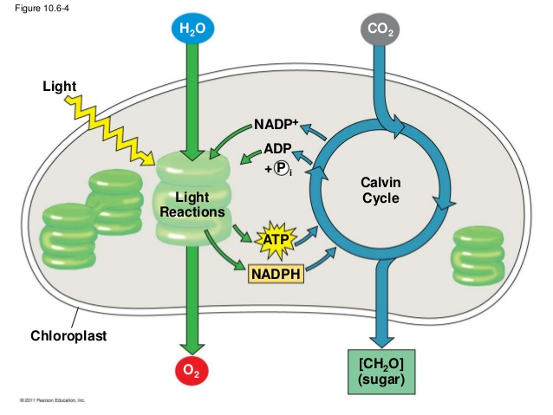
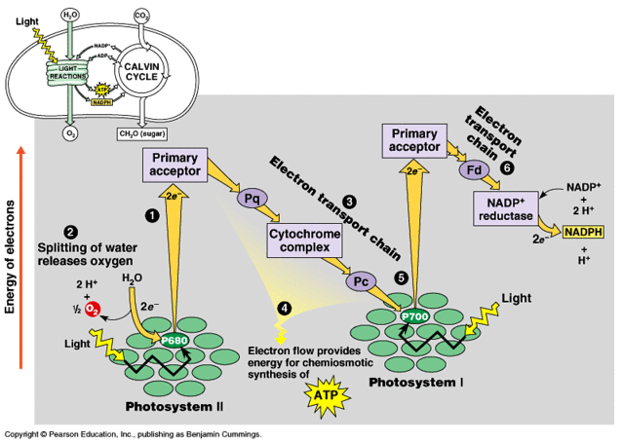
The light reactions
Chemical equation of photosynthesis:
6CO₂ + 6H₂O → C₆H₁₂O₆ + 6O₂
_{Light energy}
Campbell & Race, © Pearson Education Inc.

Slide 3
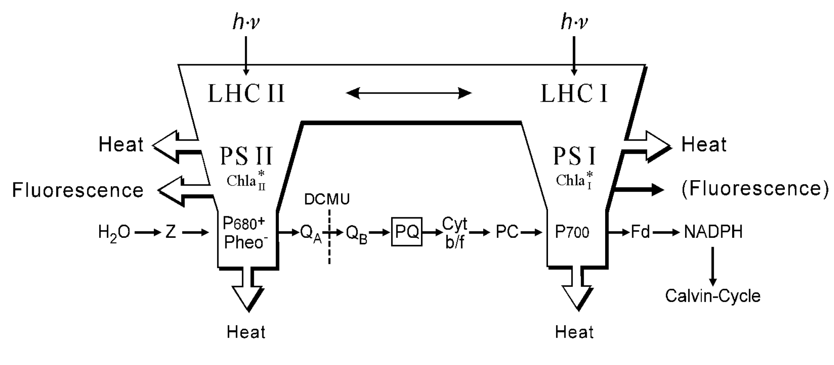
Fluorescence emission
© Walz Inc.
Fluorescence emission is complementary to the alternative pathways of
de-excitation, which are photochemistry and heat dissipation.

Slide 4
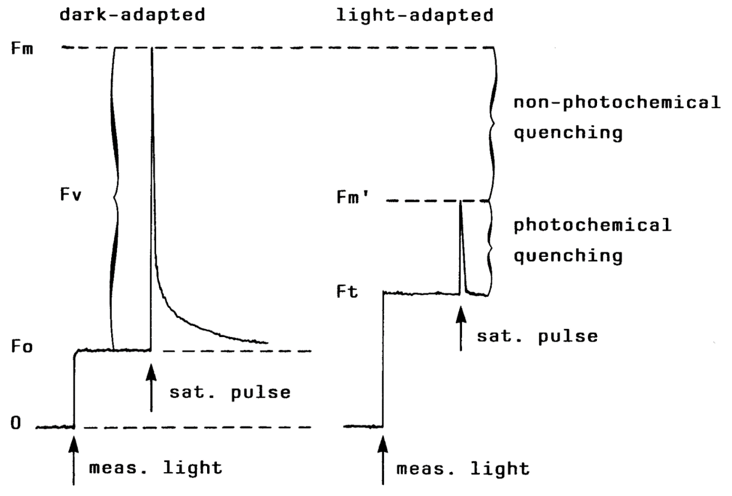
Fluorescence measurement
Dark adapted YIELD = (Fm-F0)/Fm = Fv/Fm
maximum photochemical efficiency
Light adapted YIELD = (Fm’-Fm)/Fm' = ΔF/Fm’
effective photochemical efficiency
© Walz Inc.

Slide 5
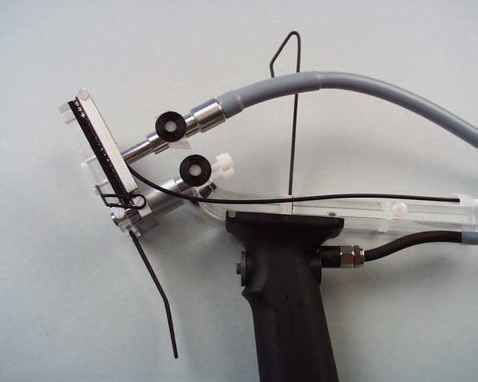
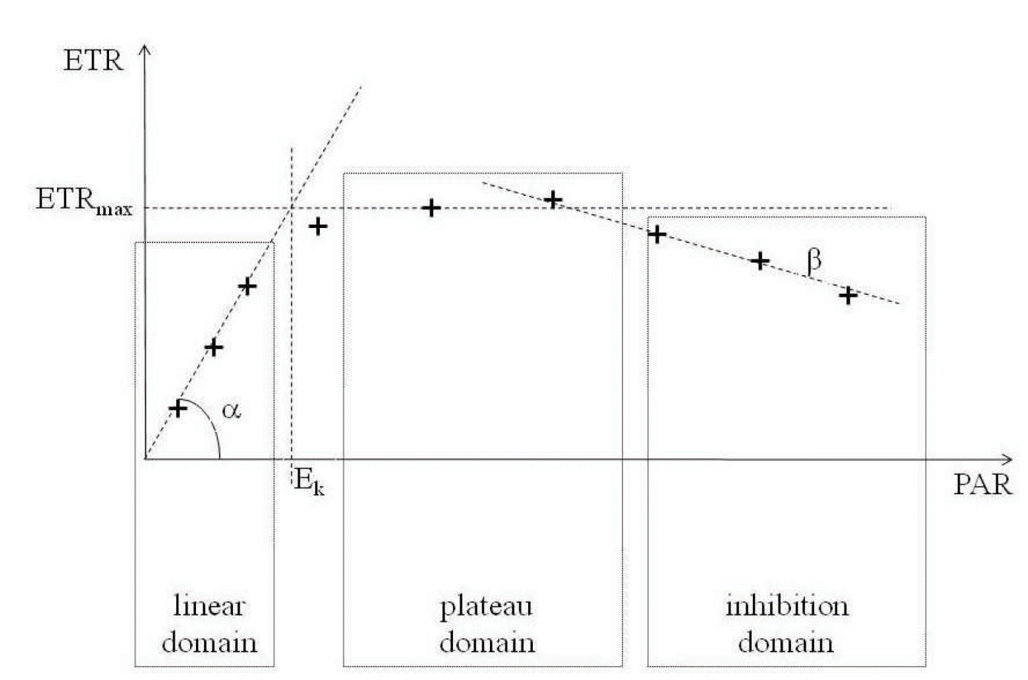
ETR - RLC
Relative Electron Transfert Rate : ETR = YIELD x PAR x 0.5 x ETR-factor
Rapid Light Curve : photosynthetic flexibility with which a sample can adapt its photosynthetic aparatus to rapid changes of ligh intensity
ETR_{max} = maxixmum electron tranport rate
E_{k} = compensation irradiance
(Lassauque, 2008)

Slide 6
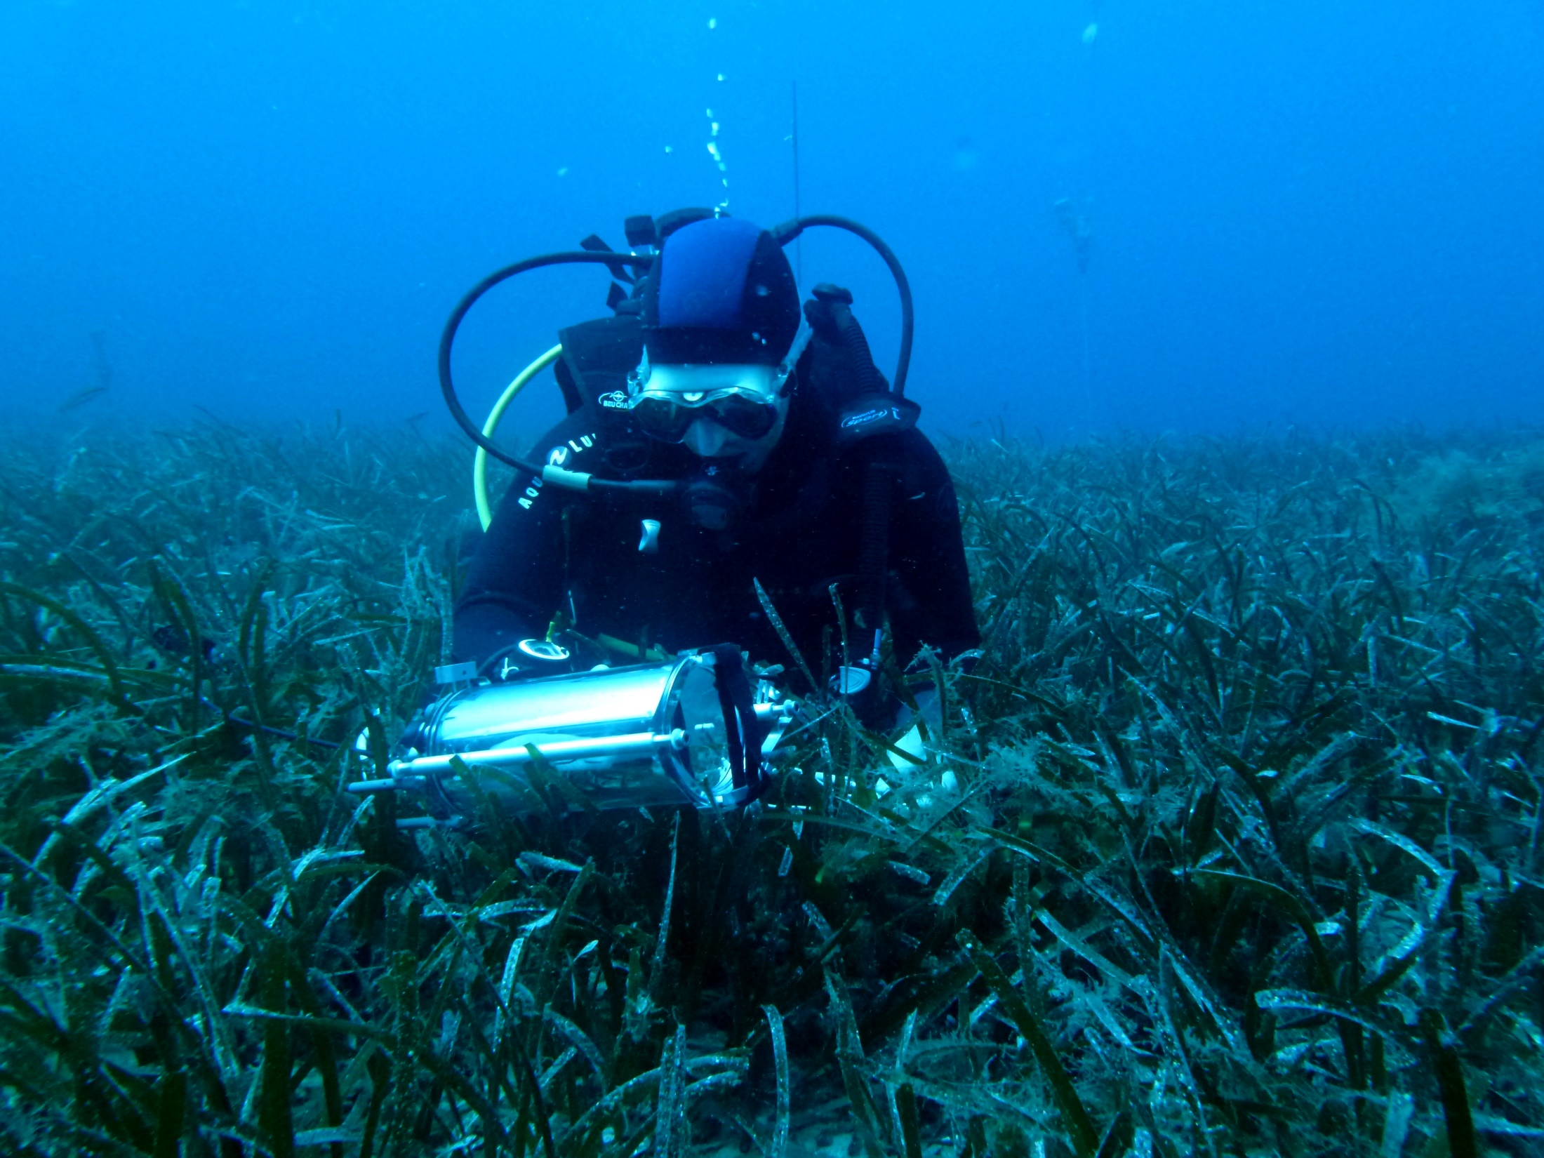
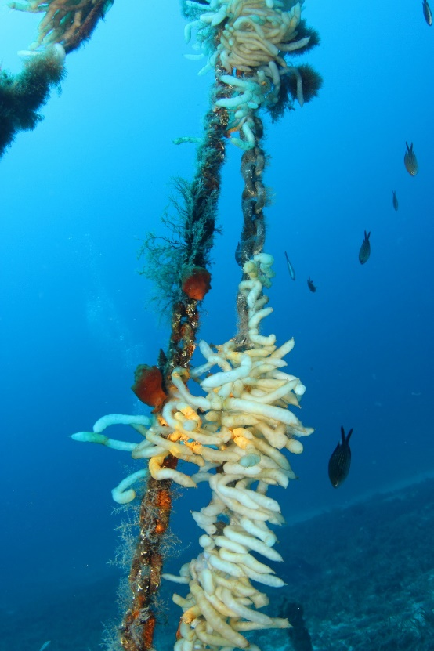
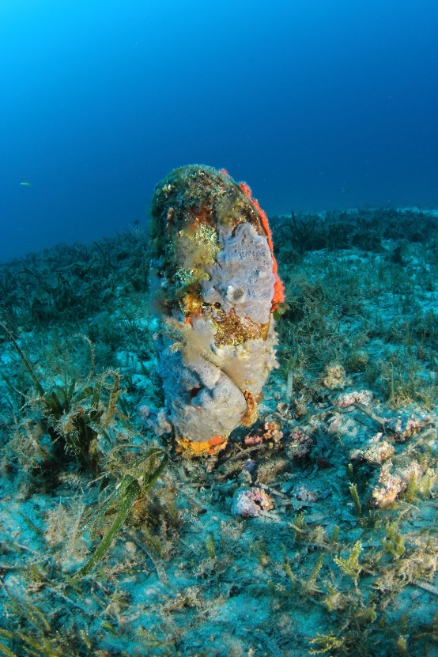
One-year survey (2015-2016)

Slide 7
Rapid Light Curve

Slide 8
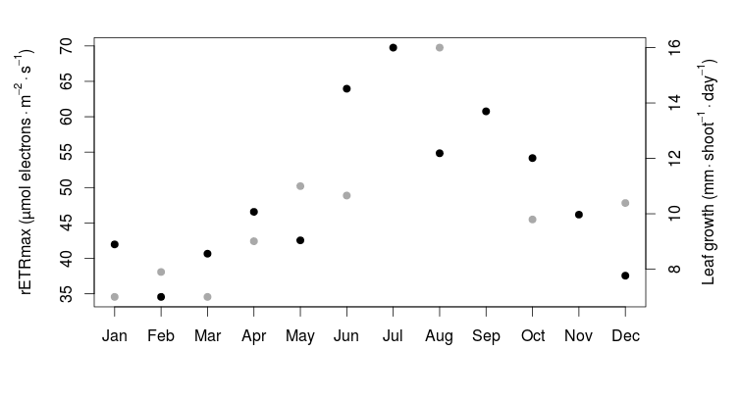
rETRmax = leaf growth proxy ?

Slide 9
