Slide 1
11th SiF conference
3°/11-02/12/2020
STEEL SHEET PILES EXPOSED TO FIRE
EXPERIMENTAL TESTS AND NUMERICAL MODELLING
Jean-Marc Franssen, João Martins
Liege University - ArcelorMittal

Slide 2
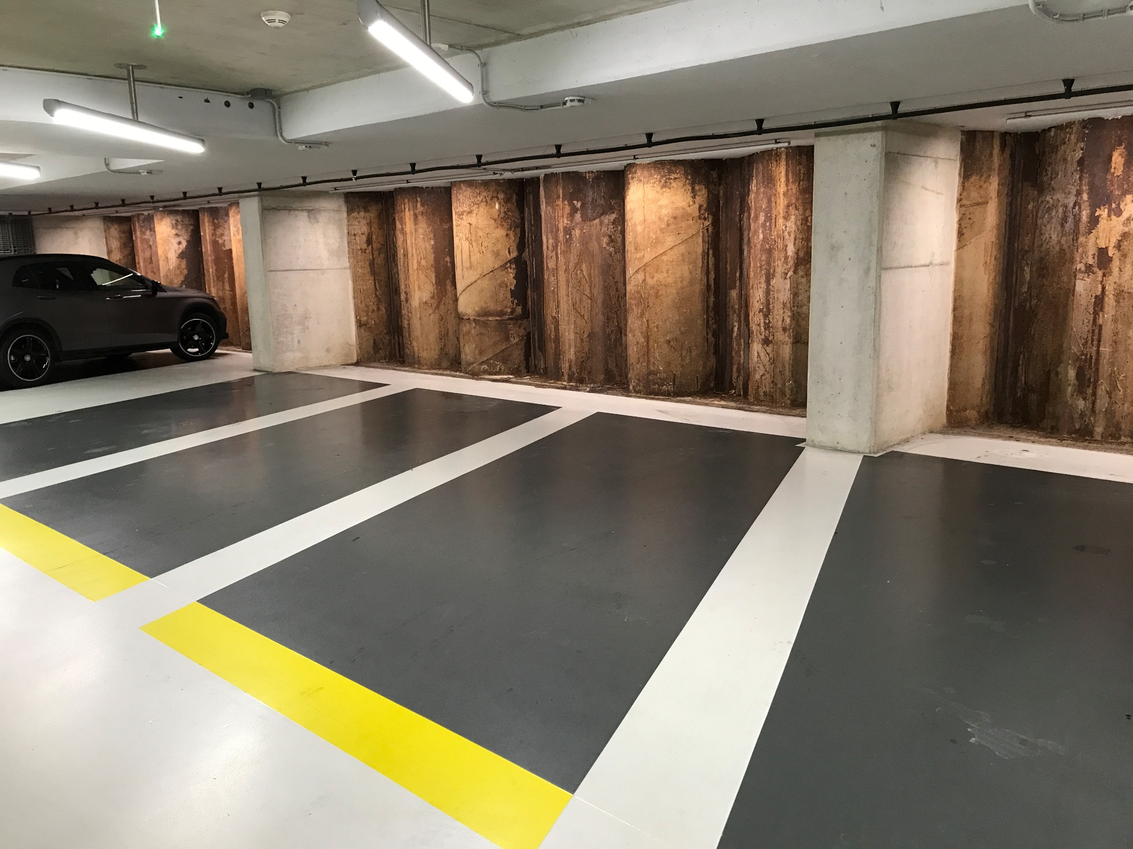
Underground car park with concrete piles

Slide 3
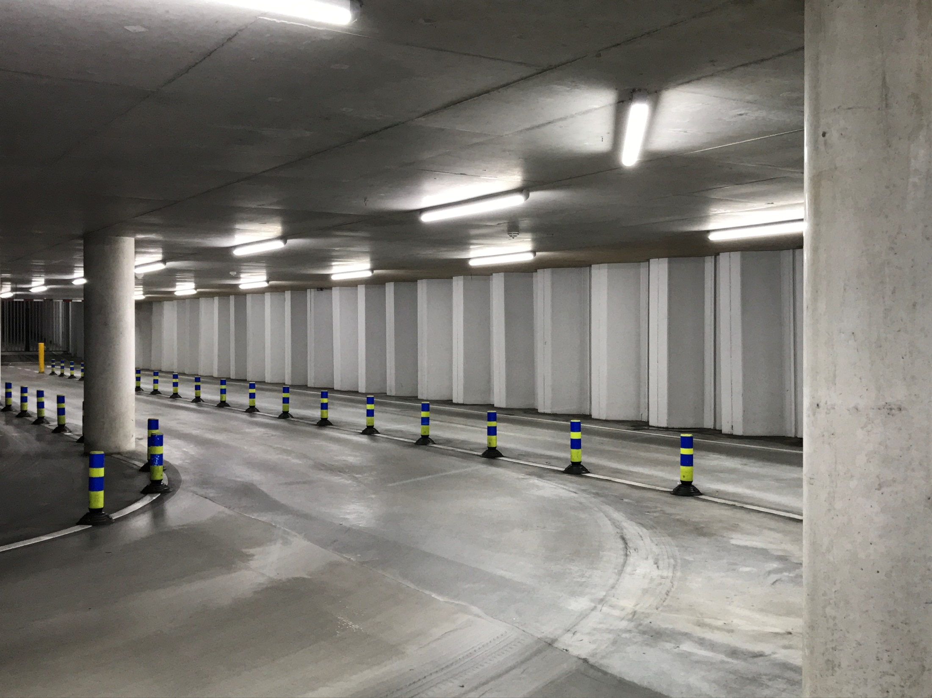
Underground car park with steel sheet piles

Slide 4
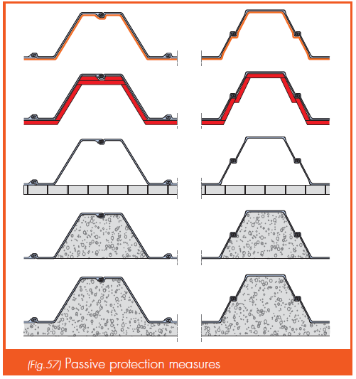
STEEL sheet pile ⬄ Fire !!!
Can we protect ?
Yes
Anyway, we have to prove the fire resistance

Slide 5
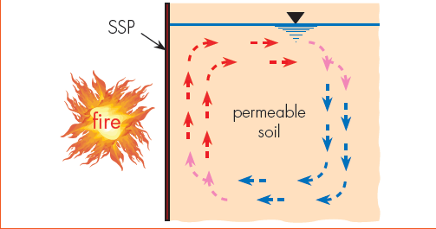
1) Thermal calculation of the temperatures in the steel sheet piles.
Thermal properties of steel: OK
Thermal properties of concrete or thermal insulation: OK
Physical phenomena in the ground : complicated (water movements)
=> Simple approach is required: conduction with « evaporation » of moisture taken into account (movements not modelled explicitly)
Equivalent thermal properties of soils ? => Tests.

Slide 6
Furnace

Slide 7
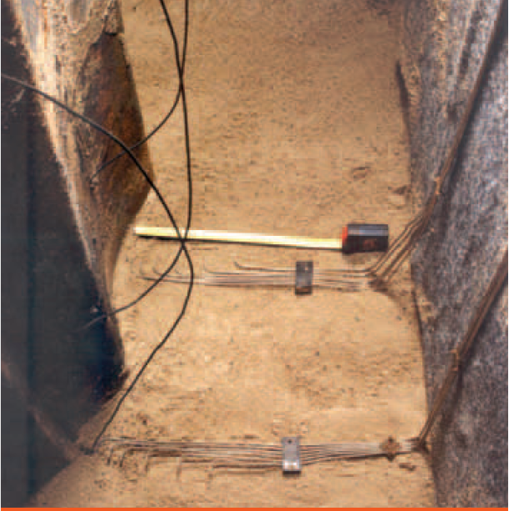
Installation of a thermocouple tree

Slide 8
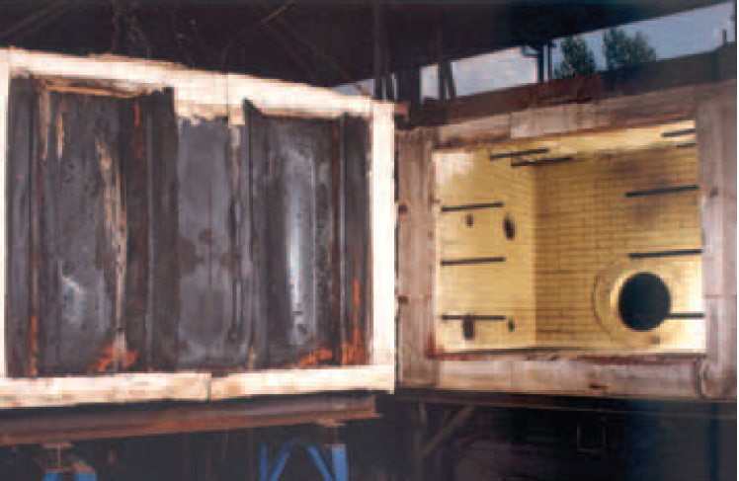
4 tests made:
Sand: saturated with water
not saturated
Clay: saturated with water
not saturated
Sheet piles – furnace
after one test

Slide 9
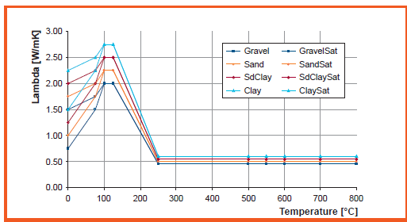
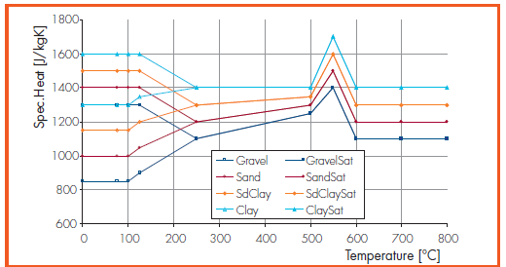
Thermal conductivity
Specific heat

Slide 10
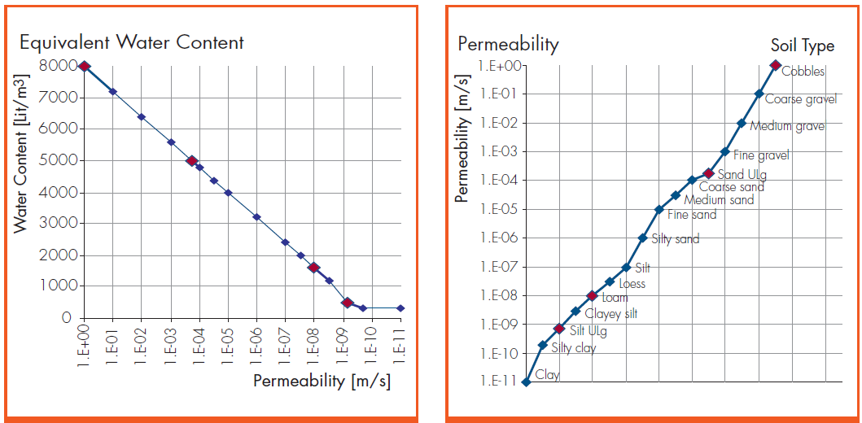

Slide 11
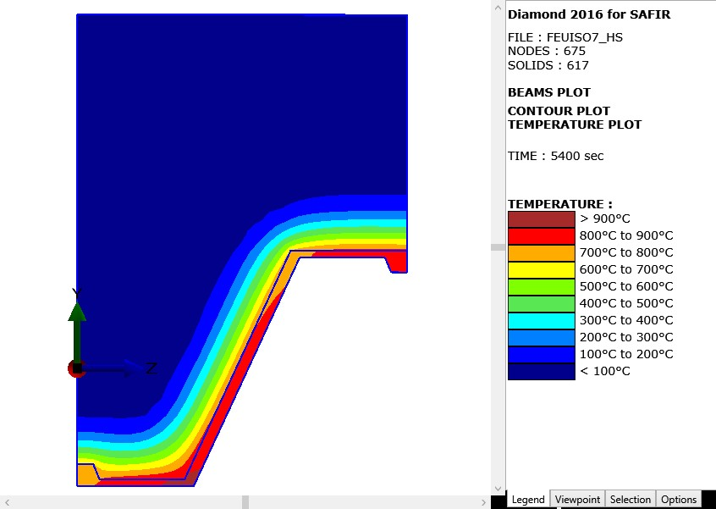
Temperatures computed by SAFIR®

Slide 12
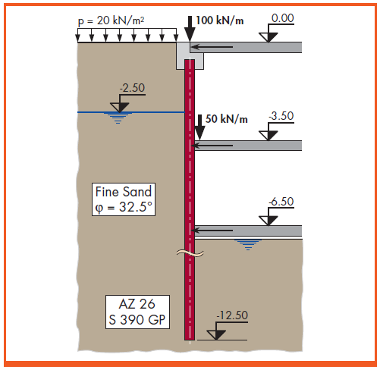
2) Loading from the ground
Traditional approach: linearly z dependent functions
OK in static equilibrium

Slide 13
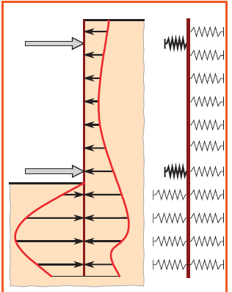
During the fire, the structure is subjected to large horizontal displacements
away from the ground
to the ground

Slide 14
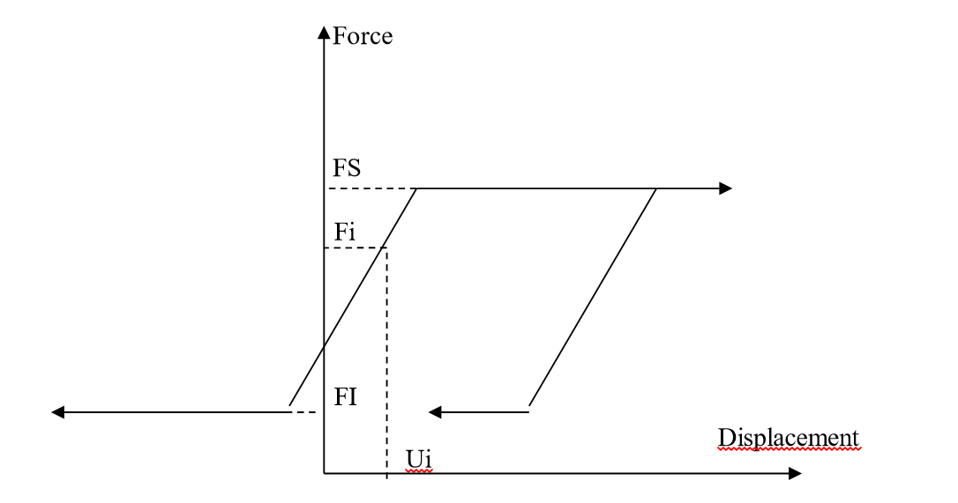
New SPRING finite element
Characterised by
One single node
One direction
One relationship (Force – displacement)

Slide 15
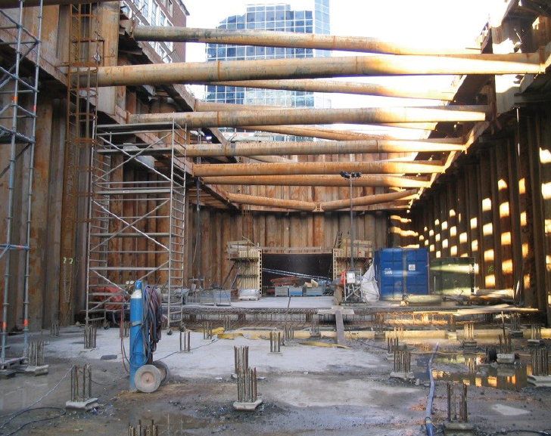
3) Complex construction phases
Installation of the sheet piles
Lower the water table
Excavation (partial)
Temporary supports (struts)

Slide 16
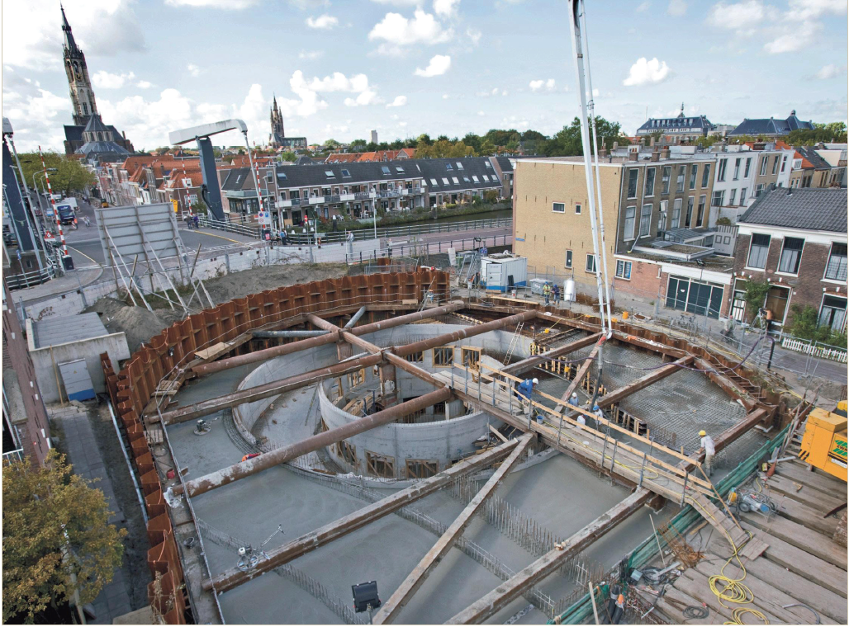
Installation of the sheet piles
Lower the water table
Excavation (partial)
Temporary supports (struts)

Slide 17
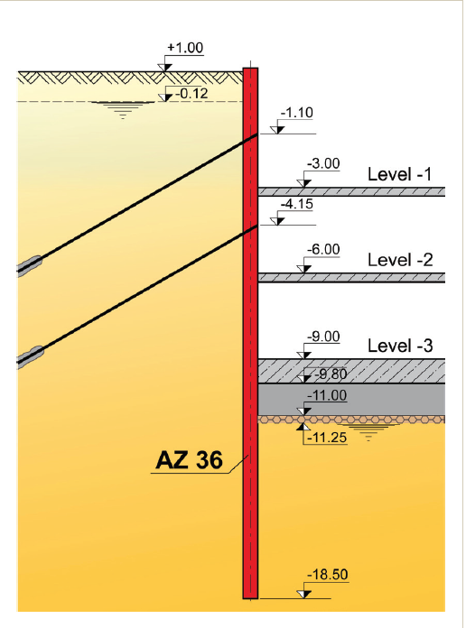
Installation of the sheet piles
Lower the water table
Excavation (partial)
Temporary supports (struts)
Utilisation of anchors (temporary or permanent)
Casting the slabs
Water table to original position

Slide 18
The situation in our system when the fire starts results from all these phases:
in terms of displacements
in terms of pressure from the ground
Need of a specialised software:
RIDO
Model the complex sequence of construction phases
Produces the situation in the system after completion
=>
Input file
=>
SAFIR

Slide 19
2 application examples:
A steel sheet pile
A concrete tunnel

Slide 20
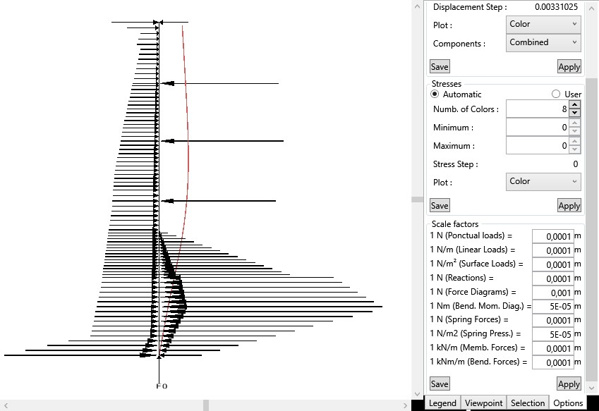
Pressure from the ground: cold condition
FIRE

Slide 21
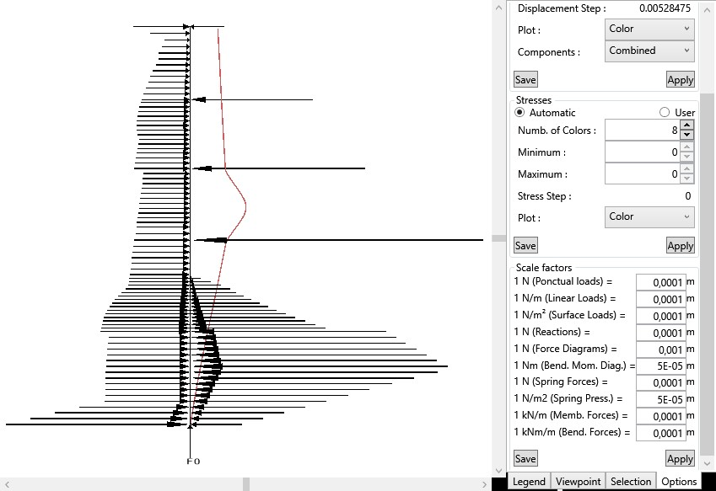
Pressure from the ground: fire condition

Slide 22
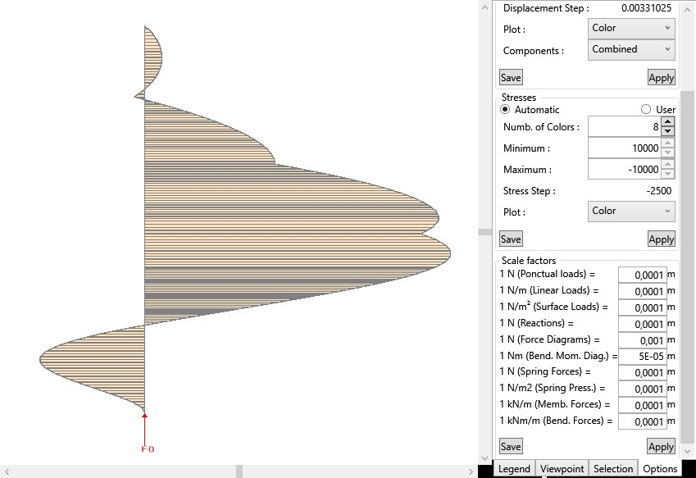
Bending moments: cold condition

Slide 23
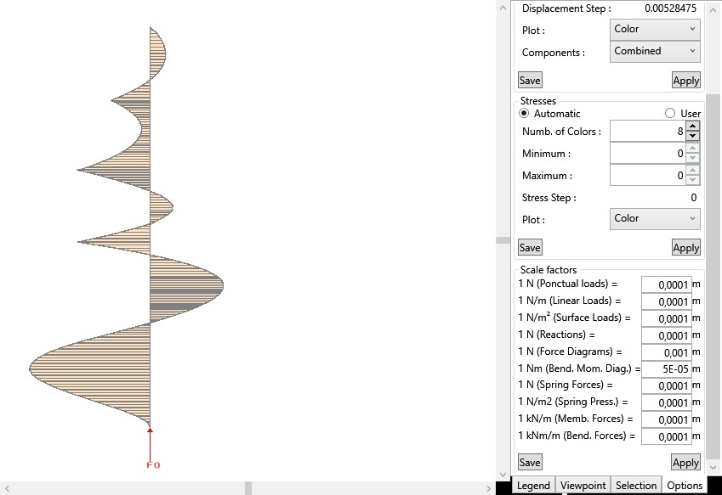
Bending moments: fire condition

Slide 24
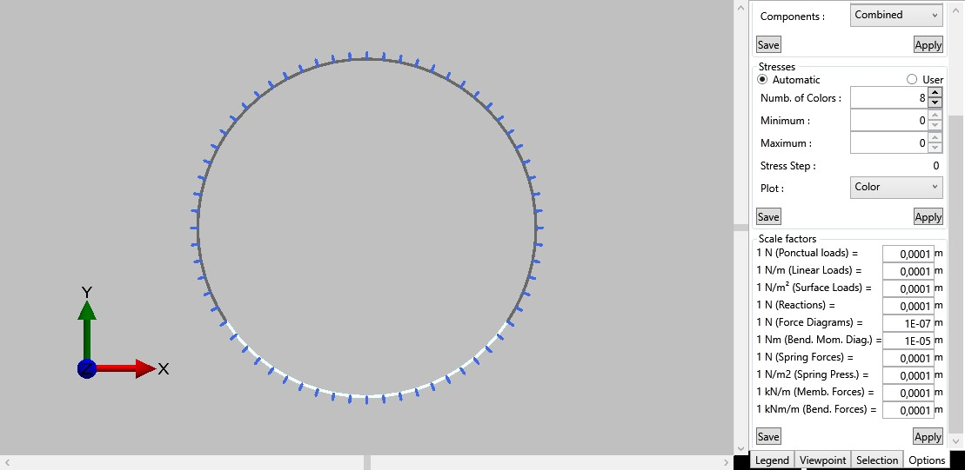
13 tunnels in Poland
Length: from 300 m to 3 860 m
Diameter: 10 meters
Courtesy: Egis Rail / Egis Tunnel France

Slide 25
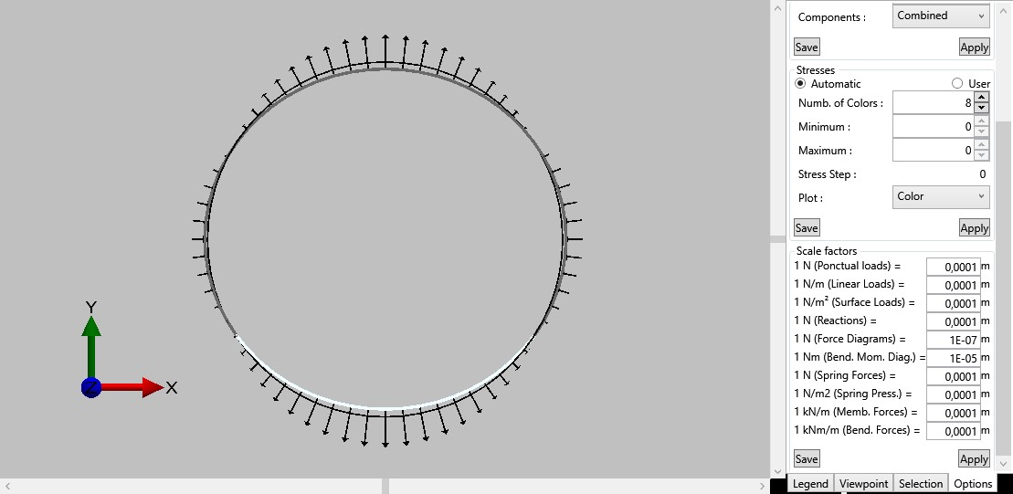
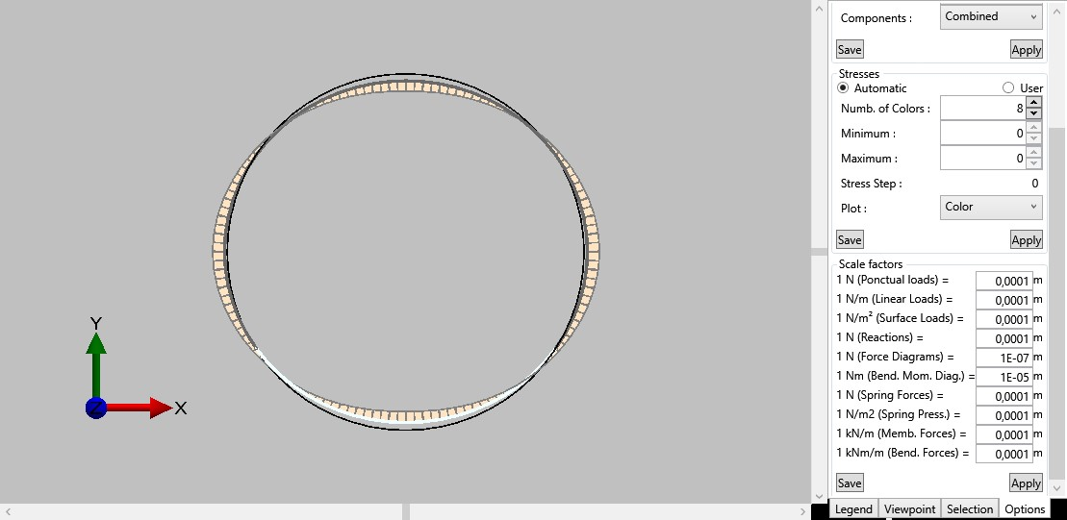
½ loading
Variation of pressure compared to a static loading
Bending moment diagram

Slide 26
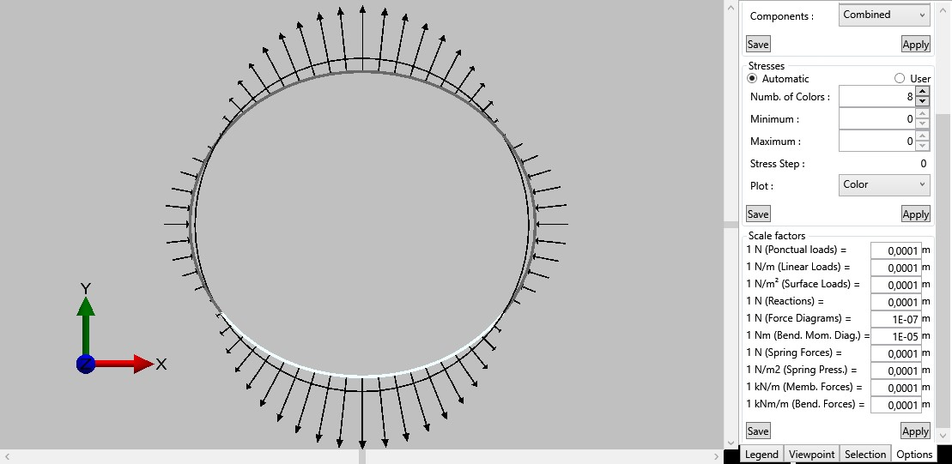
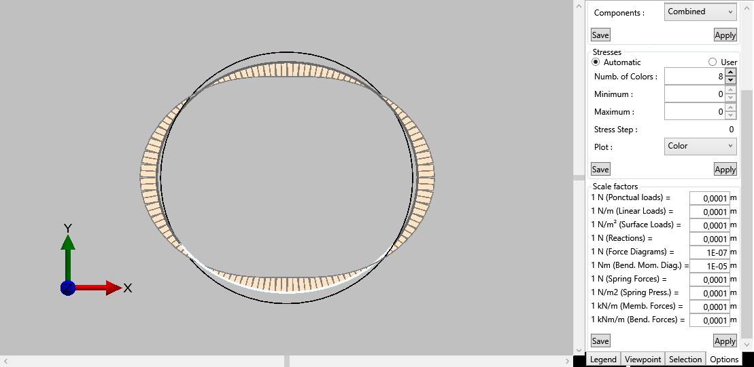
Full loading
Variation of pressure compared to a static loading
Bending moment diagram

Slide 27
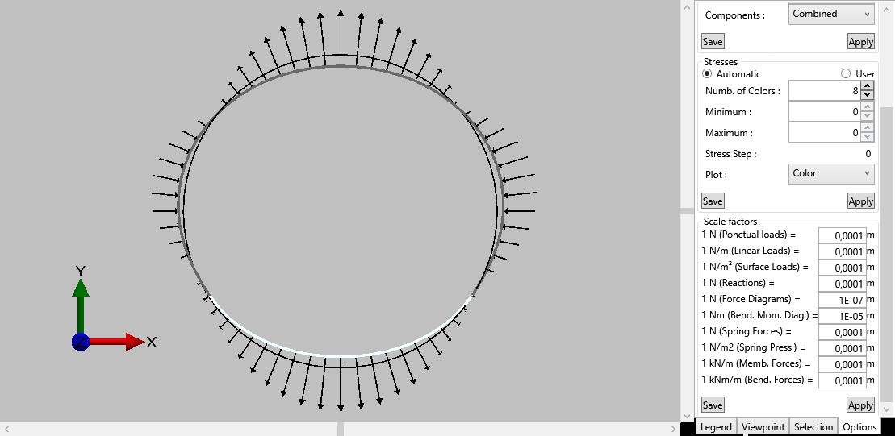
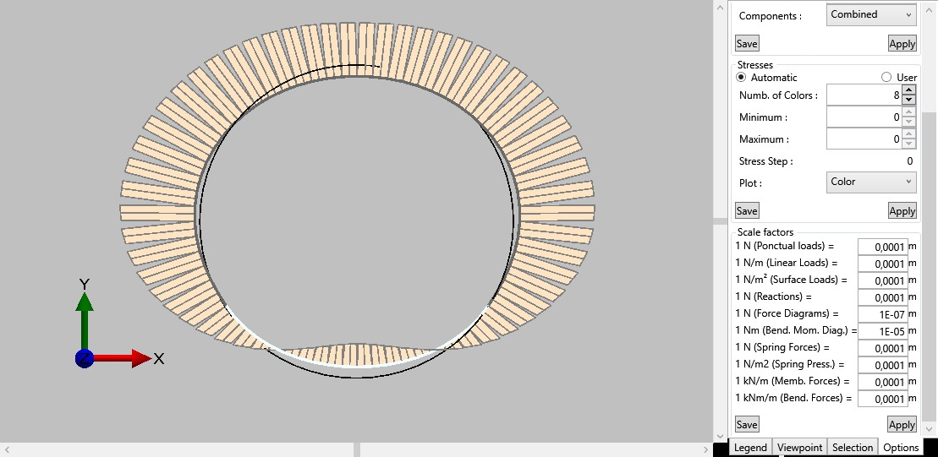
60 minutes fire
Variation of pressure compared to a static loading
Bending moment diagram

Slide 28
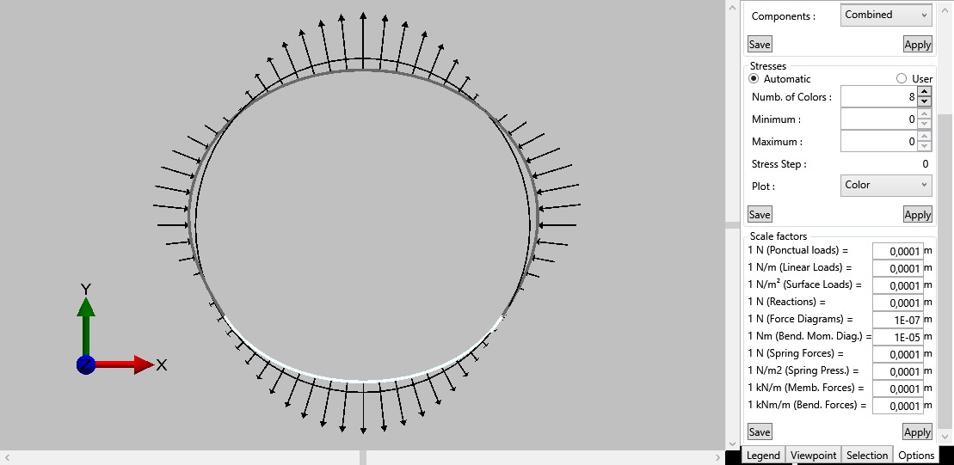
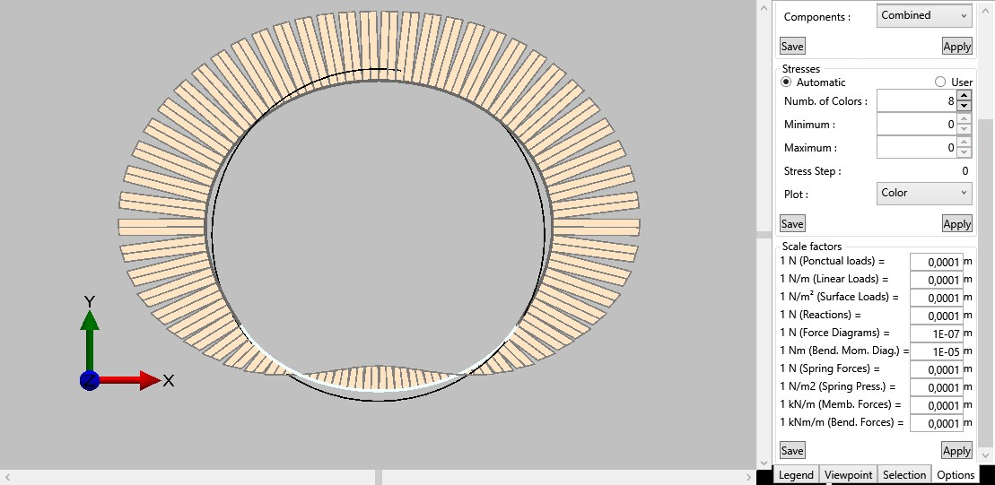
120 minutes fire
Variation of pressure compared to a static loading
Bending moment diagram

Slide 30
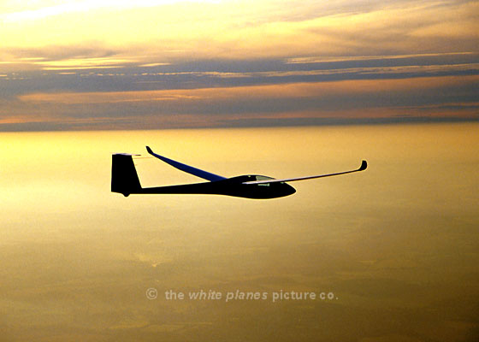
Thank you

