Slide 1
DMT and its theoretical framework: A bottom-up approach to the analysis of deliberate metaphor in political discourse
Heyvaert Pauline
Université de Liège,
Université catholique de Louvain
Symposium: Figurative Framing in Political Communication, Amsterdam 15/12/2017

Slide 2
Starting point of the project: The Paradox of metaphor - Deliberate Metaphor Theory (DMT)
Most metaphors are processed by lexical disambiguation, and not by comparison
Solution to this paradox: 3-dimensional model of metaphor analysis
Linguistic level: direct versus indirect
Conceptual level: conventional versus novel
Communicative level: deliberate versus non-deliberate
Symposium: Figurative Framing in Political Communication, Amsterdam 15/12/2017

Slide 3
Starting point of the project: The Paradox of metaphor - Deliberate Metaphor Theory (DMT)
Deliberate metaphor concerns the intentional use of metaphors as metaphors between sender and addressee. This definition minimally implies that language users, in production or reception, pay distinct attention to the source domain as a separate domain of reference
(Steen, 2017)
Most metaphors are processed by lexical disambiguation, and not by comparison
Solution to this paradox: 3-dimensional model of metaphor analysis
Linguistic level: direct versus indirect
Conceptual level: conventional versus novel
Communicative level: deliberate versus non-deliberate
Symposium: Figurative Framing in Political Communication, Amsterdam 15/12/2017

Slide 4
DMT & it’s theoretical framework
The idea of deliberate metaphor = a hotly debated issue in literature
Theoretical & empirical
Steen versus Gibbs
Evolution of DMT : 2008 ⟹ 2017
However: still need for empirical research on how notion of deliberate metaphor may be conceived
Symposium: Figurative Framing in Political Communication, Amsterdam 15/12/2017
Notes:
“However: still need for empirical research on how notion of deliberate metaphor may be conceived”
Because a lot of metaphor scholars do agree that deliberate metaphors do exist, but research on what characterizes these metaphors and what differentiates them from other types of metaphor remains scarce

Slide 5
DMT & it’s theoretical framework
Existing research on deliberate metaphor: Krennmayr (2011), Pasma (2011), Perrez & Reuchamps (2014), Heyvaert et al. (submitted), etc.
Top-down approach to the identification of deliberate metaphor
Need for bottom-up approach ⟹ fully understand what deliberate metaphors are and what characterizes them
Aim of the research
“important to perform the identification of potentially deliberate metaphor in a bottom-up fashion, starting from the data rather than from a set list of features to look for.” (Reijnierse, 2017)
Symposium: Figurative Framing in Political Communication, Amsterdam 15/12/2017
Notes:
“Top-down” versus “bottom-up approach”: top-down approach starts from existing list of features to find potentially deliberate metaphors
Bottom-up approach might offer a more complete overview of what characterizes deliberate metaphors, because starting from an existing list of features (as is the case with top-down) limits the identification of potentially deliberate metaphors, since the researcher might overlook some important cases or features of deliberate metaphor

Slide 6
Corpus: Belgian Political Discourse
metaphors which constitute
the type of language use that people usually use to talk about
certain topics (⇾ non-deliberate)
metaphors which are produced/perceived
as metaphors (⇾ deliberate)
Political discourse = situated in a space of “conflicts” between representations of topics and issues
Political discourse = ideal: Lends itself quite naturally to the use of deliberate metaphors
Symposium: Figurative Framing in Political Communication, Amsterdam 15/12/2017

Slide 7
Corpus: Belgian Political Discourse
Belgian governmental declarations from 2006 – 2016
Bilingual corpus (FR – NL)
1 million words
Consists of 2 types of political discourse: 1. Speech given by Belgian Prime Minister about current state of affairs regarding Belgian politics 2. Responses and reactions of Presidents and other prominent members of Belgian political parties
⟹ spoken language, but written transcripts
Symposium: Figurative Framing in Political Communication, Amsterdam 15/12/2017

Slide 8
Analysis of deliberate metaphors: Methodology
Deliberate Metaphor Identification Procedure (DMIP)
= bottom-up approach to the identification of potentially deliberate metaphors, Reijnierse 2017
Quantitative perspective: distribution and frequency of DM in language use
+/- 210 relevant contexts
Symposium: Figurative Framing in Political Communication, Amsterdam 15/12/2017

Slide 9
Analysis of deliberate metaphors: Methodology
Quantitative results
Qualitative perspective: look at manifestations of DM in order to analyse functions and forms of DM
Essence of the project
What characterizes deliberate metaphor?
linguistic – conceptual – communicative
Provide a more complete list (++ “top-down”-list)
Symposium: Figurative Framing in Political Communication, Amsterdam 15/12/2017
Notes:
Only finishing the quantitative side of things, so unfortunately not possible to already provide results from the qualitative aspect of the research

Slide 10
Deliberate metaphor in political discourse
This is an exercise in political marketing, meant to show the other countries that the Belgian Titanic is still floating.
(Jean-Marie Dedecker, LDD, right-wing)
They tried to make a community mayonnaise with the wrong ingredients and with the wrong tools. Moreover, they forgot to put lubricating oil in it to keep the Belgian system running. They wouldn’t understand that the Flemish oil will now continue rippling with the French vinegar, and that the Brussels egg yolk will never come along in the plate.
(Jean-Marie Dedecker, LDD, right-wing)
The Prime Minister presents himself as a red fairy with a green magic wand, but it is typical for fairies to put a spell on people.
(Roel Deseyn, CD&V)
Symposium: Figurative Framing in Political Communication, Amsterdam 15/12/2017

Slide 11
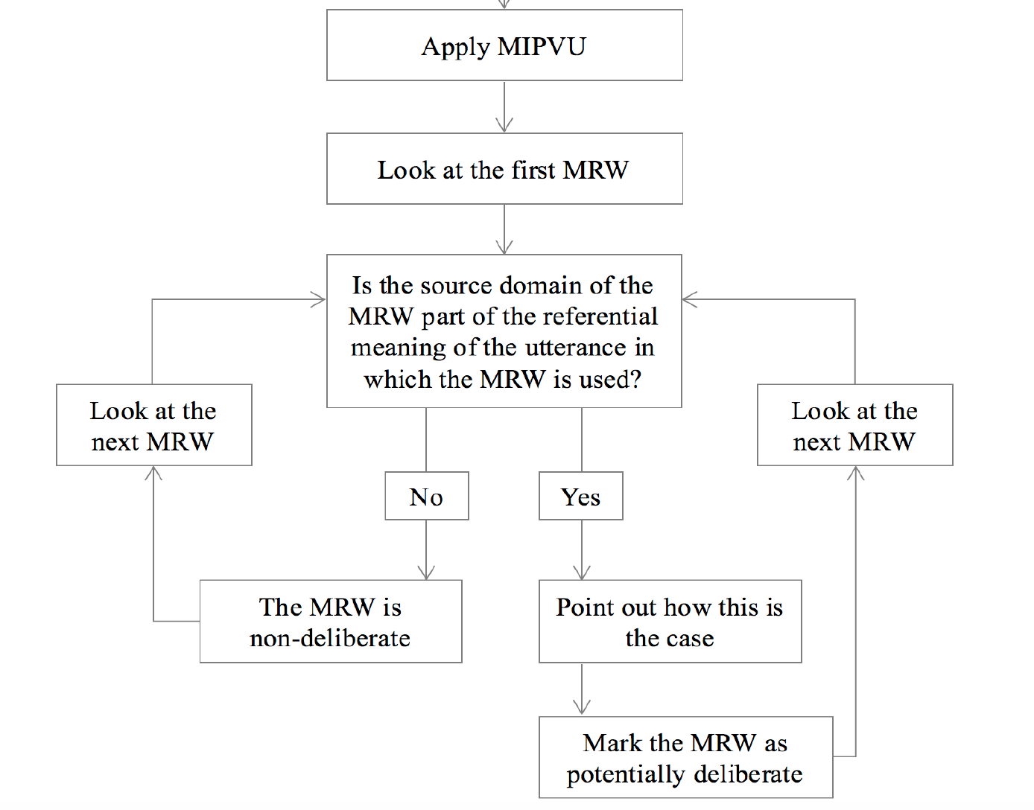
Why a bottom-up analysis of the characteristics of deliberate metaphors?
Further contribute to development of theoretical framework of DMT
(Reijnierse, 2017)
Symposium: Figurative Framing in Political Communication, Amsterdam 15/12/2017

Slide 12
Circulation of deliberate metaphors
« The Prime Minister resurrects as if it’s nothing: he’s born on Christmas and will die on Easter … But on Easter the political observers will look out for the third day! »
« For that, we still have to wait until the Easter bells toll, if this forced marriage lasts that long »
« The Christian corner has managed to « secure » some symbolism, with a government from Christmas, the birth, till Easter, the resurrection. Although it could also become a crucifixion »
« The government is not a political marriage and not even a marriage of convenience, but at the very most a sham marriage. And a sham marriage always leads to a catastrophe, because it’s based on deception. »
« Even before the family sits at the table for the Christmas feast, people are already arguing about who gets to cut the turkey. The appetizer – a fat fish** – gets skipped. This is a sham marriage, of which the expiration date is already known. »
« Love at first sight is beautiful, but also in politics, marriages of convenience are the ones that last the longest »
Symposium: Figurative Framing in Political Communication, Amsterdam 15/12/2017

Slide 13
Circulation of deliberate metaphors
There are two ways to do politics like there are two ways to navigate a ship. Either your only concern is to keep the ship floating, without a specific beacon, without a specific purpose. You just keep on floating in whatever direction. Or you have a mission, a vision, a dream. You have a clear purpose in mind, even though you know you might have to face wild waters and heavy storms.
(2006, Guy Verhofstadt, Prime Minister)
You enthusiastically talked about yourself as a captain leading his ship through wild waters, Mr. Prime Minisiter, but this doesn’t get to me one bit.
(2006, Patrick De Groote, N-VA, right-wing)
Symposium: Figurative Framing in Political Communication, Amsterdam 15/12/2017

Slide 14
Circulation of deliberate metaphors
Will Prime Minister Leterme lead this out-of-control ship and disappoint the elector? Or will the cartel guide him towards a new Flemish ship that sets sail right next to the Walloon ship? I hope he picks the latter, otherwise part of his crew will mutiny or jump overboard.
(2008, Bruno Valkeniers, Vlaams Belang, extreme right-wing)
In this context, we have to offer the citizens security, we have to offer them trust … by being – through these wild waters – a safe beacon and, if necessary, the last lifebuoy.
(2008, Yves Leterme, Prime Minister)
Symposium: Figurative Framing in Political Communication, Amsterdam 15/12/2017

Slide 15
Circulation of deliberate metaphors
The Prime Minister uses the economic crisis to hide the fact that the system is crashing. He does so by using the image of the wind and sails: the wind blows and the only thing we can do is set the sails*.The reality, however, is that we are sailing on two different ships, with two poles and two sets of sails. These ships are sailing next to each other and between them, there is a footbridge with a chair, on which – in a very unstable way – the Prime Minisiter sits.
(2009, G. Annemans, Vlaams Belang, extreme right-wing)
The Prime Minister uses the image that as a country, you cannot change the wind’s direction, but that you are able to set the sails. He seems to forget that while sailing, you might dash against a cliff.
(2009, Jean-Marie Dedecker, LDD, right-wing)
Symposium: Figurative Framing in Political Communication, Amsterdam 15/12/2017

Slide 16
Circulation of deliberate metaphors
The Prime Minister uses the economic crisis to hide the fact that the system is crashing. He does so by using the image of the wind and sails: the wind blows and the only thing we can do is ZEILEN BIJZTTEN … The reality, however, is that we are sailing on two different ships, with two poles and two sets of sails. These ships are sailing next to each other and between them, there is a footbridge with a chair, on which – in a very unstable way – the Prime Minisiter sits.
(2009, G. Annemans, Vlaams Belang, extreme right-wing)
The Prime Minister uses the image that as a country, you cannot change the wind’s direction, but that you are able to ZEILEN BIJZTTEN. He seems to forge that while sailing, you might dash against a cliff.
(2009, Jean-Marie Dedecker, LDD, right-wing)
To ask for people’s trust, the government has given itself the role of a captain who, to avoid a shipwreck, asks the passengers to give up their privileges.
(Laurette Onkelinx, 2014, Socialist Party)
Symposium: Figurative Framing in Political Communication, Amsterdam 15/12/2017

Slide 17
DMT and its theoretical framework: A bottom-up approach to the analysis of deliberate metaphor in political discourse Thank you ! Suggestions and comments are welcome!
Heyvaert Pauline
Université de Liège,
Université catholique de Louvain
Symposium: Figurative Framing in Political Communication, Amsterdam 15/12/2017

