Slide 1
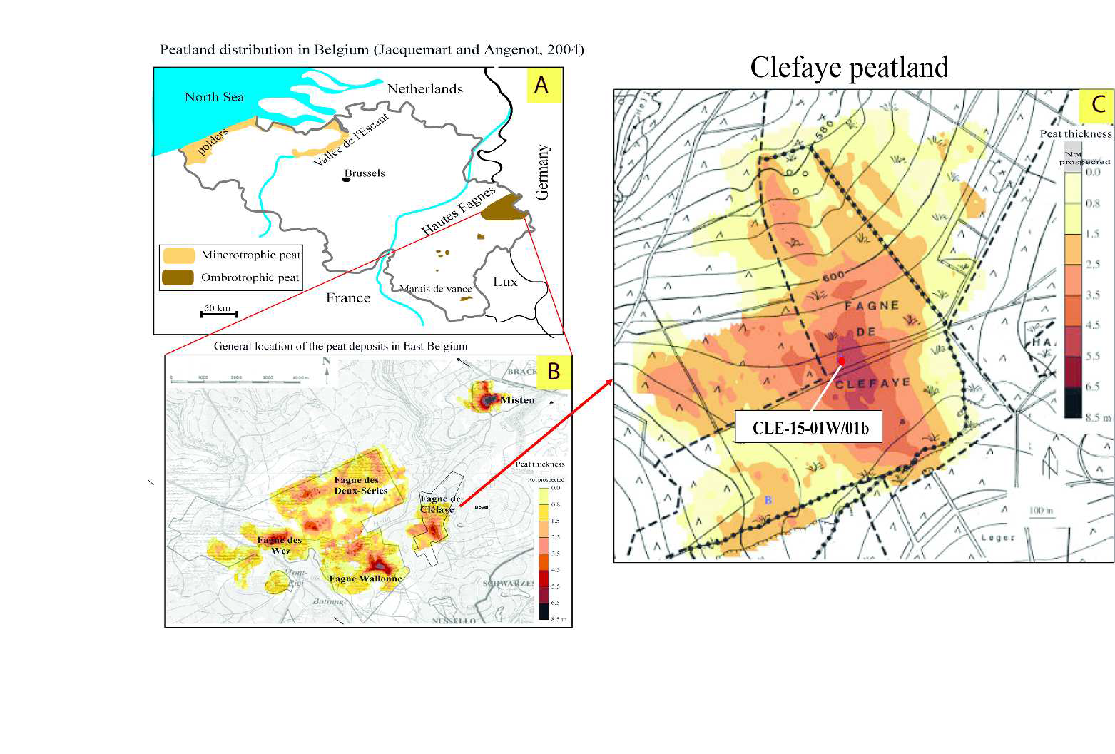
1
Location (B) of the three deepest and most studied ombrotrophic peat-bogs in East Belgium : Fagne Wallonne, Fagne de Clefaye and Misten.
Damblon 1969 FCB
Damblon 1969 FCB

Slide 2
Comparison of pollen analysis in Atlantic-Subboreal times between HATTLICH trench (Persch 1950) and MIS-08-01b (Streel et al. 2018) in the Misten peatland
2
Comparison of pollen analysis in Atlantic –Subboreal times between HATTLICH trench (Persch 1950)
and MIS-08-01b (Streel et al. 2018) in the Misten area

Slide 3
3
Comparison of pollen, thecamoebian and peat analysis in Atlantic –Subboreal times in MIS-08-01b (Streel et al. 2018)
Red: Humification rate
Blue:

Slide 4
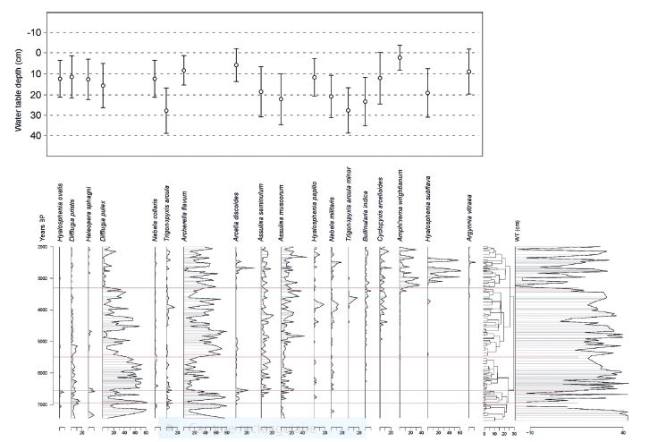
Distribution of selected testate amoebae according to the data issued from the transfer function of Amesbury et al. (2016). Range and optimal distance of these taxa above the water-table (WT). Blue lines position (Biozones A to E) is deduced from CONISS analysis. Blue arrows show some characteristics within biozones B, C and D.
4
E
D
C
B
A

Slide 5
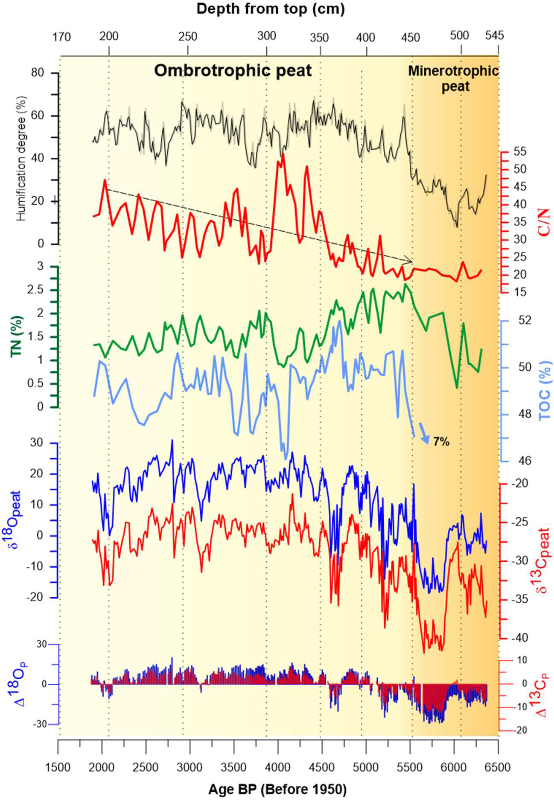
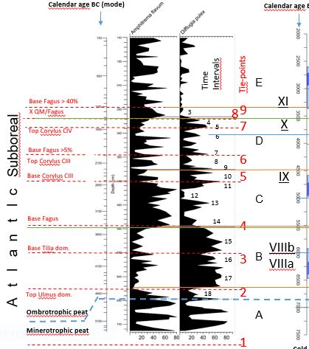
5
Comparison by calendar ages of Thecamoebian (and pollen) analysis in MIS-08-01b (Streel et al. 2018) and ombrotrophic peat analysis in Clefaye CLE-15-01W/b (This paper)

Slide 6
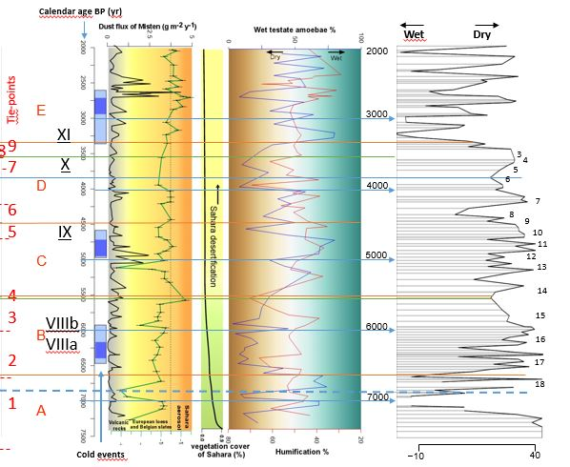
6
Comparison by calendar ages of pollen, thecamoebian and peat analysis in Atlantic–Subboreal times in MIS-08-01b (Streel et al. 2018) and ombrotrophic peat analysis in Clefaye CLE-15-01W/b (This paper)

Slide 7
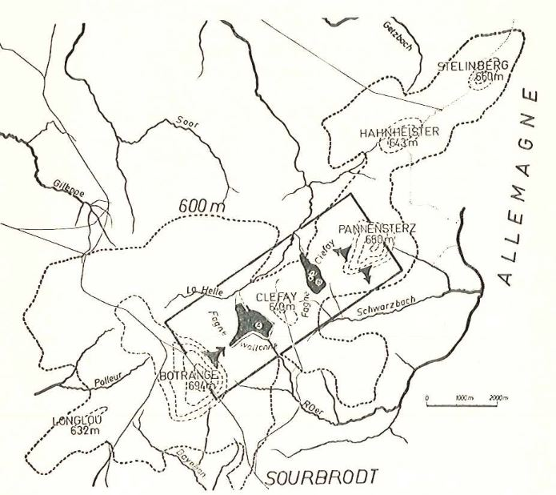
Clefaye peatland between Pannensterz and Clefaye highs
7
MISTEN
MISTEN

Slide 8
8 Vegetation map of the Fagne Wallonne and Clefaye peatlands (Streel 1959) . Localisation of the two sections in Clefaye peatland.
This paper
Damblon 1969 FCB

Slide 9
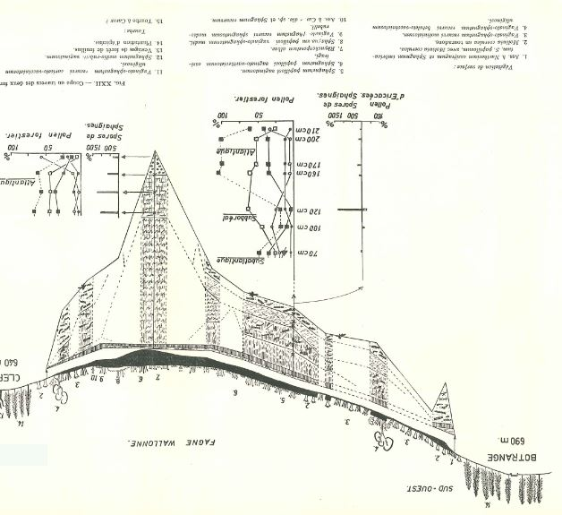
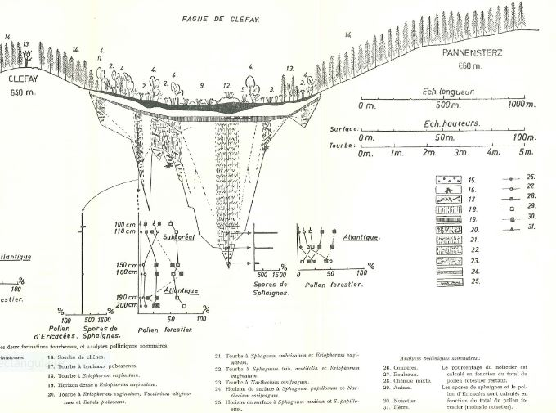
9
First Atlantic-Subboreal pollen analysis in the deepest part of the Fagne Wallonne and Clefaye peatlands (Streel 1959)
Scheuchzeria palustris

Slide 10
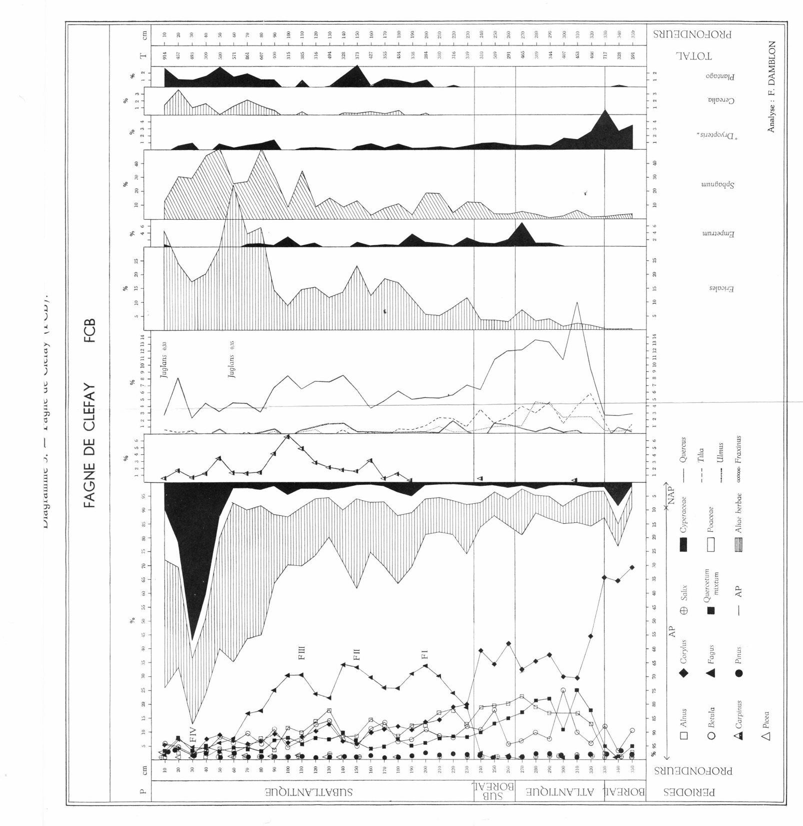
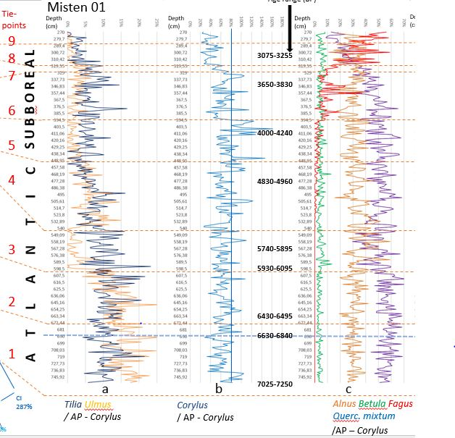
10
Comparison of pollen analysis in Atlantic –Subboreal times between MIS-08-01b (Streel et al. 2018) and Clefaye FCB (Damblon 1969)
Age range (cal BP)
v

Slide 11
11
Comparison of pollen (and Thecamoebian) analysis in Atlantic –Subboreal times between MIS-08-01b (Streel et al. 2018) and Clefaye FCB (Damblon 1969)

Slide 12
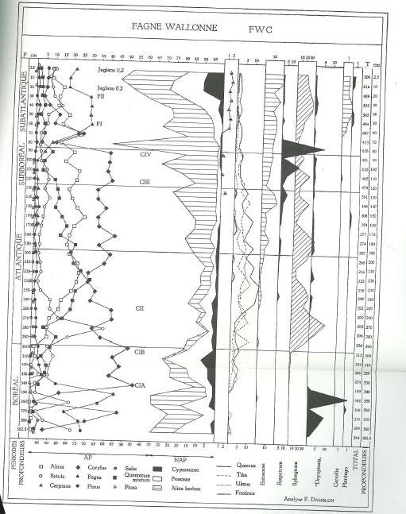
12
Comparison of pollen analysis in Atlantic–Subboreal times between MIS-08-01b (Streel et al. 2018) and Fagne Wallonne FW (Damblon 1970)
Age range (cal BP)

Slide 13
13
Comparison of Thecamoebian (and pollen) analysis in Atlantic–Subboreal times between MIS-08-01b (Streel et al. 2018) and Fagne Wallonne FW (Damblon 1970)

Slide 14

14
Correlation (by calendar ages) between Misten 01b and Clefaye CLE-15-01Wb and (by pollen zones) through all three sections.

