Slide 1
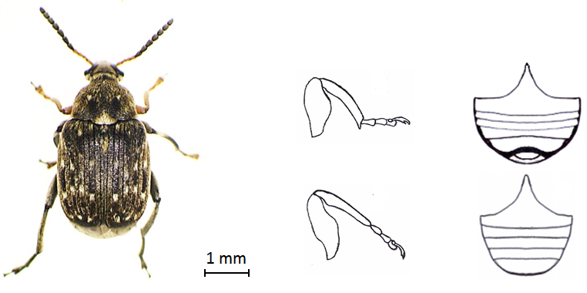
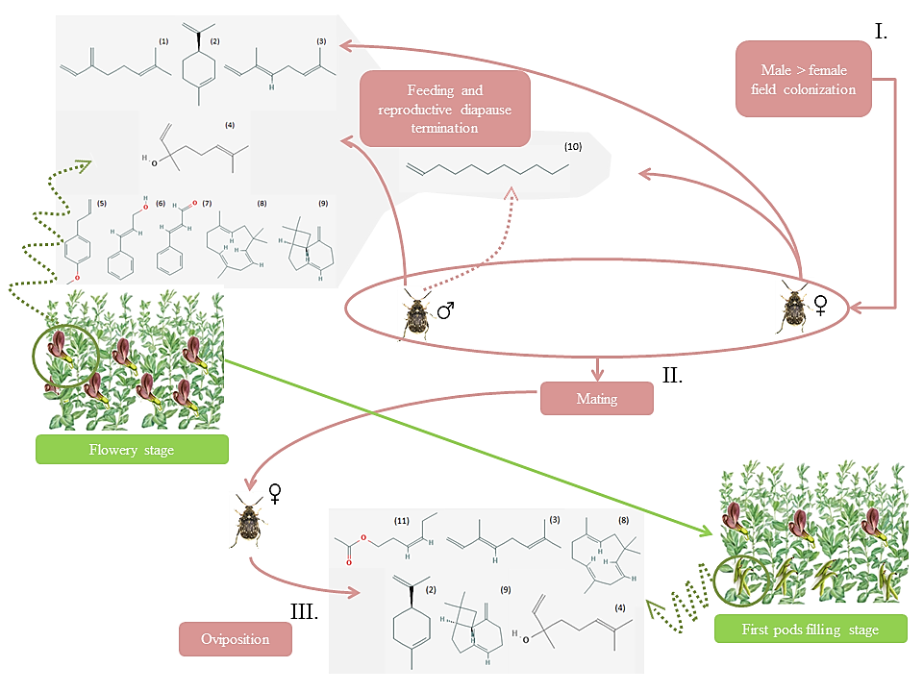
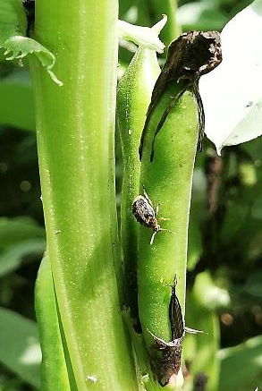
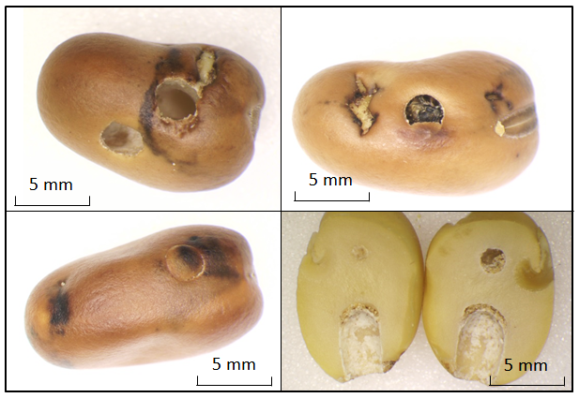
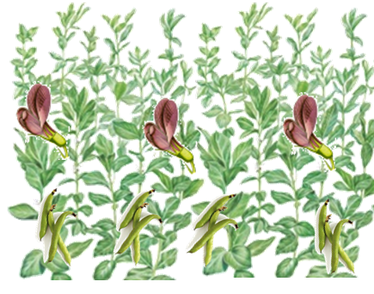
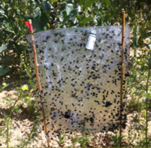
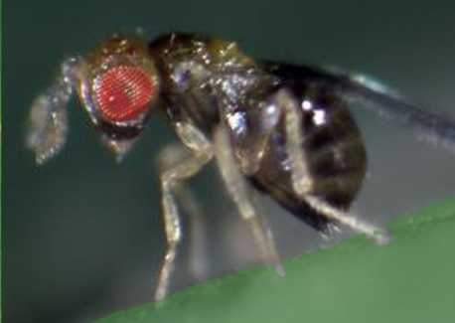
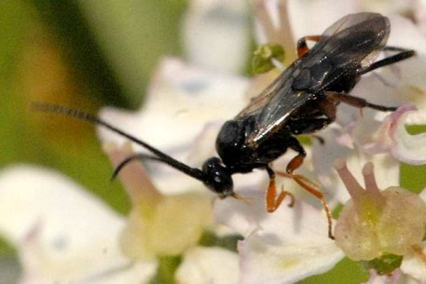
FEVERPRO Project
Development of biological control methods in alternative to pesticides to manage Bruchus rufimanus Boheman 1833 in field bean crops
Arnaud Segers*¹ ; Rudy Caparros Megido¹ ; Frédéric Francis¹
¹ Functional and Evolutionary Entomology–Gembloux Agro-Bio Tech (University of Liège), Gembloux, Belgique, Belgium.
Introduction
Field bean (Vicia faba var. minor) provides many agricultural services to cropping systems: (i) seeds rich in starch and protein (alternative to imported soybeans), (ii) natural N2 fixation, (iii)↘GES emissions, (iv) floral resources for pollinators (Köpke et al. 2009);
Promotion of V. faba cultivation by UE but concurrent restriction of efficient pesticides (λ-cyhalotrin/ζ-cypermethrin) against B. rufimanus, a specific pest whose larva develop inside seeds and prevent their valuation;
Alternative control methods must be found => Semiochemical based control method.
Bruchus rufimanus Boheman 1833
(COLEOPTERA : Chrysomelidae)
Chemical ecology of adults
Segers et al. 2019
B. rufimanus = univoltine species whose seminovorus larvae develop inside seeds during all seed maturation;
The targetable phase of the life cycle = external phases from V. faba, i.e. adults and eggs.
VOCs identified to date:
V. Faba flowers kairomone (FK) (Bruce et al. 2011)
(1) Myrcene
(2) (R)-limonene
(3) (E)-ocimene
(4) (R)-linalool
B. rufimanus sexual pheromone (Bruce et al. 2011)
(10) 1-undecene (synergy with FK)
V. Faba pods kairomone (PK) (Frerot et al. 2014)
(11) Cis-3-hexenyl acetate
(2) (R)-limonene
(3) (E)-ocimene
Avenue of future researches in chemical ecology
Oviposition deterring pheromone laid on pods?
Additional components to sexual pheromone emitted by male?
Aggregation/sexual pheromone?
(5) Estragol
(6) Cinnamyl alcohol
(7) Cinnamaldehyde
(8)-(9) β and α caryophyllene
(a)
(4) (R)-linalool
(8)-(9) β and α caryophyllene
(b)
Segers et al. 2019
(a)
(b)
© A. Segers, 2019.
© A. Segers, 2019.
0,5 mm
© A. Segers, 2019.
Damages incurred to seeds due to adults emergence
Alternative control methods to investigate: semiochemical based control method in IPM strategy
Mass trapping
Push pull
Lure and kill
1/ Target = Gravid females before oviposition with pods kairomone diffusor combined to a sticky transparent plate (Frerot and Leppik 2016)
Trap crop
Protected field bean crop
Trap crop
Combination of attractant with entomopathogenic agent.
Attractant
V. Faba flowers kairomone
V. faba pods kairomones
Aggregation pheromones?
Entomopathogenic agent
Fungi (Beauveria bassiana (Bals.-Criv.) Vuill. 1912 ; Metarhizium anisopliae (Metschn.) Sorokīn 1883)
Bacteria (Bacillus thuringiensis Berliner, 1915)
Host plant flower-pods kairomone?
Attractive cultivar?
Substitutive host(s)?
Oviposition deterring pheromone? Repulsive essential oil?
Weakly attractive cultivar?
Host plant flower-pods kairomone?
Attractive cultivar?
Substitutive host(s)?
Parasitoids
2/ Target = male and female during field colonization with aggregation pheromone
Uscana senex (Grese, 1923)
(Hymenoptera: Trichogrammatidae)
=> Egg parasitoid
Attractive signal?
Triaspis thoracica (Curtis, 1860)
(Hymenoptera: Braconidae)
=> Larva parasitoid
Attractive signal?
Projet FEVERPRO - référence dossier: D31-1395, WP 1/5 *Contact: arnaud.segers@uliege.be
Références bibliographiques
Frerot B, Taupin P, Lefranc M (2015) Bruche de la fève sur féverole: des messages chimiques décryptés. Perspectives agricoles 60–63
Köpke U, Nemecek T (2010) Ecological services of faba bean. Field Crops Research 115:217–233.
Bruce TJ, Martin JL, Smart LE, Pickett JA (2011) Development of semiochemical attractants for monitoring bean seed beetle, Bruchus rufimanus. Pest Management Science 67:1303–1308.
NSABS 2020
25th National Symposium for Applied Biological Sciences

