Slide 2
From the distribution network operator to the distribution system operator: will artificial intelligence, machine learning and deep learning be the catalysts for this transformation?”
AI4Energy
Prepared for ORES by D. Vangulick

Slide 3
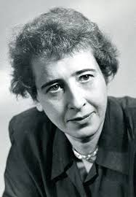
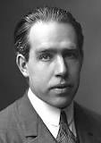
Disclamer
"Predictions of the future are never anything but projections of present automatic processes and procedures, that is, of occurrences that are likely to come to pass if men do not act and if nothing unexpected happens”
Hannah Arendt (1906-1975)
« Prediction is very difficult, especially if it's about the future”
N. Bohr (1885-1962)
« Difficult to see. Always in motion is the future »
Master Yoda (Empire strikes back)

Slide 4
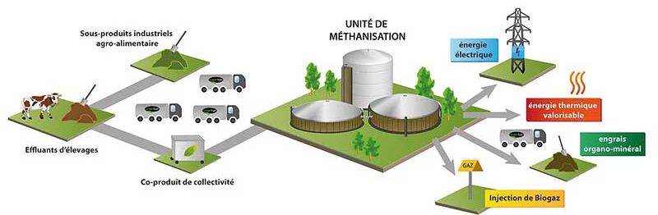
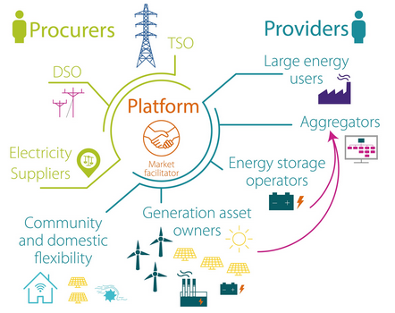
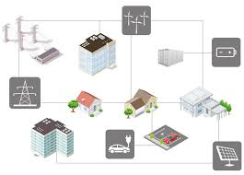
A lot of new elements in the DSO’s backyards, just to mention of few…
Bio-methanization
Gas
Flexibility
Electric Vehicle
Renewable energy
communities

Slide 5
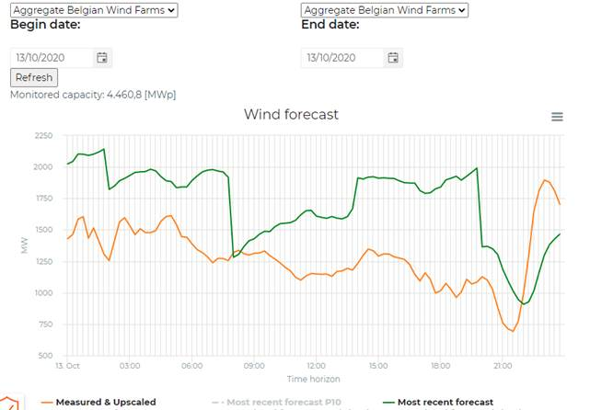
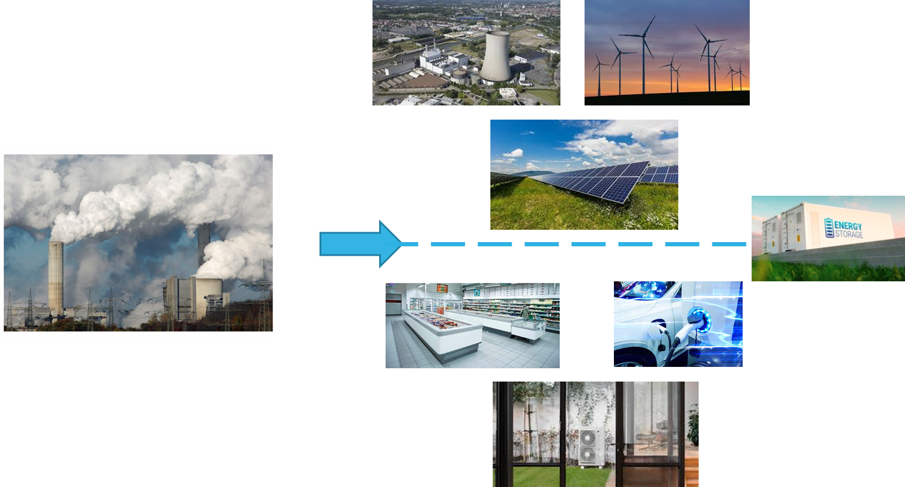
A drastic change in the generation and balancing
Flexibility
+

Slide 6
A drastic change in the generation and balancing
Flexibility
+

Slide 7
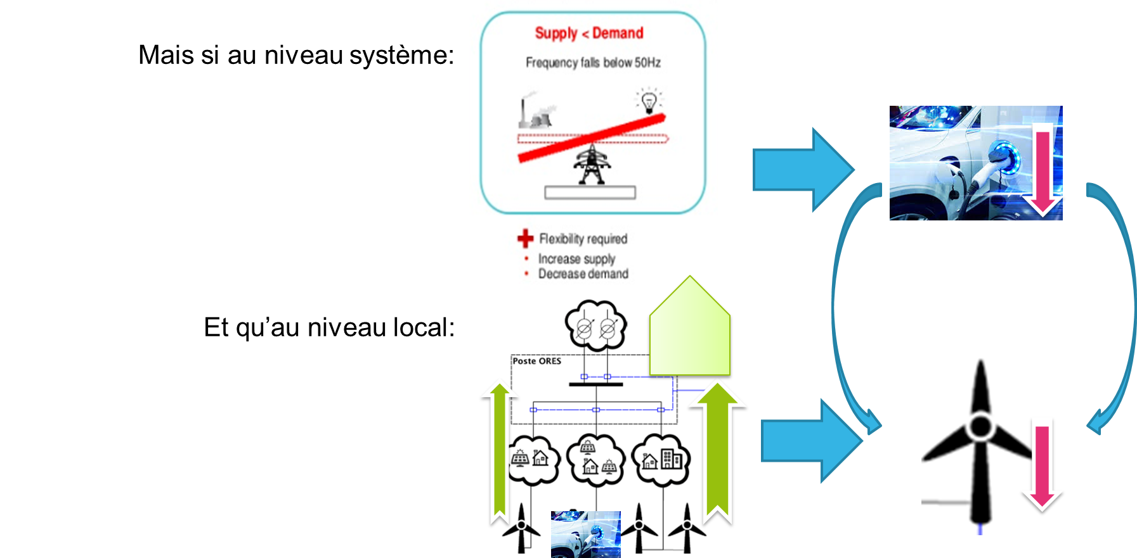
Coordination between System needs and local constraints
Flexibility to balance the system
Flexibilité = Equilibrage du système
If at the system level :
But meanwhile at local level:

Slide 8
Problem statement
Increasing risk of congestion on the DSO network, due to
Intermittent and decentralized RES generation
New demand appliances
Flexibility market
Risk of contradictory request in real time operation, e.g.
DSO requests to decrease generated power due to congestion on DSO grid
while TSO/balancing market asks to increase generated power
“Max winter Peak” approach is no longer a viable method to plan and to assess operational security
To avoid these risks, there is a need to
Observability: better knowledge of the network state
Forecast the DSO network state
Inform in advance the market about the state estimation of the network (mainly on the MV part)
From an Asset Owner to a System Operator

Slide 9
On the time line
ORES Approaches
Planning horizon
Operational planning horizon
Operational Receding horizon
Real Time Operation
horizon
Decision investment & contracting
Decision preventive actions
Curative actions
5 Years … 1 month
1 month … 1 day
1 day … 1/4h
< 1/4h
Rep. Day
Observability
ODESA
Trafic light
O-ONE

Slide 10
ORES Approaches
A future « Proof » Management of the DSO Network
Real Time Operation
Low latency between “see” to “act”
Accurate and reliable actions means
Operational Planning
Forecasting load flow W-1 à ¼-1
Knowledge of the potential flexibility
Long Term Planning
Forecasting the loads at 15 … 30 years
Knowledge of the flexibility potential
Better “know your asset”
Data Quality
Observability Measures /Pseudo-measures
RT network topology

Slide 11
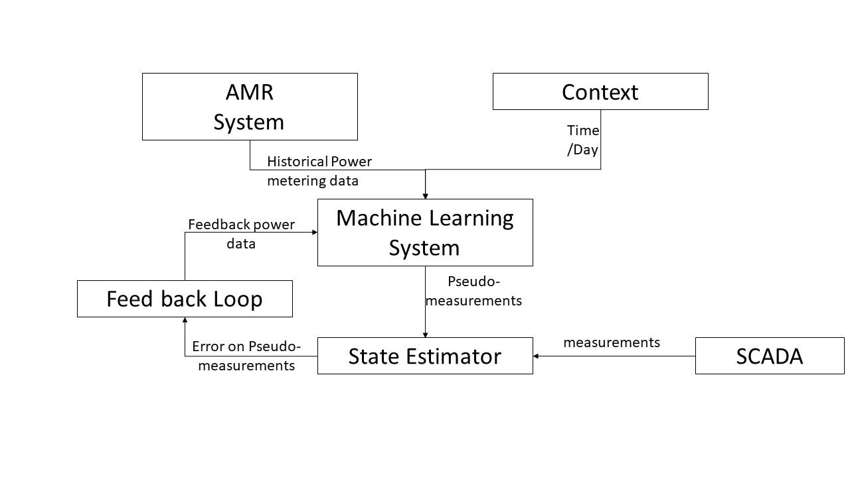
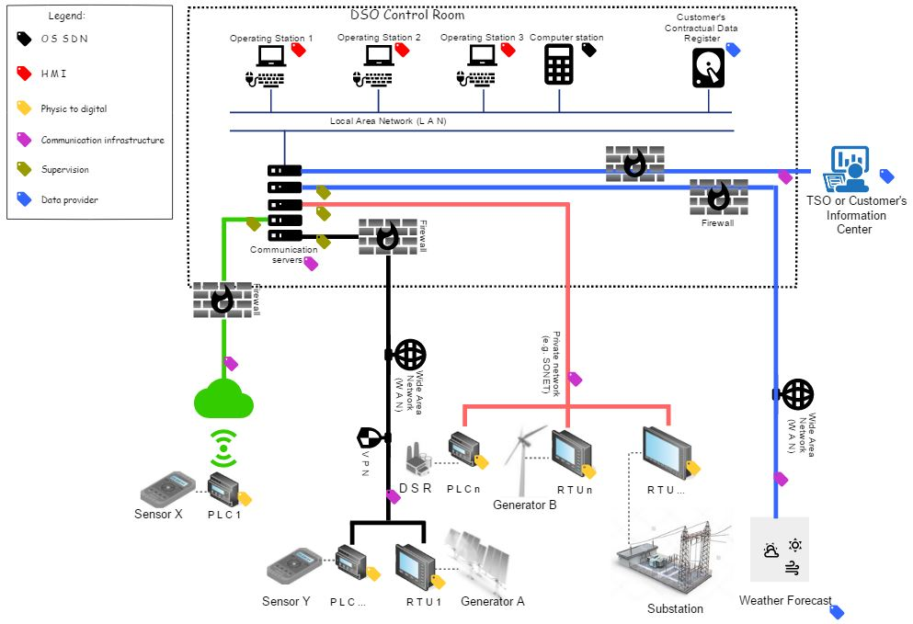
Observability and Pseudo-measures
Historically:
Need of observability very low in DSO system
Very few measurements devices (e.g only on primary substation)
Change in load flow => need to increase observability
Increase the number of measurement points
But measurements points €€€
Data-pseudo measures
Objective function of the cluster: Energy, peak, power gradient

Slide 12
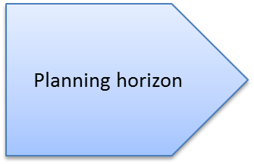
Planning Horizon
Representative Day
Planification = load flows in 20yy+20 …+30 = 1 year load flows
Clustering techniques (e.g. K-Means with genetic algorithm):
- 365 x 1/4h problem can be reduced to 12 x 1/4h
Objective function of the cluster: Energy, peak, power gradient
Type of day | # day | Type of day | # day
Summer week | 3 | Winter week | 3
Summer WE | 2 | Winter WE | 2
Highest injection | 1 | Highest off-take | 1

Slide 13
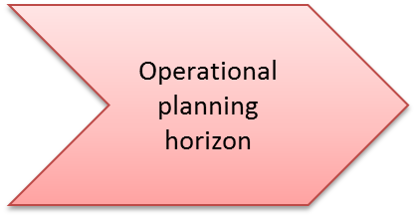
Operational Planning and trafic light
Smart
Grid
Network topology
D+1
Alert activation T-Flex
State grid D+1
Consumption
(>< off take)
Estimation load
D+1
Trafic light
estimation
D+1
Network reconfig
Generation
(>< In feed)
Knowing the potential flex capacity
(T and M)
Alert on limit action of the flex. market
Installed capacity
Generation scheduling
RES generation forecast
(weather)

Slide 14
Operational Planning and trafic light
Smart
Grid
Network topology
D+1
Alert activation T-Flex
State grid D+1
Consumption
(>< off take)
Estimation load
D+1
Trafic light
estimation
D+1
Network reconfig
Generation
(>< In feed)
Knowing the potential flex capacity
(T and M)
Alert on limit action of the flex. market
Installed capacity
Generation scheduling
RES generation forecast
(weather)

Slide 15
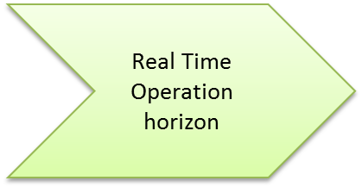
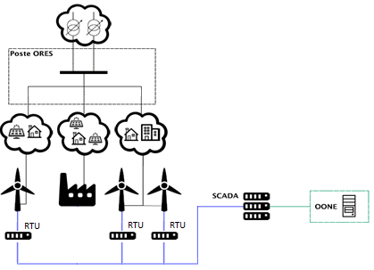
O-ONE
Max possible Generation =
Max Cap Trafo HV/MV+ Local consumption
O-ONE
Forecast each 5 minutes
Probable Generation
Probable consumption
Risk Assessment
If risk unacceptable => set limits for each generator

Slide 16
O-ONE
ELIA
t=0
t+5’
t+10’
t+15’
RTU

Slide 17
Conclusion
will artificial intelligence, machine learning and deep learning be the catalysts for this transformation?
Yes for sure but
Not immediately the full scope
Not every where
Not for ever
Pragmatic approach
Other DSO’s aspects (not covered in these slides) will also require these methods e.g.
tampering detection,
power quality follow up,
injection in gas network, …

