Slide 1
AI for energy: the uncertain promising opportunity
Prof. Damien ERNST

Slide 2
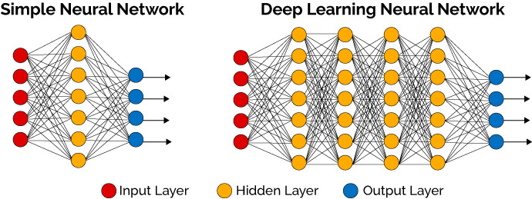
“Recent” changes in AI: 1. Deep neural nets
A deep-learning neural network (DNN) is an artificial neural network (ANN) with multiple layers between the input and output layers. No universally agreed upon threshold of depth separates shallow learning from deep learning, but most researchers agree that deep learning involves a chain of transformations from input to output higher than 2.

Slide 3
1. Outperform supervised learning algorithms but more tuning is often necessary as well as much higher computational costs for training.
2. Dedicated hardware architectures have been developed for training and executing those networks (e.g., GPU networks).
3. Open-source software libraries for designing and training DNNs are available and very well created. The most popular ones include: PyTorch (Facebook’s AI Research Lab) or Tensorflow (Google Brain).

Slide 4
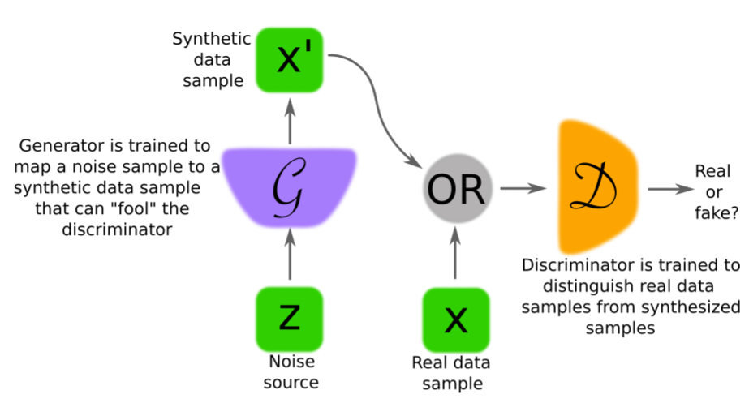
2. Generalised adversarial nets (GANs)

Slide 5
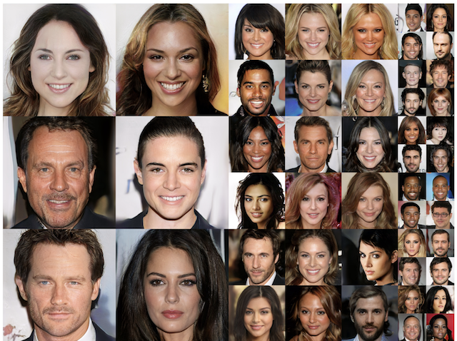
Examples of Photorealistic GAN-Generated Faces.Taken from Progressive Growing of GANs for Improved Quality, Stability, and Variation, 2017

Slide 6
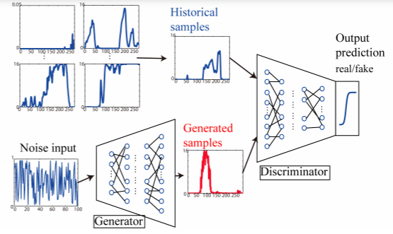
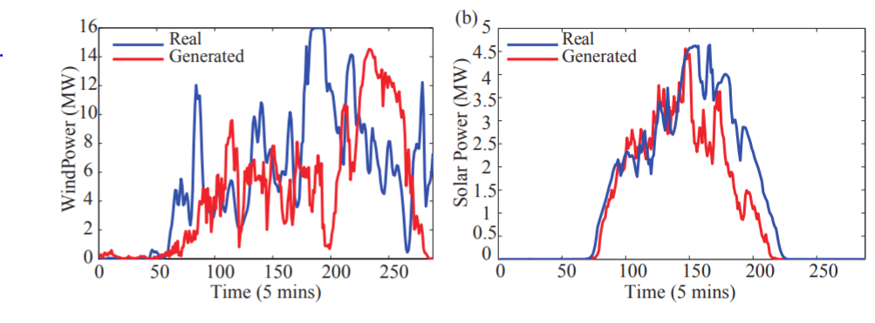
Left: The architecture of a GAN used for a wind/solar generation scenario.
Below: Generated scenarios versus real-life ones.
Figures taken from: “Model-Free Renewable Scenario Generation Using Generative Adversarial Networks”. Yize Chen, Yishen Wang, Daniel Kirschen and Baosen Zhang, 2018.

Slide 7
3. Powerful new reinforcement learning agents
Environment
state
reward
action
numerical value
Agent

Slide 8
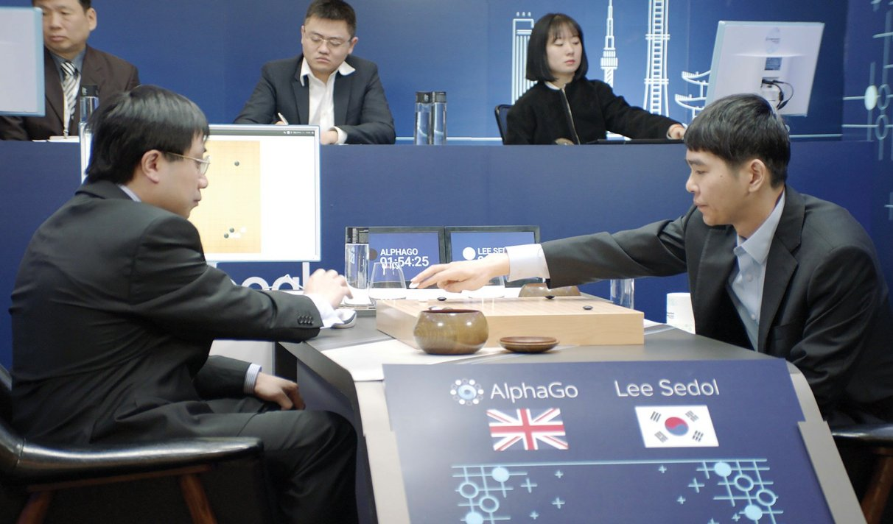
Lee Sedol, is a former South Korean professional Go player with a 9 dan ranking.
He was defeated by the computer program AlphaGo (based on RL algorithms combined with DNN) in a series in March 2016.
On 19 November 2019, Lee announced his retirement from professional play as artificial intelligence had created an opponent that "cannot be defeated."

Slide 9
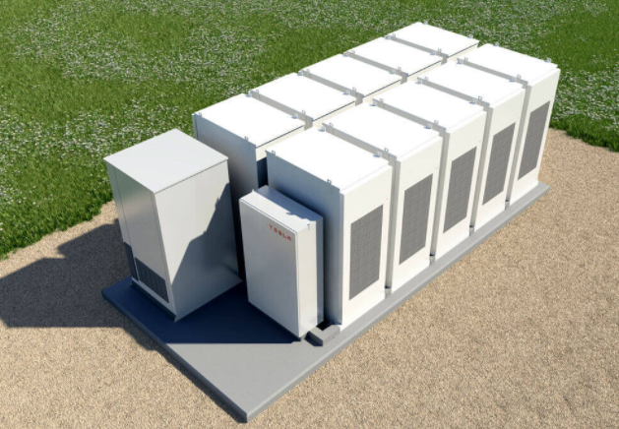
+ the energy
market
State: (i) the battery level (ii)
Everything you know about the market
Reward: The money you make during the market period.
The battery setting
for the next market period.
The battery
controller

Slide 10
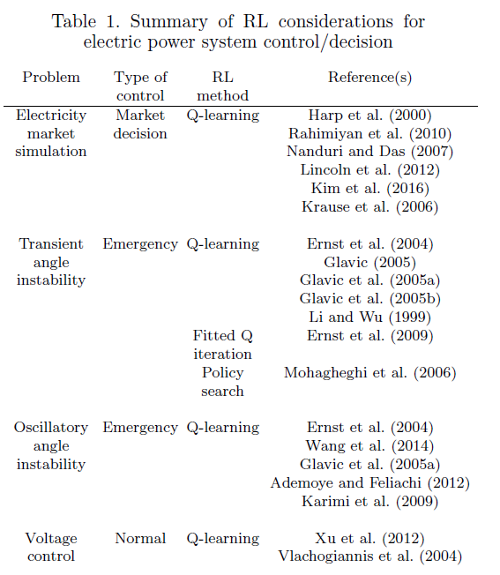
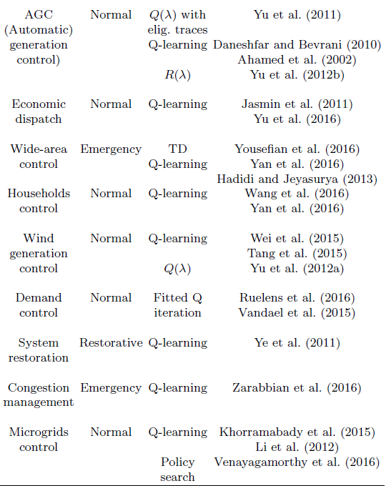
Table taken from: “Reinforcement Learning for Electric Power System Decision and Control: Past Considerations and Perspectives”. M. Glavic, R. Fonteneau and D. Ernst. Proceedings of the 20th IFAC World Congress.

Slide 11
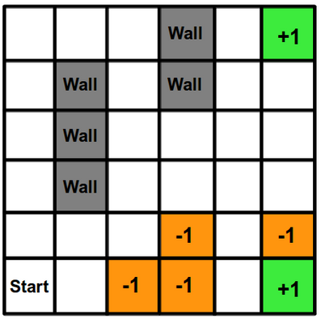
Learning:
Exploration/exploitation: Do not always take the action that is believed to be optimal to allow exploration.
Generalisation: Generalise the experience gained in certain states to other states.

Slide 13
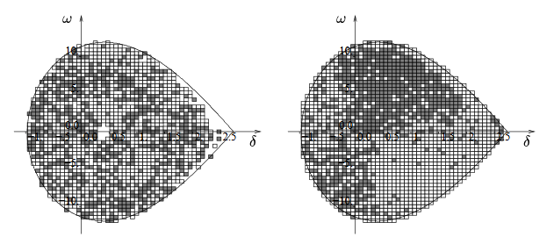
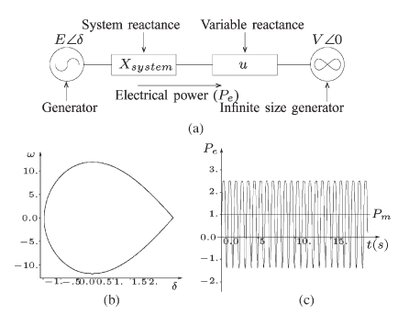
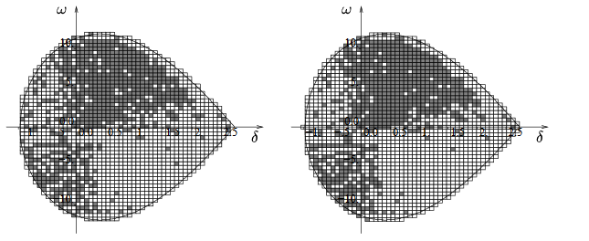
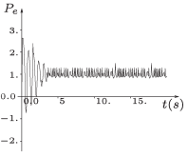
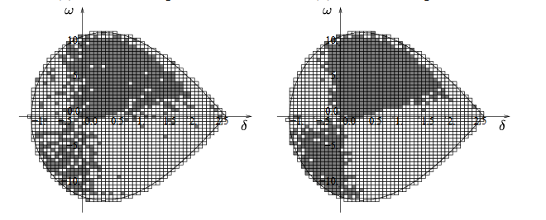
Learning
phase
Effect of the
resulting control
policy
First control law for stabilizing power systems every computed using reinforcement learning. More at: “Reinforcement Learning Versus Model Predictive Control: A Comparison on a Power System Problem”. D. Ernst, M. Glavic, F.Capitanescu, and L. Wehenkel. IEEE Transactions on Syestems, Man, An Cybernetics—PART B: Cybernetics, Vol. 39, No. 2, April 2009.

Slide 14
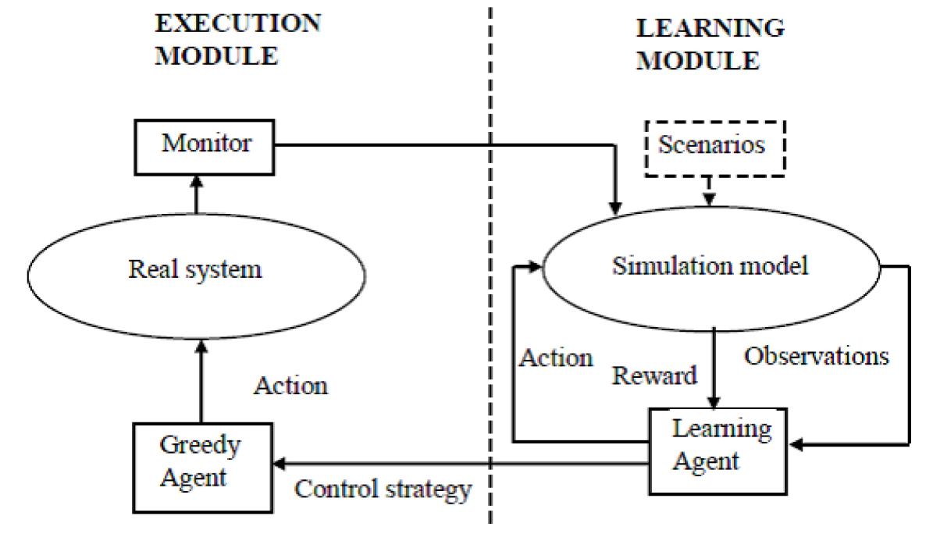

Slide 15
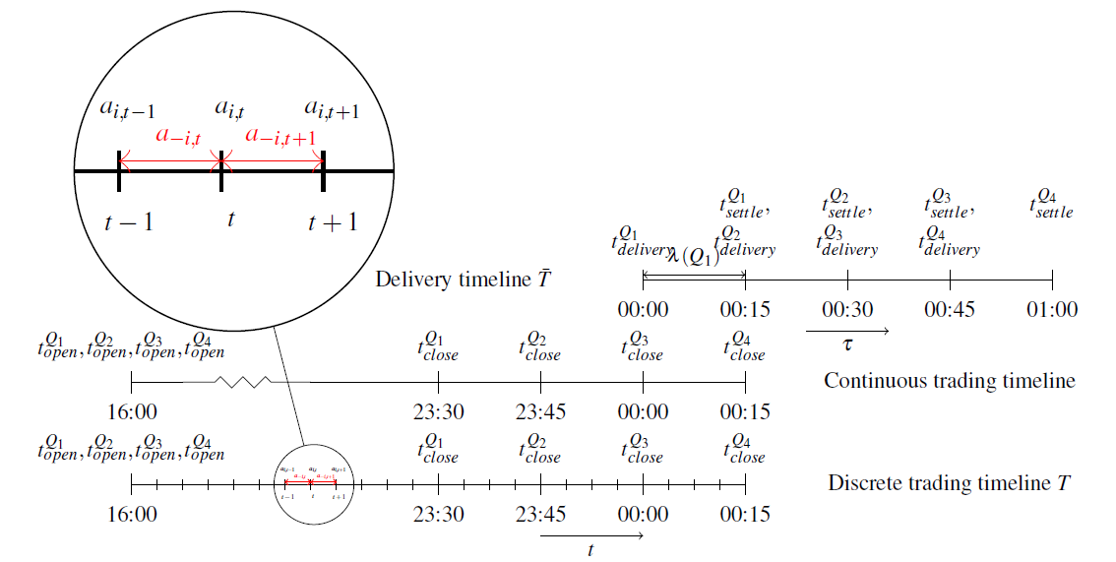
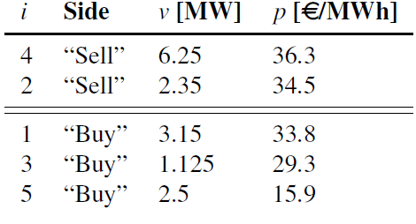
RL for trading flexibility in the intraday market
Order book
Taken from: “A Deep Reinforcement Learning Framework for Continuous Intraday Market Bidding”. Ioannis Boukas et al., 2020.

Slide 16
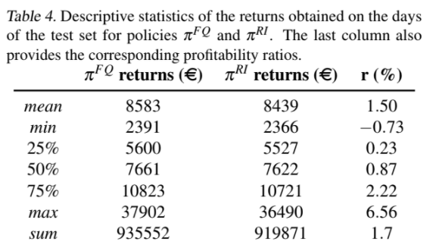
Very complex decision-making problem.
Good results could be obtained by using the RL Fitted Q Iteration algorithm (FQI) combined with DNNs.
Trajectories generated artificially on the order the book.
1.5% increase in profit!

Slide 17
“A critical present objective is to develop deep RL methods that that can adapt rapidly to new tasks.”
Deepmind, “Learning to reinforcement learn.” (2016).

Slide 18
Walking: a meta-RL problem solved through synaptic plasticity and neuro-modulation
Synaptic plasticity
Neuro-modulation

Slide 19
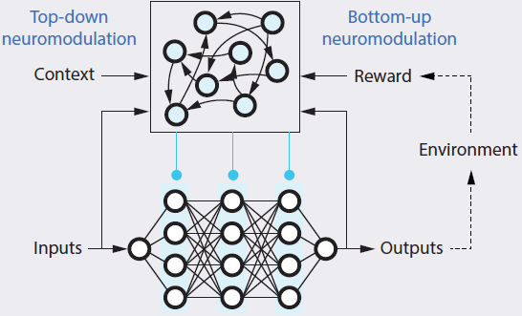
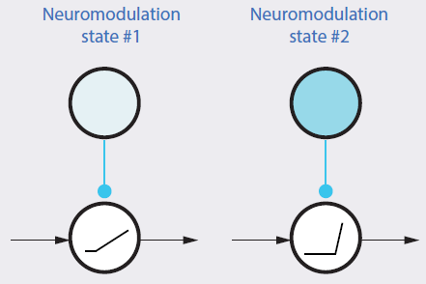
Classical architecture for solving meta-RL problems:
Our new architecture:

Slide 20
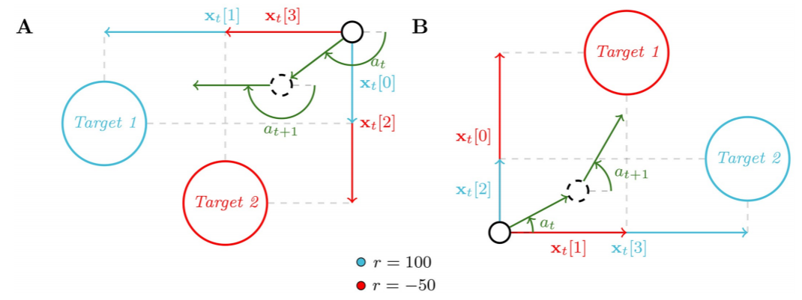
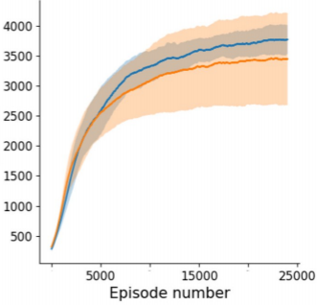
Benchmark description: The RL agent has to navigate on a plane to reach the blue target that leads to high rewards. The environments differ through the positions of the target.
Results: Blue curve represents the neuromodulated neural net. Orange curve represents the classical architecture.

Slide 21
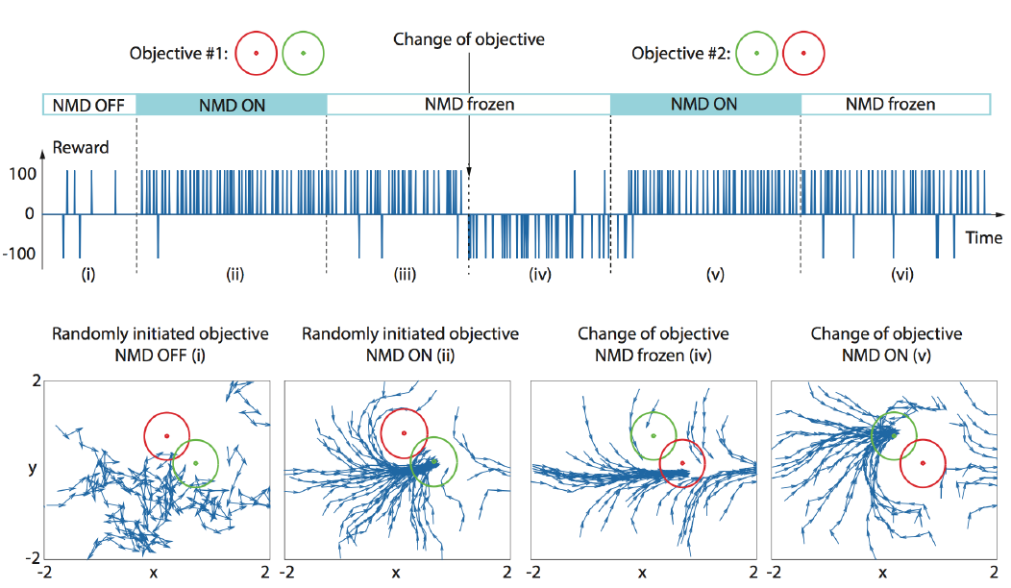
More: “Introducing neuromodulation in deep neural networks to learn adaptive behaviours”. N. Vecoven, D. Ernst and G. Drion, 2020.

Slide 22
A question that I was asked a few months ago, and my answer
What types of power system problems can one resolve with machine learning?
We could potentially address them all, but I fear that the power system community will not address many of them in the future. Why? Because the power system community will never be able to attract enough bright machine-learning scientists who prefer the high-paying salaries of major companies and corporations (e.g., Facebook, Google) or working on problems related to robotics that they believe are ‘fancier’. The power system community should therefore scale back its ambitions to build a very intelligent grid and focus on the building of grids which do not require a lot of intelligence to be effectively operated.

Slide 23
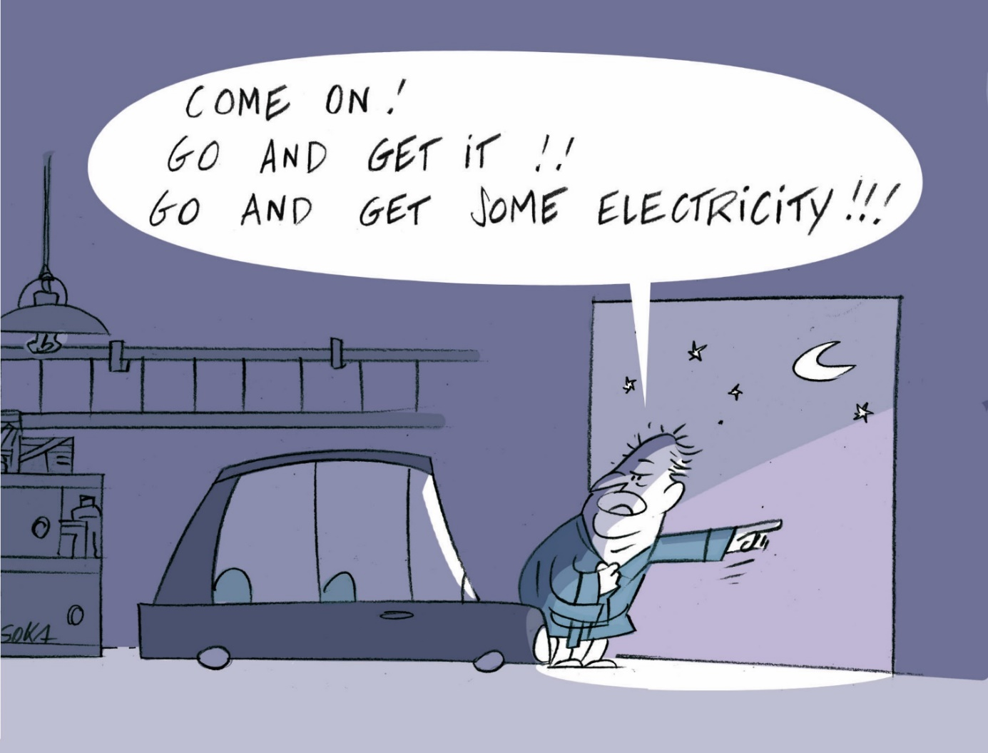
But what if big tech was disrupting the energy industry with its fancy AI solutions?
Autonomous electrical vehicle going out to collect electricity that is discharged into domestic batteries afterwards.
No need to be connected to the electrical grid anymore.

Slide 24
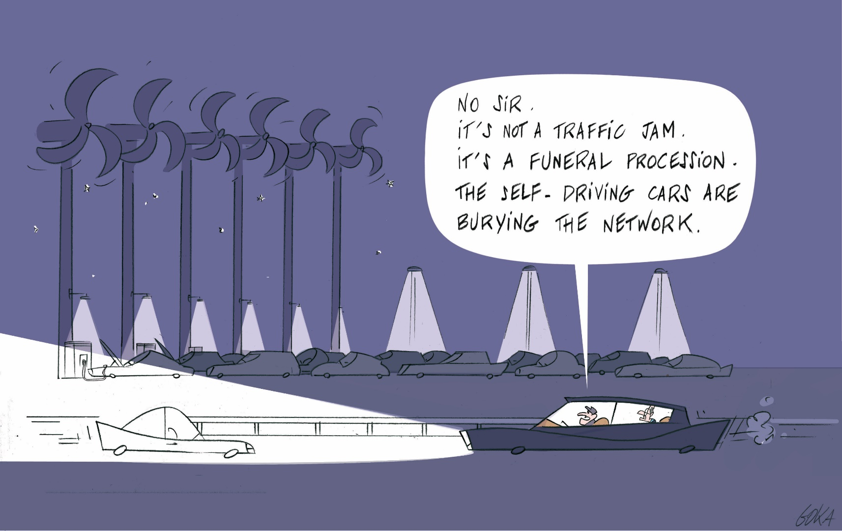
Self-driving EV cars could be charged next to electricity sources at a cheap price. Afterwards, EVs could directly sell their electricity (without using the grid) to any electricity consumer at a higher price. As such, they will act as a true competitor for the utility grid.

