Slide 1
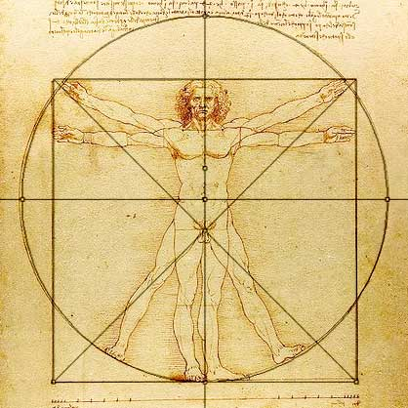
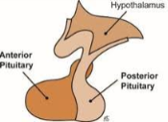
ENDOCRINOLOGY
Vitruvian Man
Leonardo Da Vinci
.
Hernan Valdes-Socin MD,PhD
Assistant Professor

