Slide 1
Algorithmic Tacit Collusion Ashwin Ittoo

Slide 2
About Myself – Ashwin Ittoo
Associate Professor HEC Liège, ULiège
Research Associate, JAIST (Japan)
Associate Editor, Elsevier (Computers in Industry)

Slide 3
Tacit Collusion
When oligopolists
Coordinate prices (and/or other variables)
Jointly achieve supra-competitive profits
Without institutional agreement
Similar to cartels: reduction in welfare
Sustainable in concentrated markets
Algorithmic Tacit Collusion
Collusion between algorithmic agents
E.g. ticket pricing agents of airlines

Slide 4
Tacit Collusion (cont)
Does AI make tacit collusion likelier?
Confusion in literature
2 school of thoughts
“Optimists”
Increased occurrence of tacit collusion
Tacit collusion as credible threat
(Ezrachi & Stucke, 2015; Zhou, Zhang, Li, & Wang, 2018)
“Rationalist”/“Pessimistic”
Tacit collusion as theoretical conjecture
Hard to replicate and validate in practice
(Zhou, Zhang, Li, & Wang, 2018)

Slide 5
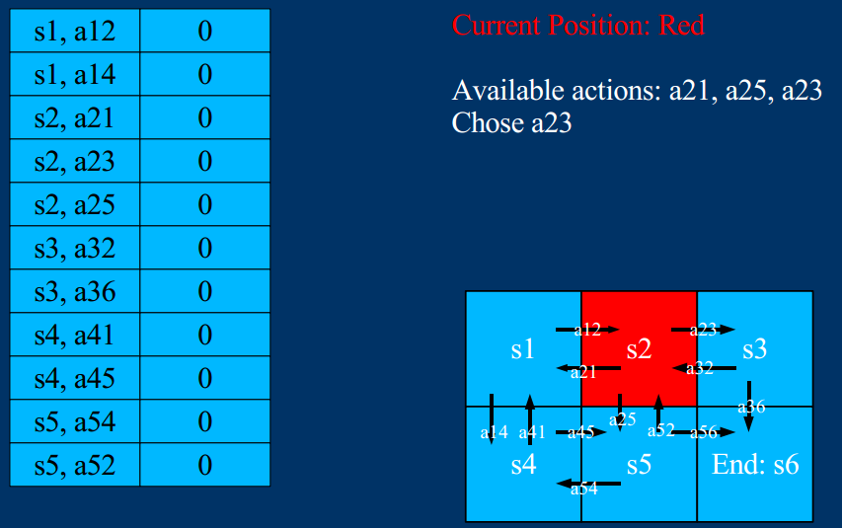
Current State-of-the-Art/Reinforcement Learning
Tacit collusion
Instance of decision-making problem
Requires coordination between multiple agents
Modeled as Reinforcement Learning (RL)
Reinforcement Learning (RL)
Agent (e.g. pricing algorithm) explores environment
Learns best action sequences (e.g. increase price)
Reach goal (e.g. maximize profits)
Update Q-value (discounted reward) for each action

Slide 6
Deep Reinforcement Learning & Coordination Games
Deep RL
Deep neural networks to lean Q-function
Coordination/competition between Deep RL agents in multi-agent games
Active, recent research area
Fail or lack propensity to cooperate even if beneficial in long-run
(Crandall, et al., 2018; Peysakhovich & Lerer, 2018; Leibo, Zambaldi, Lanctot, Marecki, & Graepel, 2017).
Cooperation enforced, stimulated via specific mechanisms
(Zhou, Zhang, Li, & Wang, 2018; Peysakhovich & Lerer, 2018; Perolat, et al., 2017)

Slide 7
Possible Research Direction
Algorithmic Collusion
Natural emergence of cooperation
Potentially N selfish agents
Likelihood for algorithms to collude?
Empirical, experimental verification?

Slide 8
Possible Research Direction/Experiment Design (cont)
Oligopoly setting
N competing (seller) agents
Sellers, producers of product/service
DRL (AI) to determine best strategies (+, - price) → max. profits
M customer agents
No AI
Heuristic: buy from cheapest seller (agent)

Slide 9
Possible Research Direction/Experiment Design (cont)
How would seller agents behave?
“Price war”
Decrease prices
Extremely competitive prices
Collude
Increase prices
Results in cartel, detrimental to customers
Threat of defection?

Slide 10
Possible Research Direction/Experiment Design (cont)
Stag-Hunt (SH) game formalization
Risk dominant equilibrium
(SH players forage mushrooms)
Sellers decrease prices
Sub-optimal profits (price-war)
Payoff dominant equilibrium
(SH players collaborate to hunt)
All sellers agree to increase prices → Collusion
Max. profits (rewards) for all
Defection risk
(SH player hunts alone , get gored)
1 seller defects from cartels , lowers its price
Max. its own profits

Slide 11
Possible Research Direction/Experiment Design (cont)
Parameters that incite agents to defect, collaborate (collude)?
Value of reward (profit)?
Number of agents (customers, sellers)?
Price?
Language/messages (agents learn about others’ intention)?
But many other external, economic parameters:
Demand forecasts?
Countervailing buyer power?
More generally:
Communication/collaboration between competitors’ pricing algorithms?
Detection of algorithmic collusion by regulators?

Slide 12
THE END
Thank you for your attention

