Slide 1
AI & Law
Can algorithms collude?
Keynote @ NICS 2018
Ho Chi Minh, Vietnam

Slide 2
Agenda
Personal Background & Research Group
Examples of AI & Law
Criminal Law
Competition Law/Antitrust
Algorithmic Collusion/Reinforcement Learning
Legal, Ethical Implications of AI
Notes:
First, I will introduce myself, the research group where I am currently the head, and my own phd candidates
Then, to whet you appetitite on the topic , I will provide some examples of how the use of AI tehcnologies, in particular machine learning and deep learning have given rise to many legal and philosophical questions. My illustrations will be in the domain of criminal law and antitrust or competition law
Subsequently, i present the core subject of my talk, i.e. tacit collusion. I will discuss the econmics foundation of tacit collusion, and then discuss the algorithmic aspects, i.e. can algorithms collude.
Finally, i will discuss some general, legal implcations of AI

Slide 3
Personal Background & Research Group

Slide 4
Brief Overview & Research Group
Assoc. Professor, HEC Liège, University of Liège Belgium
Head Quantitative Methods Unit, HEC Liège
Associate Editor, COMIND, Elsevier

Slide 5
Brief Overview & Research Group
PhD candidates
2 open positions

Slide 6
AI Applications → Legal Ramifications
Notes:
To arouse your interest in the topic, I will present some applications of AI technologies, which have started to attract the attention of regulatory agencies, at the local, national, and international levels, e.g. the OECD and EU Commission
These AI applications have also created public uproar, and will pave the way for philosophical, ethical and societal reflections

Slide 7
Criminal Law
https://sites.google.com/a/chufsd.org/mr-bowden---social-studies/class-2
Notes:
First, in the area of criminal law

Slide 8
Criminal Law Case of Eric Loomis
Eric Loomis
Five criminal offenses
Drive-by shooting
Denies participation in shooting, but
Pleads guilty on 2 minor charges
Attempting to flee a traffic officer
Operating a motor vehicle without the owner’s consent
Image: https://www.clevescene.com
Notes:
I will consider the case of Mr. Eric Loomis
Mr. Loomis was charged with 5 criminal offenses, related to a drive-by shooting.
When convicted, he denied participation in the shooting but pleaded guilty to minor charges:
Attempting to flee traffic officer
Operating a motor vehicle without the owner’s consents
Loomis charged with 5 criminal offenses related to a drive-by shooting
Denies participation in shooting, But admits that he drove that car later in the evening

Slide 9
Case of Eric Loomis (cont)
Presentencing Investigation
Offenders’ background information
Includes Recidivism Risk (score)
Recidivism Risk Score predicted using COMPAS
COMPAS (now Equivant)
Machine Learning/Statistical Prediction Methods
Developed by Northpointe Inc (Michigan)
Recidivism Risk Score: 1 -10
Based on > 100 features (age, sex, history,…)
Notes:
The presentencing invetigation report for Mr. Loomis was generated using COMPAS
There are 2 things, first the PSI and COMPAS
The PSI: presentencing investigation report provides background information on the offender to the sentencing court.
One important information in the PSI is the recidivism risk, i.e. how likely is it that the offender will engage in criminal activities again
In the case of Mr. Loomis, his recidivism risk score was predicted using COMPAS, which is a software tool, based on machine learning and statstical methods, developed by Northpointe. As can be expected, the actual algorithms being used have not been disclosed, understandably so, for commercial interests
The recidivism risk score predicted lies in the range from 1 to 10, with 10 corresponding to the highest risk. Northpointe claims that the prediction is based on more than 100 features, 137 to be exact.
However, as a side note, one study has shown that simple logistic regression classifier using only 2 features had similar performance as the COMPAS tool http://advances.sciencemag.org/content/4/1/eaao5580.full

Slide 10
Case of Eric Loomis (cont)
Sentencing Decision based on
Crime seriousness
History
COMPAS assessment: Loomis → high risk of recidivism
Loomis sentenced
6 years imprisonment
5 years of extended supervision
Notes:
Sentencing decision, in the case of Mr. Loomis, was based on Seriousness of the crime (read-in charges of the shooting); History of the defendant; and COMPAS assessment identifying Loomis as high risk reoffender
Finally, Mr. Loomis was sentenced to 6 yrs of imprisonment and 5 years of extened supervision

Slide 11
Case of Eric Loomis (cont)
Loomis refutes decision
Filed for post-conviction relief
Requested new sentence hearing
“Violation of due right as COMPAS (tool) used for sentencing”
Training Data
Far more African-Americans classified as High Risk
Biased against African-Americans
Accept or Reject New Hearing Request?
Notes:
As can be expected, Mr Loomis disagreed with this decision, and filed a motion for post-conviction relief requesting a new sentencing hearing
The main argument was that there has been a violation of due process rights as COMPAS, an automatic tool, was used at sentencing .
Furthermore, it was shown that the data used to train COMPAS contained far more examples of African-Americans classified as high risk. Therefore, COMPAS was inherently biased against African-Americans
Mr loomis was an african american
I know that most, if not all of us, in the audience are acquainted with legal issues…nevertheless, let me ask you the following question: would you have accepted or reject the request of Mr. Loomis for a new hearing?

Slide 12
Case of Eric Loomis (cont)
Request for new hearing denied
COMPAS used by court
Corroborate/confirm decision
Same sentence without COMPAS
COMPAS not biased against African-Americans
Accurately discriminate between high and low risk regardless of race
But COMPAS
Not transparent/commercial software
Explainability/decisions and scores hard to explain
Notes:
Actually, his request denied:
Circuit court only used the COMPAS risk assessment to corroborate, i.e. confirm its findings
Would have imposed the same sentence without this assessment
http://advances.sciencemag.org/content/4/1/eaao5580.full
. Specifically, it is argued that the COMPAS score is not biased against blacks because the likelihood of recidivism among high-risk offenders is the same regardless of race (predictive parity), it can discriminate between recidivists and nonrecidivists equally well for white and black defendants as measured with the area under the curve of the receiver operating characteristic, AUC-ROC (accuracy equity), and the likelihood of recidivism for any given score is the same regardless of race (calibration). The disagreement amounts to different definitions of fairness. In an eloquent editorial, Corbett-Davies et al. (6) explain that it is impossible to simultaneously satisfy all of these definitions of fairness because black defendants have a higher overall recidivism rate (in the Broward County data set, black defendants recidivate at a rate of 51% as compared with 39% for white defendants, similar to the national averages).

Slide 13
Competition Law/Antitrust
https://fedsoc.org/commentary/podcasts/antitrust-regulation-of-the-use-of-intellectual-property
Notes:
Another area of law, whereby the application of AI, has created much uproar is that of Competition Law or Antitrust

Slide 14
Competition Law Personalized Pricing
Type of Price Discrimination
Customers charged different prices
Based on WTP
Staples
Pricing based on
Location, Distance from competitors’ stores
Discounts if competitors within 20 miles of Staples store
See WSJ Article
Notes:
Specifically, I will consider the practice of Price Personalization.
PP is a form of PD whereby individual customers are charged different prices based on what they are willing to pay
Shoppers accessing the same website at the same time can be shown different prices for the same product
Practice commonly adopted in e-commerce
Reports of personalized pricing provoked great deal of negative publicity of the companies involved
Staples and Amazon example from WSJ and other sources
A WSJ investigation found that Staples Inc. Displays different prices to customers after estimating their locations and distance from competitors stores.
Staples offered discounted prices if competitors were situated with 20 miles of an existing Staples store.
Several other companies involved in such discriminative practices, e.g. Rosetta Stone Inc, Discover Financial Services; and Home Depot Inc.
Study 2: The Conversation.com: Buyer Beware
Tested for personalized pricing based on Brower (chrome vs. Firefox vs. IE); platform (OSX, iOS, Android, Windows), logging-in to a user account. Some surprising results: TravelVelocity reduced the prices by 15 USD on 5%of hotel rooms. For Home Depoit, mobile users received more search results with a higher average price per item than desktop users.
Amazon case in 2000:
Amazon in 2000, when one online buyer deliberately cleared the cache before buying a DVD. The so called smartly designed website recognized him as a new user and showed lower prices to lure him. He reported a gain of $3.5 after deleting the cookies.
In September 2000, Amazon.com outraged some customers when its own price discrimination was revealed. One buyer reportedly deleted the cookies on his computer that identified him as a regular Amazon customer. The result? He watched the price of a DVD offered to him for sale drop from $26.24 to $22.74.
The company said the difference was the result of a random price test and offered to refund customers who paid the higher prices. And apparently, Amazon had experimented with such random price tests more than once: Consumers also discovered in 2000 that Amazon was using dynamic pricing when customers comparing prices on a "bargain-hunter" Web site discovered that Amazon was randomly offering the Diamond Rio MP3 player for up to $51 less than its usual $233.95 price.
Machine learning (and revenue and yield management) are at the basis of personalized pricing and predicting the WTP.
Even though offering different prices to different customers is legal, except is such offers are made on the basis of sensitive information such as race
Personalized pricing is not against the law unless it helps a company take over and dominate a market,
76% of American customers would be annoyed if they found out that they paid a different price for the same product, and the majority of customers think that the practice of price discrimination is illiegage, but it is not
PD gives rise to several ethical and legal questions:
There is lack of transparency, algorithms and features used are not publicly disclosed?
It is unclear how widespread is the practice of discriminating on prices?
What customer information is used ? By how much are personalized prices different from the normal price?
As a customer, impossible to know whether prices being shown have in fact being altered or if cheaper products have been hidden from search results
Is it fair?
Notion of an unbiased, impersonal internet is fast giving way to an online world, which is getting tailored and targeted
How does the regulator monitor what the consumer marketplace is like if every consumer is their own marketplace?
(even if law exists) The Competition Bureau, for example, has a lot of great laws in theory, but it's difficult to apply those laws when every consumer gets a different experience,"
"What I've seen consistently is consumers saying, I want two things simultaneously: personalized recommendations — I want retailers to show me things that are relevant to me — but I also want privacy,

Slide 15
Competition Law Personalized Pricing (cont)
TravelVelocity
Pricing based on
Browser (IE, FireFox, IE)
Platform (OSX, iOS, Android, Windows)
Account log-in
Amazon
Clearing cache, deleting cookies
Drop in DVD price: $26.24 to $22.74
Customers refunded
Notes:
In another case, the travel website, tavelvelocity was found to discriminate users based on their browesers (Firefox, IE), type of OS (Windows, Osx, IoS) and whether they user had logged in to the site.
Fianlly, we have the famous case of Amazon.com in the year 2000. A user found out that by deleting clearing his browers’s cache and deleting cookies, the prices ofa DVD on Amazon dropped from from $26.24 to $22.74
Amazon later stated that the price difference was due to a random price test, and offered to refund all customers who had paid a hidher price.
Amazon case in 2000:
Amazon in 2000, when one online buyer deliberately cleared the cache before buying a DVD. The so called smartly designed website recognized him as a new user and showed lower prices to lure him. He reported a gain of $3.5 after deleting the cookies.
In September 2000, Amazon.com outraged some customers when its own price discrimination was revealed. One buyer reportedly deleted the cookies on his computer that identified him as a regular Amazon customer. The result? He watched the price of a DVD offered to him for sale drop from $26.24 to $22.74.
The company said the difference was the result of a random price test and offered to refund customers who paid the higher prices. And apparently, Amazon had experimented with such random price tests more than once: Consumers also discovered in 2000 that Amazon was using dynamic pricing when customers comparing prices on a "bargain-hunter" Web site discovered that Amazon was randomly offering the Diamond Rio MP3 player for up to $51 less than its usual $233.95 price.
Machine learning (and revenue and yield management) are at the basis of personalized pricing and predicting the WTP.
Even though offering different prices to different customers is legal, except is such offers are made on the basis of sensitive information such as race
Personalized pricing is not against the law unless it helps a company take over and dominate a market,
76% of American customers would be annoyed if they found out that they paid a different price for the same product, and the majority of customers think that the practice of price discrimination is illiegage, but it is not
PD gives rise to several ethical and legal questions:
There is lack of transparency, algorithms and features used are not publicly disclosed?
It is unclear how widespread is the practice of discriminating on prices?
What customer information is used ? By how much are personalized prices different from the normal price?
As a customer, impossible to know whether prices being shown have in fact being altered or if cheaper products have been hidden from search results
Is it fair?
Notion of an unbiased, impersonal internet is fast giving way to an online world, which is getting tailored and targeted
How does the regulator monitor what the consumer marketplace is like if every consumer is their own marketplace?
(even if law exists) The Competition Bureau, for example, has a lot of great laws in theory, but it's difficult to apply those laws when every consumer gets a different experience,"
"What I've seen consistently is consumers saying, I want two things simultaneously: personalized recommendations — I want retailers to show me things that are relevant to me — but I also want privacy,

Slide 16
Competition Law Tacit Collusion
Collusion (cartel formation)
Agreement between firms (e.g. on price, quantity,…)
Profits (under collusion) > Profits (under normal competition)
Explicit vs. tacit (with vs. without prior agreements)
Illustration: Competitors on Paris-Saigon Trip
COLLUSION
Competition Price: 1600 EUR
Competition Price: 1400 EUR
Collusive Price: 1700 EUR
Higher Profits
Notes:
So that was Personalized Pricing
Another phenomenon, brought about by the advent of AI and, which has been predicted to disrupt Competition Law is that of algorithm tacit collusion.
Before discussing the AI technolgies and algos underlying tacit collusion, I will provide a brief overview of the econs foundations of tacit collusion.
Collusion (or cartel formation) refers to a situation whereby firms agree to realize profits superior to normal profits they would get in a situation of compeption.
From CRIDS lecture?
We talk about collusion (or cartels) when firms on a market agree to realize profits superior to the "normal" profits they should get in a situation of competition
Collusion can be: Explicit: the firms agree explicitly on prices, but also on quantities, production capacities, investments in R&D, etc. Tacit: behavior that allows firms to realise profits superior to the "normal" profits, without an explicit agreement
Firms in a market are tempted to collude to raise their market power (their profits)... We suppose that in the case of competition, firms "maximize their profit". Why then forming a cartel makes it possible for firms to raise their profits? Because a situation of competition is comparable to the prisoner dilemma: A firm decides of its strategy (by setting prices, quantities, investments...) to maximize its profits... ... but it doesn’t take into account the effect of its decision on the other firms. In a cartel, the firms take into account how the decisions of each of one them impacts the profits of the others.

Slide 17
Competition Law Tacit Collusion (cont)
Firms in collusion
Incentives to cheat/deviate from cooperative equilibrium
Setting lower price than collusive price
Increase market share → more profits
COLLUSION
Competition Price: 1600 EUR
Competition Price: 1400 EUR
Collusive Price: 1700 EUR
Higher Profits
Deviation Price: 1500 EUR
Higher Market Share
Notes:
Firms in cartels have clear incentives to cheat or deviate from the cooperative equilibrium
Breaks unilaterally from the collusion agreement by setting a lower price than the cartel price and capturing a larger market share
Why don’t all firms collude?
Forbidden by various competition policy (EU) antitrust laws (US)
Firms in cartels have clear incentives to cheat or deviate from the cooperative equilibrium
Breaks unilaterally from the collusion agreement by setting a lower price than the cartel price and capturing a larger market share
Thus, at the cornerstone of collusion is punishment mechanisms.
Punishments
The "punishment": a temporary price war, or any other actions aiming at reducing the deviant firm’s profits.
The "punishment" should be sufficiently costly compared to the deviation profits.
Two important aspects:
Detection of deviation
Punishment
Use Axel’s example of discount factor, and t+21 etc

Slide 18
Competition Law Tacit Collusion (cont)
Punishment essential to discourage deviations
Punishment mechanisms
Temporary price wars; Reduce deviant firm’s profits
Should be costly compared to deviation profits
COLLUSION
Competition Price: 1600 EUR
Competition Price: 1400 EUR
Collusive Price: 1700 EUR
Higher Profits
PUNISHMENT
Price war! 1200 EUR
Deviation Price: 1500 EUR
Higher Market Share
Notes:
Thus, at the cornerstone of collusion is punishment mechanisms.
Punishments
The "punishment": a temporary price war, or any other actions aiming at reducing the deviant firm’s profits.
The "punishment" should be sufficiently costly compared to the deviation profits.
Two important aspects:
Detection of deviation
Punishment
Use Axel’s example of discount factor, and t+21 etc

Slide 19
Algorithmic Collusion
Advent of sophisticated AI
Increase occurrences of tacit collusions
More transparent markets
Monitoring competitors’ prices easier
More sophisticated learning paradigms
Pricing algorithms learning how to adjust prices
Realize that Collusion → higher profits
Algorithmic Collusion
High up on agenda of scholars and institutional policy makers
Notes:
Advent of more sophisticated AI, concerns that deployement of “intelligent” pricing algor increase the occurrences of collusion→ algo collusion
Amongst the wealth of concerns raised by Artificial Intelligence (“AI”), one is the risk that the deployment of algorithmic pricing agents on markets will increase occurrences of tacit collusion by orders of magnitude, and well beyond the oligopoly setting where such markets failures have been traditionally observed. This concern has already generated policy interest, and regulatory options are now commonly discussed at academic, commercial and official conferences
Two main hypotheses are put forward to support this claim:
Markets become more transparent, e.g. price monitoring algorithms that monitor competiors’ prices
Pricing algorithms adopt more sophisticated learning paradigms, and can learn that they reap higher profits when colluding
Algorithmic collusion is therefore high up the agenda of scholars and of institutional policy makers
Transparancy: undoubtedly algorithms and big data increase market transparency so at first we could consider them as pro-collusive
A prominent issue, which has recently garnered the interest of scholars and institutional policymakers (e.g. EC, OECD) is that of algorithmic tacit collusion, whereby AI-enabled pricing algorithms learn autonomously that they reap higher rewards by colluding than by competing (Klein 2018, Ezrachi and Stucke 2017).
With algorithms, several pieces of legal scholarship have advanced the conjecture that tacit collusion will be sustainable in markets which no longer need significant levels of oligopoly concentration. Ezrachi and Stucke write that an “industry’s shift to pricing algorithms can spread tacit collusion beyond duopolies to markets with five or six large firms”
(A Ezrachi and ME Stucke. Virtual Competition: The Promise and Perils of the Algorithm-Driven Economy (2016). )
review paper of the OECD indicates that “algorithms might affect some characteristics of digital markets to such an extent that tacit collusion could become sustainable in a wider range of circumstances possibly expanding the oligopoly problem to non-oligopolistic market structures”.
OECD, Algorithms and Collusion - Background Note by the Secretariat, 21-23 June 2017. OECD, Algorithms and Collusion - Background Note by the Secretariat, 21-23 June 2017.
Topkins-like crimes, the collusion is explicit collusion, because the seller had otherwise demonstrated a will to collude with other parties and then coded the algorithm to carry out the agreement. These collusion were not established automatically by algorithms,
Illustration using AF and BA: algos learn tacility to set collusive prices (as prices are now transparent)
We remain in lack of understanding of whether current AI technology holds the capabilities that entitle algorithmic pricing agents to autonomously enter into tacitly collusive strategies without human intervention

Slide 20
Algorithmic Collusion (cont)
Fundamental Question
Can algorithms learn how to collude?
Collusion
Coordinating on prices
Punishing deviators (reduce incentives to cheat)
Algorithmic collusion demonstrated
Zhou et al. (2018)
Klein et al. (2018)
But…
Notes:
From a tech perspective, a fundamental question is whether algorithms can learn how to collude given the current sota in AI?
Remember, there are 2 aspects to collusion
Coordinating prices
Punishing deviators via a credible punishment mechanisms so that firms are not tempted to deviate/cheat
Research on algorithmic tacit collusion is divided into two schools: those perceiving it as a credible threat (Klein 2018, Ezrachi and Stucke 2017, Mehra 2015) and those adopting a more nuanced stance (Zhou et al., 2018). Nevertheless, recent studies (Zhou et al. 2018, Klein 2018)have attempted to empirically demonstrate that algorithms can tacitly collude. However, the duopolistic environment considered is overly-restrictive. Also, the algorithms in (Zhou et al. 2018) do not learn autonomously, but behave according to a well-defined zero-determinant strategy.

Slide 21
Algorithmic Collusion (cont)
Simplified duopolistic environment
Real-life oligopolist
Algorithms (agents) follow pre-defined strategies
No autonomous learning of behavior
E.g. in Zhou et al. (2018)
Zero-Determinant (ZD) strategy in Iterated Prisoner’s Dilemma
ZD strategy coerces opponent to cooperate fully
Notes:
Talk a bit about Zhou here.
how to design an explicit algorithm, which can practically enforce a human rival to collude in laboratory experiment : they focus on algo-human interaction and not algo-algo
zero-determinant (ZD) strategy theory in iterated prisoner’s dilemma (IPD) [24]. The ZD strategies are a new class of memoryone, probabilistic and conditional response strategies that are able to unilaterally set the expected payoff of its opponent in the IPD irrespective of the opponent’s strategy (coercive strategies). ZD strategist simplify its opponent decision making — from strategy interaction problem to a optimal problem. According to ZD theory, in an algorithmhuman interaction IPD game, if the algorithm applying ZD strategy, its rational humanrival has to cooperate fully. → some form of coercive strategies here?
Cournot duopoly model is a basic economic model for business competitions [21]. In this model there are only two agents (firms) to make a same product, and the competition is on quantity. The competition is to make decisions how many production they offer at the same time. If both firms collude with the other, they can reduce product supply to a quantity (denoted as Qc) to make their profit biggest. The Nash equilibrium quantity (denoted as Qn) in this model is a situation in which firms interact with each other and choose their best strategy given the strategies that the other have chosen
Considering the equivalent of Cournot duopoly model and iterated prisoner’s dilemma (IPD) game, our algorithm design is inspired by IPD. A class of IPD strategy is described by the
outcomes of the previous round, namely memory one strategy.
Explaining equn
Memory one strategy states that, in a long rounds time (e.g., day, hour, minute) series T = {1, 2, 3, ..., t − 1, t, t + 1, ...}, the strategy at t round depends only on the latest previous round (t− 1). In a (X, Y) two player game, at t, the player Y can use the information set at time t − 1 to decide its own strategy y at t
S represents normalized payoff of Y and its opponent X
as..SEE ARTICLE FOR EQN
Conclusion: we show that, the algorithm can successfully extort its human rival and gets higher profit in long-run, meanwhile the human rival will fully collude with the algorithm. As a result, the social welfare declines rapidly and stably.
. algorithms in (Zhou et al. 2018) do not learn autonomously, but behave according to a well-defined zero-determinant strategy
Then, talk about our 1st article: RL

Slide 22
Algorithmic Collusion (cont)
Can algorithms collude?
Still an open research question
Addressed by large consortium: AI, Law, & Economics
See Ittoo & Petit, 2017
Notes:
Together with colleagues from econs and law, our research is targeted at trying to solve this RQ
To study the phenomenon of algo collusion, we adopted a framework based on RL
Definition of RL:
Reinforcement Learning refers to class of AI/learning algorithms, which are goal-oriented. These algos, known as agents, learn how to achieve an objective of maximizing a rewards over several episodes.
The agent is may start from a completely blank state, and learns via trial and error about rewards it obtains when interacts with its env
To interact with its env, the agent performs actions, which cause a transition from the current state of the env to a new one
Show illustration of agents interacting with SummerSchool or HK notes.
Thus, RL can be formulated as an MDP
Why RL is suitable to study algorithmic collusion? (see points in slide above, from CRIDS article)
Two main RL paradigms:
Model based and model-free methods:::show diagram from SummerSchool, slide 7: overview of RL

Slide 23
Algorithmic Collusion (cont)
Reinforcement Learning (RL) Approach
Class of AI methods
Algorithms/Agents interact with environment
Perform actions, e.g. increase, decrease, maintain price
Actions result in state transitions
Goal: Learn action sequences yielding highest rewards, e.g. profits

Slide 24
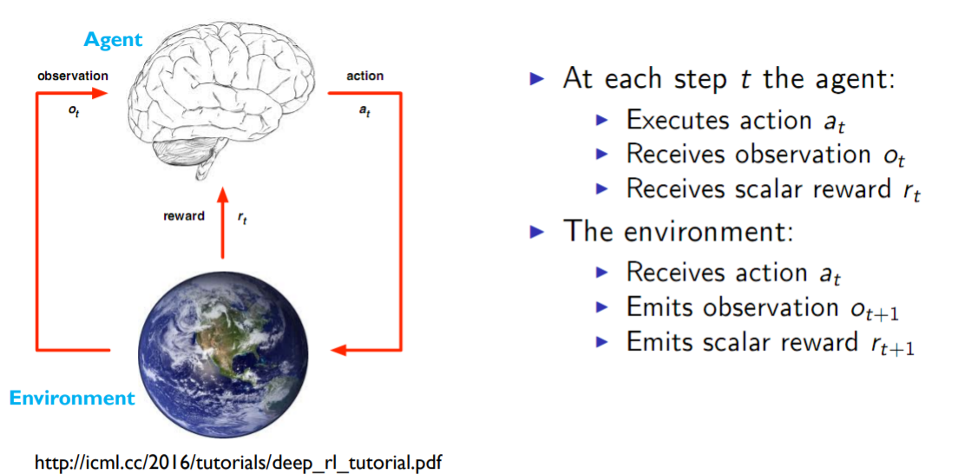
Algorithmic Collusion (cont)
Notes:
Show illustration of agents interacting with SummerSchool or HK notes.
Thus, RL can be formulated as an MDP
Why RL is suitable to study algorithmic collusion? (see points in slide above, from CRIDS article)
Two main RL paradigms:
Model based and model-free methods:::show diagram from SummerSchool, slide 7: overview of RL

Slide 25
Overview of Reinforcement Learning
Our study focuses on reinforcement learning algorithms. RL is a suitable framework to study the interaction of profit maximizing algorithmic agents because it shares many analogies with the situation of oligopolists in markets:
RL is a trial-and-error approach. With RL, a pricing agent thus has to try different strategies (policies/actions) before deciding which one to choose
A RL pricing agent faces an exploration v exploitation tradeoff in choosing the next action, which can be compared to pricing tradeoffs in oligopoly markets
Rewards are delayed as a RL pricing agent does not immediately know whether it chose the best policy (i.e. whether they took the most “optimal” action), in line with the idea that prices on markets do not adjust instantly
A RL pricing agent tries to learn the best actions to outperform its opponents or to reach a consensus (Nash equilibrium of tacit collusion). In that respect, RL encourages or discourages certain actions via positive or negative feedback
Notes:
Together with colleagues from econs and law, we are also participating in a large scale project aiming at addressing the question of whether pricing algorithms can learn how to form collusion in order to maximize their profits
To study the phenomenon of algo collusion, we adopted a framework based on RL
Definition of RL:
Reinforcement Learning refers to class of AI/learning algorithms, which are goal-oriented. These algos, known as agents, learn how to achieve an objective of maximizing a rewards over several episodes.
The agent is may start from a completely blank state, and learns via trial and error about rewards it obtains when interacts with its env
To interact with its env, the agent performs actions, which cause a transition from the current state of the env to a new one
Show illustration of agents interacting with SummerSchool or HK notes.
Thus, RL can be formulated as an MDP
Why RL is suitable to study algorithmic collusion? (see points in slide above, from CRIDS article)
Two main RL paradigms:
Model based and model-free methods:::show diagram from SummerSchool, slide 7: overview of RL

Slide 26
Algorithmic Collusion (cont)
Q-Learning for RL
Commonly employed (cellular channel allocation, robotic control, wholesale electricity market)
Q-value at the core of Q-learning
Expected total reward, r,, e.g. profit
Taking action a (e.g. increase price) in state s
γ: discount factor
Agent computes Q-values
Stored in a Q-matrix
Notes:
In our initial experiments to study algorithmic collusion, we employed a type of RL known as Q-learning.
Q-learning has been commonly deployed in various applications, e.g. cellular phone channel allocation and robotic control, and for pricing of electricity in wholesale markets
At the core of Q-learning is a Q-value:
Expected future discocunted reward of taking action a in state s, gamma is a discount factor
In our first set of experiments, we employed a value-based model of RL, known as Q-learning. It has been commonly employed in various applications,, such as cellular phone channel allocation, pursuit-games and robotic control. The Q-Learning algorithm has also been commonly employed for dynamic pricing applications like airline fares or wholesale electricity markets.
At the core of Q-Learning, is a Q-value, which …see HK slides (already in above slides)
The learning procedure formalized in terms of Bellmans’s equation, show eqn for optional Q-value function: and explanation as above.

Slide 27
Algorithmic Collusion (cont)
Optimal Q-value function, Q*
Max. expected cumulative future rewards of a in s
Satisfies Bellman’s equation
Notes:
In our initial experiments to study algorithmic collusion, we employed a type of RL known as Q-learning.
Q-learning has been commonly deployed in various applications, e.g. cellular phone channel allocation and robotic control, and for pricing of electricity in wholesale markets
At the core of Q-learning is a Q-value:
Expected future discocunted reward of taking action a in state s, gamma is a discount factor
In our first set of experiments, we employed a value-based model of RL, known as Q-learning. It has been commonly employed in various applications,, such as cellular phone channel allocation, pursuit-games and robotic control. The Q-Learning algorithm has also been commonly employed for dynamic pricing applications like airline fares or wholesale electricity markets.
At the core of Q-Learning, is a Q-value, which …see HK slides (already in above slides)
The learning procedure formalized in terms of Bellmans’s equation, show eqn for optional Q-value function: and explanation as above.

Slide 28
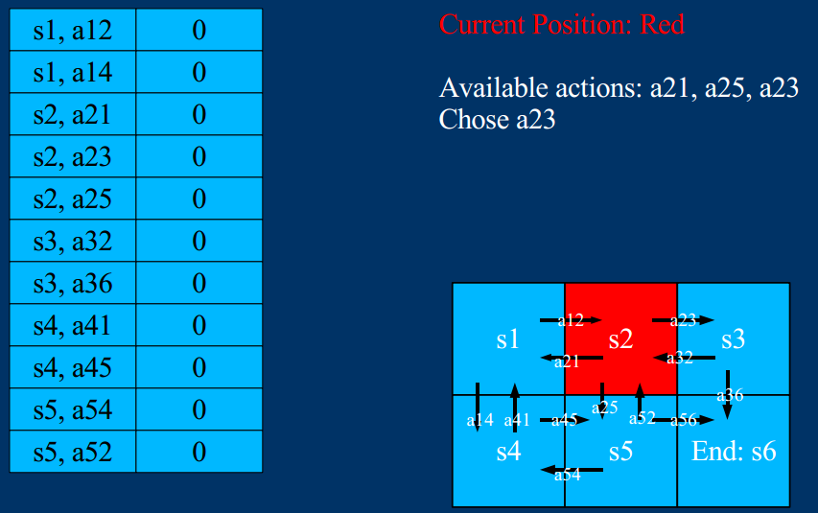
Algorithmic Collusion (cont)
Q-values maintained in Q-table (Tabular Q-learning)
Agent takes actions
Q-values updated
Learning action sequence that max. reward to reach goal
Notes:
I

Slide 29
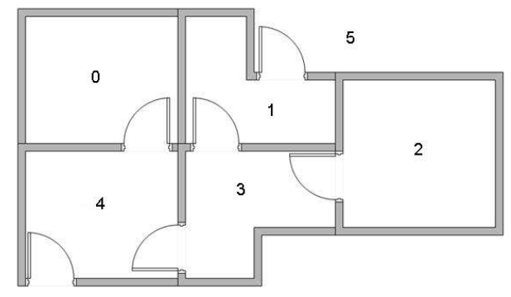
Algorithmic Collusion (cont)
Q-Learning Illustration
Autonomous agent
Learns how to exit building (state 5)

Slide 30
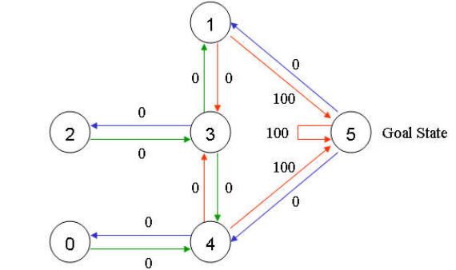
Algorithmic Collusion (cont)
Q-Learning Illustration (cont)

Slide 31
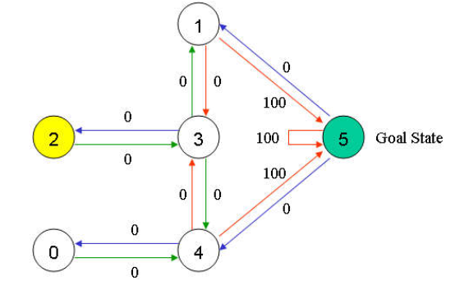
Algorithmic Collusion (cont)
Suppose agent starts in state 2

Slide 32
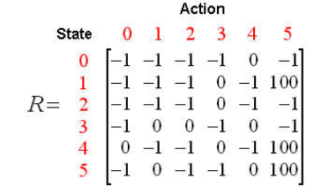
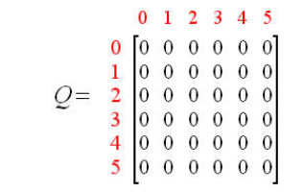
Algorithmic Collusion (cont)
Initialize
R (reward) matrix
Q-matrix

Slide 33
Algorithmic Collusion (cont)
Update Q-matrix in each iteration

Slide 34
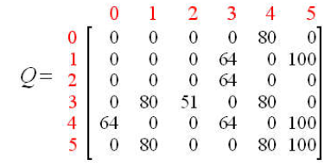
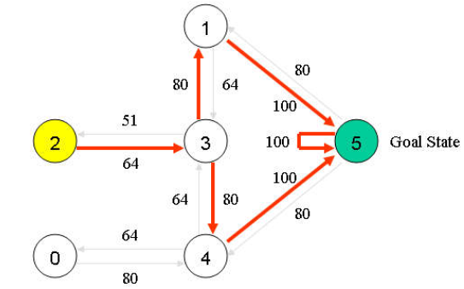
Algorithmic Collusion (cont)
Until convergence
Optimal Sequence
Highest-valued links
Notes:
Suppose Q-matrix computed by agent, represented as a graph
To go from state 2 to state 5 → simply follow links with higest Q-values
Tracing the best sequences of state = follow links with highest value at each state

Slide 35
Notes:
Two main RL paradigms:
Model based and model-free methods:::show diagram from SummerSchool, slide 7: overview of RL
In our first set of experiments, we employed a value-based model of RL, known as Q-learning. It has been commonly employed in various applications,, such as cellular phone channel allocation, pursuit-games and robotic control. The Q-Learning algorithm has also been commonly employed for dynamic pricing applications like airline fares or wholesale electricity markets.
At the core of Q-Learning, is a Q-value, which …see HK slides (already in above slides)
The learning procedure formalized in terms of Bellmans’s equation, show eqn for optional Q-value function: and explanation as above.

Slide 36
Algorithmic Collusion (cont)
Algorithmic Collusion
Involves multipme agents, n > 2
Multi-Agent system
Nash Q-Learning
For each state, m, each agent explicitly represents
Its own payoff information
Payoff information about other agents
Notes:
Algo collusion is an example of a multi-agent system, where each agent could correspond to the pricing algo of a firm in the collusion
Learning in the presence of multiple agents is challenging, and we have to employ an extention of the basic Q-learning approach, known as Nash-Q Learning

Slide 37
Algorithmic Collusion (cont)
But with n > 2 agents : Q-learning breaks down
Explosion in space requirements, 𝑛𝑚𝐴^𝑛
Exponential in the number of agents, possibly infinite
Non-stationary environment
Agents learning simultaneously
Need to track learning of other agents

Slide 38
Can algorithms learn how to collude?
Notes:
Still an open research question

Slide 39
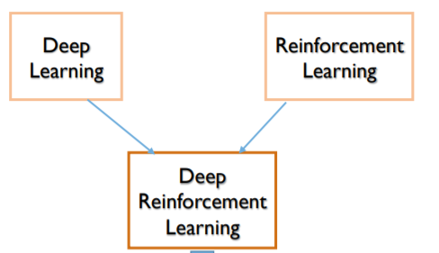
Algorithmic Collusion (cont)
Deep Learning to learning Q-value
Deep Reinforcement Learning/Deep Q-Networks (DRL/DQN)
Notes:
DRL much success solving problems that in the past provded to be formidable challenges for classical AI
Game of GO: ATARI GAME

Slide 40
Algorithmic Collusion (cont)
DRL
Solve many formidable problems
Self-driving car
Game of GO
Playing Atari video games
Notes:
DRL much success solving problems that in the past provded to be formidable challenges for classical AI
Game of GO: ATARI GAME
The primary goal is to investigate the emergent behavior of algorithmic agents in multi-agent environments for acquiring a deeper understanding of circumstances under which potentially selfish agents (may) cooperate
be grounded in multi-agent coordination games, whereby several agents (e.g. pricing algorithms from competing airline ticket vendors) evolve in a given environment and participate in decision-making such that collective rewards > individual rewards
cooperation (and competition), among (multiple) agents in multi-agent games, e.g. Stag-Hunt, Wolfpack, StarCraft (Leibo, Zambaldi, Lanctot, Marecki, & Graepel, 2017)
Overall, our DRL multi-agent environment and training procedure will be based on those presented in (Ref: Cooperation in complex social dilemma; stabilizing experience-replay). Due to space constraints, we do not elaborate on these technical aspects, but refer the reader to the aforementioned studies.
To perform our experiments on the emergence of collusive behavior, we adopt the game-theoretic settings of Prisoner’s Dilemmas (PD) and Stag Hunt (SH), which have been extensively used for studying multi-agent coordination (Ref: ). PD is one of the most elegant models to study cartels (Deng, Crandall), and SH embeds coordination dynamics ubiquitous in real-life (Ref: Prosocial). Briefly, in PD, players (prisoners) are better off and incur a shorter sentence if they cooperate (remain silent). However, the Nash equilibrium strategy is for both of them to defect (betray each other), each incurring a longer sentence. In SH, there are 2 equilibria: 1) risk dominant: each player individually forages for mushrooms, with a low reward, 2) payoff dominant: players cooperate to collectively hunt stags, with higher rewards. Individual players who hunt (alone) are gored by the stags. According to past research, the slightest doubt as to whether players will cooperate and show up to hunt causes agents to choose the safe action of mushroom foraging, leading the entire system to the inefficient (risk-dominant) equilibrium (Ref: Pro Social). A direct analogy can be drawn from these game-theoretic settings and our domain of DRL (seller) agents. For e.g. in the SH setting, we investigate whether our DRL agents eventually learn how to coordinate their actions by collectively increasing (or decreasing) their prices, resulting in a collusive strategy. This is analogous collectively hunting stags, which yields a high reward. However, such a strategy also entails a significant risk: an agent which has increased its prices, with the intention of creating collusion, may be exploited by other agents, which may choose to actually decrease their prices in order to acquire more customers. This is analogous to an agent hunting alone and being gored.
Cooperation seems easy, but not punishment

Slide 41
Algorithmic Collusion
Deep-Q learning formulation algorithmic collusion
N competing firms
N algorithmic DQN agents
Experience Replay to ensure convergence
DQN agents’ actions
{increase, decrease, maintain} price
Objective
Learn best actions → max profits
Notes:
Now, how do we formulate the problem of algo collusion within the framework of deêp Q-learning
In the context of algo collusion,
We will have a number firms, competitors
Each uses a Q-learning algorithm/agent, which can perform a number of actions, such as increase/decrease or maintain price, in order to maximize a goal, which corresponds to profits
However, classical applications of Q-learning have been restricted to relatively simplistic environment, consisting of a single agent, e.g. in robotic control, or in zero-sum games, whereby one agents’ loss corresponds to the other agents’s gain
Our env is more challenging
Multi agents interacting, each ones actions can influence the other’s decision
In game theory, we have a general sum game (vs. a zero-sum game)

Slide 42
Algorithmic Collusion
In game-theory
Algoritmic collusion → social dilemma
Social Dilemma?
Capture reward (profit) individually, R₁
Coordinate and cooperate, reward R₂
R₂ > R₁
Notes:
In game theory parlance, algorithc collusion is akin to a social dilmmea,
That is agents face a dilmmena

Slide 43
Algorithmic Collusion
Game theoretic setting: stage-hunt game
2 Agents
Hunt stags (High rewards)
Collect mushrooms (Low rewards)
But
Impossible to hunt alone→ must cooperate to hunt
Possible to collect mushrooms alone
Notes:
In game theoretic setting, modelled as stag-hunt

Slide 44
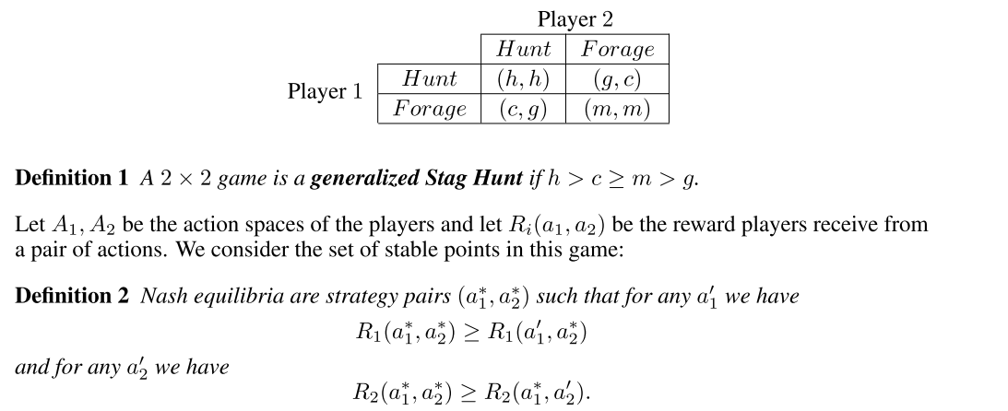
Stag Hunt Payoff Matrix
Notes:
Initial results:
Chalenges from article ; Algo and Markets: P 10

Slide 45
Algorithmic Collusion (cont)
Agents implemented as Deep Q-Networks
Deep Learning to approximate Q-function
Loss function
Backprop & gradient descent
Update network weights

Slide 46
Algorithmic Collusion (cont)
Allow agents to play
Observe emergent behavior over multiple rounds
Do agents cooperate for higher reward (hunt stag)?
Does 1 agent deviate from cooperation? When?
What parameters favor cooperation & deviation?
Notes:
This is our current research,
We would love to hear from you if you have insights

Slide 47
reinforcement learning, an agent interacting with its
environment is attempting to learn an optimal control pol- icy. At each time step, the agent observes a state s, chooses an action a, receives a reward r, and transitions to a new state s?. Q-Learning is an approach to incrementally esti- mate the utility values of executing an action from a given state by continuously updating the Q-values using….
See Egorov with. Combined Egorove with Leibo
Contains equantion fo loss function an ADAM optimizer
Mention about experience replay

Slide 48
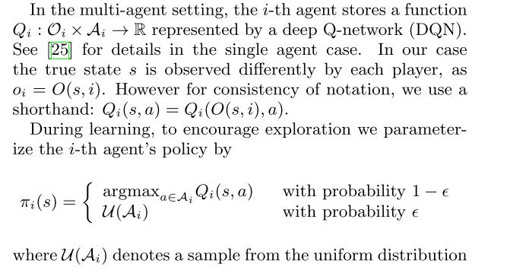
Leibo
The network representing the function Q is trained through gra- dient descent on the mean squared Bellman residual with the expectation taken over transitions uniformly sampled from the batch → looks better than the description of Stag Hunt Peyskovik etc
→ no need to talk about policy gradients then
--
Peysjovick
policy gradient based agents with softmax action implementation. For optimization we use Adam (Kingma and Ba, 2014) with a learning rate of .01 as well as random initialization. We train each pair of agents for 400 rounds and look at average behavior in the last 50 rounds. We train 300 replicates and average them together

Slide 49
Investigations underway
we investigate whether our DRL agents eventually learn how to coordinate their actions by collectively increasing (or decreasing) their prices, resulting in a collusive strategy.
an agent which has increased its prices, with the intention of creating collusion, may be exploited by other agents, which may choose to actually decrease their prices in order to acquire more customers.
An agent may deliberately decrease its price in order to capture a large market share and max its profits. → in actual collusion: punished by other agents, price wars → but will algo also undercut each others prices

Slide 50
Legal, Ethical Considerations
Notes:
To arouse your interest in the topic, I will present some applications of AI technologies, which have started to attract the attention of regulatory agencies, at the local, national, and international levels, e.g. the OECD and EU Commission
These AI applications have also created public uproar, and will pave the way for philosophical, ethical and societal reflections

Slide 51
Legal and Ethical Issues
Transparency
Transparency in the design of the algorithm or of inputs and results?
Carlson, 2017: private companies providing a public service “should be held to the same transparency requirements as public agencies” ⬄ trade secret
Burrell, 2016: three types of opacity: intentional whether corporate or state secrecy – technical illiteracy – opacity due to machine learning characteristics
Need for monitoring? Regulatory bodies?
Notes:
Now, back to some more general legal and ethical issues concerning Ai&Law

Slide 52
Legal and Ethical Issues (cont’d)
Explainability
“Explainability matters because the process of reason-giving is intrinsic to juridical determinations” (Pasquale, 2017)
Accountability
Who is accountable? Role of human beings?
Due process (‘fair trial’) rights (Freeman, 2016)
Important to be able to assess and monitor validity of algorithms (how does it work?)
Training judges to understand benefits and limitations of algorithms

Slide 53
Legal and ethical issues
Impact GDPR and Directive 2016/680? (Personal data)
Right to be informed, right of access, right to rectification (see also Article 29 Data Protection Working Party, Guidelines on automated individual decision-making and profiling for the purposes of Regulation 2016/679, WP251, 3 October 2017)
Right not to be subject to a decision based solely on automated decision-making – ‘human intervention is a key element’
“The data subject should have the right not to be subject to a decision evaluating personal aspects relating to him or her which is based solely on automated processing and which produces adverse legal effects concerning, or significantly affects, him or her. In any case, such processing should be subject to suitable safeguards, including the provision of specific information to the data subject and the right to obtain human intervention, in particular to express his or her point of view, to obtain an explanation of the decision reached after such assessment or to challenge the decision.” (Recital (38), Directive 2016/680, emphasis added)

Slide 54
THANK YOU
Notes:
With this I End my presentation
My main aim was to create awareness of the implications that AI will have in many the judicial domain.
As you can see, many unnwered questions and we might be caught unprepared

