Slide 1
Multidisciplinary Perspectives on Algorithms, Regulations, Governance, Markets

Slide 3
AI & Law
DG CONNECT
DG JUSTICE
Algorithmic Collusion
Price Discrimination
Brussels School of Competition
Law, Cognitive Technologies & AI Programme for Legal Experts

Slide 4
Agenda
Demystifying AI
Financial Legislation Information Extraction
Legal/Ethical Implications*
* If time permits

Slide 5
DEMISTIFYING AI

Slide 6
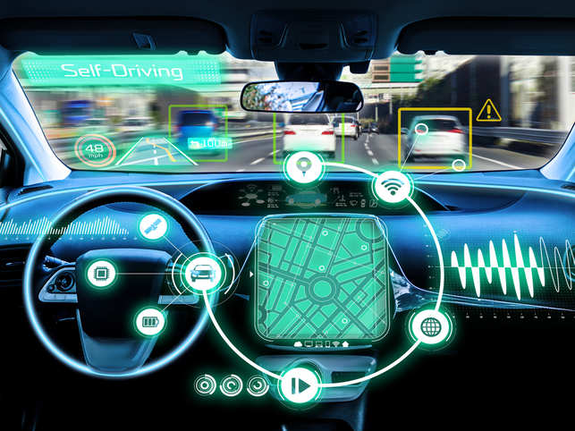
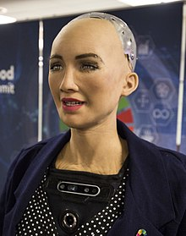
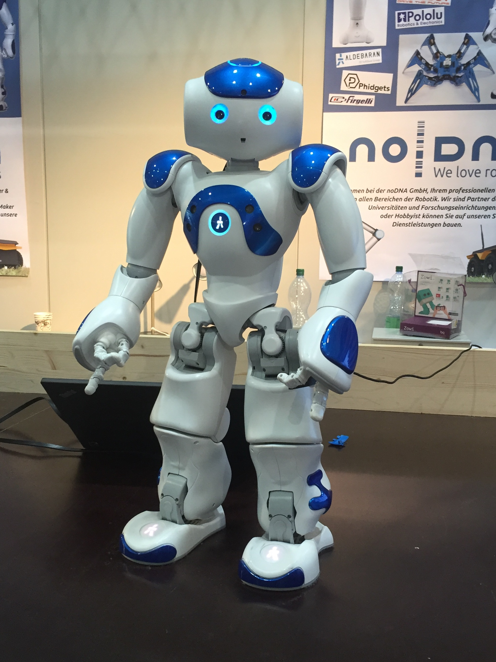
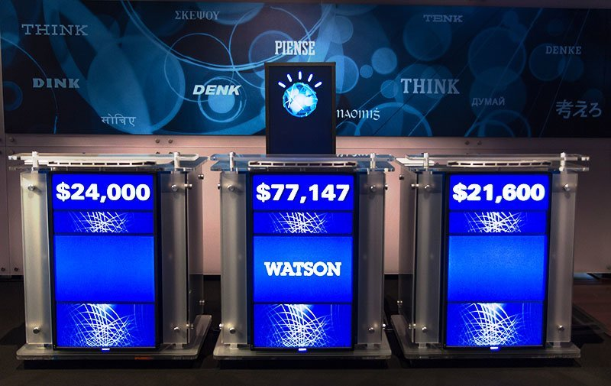
AI
Image source: Economic Times, ZDNET

Slide 7
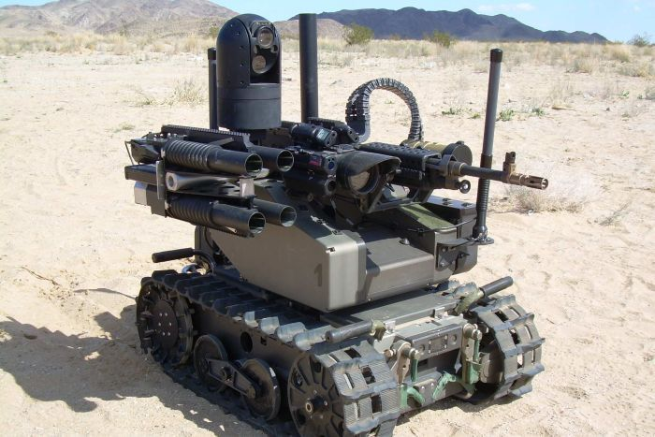
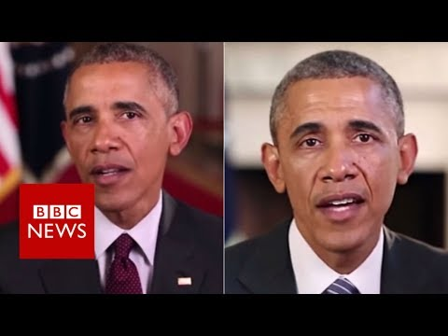
Also …
https://www.youtube.com/watch?v=AmUC4m6w1wo
Image source: BBC News, ABC News
Notes:
Also : fake news, ai in military warfare

Slide 8
Learning & Intelligence
Machine intelligence via learning → machine learning
3 main machine learning paradigms
Reinforcement Learning
Supervised Learning
Unsupervised Learning
Notes:
Aim in AI is to design machines (and algorithms) that acquire intelligence via learning and that can also develop their intelligence, which brings us to machine learning
There are 3 main types of machine learning paradigms,

Slide 9
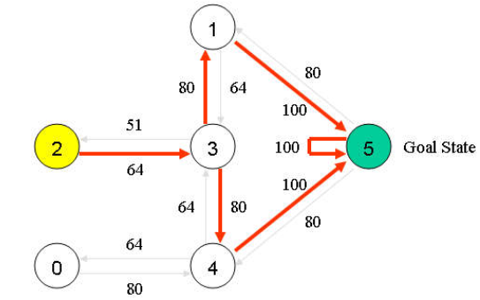
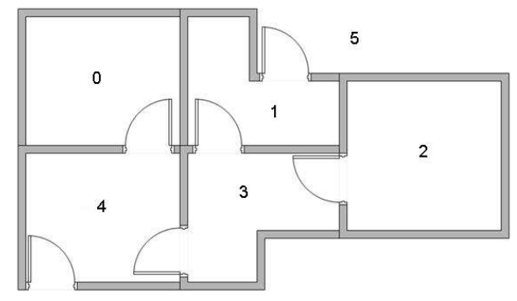
Reinforcement Learning
Example
Agent’s goal: find optimal solution to reach state “5” (exit of building)
Optimal= maximizes rewards (minimum distance travelled)
Actions: up, down, left, right
Agent learns via exploration

Slide 10
Supervised Learning
Supervised Learning
Predominant form of machine learning
Algorithms learn from past data
Data annotated with information of interest
What is to be predicted
Notes:
Predomonant form of machine learning where the algoroithls learn from past data
However, an important prerequisite is that the data is labeled or annotated with the information of interest
The information of interest is what we want to learn

Slide 11
Sample Data from COMPAS
Risk
Dependent variable
What we predict (info. of interest)
Independent variables/attributes/features
Used to make prediction
Notes:
The sample dataset consist of offernders records, described in terms of several variables. Such as gender, date of birth, and in this case, also the ethnic code
As can be seen, each record is labeled to the recidivs risk score, which is the information of interest
Algorithms are **trained** learn how to predict information of interest based on other variables
Training often involves learning of statistical relationships between them
And btw, this dataset is from COMPAS, a TOOl used in certain circuit courts in the US.
Several methods can be employed for supervised learning, starting from linear regressions…..(next slide)

Slide 12
Decision Tree
Fundamental SL method
No assumptions about linear separability
Mostly used for Classification problems (vs. Regression problems)
Dependent variable is a class/category
Recidivism risk level (high, medium, low)
Training on past data to induce a Decision Tree
Tree nodes → independent variables
Branches → variables’ values
Tree leaves → dependent variables (class/category)
Tree traversal to classify new case
Sex
male
female
Age
> 45
<= 45
…
No Risk
High Risk
Medium Risk
Notes:
To decision trees

Slide 13
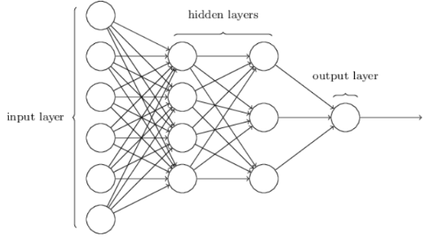
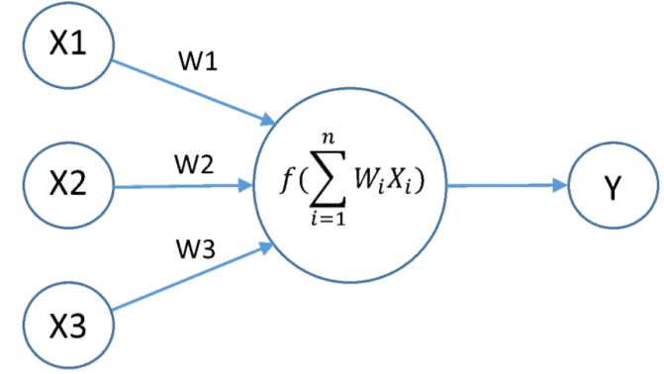
Artificial Neural Networks
At each neuron j
Outputs of previous neurons; x1,x2, x3
Apply weights; w1,w2, w3
Sum & Apply activation function, f(.)
Result input to next neuron
Repeat until final output neuron (prediction)
At output layer, check predicted value
Dependent variable value from dataset
If prediction ok: stop
Else: back-propagate error
Adjust weights
Until correct prediction
Notes:
And artificial neural networks

Slide 14
Deep Learning
Artificial Neural Networks
Large number of hidden layers (e.g. 10, 300)
Performs more sophisticated/complex tasks
Facebook Face Recognition
Voice/Speech recognition, e.g. Siri, Alexa
Often combined with Reinforcement Learning → Deep Reinforcement Learning
Game of GO
ATARI games

Slide 15
Unsupervised Learning
Learning from past data
But not labelled with information of interest
Algorithm infers relevant information from data
Encompasses plethora of different methods
Large research area
Human learning unsupervised
Notes:
The third form of learning, after reinforcement learning and supervised learning is unsupervised learning
Algorithms learn from data.
However, these data are not annotated with the information of interest
Instead the algorithm tries to infer relevant information from the data itself
It is currently an active research area, as, compared to SL and RL, unsupervised learning best reflects how humans learn
And this brings me to 2n part of my talk, on extracting information from financial legislations

Slide 16
Information Extraction from Financial Legislations

Slide 17
Context
DG FISMA
Directorate‑General for Financial Stability, Financial Services and Capital Markets Union
European Commission’s Department
Responsible for EU policy on banking and finance
Notes:
Directorate‑General for Financial Stability, Financial Services and Capital Markets Union is the Commission department responsible for EU policy on banking and finance

Slide 18
Context (cont)
Accumulation of huge volumes of financial legislations
Challenging
Financial legislation concepts?
Concepts’ definitions?
Contradictory definitions?
Location of concepts/definitions?
Large corpus of legal text
Unwieldly for human consumption, processing
Notes:
Over the years..and especially after the 2008 crises, we have seen the creation of a large number of financial legislations.
This has resulted in a huge corpus of text documents, making it challenging for legislators and private/public authorities to determine which fiancnai concepts are mentioned in these legislations, how are these concepts defined, where are they defined, e.g. in which sections/annexes, and whether there are contradictory definitions
However, the sheer size and complexity of the corpus rendered it unwieldly for human consumption and manual processing

Slide 19
Context (cont)
Can machine learning help?
Detect concepts
Determine concepts’ positions (section #, annex)
Extract concepts’ definitions
Automatically
Unsupervised fashion
Unavailability of data annotated with information of interest (e.g. concepts)
Inferred/extracted from available corpus
Notes:
he key question was therefore whether machine learning could help in detecting concepts mentioned in the legislations, and in extracting their definitions as well as information on where (which annex of which legislation) these definitions occurred.
These had to be done automatically via appropriate ML algorithms,
Furthermore, Data annotaoted with the info of interest, e.g. concepts or definitions, not available for training
Entails that we could not rely on std supervised learning methods, but had to investigate unsupervised methods.

Slide 20
Mining Financial Legislations
Automatically read & “analyze” financial legislations
Available online (EurLex)
Notes:
I will now describe the unsupervised algoritms that we developed to answer these questions
I will omit technical details, and provide a very high level overview of what the algorithms do.
To start with, financial legislations for the EU regions area available from the EurLex reposority. And example of which can be seen here.

Slide 21
Crawling/Harvesting Data
Implemented Web Crawler
Visits EurLex URLs
Selects EN version
Retrieves and stores contents (pdf, html) into text files
Notes:
The first step was to develop a crawler, to harvest the financial legislations from the online EurLex repository, and to store the contents (pdf, html..) into text files.
Our crawler also implemented a language detection to retrieve only those legislations in EN as we focus on EN

Slide 22
Concept Extraction
Concepts realized as terms
Single words: capital
Multi-word: capital risk structure
Can take on complex forms
Financial assets designated at fair value through profit and loss
10 words → 1 concept
Mix of relevant (e.g. financial assets) & irrelevant words (e.g. at, or, through)
Notes:
The second step was that of extracting concepts from the downaloded contents
Concepts are lexically manifested as words or word sequences, are they are domain specific
E.g. capital is a single word concept while capital risk structure is a multiword
Also had to automatically detect concepts with complex forms, such as “financial assets.”…10 words, some of which are relevant, and others are not

Slide 23
Concept Extraction (cont)
Concept extraction algorithm
Grounded in compositional semantics (shorter terms composed into longer ones)
Word co-occurrences statistically significant
Statistical significance of word co-occurrences
Ensures that co-occurrences are not spurious
Estimated using Pointwise Mutual Information (PMI)
Notes:
Grounded in compositional semantics, whereby shorter terms are composed into longer ones.
Furthermore, the composition of multi words had to be statistically significant.
To prevent the detecti of words that are collocated just by chance
n our algorithm, this significance is estimated using an extended form of the point wise mutual information, a measure originanting from the information theory of shanon.

Slide 24
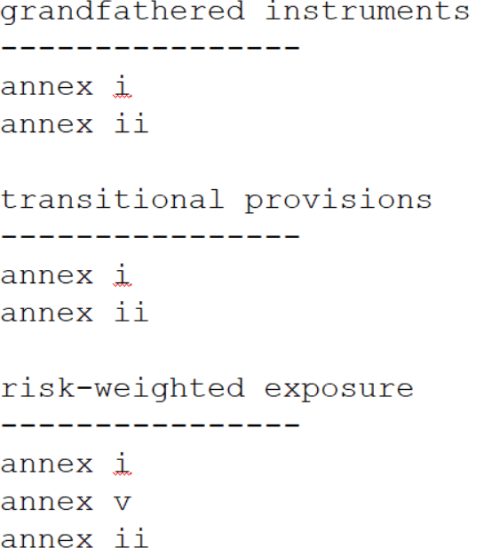
Concept Extraction
Concept Extraction Algorithm Output
Unsupervised: no annotated data, no human intervention
Frequency information
Concepts extracted
Positional information
False positives

Slide 25
Definition Extraction
Multifarious ways to express definitions in EN
Brute force solution
Create list of “definition” words (manually)
Search financial legislation corpus
Limited coverage
Unable to capture all different ways of expressing definitions
Automatically learn
How definitions are expressed (EN)?
Unsupervised?
Notes:
After concept extraction: next step, extract concepts’ definitions.
Challenge : different ways to express definitions in EN
Bute force soluton: create list of words expressing definitions and search for theem in the corpus of financial legislations.
However, we might not be able to capture al different ways
Therefore, we need to learn how definitions are expressed in EN and do so in an unsupervised manner

Slide 26
Definition Extraction (cont)
Definition Extraction Algorithm
Distributional Semantics (vs. Compositional Semantics for Concepts)
Words occurring in same contexts → similar meaning
Notes:
To this aim, we developed a definition extraction algorotihm,
Operates upon the premis of Distributional semantics

Slide 27
Definition Extraction (cont)
Large corpora of texts
Wikipedia
Tweets
Financial Legislations
For each word
Learn most probable contexts
Learning using Neural Networks
Wod2Vec
GLOVE
Notes:
We imlpelement the distributional semantics apprpachng by taking serveral large corpora, wilikedia, tweets and corpus of financial lesgislations
And for each word, we learnt the probability that it occurred in certan contexts
Learning was achieved using a neural network

Slide 28
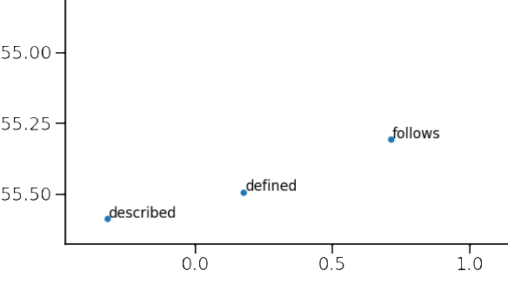
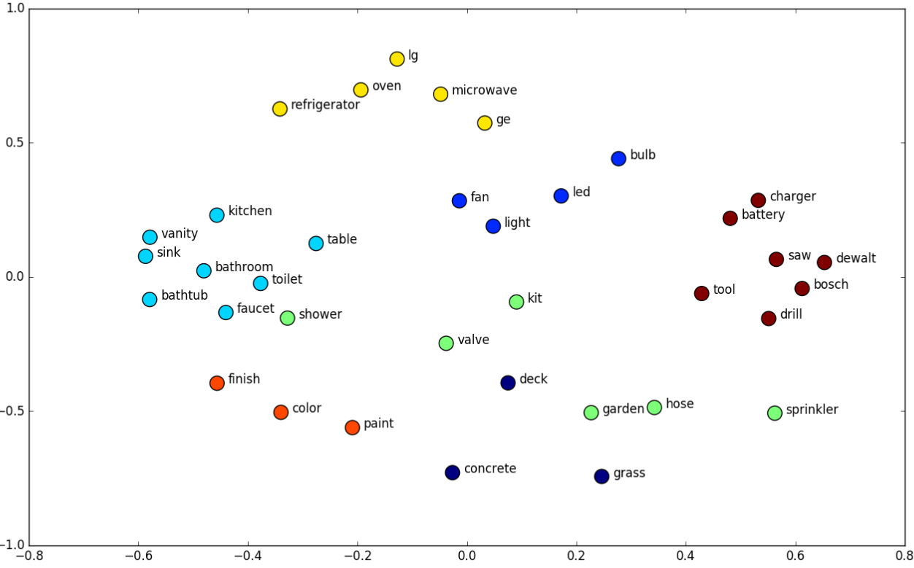
Definition Extraction (cont)
Words represented as vector
Notes:
After training or learning, each word is represented as a vector in a multi-diemanionsl apsce
A nice property of these vectors is that vectors of similar words will be close by to each other, as can be seen in the slides.
Based on the distance between vectors, we then estimate which words express deinitions

Slide 29
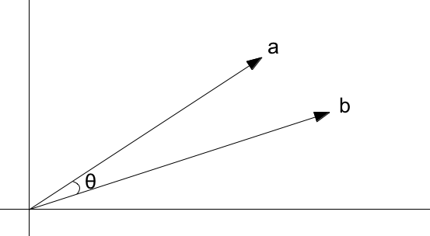
Definition Extraction (cont)
To find words expressing “definition”
Estimate similarity between vectors
Cosine similarity measure

Slide 30
Definition Extraction (cont)
Sample of extracted “Definition” words
Automatically learns which words express “definitions”
Unsupervised:
No annotated training data
No human intervention

Slide 31
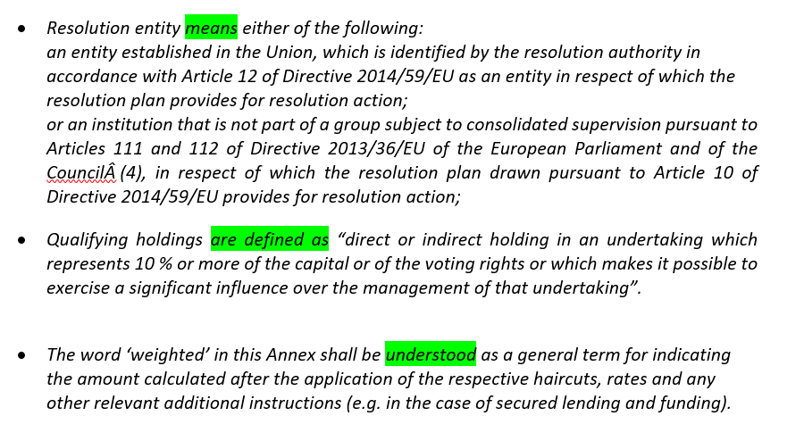
NLP Applications – DG FISMA (cont)

Slide 32
Information Extraction from Financial Legislations
Basis for legislation search engine
Legislators, regulators, public/private authorities
Search for concepts, definitions
Illustrates AI/Machine Learning use-case for legal professionals
Notes:
Our algoriths will be constitute the basis of a search engine, enabling legislators and public and private authors to search and determine what concepts are relevant for them and how these concepts are defined, which is useful in reporting.
It illustrates an interesting application of AI for the legal professon, albeit a specific domain of the law
Other aplications…next slide
Illustrates a relevant application of AI in the legal or legislative domain
Our application is an interesting example of how AI technologies can be beneficial to the legal professional1
Legislators can now easily and efficiently determine how relevant financial conets are defined and how to deal with contractradictory definitions
Our application will be used as a basis for a search engine over

Slide 33
AI Applications for the Legal Profession
Notes:
Recently, we have witnesses a surge in legaltech, especially relating to the use of AI tech in the legal domain
In the next slides, I have listed some tood these tooks, categorized according legal applications

Slide 34
Some Applications
Due Diligence
Kira systems: automating due diligence contract reviews
Search, highlight, extract relevant content
More accurate
40%-90% efficiency gains (faster)
ThoughtRiver: summarizing voluminous contract reviews
Detects risky contracts
CaseText Cara: forecasting opposing counsel’s arguments
Finds opinions/arguments previously used by lawyers
Judicata Clerk: evaluates legal briefs pros, cons

Slide 35
Some Applications (cont’d)
Prediction
Daniel Katz et al. (2017)
Prediction of justice votes and case outcomes
2 century work of cases (1816-2015)
~ 70% accuracy
Intraspexion
Warns lawyers when litigation threats detected
Ravel Law
Predicts outcomes based on case laws, judges rulings
Premonition
Predicts lawyers’ success based on win-rates, case types & duration, pairing with judge
~ 31% accuracy

Slide 36
Some Applications (cont’d)
Intellectual Property
TrademarkNow
Drastically reduces patent/trademark search time
ANAQUA Solution
Aid to drafting patents, prosecution
Detects document errors, circular claim references
Generates claim support
SmartShell
Supports paralegals
Reviews documents, identifies issues on patent applications

Slide 37
AI & Law
General Ethical Issues
Notes:
AI/ML applications are increasingly being used to automate various aspects of the legal profession.
However, the use of such tech in law also raises a number of ethica issues, ramifications..
And I will therefore conclude my presentation with some general, ethical issues of AI in law

Slide 38
Issues
Liability in case of errors/damages
Accountability and imputability
Calculation of the damages
Privacy
Input side: consent (privacy by design)
Output side: profile, automated decision
Transparency & explainability
Especially for deep learning models
Proprietary nature of AI tools, e.g. COMPAS
Limited understanding of operations

Slide 39
Issues (cont)
Contestability & due process
Case of Wisconsin vs. Loomis (2017)
Violation of due process rights COMPAS score during sentencing
AI facilitates personalization
E.g. Amazon recommendations based on personal profiles
Personalized pricing (issue in competition law)
Personalized law?
Bias
Bias in data reflected in algorithm’s prediction

Slide 40
THANK YOU

