Slide 1
2019 Eurofiling Conference
Machine Learning for EUR-Lex Legal Measures
Ashwin Ittoo, Uliège, BE
19th June 2019
ECB
Frankfurt
Notes:
Talk will be on ML research applied to financial legal measures, available in Eur-Lex

Slide 2
About Myself
HEC Liège, University of Liège, BE
Japan Advanced Institute of Science & Tech, JP
Expertise
Machine Learning/Deep Learning & NLP
AI & Law
Competition Law: Algorithmic Collusion
Penal, Criminal Law: Bias & Fairness

Slide 3
Agenda
Part 1: Laying out the foundations
Scientific, Technical Background
Part 2: Actual project
Machine Learning for EUR-Lex Legal Measures

Slide 4
Part 1: Laying out the Foundations

Slide 5
Machine Learning Intro
Machine Learning (ML) subfield of AI
Other AI subfields
Robotics
Control & Automation
Planning & Scheduling
Heuristic Search & Optimization
…

Slide 6
ML Intro (cont)
Core principle
Train a “machine”
Learn how to perform a task
From experience collected in the past
Machine
Computer, software, piece of hardware
Tasks
Predict sentiment of customer reviews
Predict recidivism risk of offenders
Recognize objects in images
Experience
Data collected in the past

Slide 7
How to Learn?
Main paradigms
Supervised Learning
Unsupervised (self-supervised learning)
Reinforcement Learning
Most for agent-based systems
Algorithmic Collusion
Notes:
In addition, RL, which I will skip in this talk. It lends itself well to agent-based settings such as when investiging algorithmic collusion.

Slide 8
Supervised Learning (SL)
Most popular ML paradigm
Learning from past data…but
Annotated/labeled with information of interest
Sentiment (POS, NEG)
Review:
films adapted from comic books have had plenty of success , whether they're about superheroes ( batman , superman , spawn ) , or geared toward kids ( casper ) or the arthouse crowd ( ghost world ) , but there's never really been a comic book like from hell before . for starters , it was created by alan moore ( and eddie campbell ) , who brought the medium to a whole new level in the mid '80s with a 12-part series called the watchmen . to say moore and campbell thoroughly researched the subject of jack the ripper would be like saying michael jackson is starting to look a little odd . the book ( or " graphic novel , " if you will ) is over 500 pages long and includes nearly 30 more that consist of nothing but footnotes . in other words , don't dismiss this film because of its source . if you can get past the whole comic book thing , you might find another stumbling block in from hell's directors , albert and allen hughes . getting the hughes brothers to direct this seems almost as ludicrous as casting carrot top in , well , anything , but riddle me this : who better to direct a film that's set in the ghetto and features really violent street crime than the mad geniuses behind menace ii society ? the ghetto in question is , of course , whitechapel in 1888 london's east end .
Sentiment: POS

Slide 9
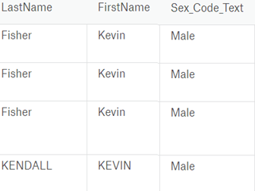
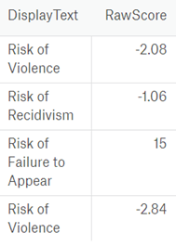
Supervised Learning (cont)
Data Annotated/labeled with information of interest
Recidivism Risk Scores
Data used for training COMPAS system
Decision support tool in certain US Courts
Notes:
As anothr example is data on criminal offenders labeled or annotated with corresponding risk scores

Slide 10
Supervised Learning (cont)
SL in a nutshell
Feed millions of annotated/labelled data examples to machine (algorithm)
Ask algorithm to learn which variables are most predictive
Words, parts-of-speech → sentiment
Age, education level, sex → recidivism risk
Process known as TRAINING
Various SL algorithms
Notes:
Which words, parts of speech impact sentiment, i.e. most predictive, for sentiment of movie reviews
Which age, education and sex values are most predictive for the recidivism

Slide 11
Supervised Learning (cont)
Algorithms for Training
Tree-based
Decision-trees, Random Forest
Support Vector Machines
Neural Networks
And many others…
Notes:
Which words, parts of speech impact sentiment, i.e. most predictive, for sentiment of movie reviews
Which age, education and sex values are most predictive for the recidivism

Slide 12
Tree-Based
Learns a Decision-tree or Random Forest from training data
Given new case
Follow tree branches/values
Make prediction
Many variants
Gradient boosted trees
Ensemble of trees
Sex
male
female
Age
> 45
<= 45
…
No Risk
High Risk
Medium Risk
Notes:
Which words, parts of speech impact sentiment, i.e. most predictive, for sentiment of movie reviews
Which age, education and sex values are most predictive for the recidivism

Slide 13
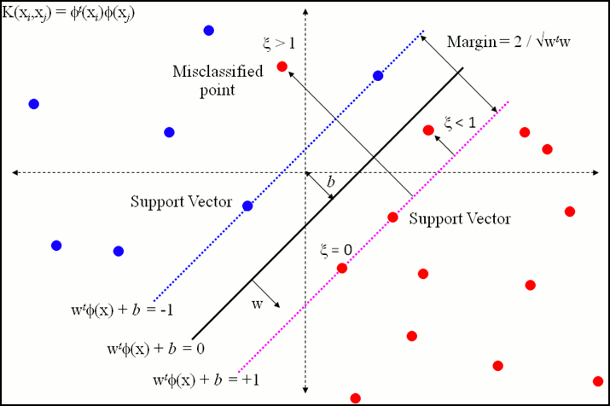
Support Vector Machines (SVM)
Learns decision boundaries
Maximizes separation between examples
High vs. low risk
POS vs. NEG sentiment
Source: stackexchange
Notes:
Which words, parts of speech impact sentiment, i.e. most predictive, for sentiment of movie reviews
Which age, education and sex values are most predictive for the recidivism

Slide 14
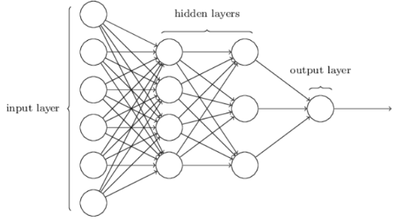
Artificial Neural Networks
Interconnected neurons
Responsible for most of the computation
Tries to predict dependent variable, e.g. recidivism risk
Independent variable,
e.g. age, past cases, sex,..

Slide 15
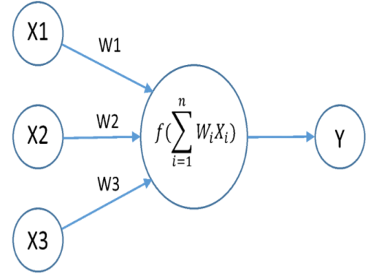
Artificial Neural Networks (cont)
At each neuron j
Outputs of previous neurons; x1,x2, x3
Apply weights; w1,w2, w3
Sum & Apply activation function, f(.)
Result input to next neuron
Repeat until final output neuron (prediction)
At output layer, check predicted value
Dependent variable value from dataset
If prediction ok: stop
Else: back-propagate error
Adjust weights
Until correct prediction

Slide 16
Deep Learning
Artificial Neural Networks
Large number of hidden layers (e.g. 10, 300)
Performs more sophisticated/complex tasks
Outperformed human champion at game of GO
Learns masters level chess by playing against itself
However
High computational time & complexity
Difficult to interpret models
Common Applications
Facebook Face Recognition
Voice/Speech recognition, e.g. Siri, Alexa

Slide 17
Supervised Learning Limitations
SL matured learning paradigm
But
Presupposes annotated data
Data in real-life not annotated
Manual annotation expensive, time-consuming
Unsuitability of SL for many applications
Need for other learning paradigms

Slide 18
UNSUPERVISED/SELF-SUPERVISED LEARNING
Notes:
Pave the way to actual project
Illustrate the challenges vs. supervised learning.

Slide 19
Unsupervised/Self-Supervised
No specific unsupervised methods
Clustering
Similarity metrics (cosine, Jacquard)
PCA
LDA
Energy-based methods
Auto-encoders
…
Aim
Not so much on prediction
But discovering patterns in data
Notes:
Active research aread

Slide 20
Unsupervised/Self-Supervised
Self-Supervised Learning
Unsupervised learning variant
Data provides the supervision
Finding semantically-similar words
Synonyms
Near-synonyms
Notes:
Exploit data for some form of supervision
Let’s take an example. Suppose we want to find a set of semantically-similar words in a given language. These can be synonyms of near synonyms

Slide 21
Unsupervised/Self-Supervised
Distributional Semantics
“Similar words tend to occur in similar contexts”
“In the new regulation assets are defined as properties…”
“The regulation refers to derivatives as products…”
“Counterparty is specified in the regulation as …”
Target words defined (as), refer (to), specified (as)
Share similar meaning
Share similar contexts
Supervised Learning Formulation
Target words = annotations
Predicted from contexts
Notes:
In sl formulation, target words considered as analoguous to annotations
Predicted from context words

Slide 22
Unsupervised/Self-Supervised
Train a neural network
Predict target words given contexts
Target words represented as word-embeddings
Low-dimensional vectors, capturing semantics
Well-known methods for generating word-embeddings
Word2Vec (Google)
FastText (Facebook)
GLOVE (Stanford U)
Methods used in Eur-Lex Project
Notes:
We can then train a neural network to predict the target work given the context
The neural network will learn how to represent each word as a low dimensional vector, known as word embeddings
Peculiarity about these vectors/embeddings is that they inherently capture information about the semantics of the words. Examples to be shown later.

Slide 23
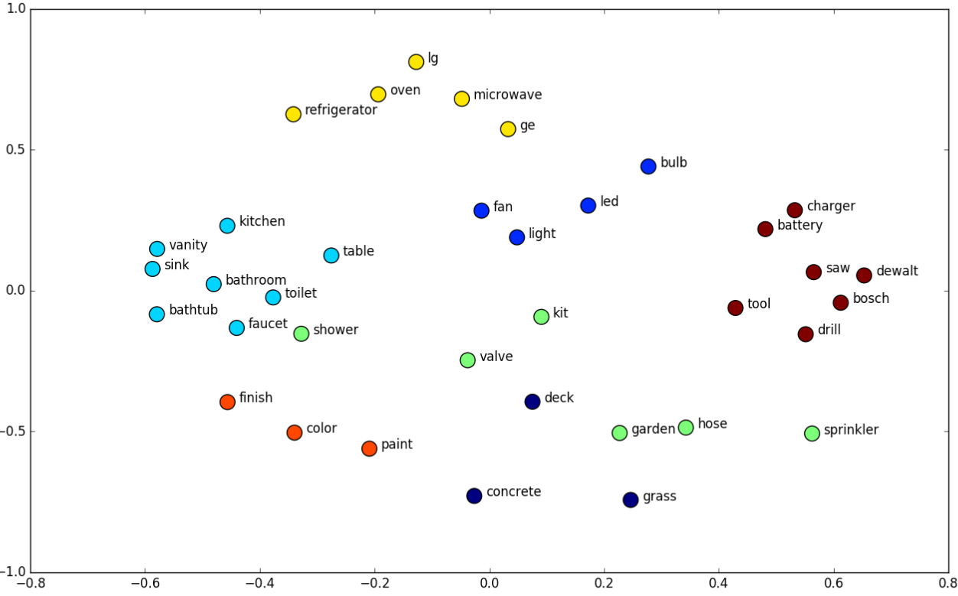
Word Embeddings Plot
Vectors (embeddings) of similar words are close to each other
Notes:
On this plot, you can see a number of word embeddings that have been plotted
As can be observed, words with similar meanings tend to appear close to each other→ embeddings capture semantic information.

Slide 24
Natural Language Processing (NLP)
Processing natural language, texts
Machine Learning & Deep Learning
Supervised & unsupervised
Several sub-tasks
Part-of-Speech (POS) Tagging
Syntactic Parsing
Notes:
This makes a smooth transition to another concept has been receiving much attention laterly, namely NLP
Ml, dl,
Sup, unsup
Several subtasks in NLP,
Present only 2 , which we employed in our project
1st: POS tagging/ determine the part of speech of words
E.g.:this sentence (original)…
Syntacting parsing: extracting syntacting information from sentence.

Slide 25
End of Part 1
Questions?
Notes:
Brings me to the end of the 1st part of my presentation, which was an introduction to ML, and paved the way to the 2nd Part.

Slide 26
Part 2: Eur-Lex Machine Learning Project
Notes:
In the 2nd part of my presentation, I will describe how we used different ML and NLP methods to process financial sector regulations available at Eur-Lex, which I refer to as the Eur-Lex ML pronect

Slide 27
Project Team
Myself
PhD and Masters researchers at ULiège

Slide 28
EUR-Lex ML Project Overview
Objective
Automatically analyze given set of EUR-Lex financial sector regulations
Identify relevant legal concepts
Related to supervisory reporting requirements
Organize concepts in dictionary
With references to “where” they occur
URL, Articles or Section numbers
Extract concept definitions
Extracting reporting information
“banks shall submit their filings to the central authority”
Overarching Aim
Generate supervisory reporting concept dictionary

Slide 29
Methodological Overview
Main methods employed
NLP
Unsupervised & self-supervised setting
No annotations available
Manual annotations not viable (expensive, time-consuming)
Implemented in an NLP pipeline
3 main Work Packages (WP)/steps

Slide 30
Work Packages
Data Gathering
Concept Extraction
Relation extraction
Definitions
Report-to

Slide 31
WP1: Data Gathering
Eur-Lex regulations published online (HTML)
Example
Notes:
The financial sector reguations are available online at eur-lex
To analyze those documents, we first have to retrieve them from their online sources and store them locally in a local repositor

Slide 32
Data Gathering (cont)
Retrieve online HTML documents
Store documents in local repository
Implemented a web-crawler (spider)
Starts from a predefined URL list (621 for prototype)
Automatically selects EN version
Reads and parses HTML documents
Enriches contents with additional meta-data
Useful for subsequent WP

Slide 33
Data Gathering (cont)
Enriched HTML contents dumped locally
Plain Text files (.txt)
Lightweight
Portable
Crawled contents in text files

Slide 34
Data Gathering (cont)
Crawler Characteristics
Python implementation
Lightweight
Fast (621 documents approx. 1hr-1.5hr)
Parses PDF & HTML

Slide 35
WP2: Concept Extraction
Identifying & extracting relevant legal concepts from crawled contents
Concepts linguistically realized as terms
Single-word: derivative
Multi-word: credit derivative volume
NLP algorithms for Term Extraction
Initial approaches
Linguistic
Statistical
(Linguistic & Statistical)

Slide 36
Concept Extraction (cont)
Linguistic Approach
Terms are sequences of adjectives followed by any number of words
Determine Part-of-Speech of each word in documents
Terms dectected
Futures and forwads
Futures
Swaps
Securities
Counterparty (side)

Slide 37
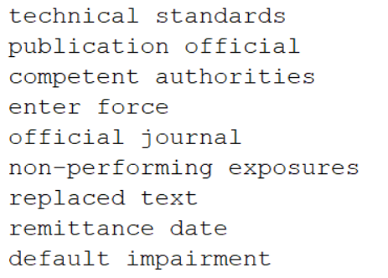
Concept Extraction (cont)
Statistical Approach
Terms detected according to
Occurrence frequencies /probabilities (single-word terms)
Co-occurrence frequencies/probabilities (multi-word terms)
Numerous statistical measures
Mutual Information
Chi-square
Good results for 2 or 3-word terms
Notes:
In the statistical approach, tems are detected according to their occurrence freq for single word terms or their their co-orrucence freq. for multi-word tems
Various statistical measures can be employed:

Slide 38
Concept Extraction (cont)
Several challenges posed by Eur-Lex project
Terms not restricted to adjectives and nouns
Very long terms
Composed of > 4 words
“Financial assets designated at fair value through profit or loss”
Valid terms with low frequency/probability
Annotated data/examples unavailable
Require unsupervised approaches

Slide 39
Concept Extraction (cont)
Implemented novel, unsupervised Term Extraction algorithm
Dynamic frequency threshold, t
Varies depending on the document length
Terms with frequency < t are discarded
Keep tracks of terms’ positions in document
Article, section, annex numbers
Character positions (in progress)
Notes:
To address those challenges, we implemented a novel unsupervised TE algo
Another innovation is that the algo maintains a dynamic freq threshold, which varies depending on the document’s size, such that terms with freq less than t are automatically discarded
Furthermore, our algo also keep tracks of positional information, i.e. where the term occur in a document, such as article numbers and the character positions

Slide 40
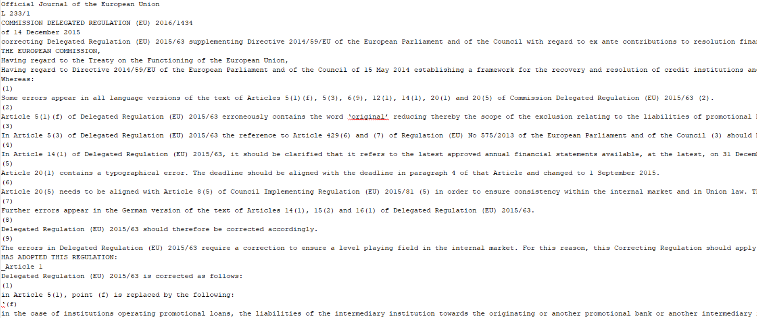
Concept Extraction (cont)
Example Input to Algorithm (crawled HTML in txt format)

Slide 41
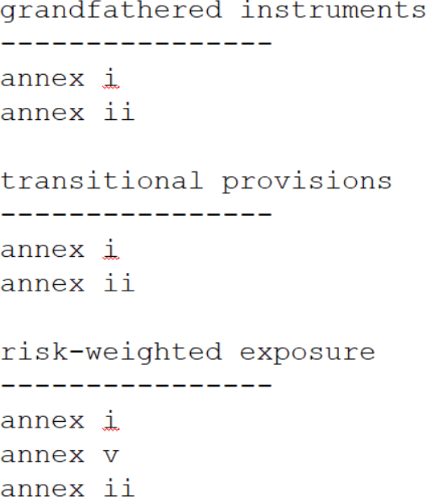
Concept Extraction (cont)

Slide 42
Concept Extraction (cont)
Algorithm’s Characteristics
Implemented in Python
Lightweight, easy to install
Efficient
Uses memoization
~35 000 characters analyzed per second

Slide 43
WP3: Semantic Relationship Extraction
Data gathering
Identifying concepts (terms) & positions
Extracting
Concepts’ definitions
Reporting information (concept A shall submit to concept B…”)
Semantic Relationship Extraction in NLP
No annotated data for current project
Devise unsupervised methods
Notes:
Best perfoming methods are those based on SL

Slide 44
Semantic Relationship Extraction
Extracting Concepts’ Definitions
Various lexical patterns to express definitions
“In the new regulation assets is defined as properties…”
“The regulation refer to derivatives as products…”
“Counterparty is specified in the regulation as …”
Challenge:
Learn how definitions are expressed in documents automatically
Unsupervised fashion
Solution: Word Embeddings
Notes:
The main challenge is to learn how defn are expressed in the texts autom and we want to do so in an unsupervised mannuer
Solution; is o rely word embeddings

Slide 45
Extracting Definitions
Word embedding
Low dimensional vector representation of words
Vectors inherently captures semantic information
Generated via neural networks
E.g. Predict word given its contexts
Notes:
The main challenge is to learn how defn are expressed in the texts autom and we want to do so in an unsupervised mannuer
Solution; is o rely word embeddings

Slide 46
Extracting Definitions (cont)
Investigated different methods
Word2Vec (Google)
FastText (Facebook)
GLoVE (U. Stanford)
Generate word embeddings for words from
Google news
Wikipedia
WebCrawl
Eur-Lex corpus of financial sector regulations
Notes:
We investigated different methods and use them to generate word embeddings from….

Slide 47
Extracting Definitions (cont)
Investigated different methods
Word2Vec (Google)
FastText (Facebook)
GLoVE (U. Stanford)
Generate word embeddings for words from
Google news
Wikipedia
WebCrawl
Eur-Lex corpus of financial sector regulations
Notes:
We investigated different methods and use them to generate word embeddings from….

Slide 48
Extracting Definitions (cont)
Explicit definition word: “(to) define”
Look up its vector (word embedding), v
Compute distance(v, x), x = embedding of all other words
If distance(v,x) < threshold
x: vector word w
Similar meaning as “define”
Distance: Cosine of the angle between vectors
Notes:
Then, we considered a typical word used to express definition, namely define.

Slide 49
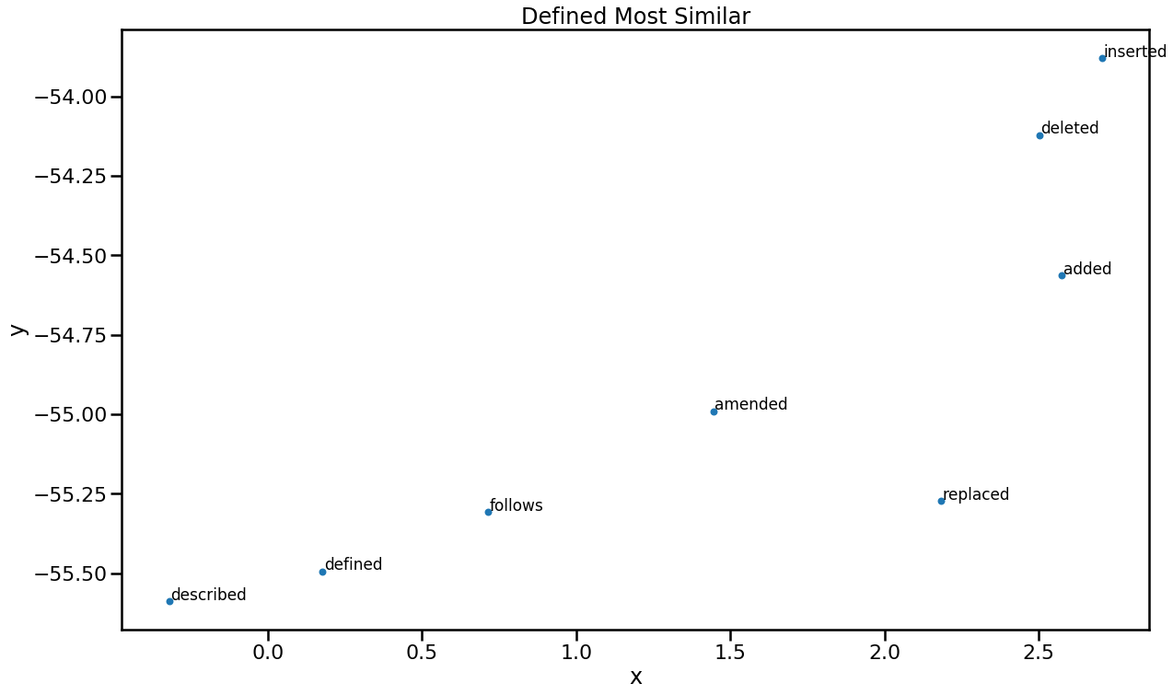

Slide 50
Extracting Definitions (cont)
Recap
Concepts extracted
Identified how “definitions” are expressed
Straightforward identification of concepts definitions in corpus
False Positive
→ Need only verbs

Slide 51
Extracting Reporting Information
Same procedure as Definition Extraction

Slide 52
Evaluation of Results
Automatic
But requires domain-knowledge for objective evaluation

Slide 53
End of Part 2
Questions?
Notes:
Brings me to the end of the 1st part of my presentation, which was an introduction to ML, and paved the way to the 2nd Part.

