Slide 1
Unsupervised Machine Translation

Slide 2
Brief Overview & Research Group
Assoc. Professor, HEC Liège, University of Liège Belgium
Head Quantitative Methods Unit, HEC Liège
Associate Editor, COMIND, Elsevier

Slide 3
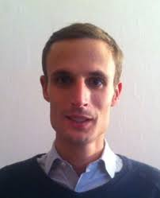
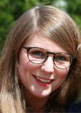
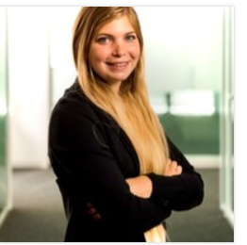
Brief Overview & Research Group
PhD candidates
1 open position

Slide 4
Why unsupervised?
Statistical, Neural MT systems
Require large parallel corpora for training
Learn mapping source – target language mapping
Existing, reasonably large parallel corpora
English, Chinese, Arabic, German
However, a plethora of low resource languages
Vietnamese, Malay, Indonesian, Croatian,….

Slide 5
Why unsupervised? (cont)
Lack of parallel corpora
Hinders low resource language MT system development
Vietnameses → Indonesian?
Croation → Malay
Solution?
For low resource language pair, e.g. Vietnamese → Indonesian
Manual creation, curation of large parallel corpora
However,
Costly
Time-consuming

Slide 6
Why unsupervised? (cont)
More efficient and scalable approaches?
Exploit existing resources, e.g. Wikipedia
MT with minimal supervision
Semi-supervised approach
Unsupervised MT

Slide 7
Agenda
This talk on current state of the art
Semi-supervised MT
Unsupervised MT
Semi-supervised MT
Back-translation (briefly), Sennrich et al., 2015
Unsupersived
Word Translation Without Parallel Data, Conneau et al. 2018

Slide 8
Semi-supervised
Semi-supervised → some supervision
Back-translation method, Sennrich et al., 2015
Small parallel corpora, e.g. EN-FR
Large monolingual corpus in FR (target language)

Slide 9
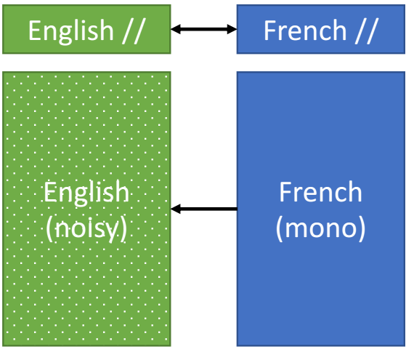
Semi-supervised (cont)
Translate back, from target to source, M_{TS}
Use small parallel corpora, FR → EN
Use M_{TS}
Translate large FR corpus into EN
Results in large EN corpus
EN corpus is noisy but
Large

Slide 10
Semi-supervised (cont)
Concatenante to create parallel corpus
Small English + Large (noisy) English
Small French + Large French
Train MT system on parallel corpus
EN-FR
Much better performance
Vs. training on small EN-FR corpus

Slide 11
Semi-supervised (cont)
Process can be repeated
Previous example:
Use FR data for better EN-FR MT
But if additional EN sentences available
Train an EN-FR system
Use model to improve FR-EN performance
Simple technique
Good performance in practice

Slide 12
Weakly-Supervised
&
Unsupervised

Slide 13
Weakly-supervised
Weakly-supervised MT
Basis for unsupervised MT
Inspired many unsupervised MT studies
Seminal article: Exploting Similarities between Language for MT
Mikolov et al., 2013

Slide 14
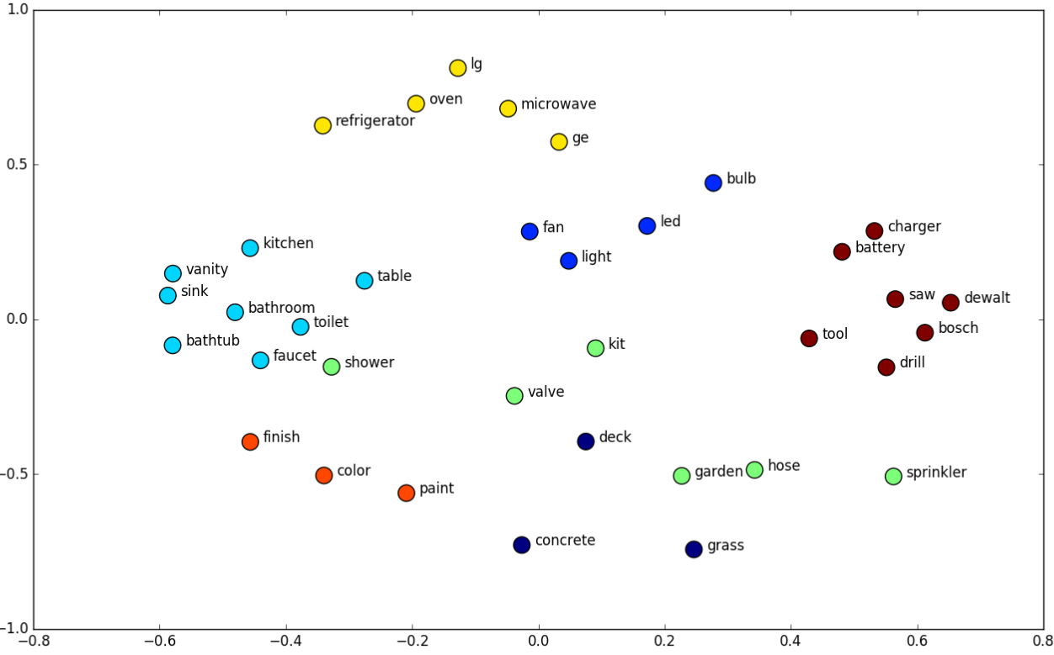
Word Embeddings
Word embeddings
Notes:
An example of word embeddings plootted in a vectors space
As can be seen, vectors of similar words tend to appear near each other.

Slide 15
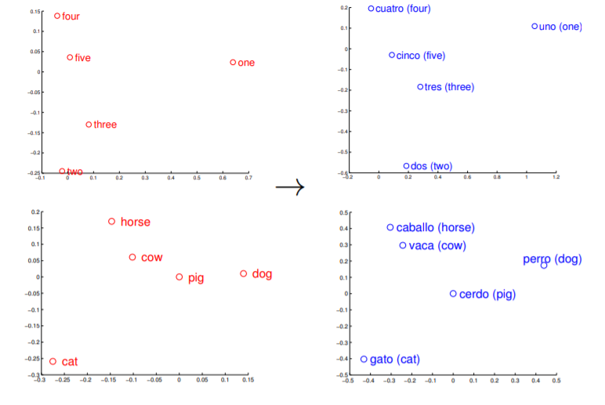
Weakly-supervised (cont)
Relies on word embeddings for source and target language
E.g.: EN → IT
Geometrical corrspondences

Slide 16
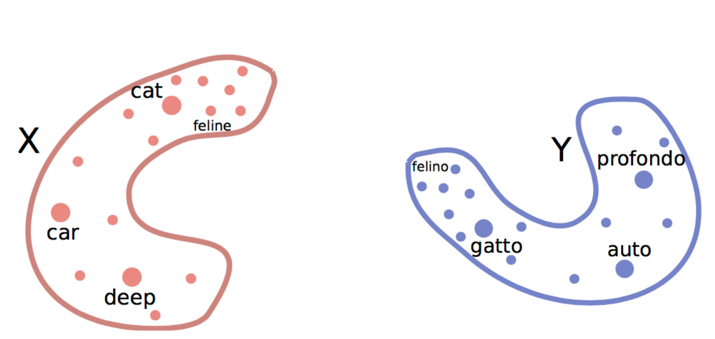
Weakly-supervised (cont)
Relies on word embeddings for source and target language
E.g.: EN → IT
Monolingual space look similar

Slide 17
Weakly-supervised (cont)
Mikolov et al.
Learn a very simple, linear mapping
Map EN space → IT space
Find matrix W such that
Linear mapping outperformed neural network model
Matrix W for mapping EN → ES
Best performance if W is orthogonal (Smith et al. 2017)

Slide 18
Weakly-supervised (cont)
Approach of Mikolov et al.
Learn word embeddings for 5000 word pairs in src & tgt languages
E.g. EN, IT
Stack them in 2 matrices X, Y, both ∈ $R^{5000×d}$
X: matrix of EN embeddings
Y: matrix of IT embeddings
1st row X (Y): word embedding of 1st EN (IT) word
Learn a matrix W such that
Notes:
Miklov start with a dict of 5000 word pairs
Create 2 matrices X, Y: X matrix of EN embeddings, Y : matrix of IT embeddings
Matrices of 5000*d, where d is the embeddign size
E.g., first row of X give the embedding for the first word in EN
Then, compute matrix W such that it min. the distance between X and Y.

Slide 19
Weakly-supervised (cont)
If W is orthogonal
Closed form solution to minimization problem exists
Proscrustes Problem
W easily computed using SVD as
Given W, for source word s (not in dictionary),
Notes:
If we impose a constraint that W is orthogonal, then we have a closed form solution, called the Proscrutes problem
W can be computed using the SVD of Y and X transpose
Now, we can take some words not found in dict (5000 initial words)
Map them to the source space and make a projection, and in the target space, the nearest neighbor will be a very close translation
E.g. if we take word “dog” in source language, create its embedding, in vector xs
Map/project xs to target space by multiplying with w
Then, if we look at at yt, the nearest neighbor in terms of cosine distance, it will be a very relevant translation of the source word x

Slide 20
Unsupervised
From the initial space
X can be mapped onto Y via rotation
But large number of dimensions in practice
Cannot simply map by rotating
Unsupervised learning of mappings?

Slide 21
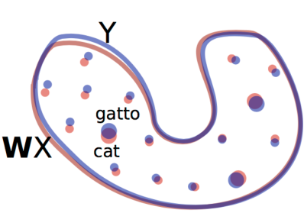
Unsupervised (cont)
If WX and Y align perfectly
Indistinguishable
Advesarial game formulation
Train a discriminator, predicts words, z
z ∈ X predict as source words (source =1)
z ∈ Y predict as target words (source =0)
Notes:
If WX and Y are aligned, then they should be indistinguishable , not possible to say which words belonged to Y and which words came from WX.
Train discriminator:sort of classifier, predict
Everything in X as source=1 (source words)
Everything in Y as source = 0 (target wods)
At the same time of training a discriminator, train the mapping W
But train to fool the discriminator, in a kind of adversarial game
On one side: discriminator trying to find difference between wx and y, and on the other side, W that tries to fool discriminator, to prevent it from making accurate predictions
Look at loss function: make discriminator believe that x is a target word (source=0)

Slide 22
Unsupervised (cont)
Makes discriminator believe that Y is from source (source = 1)
Train the mapping W
W generates fake items
Discriminator has access to correct info (source & trgt words)
Sends signals to W, W learns
Makes discriminator believe that X is from target (source = 0)
Notes:
At the same time of training a discriminator, train the mapping W
But train to fool the discriminator, in a kind of adversarial game
On one side: discriminator trying to find difference between wx and y, and on the other side, W that tries to fool discriminator, to prevent it from making accurate predictions
Look at loss function: make discriminator believe that x is a target word (source=0)
So the W generates fake items and the discriminator which has the correct information (which words are source and which are signals) sends a signal to the generator W so that generator can learn from signals
We are interested in W anyway

Slide 23
Unsupervised (cont)
Notes:
Can be trained using standard methods of GAN
We look at the case when these networks applied to word translation task
200K target words and very few source words (1,5k)
Take a word from source, create an embedding, map it to target space , how correct is translation, how often do we get a good translation of source to target
Blue: procrustes baseline, weak supervision of 5000 word embeddings
70% correct translation for EN-ES

Slide 24
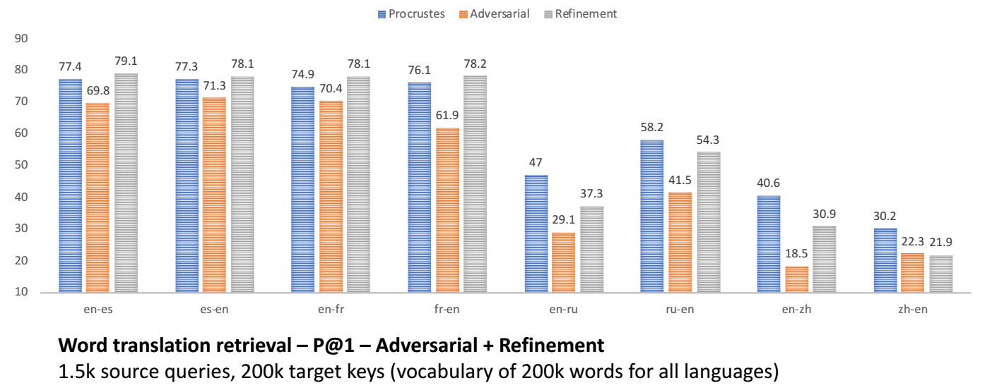
Unsupervised (cont)
Enhancement
Use high quality word translations from Adversarial training
Apply Proscrustes
Repeate until convergence
→ Performance Improvements

Slide 25
Summary
Generate monolingual embeddings
Align embeddings using Adversarial training
Improvement
Select high quality pairs from Adversarial training
Apply Proscrustes
Generate translations

Slide 26
Language Modelling
Learn statistical representation of languages
E.g. predict next most likely word
“I like to eat ____”
OpenAI
Transformer network (Vaswani et al., 2017)

Slide 27
SYSTEM PROMPT (HUMAN-WRITTEN)
In a shocking finding, scientist discovered a herd of unicorns living in a remote, previously unexplored valley, in the Andes Mountains. Even more surprising to the researchers was the fact that the unicorns spoke perfect English.
MODEL COMPLETION (MACHINE-WRITTEN, 10 TRIES)
The scientist named the population, after their distinctive horn, Ovid’s Unicorn. These four-horned, silver-white unicorns were previously unknown to science.
Now, after almost two centuries, the mystery of what sparked this odd phenomenon is finally solved.
Dr. Jorge Pérez, an evolutionary biologist from the University of La Paz, and several companions, were exploring the Andes Mountains when they found a small valley, with no other animals or humans. Pérez noticed that the valley had what appeared to be a natural fountain, surrounded by two peaks of rock and silver snow.
Pérez and the others then ventured further into the valley. “By the time we reached the top of one peak, the water looked blue, with some crystals on top,” said Pérez.
Pérez and his friends were astonished to see the unicorn herd. These creatures could be seen from the air without having to move too much to see them – they were so close they could touch their horns.
While examining these bizarre creatures the scientists discovered that the creatures also spoke some fairly regular English. Pérez stated, “We can see, for example, that they have a common ‘language,’ something like a dialect or dialectic.”
….

Slide 28
Conclusion
Significant progress in MT
Unsupervised MT
But
Translation of syntactically complex texts/discourses
Evaluating translation quality: is BLEU score relevant?
How to choose between multiple possible translations
How to incorporate human feedback?

