Slide 1
Isotopic and microbiologic evidence of greenhouse gases transformation mechanisms in groundwater
Doctoral thesis defense
University of Liège (Belgium)
24.11.2020
by Olha Nikolenko
Supervisor: Serge Brouyère
Co-supervisor: Alberto V. Borges

Slide 2
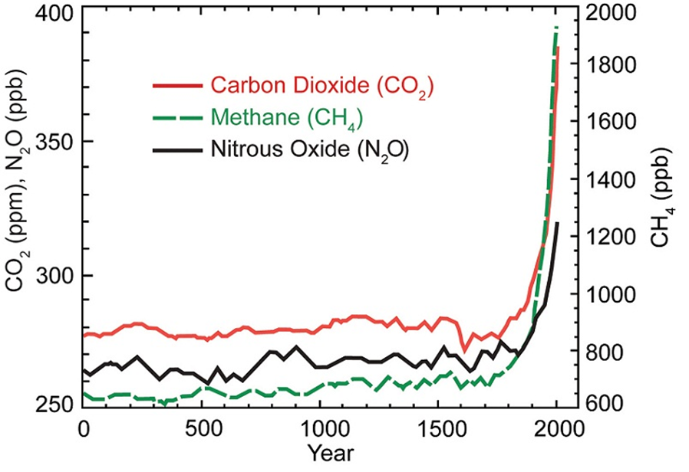
Background of the study
1
H₂O
CO₂
CH₄
O₃
N₂O
Most significant greenhouse gases
(GHGs)
Strong ozone
depleting substance
Source: IPCC AR5 WGIII, 2014
Fig. 2. The historical change in the
atmospheric concentrations of GHGs
Source: http://www.ehso.com/climatechange/climatechangecauses-
greenhouseeffect.php
Fig. 1. The greenhouse effect of solar
radiation on the Earth's surface

Slide 3
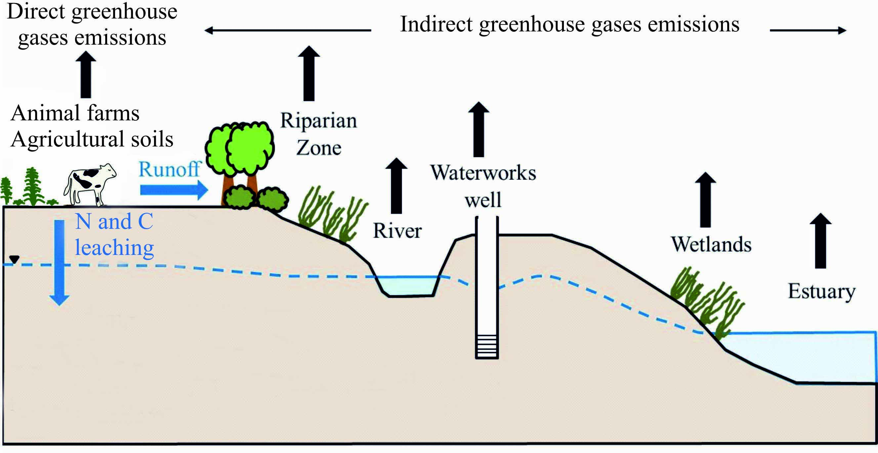
Background of the study
2
2/3 N₂O ?
Young et al., 2016
nitrification
NH₄⁺→ NO₂⁻
↓
denitrification
N₂O
NO₃⁻ → NO₂⁻→ NO → N₂O → N₂
Source: Jurado et al., 2017
Fig. 3. Types of GHGs emissions from agricultural areas

Slide 4
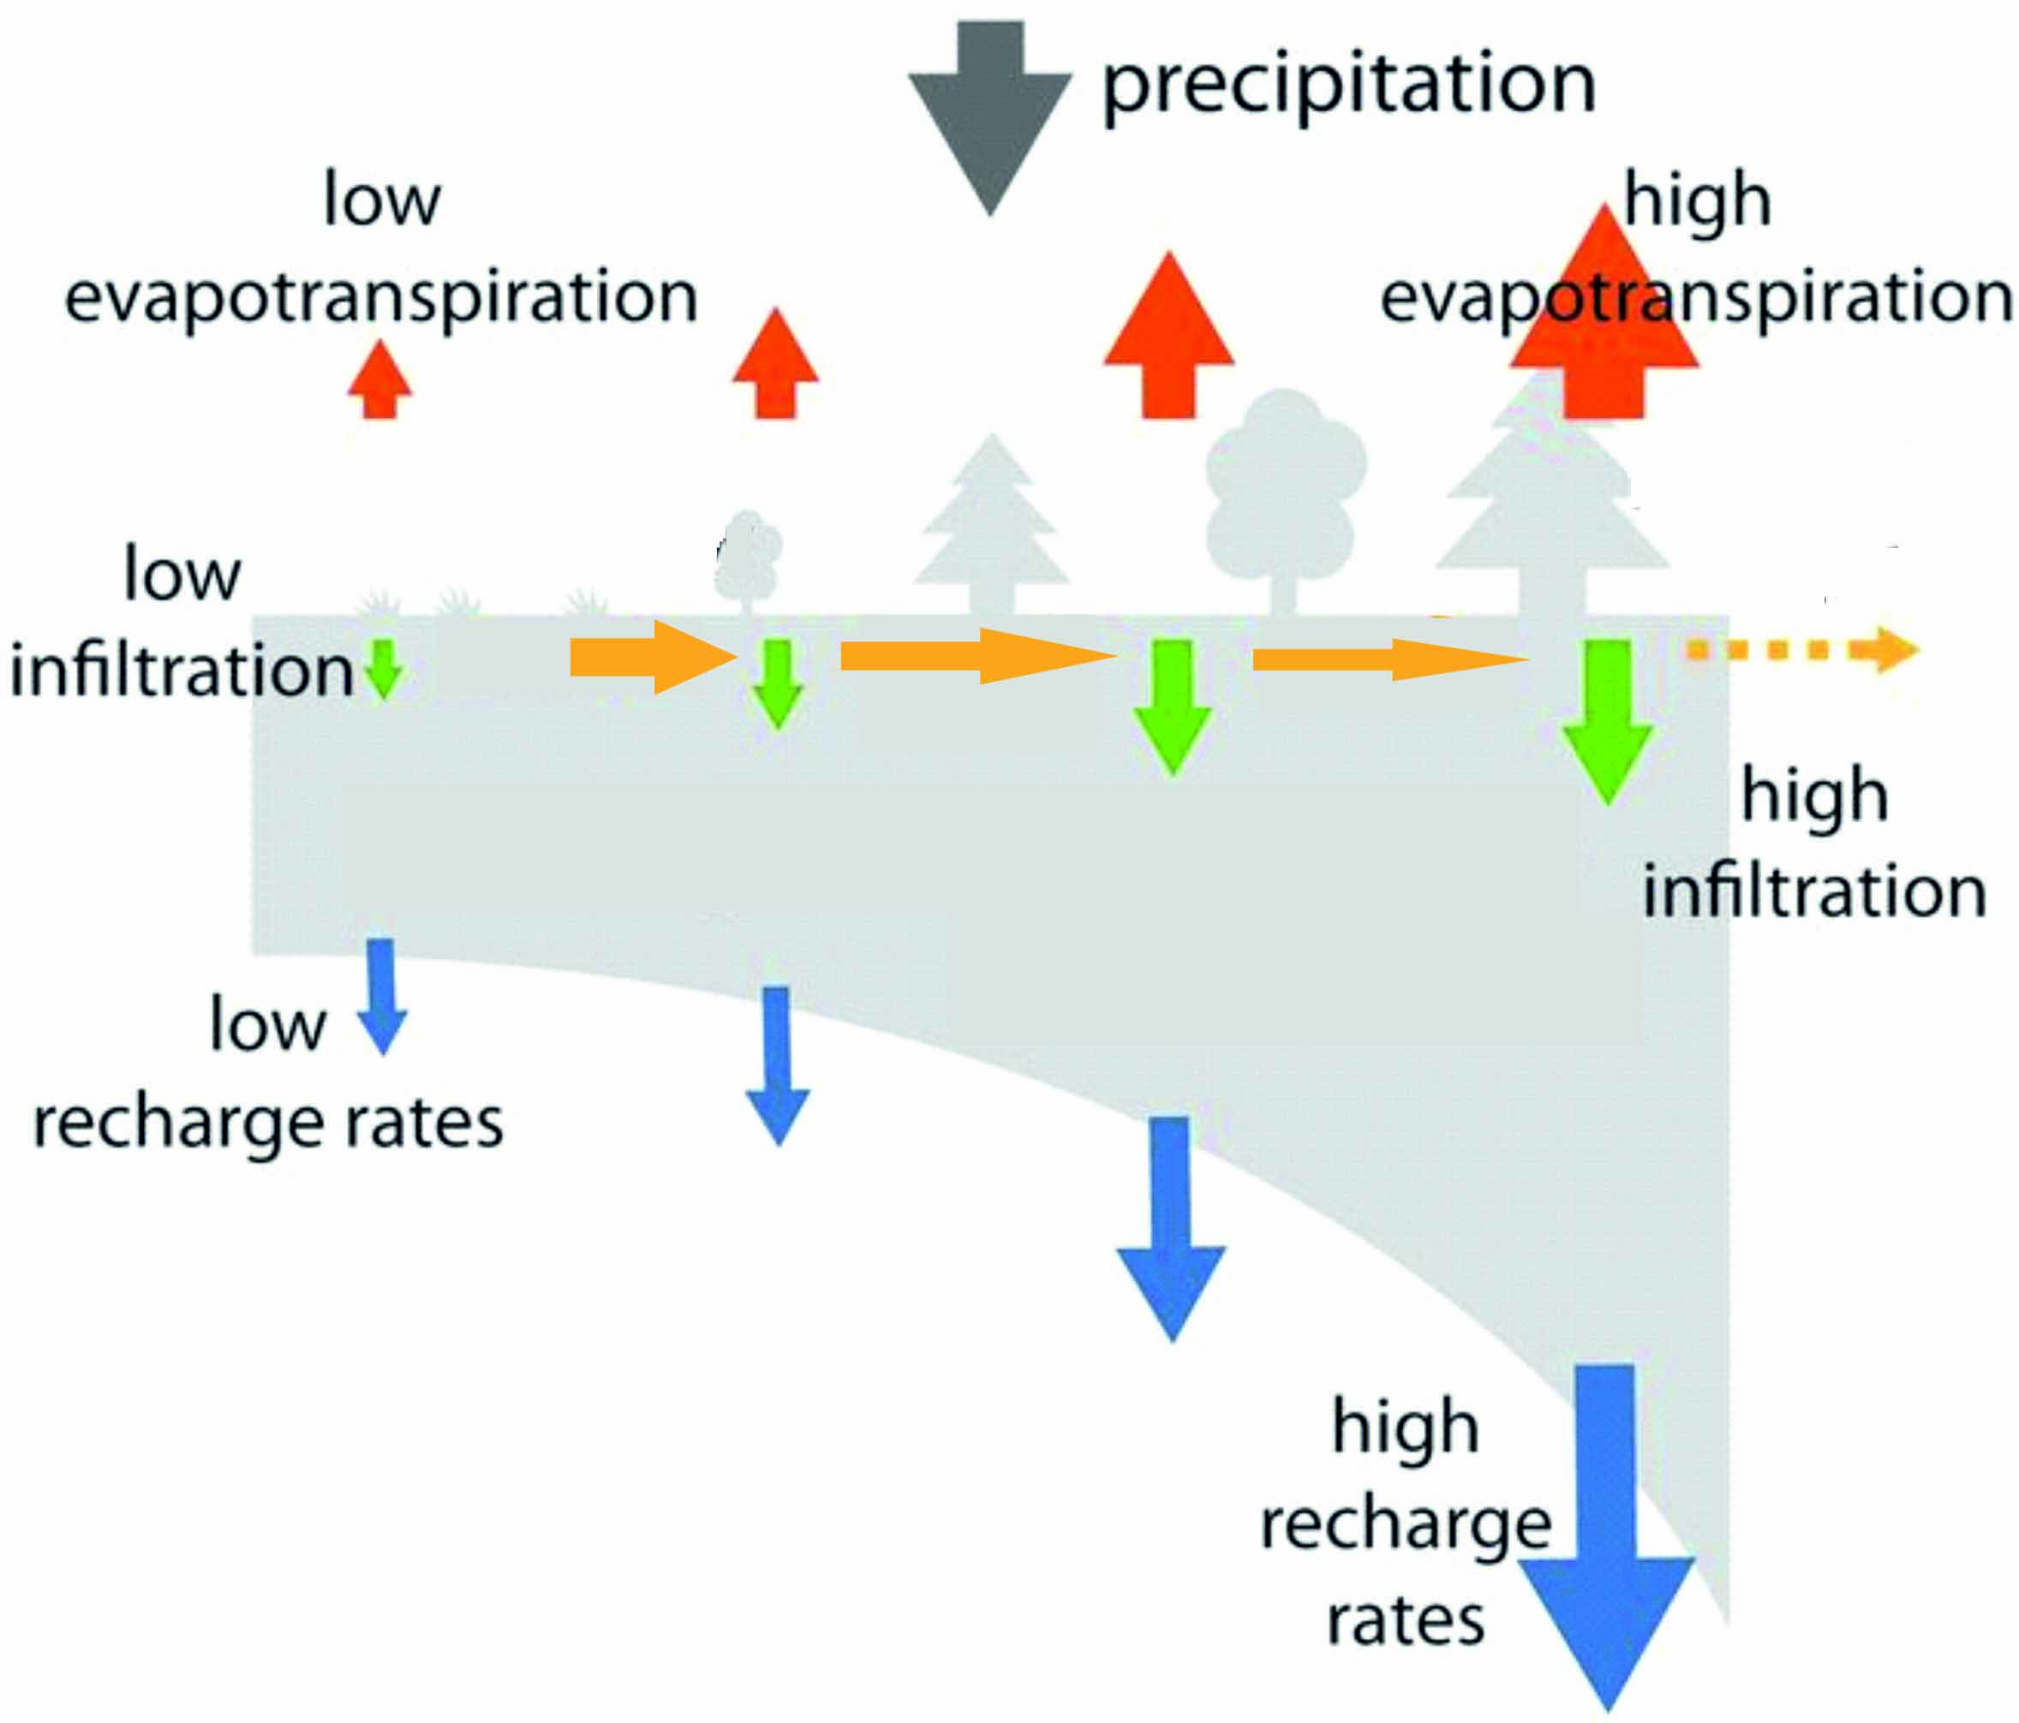
Main challenges
3
Unsaturated
zone
Production →
N₂O, CH₄,
CO₂
↓
Consumption
Saturated
zone
Production →
N₂O, CH₄,
CO₂
↓
Consumption
Fig. 4. Heterogeneous subsurface
Source: Hartmann et al., 2017

Slide 5
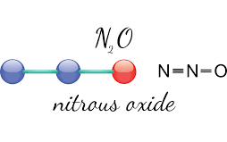
Approaches applied
4
Stable isotope and isotopomer analysis.
Isotopomers are molecules having the same number of each isotopic atom but differing in their positions.
decrease
increase
production
Site preference = δ¹⁵N^{α} – δ¹⁵N^{β}
consumption
peripheral (β) position (¹⁵N¹⁴NO)
central (α) position (¹⁴N¹⁵NO)
Fig. 5. N₂O isotopomer representation

Slide 6
Microbiological studies
5
Nitrification
Denitrification
Fig. 6. Biotic nitrification and denitrification pathways

Slide 7
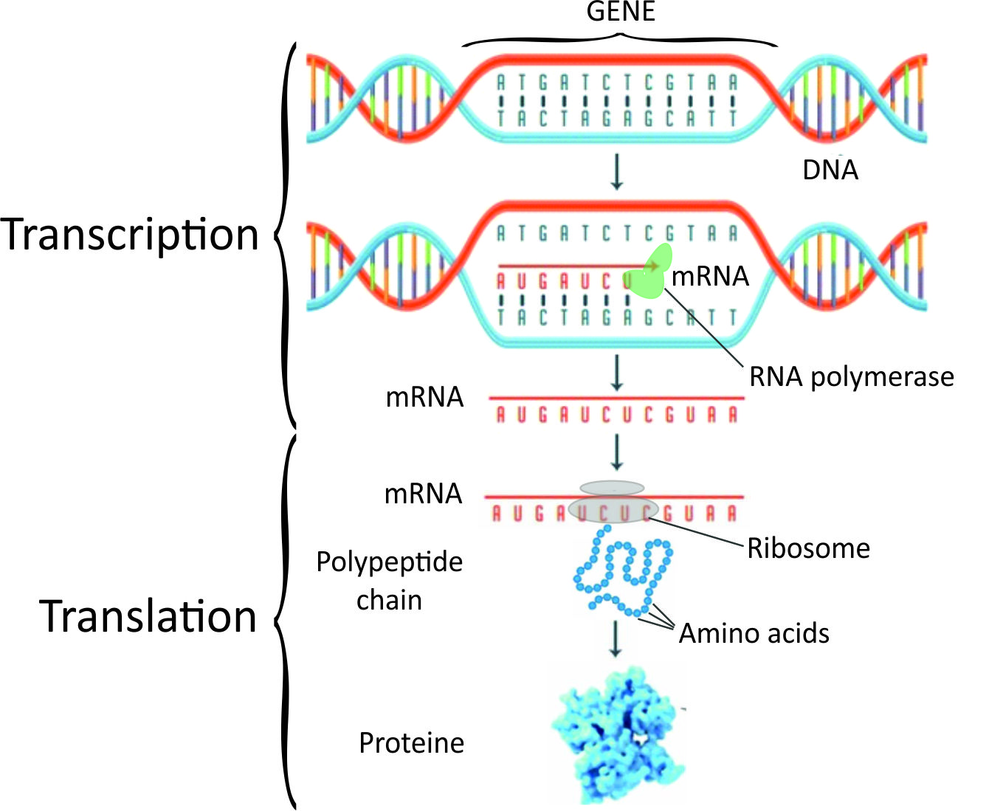
Approaches applied
6
Source: Campbell et al., 2019
Fig. 7. Schematic representation of a protein formation

Slide 8
Objectives of the study
7
Theoretical part:
review available information about the variability of ¹⁵N isotopes in groundwater under agricultural areas.
Practical part:
to estimate the variability of GHGs concentrations in groundwater under different hydrogeological, hydrochemical and land management conditions;
to identify the N₂O production and consumption processes and reveal conditions that govern N₂O accumulation in groundwater;
to collect in situ evidence about the SP ranges of N₂O and activity of bacteria involved into N₂O production and consumption processes.

Slide 9
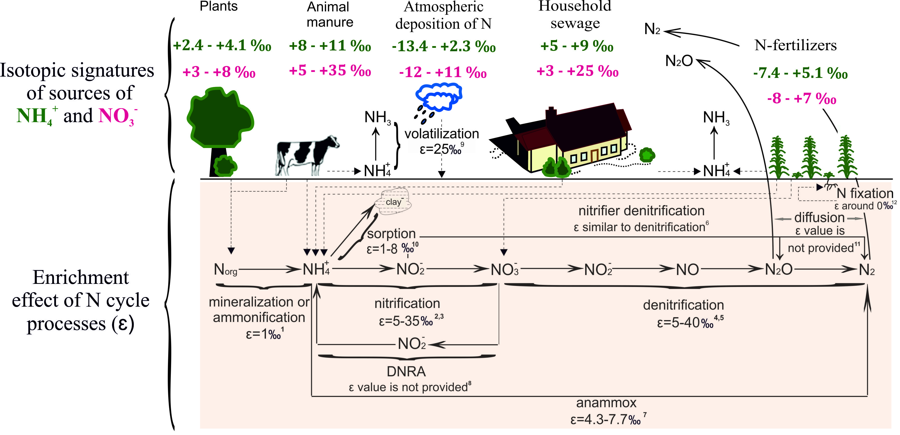
N stable isotopes
8
Source: Nikolenko et al., 2018
Fig. 8. N sources and transformation processes that affect N species in the subsurface

Slide 10
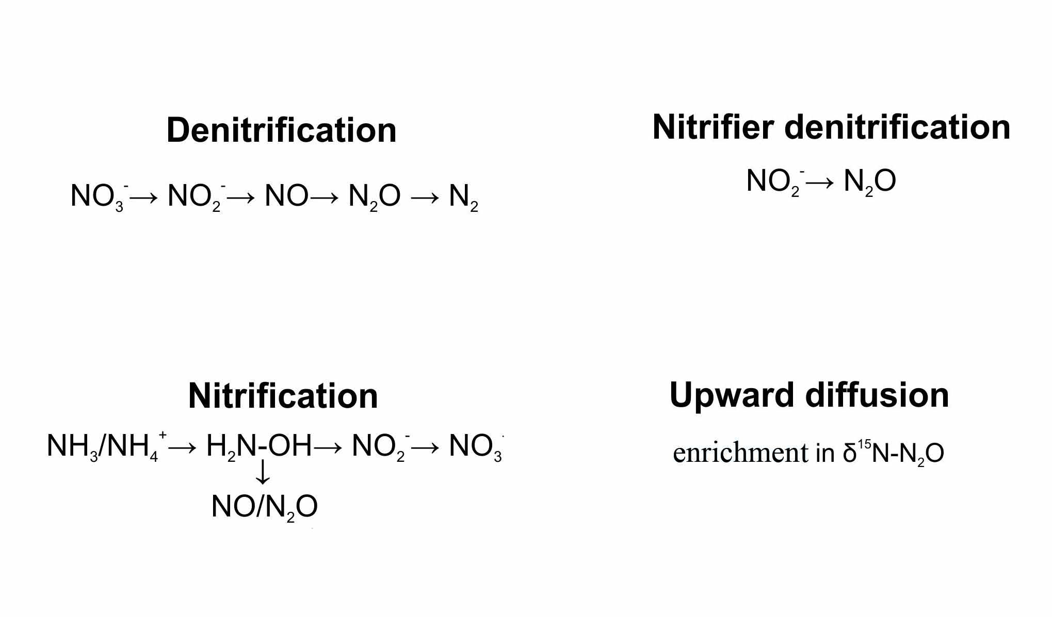
N stable isotopes
9
depletion in
δ¹⁵N-N₂O
enrichment in
δ¹⁵N-N₂O
depletion in
δ¹⁵N-N₂O
depletion in
δ¹⁵N-N₂O
Fig. 9. N Sources, processes and factors that influence δ¹⁵N-N₂O values

Slide 11
Complementary isotope studies: O, B, S, C
10
δ¹⁸O-NO₃⁻
δ¹¹B
Nitrification:
δ¹⁸O_{nitrate} = 1/3* δ¹⁸O_{O2} + 2/3 * δ¹⁸O_{H2O}
δ11B of sewage: -7.7‰ to +12.9‰
Denitrification:
δ¹⁸O-NO₃⁻ ↑ and δ¹⁵N-NO₃⁻ ↑
1:2 (Kendall & Aravena, 2000), 1:1 (Koba et al., 2009) etc.
δ11B of manure: +14.5‰ to +42.5‰
δ¹³C-DIC
δ³⁴S-SO₄²⁻
heterotrophic denitrification
autotrophic denitrification

Slide 12
Practical part
11
regional scale investigations:
The aim:
examination of the distribution and accumulation of GHGs in different parts of the studied aquifer across its lateral and vertical dimensions;
collecting information about hydrochemical conditions of the subsurface.
local scale explorations:
The aim:
identification and quantification of the rates of N₂O production and consumption processes within the studied aquifer using in situ and laboratory designed hydrogeological, isotope and microbiological experiments.

Slide 13
Regional studies: objectives
12
explore the variability of GHGs concentration along groundwater flow;
reveal the sources of N and C loads across the aquifer;
identify the processes that govern biogeochemistry of GHGs under different environmental settings.

Slide 14
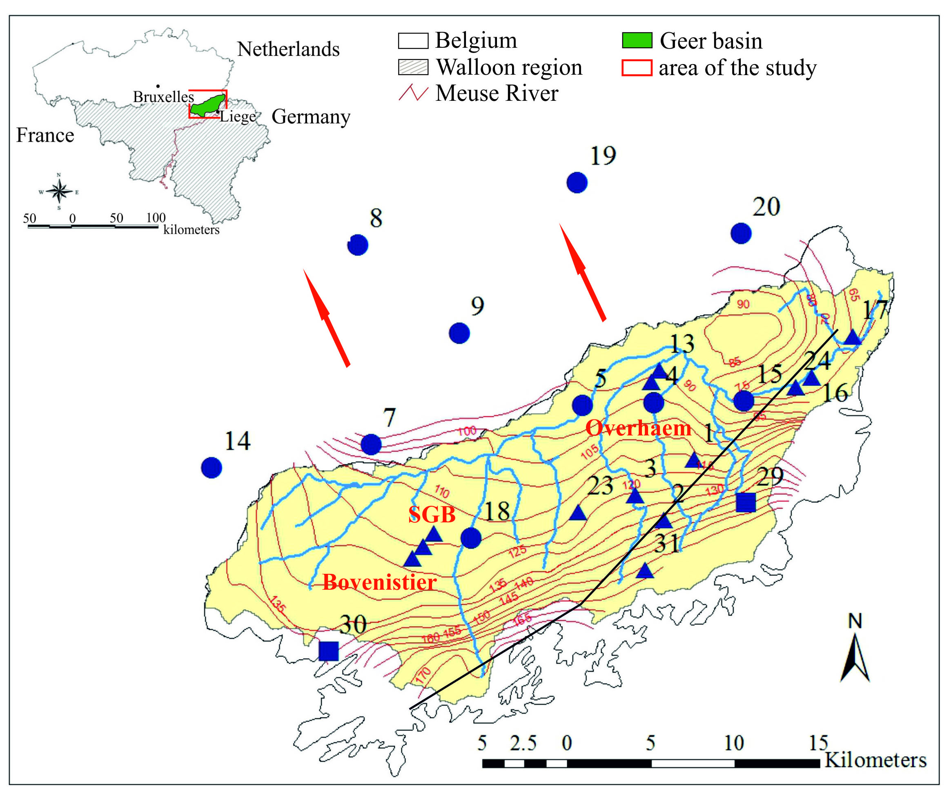
Regional studies: description of the area
13
Peculiarities of the studied area:
area: 480 km²;
65% of agricultural activities;
high fracturing of chalk aquifer;
unconfined – the South;
semi-confined – near the Geer river;
confined – the North-West.
Source: Nikolenko et al., 2019
Fig. 10. Map of the studied area in the Geer basin

Slide 15
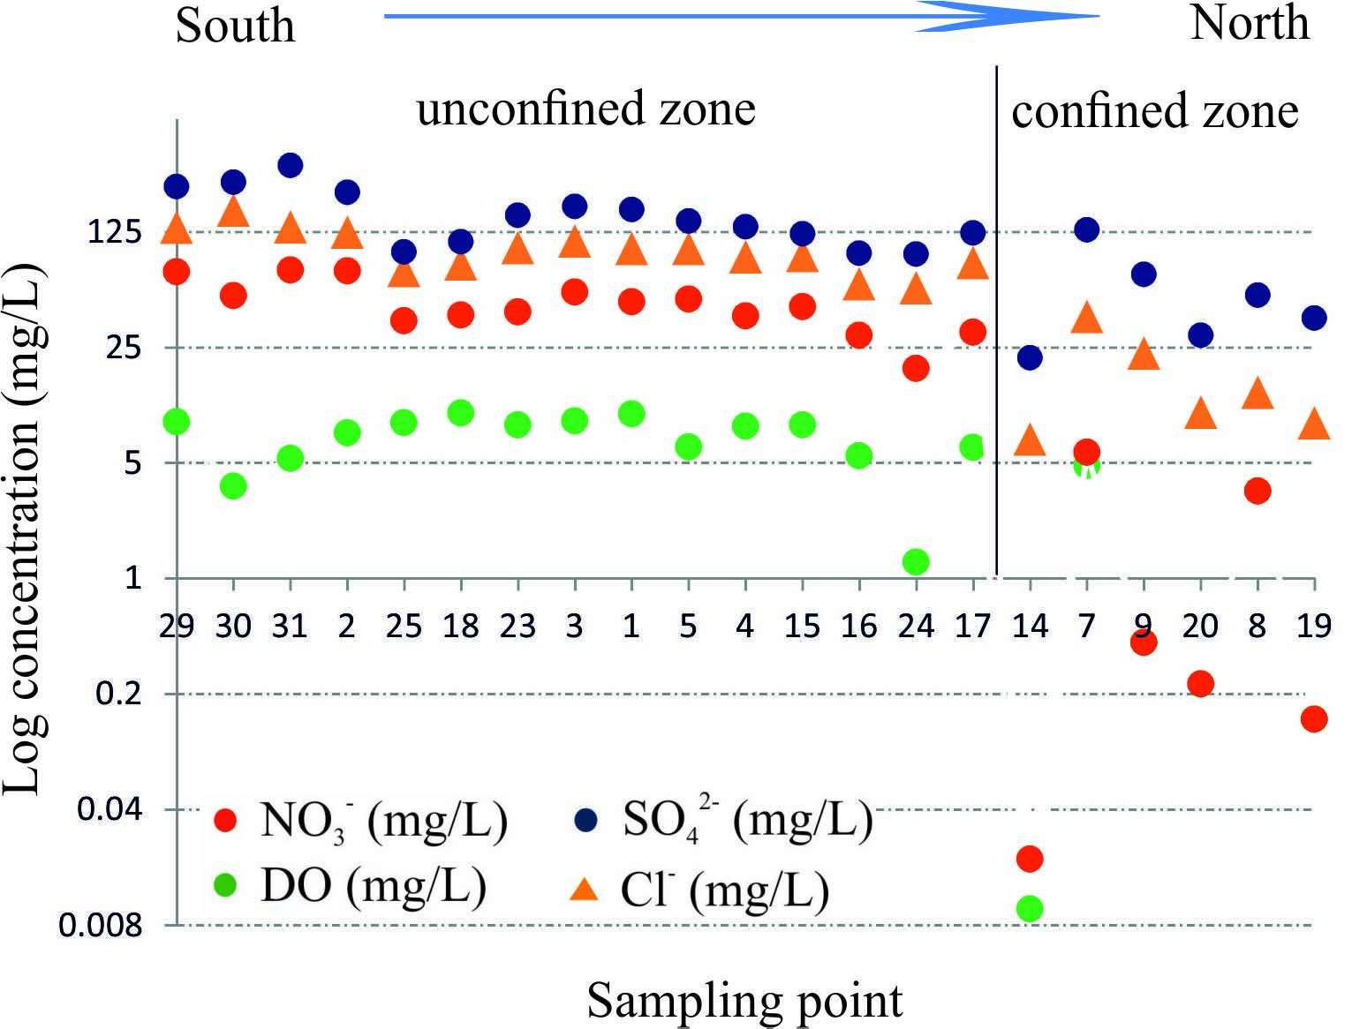
Regional studies: analyzed parameters
14
hydrogeochemical controls (DO, DOC, SO₄²⁻, HCO₃⁻, pH etc.);
concentrations of N-species (NO₃⁻, NH₄⁺, NO₂⁻ and N₂O);
isotope signatures of N₂O, NO₃⁻, SO₄²⁻, ¹¹B, ³H.
Fig. 11. Distribution of NO₃⁻, DO, Cl⁻, SO₄²⁻along
groundwater flow

Slide 16
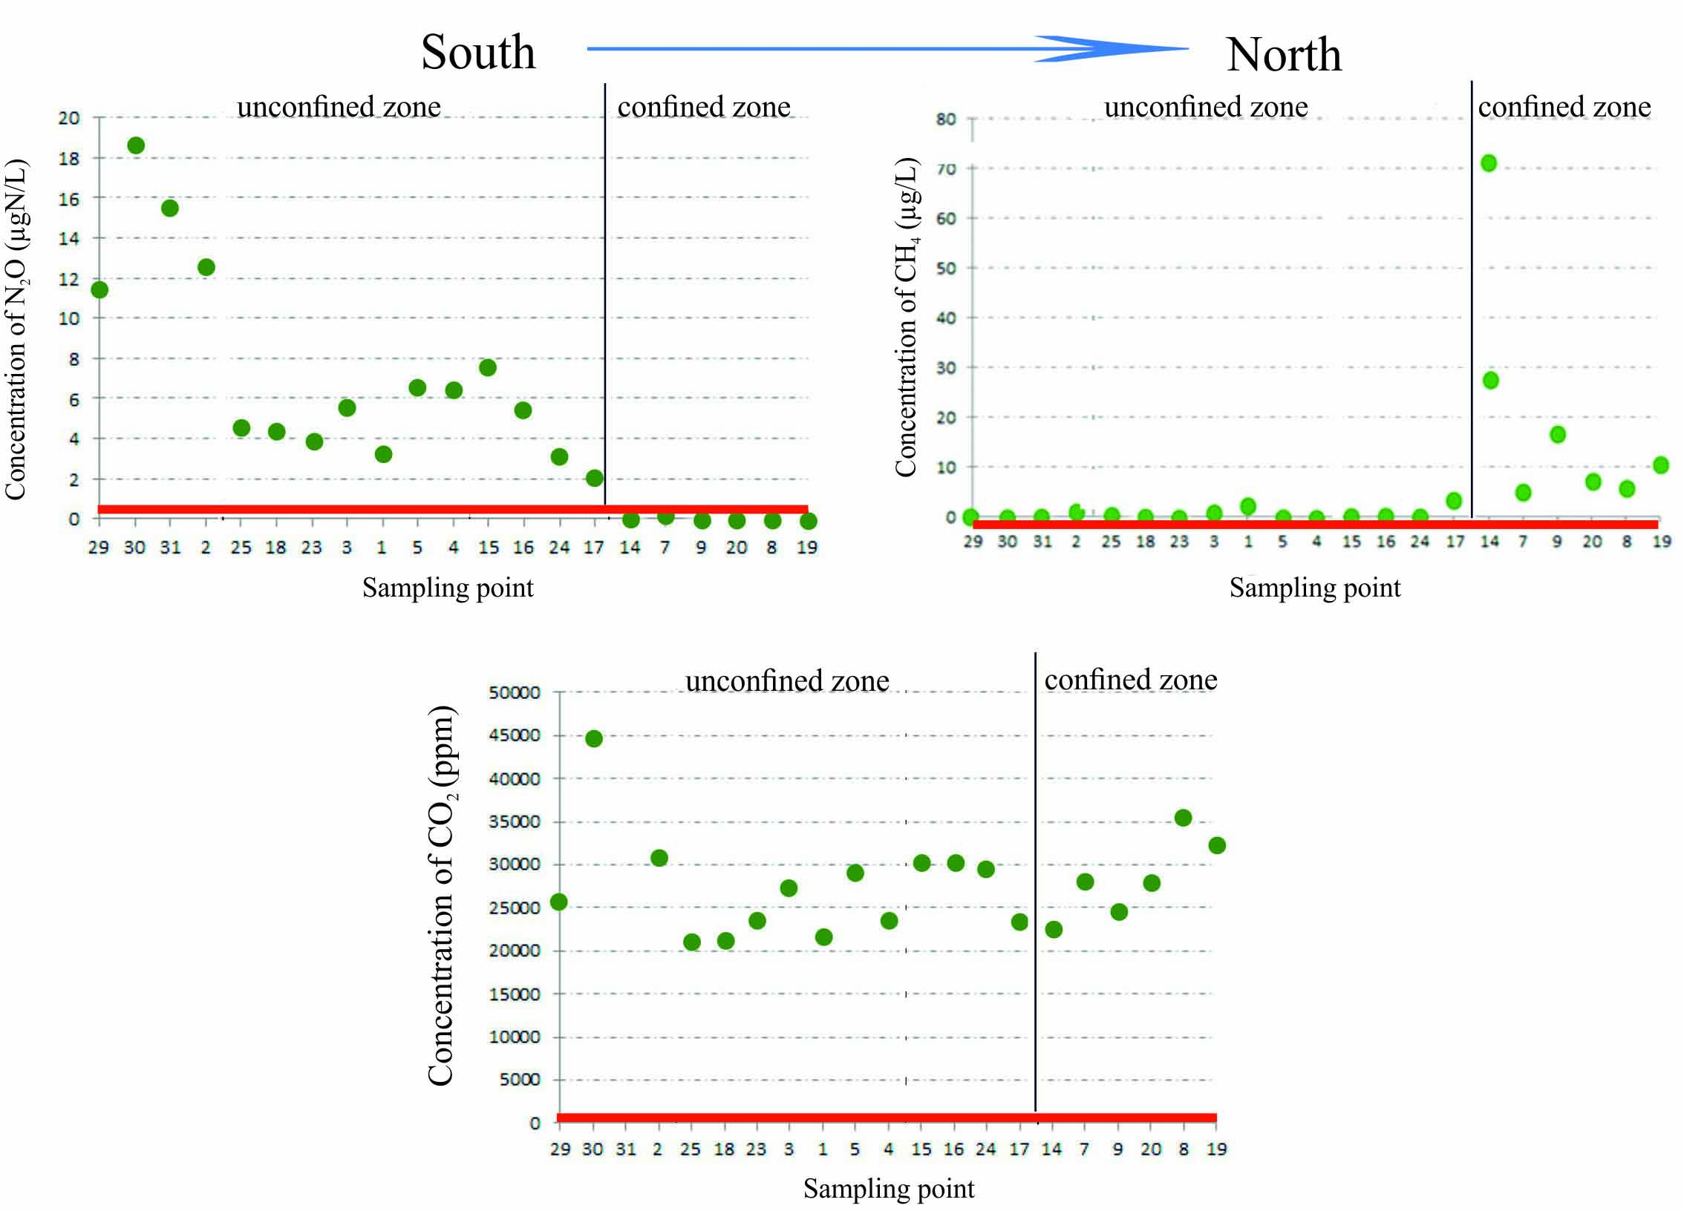
Regional studies: distribution of GHGs
15
Fig. 12. Distribution of N₂O, CH₄ and CO₂ along groundwater flow

Slide 17
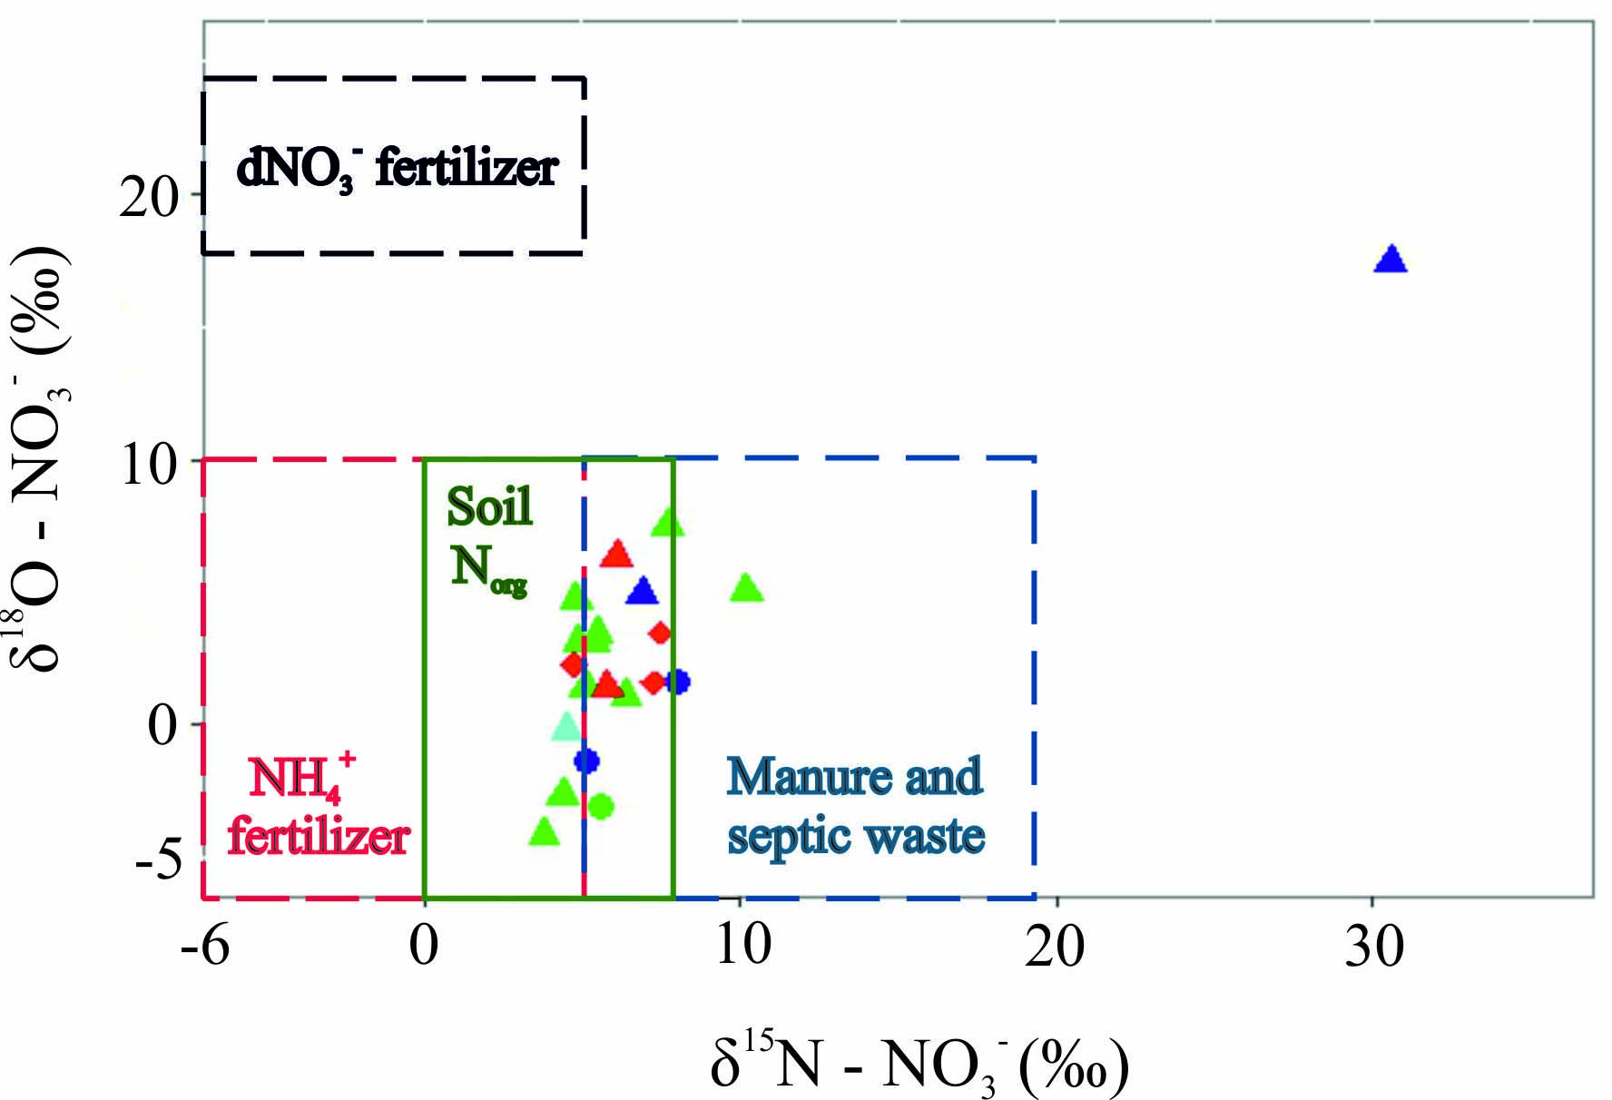
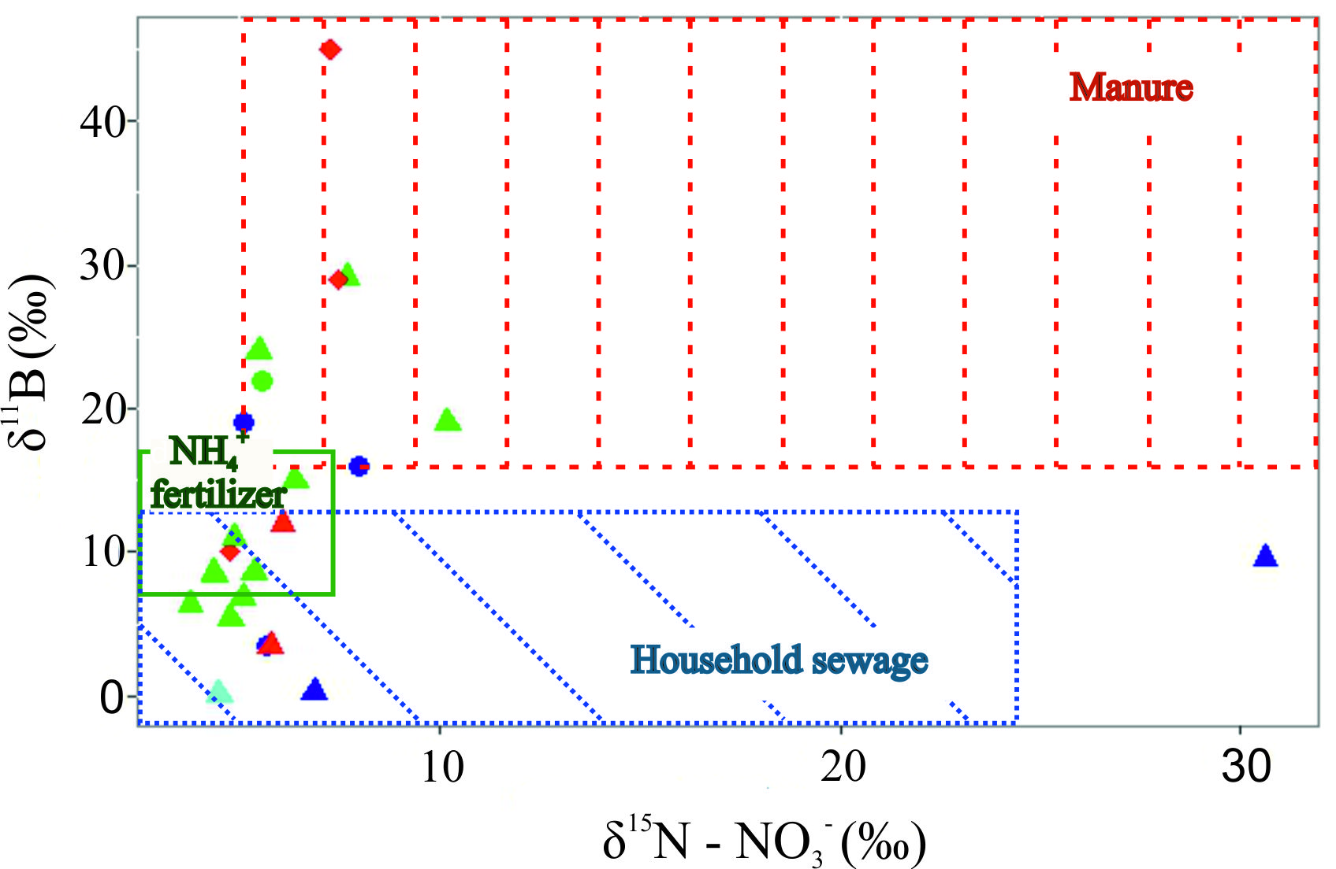
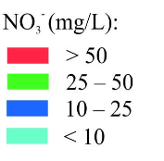
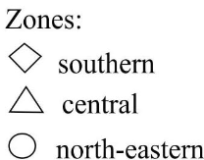
Regional studies: N sources
16
Source: Nikolenko et al., 2019
Fig. 13. Sources of N loading across the aquifer

Slide 18
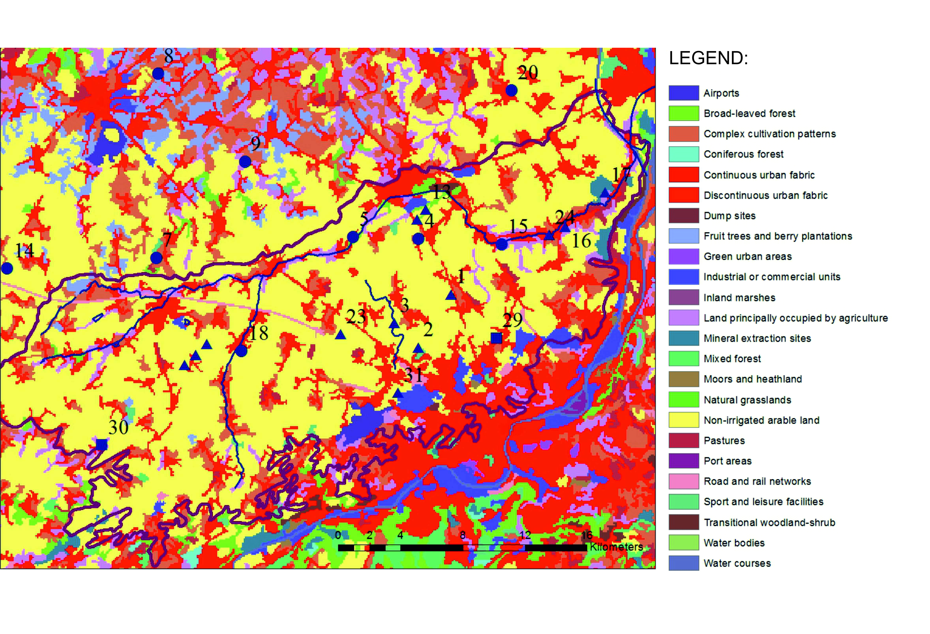
Regional studies: N sources
17
N
Fig. 14. Land use map of the studied area

Slide 19
Regional studies: CO₂ and CH₄ biochemistry
18
tendency towards accumulation of CO₂
the subsurface dynamics of CO₂ is governed by two processes:
dissolution of carbonate minerals;
degradation of DOC derived from the mineralization processes in the soil.
CH₄ accumulation
northern zone is characterized with the higher tendency towards CH₄ accumulation;
presence under aerobic conditions in southern, central and north-eastern zones suggests its thermogenic origin.

Slide 20
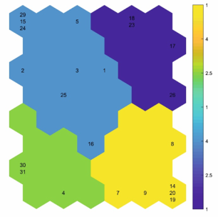
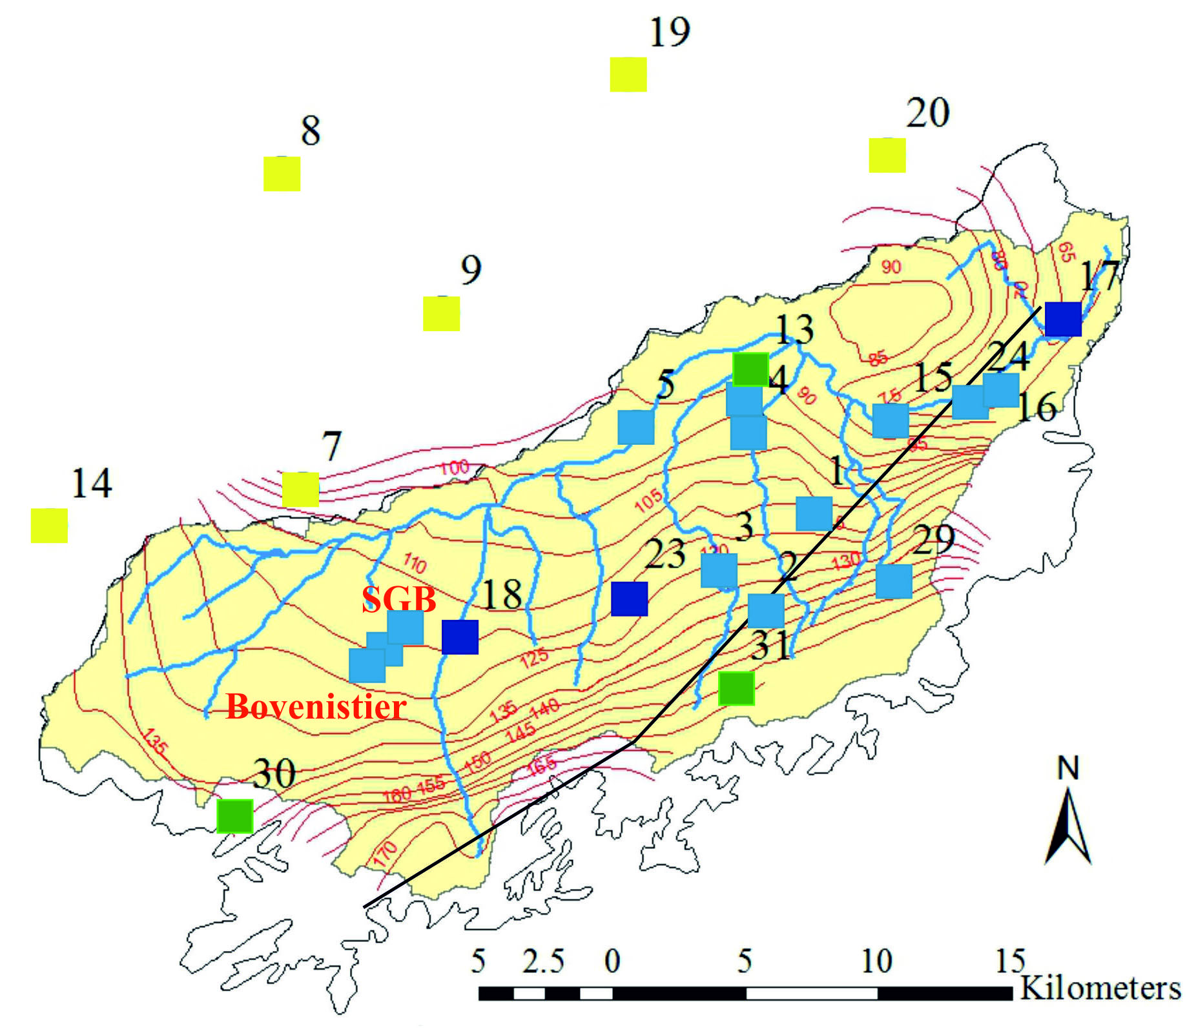
Regional studies: N₂O biochemistry
19
Group 1 – dark blue, group 2 – green, group 3 – blue and group 4 – yellow.
Source: Nikolenko et al., 2019
Fig. 15. Clustering of the groundwater samples using SOM algorithm
Group | N₂O (µg N/L) | SP (‰) | DO (mg/L) | NO₃⁻ (mg/L) | Processes
Group 1 | 3.4 ± 1.2 | 11.2 ± 1.6 | 8.2 ± 1.9 | 28.7 ± 3.8 | nitrification and incomplete denitrification
Group 2 | 13.6 ± 6.3 | 26.1 ± 3.4 | 5.7 ± 2.4 | 48.7 ± 18.7 | nitrification and complete denitrification
Group 3 | 6.7 ± 3.4 | 19.1 ± 6.7 | 7.2 ± 2.6 | 39.6 ± 16.2 | nitrification and incomplete denitrification
Group 4 | 0.1 ± 0.1 | not available | 1.5 ± 2.1 | 0.2 ± 0.4 | complete denitrification

Slide 21
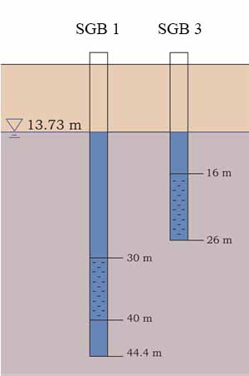
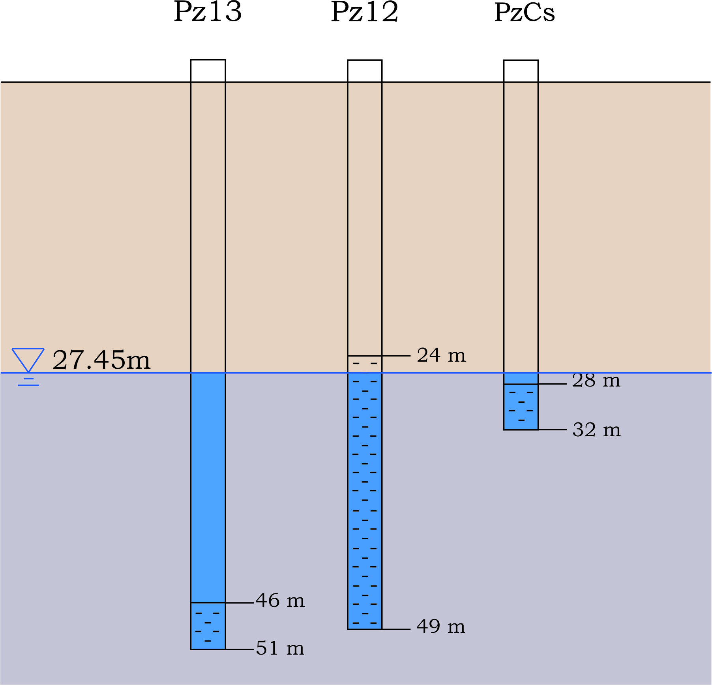
Local studies: description of the area
20
Bovenistier
SGB
9
3
5
8
4
7
6
2
1
Fig. 16. Piezometers and sampling depths at the Bovenistier and SGB sites

Slide 22
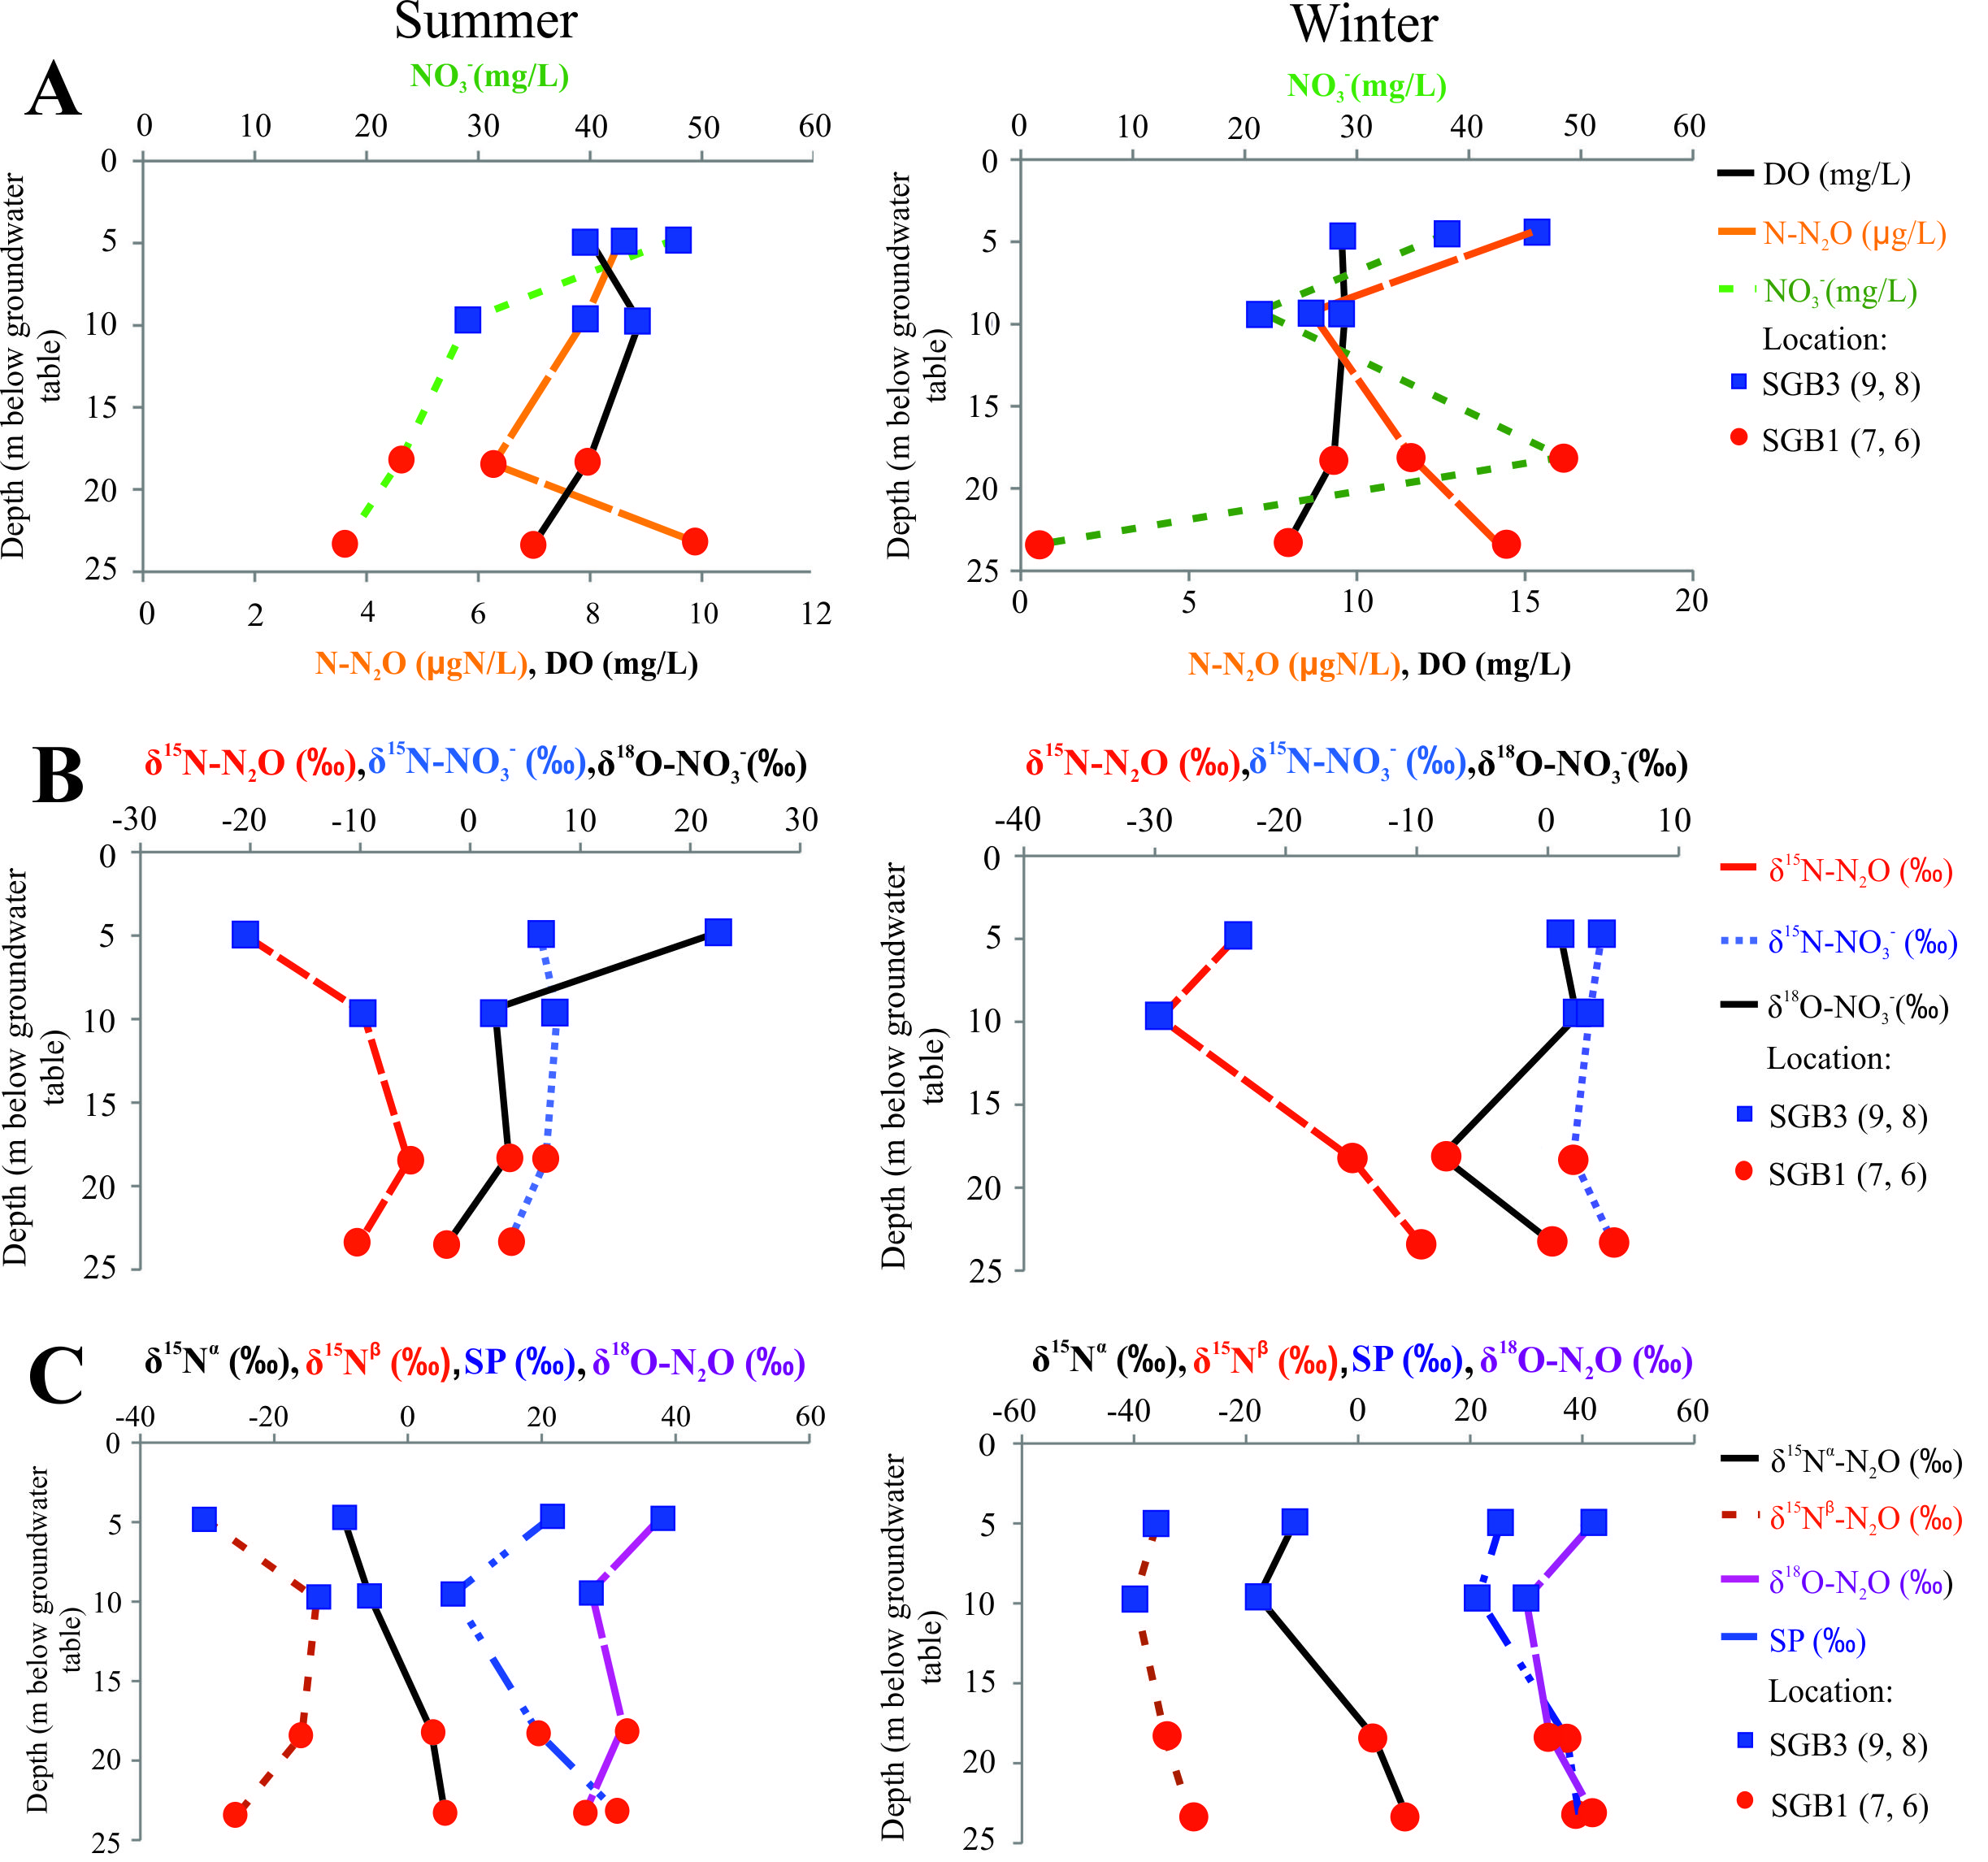
Local studies: vertical profile SGB
21
Fig. 17. Vertical distribution of N compounds, their isotopes and DO

Slide 23
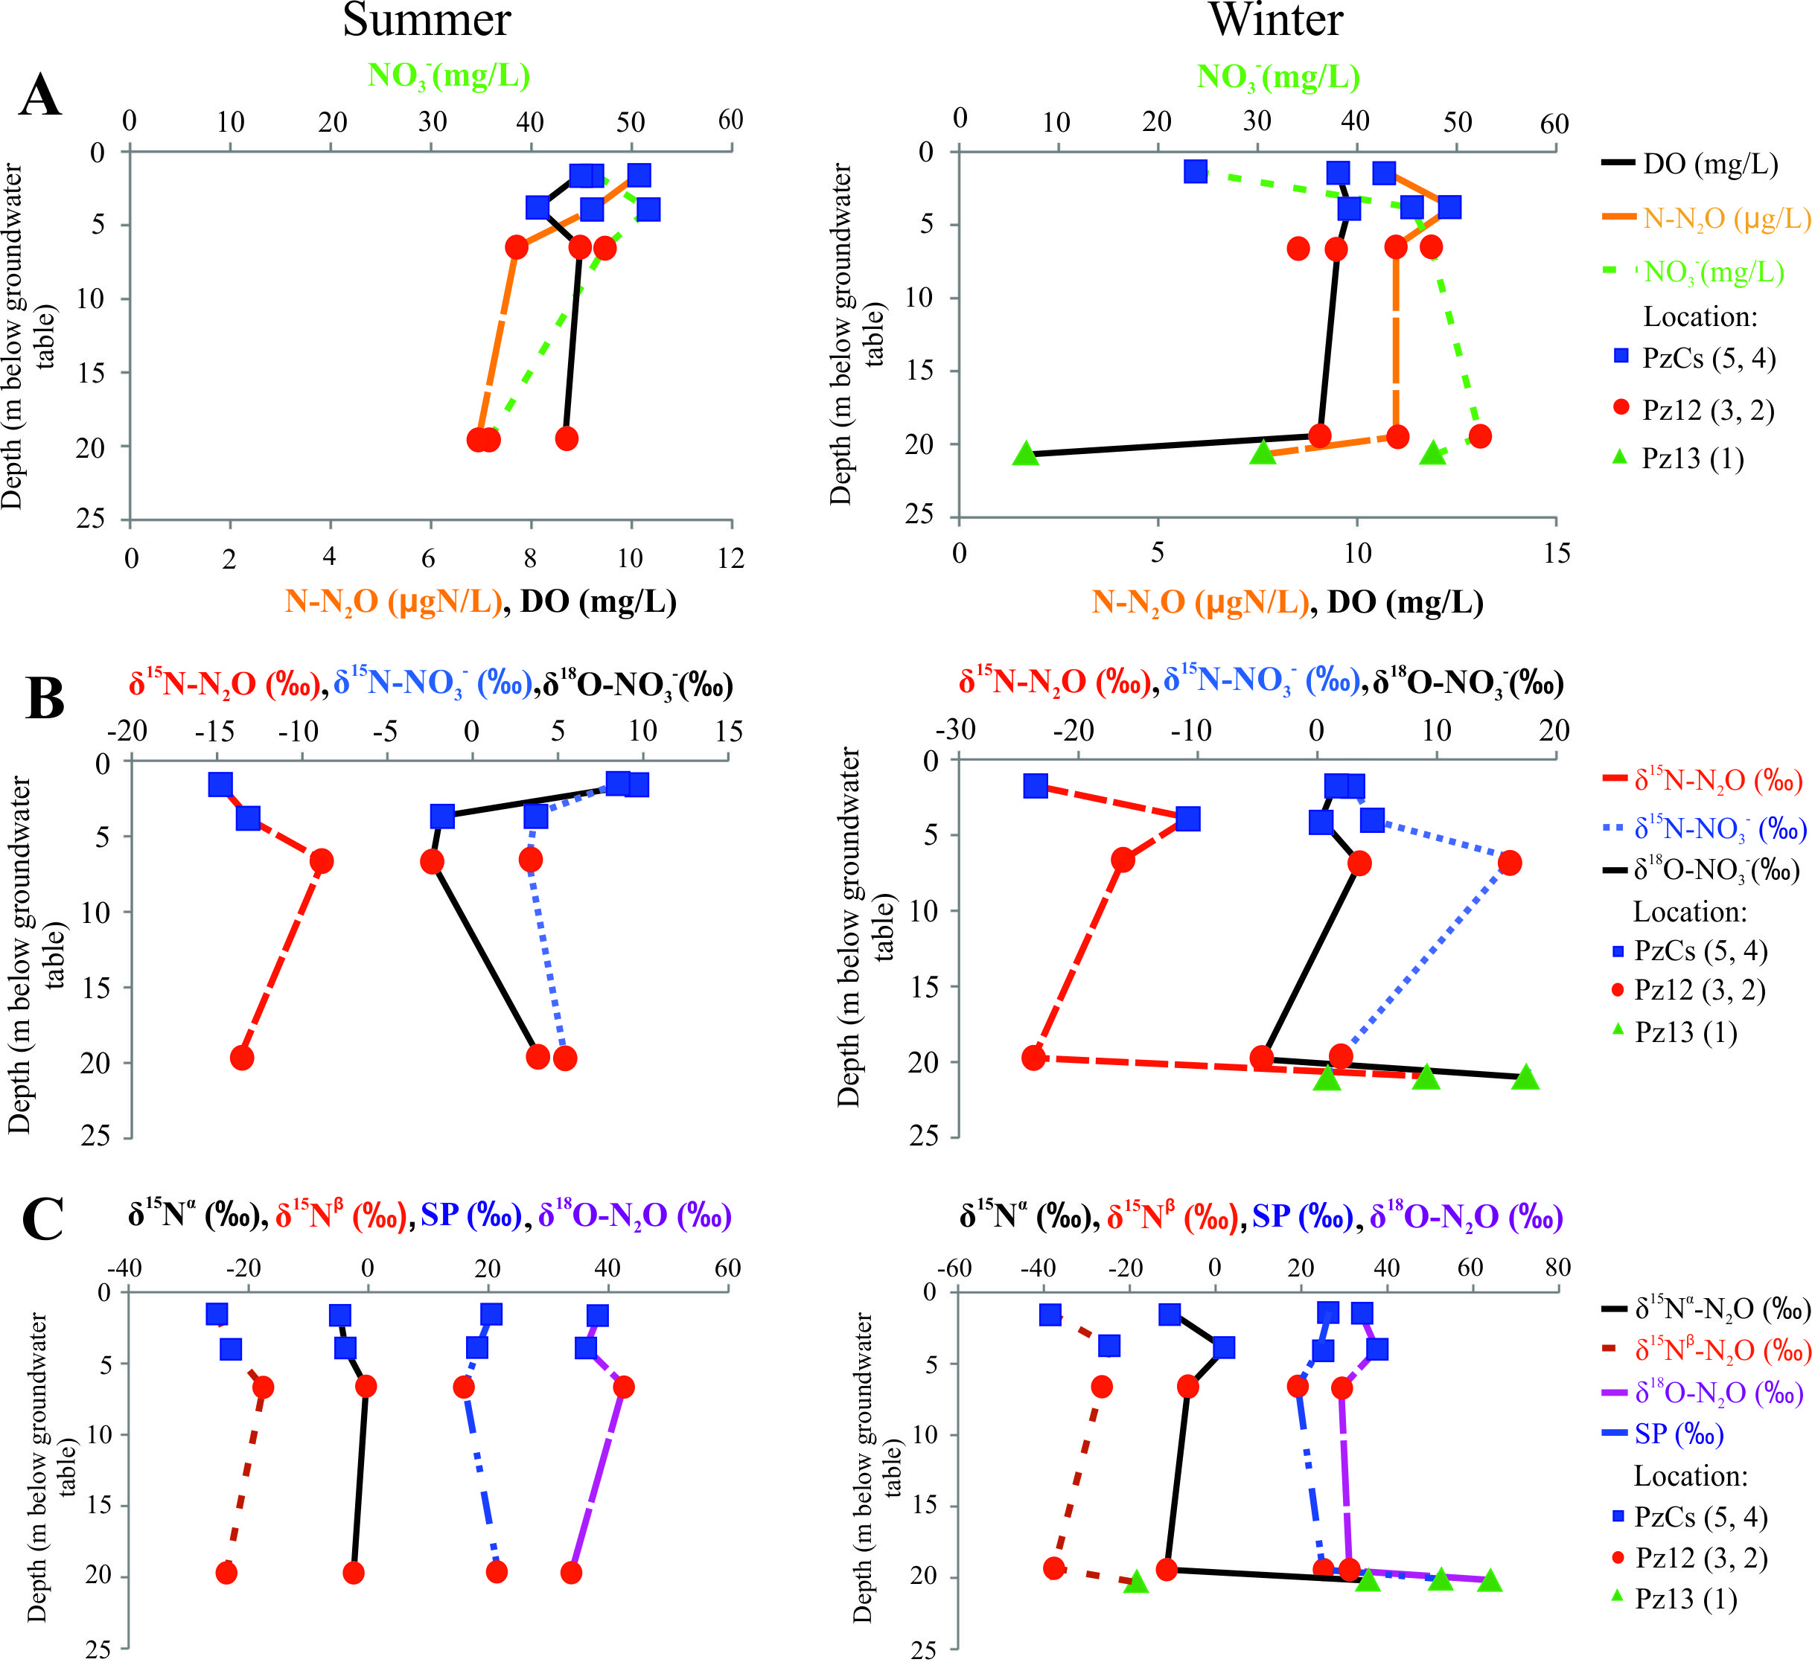
Local studies: vertical profile Bovenistier
22
Fig. 18. Vertical distribution of N compounds, their isotopes and DO

Slide 24
Local studies: isotope labeled experiment
23
Fig. 19. Scheme of laboratory ¹⁵N stable isotope labeled experiment

Slide 25
Local studies: summary
24
N₂O produced by nitrification and denitrification processes occurring within the other parts of the aquifer
OR
discrepancy between real aquifer conditions and laboratory experiments.

Slide 26
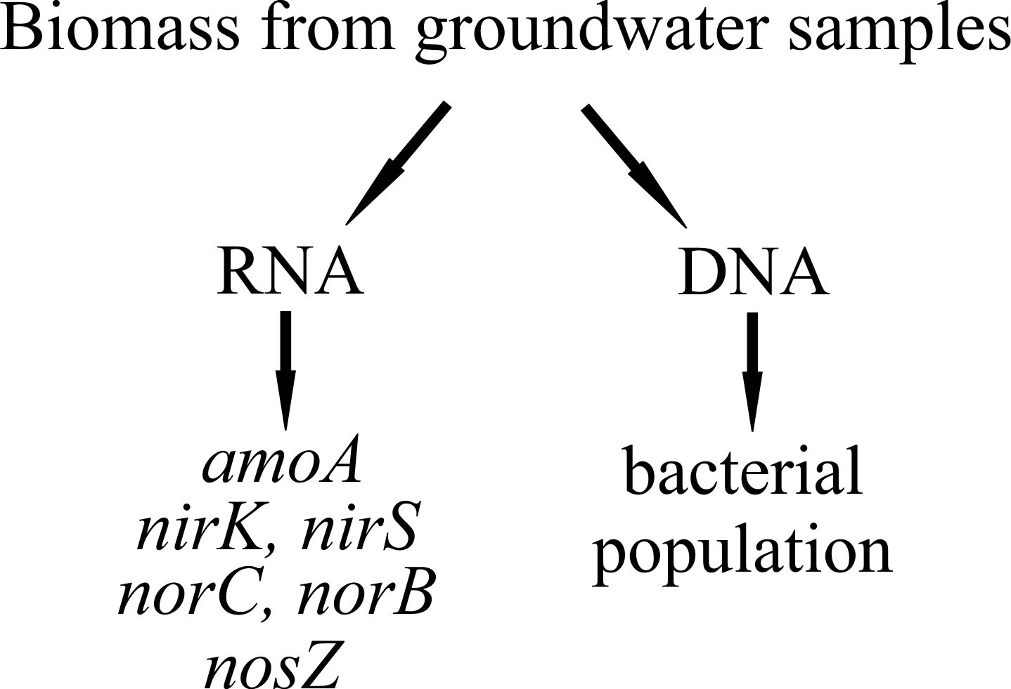
Microbiological studies
25

Slide 27
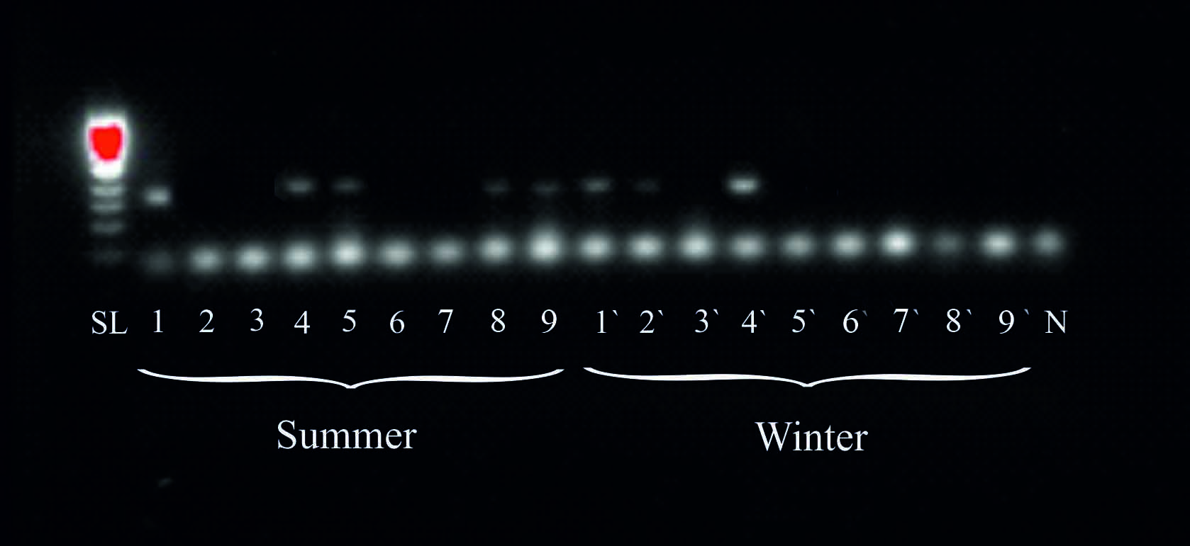
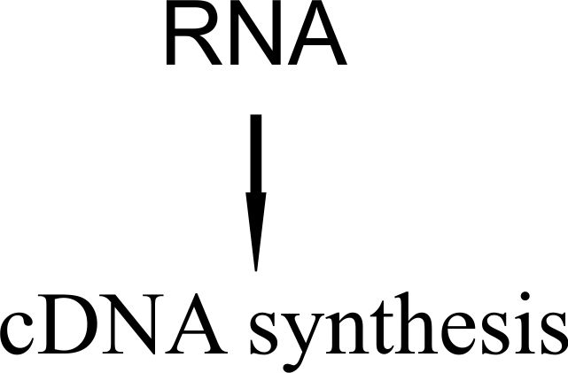
Microbiological studies
26
Fig. 20. Results of PCR analysis aimed to reveal nirS
gene expression in groundwater samples
Sanger sequence
analyses of PCR products

Slide 28
Microbiological studies
27
Location (S/W) | amoA |  | nirK_3 |  | nirK_5 |  | nirS_3 |  | nirS_5 |  | norB_4 |  | norC_2 |  | norC_3 |  | nosZ
 | PCR | SSA | PCR | SSA | PCR | SSA | PCR | SSA | PCR | SSA | PCR | SSA | PCR | SSA | PCR | SSA | PCR | SSA
1 (Pz13) |  |  |  |  | + | + |  |  | + | + | + | + | + |  |  |  | + | +
2 (Pz12 bot) | +
3 (Pz12 top) |  |  |  |  | + | + |  |  |  |  | + | +
4 (PzCs bot) |  |  |  |  | + | + |  |  | + | + | + | + | + | +
5 (PzCs top) |  |  |  |  |  |  |  |  | +
6 (SGB1 bot) |  |  |  |  | + | +
7 (SGB1 top) |  |  | + | + | + | + |  |  |  |  | + | + | + | +
8 (SGB3 bot) |  |  | + | + | + | + | + |  | + | + | + | + | + | + | +
9 (SGB3 top) |  |  |  |  | + | + |  |  | + | +
1`(Pz13) | + |  |  |  |  |  |  |  | + | + | + | + |  |  |  |  | + | +
2`(Pz12 bot) |  |  |  |  | + |  |  |  | + |  | + | + | + | +
3`(Pz12 top) |  |  | + | + |  |  |  |  |  |  | + | +
4`(PzCs bot) | + |  |  |  | + |  | + |  | + | + | + | + |  |  | +
5`(PzCs top) |  |  |  |  | + | + |  |  |  |  | + | + | + | + | +
6`(SGB1 bot) |  |  |  |  | +
7`(SGB1 top) | + |  |  |  | + |  | + |  |  |  | + | + |  |  | +
8`(SGB3 bot) |  |  |  |  | + |  | +
9`(SGB3 top) |  |  |  |  | + |  |  |  |  |  |  |  |  |  | +
nitrifiers genes
denitrifiers genes
N₂O production
N₂O consumption

Slide 29
Conclusions
28
The concentration of N₂O is the most variable which is attributed to the fact that its production/consumption pathways within the studied aquifer are controlled to a large extent by microbiological metabolism:
consequently, the total flux of N₂O originating from the given aquifer is associated with high level of uncertainty, particularly in comparison to the other GHGs.
The concentration of CO₂ does not change significantly in groundwater which might be explained by:
equal distribution of organic matter across the studied area;
aquifer geology controls the amount of CO₂ dissolved in groundwater.
CH₄ is accumulated despite oxic subsurface conditions which might be related to the presence of natural sources of this gas:
coal formations below the aquifer.

Slide 30
Conclusions
29
within the framework of this study it was not possible to obtain the complete understanding about dynamics of N₂O within the aquifer:
nevertheless, there is evidence that show that isotopic signatures of N₂O in the aquifer are affected by ongoing denitrification.
application of isotope/isotopomer mapping approach together with hydrochemical evidence can give the general idea about the occurrence of N₂O production and consumption mechanisms but it cannot differentiate which exactly microbiological processes occur in the aquifer:
the observed N₂O isotopic signatures are affected by mixing between different subsurface compartments.
in order to identify the processes occurring in situ it necessary to complement subsurface findings with the study of enzyme activities.

Slide 31
Perspectives
30
Further steps in studying N₂O dynamics:
comparison of GHGs transformation processes in the “soil – unsaturated zone – aquifer” system;
studying GHGs production and consumption processes within the riparian zones and river sediments;
comparison of N₂O fluxes in the areas of similar hydrogeological conditions but different sources of N loads;
comparison of GHGs fluxes occurring in contrasting hydrological/meteorological conditions and under different agricultural management practices.

Slide 32
THANK YOU!
This project has received funding from the European Union’s Horizon 2020 research and innovation programme under the Marie Skłodowska-Curie grant agreement No 675120.
I acknowledge support from the Department of the Applied Science of the University of Liége (Belgium).
www.inspirationitn.eu

