Slide 1


The Politics of Citizens’ Assemblies:
Why political leaders establish participatory and deliberative institutions
Hadrien Macq & Vincent Jacquet

Slide 2
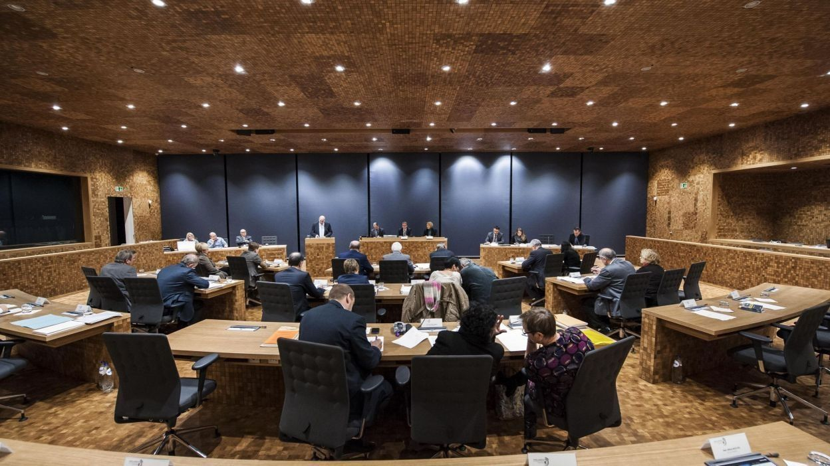

Why do political leaders establish (permanent) citizens’ assemblies?

Slide 3
The events
RESEARCH DESIGN
The German-speaking Community as an extreme case
Interpretive approach
Interviews with all of the main actors
Inductive and thematic analysis
The expected benefits
A particular context

Slide 4


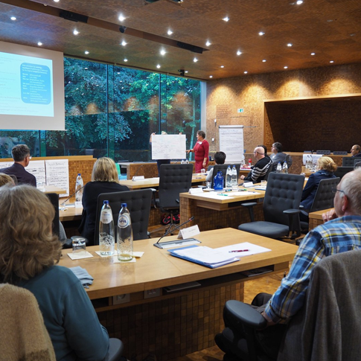

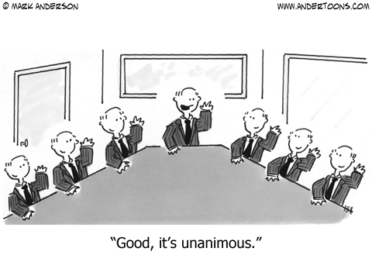
The events
The expected benefits
A particular context

Slide 5
Better Decisions
« Teaching, retirement homes, employment, (…) The citizens who has a relative in a retirement home, he may give information that I, as an entrepreneur, wouldn’t have obtained or thought otherwise. And the same goes when we speak of child care: there are practical things we do not think about.” (Leader of a parliamentary group).
The events
The expected benefits
2. Healing democracy (ex 1)
« Mutual comprehension and thinking ‘it is not that easy to make political choices after all’, because people quickly understand that there is not enough budget etc., that one has to make choices in decision-making processes” (Leader of a parliamentary group).
A particular context

Slide 6
The events
2. Healing democracy (ex 2)
« If we succeed in organizing a certain peace between citizens and politicians, if we succeed in making our representative democratic system more credible, then we take that from the populist parties, and it costs them votes because they benefit from the failure of our system, of our democracy. This is their market, where they get all their votes from. And so they do not want us to reform because we might of course take off a little bit of the people’s frustration that they benefit from on a daily basis “(Minister-President)
The expected benefits
A particular context

Slide 7
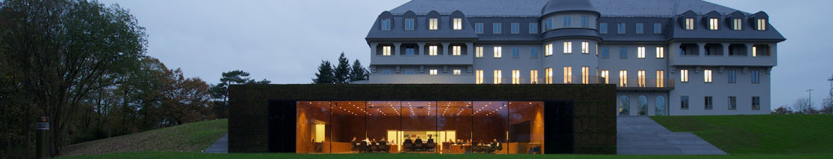
The events
Breeding ground
“We have always lived here in a small community (…) we are very close to the people, (…) so we have some ‘citizens dialogue’ almost daily, if you want” (Leader of a parliamentary group)
Building the Community
This aspect of identification is crucial for a minority, for its survival, for its autonomy. And the elected representatives, in general, they are interested in augmenting the credibility of the political work by working with [the citizens] (Member of Parliament staff).
The expected benefits
A particular context

Slide 8
Citizens’ assemblies as elites’ legitimation tools?
To me it’s crystal clear: a Bürgerdialog is a Bürgerdialog. In a democratic system like ours, the Parliament decides. This, to me, is not object to any discussion, because the elections provide us with legitimacy (Leader of a parliamentary group)
This, to me, is the crucial point. If we do not respect what the citizens have thought and discussed, then we are not trustworthy anymore. So we have to make sure that these people, which take time to participate, do not feel aggrieved (Leader of a parliamentary group).

Slide 9
The Politics of Citizens’ Assemblies:
Why political leaders establish participatory and deliberative institutions
Hadrien Macq & Vincent Jacquet

