Slide 1
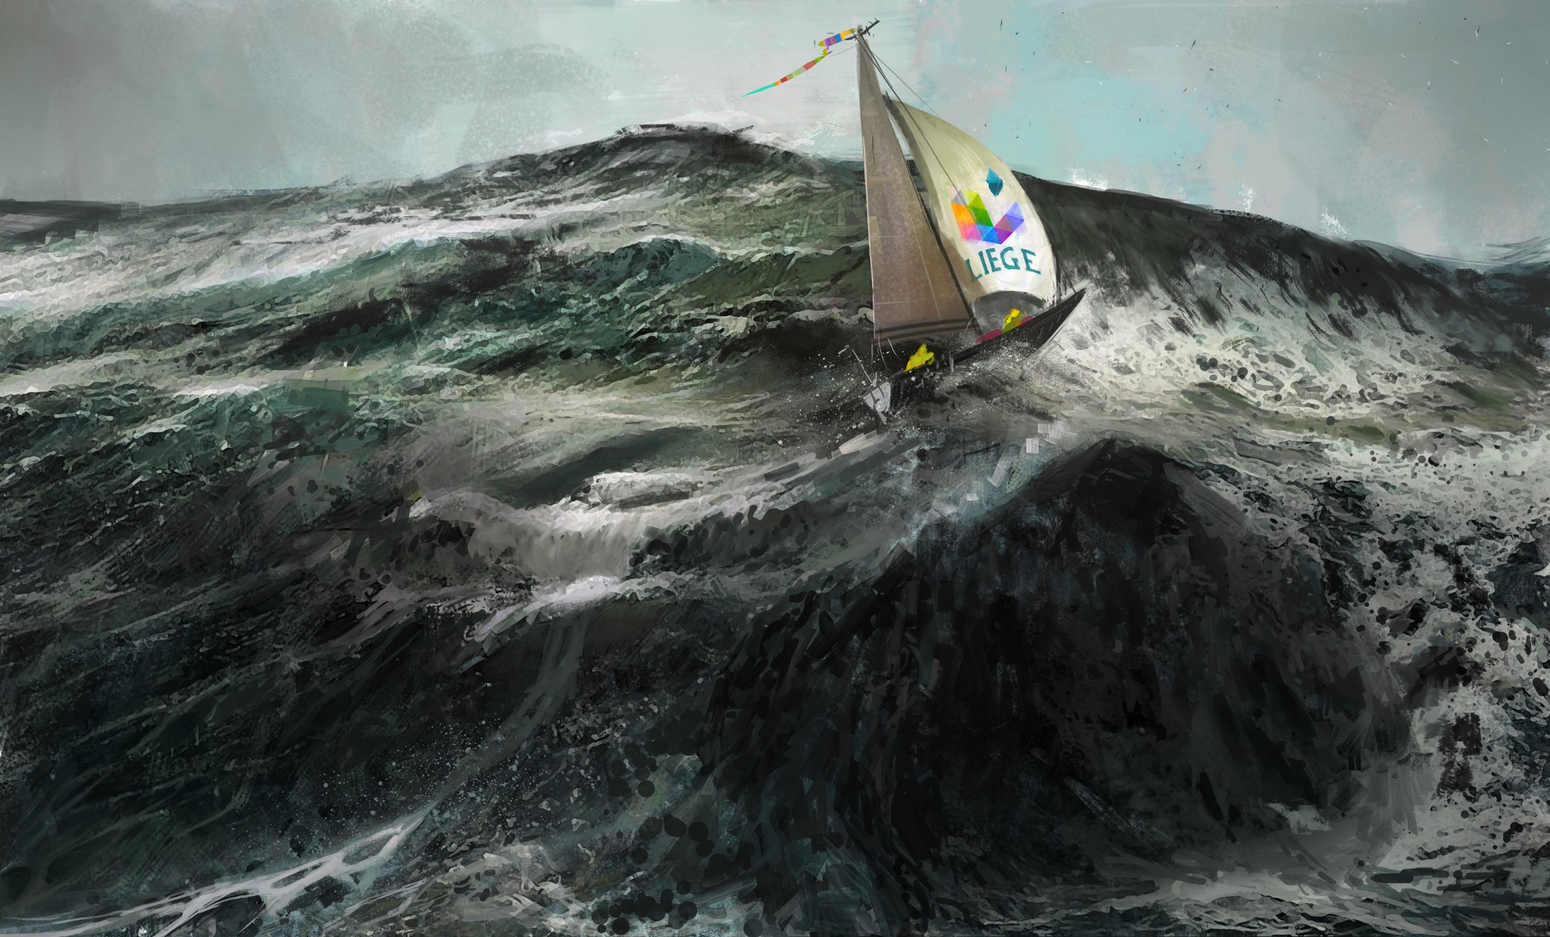
Extreme engineering for fighting climate change and the Katabata project
Damien ERNST, Xavier FETTWEIS, Michaël FONDER and Julie LOUIS

Slide 2

80% of our primary energy comes from fossil fuels.
This percentage has hardly changed in the past decade.
CO₂ concentrations are climbing at a record pace.
And now ? Extreme engineering solutions are needed.

Slide 3
Global grid:
The extreme electrical network
Fact 1: Natural smoothing of renewable energy sources and loads variability in a global grid setting. Very little investment in storage needed.
Fact 2: Renewable electricity – in €/MWh – is very cheap in high-density renewable energy fields (e.g., Atacama desert for solar energy, Greenland coast for wind energy).
Fact 3: Transporting electricity over long-distances is becoming cheap.
Fact 1 + Fact 2 + Fact 3 offer a true possibility for putting fossil fuels out of business for electricity generation (even without a CO₂ tax) by building a global grid.

Slide 4
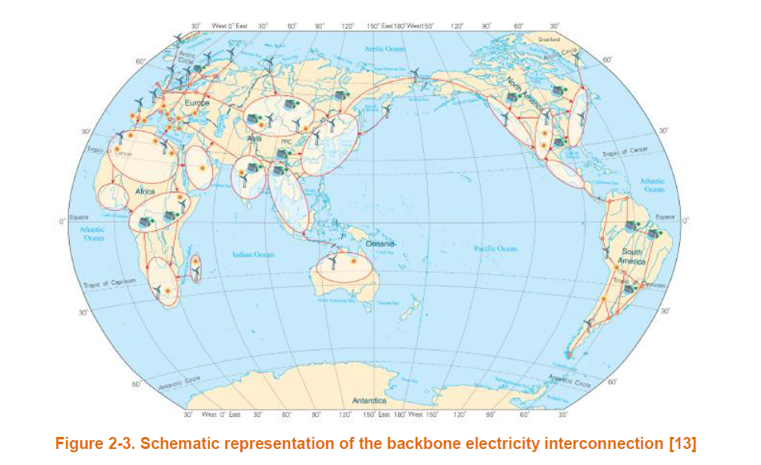
Schematic representation of the backbone electricty interconnection.

Slide 5
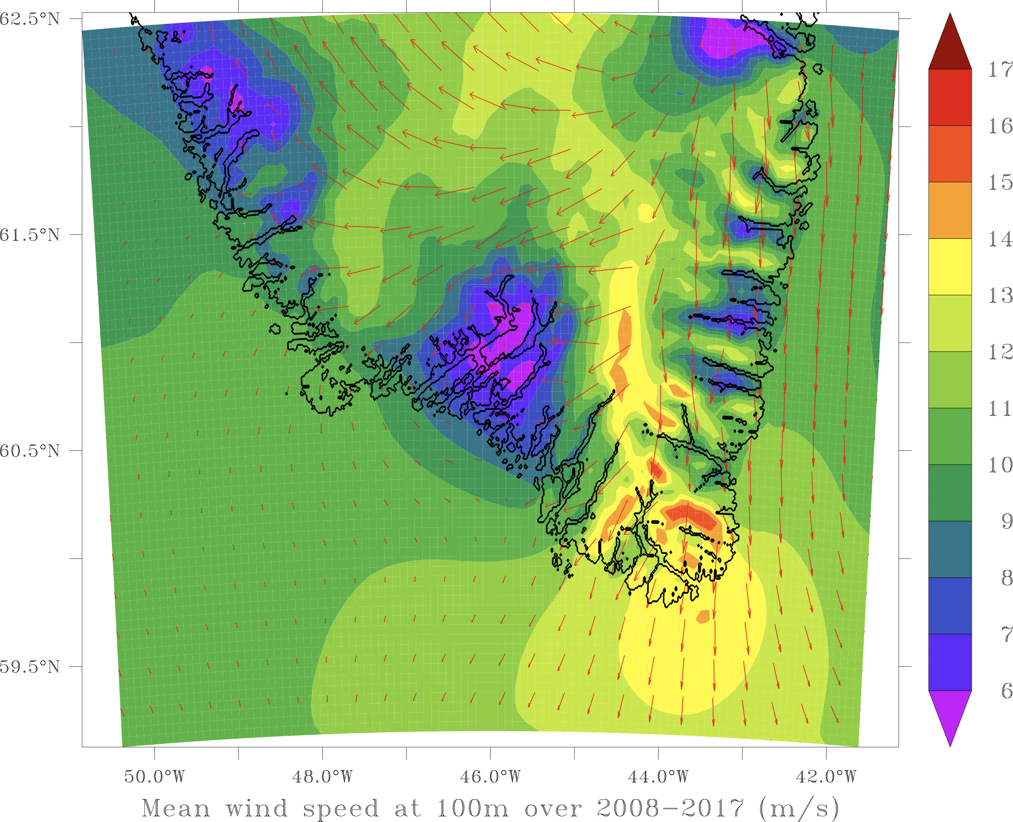
  Why should Europe harvest wind energy in Southeastern Greenland?
High wind speeds.
Decorrelation with European wind temporal variability.
Huge areas. No NIMBY issues.
Half-way between Europe and the US.
Nice flagship project for accelerating the building of the global grid.

Slide 6
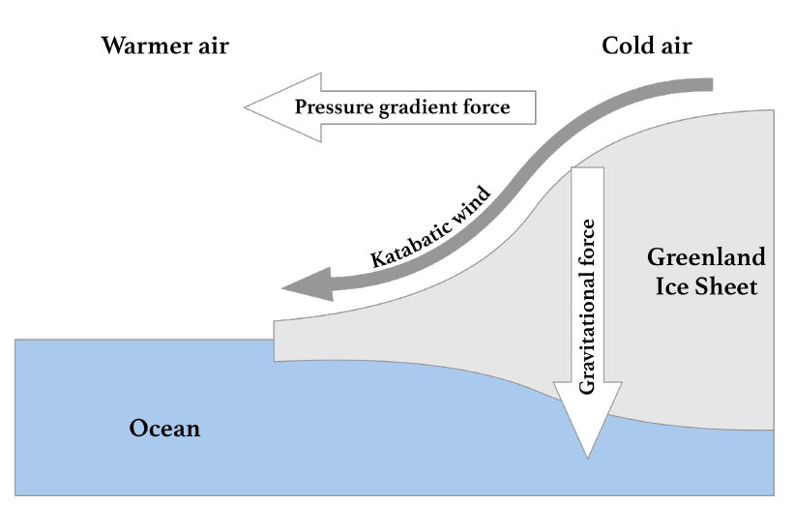
Winds in Southeastern Greenland
In the southeastern part of Greenland, general circulation (synoptic) winds (driven by the Sun’s energy) add up to Katabatic winds.
Katabatic winds are the result of heat transfer processes between the cold ice cap and the warmer air mass above it.
When the air mass temperature is higher than that of the ice sheet, the former is cooled down by radiation, thus the air density increases forcing it down the sloping terrain.
The flow of katabatic winds is driven by gravity, temperature gradient and inclination of the slope of the ice sheet.

Slide 7
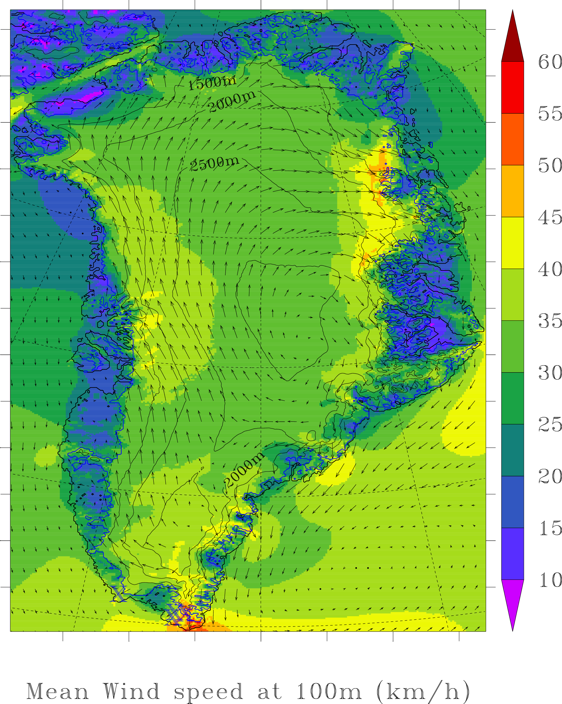
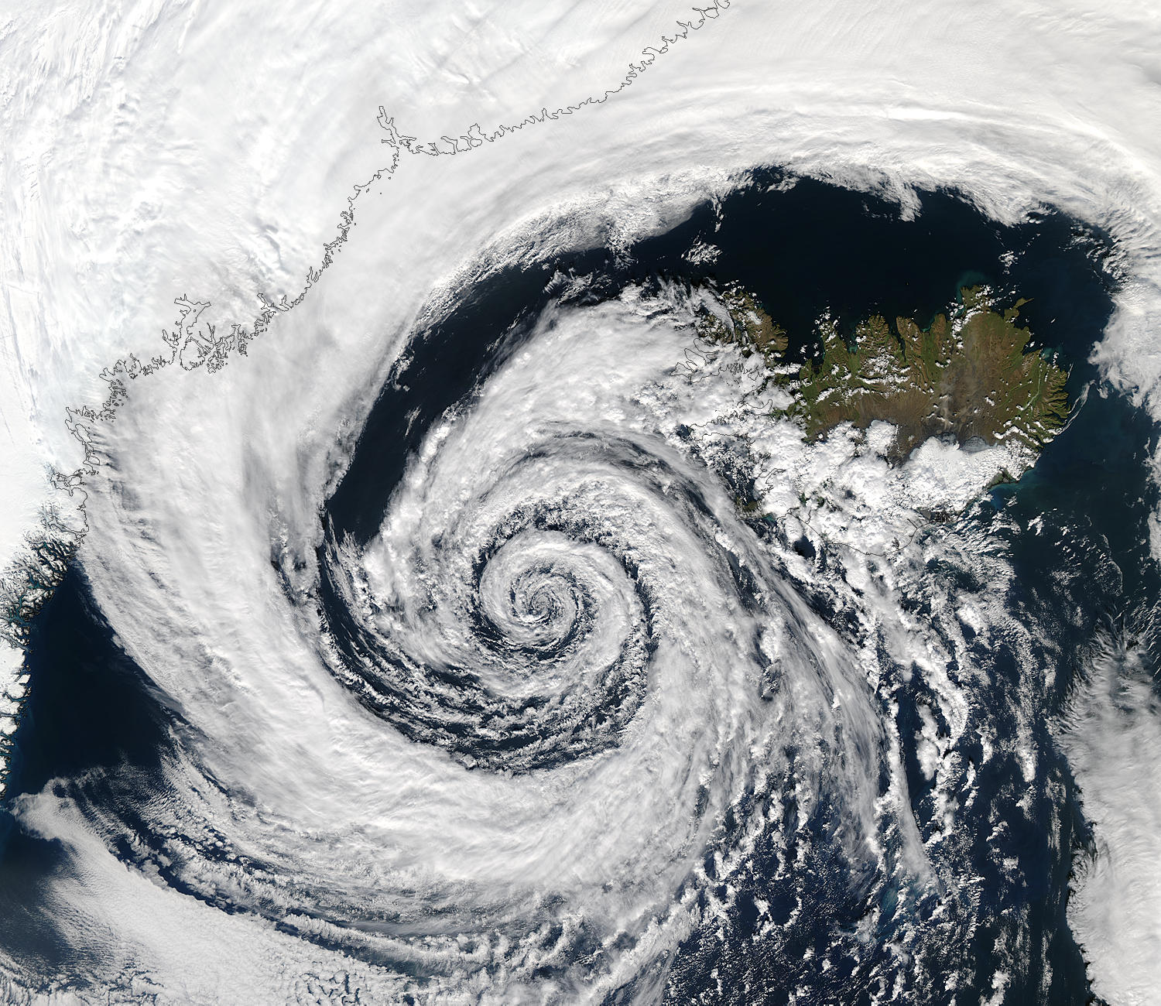
Winds in Southeastern Greenland
Real katabatic wind
(deviated on its right due to the Coriolis force)
Pure katabatic wind
Synoptic wind due to the inland low pressure.
In this area, combination of both katabatic and synoptic winds

Slide 8

Data acquisition for our analysis
We relied on data reanalysis and simulations to reconstruct wind signals from past in-situ and satellite observations.
The regional MAR (Modèle Atmosphérique Regional) model was used to simulate the weather over Greenland. This model can accurately represent physical processes in polar regions, including Katabatic winds, and has high spatial and temporal resolutions. Boundary conditions determined by the ERA5 reanalysis model.
Hourly values of wind speed at 100 meters above ground level are generated using the reanalysis models for the period 2008-2017.

Slide 9
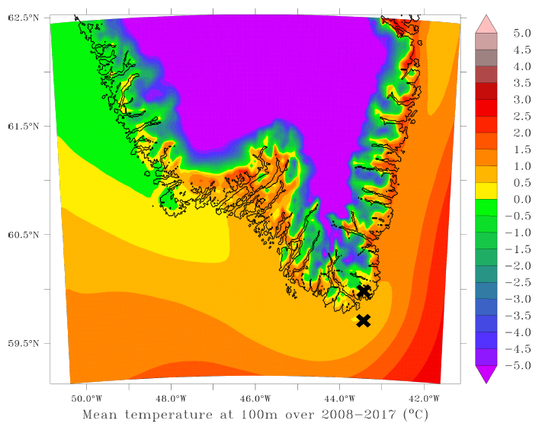
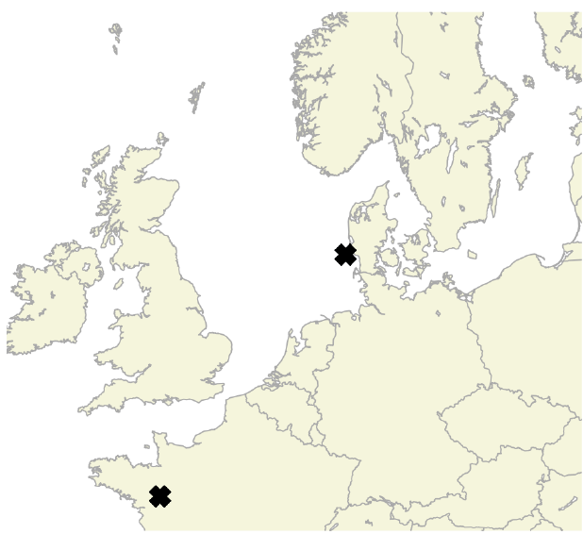
Regions selection for our analysis
Two areas in Greenland: one offshore (GR_{OFF}) and one onshore (GR_{ON}).
Temperatures too mild to have a frozen sea or permanent ice on-shore.
Two areas in Europe: one offshore wind farm in Denmark (DK) and one on-shore wind farm in France (FR).

Slide 10
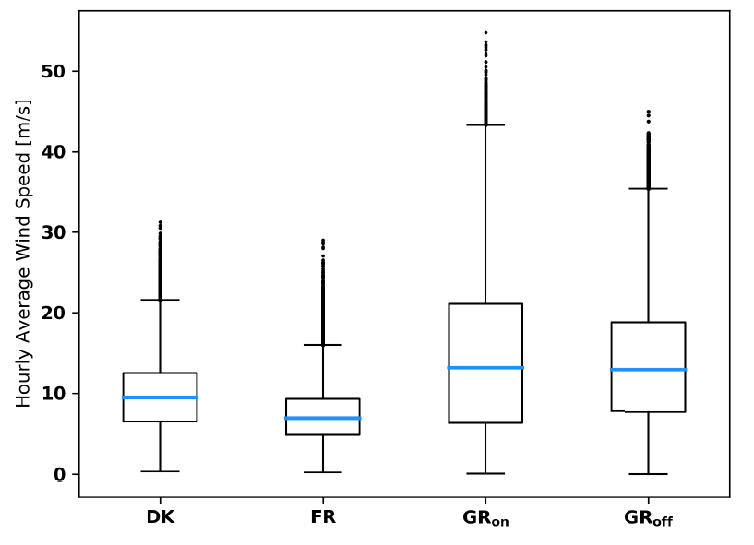
  Wind ressource assessment
Higher mean wind speeds in Greenland than in the two European locations.
Distribution of wind speeds more asymmetric for GR_{off} and GR_{on} than for DK and FR.
The high standard deviations of the wind speeds in Greenland do not correspond to a high turbulence intensity, but to the strong influence of seasonality of the local natural resource.

Slide 11
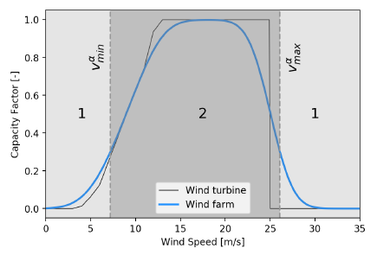
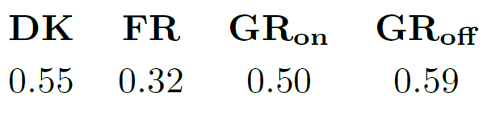
  Load factors of the wind farms
Single turbine and wind farm transfer functions. Example of wind farm power curve aggregation based on multiple aerodyn SCD 8.0/168 units.
Capacity factors for the different locations

Slide 12
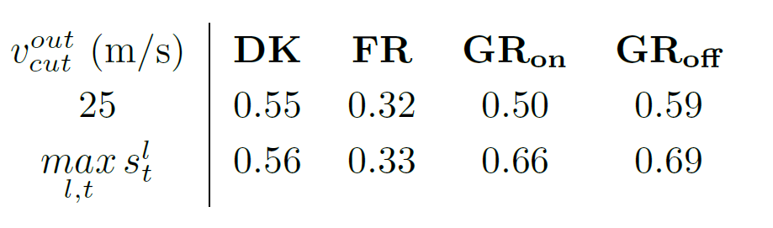
Capacity factors versus
cut-out wind speed for the wind turbines.
Highest wind speed observed
Important remarks for manufacturers of wind turbines willing to tap into the Greenland wind energy market:
Wind turbines capable of operating with higher cut-out speed lead to significantly higher capacity factors in Greenland.
May also be interesting to design wind turbines which saturate in terms of power output for higher wind speeds (i.e., turbines having a higher rated output speed).

Slide 13
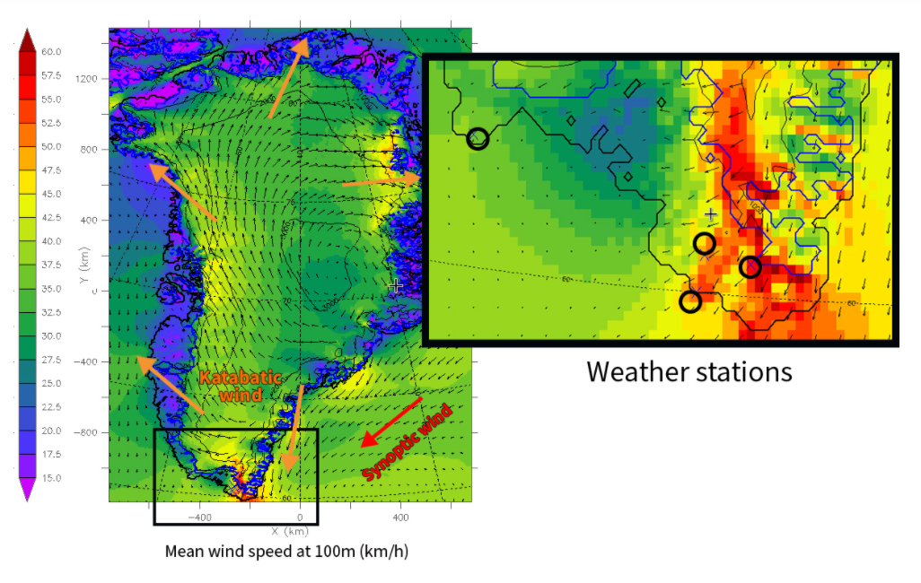
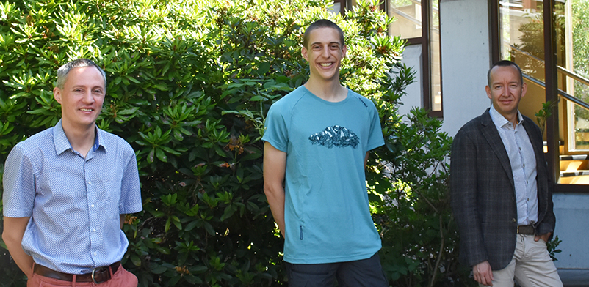
Katabata project
Goal of the project: installing three weather stations in the South-East of Greenland.
The wind in this area has never been properly measured before!
The team:
Dr. Xavier Fettweis, Michaël Fonder
and Prof. Damien Ernst

Slide 14
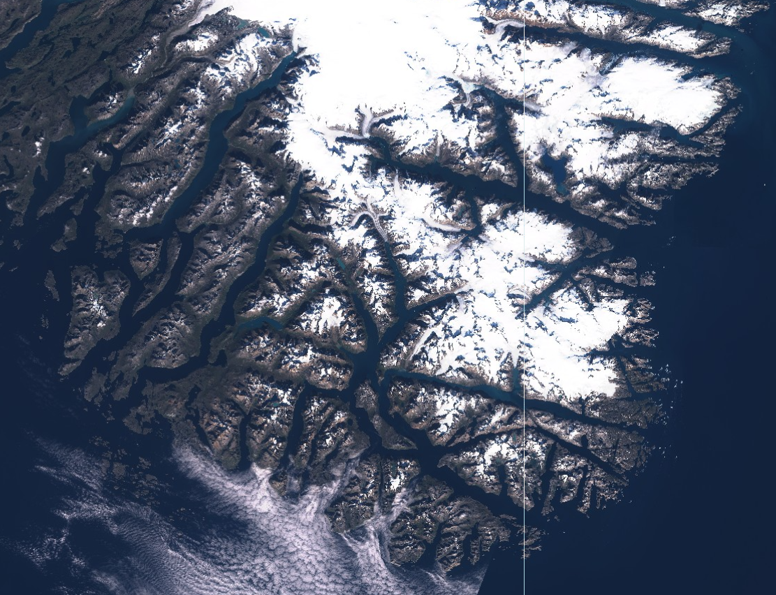
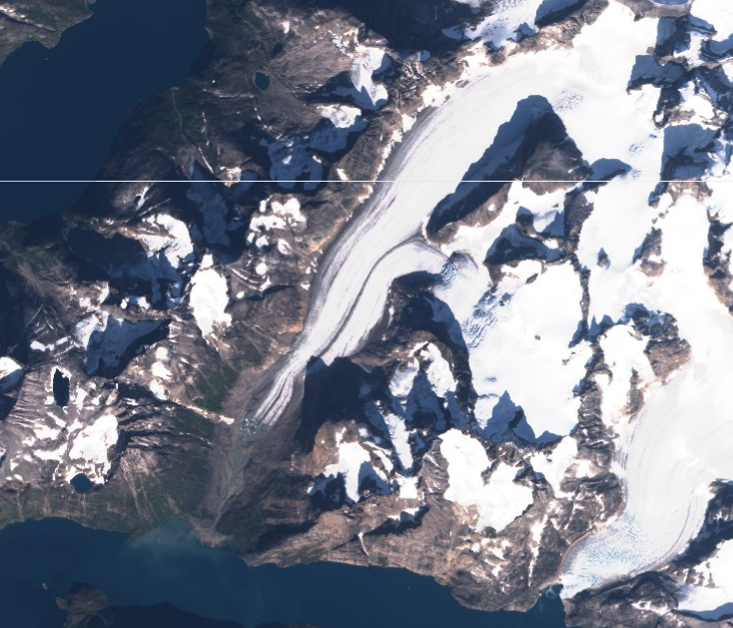
Location of the weather stations
AWS2 (both winds)
+ venturi effect
AWS3 (local katabatic winds)
AWS1 (synoptic wind + see breezes)
Zoom on AWS3

Slide 15
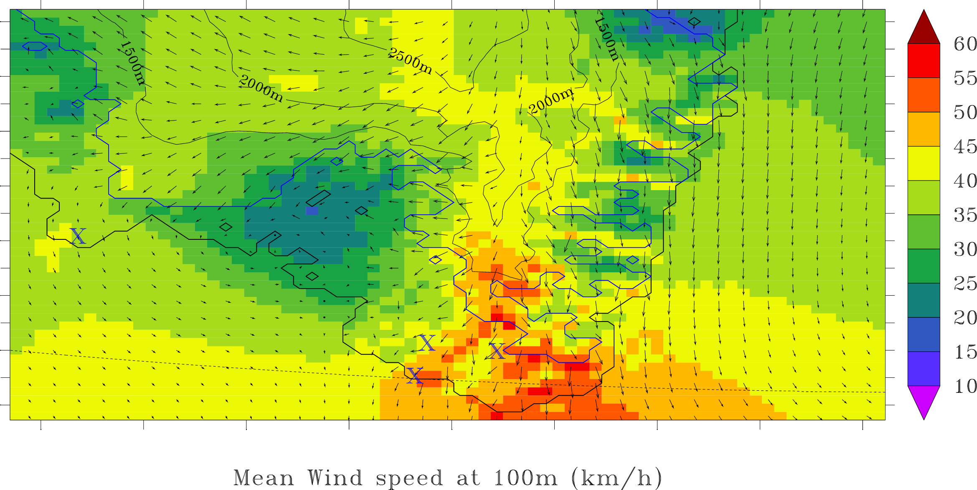
Winds at those locations
Weather stations

Slide 16
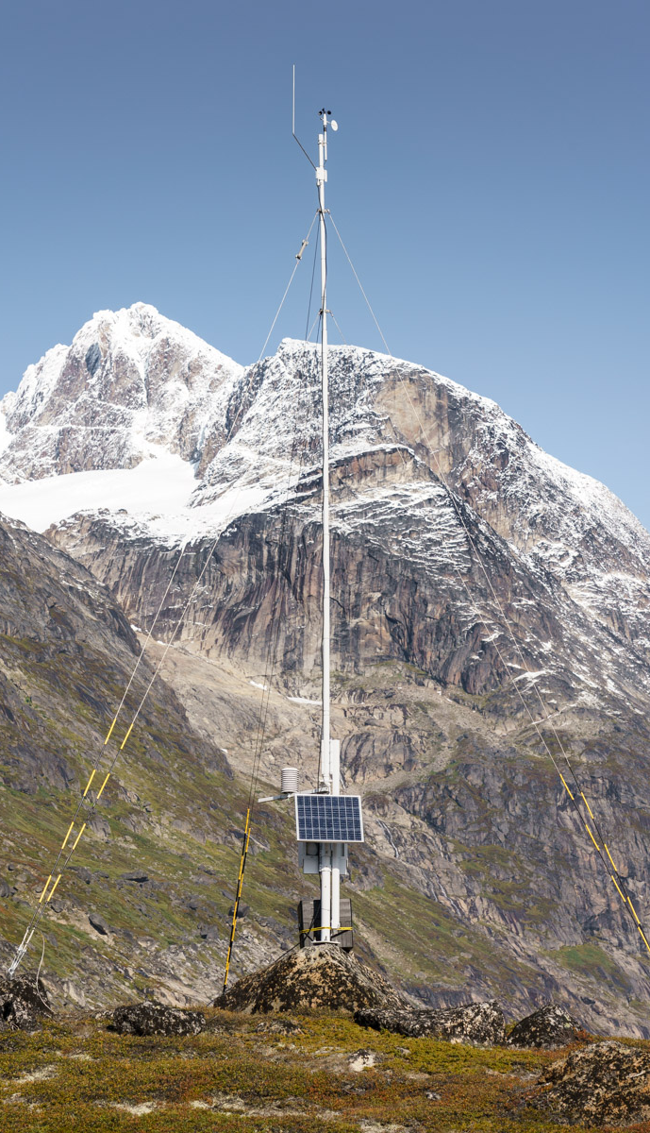
Vaisala’s AWS310 stations
Description of AWS310 stations:
4 sensors:
  Anemometer for wind speed
  Weathervane for wind direction
  Thermometer
  Humidity sensor
Satellite antenna for data transfer
10m mast with three guy wires
Battery with photovoltaic panel for lengthy operations in complete autonomy
Our AWS310s are also synonyms for an epic delivery:
Packages weighing more than 350kg for a total volume of 2m³ divided in seven boxes for each station
A total delivery delay of three months

Slide 17
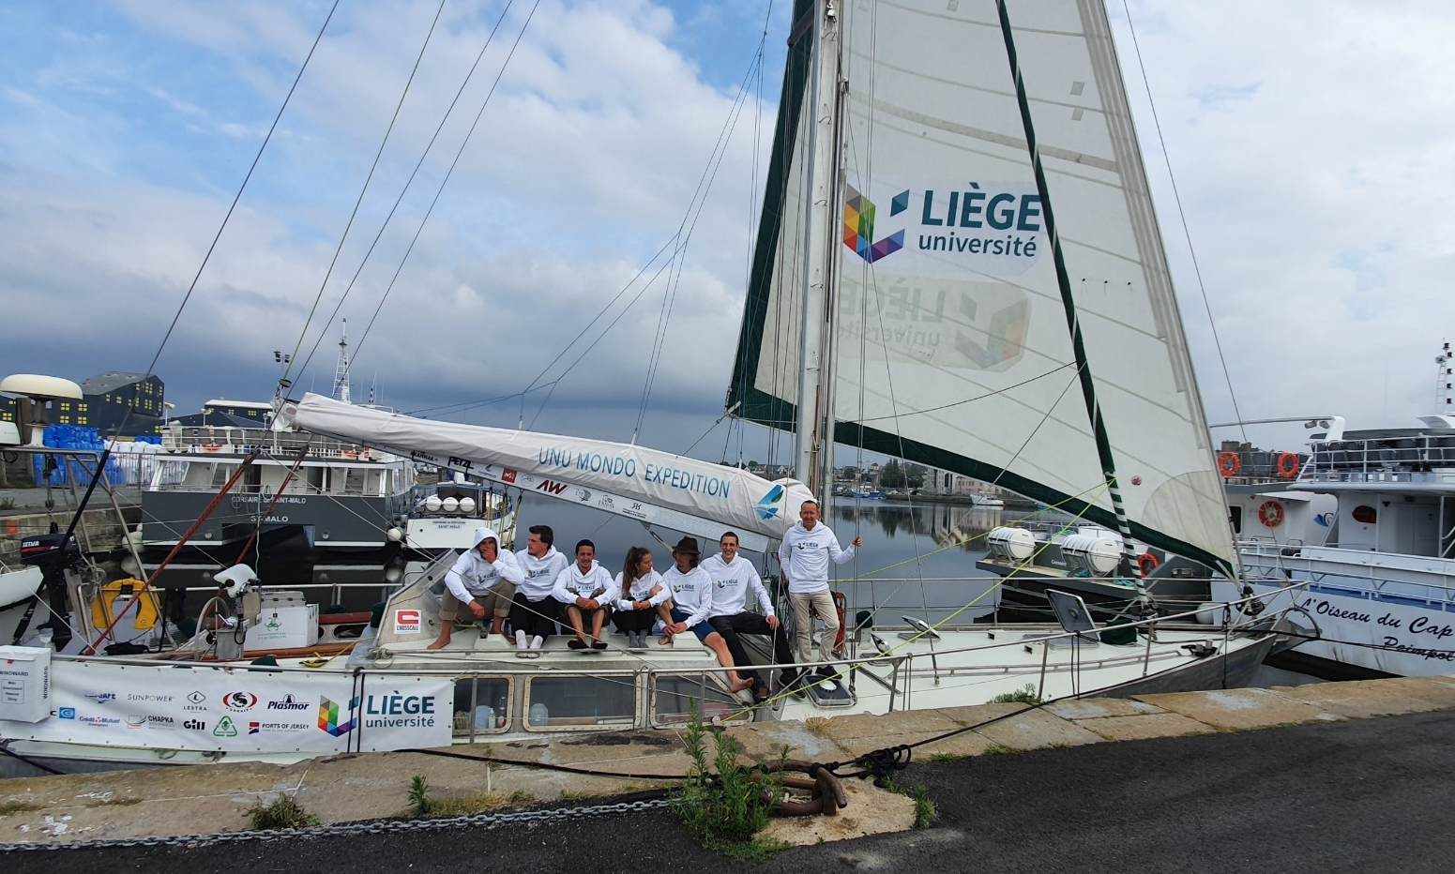
Departure from Saint-Malo

Slide 18
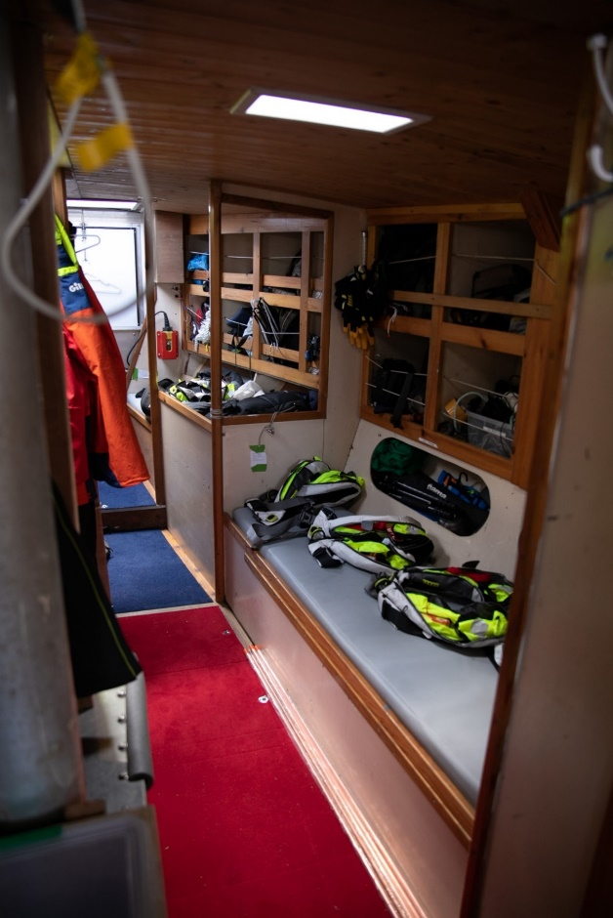
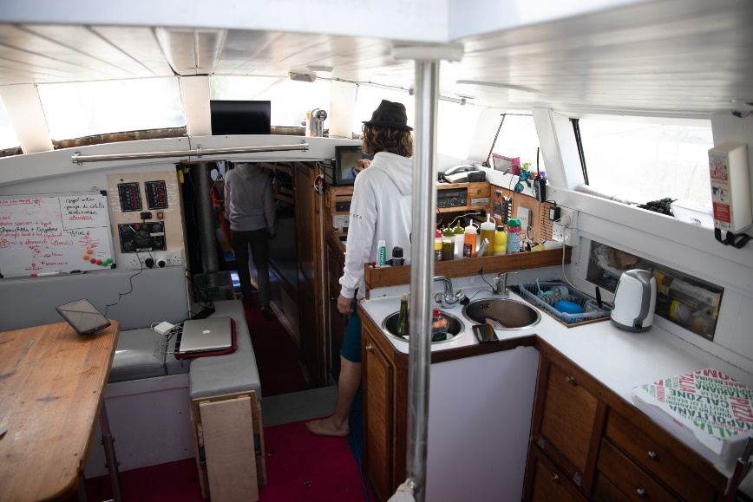
Northabout : a boat designed for polar expeditions
10 bunks
Sufficient food for 3 months
15m length, 18m mast
Reinforced aluminium hull
Extra-large fuel tanks
Photos © Studio Corsaire

Slide 19
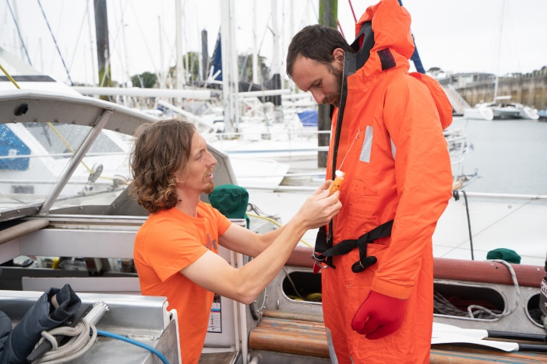
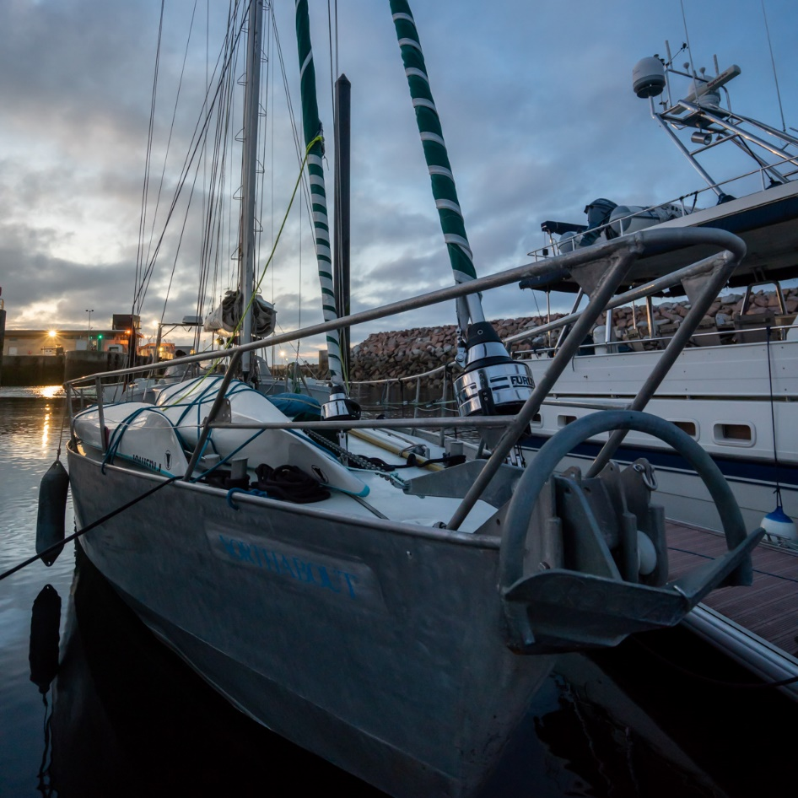
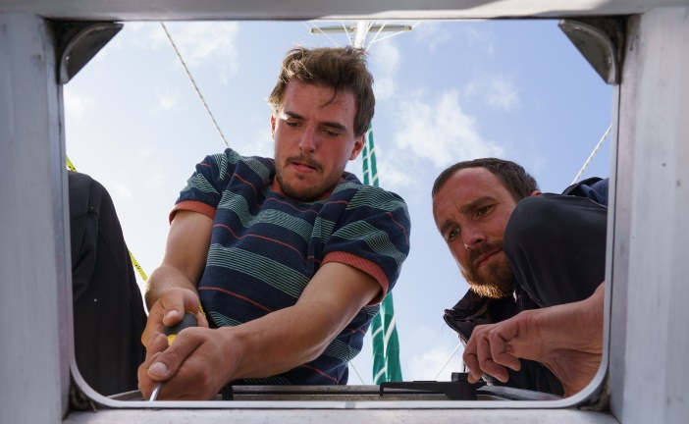
Final preparations in Roscoff

Slide 20
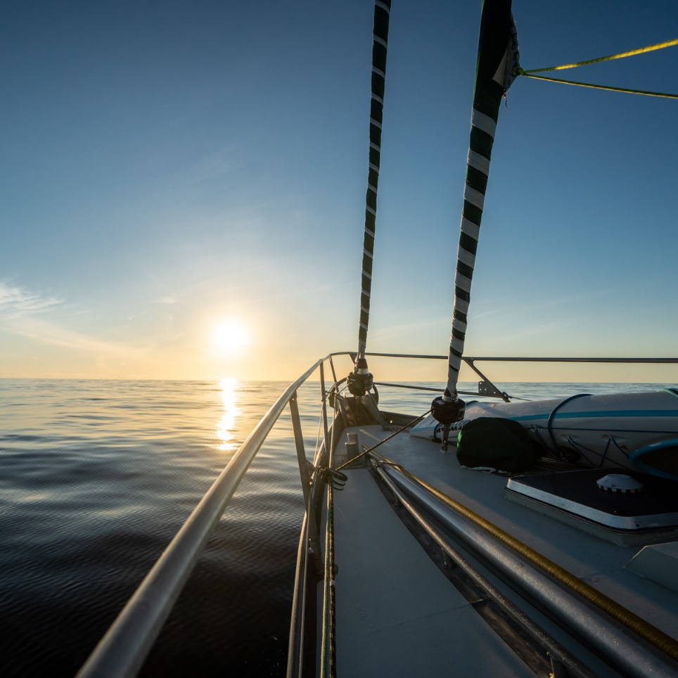
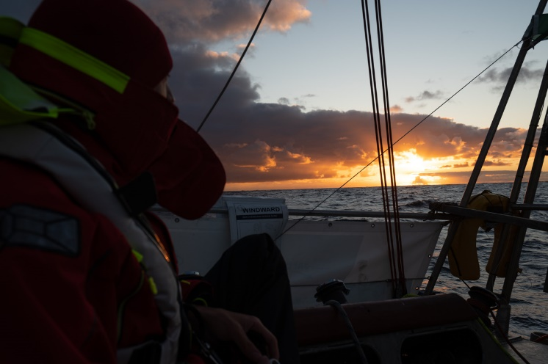
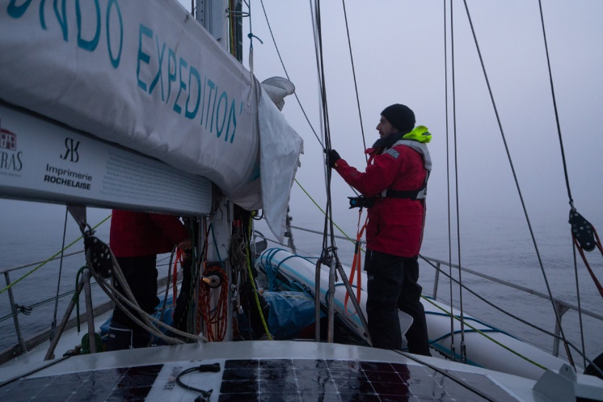
Crossing the Atlantic

Slide 21
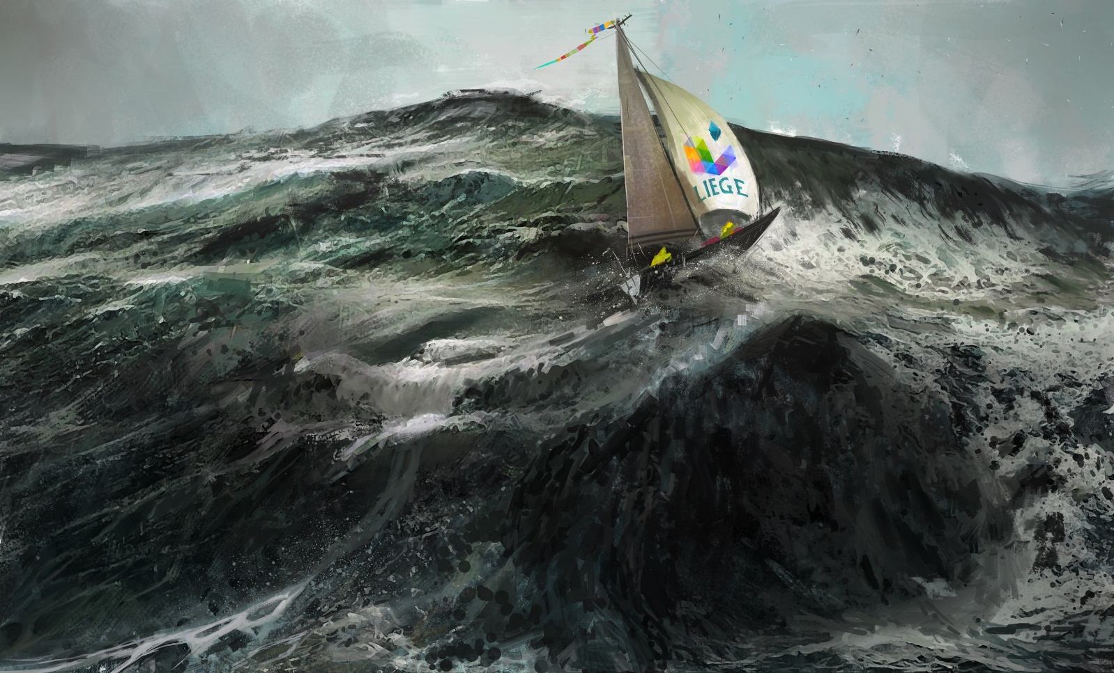
Crossing the Atlantic
(artist representation)

Slide 22
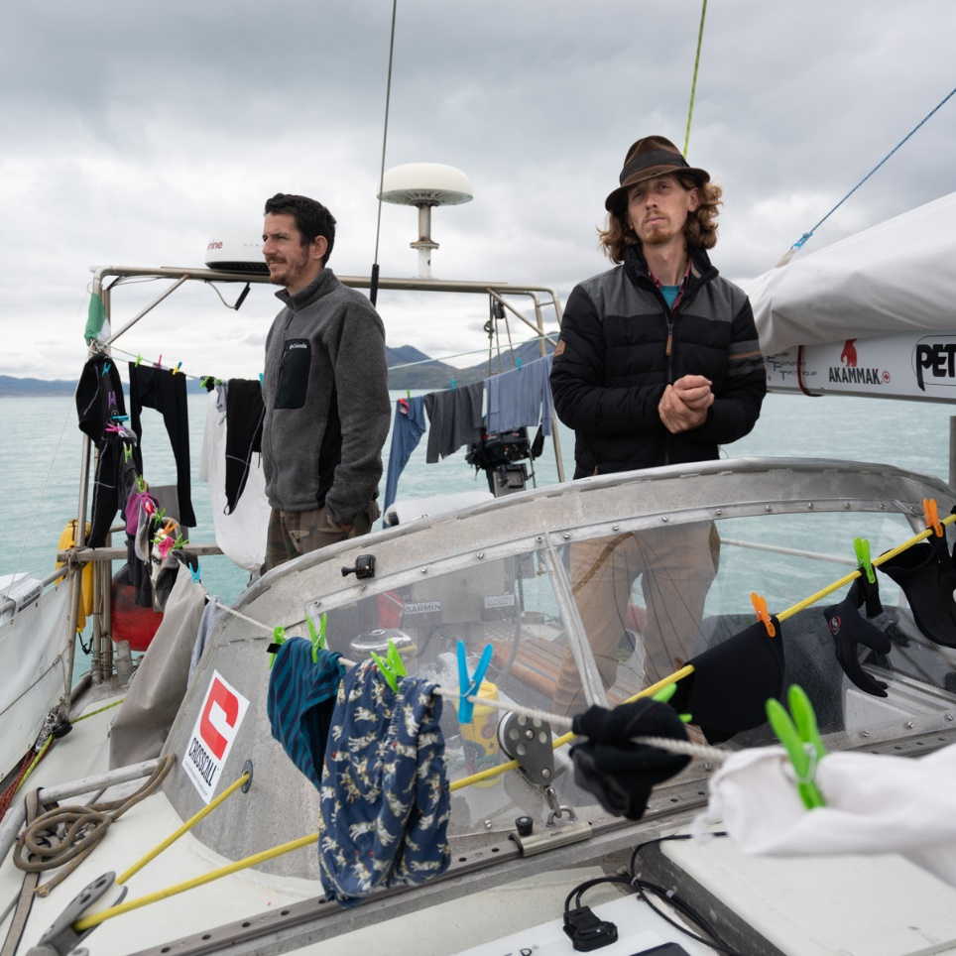
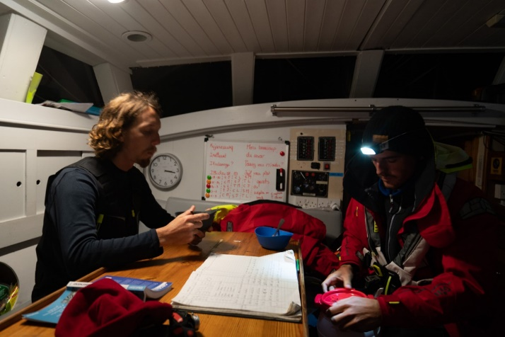
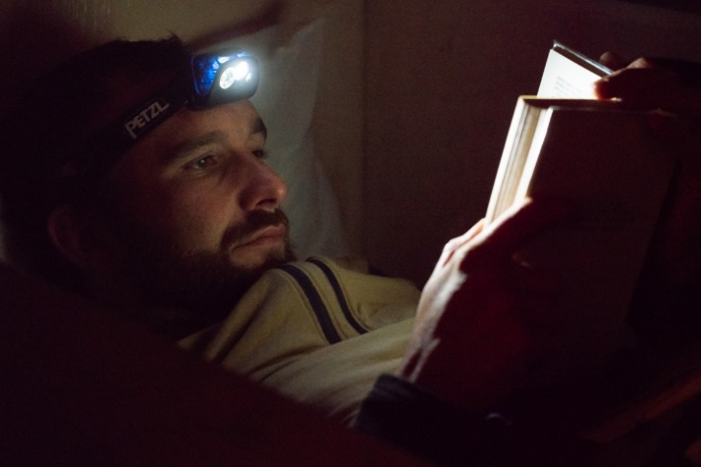
Snapshots of life onboard

Slide 23
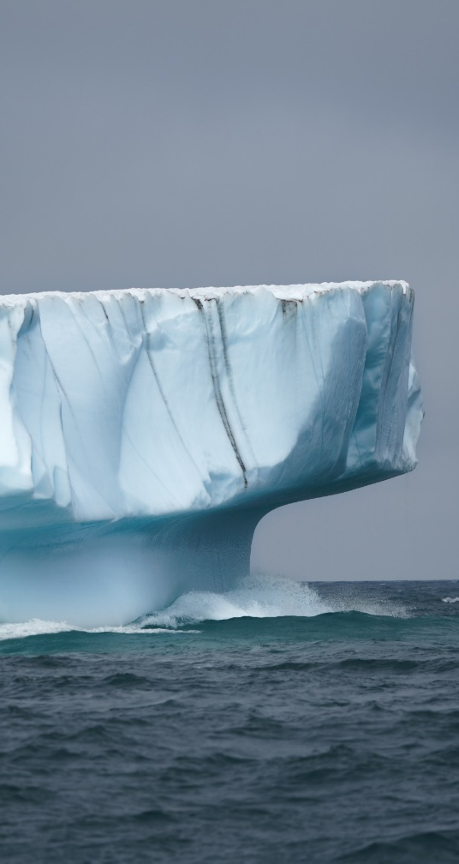
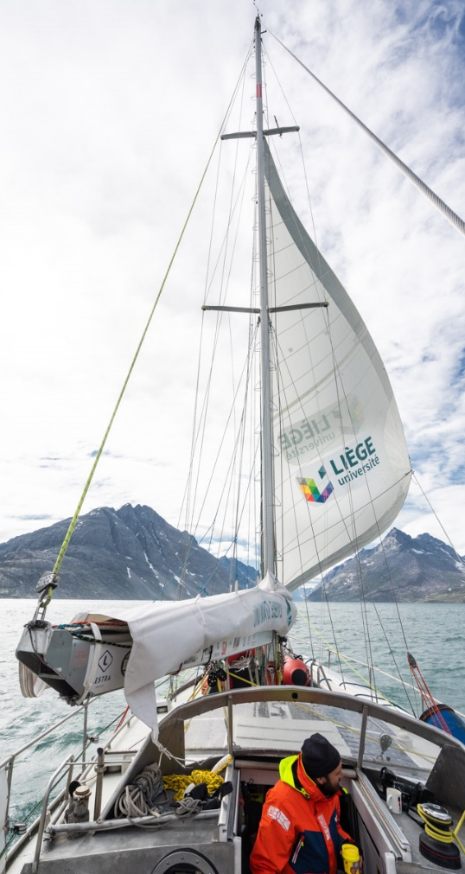
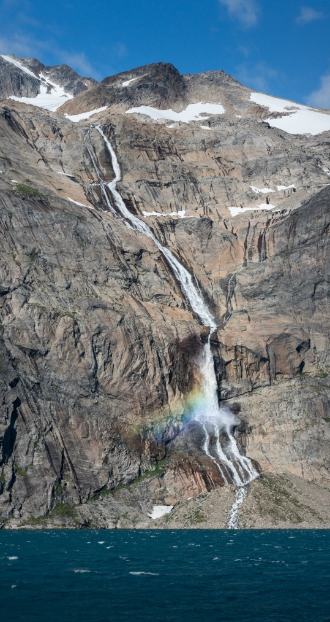
Arrival in Greenland

Slide 24
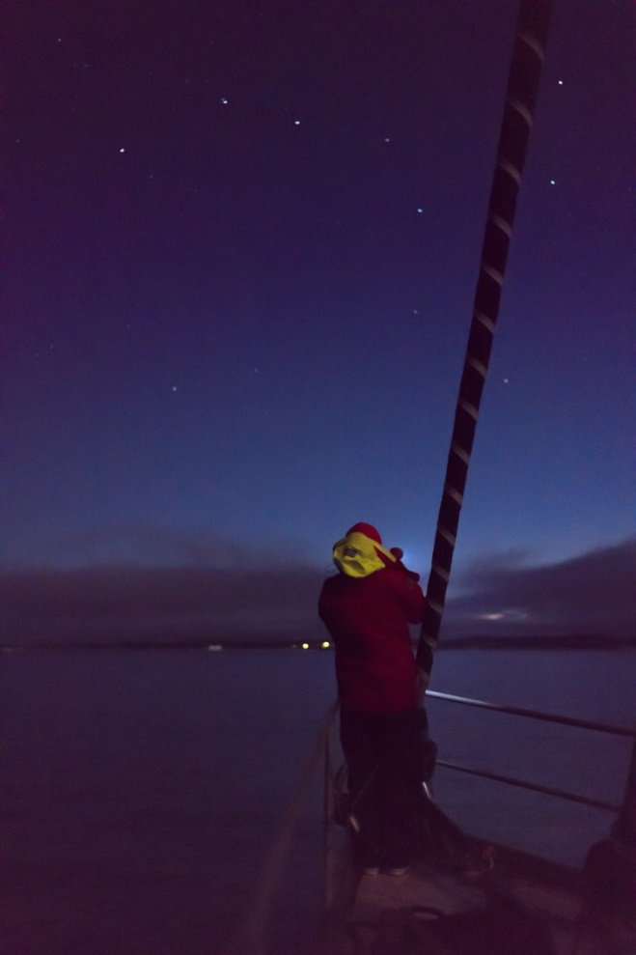
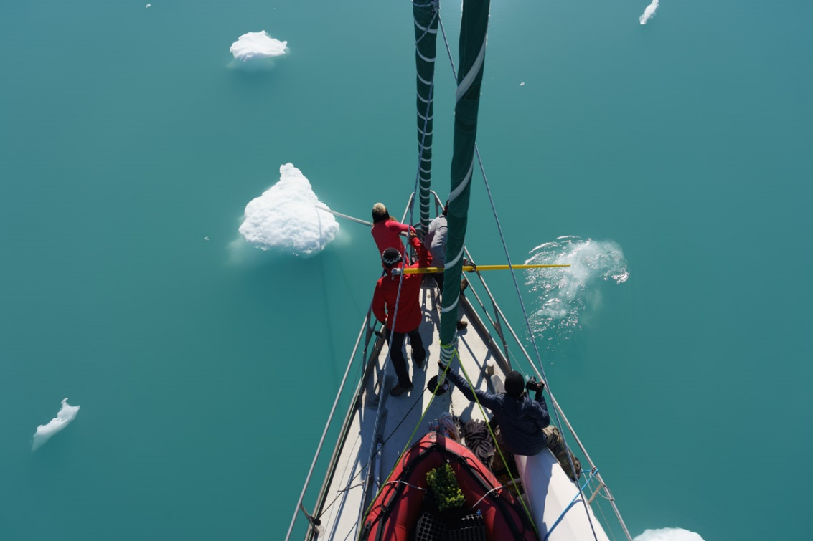
Sailing challenges in Greenland
Icebergs are everywhere!
Lack of concentration could lead to catastrophic damage.

Slide 25
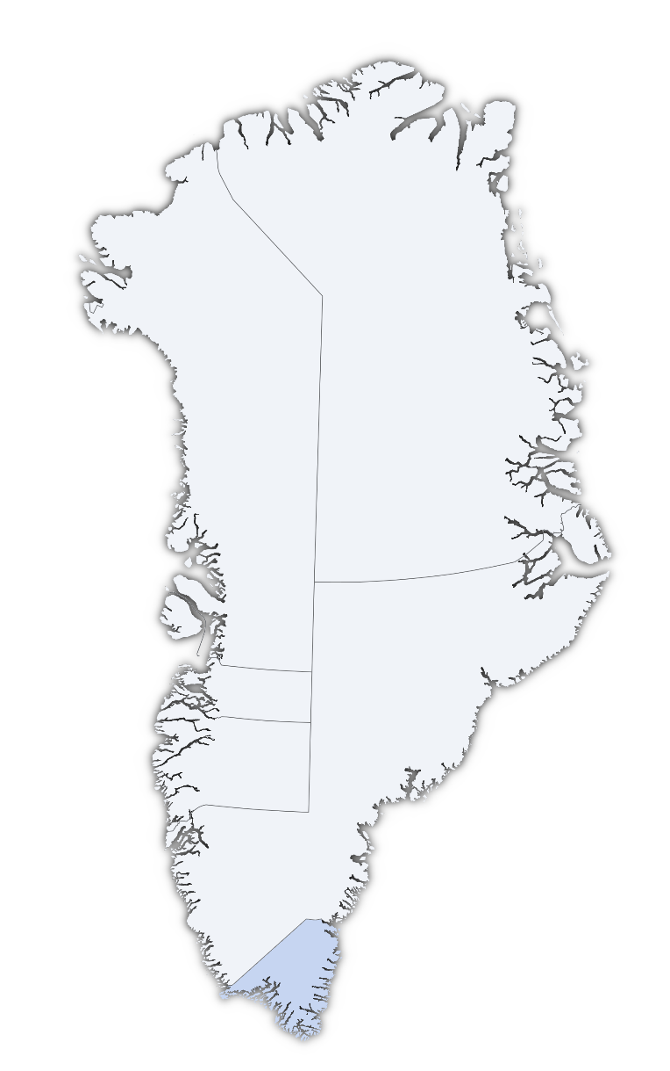
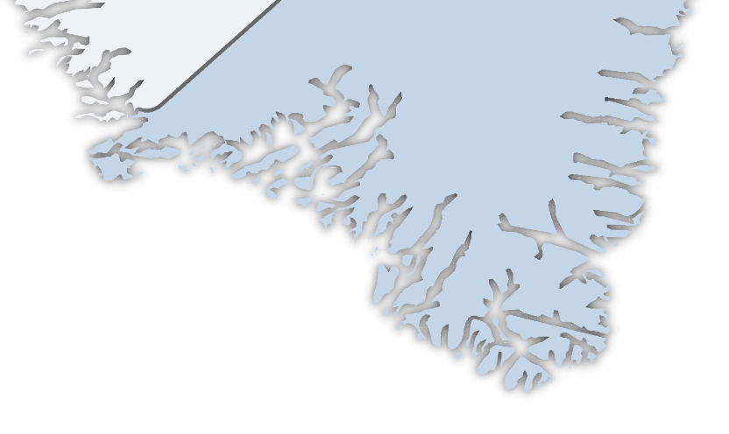
Our stops in South Greenland
Delivery and blank test of the stations in Narsaq
Use of Nanortalik as operational base for Stations 1 and 2
Use of Aappilattoq as operational base for Station 3 and maintenance
Narsaq
Station 2
Station 3
Station 1
Nanortalik
Aappilattoq

Slide 26
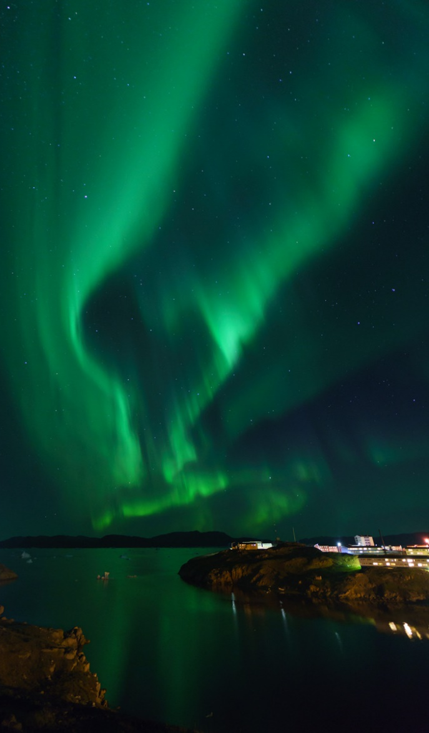
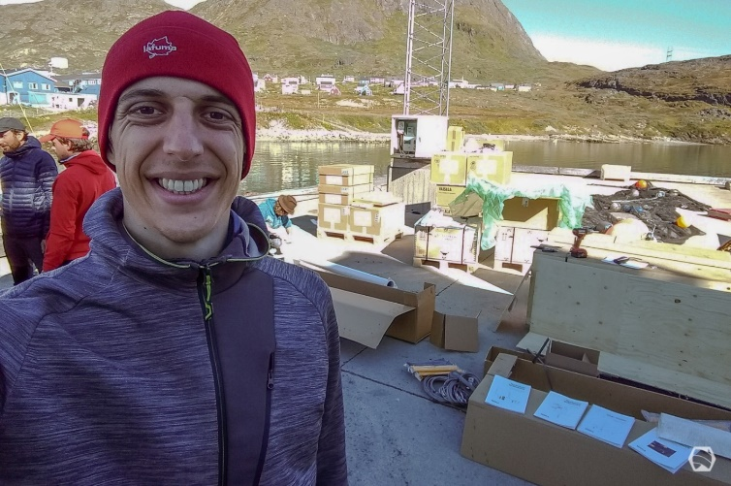
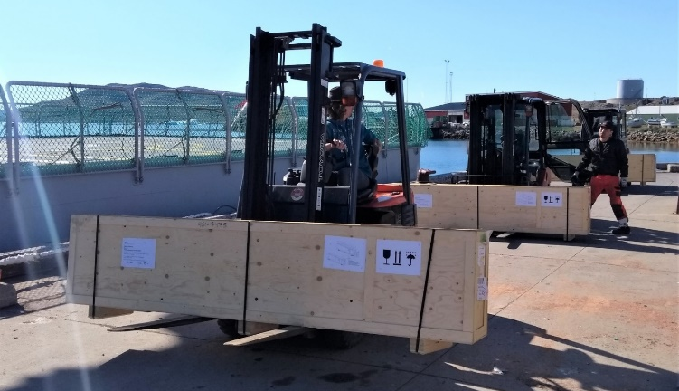
Narsaq :
Incoming boxes

Slide 27
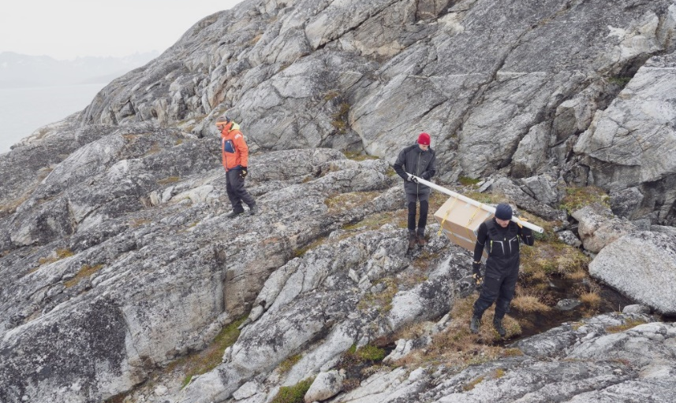
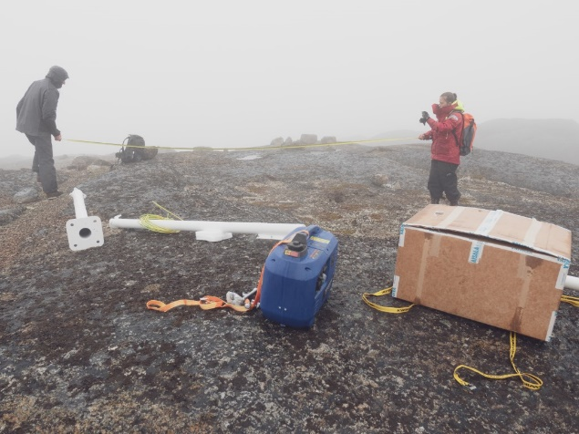
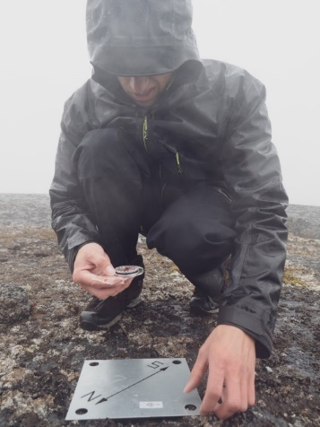
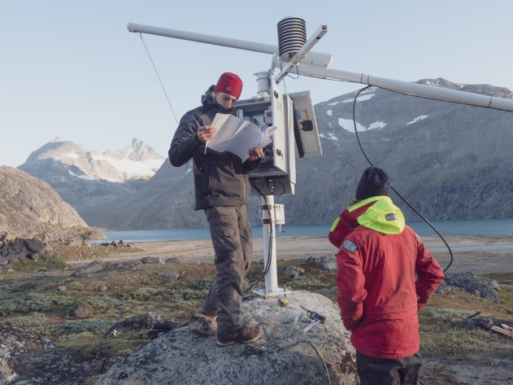
Installing a station is easier said than done!
Installing a station is a challenging task:
Planning all details on the boat
Transferring everything ashore
Finding the right spot for the station
Getting everything on site
Starting the installation, hoping for the best
Dealing with unpredictable weather
Photos © Julien Fumard

Slide 28
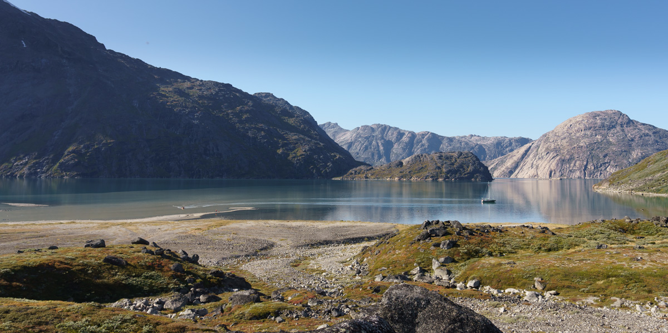
Transporting a station ashore

Slide 29
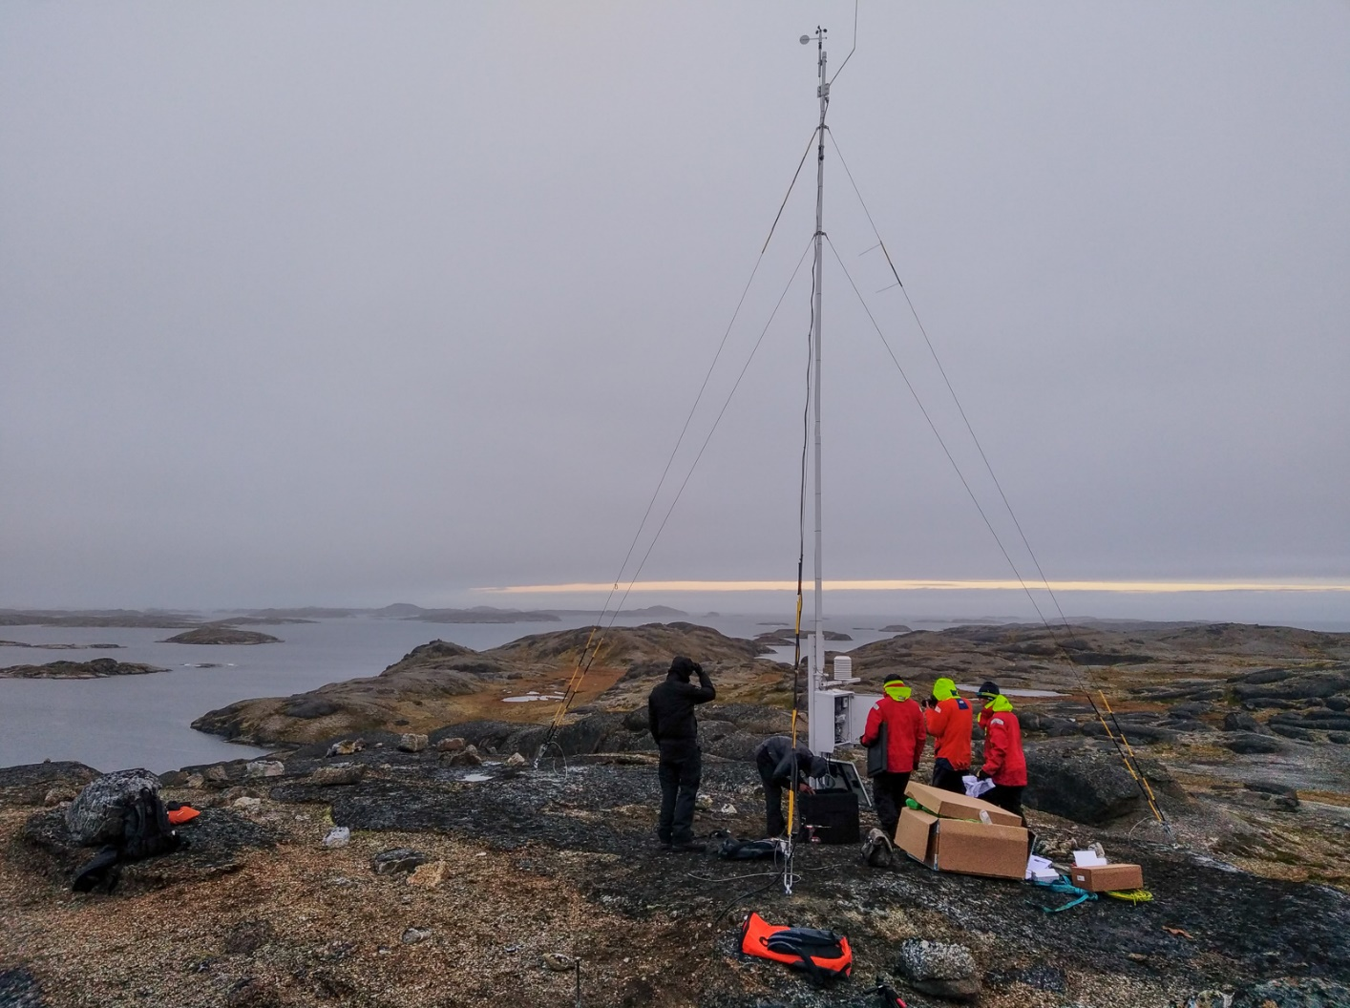
Finalizing the installation of Station 1

Slide 30
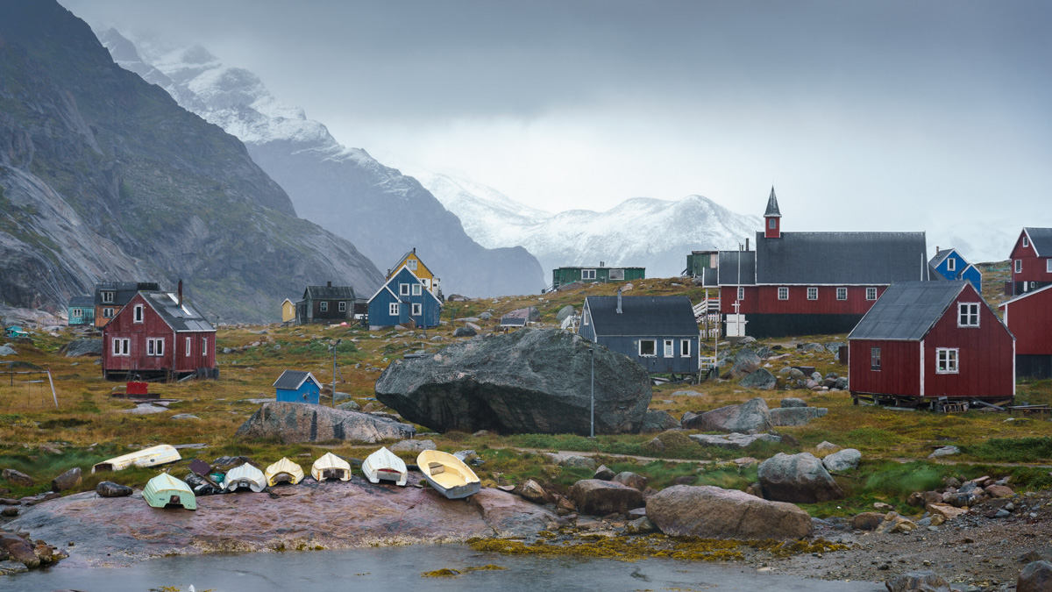
Aappilattoq, our last sheltered stop

Slide 31
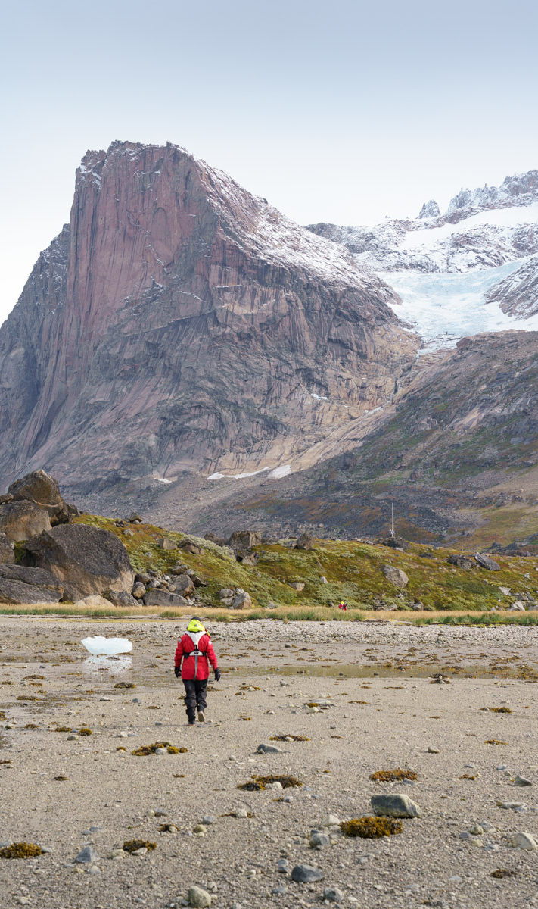
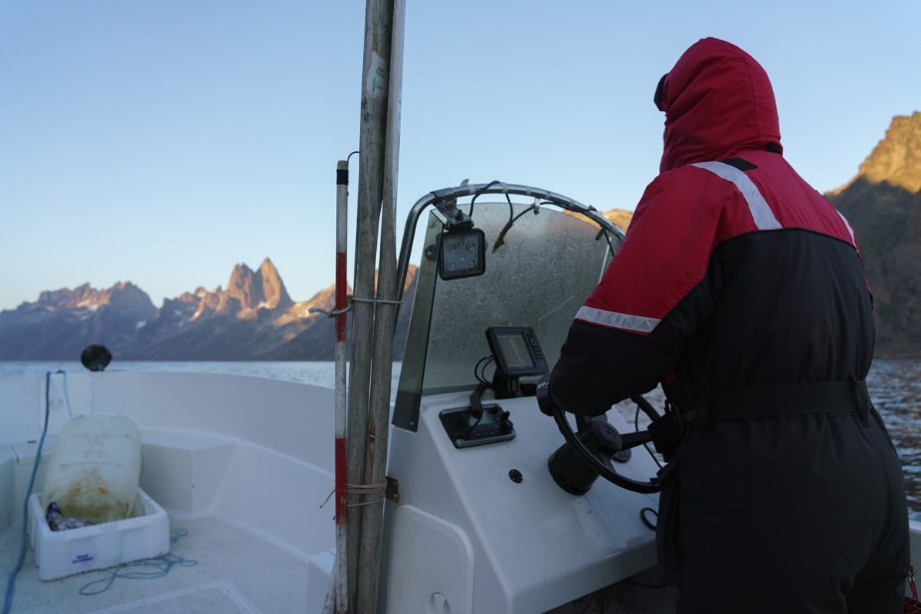
Unforseen need for early maintenance
All stations encountered some critical issues a few days after their installation
Need for going back to the installations sites for repairs! Done by hiring a local fisherman.

Slide 32

All 3 stations are now operational
and sending data

Slide 33

First comparison: MAR vs observations
AWS1
1 observation every 20m
from 6 SEP 2020 to 15 OCT 2020
Correlation: 0.87
Bias=+2.4km/h
RMSE=11km/h
Mean: 34±20km/h
AWS2
Correlation: 0.9
bias=-2km/h
RMSE=10km/h
Mean: 29±23km/h
Wind measured at 10m
AWS3
Problem with the censor when high wind speeds
Correlation: 0.86
bias=+4km/h
RMSE=11km/h
Mean: 17±17km/h
MAR is able to simulate both spatial and temporal variability observed until now at the 3 stations

Slide 34
Katabata 2?
First observations confirm the MAR results over the South of Greenland and the high wind speed in this area. Weather stations could be installed in other locations.
Next step (summer?):
Moving the weather stations to these area

Slide 35

Direct air CO₂ capture
Process commercialized by Carbon Engineering for capturing CO₂. Air exits with a CO₂ concentration of around 110 ppm. Energy required per ton of CO₂ captured and compressed at 150 bars: around 1.4 MWh of heat (at a temperature of more than 600 °C for the calciner – provided now by burning natural gas) and 0.4 MWh of electricity.
Source: htts://carbonengineering.com/

Slide 36

What can be done with this CO₂?
Storing CO₂ underground.
2. Synthesize synthetic green fuels with high energy density using hydrogen produced from water electrolysis and renewable electricity.
Example: the Sabatier reaction for producing CH₄
3. Transform CO₂ into graphite (pure coal) using, for example, the Bosch reaction, and building a mountain of coal.
High-temperature heat input can help optimise Solutions 2. and 3.

Slide 37


Slide 38


Slide 39
Energy needed to return to 280 ppm
There are around 3.25 x 1012 tons of CO₂ in the atmosphere. To return to preindustrial levels (280 ppm), (412−280)/412 * 3.25 x 1012=1.04 x 10exp(12) tons of CO₂ have to be removed from the atmosphere.
Removing 1 ton of CO₂ from the atmosphere requires (1.4+0.4)=1.8 MWh.
One ton of graphite generates 8.9 MWh when combusted. Due to the energy conservation principle, transforming one ton of CO₂ into graphite and O₂ would at least require 12/((2∗16+12)) * 8.9 = 2.42 MWh of energy.
Transforming 1.05 x 1012 of CO₂ into graphite would require a minimum of 4,431,000 TWh of energy. This is 40 times our annual final energy consumption.

Slide 40


Wouldn’t it be nice to be able to import 125 TWh of cheap synthetic green CH₄ in Belgium?

Slide 41
Remote renewable energy hub

Slide 42

Artist representation of an infrastructure where solar energy and direct capture of CO₂ in the air are used to produce green CH₄. The green gas is then liquefied and shipped to consumption centers.

Slide 43

Artist representation of a remote energy hub placed in Greenland.

Slide 44
Remote renewable energy hub in Greenland: cost breakdown
Methane comes at a price 76.4 €/MWh in Zeebrugge.

Slide 45
  References
Study Committee: C1 WG: C1.35 (2020). Global electricity network – Feasibility. CIGRE Technical Report 775. Available at http://hdl.handle.net/2268/239969
Berger, M., Radu, D., Fonteneau, R., Henry, R., Glavic, M., Fettweis, X., Le Du, M., Panciatici, P., Balea, L. & Ernst, D. (2018). Critical Time Windows for Renewable Resource Complementarity Assessment. Available at https://arxiv.org/abs/1812.02809
Radu, D., Berger, M., Fonteneau, R., Hardy, S., Fettweis, X., Le Du, M., Panciatici, P. Balea, L. & Ernst, D. (2019). Complementarity Assessment of South Greenland Katabatic Flows and West Europe Wind Regimes. Energy. Available at http://hdl.handle.net/2268/230016
Berger, M., Radu, D., Fonteneau, R., Deschuyteneer, T. & Ernst, D. (2020). The Role of Power-to-Gas and Carbon Capture Technologies in Cross-Sector Decarbonisation Strategies. Electric Power Systems Research. Available at http://hdl.handle.net/2268/235110

