Slide 1
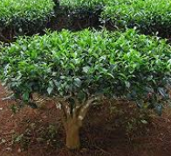
Challenges in the Tea Industry in Burundi: Upgrading and Sustainability Policies
Pierre Bitama (PhD student)
Professor Philippe Burny

Slide 2
CONTENTS
Context
Materials and Methods
Results & discussion

Slide 3
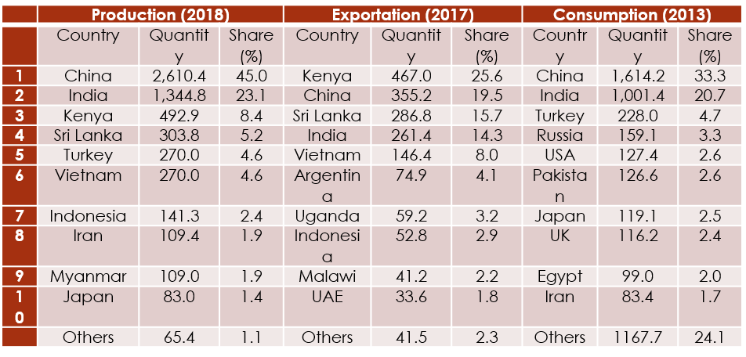
CONTEXT
Tea plant : A strategic cash crop
Black tea’s best quality
Small plots, low production (0.2% in the world)
Top ten ranked leading countries in tea production, exportation and consumption (by thousand tonnes)
Over supply on international market
Source: Chang, 2015; FAOSTAT, 2019

Slide 4
MATERIALS & METHODS
Qualitative research
Primary data
Upstream and downstream actors randomly selected
Semi-structured interviews
Focus group, observation
Secondary data: articles, books, reports, etc.
Qualitative analysis & content analysis

Slide 5
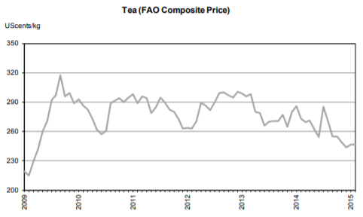
Results and discussion
Black Tea’s Price Volatility
oversupply on the market
Inelastic price (BT: -0.32 to -0.80)
Diversification
Value-added & high-quality
High quality & certification standards

Slide 6
Results and discussion
International certification
Fairtrade
Organic
UTZ
Rainforest Alliance
Rainforest alliance

Slide 7
Results and discussion
Processing Equipment
Investment in equipment
Energy
Hydroelectric power + Firewood
Reforestation
Solar & wind power energy
Deforestation
Tea variety
Productive varieties/ hybrids
Old tree tea
Appropriate fertilizers + Organic manure & mulch
Subsidize small tea farmers
Intercroping ( ex. Grevillea)

Slide 8
Results and discussion
Costs labour
Associations/cooperatives
Leaves’ price rigidity
Labor less profitable
Equipment (clothes, shoes, gloves, etc.)
Plucking machines prohibition
Training
Misapplication of fertilizers
Seminars & training
No care of the tea bush in real time
seamless collaboration
Infrastructures
Slippery roads
Cooperation with developed countries
Landlocked country

Slide 9
THANK YOU!

