Slide 1
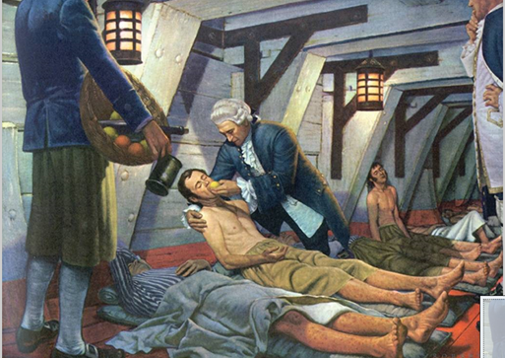
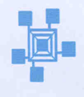
PHYSIOPATHOLOGY -Introduction-
From: Robert A. Thon, A History of Medicine in Pictures. Parke, Davis and Co., 1957
Dr Lind and scurvy
.
Hernan Valdes-Socin MD,PhD
Notes:
Sailors, spending long time in the sea, use to dy because of scurvy and vitamin C deficiency . Dr Lind,which we are seen in that picture, had the idea to investigate wether a special diet could prevent the disease. This was one of the first successfull trials in the history of medicine. Indeed , physiopathology and clinical trials are intimately connected as we are going to discover in this introduction

