Slide 1
CityJSON at the Geomatics Unit
Uliège activities related to CityJSON
3DTalks
3D Geoinformation - TUDelft
17th September 2020

Slide 2
The Geomatics Unit
University of Liège, East of Belgium
About 20 teacher-researchers
Pr. Roland Billen - Land surveying & GIScience
Pr. René Warnant - GNSS
Two chairs (retirements): 3D acquisition & GIS

Slide 3
CityJSON at the Geomatics Unit
CityJSON generation from LiDAR point cloud and building footprints
Preliminary results presented at the ISPRS Nice 2020
Automatic 3D Buildings Compact Reconstruction from LiDAR point clouds
Article published in IJGI on 31th August 2020
CityJSON Building Generation from Airborne LiDAR 3D Point Clouds
State of the art generation process
Tested on RoofN3D dataset and Belgian LiDAR campaigns
Benefits of the direct generation of CityJSON models
Native metadata management
Refined levels of detail support

Slide 4
MERN application
4 stacks :
MongoDB
Express
NodeJS
ReactJS
JS and JSON everywhere
More flexibility but less consistency

Slide 5
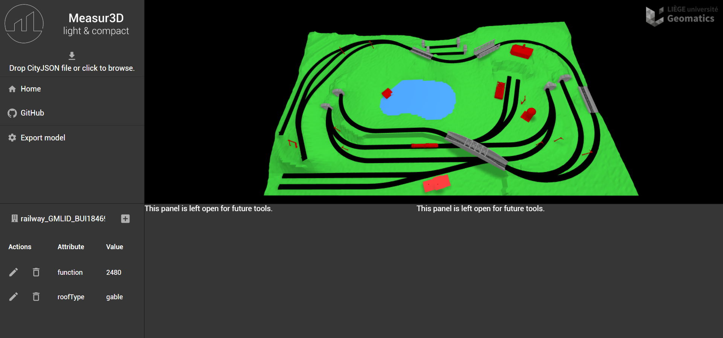
MERN application
https://github.com/GANys/Measur3D + real-time demo

Slide 6
MERN application

Slide 7
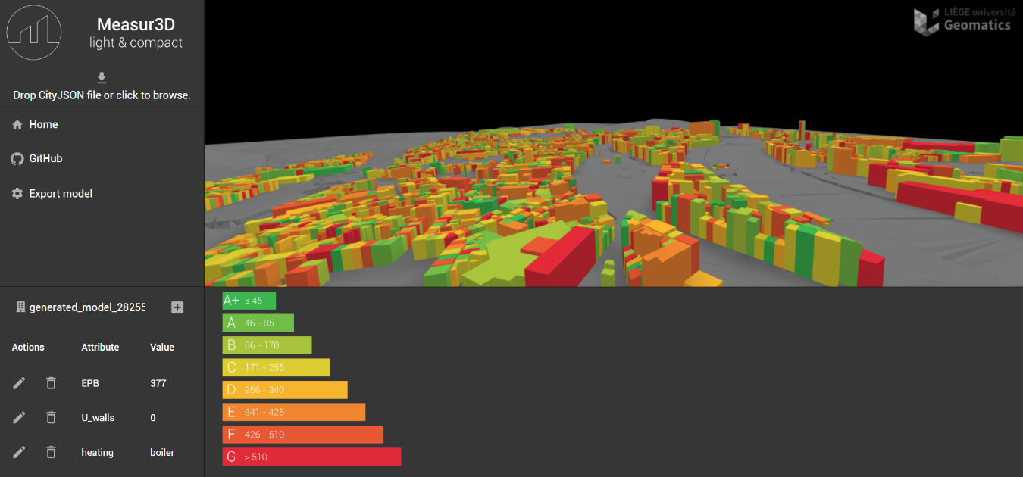
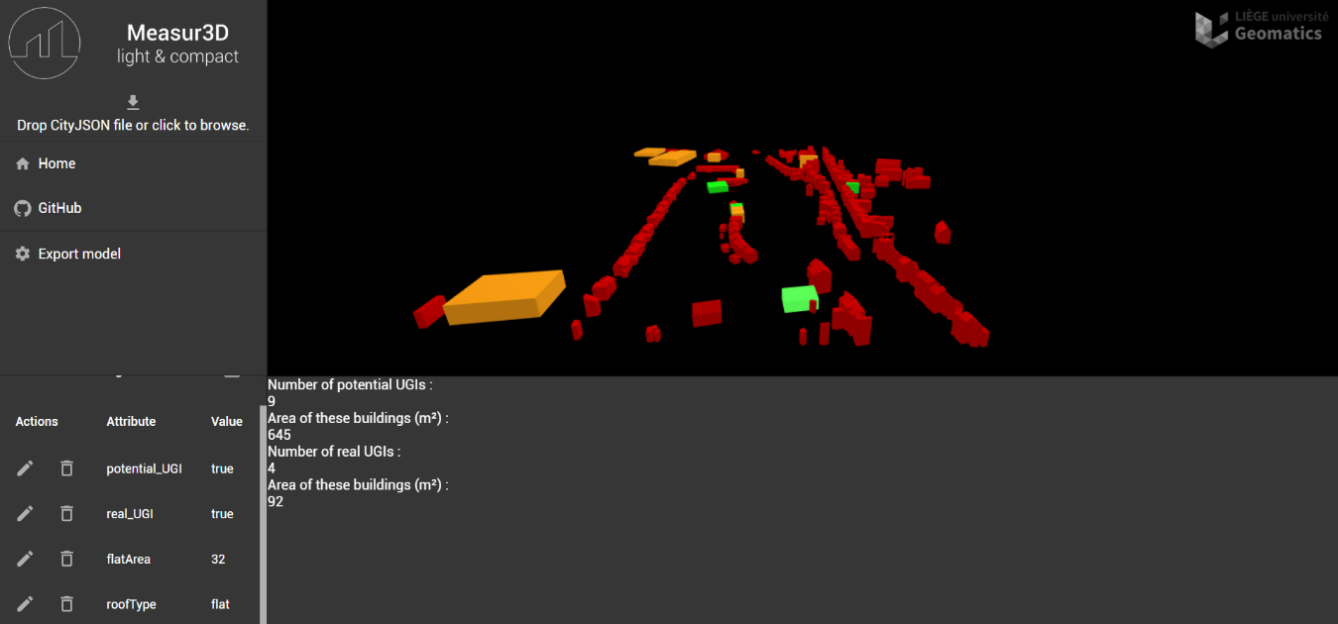
MERN application
Urban green infrastructures
Green roofs potential
EPB simulations

Slide 8
Future works
Improvements on the MERN application
Issues on the GitHub
A master thesis on CityJSON generation models from Belgian open data sources
FME or 3Dfier
Qualitative comparison of our solution with traditional tools
PostGIS, CityGML, …
Document limited to 16 mb - GridFS ?

Slide 9
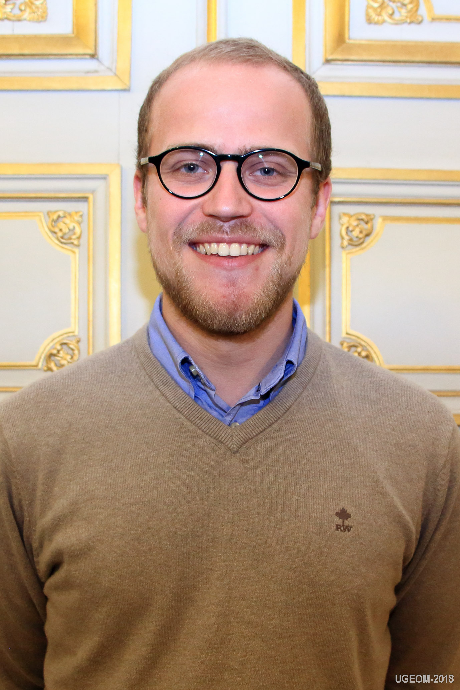
Do not hesitate to contact us !
Stay safe
Gilles-Antoine Nys
ganys@uliege.be

