Slide 1
EURAD PhD Event N°1
Webinar, 15th of September 2020
Gilles Corman ¹
Hangbiao Song ¹
¹ University of Liège – UEE Research Unit
Notes:
Front page

Slide 2
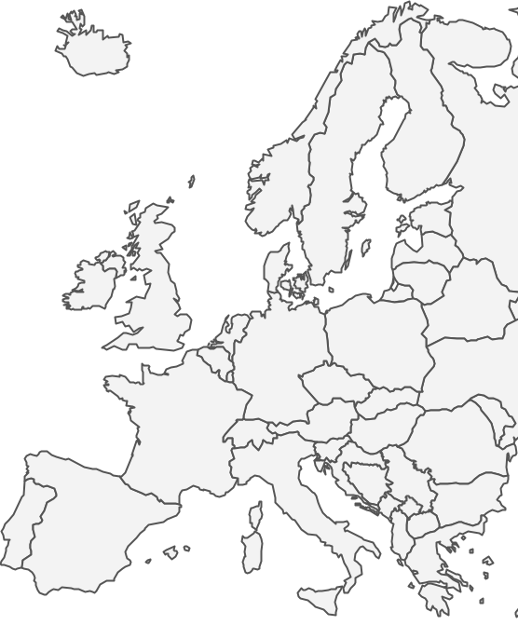
About me
Background
Belgian PhD student
University of Liège, Belgium
Geomechanics and Engineering Geology team
Thesis question:
« Can the gas overpressure generation lead to the (re)fracturing of the rock and the creation of preferential flow pathways? »
Involvement in the project
EURAD WockPackage 6 GAS
Task 2 – SubTask 2.2: Advection: conceptualisation of the gas transport mechanisms at micro and macro scales
Task 3 – SubTask 3.3: Evaluate achievements by model-supported data analyses: predictive modelling and
application of newly developed modelling tool on in situ experiments
1
Notes:
Within task 2, we planned to focus especially on the subtask 2.2, dedicated to advection, with the aim of conceptualizing the gas transport mechanisms at micro and macro scales.
To that end, we are interested:
- on the one hand in gas transfers through the excavation damaged zone
on the other hand in gas migrations in the sound rock layers
For those who wants to now exactely where Liège, where we did the first annual meeting

Slide 3
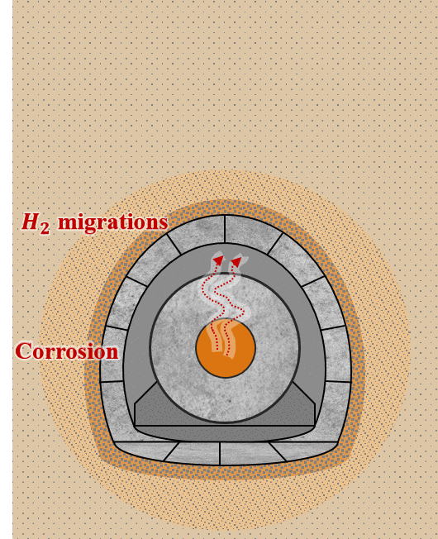
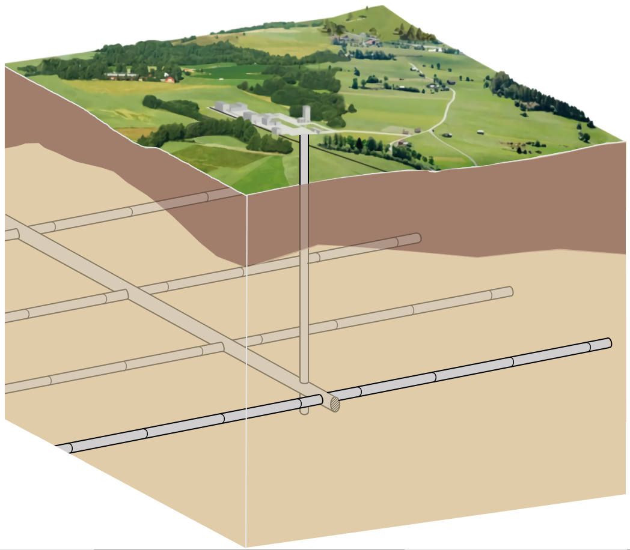
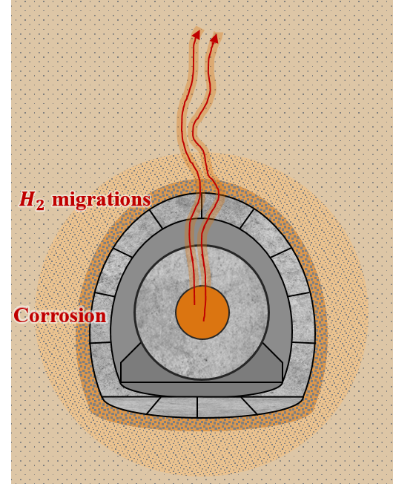
About my research
Zone II:
gas transfers in the sound rock layers
Governed by the rock structure at a micro-level
Host rock
Zone I:
gas transfers through the EDZ
Main gallery
Controlled by the hydraulic properties modifications induced by fracturation
Storage alveole
Figure: Conceptual scheme of a deep geological disposal,
adapted from [1].
Figure: Supercontainer reference design,
adapted from [2].
2
Notes:
Within task 2, we planned to focus especially on the subtask 2.2, dedicated to advection, with the aim of conceptualizing the gas transport mechanisms at micro and macro scales.
To that end, we are interested:
- on the one hand in gas transfers through the excavation damaged zone
on the other hand in gas migrations in the sound rock layers
For those who wants to now exactely where Liège, where we did the first annual meeting

Slide 4
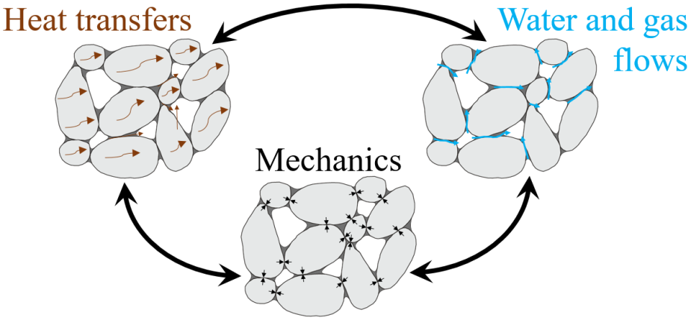
About my research
In the EDZ:
Development of a second gradient H²M model to reproduce the rock environment around the deep geological disposal
A multiphysics porous medium [3]
3 species:
Mineral species
Air species
Water species
Dissolved air
Liquid water
Water vapour
Dry air
Distributed in 3 phases:
Solid phase
Liquid phase
Gas phase
Multiphysical couplings:
3
Notes:
So far, our work focussed on the modelling of gas transfers in the EDZ.
The first objective was to develop a numerical model capable of reproducing the argillaceous rock environment surrounding the deep geological disposal. It can first be considered as a multiphysics porous medium. Moreover to properly model the localisation processes characterizing this zone, we have rather recourse to a model of second gradient type. And finally, a permeability evolution with strain has also been integrated into the model.
This model is currently operational
The second objective was to applied the developed model to the case of a large-scale gallery. At the present time, we have reached the final stage of these simulations, by performing a sensitivity study to highlight the effect of permeability variations, the effect of variations of H2 entry pressure or the influence of the type of gas relative permeability formulation
The last part of this task is to present and publish the results to the scientific community. The writing of an article is under process while the presentation of the results had to be postponed due to the crisis. This last point appears to be the only noticeable effect of the current situation on our work.

Slide 5
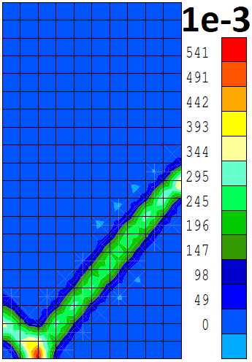
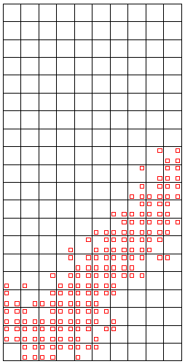
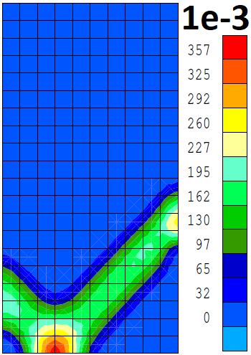
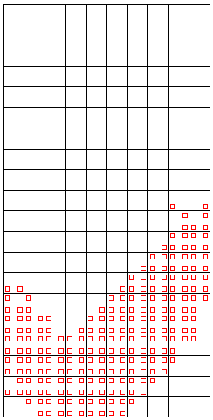
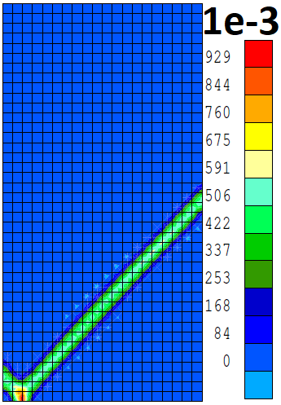
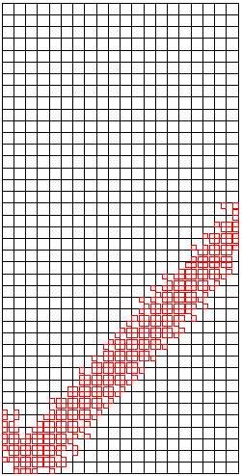
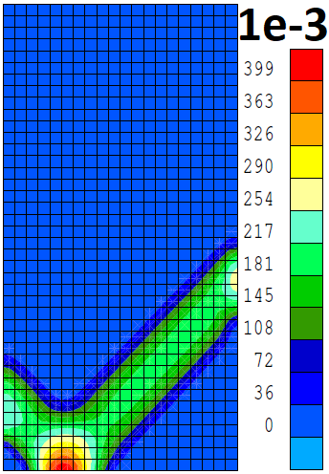
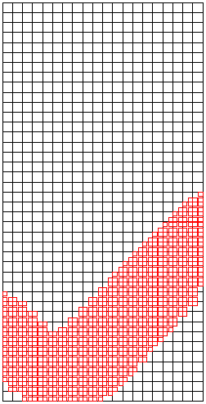
About my research
In the EDZ:
Development of a second gradient H²M model to reproduce the rock environment around the deep geological disposal
Classical FE method:
Mesh size dependency
Second gradient model = Regularisation technique
Shear band width control
No mesh size dependency
A multiphysics porous medium [3]
With strain localisation [4]
Deviatoric strain
increment
Plastic loading index
Deviatoric strain increment
Plastic loading index
$10×20$ elements
20$×40$ elements
3
Notes:
So far, our work focussed on the modelling of gas transfers in the EDZ.
The first objective was to develop a numerical model capable of reproducing the argillaceous rock environment surrounding the deep geological disposal. It can first be considered as a multiphysics porous medium. Moreover to properly model the localisation processes characterizing this zone, we have rather recourse to a model of second gradient type. And finally, a permeability evolution with strain has also been integrated into the model.
This model is currently operational
The second objective was to applied the developed model to the case of a large-scale gallery. At the present time, we have reached the final stage of these simulations, by performing a sensitivity study to highlight the effect of permeability variations, the effect of variations of H2 entry pressure or the influence of the type of gas relative permeability formulation
The last part of this task is to present and publish the results to the scientific community. The writing of an article is under process while the presentation of the results had to be postponed due to the crisis. This last point appears to be the only noticeable effect of the current situation on our work.

Slide 6
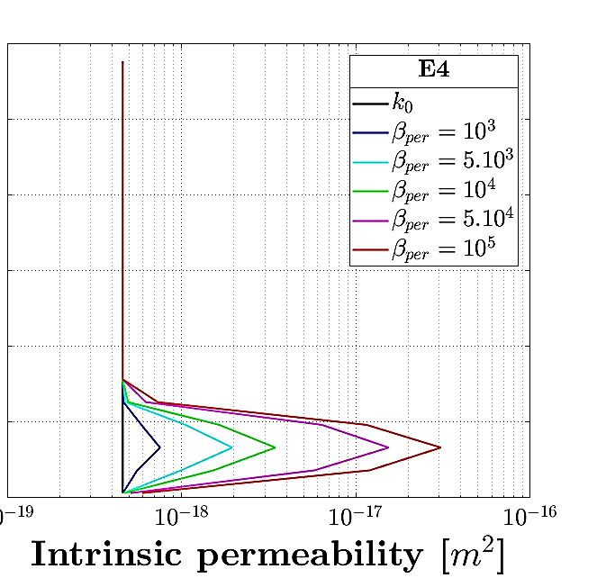
About my research
In the EDZ:
Development of a second gradient H²M model to reproduce the rock environment around the deep geological disposal
A multiphysics porous medium [3]
With strain localisation [4]
Including transfer properties evolution with strain [5]
Parameter
In situ fitting
Power cubic formulation
3
Notes:
So far, our work focussed on the modelling of gas transfers in the EDZ.
The first objective was to develop a numerical model capable of reproducing the argillaceous rock environment surrounding the deep geological disposal. It can first be considered as a multiphysics porous medium. Moreover to properly model the localisation processes characterizing this zone, we have rather recourse to a model of second gradient type. And finally, a permeability evolution with strain has also been integrated into the model.
This model is currently operational
The second objective was to applied the developed model to the case of a large-scale gallery. At the present time, we have reached the final stage of these simulations, by performing a sensitivity study to highlight the effect of permeability variations, the effect of variations of H2 entry pressure or the influence of the type of gas relative permeability formulation
The last part of this task is to present and publish the results to the scientific community. The writing of an article is under process while the presentation of the results had to be postponed due to the crisis. This last point appears to be the only noticeable effect of the current situation on our work.

Slide 7
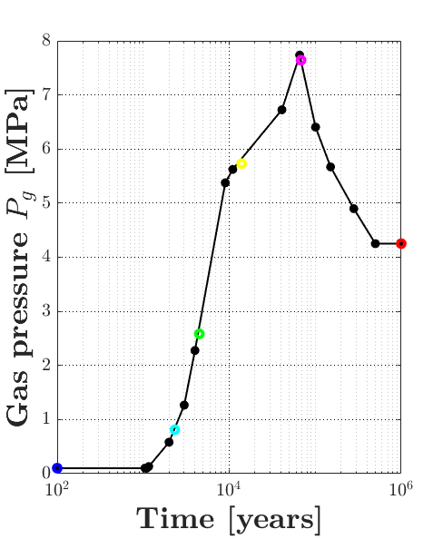
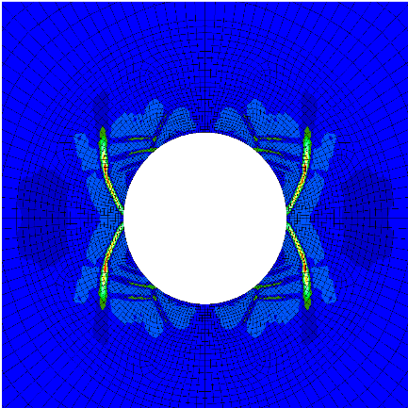
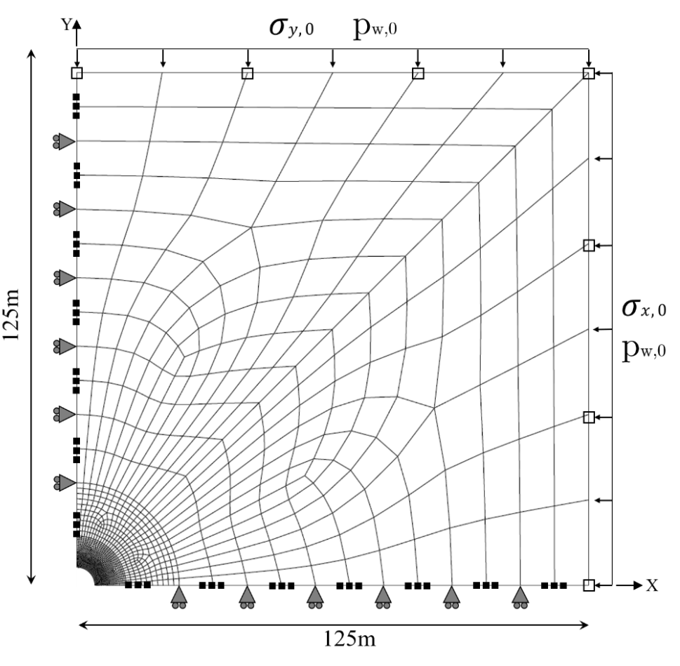
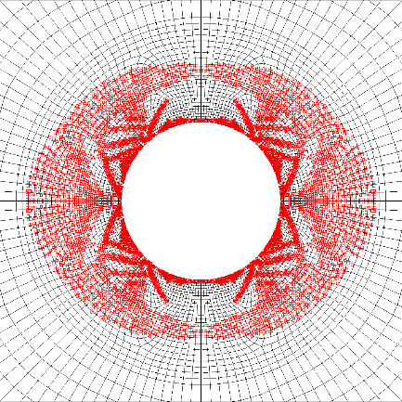
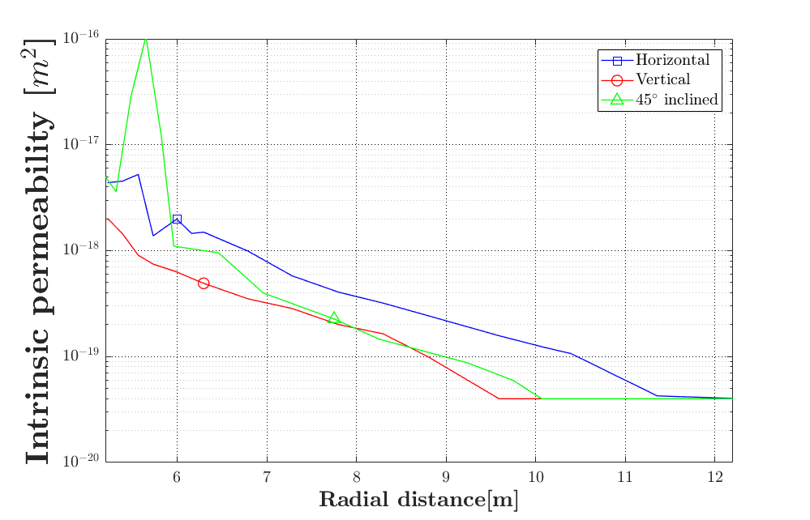
About my research
In the EDZ:
Development of a second gradient H²M model to reproduce the rock environment around the deep geological disposal
Application to large-scale storage drift
Deviatoric strain increment
1E-4
Plastic loading index
7m
10.4m
7m
3
Notes:
So far, our work focussed on the modelling of gas transfers in the EDZ.
The first objective was to develop a numerical model capable of reproducing the argillaceous rock environment surrounding the deep geological disposal. It can first be considered as a multiphysics porous medium. Moreover to properly model the localisation processes characterizing this zone, we have rather recourse to a model of second gradient type. And finally, a permeability evolution with strain has also been integrated into the model.
This model is currently operational
The second objective was to applied the developed model to the case of a large-scale gallery. At the present time, we have reached the final stage of these simulations, by performing a sensitivity study to highlight the effect of permeability variations, the effect of variations of H2 entry pressure or the influence of the type of gas relative permeability formulation
The last part of this task is to present and publish the results to the scientific community. The writing of an article is under process while the presentation of the results had to be postponed due to the crisis. This last point appears to be the only noticeable effect of the current situation on our work.

Slide 8
About my research
Zone II:
gas transfers in the sound rock layers
Governed by the rock structure at a micro-level
Host rock
Zone I:
gas transfers through the EDZ
Main gallery
Controlled by the hydraulic properties modifications induced by fracturation
Storage alveole
Figure: Conceptual scheme of a deep geological disposal,
adapted from [1].
Figure: Supercontainer reference design,
adapted from [2].
4
Notes:
Within task 2, we planned to focus especially on the subtask 2.2, dedicated to advection, with the aim of conceptualizing the gas transport mechanisms at micro and macro scales.
To that end, we are interested:
- on the one hand in gas transfers through the excavation damaged zone
on the other hand in gas migrations in the sound rock layers
For those who wants to now exactely where Liège, where we did the first annual meeting

Slide 9
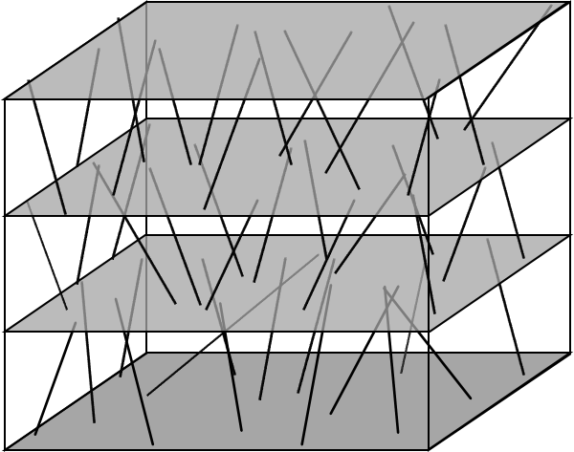
About my research
Macroscopic scale
Microscopic scale
$$H_{2}$$
In the sound rock layers:
Development of a multi-scale model in the FE² method [6]
>$dm$
Step 1: Hydraulic microscopic model
Formulation, implementation and validation of the constitutive laws at the microscale (REV) without influence of mechanics.
c$m−dm$
$$μm$$
$$σ_{3}$$
Step 2: Hydro-mechanical microscopic model
Formulation and implementation of the constitutive laws at the microscale (REV) considering
influence of mechanics.
Hydro-mechanical couplings
$$σ_{1}$$
$$σ_{1}$$
$$μm$$
$$σ_{3}$$
5
Notes:
So far, our work focussed on the modelling of gas transfers in the EDZ.
The first objective was to develop a numerical model capable of reproducing the argillaceous rock environment surrounding the deep geological disposal. It can first be considered as a multiphysics porous medium. Moreover to properly model the localisation processes characterizing this zone, we have rather recourse to a model of second gradient type. And finally, a permeability evolution with strain has also been integrated into the model.
This model is currently operational
The second objective was to applied the developed model to the case of a large-scale gallery. At the present time, we have reached the final stage of these simulations, by performing a sensitivity study to highlight the effect of permeability variations, the effect of variations of H2 entry pressure or the influence of the type of gas relative permeability formulation
The last part of this task is to present and publish the results to the scientific community. The writing of an article is under process while the presentation of the results had to be postponed due to the crisis. This last point appears to be the only noticeable effect of the current situation on our work.

Slide 10
About my research
Macroscopic scale
Microscopic scale
$$H_{2}$$
REV
In the sound rock layers:
Development of a multi-scale model in the FE² method [6]
>$dm$
Step 1: Hydraulic microscopic model
Formulation, implementation and validation of the constitutive laws at the microscale (REV) without influence of mechanics.
$$μm$$
FE calculations
FE calculations
Homogeneisation
$$σ_{3}$$
Step 2: Hydro-mechanical microscopic model
Formulation and implementation of the constitutive laws at the microscale (REV) considering
influence of mechanics.
Hydro-mechanical couplings
$$σ_{1}$$
$$σ_{1}$$
Step 3: Hydro-mechanical macroscopic model
Implementation of the model in the FE² framework
Experimental validation of the coupled hydro-mechanical model
Variability study at the scale of the sample
$$μm$$
$$σ_{3}$$
5
Notes:
So far, our work focussed on the modelling of gas transfers in the EDZ.
The first objective was to develop a numerical model capable of reproducing the argillaceous rock environment surrounding the deep geological disposal. It can first be considered as a multiphysics porous medium. Moreover to properly model the localisation processes characterizing this zone, we have rather recourse to a model of second gradient type. And finally, a permeability evolution with strain has also been integrated into the model.
This model is currently operational
The second objective was to applied the developed model to the case of a large-scale gallery. At the present time, we have reached the final stage of these simulations, by performing a sensitivity study to highlight the effect of permeability variations, the effect of variations of H2 entry pressure or the influence of the type of gas relative permeability formulation
The last part of this task is to present and publish the results to the scientific community. The writing of an article is under process while the presentation of the results had to be postponed due to the crisis. This last point appears to be the only noticeable effect of the current situation on our work.

Slide 11
References
Ensi (2013) Geologische Tiefenlager, Radioaktive abfälle sicher entsorgen, Rapport, 2013.
M. Van Geet, R. Gens (Ondraf/Niras 2014), Research on the long-term evolution of high-level waste forms in the frame of the Belgian research programme on geological disposal of high active and/ or long lived waste 19th Exchange Meeting– Rev. IFP, Vol. 60, No. 1, pp. 121-139.
F. Collin, Couplages thermo-hydro-mecaniques dans les sols et les roches tendres partiellement saturés, Doctoral thesis, University of Liege, 2003.
B. Pardoen, S. Levasseur, and F. Collin, Using Local Second Gradient Model and Shear Strain Localisation to Model the Excavation Damaged Zone in Unsaturated Claystone. Rock Mech. Rock Eng., 48(2):691-714, 2015.
B. Pardoen, S. Levasseur, and F. Collin, Excavation damaged zone modelling including hydraulic permeability evolution in unsaturated argilaceous rock, In:Khalili N, Russell AR, Khoshghalb A, eds. Unsaturated soils:research and applications. London: CRC Press, 387–1393, 2014.
B. Van Den Eijnden, P. Bésuelle, F. Collin & R. Chambon, Doublescale modelling of hydromechanical coupling and anisotropy in localization problems, International Symposium on Geomechanics from Micro to Macro, vol. 2, pp. 857-862, 2014.
6
Notes:
References

