Slide 1
Visualizing local variation in the Coffin Texts. How to use biomedical algorithms for ancient languages.
Jorke Grotenhuis
Notes:
Good morning,
Today I will be speaking about a section of my subject of my thesis. As I do not have that much time, I will have to be too short in certain fields. As the title shows, I will mostly focus on the methods, and you have to sadly believe me on my word that this method actually works.

Slide 2
Coffin Texts
Mortuary literature of the 11th/12th dynasty of the Middle Kingdom (2000-1800 BC)
Part of an continues tradition: Pyramid Text > Coffin Texts > Book of the Dead.
Written on the inside of Coffins (hence the name), although it occurs on other supports (tombs, papyri) as well.
For the elite of the elite
Decoration made in the region where it was found (usually).

Slide 3
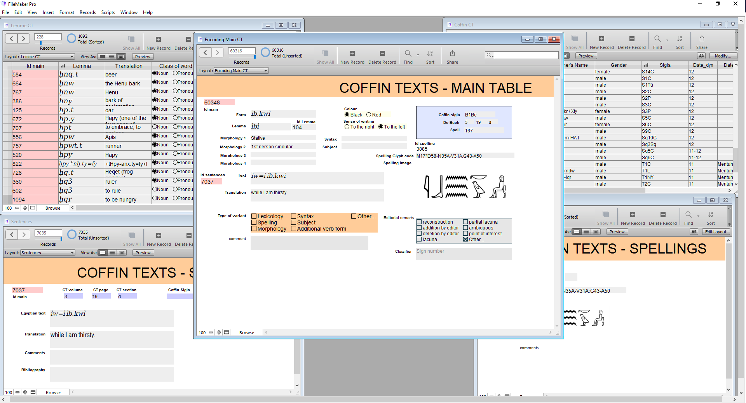
Method
Encoding a database

Slide 4
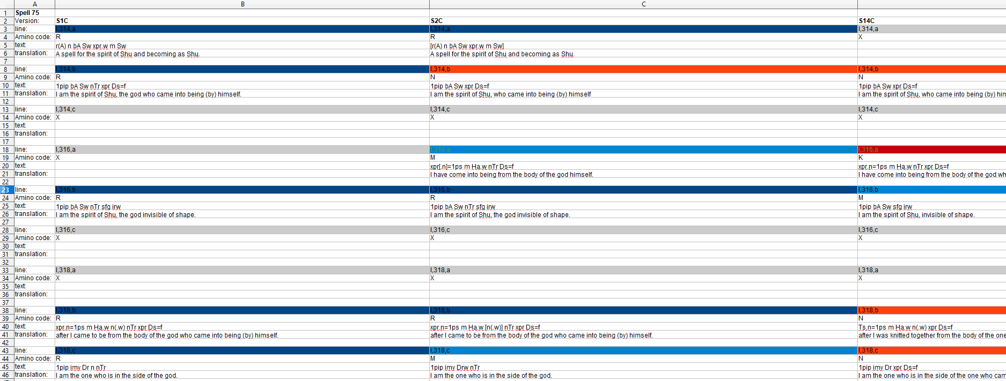
Method
Encoding a database
Create analysis files
Notes:
Second, using the data stored in my database, I decided to create a simple excel sheet, where I put the transliteration and translation of the different witnesses next to each other, spell by spell. As I retained the phrases from de Buck, it was easy to place them next to each other, and give them a colour code, where the same colour means that the phrase is identical in sentence structure. (so the exact spelling of the words might be different, but on the sentence level there was no change). Note that I tried to apply a harsh policy here, so if one witness uses a suffix pronoun for the owner, and the other witness used the name of the owner, it is a variant. Same if one has the name of the owner, and the other has the name of the owner and a demonstrative, different variant. The only exception I made here is that I did not take the gender of the owner in regard, so if one has the suffix =f for the owner, and the other has suffix =s, I would consider them the same, although of course, if one has a first person suffix, where the other has a 3rd person suffix, I would of course consider them separate.

Slide 5
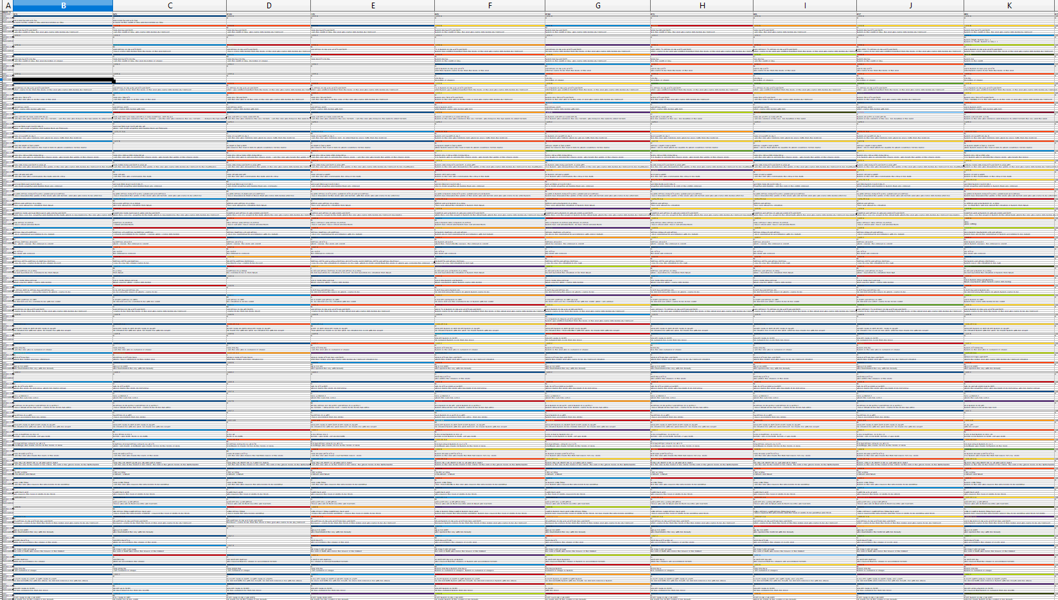
Method
Encoding a database
Create analysis files
Notes:
When one zooms out from this file, you get the following, which was responsible for my current progress, as I showed my work to some of my friends, and they said it reminded them of DNA, which caused me to wonder if I could tread it as such, and if I could automate part of my research because of it.

Slide 6
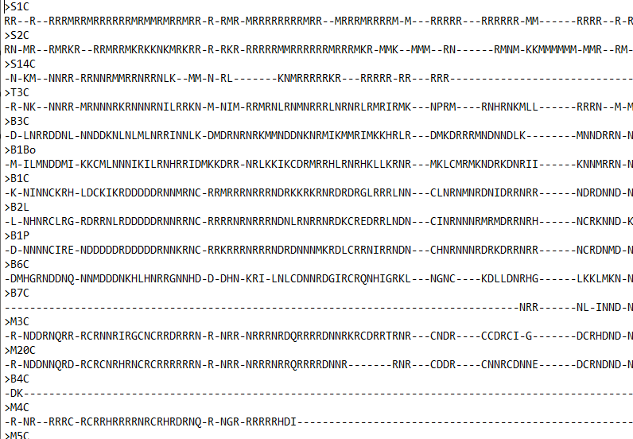
Method
Encoding a database
Create analysis files
Spells as proteins
Notes:
So, I decided to treat every witness of a spell as a protein strand, which is based on the phrases from de Buck. As there are usually more variations than 4 in every phrase, a protein fit the bill more concerning the comparison. One could consider the ‘original ideal spell’ (which of course does not exist, but can be considered an ideal version) as the DNA in the cell core, where it is turned through RNA into a protein strand, i.e the spell we currently have. To create the protein strands, I simply gave a Amino acid code to every colour in my database, and pulled the data so that I only had a file containing the Amino-acid code left:
Here, the letters stand for a variant phrase, and the strokes for not having a phrase here (which usually does not mean the phrase is lost, as I will have reconstructed it, but that there is no phrase at all).

Slide 7
Method
Encoding a database
Create analysis files
Spells as proteins
Notes:
Using these files, I have been able to use a biological program named iqtree as a sorting algorithm, which I used to construct trees, where the different versions are rated on proximity to other versions.

Slide 8
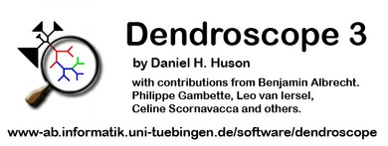
Method
Encoding a database
Create analysis files
Spells as proteins
Visualization
Notes:
The so-called tree-files this program creates, allows me to visualize the data as a dendrogram, using the program dendroscope. It allows me to visualize the data in an image like this, a tree like structure. This visualization is a lot easier on the eyes than my bulky excel file, and makes it a lot easier to actually read the data, and interpret it.
So, now I would like to show you, how it actually looks, taking spell 75 as a case study.

Slide 9
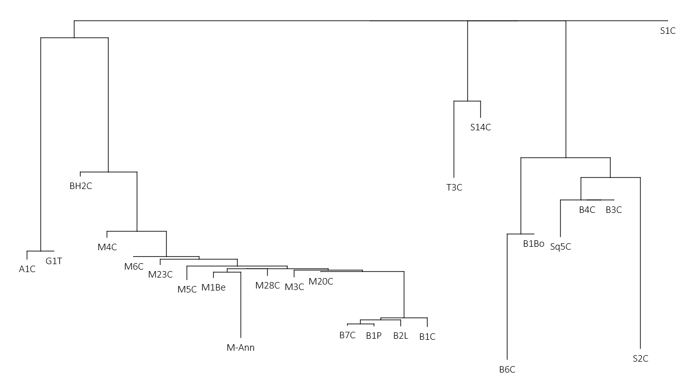
Results
South Egypt
Meir
Deir el-Bersha, later period
Deir el-Bersha, earlier period
Notes:
And S14C and T3C, one from Assiut and one from the Theban area. I cannot say why they ended up together, but as they have done so, I will not deny it.

