Slide 1
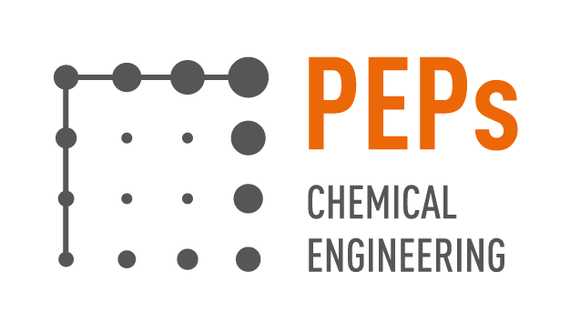
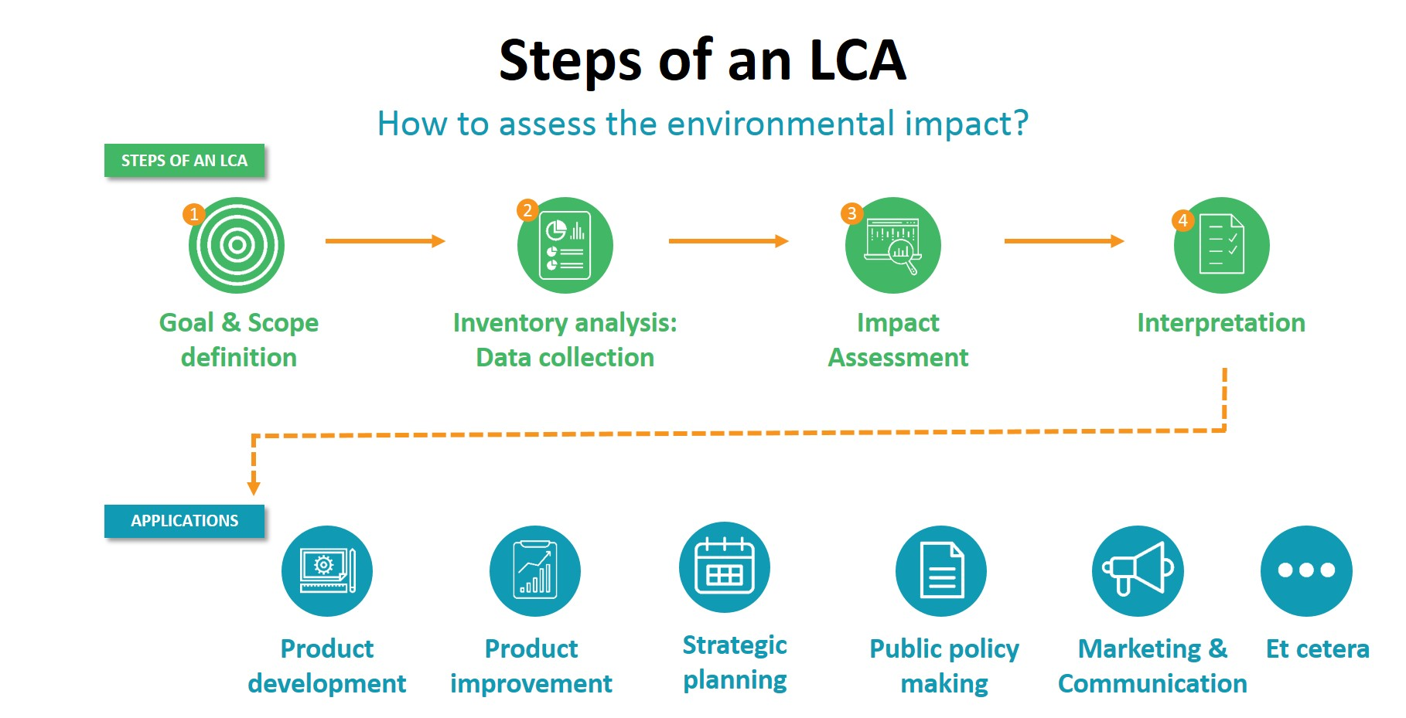
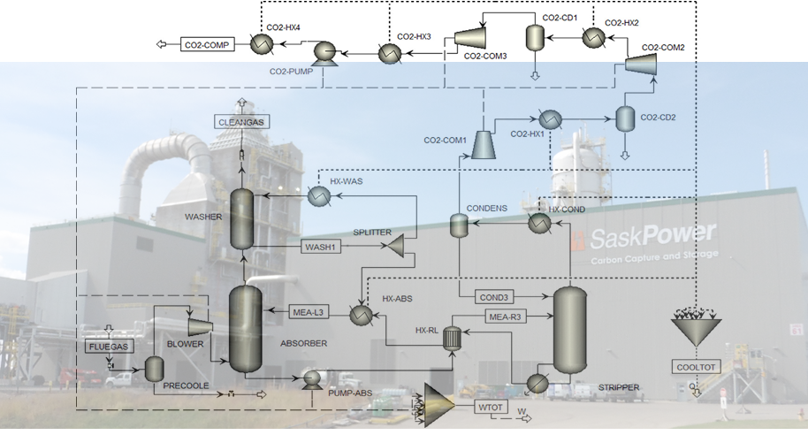
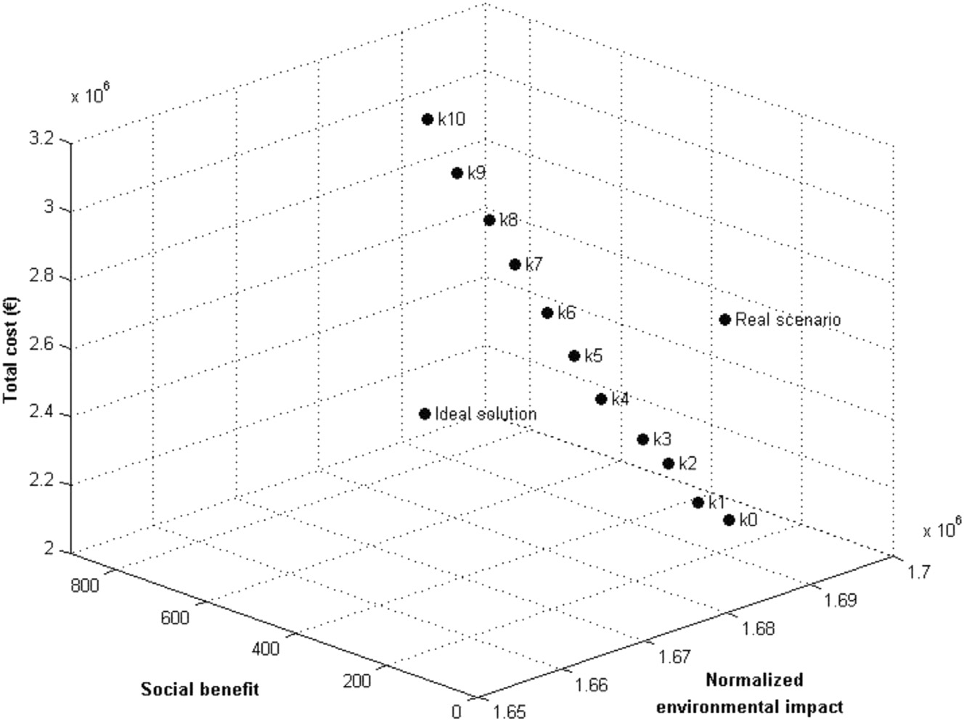
Technical, economical and environmental evaluation of pulsed plasma deposition as an joint application of viability assessment methods
A. Merlo*, A. Léonard, G. Léonard
University of Liège, Department of Chemical Engineering – PEPs www.chemeng.uliege.be
Introduction
As the number of different industrial processes increase and their economical, ecological and social implications become of utmost importance, the development of a methodology able to assess the different impacts of a process and to compare them to those of similar/alternative processes becomes necessary.
The methodology developed here will be a joint use of life cycle assessment (LCA), which assesses the ecological impacts of a process, and techno economic assessment (TEA) which studies the economical feasibility of a process.
This methodology will be developed in the framework of the PULSATEC project. As such, it will assess the impacts of a new process using High-Power Impulse Plasma Magnetron Sputtering (HiPIMS) to make metal oxides coatings and then compare them to other more conventional methods (such as Sol-Gel, electrolysis…) using data from literature and project partners.
LCA and TEA
LCA has proven to be one of the most reliable assessment methods to evaluate a process’ environmental impact and is described by the European Commission as the best framework in this regard. Its goal is to quantify the emissions as well as the resources used during the whole product life cycle. That means analyzing each step, from the extraction of resources, to the production itself, the end-use and finally, recycling.
A techno-economic assessment is the evaluation of the capital and the operating costs of a production plant. The profitability of the plant is then given by the “break-even” point, i.e. the price at which the product must be sold to make neither profit nor losses. It gives us an easily readable indication of the process viability.
In addition, process modelling (through commercial software packages such as e.g. Aspen+, GaBi) is a necessary preliminary step to compare different alternatives in a rational and efficient way.
These tools will allow us to compare the different processes used for the synthesis of metal oxides coating and, more importantly, will be the basis of the development of a more complete methodology able to assess their ecological impacts and feasibility simultaneously.
Fig. 1: The different steps of a LCA [1]
Fig. 2: An example of CO2 capture process modeling in Aspen+
Optimization and multi-objective approach
Following the modelling of the different processes, an optimization step will occur to minimize their energy consumptions. The LCA and TEA will then be made on the optimized processes as a first point of comparison.
Once the optimization step is over, a multi-objective approach can
be used. Indeed, after both the TEA and LCA, we will be able to
pinpoint which processes and model inputs minimize respectively
Production costs
Environmental impacts
Social impacts (depending on the scope of the work)
However, the ultimate goal will be to analyze all these objectives together as to find a compromise between them. The process inputs will be varied accordingly to reflect this goal.
Fig. 3: A 3D representation of the different impacts of a process [2]
Conclusions
The objective of this work will be to integrate different methods (LCA, TEA) to assess the impacts of different processes. While ecological impacts and economical feasibility assessment are both well known and tried methods, a need for a joint use and a multi-objective approach arises to reflect a more subtle way to implement industrial process modeling.
Based on the case study of comparing HiPIMS with more traditional synthesis methods for metal oxides coatings, the integration of LCA and TEA will be the fundamental constituent of a methodology that thoroughly evaluates the potential of industrial processes.
References
[1] Blonk Consultants - Giving shape to sustainability. (2018). Blonk Consultants - Richting geven aan duurzaamheid. [online] Available at: http://www.blonkconsultants.nl/ [Accessed 26 Oct. 2018].
[2] Mota, B. et al. (2015). Towards supply chain sustainability: economic, environmental and social design and planning. Journal of Cleaner Production, pp.1-14.
Klöpffer, W. (1997). Life Cycle Assessment From the Beginning to the Current State. Environmental Science and Pollution Research, 4(4), pp.223-228.

