Slide 1
Feasibility study of low-carbon
ammonia and steel production in Europe
Jean-Luc Hoxha
Marc Philippart de Foy
17th September 2020
Notes:
CHANGER ET METTRE LES BONS LOGOS

Slide 2
Introduction
Objective of the study:
European Union: carbon neutral by 2050 ^{[1]}
Feasibility of decarbonised production of ammonia and steel in 2030
What are the required assumptions to reach that goal?
→ H₂ produced by water electrolysis from renewable electricity
→ Modelling with Aspen Plus and cost analysis based on Turton et al. ^{[2]}
Feasibility study of low-carbon ammonia and steel production in Europe
J-L. Hoxha, M. Caspar, A. Donceel, J. Fraselle, G. Léonard, M. Philippart de Foy, R. Poncelet
ECEEE Industrial Efficiency Decarbonise Industry - 14-17 September 2020 - Digital Event

Slide 3
Plan
Introduction
Proton exchange membrane electrolyser
Ammonia production
Steelmaking
Cost analysis
Conclusion
Feasibility study of low-carbon ammonia and steel production in Europe
J-L. Hoxha, M. Caspar, A. Donceel, J. Fraselle, G. Léonard, M. Philippart de Foy, R. Poncelet
ECEEE Industrial Efficiency Decarbonise Industry - 14-17 September 2020 - Digital Event

Slide 4
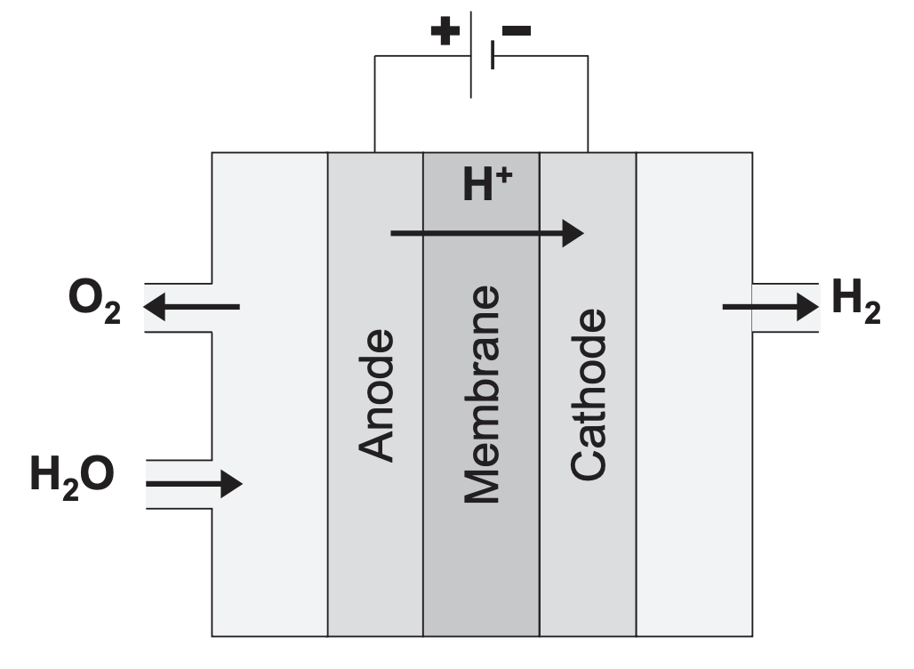
Proton Exchange Membrane (PEM) Electrolyser
Criteria for the choice of the electrolyser:
- Flexible for a fluctuating electricity supply
- Able to operate under high pressure: 200 bar max
- Assumed efficiency of 85% in 2030 ^{[3]}
Feasibility study of low-carbon ammonia and steel production in Europe
J-L. Hoxha, M. Caspar, A. Donceel, J. Fraselle, G. Léonard, M. Philippart de Foy, R. Poncelet
ECEEE Industrial Efficiency Decarbonise Industry - 14-17 September 2020 - Digital Event

Slide 5
Ammonia production
Unreacted H₂ and N₂
Natural gas reforming
(CO + H₂)
Common plants:
→ 2 t_{CO2}/t_{NH3}
Reactor
3 H₂ + N₂ → 2 NH₃
Separation
Outlets
Air
(source of N₂)
Decarbonised plant:
Unreacted H₂ and N₂
→ 0 t_{CO2}/t_{NH3}
Water electrolysis
(O₂ + H₂)
Reactor
3 H₂ + N₂ → 2 NH₃
Separation
Outlets
Pure liquid N₂
Feasibility study of low-carbon ammonia and steel production in Europe
J-L. Hoxha, M. Caspar, A. Donceel, J. Fraselle, G. Léonard, M. Philippart de Foy, R. Poncelet
ECEEE Industrial Efficiency Decarbonise Industry - 14-17 September 2020 - Digital Event
5

Slide 6
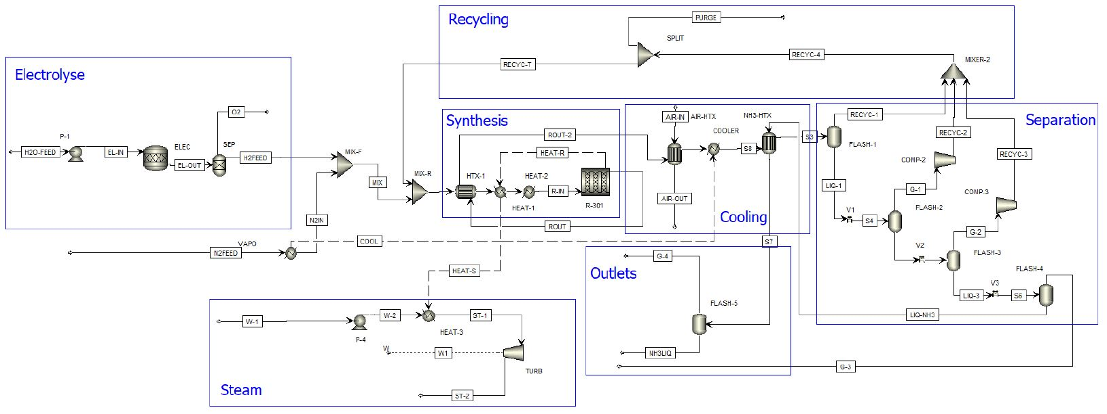
Ammonia production
Feasibility study of low-carbon ammonia and steel production in Europe
J-L. Hoxha, M. Caspar, A. Donceel, J. Fraselle, G. Léonard, M. Philippart de Foy, R. Poncelet
ECEEE Industrial Efficiency Decarbonise Industry - 14-17 September 2020 - Digital Event

Slide 7
Steelmaking – Direct reduction iron (DRI)
Common steelmaking plants: → 2 t_{CO2}/t_{steel}
Common DRI plants*:
→ 0.5 t_{CO2}/t_{steel}
unreacted CO +H₂
heating
iron ore
*DRI = 5% of the world’s steel production (BAT)
reduction
carbon, oxygen
limestone, scrap
fumes
cooling
natural gas reforming
(CO + H₂)
reducing gas
(CO > H₂)
electric arc furnace (EAF)
steel
slag
Decarbonised plant:
→ 0.15 t_{CO2}/t_{steel}
unreacted CO +H₂
iron ore
heating
reduction
carbon, oxygen
limestone, scrap
fumes
water electrolysis
(O₂ + H₂)
reducing gas
(H₂ > CO)
deeper reduction
electric arc furnace (EAF)
steel
slag
7
small CO injection

Slide 8
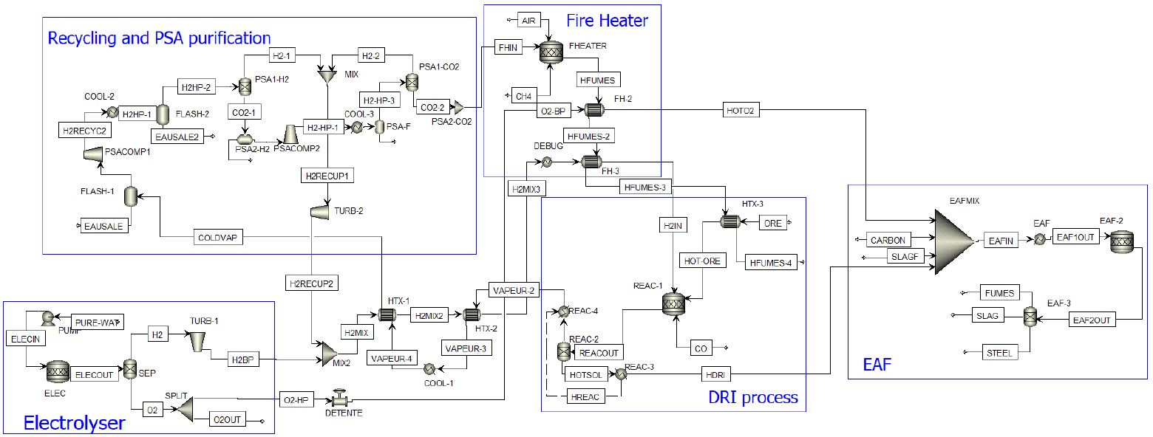
Steelmaking
Feasibility study of low-carbon ammonia and steel production in Europe
J-L. Hoxha, M. Caspar, A. Donceel, J. Fraselle, G. Léonard, M. Philippart de Foy, R. Poncelet
ECEEE Industrial Efficiency Decarbonise Industry - 14-17 September 2020 - Digital Event
8

Slide 9
Cost analysis
Reminder of the objective:
Construction of a new decarbonised grass-roots plant operating 8200 h/yr
Main variables influencing the cost:
- CAPEX (Turton et al ^{[2]})
- Electricity price
- CO₂ taxes
- Product prices
- Raw material prices
Feasibility study of low-carbon ammonia and steel production in Europe
J-L. Hoxha, M. Caspar, A. Donceel, J. Fraselle, G. Léonard, M. Philippart de Foy, R. Poncelet
ECEEE Industrial Efficiency Decarbonise Industry - 14-17 September 2020 - Digital Event
Notes:
Prix de l’electircité qui s’applique de facon similaire aux deux procédés.
Le prix des matières premieres sont des variables fixées en fonction de la littérature et des données récentes.

Slide 10
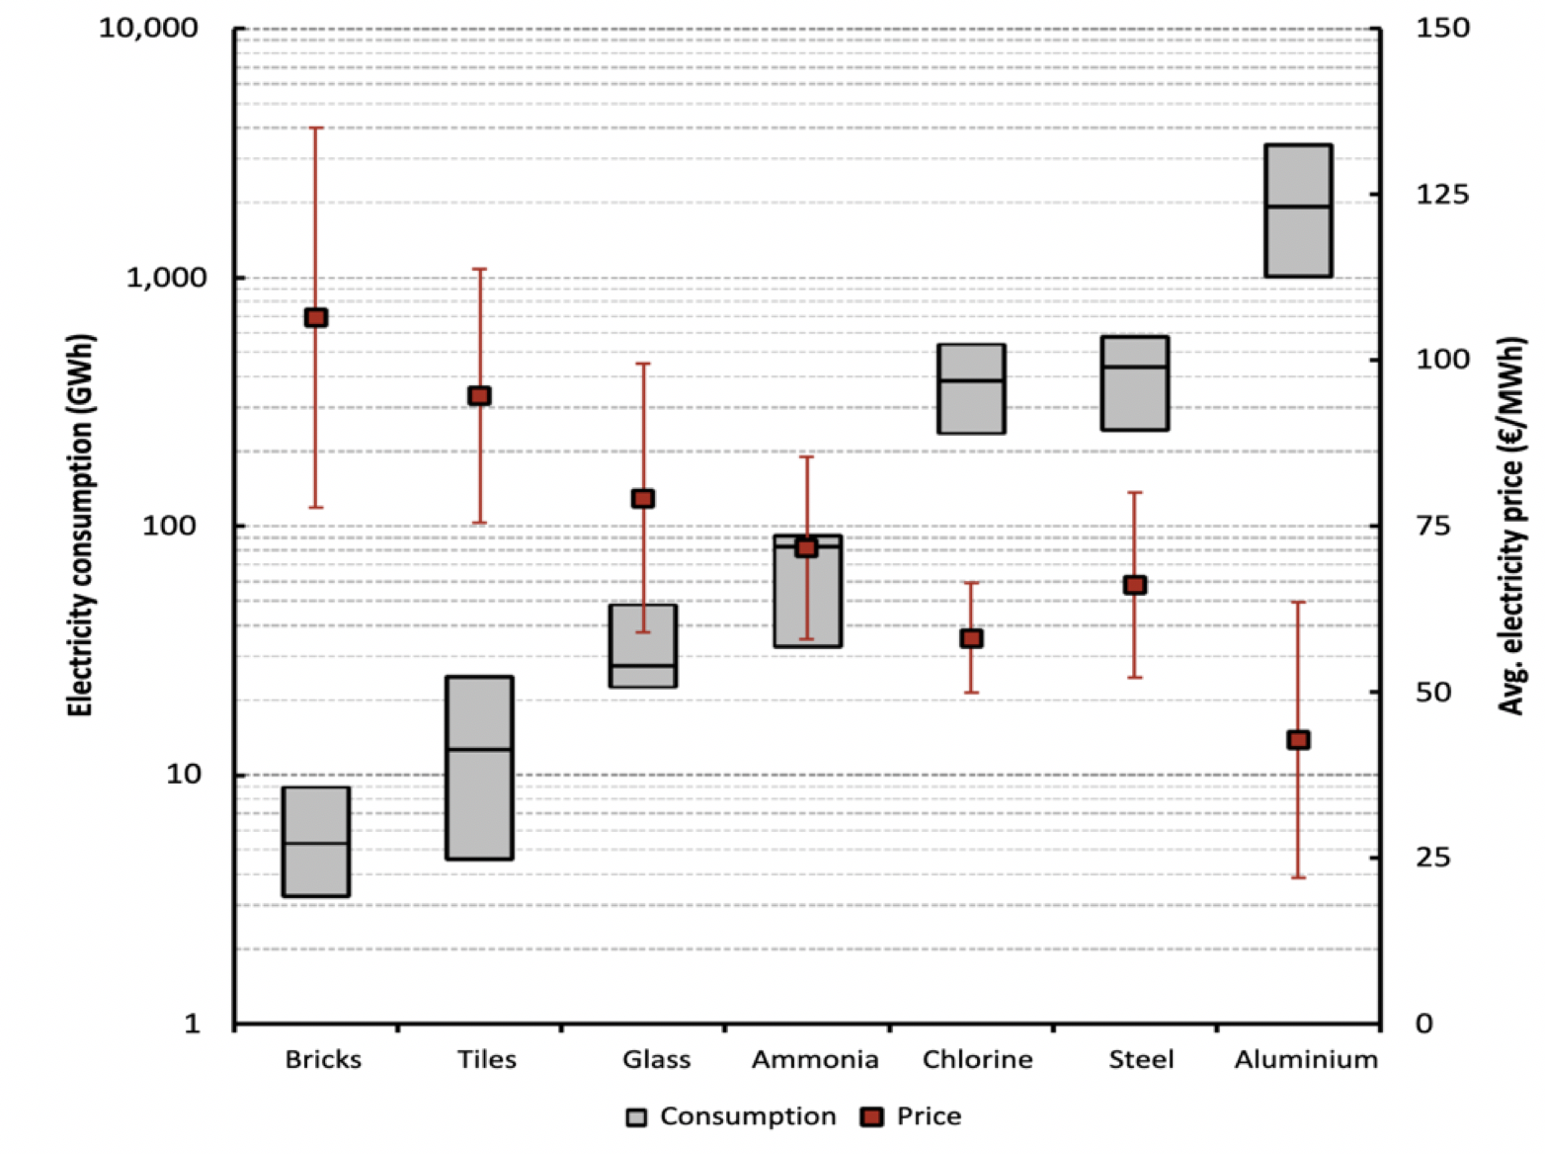
Cost analysis - electricity price
Classic ammonia plant: 100 GWh/yr ^{[4]}
Decarbonised ammonia plant: 5000 GWh/yr
→ Normal electricity price of 40 €/MWh
Peak shaving approach:
Can expect a decrease of 25 to 35%
→ Electricity price of 30 €/MWh
Feasibility study of low-carbon ammonia and steel production in Europe
J-L. Hoxha, M. Caspar, A. Donceel, J. Fraselle, G. Léonard, M. Philippart de Foy, R. Poncelet
ECEEE Industrial Efficiency Decarbonise Industry - 14-17 September 2020 - Digital Event

Slide 11
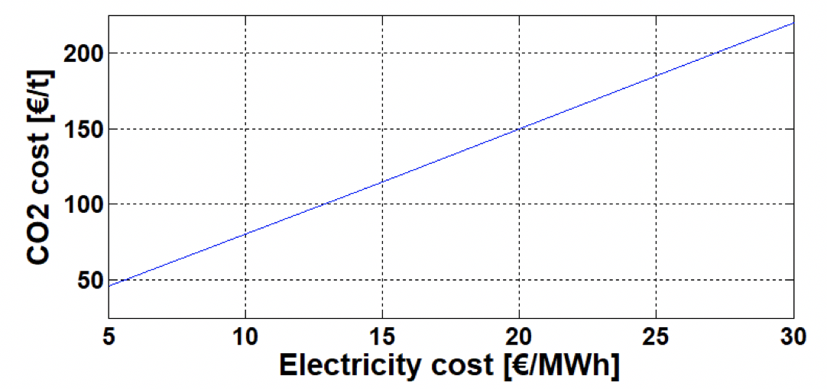
Cost analysis – Ammonia production
Sensitivity study on CO₂ taxes:
→ For an electricity cost of 30 €/MWh: 225 €/t_{CO2}
profitable
not profitable
Discounted cash flow diagram
CO₂ taxes = 250 €/t_{CO2}
electricity price = 30 €/MWh
discount rate = 10%
ammonia price = 350 €/t_{NH3}
Feasibility study of low-carbon ammonia and steel production in Europe
J-L. Hoxha, M. Caspar, A. Donceel, J. Fraselle, G. Léonard, M. Philippart de Foy, R. Poncelet
ECEEE Industrial Efficiency Decarbonise Industry - 14-17 September 2020 - Digital Event
Notes:
Fictious income compared to other classic plants.

Slide 12
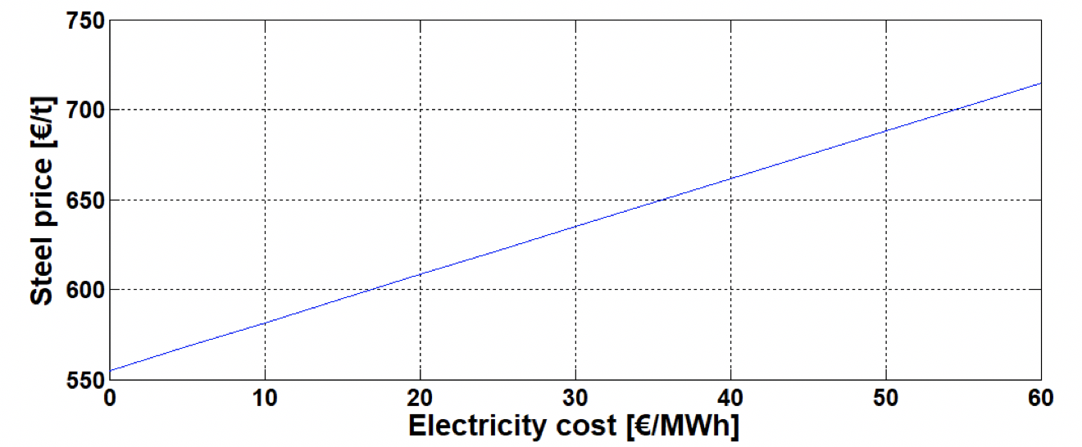
Cost analysis - Steelmaking
Sensitivity study on steel price:
→ For an electricity cost of 30 €/MWh: 635 €/t_{steel}
profitable
not profitable
Discounted cash flow diagram
CO₂ taxes = 0 €/t_{CO2}
electricity price = 30 €/MWh
discount rate = 10%
steel price = 840 €/t_{steel}
Feasibility study of low-carbon ammonia and steel production in Europe
J-L. Hoxha, M. Caspar, A. Donceel, J. Fraselle, G. Léonard, M. Philippart de Foy, R. Poncelet
ECEEE Industrial Efficiency Decarbonise Industry - 14-17 September 2020 - Digital Event

Slide 13
Conclusion
Assumptions to obtain an economically viable processes:
- Maturity of PEM electrolysers at 85% efficiency
- Electricity price can be negotiated (peak shaving)
- Fully renewable electricity supply (currently unrealistic)
Ammonia large increase of CO₂ taxes
Steelmaking high price of steel
Feasibility study of low-carbon ammonia and steel production in Europe
J-L. Hoxha, M. Caspar, A. Donceel, J. Fraselle, G. Léonard, M. Philippart de Foy, R. Poncelet
ECEEE Industrial Efficiency Decarbonise Industry - 14-17 September 2020 - Digital Event
13
Notes:
Parler des taxes CO2 en hollande et du projet européen 60%.

Slide 14
References
[1] European Commission, Rapport de la commission : Quatrième rapportsur l’état de l’union de l’énergie, 2019.
[2] R. Turton R. Bailie W. Whiting J. Shaeiwitz, D. Bhattacharyya. Analysis, Synthesis, and Design of Chemical Processes. Pearson, 2013.
[3] L. Cronin G. Chisholm. Hydrogen From Water Electrolysis, chapter ,pages 315–343. School of Chemistry, University of Glasgow, Glasgow, 2016.
[4] Schrefler F. Genoese A. Marcu A. Renda J. Wieczorkiewicz S. Roth F. Infelise G. Luchetta L. Colantoni W. Stoefs J. Timini F. Simonelli C. Egenhofer, V. Rizos. Composition and drivers of energy prices andcosts in energy intensive industries: the case of ceramics, flat glass and chemical industries. Center For European Policy Studies, 2014.
Feasibility study of low-carbon ammonia and steel production in Europe
J-L. Hoxha, M. Caspar, A. Donceel, J. Fraselle, G. Léonard, M. Philippart de Foy, R. Poncelet
ECEEE Industrial Efficiency Decarbonise Industry - 14-17 September 2020 - Digital Event
14

Slide 15
THANK YOU FOR YOUR ATTENTION Any questions ?
Feasibility study of low-carbon ammonia and steel production in Europe
J-L. Hoxha, M. Caspar, A. Donceel, J. Fraselle, G. Léonard, M. Philippart de Foy, R. Poncelet
ECEEE Industrial Efficiency Decarbonise Industry - 14-17 September 2020 - Digital Event

