Slide 1

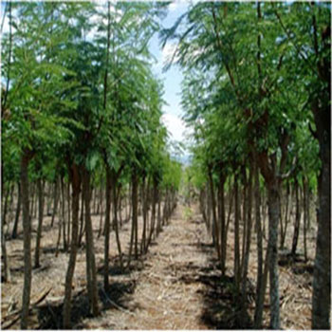
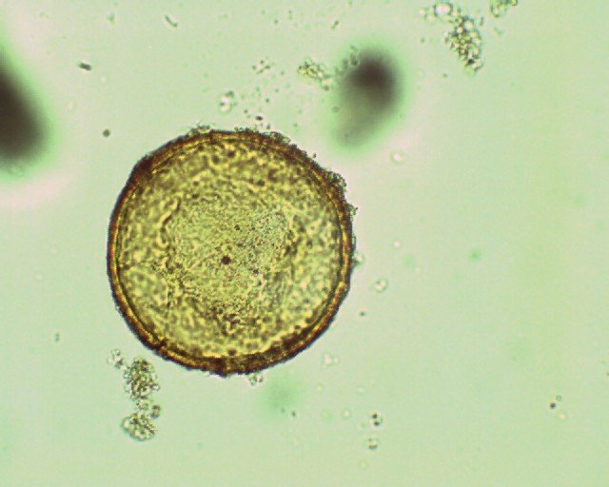
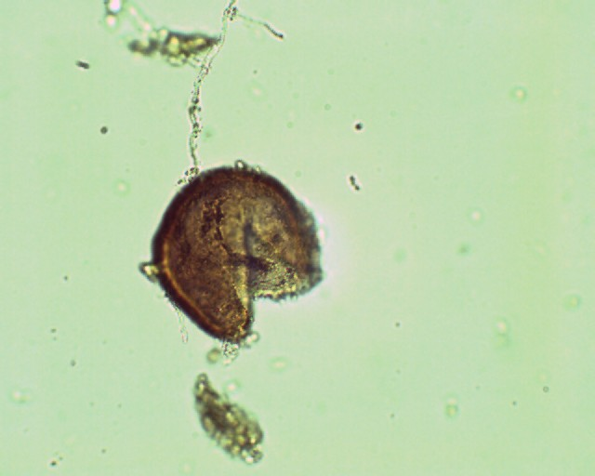
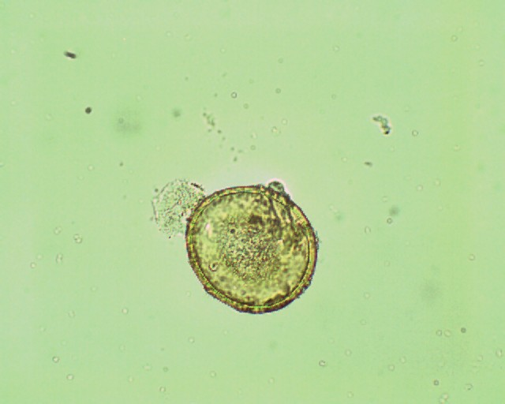
Introduction of new species of fodder shrubs in Manombo (Southern part of Madagascar): An endomycorrhizae symbiosis study
RAZAFIMANDIMBY L^{ab}*, Bindelle Jª, Rasolomampianina R^{b}.
            ªUniversity of Liège, Gembloux Agro-Bio Tech, Animal Science Unit , 2, Passage des Déportés, B-5030 Gembloux,
            ^{b}Centre National de Recherche environnementale (CNRE), Madagascar, Tananarive (101)
            *Corresponding author: larazafimandimby@student.ulg.ac.be Tél: +32 (0) 81 622 494
Bioforum (Belgium)
18 April 2013
Introduction and Objectives
Exotic fodder trees are introduced in South Madagascar (Manombo) to support the increasing population of small ruminants : (1)Leucaena leucocephala (Lam), (2) L. pallida Britton et Rose, (3)Cajanus cajan (L.) Druce, (4) L. diversifolia (Schlecht) Benth and (5) Morus alba L.. To improve the development of these shrubs while respecting the environment and to comply with farmer’s work and their economical investment, a technique using soil microorganisms, especially endomycorrhizae, could be used to increase forage production and quality. Endomycorrhizae facilitate the acquisition of minerals by plants, especially P which is a non-renewable nutrient with a low mobility. The aim of this study is to describe the natural endomycorrhizae colonization of the above-mentioned fodder species under the local conditions in South Madagascar. Profiles of endomycorrhizae consortia were drawn for the 5 new species.
Materiels and Methods
Results
Three soil samples within 3 meters around trees were taken at 0-40 cm depth under each species of fodder.
Wet sieving and decantation method were performed as developed by Gerdemann et Nicolson¹ (1963): (i) 100gr of each sample is wet sievied under three different meshes sieves (100µm, 80µm, 50µm). (ii) Each refusal sieve is put in tubes and centrifuged: first with water for 5min under 3000 towers/min then with sucrose 60% in the same conditions. (iii) Spores were recovered with cellulose-nitrate filters (0,45µm).
Spores were counted and described following their size and color under binocular.
1:Leucocephala (Lam).
2:Leucaena pallida
(Britton et Rose).
3:Cajanus cajan (L.) Druce.
4:Leucaena diversifolia (Schlecht) Benth.
5: Morus alba L.
6: soil control .
Fig3: spore distribution according to their size between each soil sample.
Different letters indicate significant differences in number of spore between each sample of soil (ANOVA p<0,05). n=6. Bars represent standard error of mean (SE)
Fig4 : Spore distribution according their color in each soil sample. 1Different letters indicate significant differences in number of spore between each sample of soil (ANOVA p<0,05). n=6. Bars represent standard error of mean (SE)
Fig5 : Proportion of color of spore in each sample compared to black spore.
Examples of spore isolated after sieving and decantation method.
Conclusion
Shrubs establishment was followed by spore proliferation. White spores appear on soil with fodder trees especially with Leucaena pallida and Cajanus cajan where those type of spore exist in high proportion.
Two profiles of consortium can be drawn:
first consortium is composed of a high number of dark spores (black, brown and dark brown) and a few proportion of colored spores. It can be seen with Leucaena leucocephala, L. diversifolia and Morus alba.
second profile of consortium is composed of a high number of dark spore but colored spores is remarkable in number. Leucaena pallida and Cajanus cajan are shrubs with this type of consortium.
These results must be verified by another counting with soil under Allium porum L. in order to reinforce what have been said and allow us to test shrubs dependency from thus consortia.
^{1:} Genderman CW, Nicolson JH. Spores of mycorrhizal species extracted from soil by wet sieving and decanting. Trans the Br Mycol Soc. 1963;46:235–246.

