Slide 1
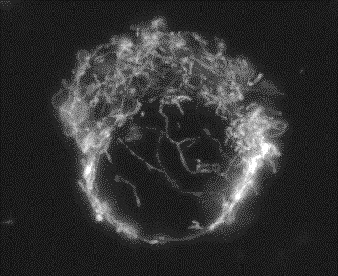
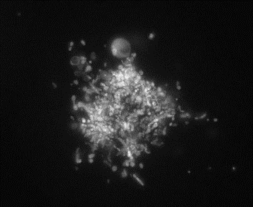
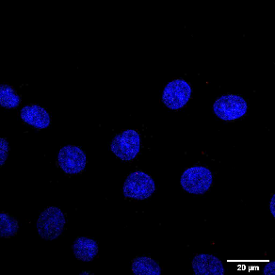
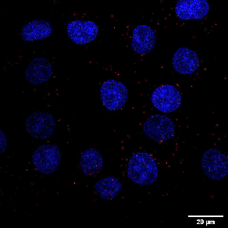
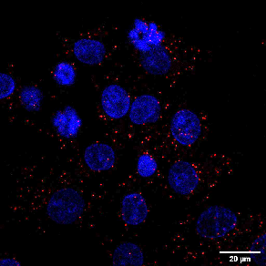
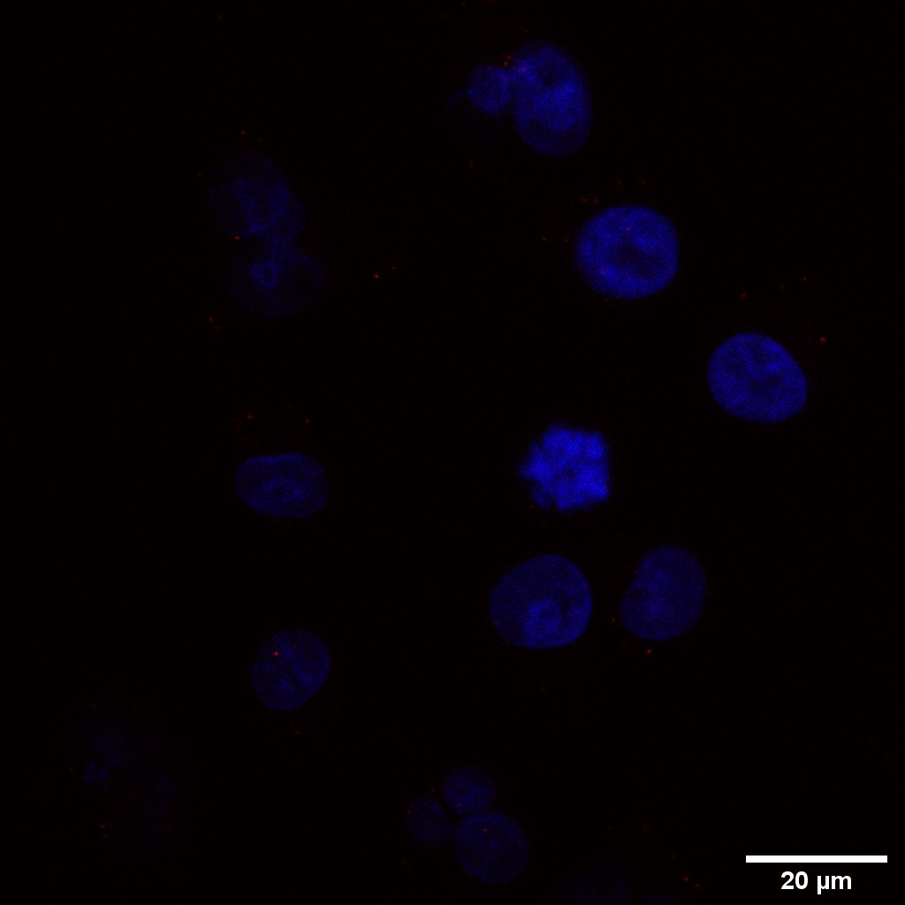
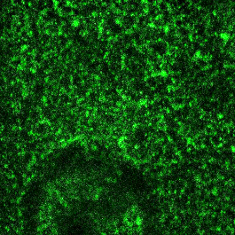
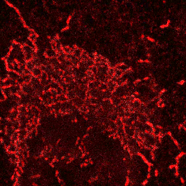
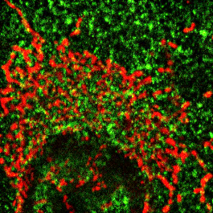
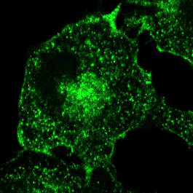
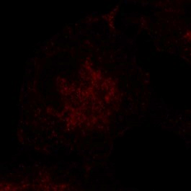
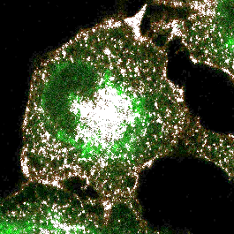
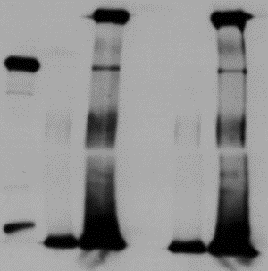
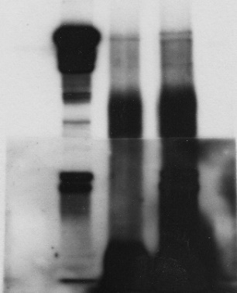
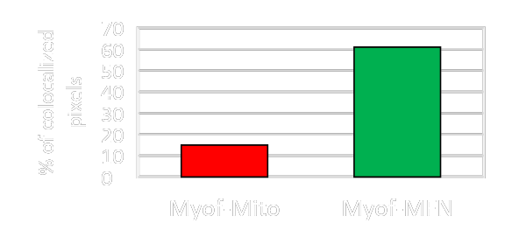
Role of myoferlin in mitochondrial dynamics and metabolic fitness
of pancreas cancer
S. Anania, G. Rademaker, T. Wissocq, A. Bellahcène, V. Castronovo, O. Peulen
Metastasis Research Laboratory, ULiege
Introduction
Pancreatic cancer is the 7th most common cause of cancer mortality in the world. It is predicted to become the second leading cause of cancer-related death in 2030. Myoferlin is a 230 kDa protein overexpressed in pancreatic cancer. Recently, our team showed a fragmentation of the mitochondrial network in PDAC cells when myoferlin was depleted using siRNA. Understanding the mechanism underlying this mitochondrial disruption would be of great interest as mitochondria are major actors in cancer development, progression and resistance.
Results
A
Mitochondrial staining
C
Proximity ligation Assay
Irrelevant siRNA
Myoferlin siRNA
(2)
(1)
Figure C: Proximity ligation assay (PLA) in PANC-1 cells. (1) Biological negative control: Sp1, a transcriptional factor, and Glut1, a glucose transporter, are known to be non-interacting proteins. (2) Myoferlin and mitochondria PLA. (3) Myoferlin and MFN PLA performed in cells targeted with irrelevant siRNA (4) MFN and myoferlin PLA performed in cells transfected with Myoferlin siRNA.
Sp1/Glut 1
Myof/Mito
Panc-1, mitochondrial TMRE staining
Irrelevant siRNA
Myoferlin siRNA
(3)
(4)
B
Immunofluorescence
MFN/Myof PLA
Myoferlin
Mitochondria
Colocalization
Myoferlin Sigma; MFN Abcam
(1)
Dilution: 1/75
Co-Immunoprecipitation
IgG
D
IgG
IgG
MFN IP
Myoferlin
MFN
Colocalization
MFN IP
MFN IP
Input
Input
(2)
WB
(1)
(2)
Myoferlin
(2)
(3)
(1)
MFN
Myoferlin Sigma;
MFN santa-Cruz
Myoferlin Sigma;
MFN Abcam
Figure B: Immunofluorescence in PANC-1 cells. (1) Myoferlin-mitochondria and (2) myoferlin-MFN colocalization map. (3) Percentage of pixel colocalizing between myoferlin- mitochondria and myoferlin-MFN using Manders coefficients
Figure D : Immunoprecipitation of MFN in PANC-1 cells using (1) Santa-Cruz antibody and (2) Abcam antibody. Detection of co-immunoprecipitated myoferlin was performed in both experiments.
Conclusion
Recently, our team showed a mitochondrial fragmentation using siRNA targeting Myoferlin. However, mechanisms underlying this process was still unclear. Our data strongly suggest that myoferlin interacts with MFN. Indeed, if myoferlin is a part of the mitochondrial fusion machinery, its silencing together with an unopposed fission would lead to mitochondrial fragmentation.
Sandy.Anania@uliege.be

