Slide 1
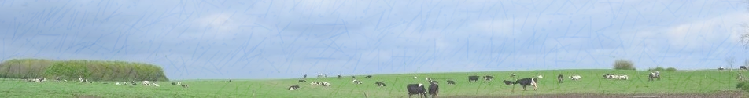





STRATEGIES
OF THE WALLOON DAIRY PRODUCERS
FACED TO THE UNCERTAIN DAIRY FUTURE
A.-C. Dalcq*¹, T. Dogot¹, H. Soyeurt¹, Y. Brostaux¹, F. Vanwindekens², E. Froidmont², P. Rondia², B. Wyzen³, A. Masure⁴, C. Bauraind⁵ and Y. Beckers¹
¹ ULg-GXABT, 5030 Gembloux, Belgium
² CRA-W, 5030 Gembloux, Belgium
³ AWE, 5590 Ciney, Belgium
⁴ FWA, 5030 Gembloux, Belgium
⁵Collège des Producteurs, 5000 Namur, Belgium

Slide 2


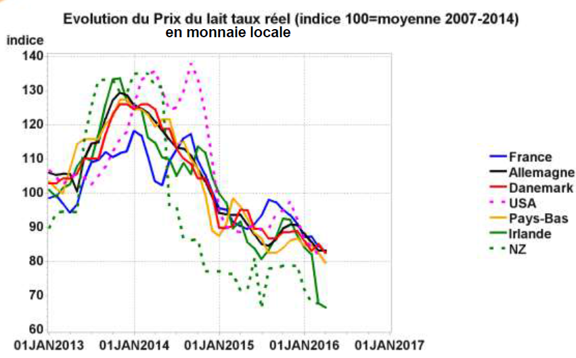

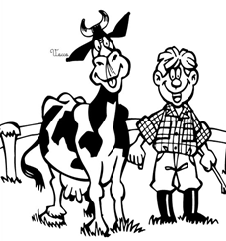
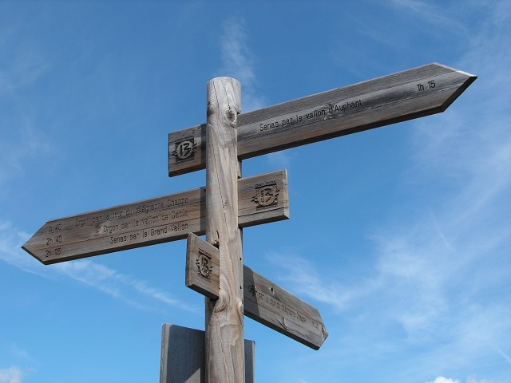
Evolution of the milk price, real rate (index100
= mean 2007-2014)
Source : Observatoire européen du marché du lait – traitement institut de l’Elevage, 2016

Slide 3
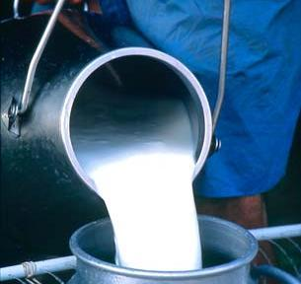

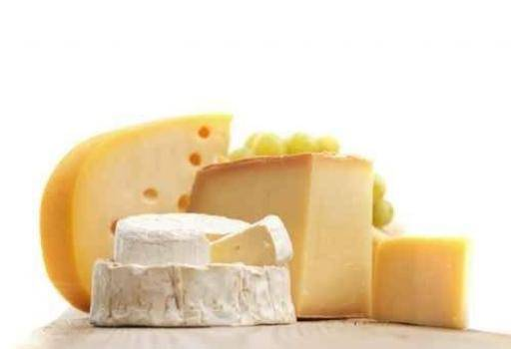
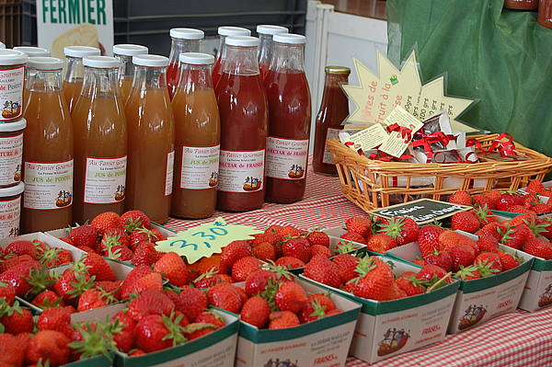
Workforce
Agricultural area
Legal status
Animal production
…
Quantitative variables:
Study of the difference between the groups (GLM)
Survey of Walloon dairy breeders
(N = 245)
Nov 2014 - Feb 2015
Creation of groups
Qualitative variables:
Study of the independence with the groups (Xhi²)

Slide 4
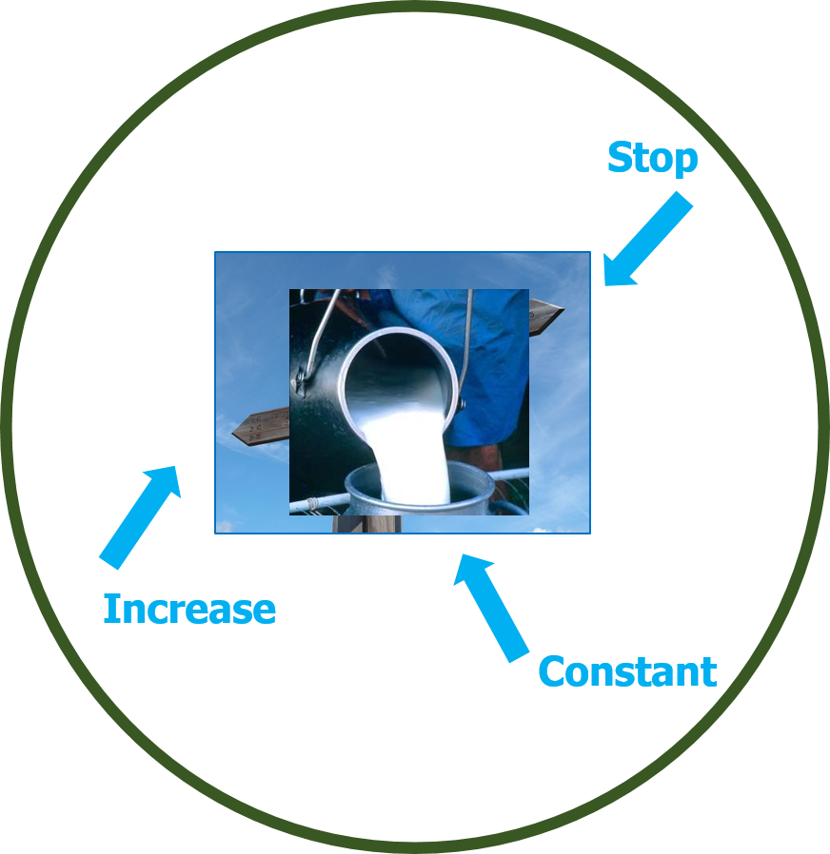
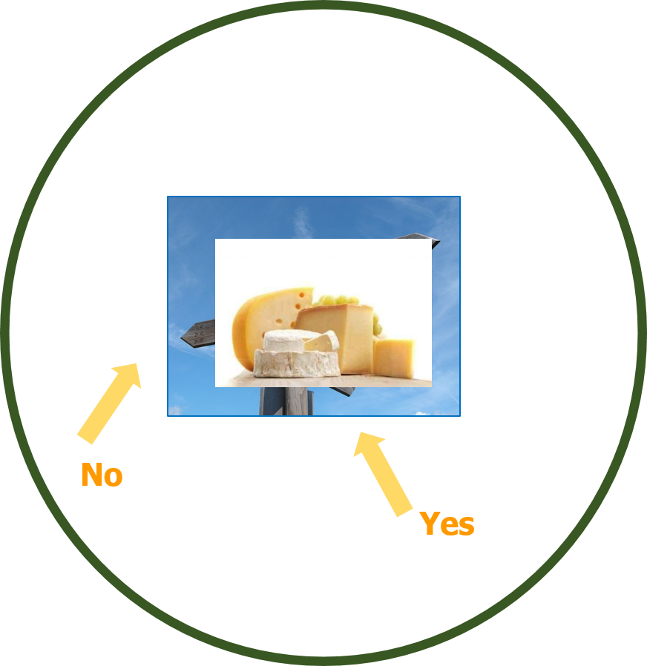
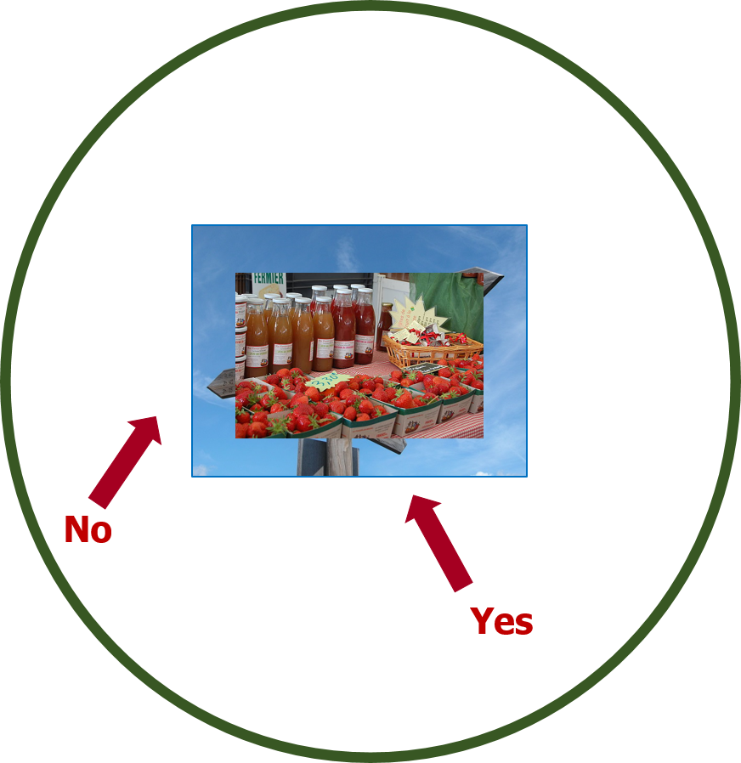
8%
38%
90%
54%
92%
10%
8%

Slide 5
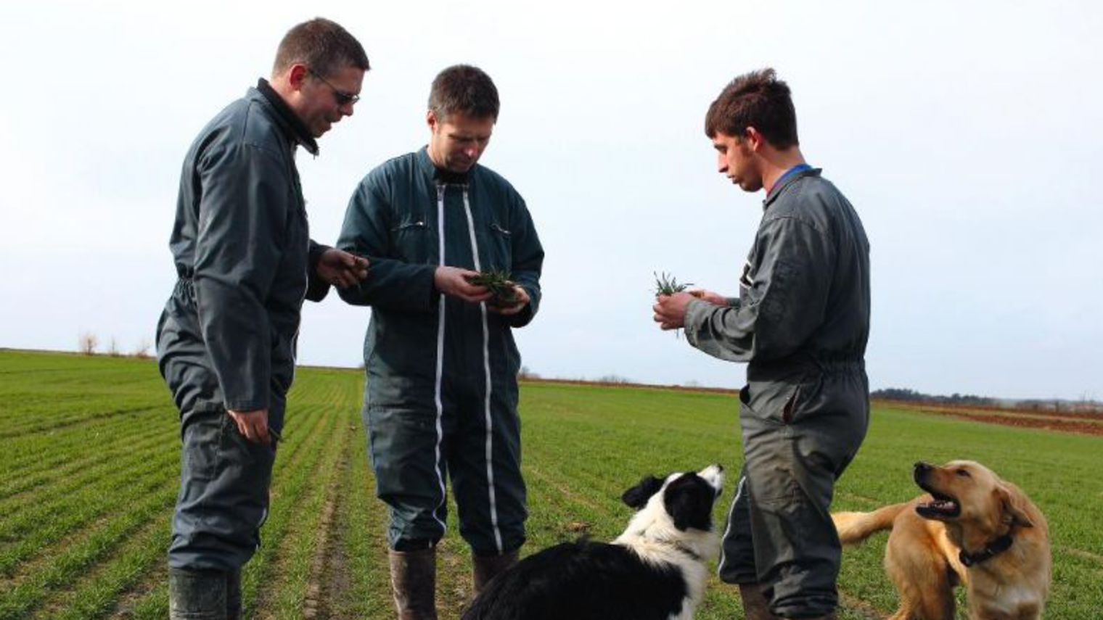
Workforce
Number of family members
Number of full-time workers
3.5^{b}
1.3^{b}
4.5ª
1.9ª
3.7^{a,b}
1.7 ^{a,b}

Slide 6
Workforce
Number of employees
Number of half-time workers
0.2^{b}
0.5ª
0.2^{b}
0.5^{b}
0.4ª
0.6ª
0.4ª
0.7ª

Slide 7
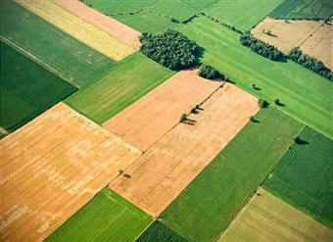
Agricultural area
Agricultural area : 1 km < distance < 4 km
Agricultural area : distance > 10 km
17^{b}
18ª
27ª
10^{a,b}
23ª
9ª
22^{b}
8ª
20^{a,b}
7^{b}
22ª
3ª
33ª
5ª
Investment for and in the next 5 years
more present than expected
for increase production strategy
Lowly fragmented agricultural area
more observed than expected
for valorisation strategy

Slide 8
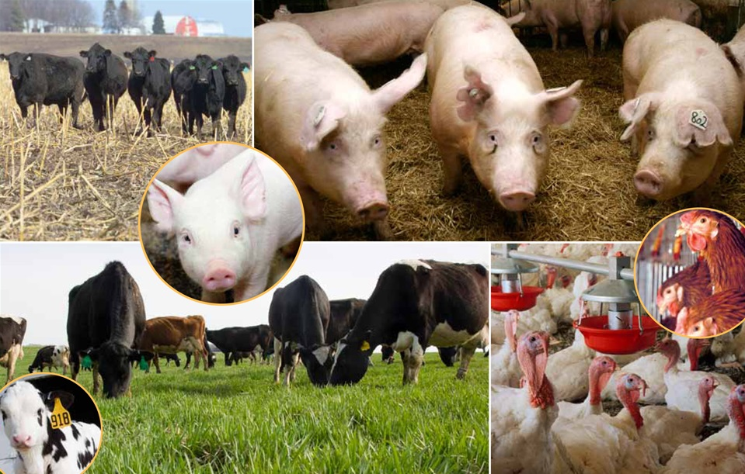
Animal production informations
2015 delivery quota number of cows
301 000^{b}
52.7ª
659 000ª
84.1ª
514 000^{b}
79.1ª
Other animal production
more present than expected
for diversification strategy

Slide 9
Others characteristics
Year of installation
Legal status
1994.8^{b}
2002.1ª
Legal person as legal status
more observed than expected
for increase production strategy

Slide 10
Take home message
The strategies chosen by the producers to face to the uncertain dairy future are multiple.
The choice of this strategies is related to the farm characteristics..
Evolution
of the dairy production
Dairy production
alternative valorisation
Diversification
Stop
Farms characteristics
Farms characteristics
No
Farms characteristics
Yes
Increase
- Workforce
Yes
No
- Legal status
Constant
- Agricultural area
- Workforce
- Agricultural area
- Workforce
- Agricultural area
- Year of installation
- Animal production
- Animal production

Slide 11

Acknowledgments
Data
Financial support
Thanks for your attention!
Mail : anne-catherine.dalcq@uliege.be

Slide 12
Take home message
The strategies chosen by the producers to face to the uncertain dairy future are multiple.
The choice of this strategies is related to the farm characteristics..
Evolution
of the dairy production
Dairy production
alternative valorisation
Diversification
Stop
Farms characteristics
Farms characteristics
No
Farms characteristics
Yes
Increase
- Workforce
Yes
No
- Legal status
Constant
- Agricultural area
- Workforce
- Agricultural area
- Workforce
- Agricultural area
- Year of installation
- Animal production
- Animal production

