Slide 1
Successful economic management differs between intensive and extensive dairy producers
A.-C. Dalcq¹, Y. Beckers¹, B. Wyzen², E. Reding², P. Delhez³, H. Soyeurt¹
¹ULg-GXABT, Passage des Déportés 2, 5030 Gembloux, Belgium
² AWE, Rue des Champs Elysées 4, 5590 Ciney, Belgium
³ National Fund for Scientific Research (FNR-FNRS), rue d’Egmont 5, 1000 Bruxelles

Slide 2
Dairy farms in 20 years…
Notes:
I’m going to ask you to project in 20 years and imagine the dairy farms that would exist and provide you your dairy products. .
You have it in mind?

Slide 3
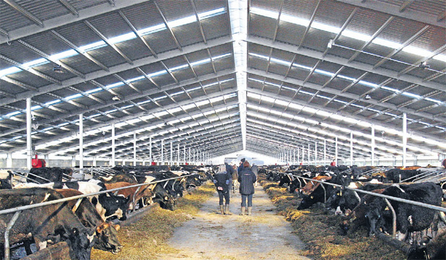
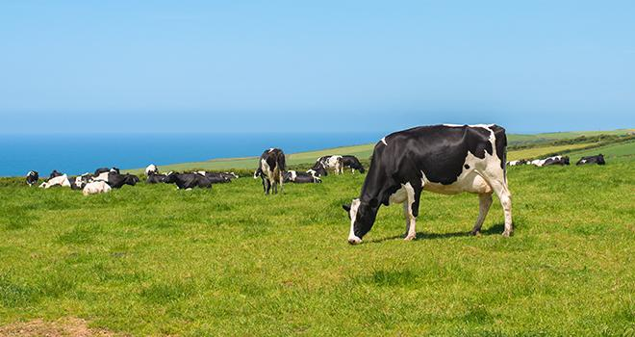
Well different dairy farms appearance
Notes:
If I ask to each one of you to explain the farm imagined, it would be quite a lot of different farms. Indeed different kind of farms seem to appear and are going to evolve in the future.
European dairy producers are facing a new economic context, where costs price is constantly increasing and milk price is not showing similar increase and volatility. This volatility was strenghtened by quota removal. Faced to this situation, dairy farmers must think again their way to work to stay profitable. Quite well different farms are going to appear, depending on a lot of factors but also new environmental and social new issues.
Sources
Dalcq et al., 2017
Autres sources de mon article
What about technicoeconomic advice to give to them? Same breeding obejctives must be followed by all kinds of farms/in each dairy systems?
This work aimed to if management must be differentiated between dairy systems, as… (métaphore qui rend la chose évidente)

Slide 4
Material
What? | 342 Accountings realised by Walloon Association of Breeding
Who? | Farms with dairy activity
Where? | Wallonia (Southern part of Belgium) Temperate region, existence of different geopedologic contexts
When? | 2014-2017 => Mean
Why? | Field data
Notes:
But on the basis of which data?
…
Why?
+ et – normalement pour être complet et j’ai ts les arguments

Slide 5
Method
Intensification groups
Level of revenue groups
Management variables
in function of revenue
in intensification groups
Creation of intensification index
Notes:
Constant => sd < 20% of extreme value of intensification index

Slide 6
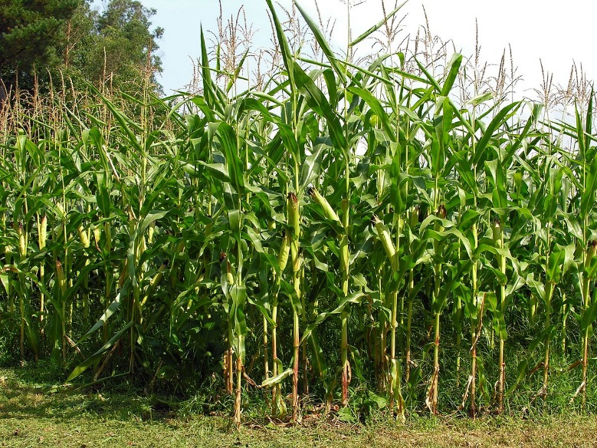
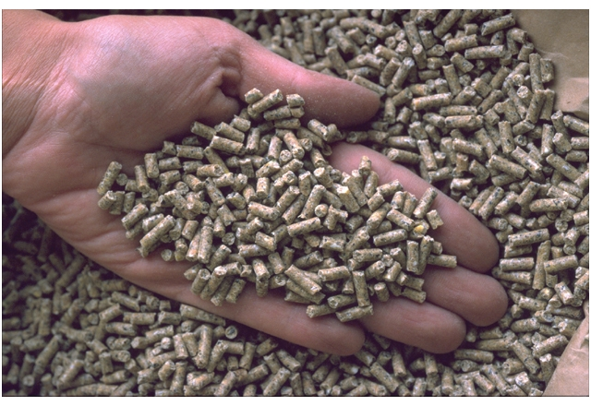
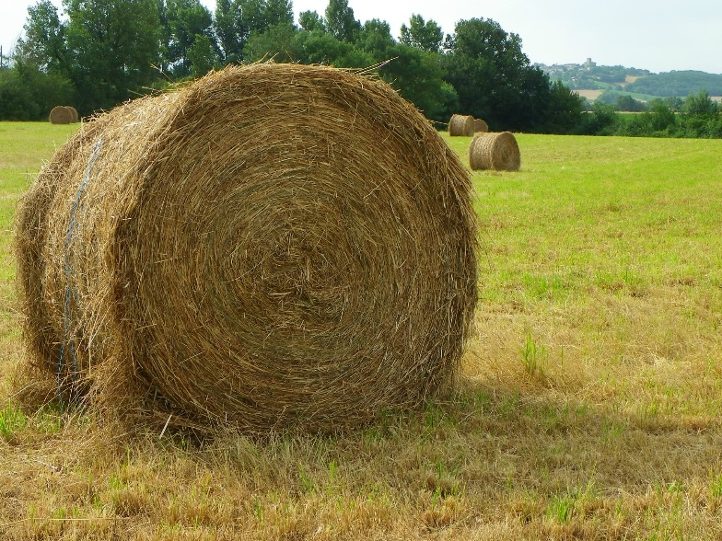
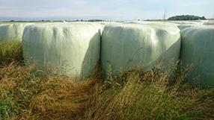
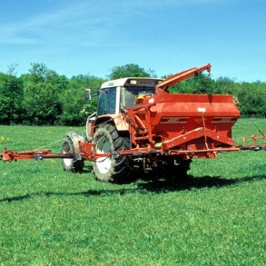
Creation of intensification index
Notes:
Information about meadow, hay, grass silage (1st or other cut), corn silage, N fertilizer of corn silage, purchased concentrated and resulting milk or cows per hectares were 15 varibles included in a ACP
(image pour chaque mot)
Et puis pAF le cercle de corrélations de l’ACP dessus

Slide 7
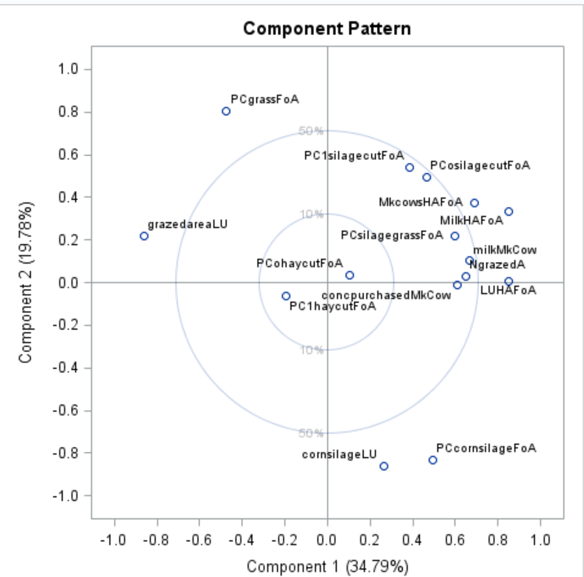
Creation of intensification index
Notes:
Information about meadow, hay, grass silage (1st or other cut), corn silage, N fertilizer of corn silage, purchased concentrated and resulting milk or cows per hectares were 15 varibles included in a ACP
(image pour chaque mot)
And resulting cows and milk production per hectare and milk per cows
=> So a total of fifteen variables included in a ACP.

Slide 8
Notes:
Information about meadow, hay, grass silage (1st or other cut), corn silage, N fertilizer of corn silage, purchased concentrated and resulting milk or cows per hectares were 15 varibles included in a ACP
(image pour chaque mot)
And resulting cows and milk production per hectare and milk per cows
So a total of fifteen variables included in a ACP.
(refaire un beau grpahe d’ACP avec les noms en anglais)

Slide 9
Creation of intensification index
Extensive producers
Intensive producers
Notes:
Information about meadow, hay, grass silage (1st or other cut), corn silage, N fertilizer of corn silage, purchased concentrated and resulting milk or cows per hectares were 15 varibles included in a ACP
(image pour chaque mot)
And resulting cows and milk production per hectare and milk per cows
So a total of fifteen variables included in a ACP.
(refaire un beau grpahe d’ACP avec les noms en anglais)

Slide 10
Method
Intensification groups
Level of revenue groups
Management variables
in function of revenue
in intensification groups
Creation of intensification index
Constant farms regarding intensification kept
4 groups of level of revenue
Q25% = 25000€
Q50% = 35000€
Q75% = 55000€
Generalised linear models
effect = revenue
/ intensification group
Notes:
Constant => sd < 20% of extreme value of intensification index

Slide 11
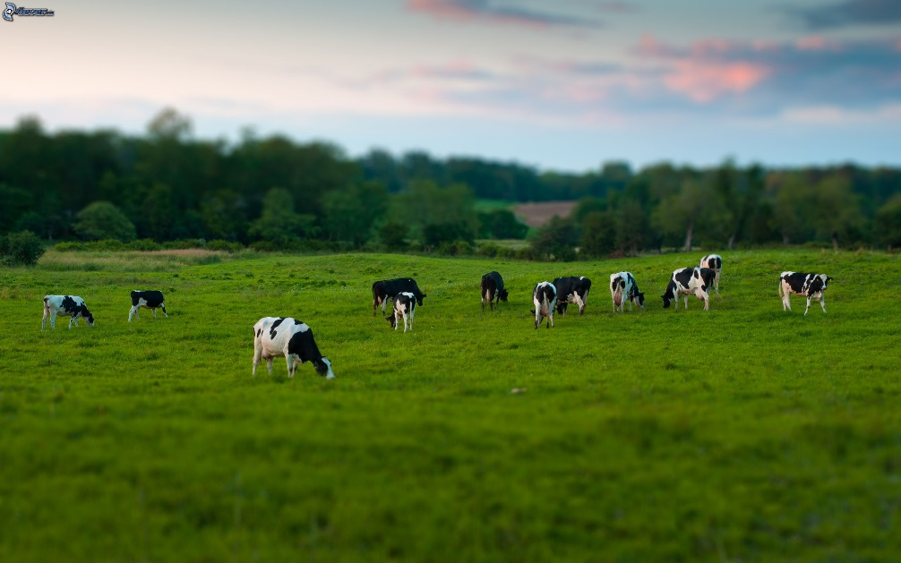
Method

Slide 12
Method
Notes:
And what about economic results of these two different kinds of dairy systems?
Same revenu/person is found in the two groups
(sortir tableau ac valeurs attentites par 75% et 90% int (aussi pour ext?)

Slide 13
Method
Notes:
And what about economic results of these two different kinds of dairy systems?
Same revenu/person is found in the two groups
(sortir tableau ac valeurs attentites par 75% et 90% int (aussi pour ext?)

Slide 14
Results management
Notes:
The life of a cow can be resumed by, at the beginning, the its birth

Slide 15
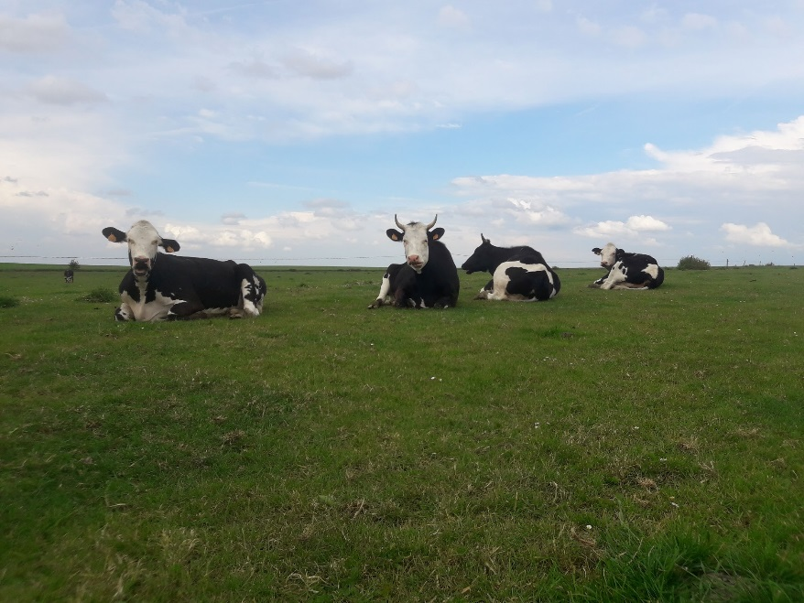
Results management
Notes:
Then its breeding, the heifer state/stage
No diffreent of obejctif

Slide 16
Results management
Notes:
Then its breeding, the heifer state/stage
No diffreent of obejctif

Slide 17
Results management

Slide 18
Results management

Slide 19
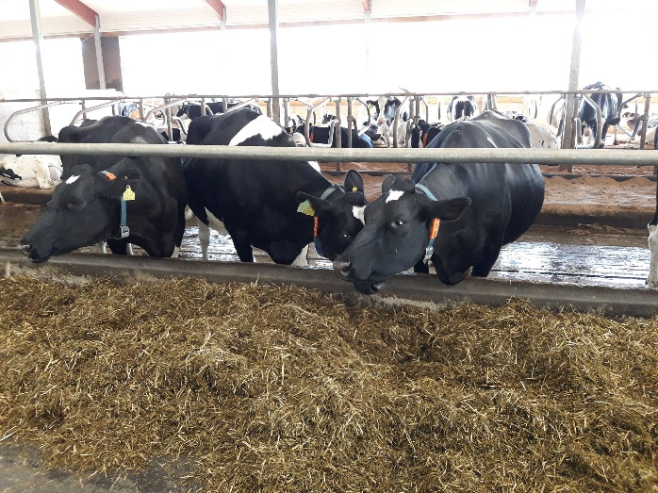
Results management

Slide 20
Results management
…
Notes:
Parler des % dans le texte oral

Slide 21
Results management
…
Notes:
Parler des % dans le texte oral

Slide 22
Results management
…
Notes:
Parler des % dans le texte oral

Slide 23
Results management
…
Notes:
Parler des % dans le texte oral

Slide 24
Results management
…
culling
Notes:
Et dire que pas plus de veaux/vache => comme vu avec IVV, de + longues lactations

Slide 25
Results management
…
culling
Notes:
Et dire que pas plus de veaux/vache => comme vu avec IVV, de + longues lactations

Slide 26
Results management
…
culling
Notes:
Peut-être expliqué par état d’embonpoint mais surtout race (cf les 2 pictures ;)

Slide 27
Results management
…
culling
Notes:
Peut-être expliqué par état d’embonpoint mais surtout race (cf les 2 pictures ;)

Slide 28
Differentiated management beween dairy systems
Notes:
Vérif en comparant 4 et 4 => GLM
Before this presentation, did you know that management must be differnetiated between dairy systems, regarding % of heirfers, of multparous cows, of CI or culling?
For myself, before thistudy I was not aware about that and a few lietartre at my knowledge precise targets of breeding diffrentiated to be applied in dairy farms, in function of kind of dairy which are appearing in Wallonia and in UE.
This study highlights tendencies in order to begin the reflexion and the reseach of precise breeding obejctivs to advice in function of dairy systems.
Really thank you for your attention!

