Slide 1



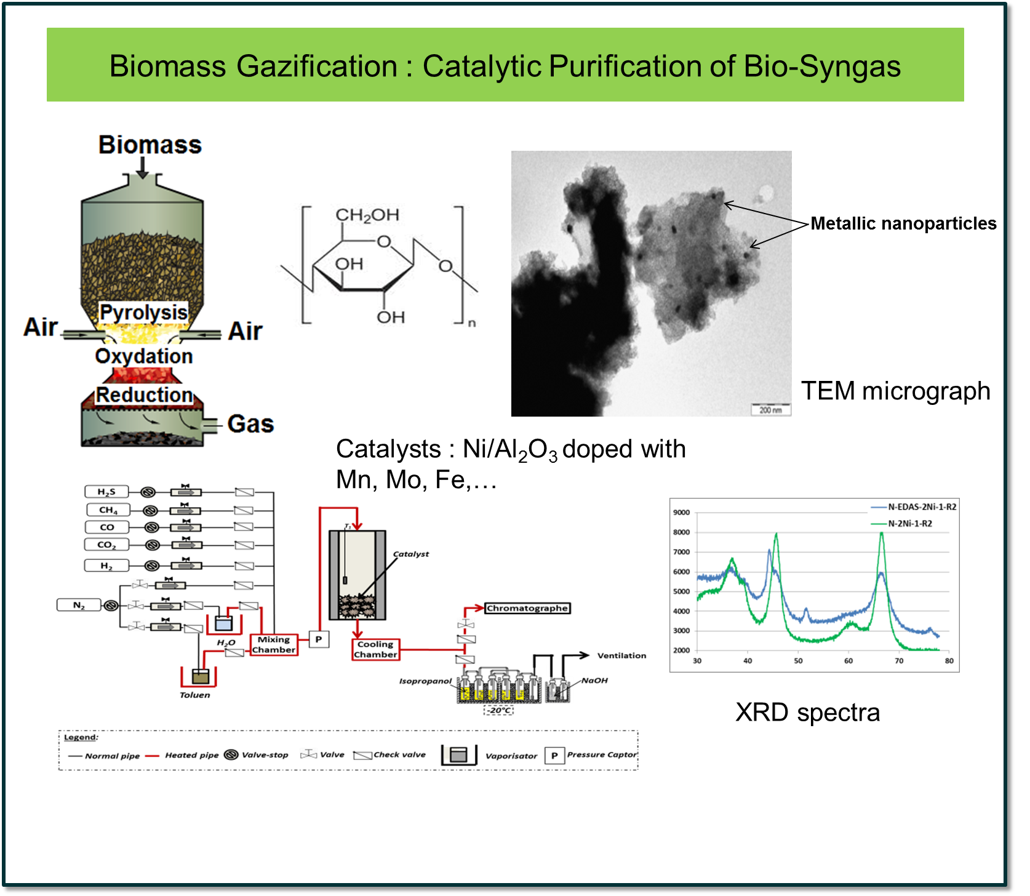
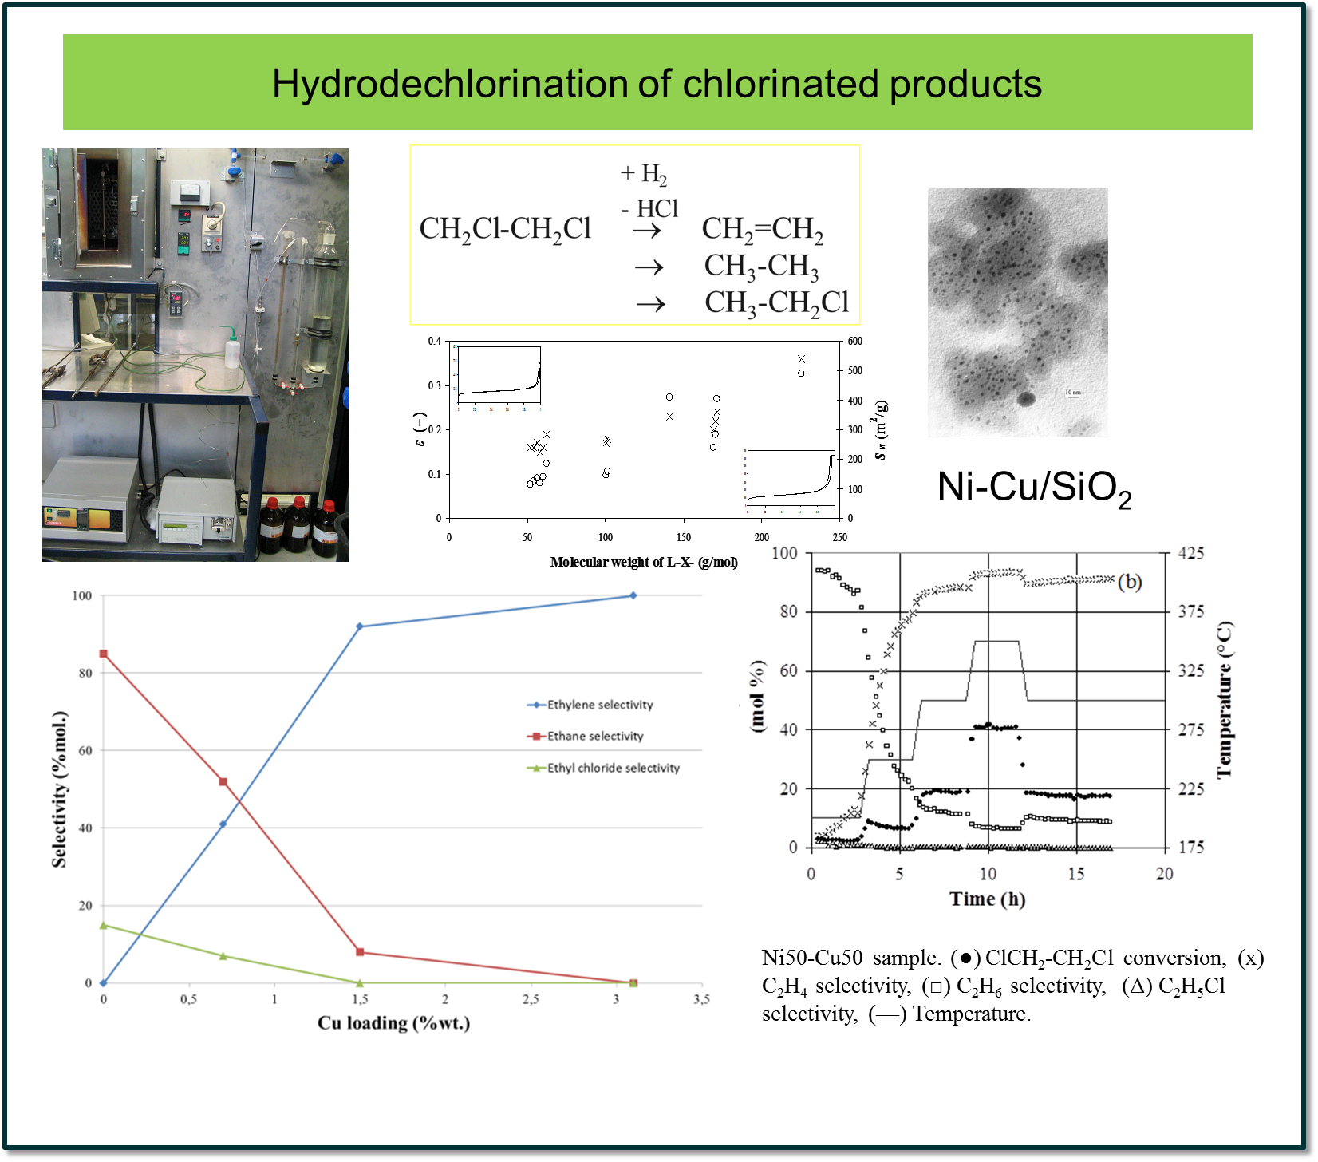
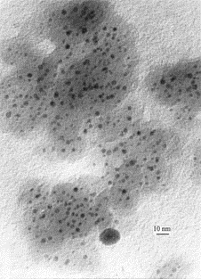



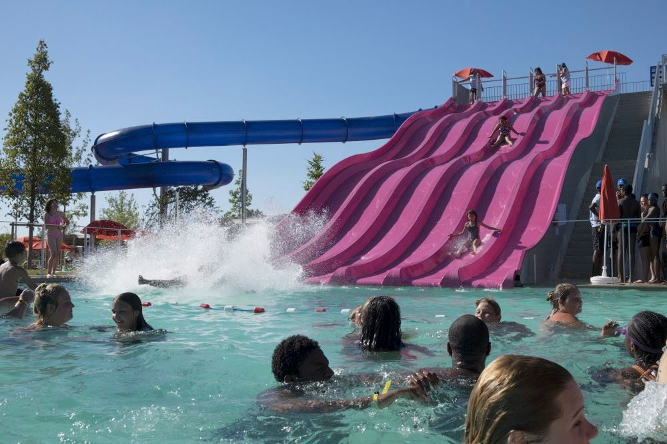


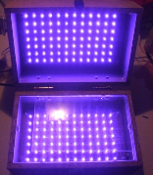
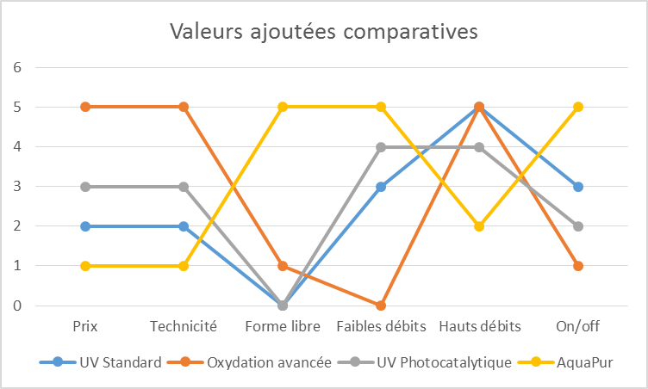
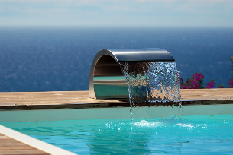
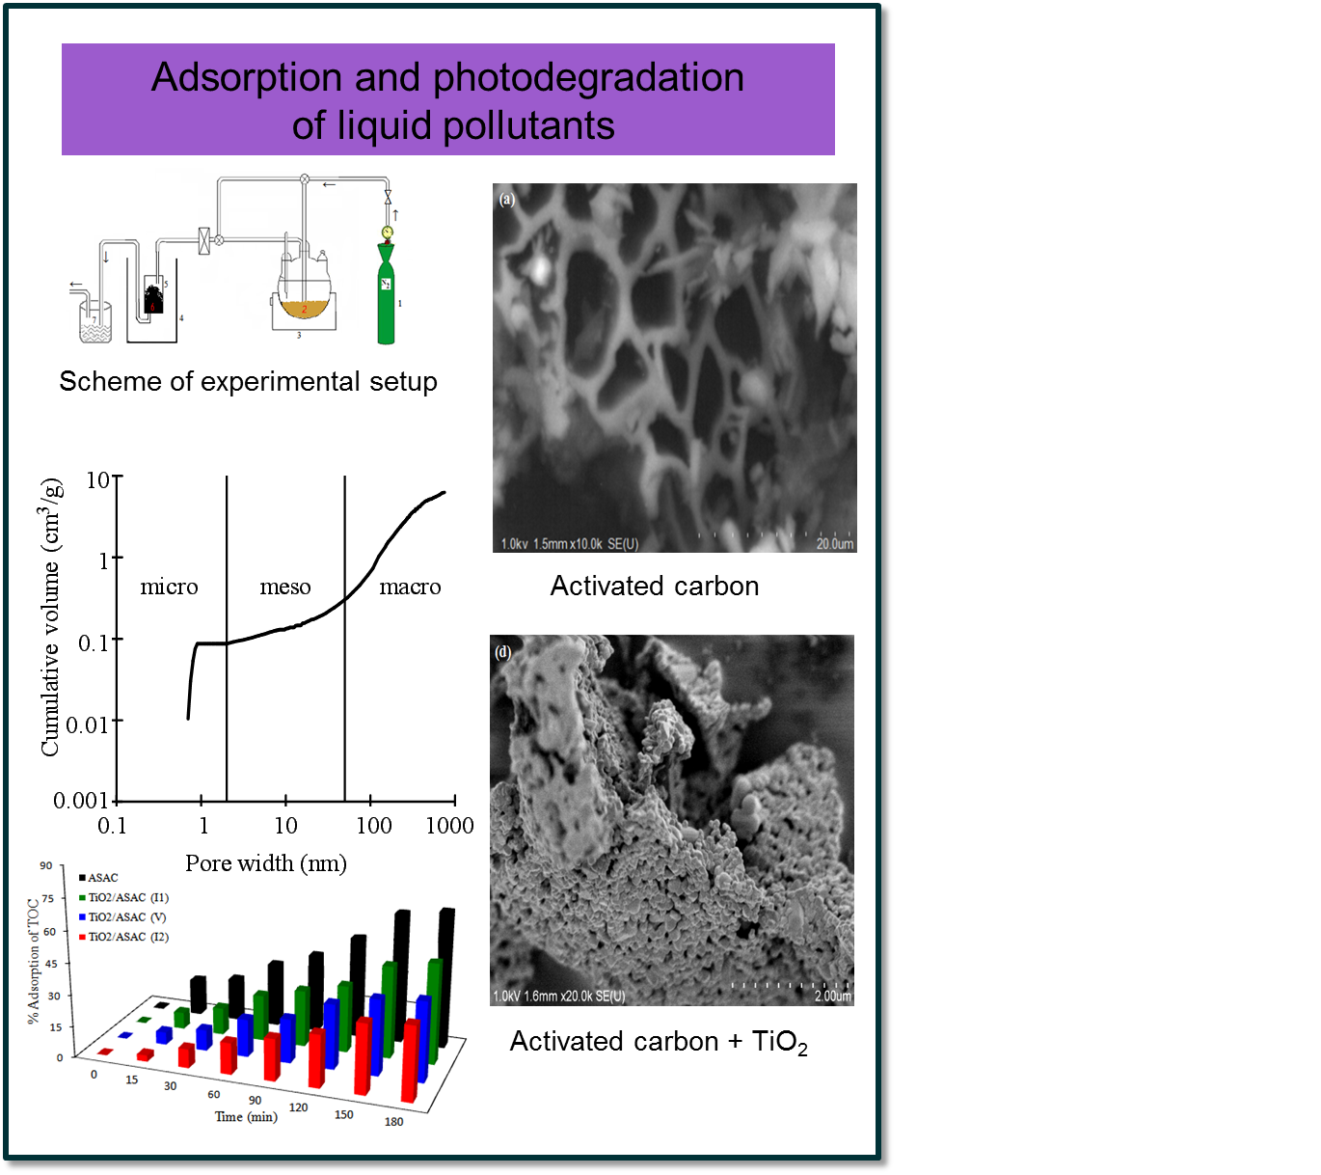
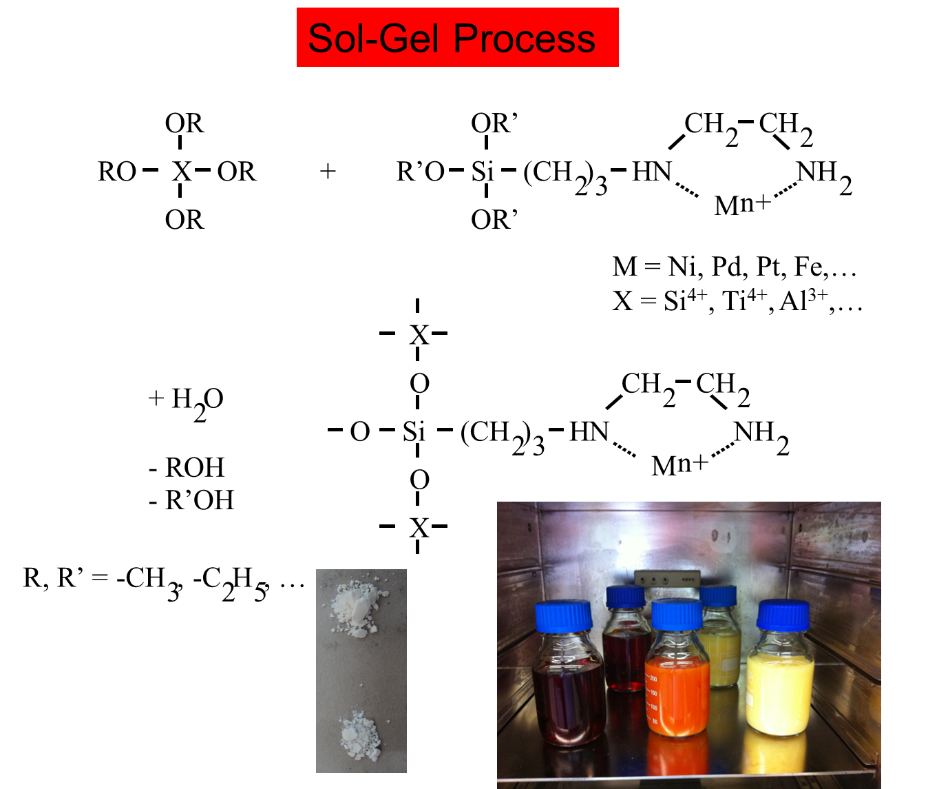
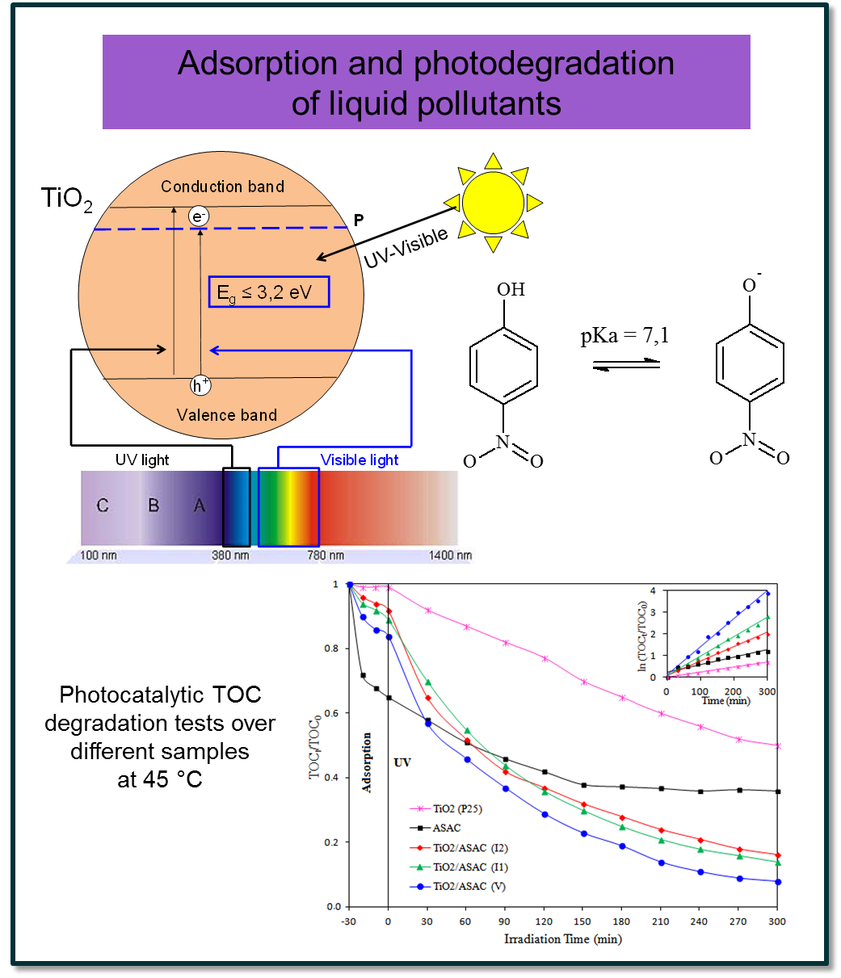


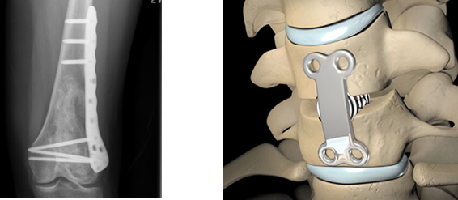

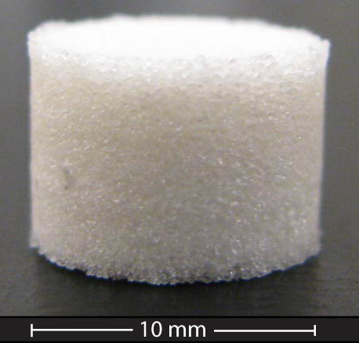
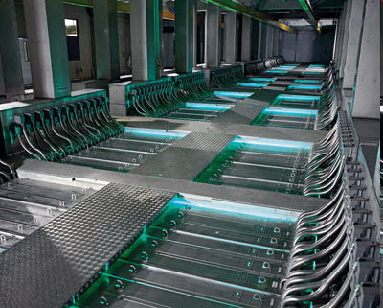
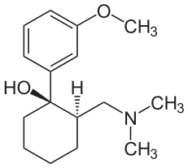
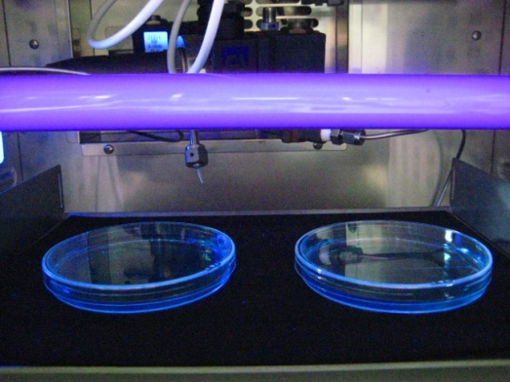
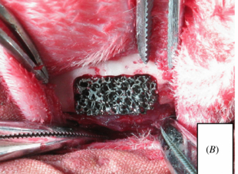
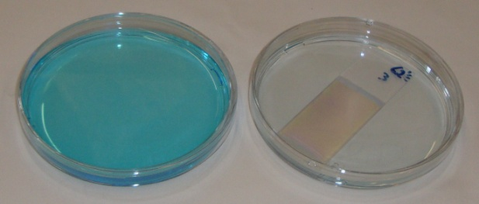

Synthesis of tailored materials
by the sol-gel process
Stéphanie LAMBERT
Department of Chemical Engineering – Nanomaterials, Catalysis, Electrochemistry
http://www.chimapp.uliege.be – stephanie.lambert@uliege.be
Development of decontamination and disinfection devices
Greenwin – 19th Call
01/12/2017 – 30/11/2020
LED de 300 W (λ = 395 nm)
Porous hybrid polymer-ceramic biomaterials
for tissue engineering
Catalytic oxidation treatments of micropollutants
in waste waters
European CORNET project
Surface modification of an inorganic matrix (HA/TCP)
to promote cell adhesion and proliferation
Inclusion of growth factors (BMP)
in silica gel
Physisorption of amphiphilic functionnalized polymers
1,2 kg tramadol/month

