Slide 1

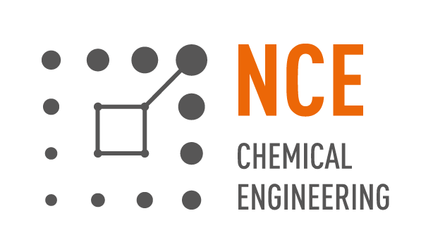

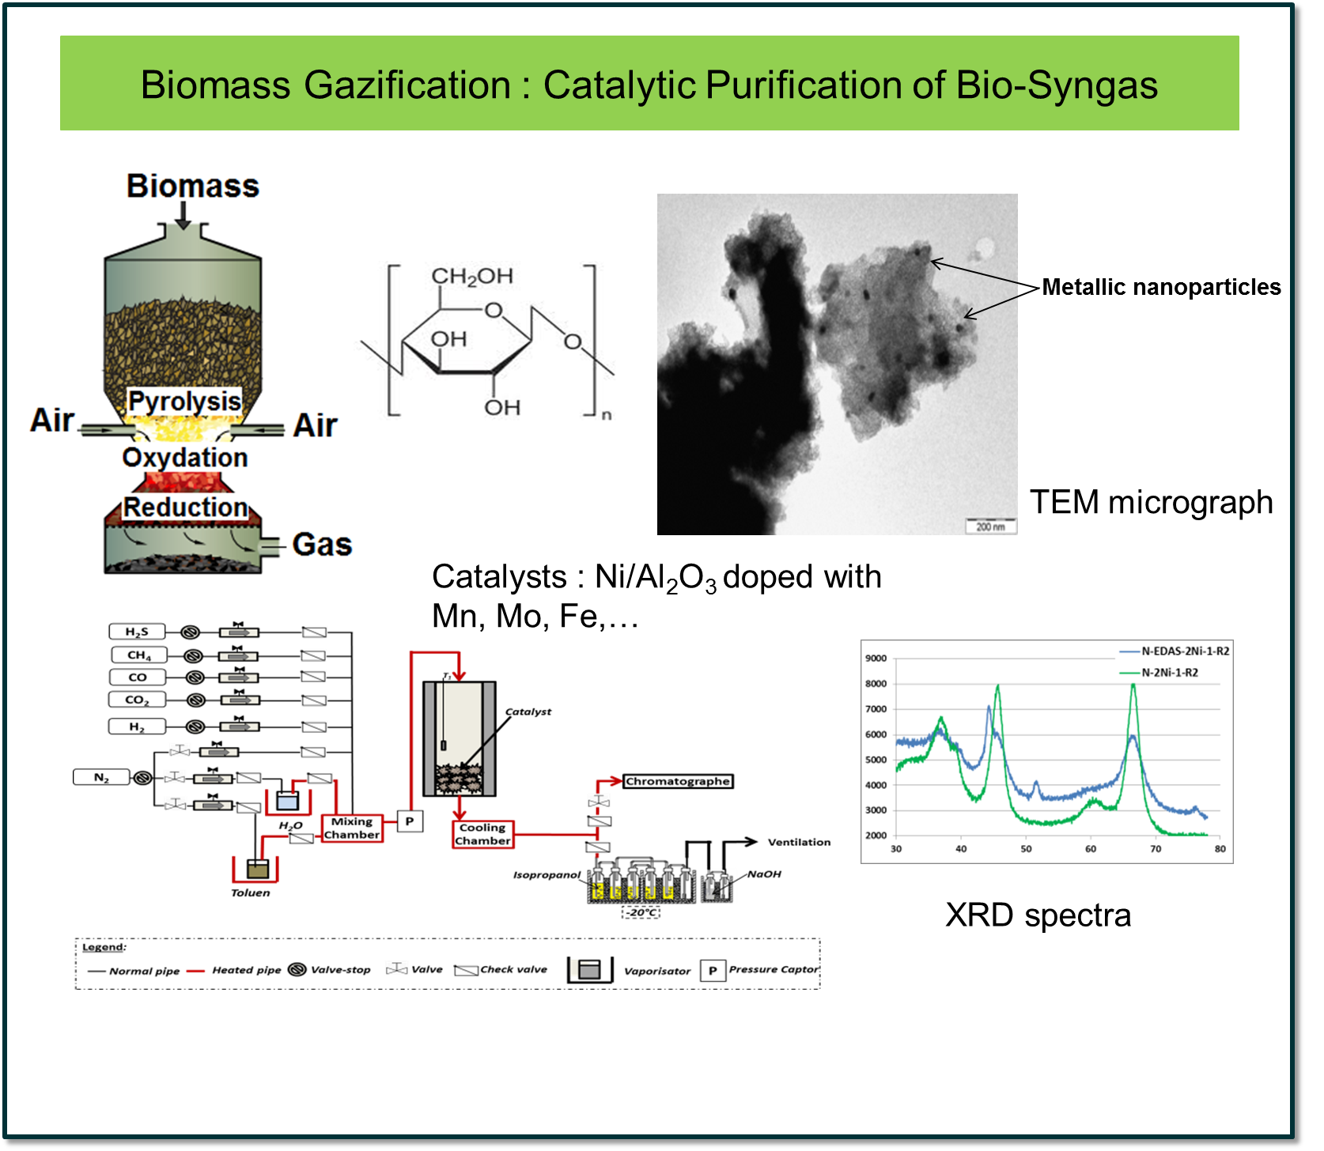
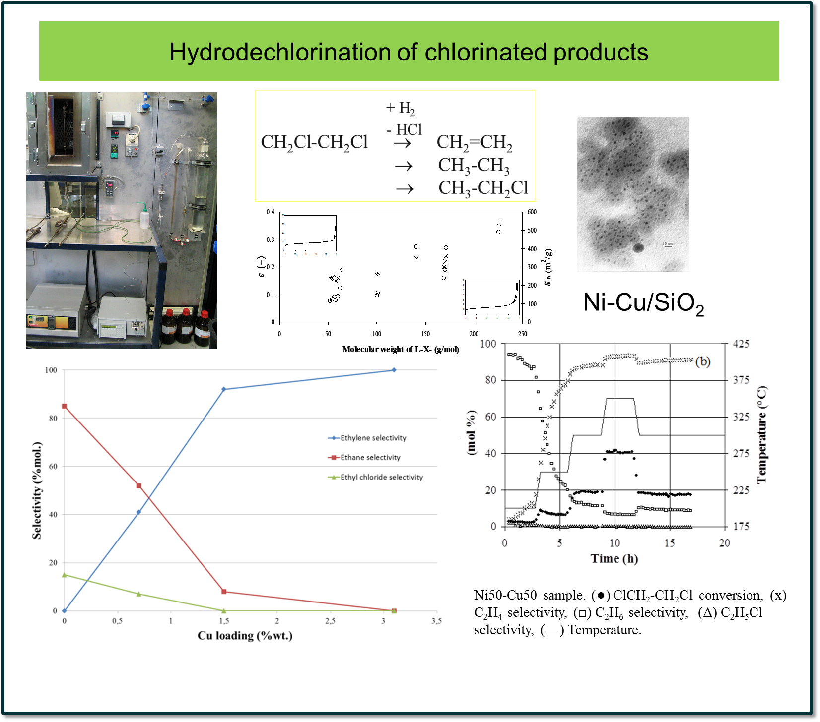
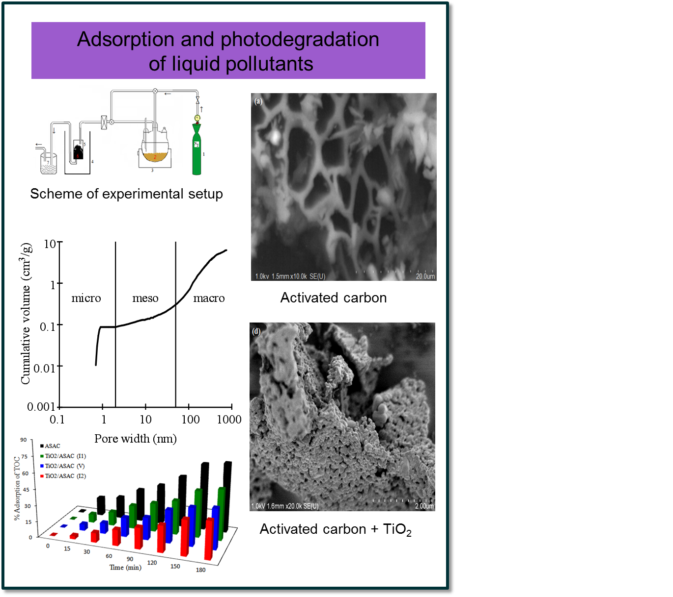
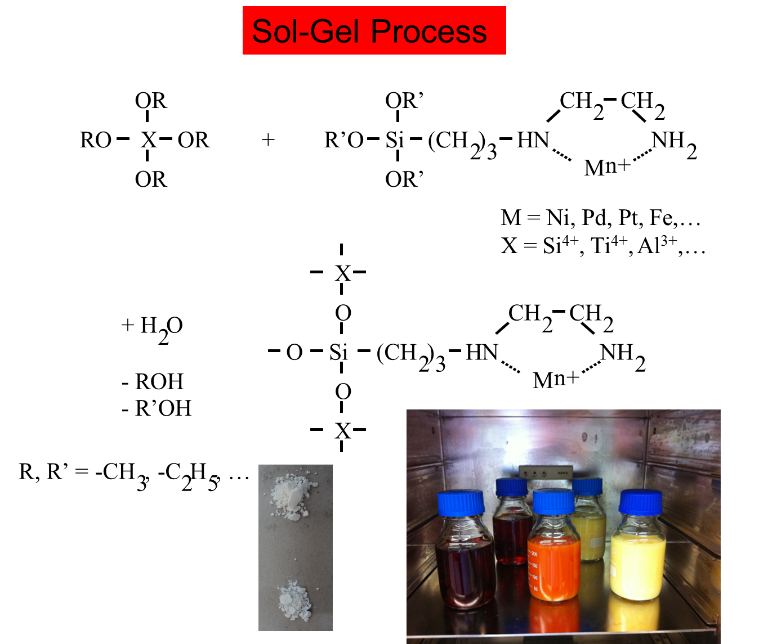
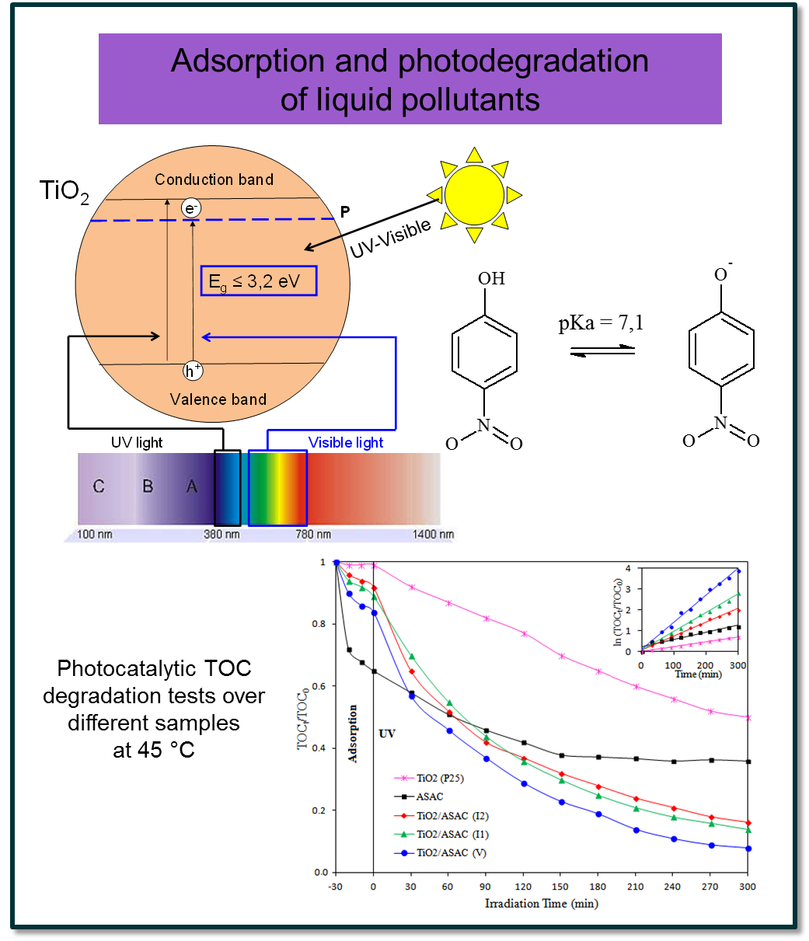


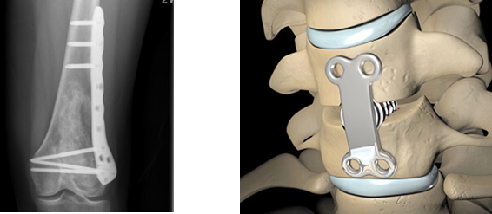

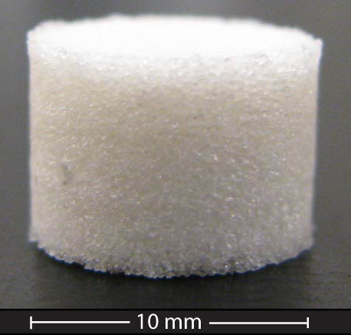
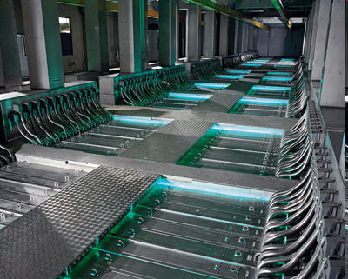
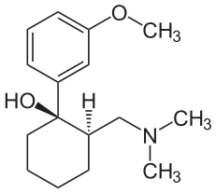
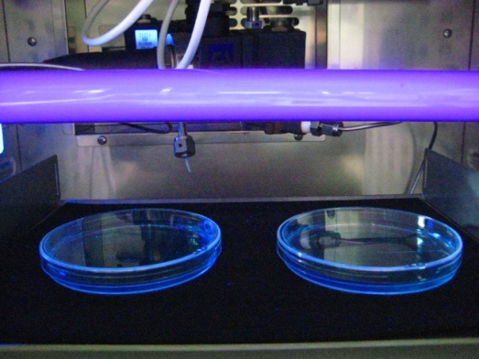
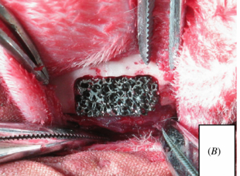
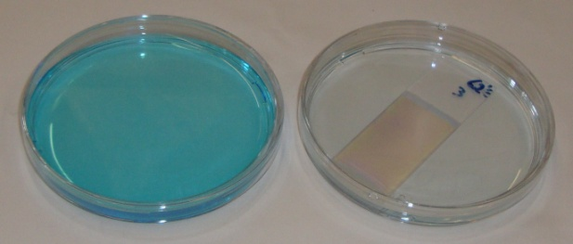

Synthesis of tailored materials
by the sol-gel process
Stéphanie LAMBERT
Department of Chemical Engineering – Nanomaterials, Catalysis, Electrochemistry
http://www.chimapp.ulg.ac.be – stephanie.lambert@ulg.ac.be
Porous hybrid polymer-ceramic biomaterials
for tissue engineering
Catalytic oxidation treatments of micropollutants
in waste waters
European CORNET project
Surface modification of an inorganic matrix (HA/TCP)
to promote cell adhesion and proliferation
Inclusion of growth factors (BMP)
in silica gel
Physisorption of amphiphilic functionnalized polymers
1,2 kg tramadol/month

