Slide 1
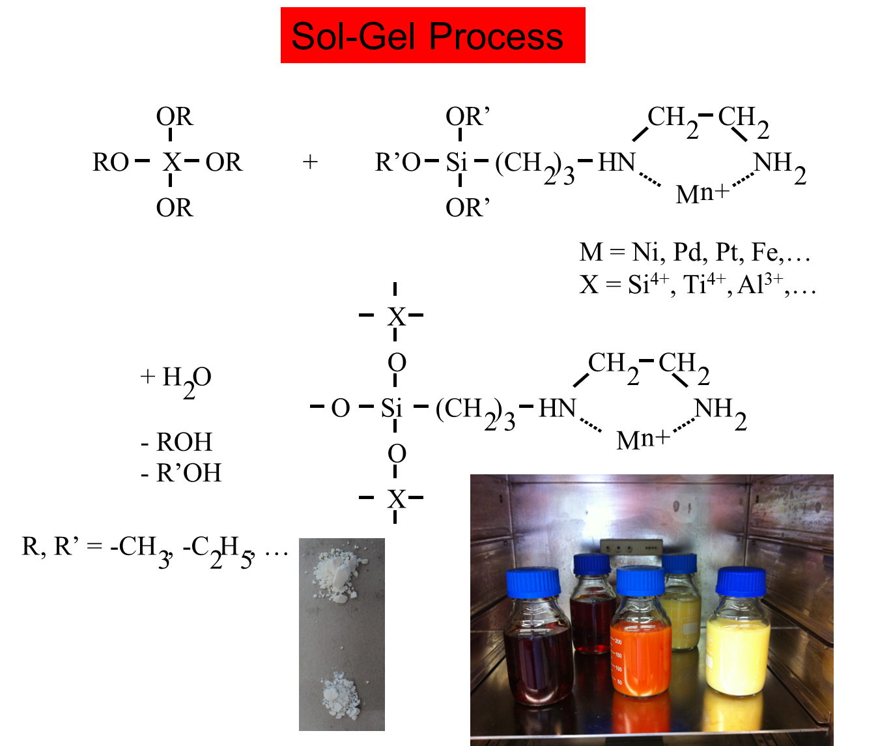
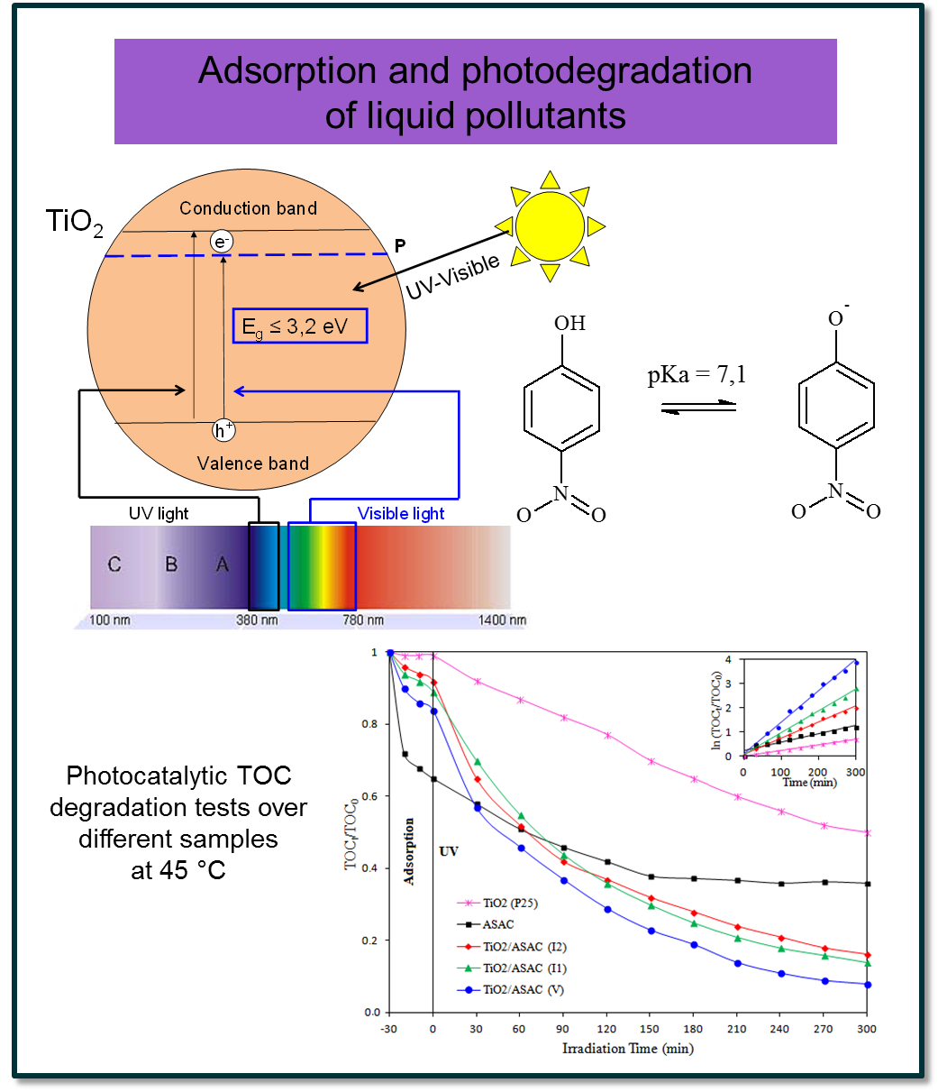
Synthesis of tailored materials
by the sol-gel process
Stéphanie LAMBERT
Department of Chemical Engineering – Nanomaterials, Catalysis, Electrochemistry
http://www.chimapp.ulg.ac.be – stephanie.lambert@ulg.ac.be

